Slide 1
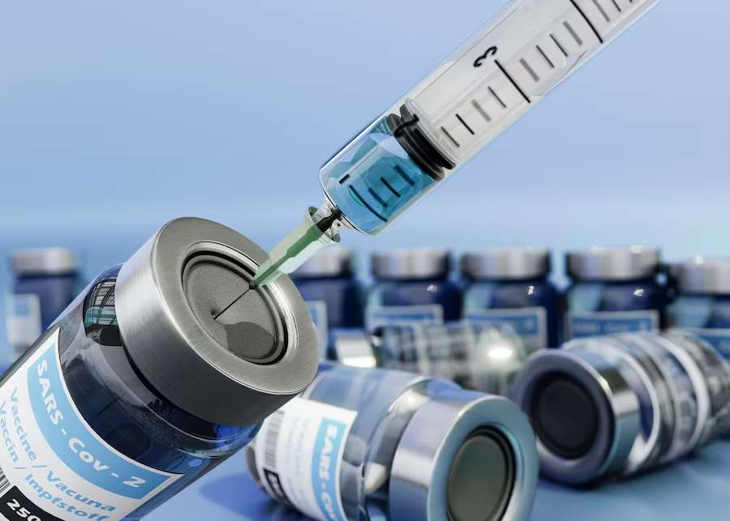
mRNA VACCINE
MARKET REPORT

Slide 2

INTRODUCTION
mRNA is a biological substance that is given in a series of shots to protect the body from developing a disease. It works by triggering the immune system to create antibodies. These antibodies then fight bacteria and viruses that cause disease. Most mRNA vaccines are multi-antigen vaccines, where mRNA has advantages over peptide-based vaccines.

Slide 3


KEY INSIGHTS
MARKET SIZE
$66.5 Bn
2022
FORECAST
$91.1 Bn
2030
2023-
2030
CAGR
6.7%

Slide 4





REVENUE MARKET SHARE BY SEGMENTS 2022
  IV:61.2%
  COVID-19:68.5%
  Self-amplifying mRNA Vaccines:61.0%
  Hospitals:71.2%

Slide 5

GLOBAL MRNA VACCINE MARKET REVENUE SHARE FOR 2022
North America
35.1%

Slide 6

DRIVERS
Rise in the prevalence of infectious diseases
RESTRAINTS
Fuelled by the successful utilization of the mRNA Covid-19 vaccines, RNA therapeutics is expected to make more significant strides in 2023. Hence, companies are harnessing RNA research through collaborations.

Slide 7
AUTHOR'S PERSPECTIVE
  Global mRNA Vaccine Market Report 2023 talks about crucial market insights with the help of segments and sub-segments analysis.
  mRNA vaccines basic MOA includes teaching to body cells to make copies of the spike protein
  Severe acute respiratory syndrome coronavirus 2 (SARS-CoV-2), the cause of coronavirus disease 2019 (COVID-19), emerged in China in December 2019 and quickly spread around the globe

Slide 8



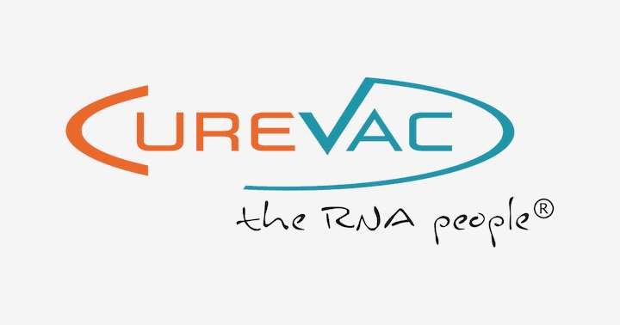






KEY PLAYERS

Slide 9


For Full Report
Contact us
COGNITIVE MARKET RESEARCH
Tel: +1 312-376-8303 | +44 020-8123-0732
India: (+91) 983-496-8611
sales@cognitivemarketresearch.com
Access the Full Report : https://shorturl.at/lnvzN
Please visit our website:
https://www.cognitivemarketresearch.com

