Slide 1

GLOBAL
WRIST WATCH MARKET REPORT 2024
Global,Regional,CountryAnalysis

Slide 2
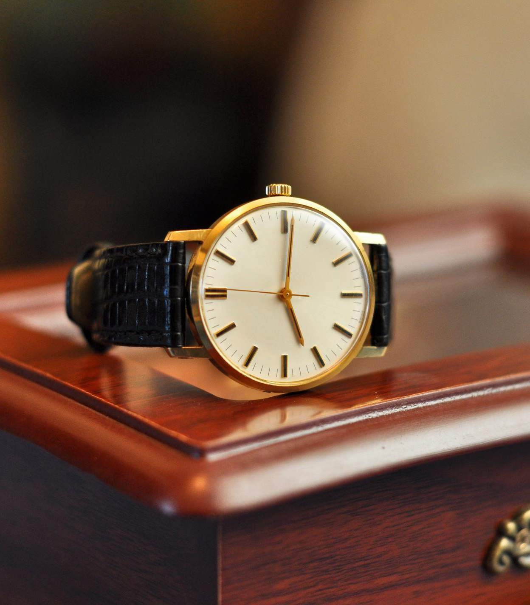
INTRODUCTION
The wristwatch market is one of the fastest- growing segments of the global watch business. It includes various watch designs, including luxury, smartwatches, and analog and digital timepieces. Technological developments, fashion trends, and the timeless appeal of classic timepieces are major industry drivers. Due to their numerous uses, such as networking and health tracking, smartwatches, in particular, have become more popular. Classic watchmakers are still at the forefront of innovation with their classic styles and fine craftsmanship. As prestige symbols, luxury timepieces are still in high demand. The market for wristwatches exhibits a fusion of tradition and technology, catering to customers' varied tastes and lifestyle requirements.

Slide 3
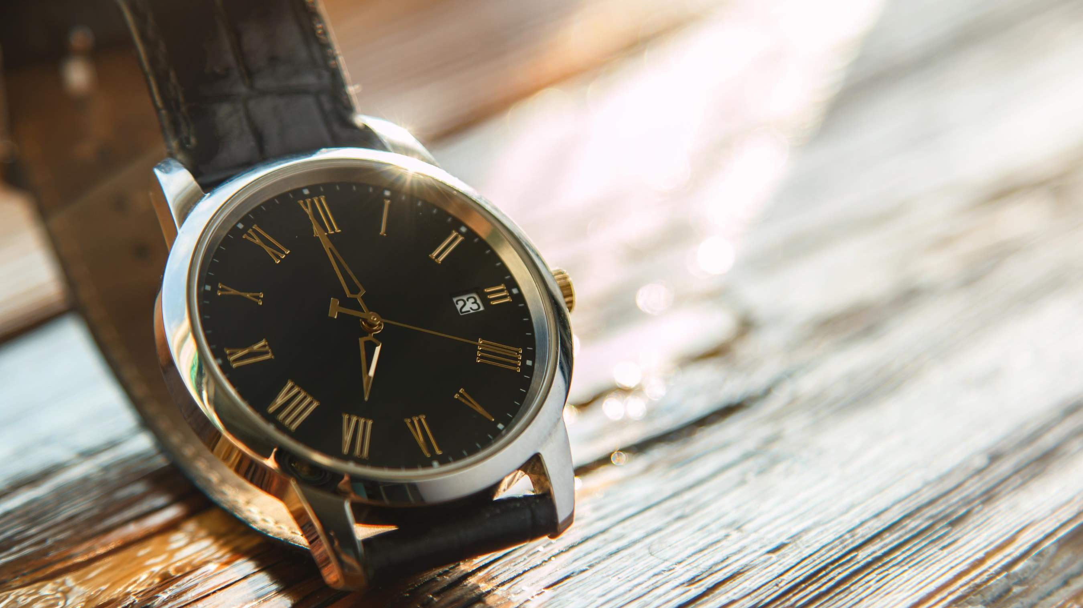

KEY INSIGHTS
MARKET SIZE
USD 63.9 billion
2023
20₋23
CAGR 5.30%
2030

Slide 4
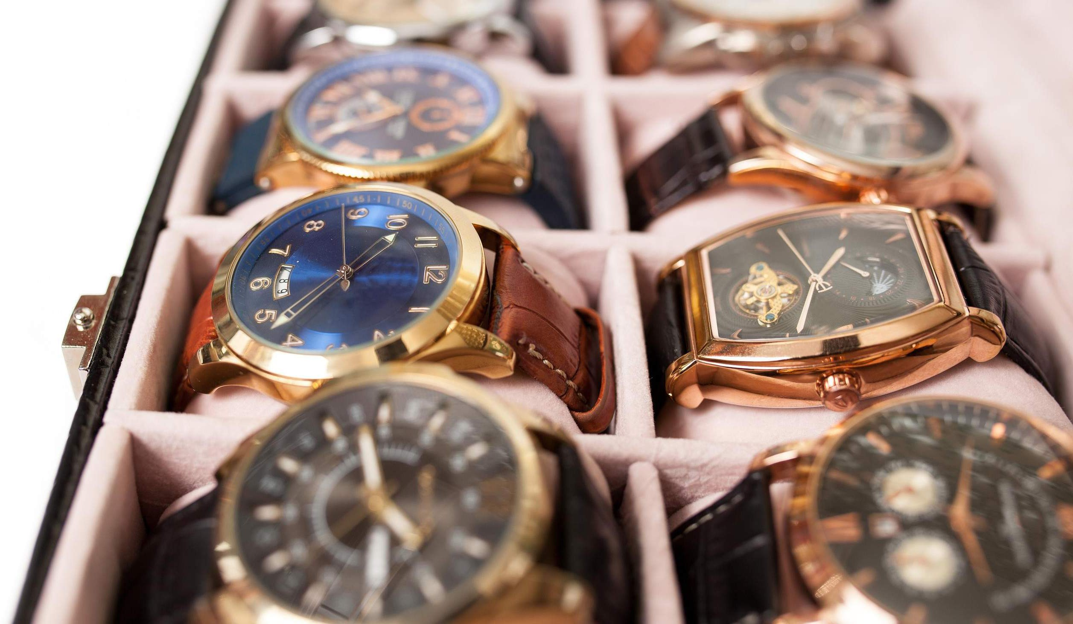
REVENUE MARKET SHARE BY SEGMENTS 2022
Smart Watches
Hybrid Watches
Analog Watches
Digital Watches
Online
Retail Stores
Department Stores
Specialty Stores
Products Segment
Distribution Channel
Men
Women
Unisex
Regular
Sports
Luxury
Fashion
End Use Segment
Functionality Segment
Leather
Metal
Rubber
Ceramic
Children
Adolescents
Adults
Material Segment
Age Group Segment

Slide 5
Global Wrist Watch Market Revenue share for 2022
North America 40%

Slide 6
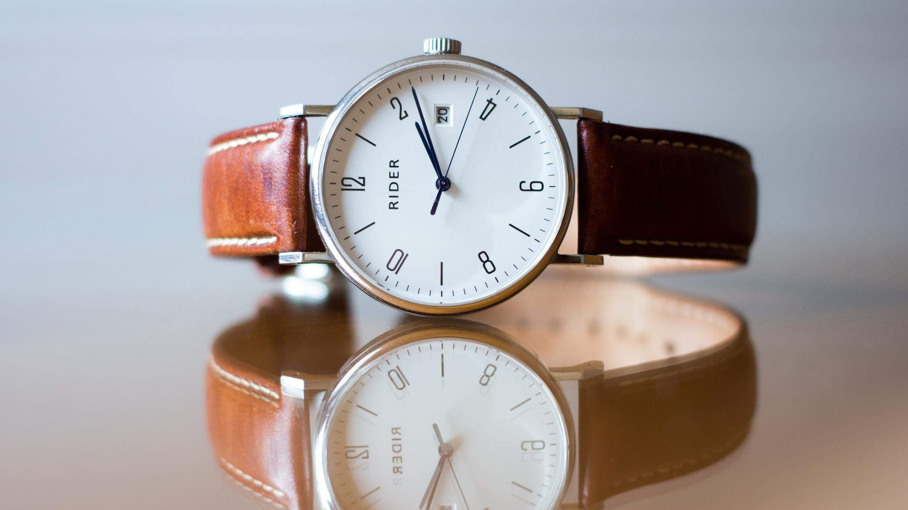






Slide 7
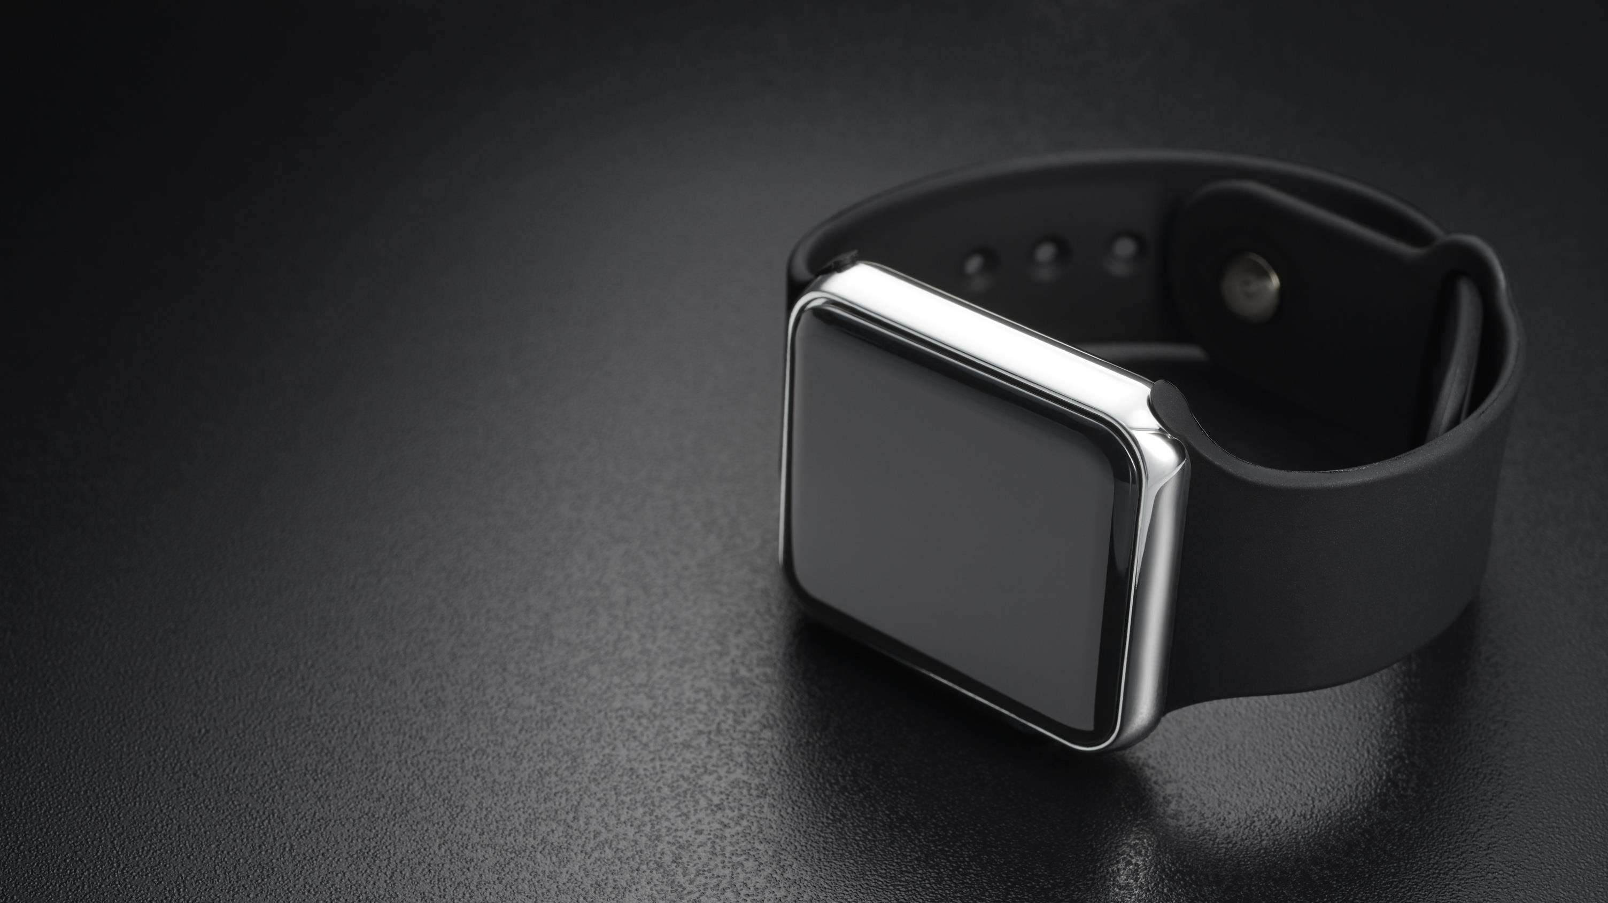
AUTHOR'S PERSPECTIVE
The Global Wrist Watch Market is witnessing significant growth in the near future.
Analog Watches is the second-most used product. Despite technological developments in the wristwatch market, analog watches are popular because of their classic elegance, fine craftsmanship, and lasting appeal.
Men frequently see timepieces as necessary accessories that showcase their sense of fashion, character, and achievement.
Women value the variety of styles, materials, and
sizes available since it allows them to show their individuality and coordinate their timepieces with various ensembles.
Stainless steel is perfect for beautiful and athletic watch designs because of its strength and resistance to corrosion.

Slide 8
KEY PLAYERS

Slide 9


Contact us
For Full Report
COGNITIVE MARKET RESEARCH
Tel: + 1 312 - 376 - 8303 | + 44 020 - 8123 - 0732
India: ( + 91 ) 983 - 496 - 8611
sales@ cognitivemarketresearch. com
Access the Full Report : http://tinyurl.com/4x4uenjj
Please visit our website:
https://www.cognitivemarketresearch.com

