Slide 1
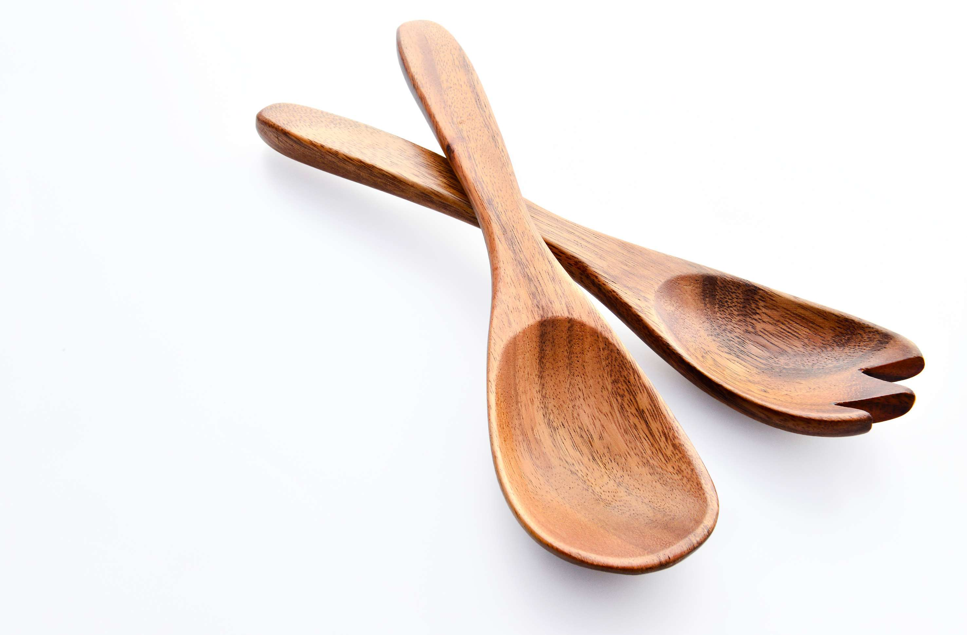
GLOBAL
WOODEN SPOON
MARKET REPORT
2024
Global,Regional,CountryAnalysis

Slide 2

INTRODUCTION
The wooden spoon market is a niche but robust section within the wider kitchen equipment and cookware business. Wooden spoons have been a staple of kitchenware since prehistoric times. Their sustainability, versatility, and enduring appeal have all contributed to their ongoing appeal.

Slide 3


KEY INSIGHTS
CAGR
5.60%
2024- 2031

Slide 4

REVENUE MARKET SHARE BY SEGMENTS 2022
  Disposable Wooden Spoons
  Reusable Wooden Spoons
Type Segment
  Food Service Outlets
  Institutional Use
  Online Catering
  Home Use
Application Segment
  Retail Stores
  Supermarkets
  E-commerce
Sales Channel

Slide 5

Global Wooden Spoon Market Revenue share for 2024
North America
38%

Slide 6

Rising Demand for Wooden Spoons in Hospitality Industry to Drive Market Growth
Drivers
Competition from Alternative Materials to Hinder Market Growth
Restraints

Slide 7

AUTHOR'S PERSPECTIVE
  The Global Wooden Spoon Market is witnessing significant growth in the near future.
  Reusable wooden spoons are essential for everyday cooking tasks such as stirring, mixing, and tasting food.
  Wooden spoons are commonly used in food preparation, including sautéing, frying, and stirring, as they are less likely to scratch cookware and are safe for various ingredients.
  Disposable wooden spoons are frequently used in restaurants, food trucks, and catering businesses
  Wooden spoons are vital culinary equipment because they are utilized in institutional kitchens for large-scale ingredient mixing, stirring, and combining.

Slide 8








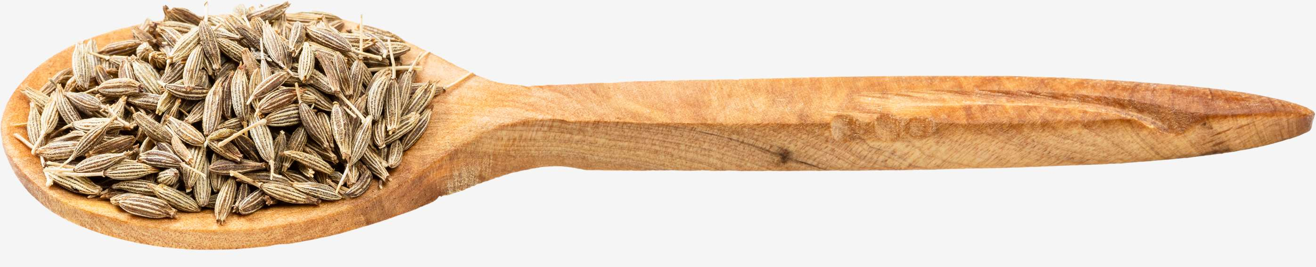
KEY PLAYERS

Slide 9


For Full Report
Contact us
COGNITIVE MARKET RESEARCH
Tel: +1 312-376-8303 | +44 020-8123-0732
India: (+91) 983-496-8611
sales@cognitivemarketresearch.com
Access the Full Report : https://tinyurl.com/yck498pe
Please visit our website:
https://www.cognitivemarketresearch.com

