Slide 1
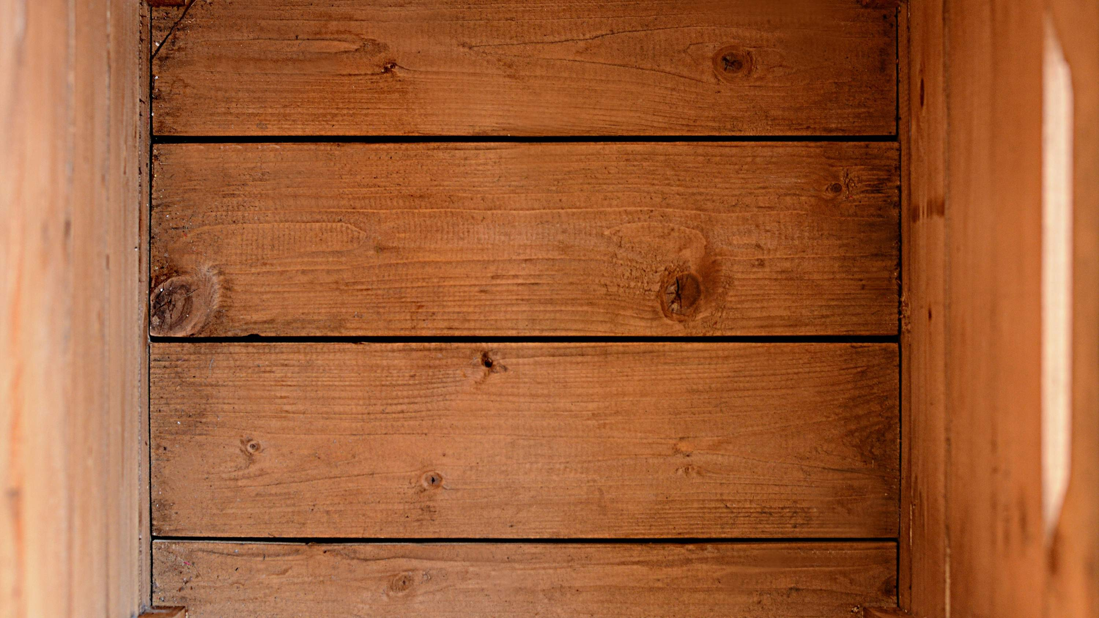
GLOBAL
WOODEN BOXES
MARKET REPORT 2024
Global,Regional,CountryAnalysis

Slide 2
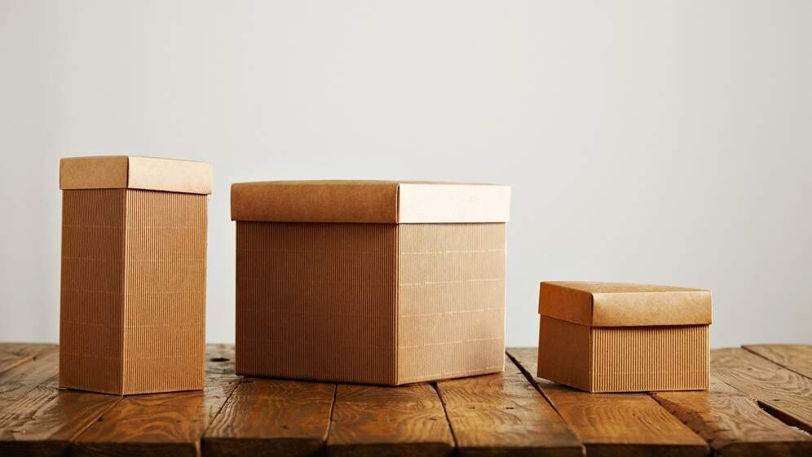
INTRODUCTION
Increased import and export activity, technological advancements in wooden box design, and the explosion of new end-use industries are all factors fueling the rapid expansion of the rigid box market. Further driving market expansion in the following years is the rising demand for wooden boxes to store and transport fragile objects such as those found in automobiles, buildings, electronics, etc. Because of this, the market for wooden boxes is booming worldwide. The rising popularity of wooden boxes can be attributed to their ability to prolong perishables' freshness, like fruits and vegetables, and wooden crates are becoming increasingly popular. Owing to their unique construction, Wooden boxes are ideal for storing perishable goods since they allow for controlled humidity and enough ventilation, which has contributed to the growth of the wooden boxes market, which is expected to increase in the next few years.

Slide 3
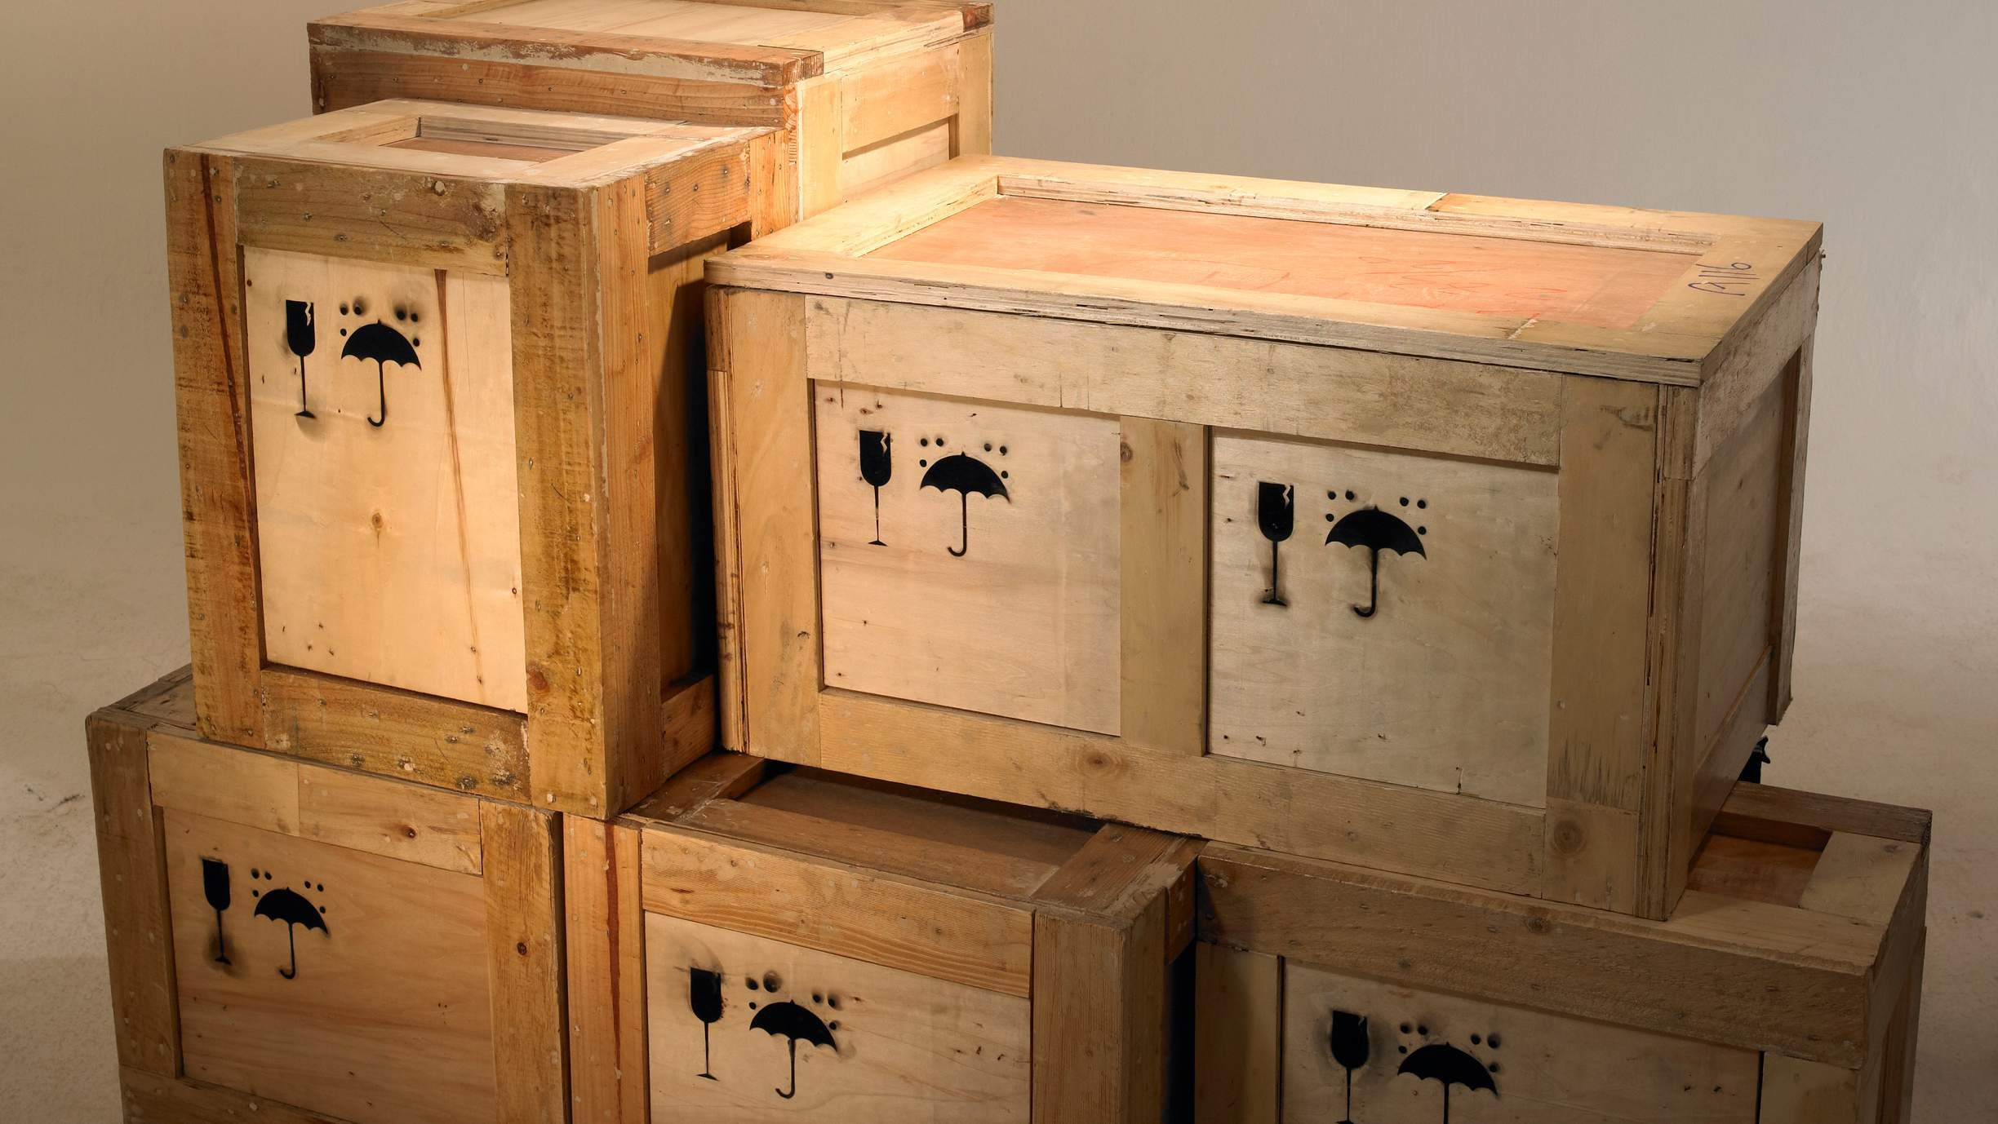

KEY INSIGHTS
MARKET SIZE
USD 9.2 billion
2023
20₋23
CAGR 7.60%
2030

Slide 4
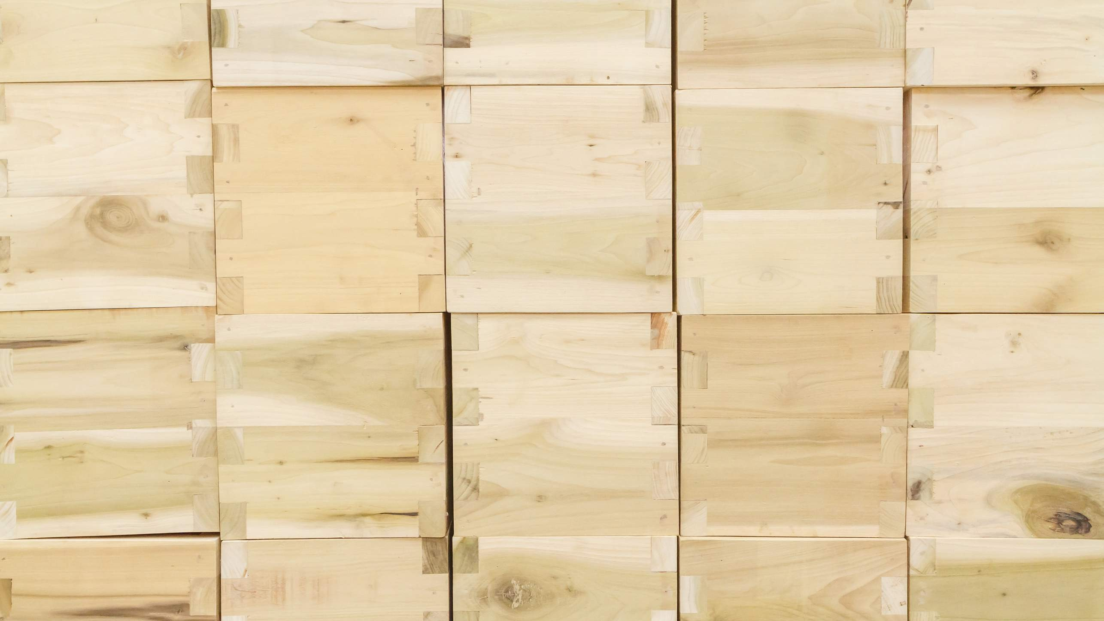
REVENUE MARKET SHARE BY SEGMENTS 2022
Teak Wood Sandal Wood Bamboo Wood Ply Wood
Type Segment
Retail Packaging Industrial Packaging
Application Segment
Food and Beverages Packaging
Electrical and Electronics Packaging
End-User Segment

Slide 5
Global Wooden Boxes Market Revenue share for 2022
Asia-Pacific 7.60%

Slide 6

Increasing Need For Innovative Wood Packaging Boxes Is Expected To Propel Market Growth
Drivers
Adverse Effects on the Environment Caused by Tree Cutting Wooden Boxes Market to Hinder Market Growth
Restraints

Slide 7
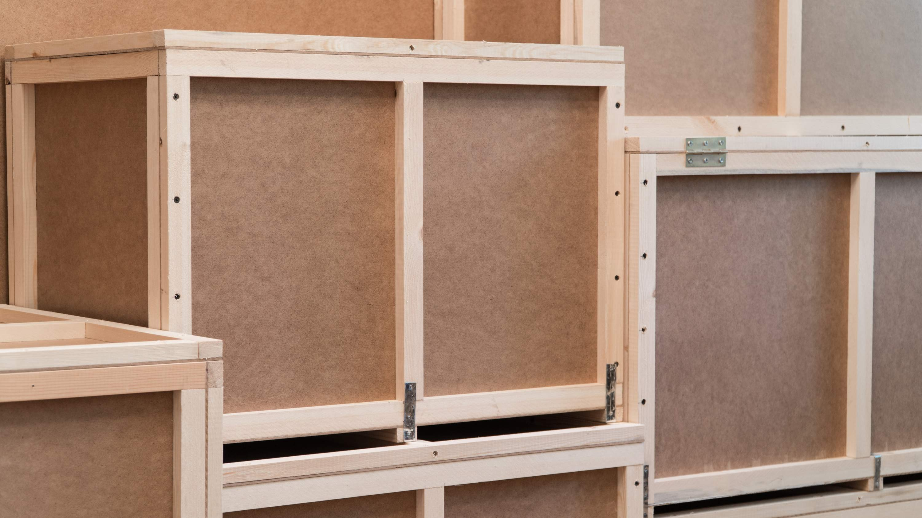
AUTHOR'S PERSPECTIVE
The Global Wooden Boxes Market is witnessing significant growth in the near future. Bamboo wood is the second most popular segment because it is lightweight and easily transported; bamboo also offers a low-maintenance trait that adds to its overall cost-effectiveness and convenience when making wooden boxes, especially in light of the increasing global emphasis on sustainable and ecologically friendly materials.
Industrial Packaging is the second-most popular application because wood is a cost- effective solution for industrial packaging, and it can be tailored and adapted to meet varied product specifications, forms, and sizes. Industrial packaging protects items during storage, handling, and transportation.

Slide 8
KEY PLAYERS

Slide 9


Contact us
For Full Report
COGNITIVE MARKET RESEARCH
Tel: + 1 312 - 376 - 8303 | + 44 020 - 8123 - 0732
India: ( + 91 ) 983 - 496 - 8611
sales@ cognitivemarketresearch. com
Access the Full Report : http://tinyurl.com/4arek3b9
Please visit our website:
https://www.cognitivemarketresearch.com

