Slide 1

GLOBAL
WIG
MARKET REPORT
2024
Global,Regional,CountryAnalysis

Slide 2

INTRODUCTION
Hair wigs and hair extensions are artificial hair additions used by both men and women to achieve a certain hairstyle and cover up balding or bald patches caused by alopecia or hair loss. Hair wigs and extensions are an increasing section of women's beauty and personal care. Extensions have recently gained appeal among women, resulting in a substantial transition fueled by rising per capita spending on fashion accessories. Women with short hair often use an extension to make it appear longer. Extensions will expand rapidly during the projection period due to their availability in various colors, although demand for hair wigs is expected to remain stable.

Slide 3


KEY INSIGHTS
CAGR
USD 3915.2 million
2023
CAGR
7.90%
2023- 2030

Slide 4
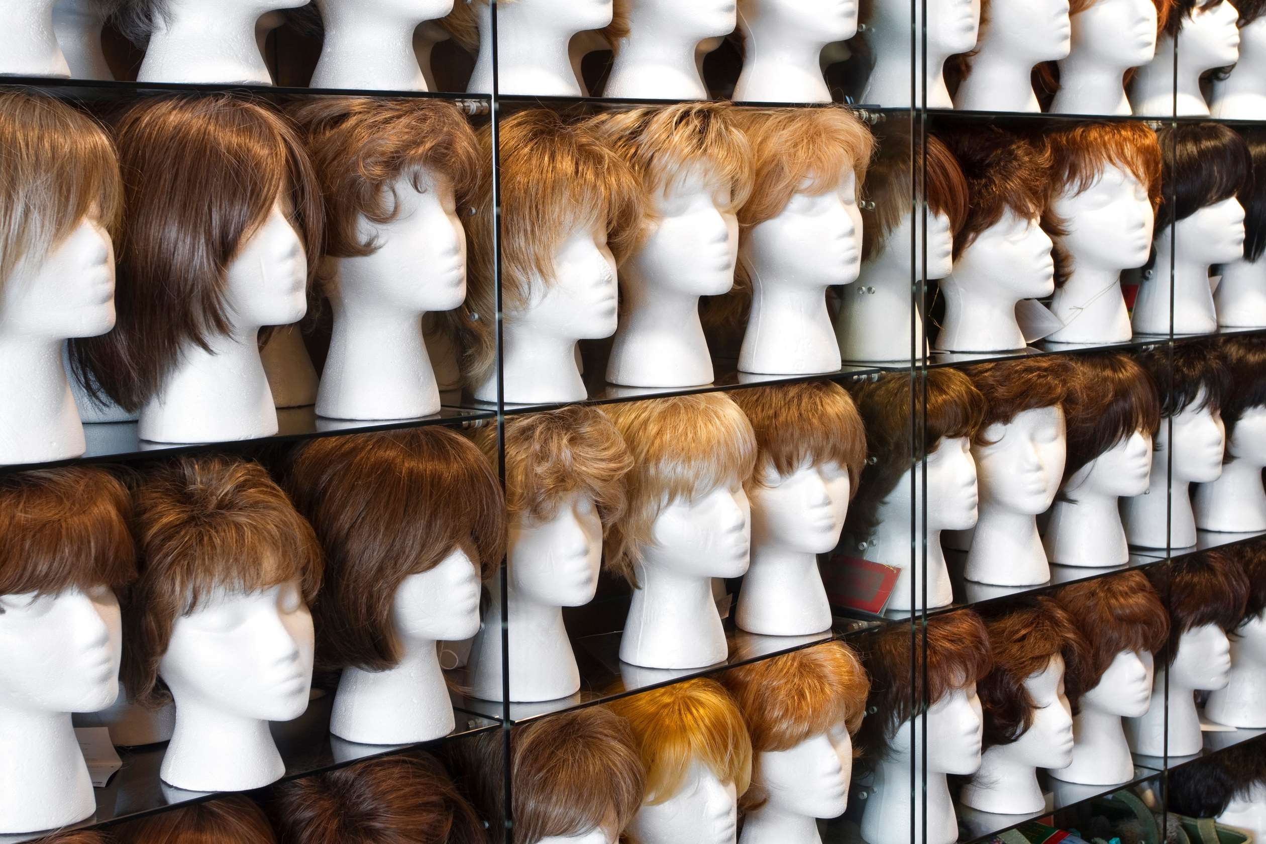
REVENUE MARKET SHARE BY SEGMENTS 2022
  Hair extension Wig
  Full head hair wigs
Material Segment
  Synthetic Wig
  Natural hair Wig
Type Segment
  Men
  Women
  Youth
  Commercial Users
  Individual Users
Application Segment
End-use Segment

Slide 5

Global Wig Market Revenue share for 2024
North America
40%

Slide 6

Mounting Mandates for Superior Goods to Propel Market Growth
Drivers
The High Cost & un-comfortability of Hair Wigs to Limit the Sales
Restraints

Slide 7
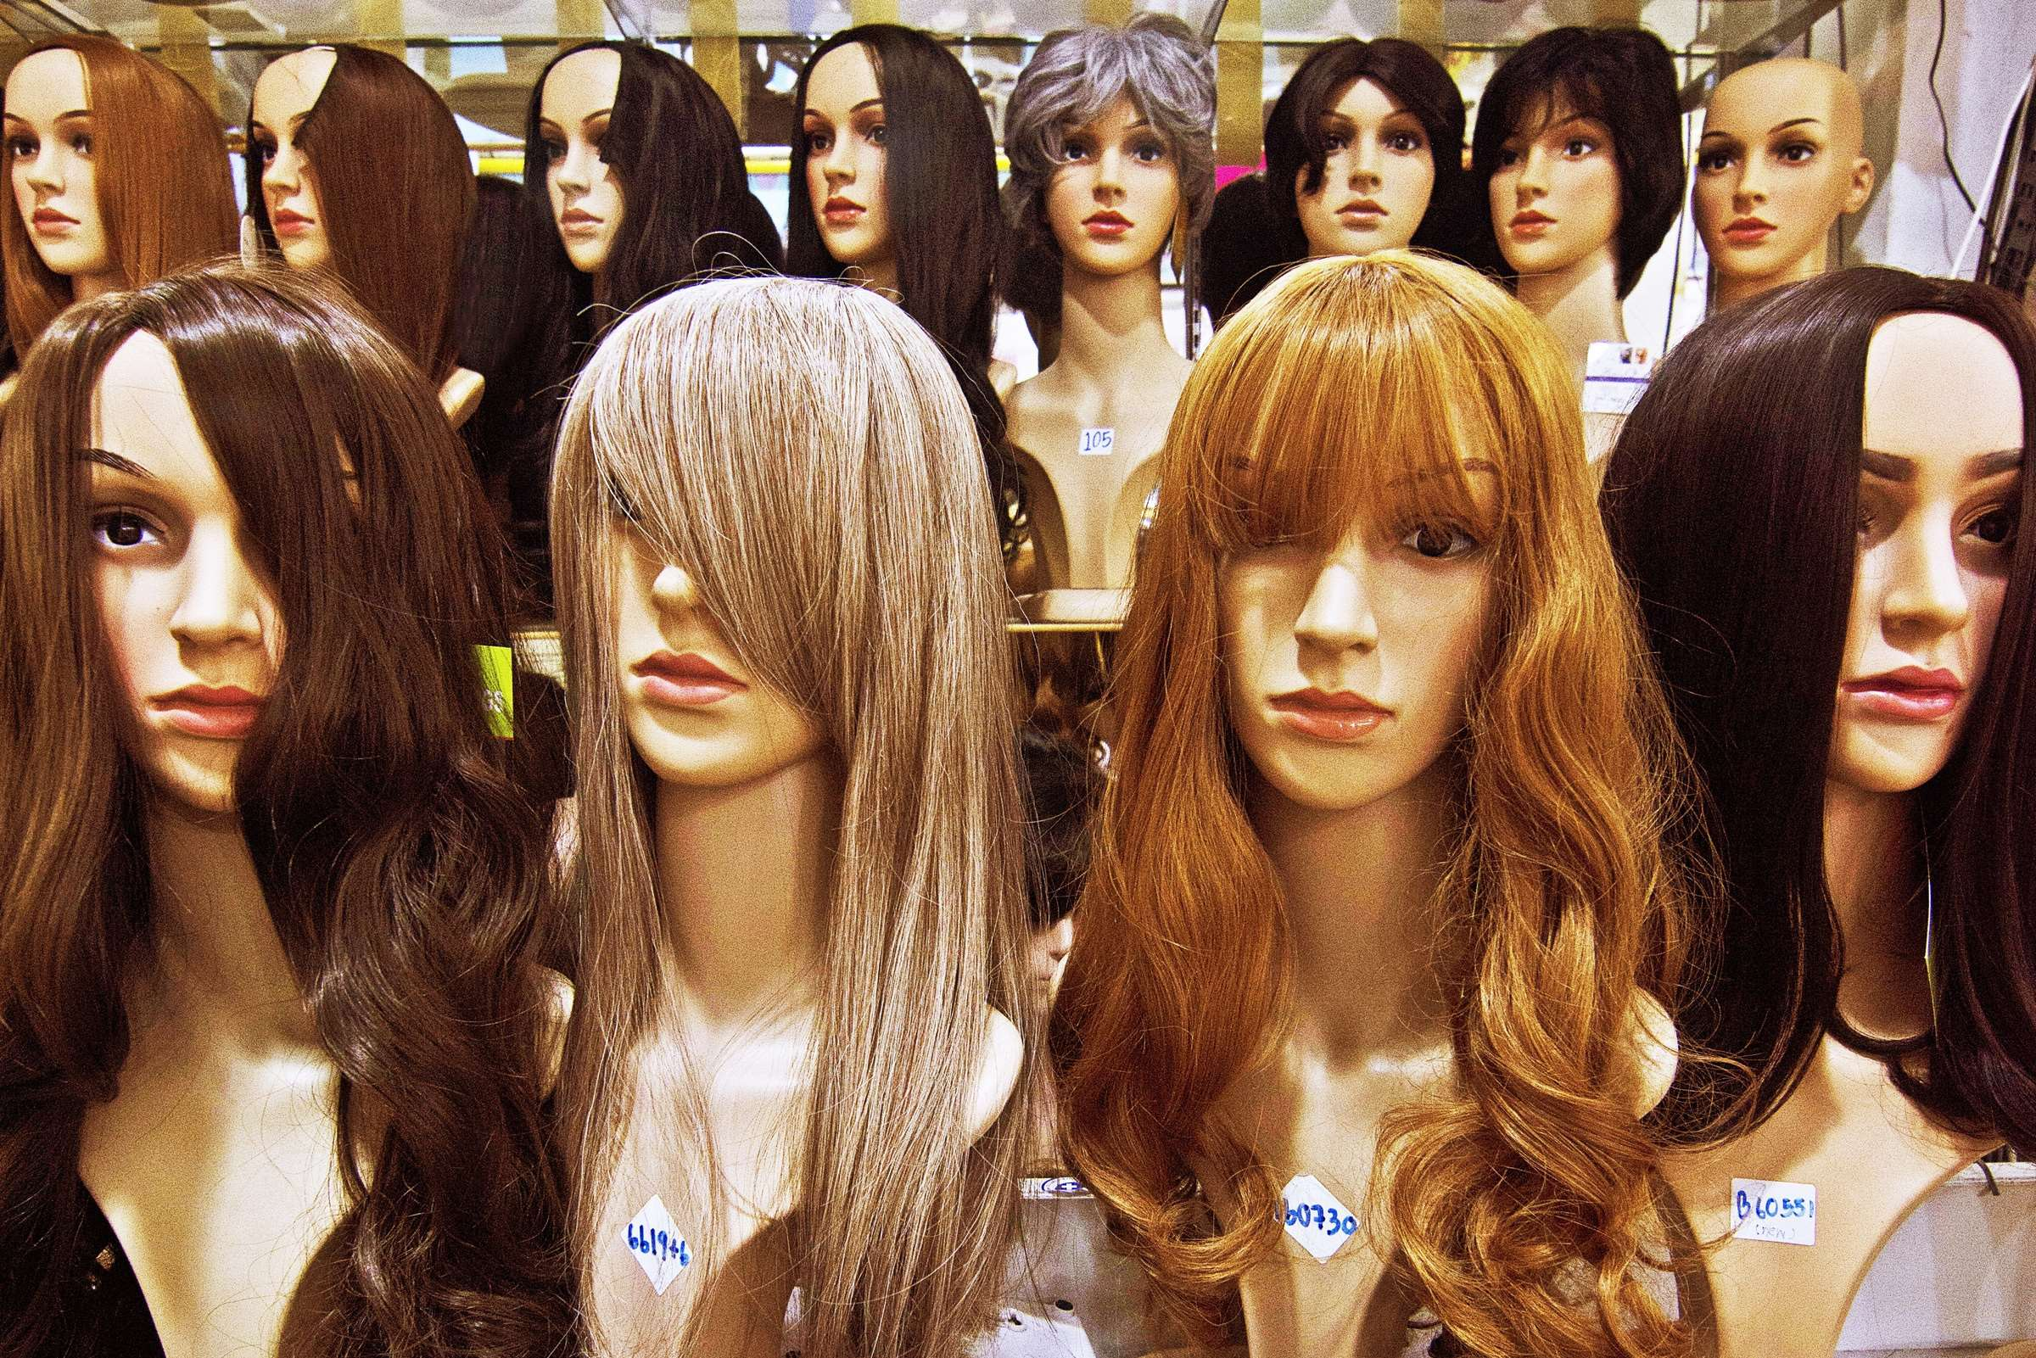
AUTHOR'S PERSPECTIVE
  The full-head hair wigs segment is set to rise. These wigs give off the most realistic impression with their full head coverage. They are constructed from a range of materials, including a combination of synthetic and human hair.
  Demand for wigs is higher because women utilize them for various fashion purposes, such as experimenting with different haircuts, colors, and lengths.
  The natural hair wig held the highest wig market revenue share in 2024.

Slide 8








KEY PLAYERS

Slide 9


For Full Report
Contact us
COGNITIVE MARKET RESEARCH
Tel: +1 312-376-8303 | +44 020-8123-0732
India: (+91) 983-496-8611
sales@cognitivemarketresearch.com
Access the Full Report : https://tinyurl.com/5863nhkv
Please visit our website:
https://www.cognitivemarketresearch.com

