Slide 1


WHEEL
MARKET REPORT
2024
Qualitative Analysis + Quantitative Analysis

Slide 2

INTRODUCTION
The wheel market encompasses a wide array of products used in various industries, primarily automotive, aerospace, and industrial sectors. Wheels are integral components of vehicles, aircraft, and machinery, playing a crucial role in mobility, load-bearing, and performance. The market for wheels is dynamic, influenced by factors such as technological advancements, changing consumer preferences, and regulatory requirements.

Slide 3


KEY INSIGHTS
MARKET SIZE
USD 36142.2 million
2024
CAGR
5.50%
2024- 2031

Slide 4
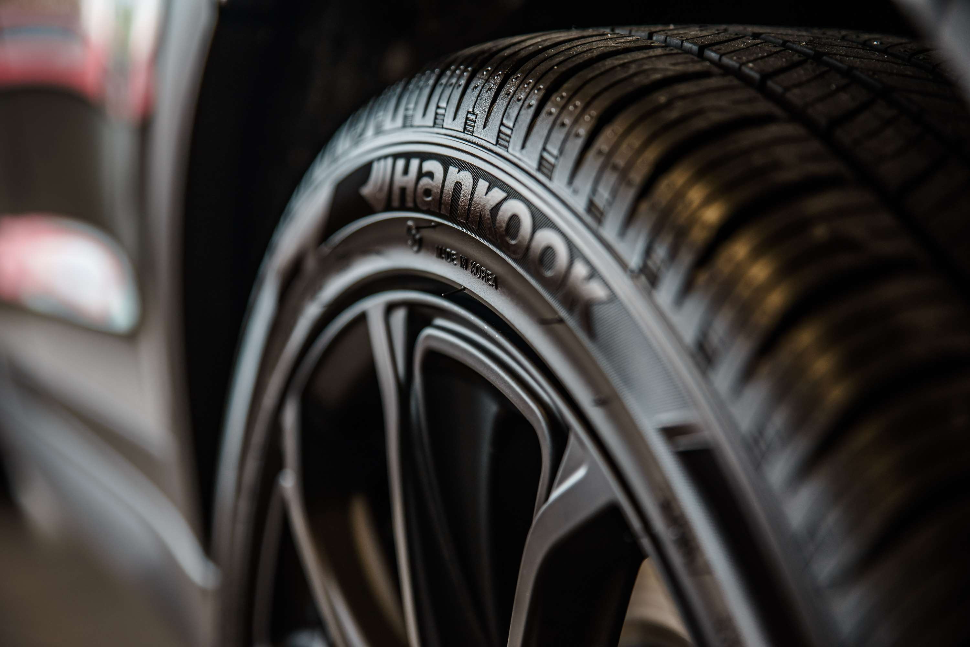
REVENUE MARKET SHARE BY SEGMENTS 2024
  Passenger Vehicle
  Light Commercial Vehicle
  Heavy Commercial Vehicle
  13-15
  16-18
  19-21
  >21 inch
Application Segment
Vehicle Type Segment
  Steel
  Alloy
  Carbon Fiber
  Economy
  Mid-Priced
  Luxury-Priced
Material Segment
Vehicle Class Segment
  Construction & Mining
  Agriculture Tractors
  OEM
  Aftermarket
Off-highway Segment
End-Use Segment

Slide 5

REGION ANALYSIS
NORTH AMERICA
Europe
Asia Pacific
Latin America
MIDDLE EAST AFRICA
USD 14456.88 million
USD 10842.66 million
USD 8312.71 million
USD 1807.11 million
USD 722.84 million

Slide 6

  Increasing Demand for Lightweight and Fuel-Efficient Vehicles to Increase the Demand Globally
  Growing Automotive Industry and Vehicle Production to Propel Market Growth
Drivers
Restraints
Fluctuating Raw Material Prices to Limit the Sales

Slide 7
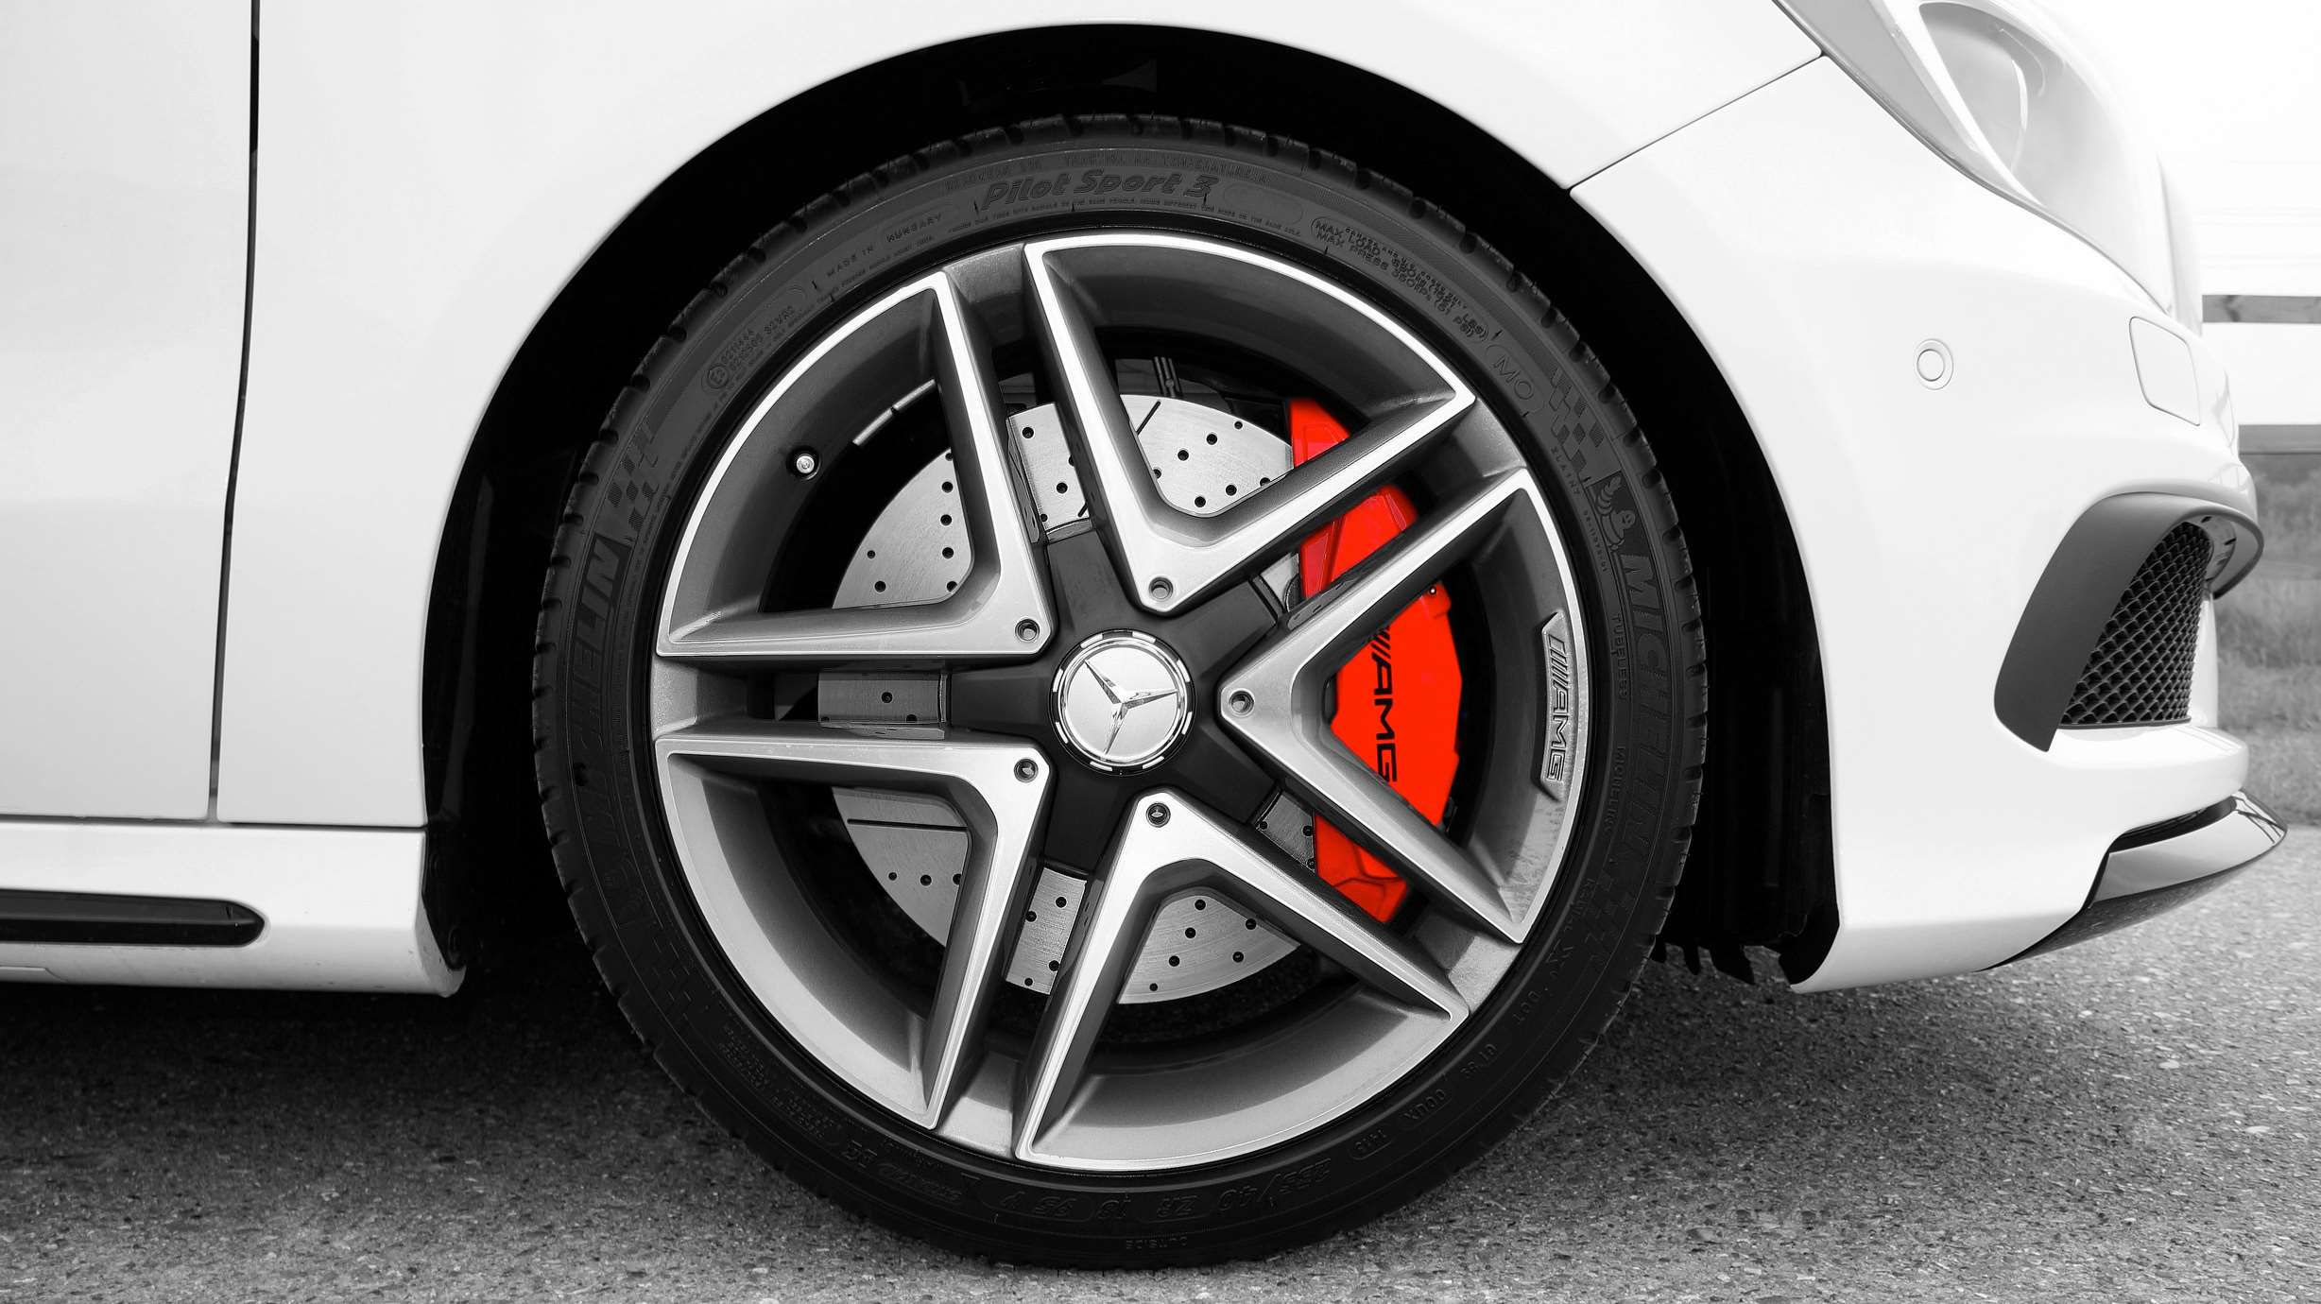
AUTHOR'S PERSPECTIVE
  The global Wheel market will expand significantly by 5.50% CAGR between 2024 to 2031.
  The dominant rim size category is the 16-18 inch segment. These sizes are popular among a wide range of vehicles, including sedans, SUVs, and trucks. Vehicles in this category often prioritize a balance between performance, comfort, and style, making the 16-18 inch rims a popular choice.
  The dominant material category is alloy wheels. Alloy wheels offer several advantages over steel wheels, including lighter weight, better heat conduction, and improved aesthetics. Vehicles equipped with alloy wheels often have a more premium look and feel, making them a popular choice among consumers.

Slide 8
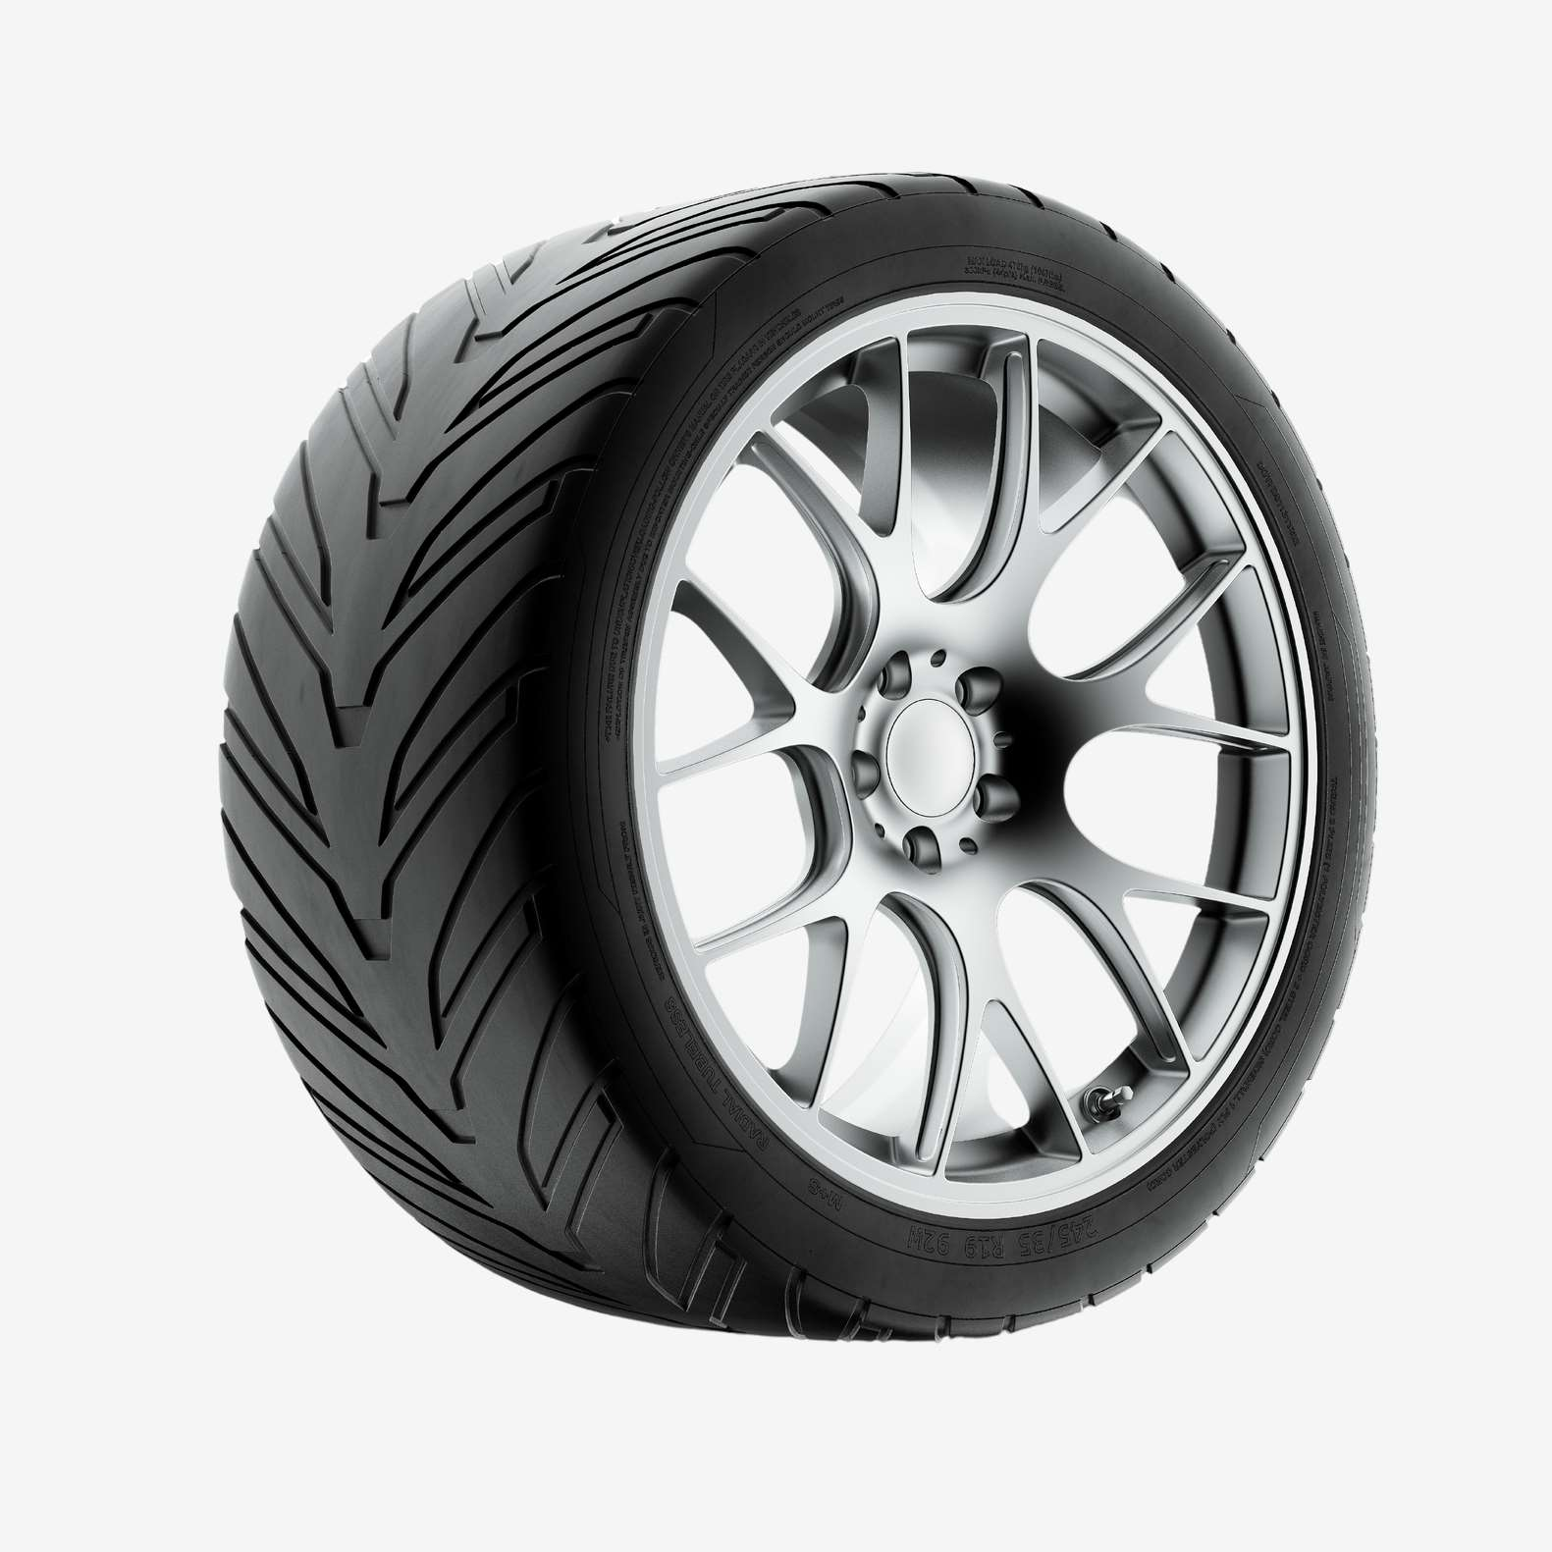





KEY PLAYERS

Slide 9


For Full Report
Contact us
COGNITIVE MARKET RESEARCH
Tel: +1 312-376-8303 | +44 020-8123-0732
India: (+91) 983-496-8611
sales@cognitivemarketresearch.com
Access the Full Report : https://tinyurl.com/yczryzwu
Please visit our website:
https://www.cognitivemarketresearch.com

