Slide 1
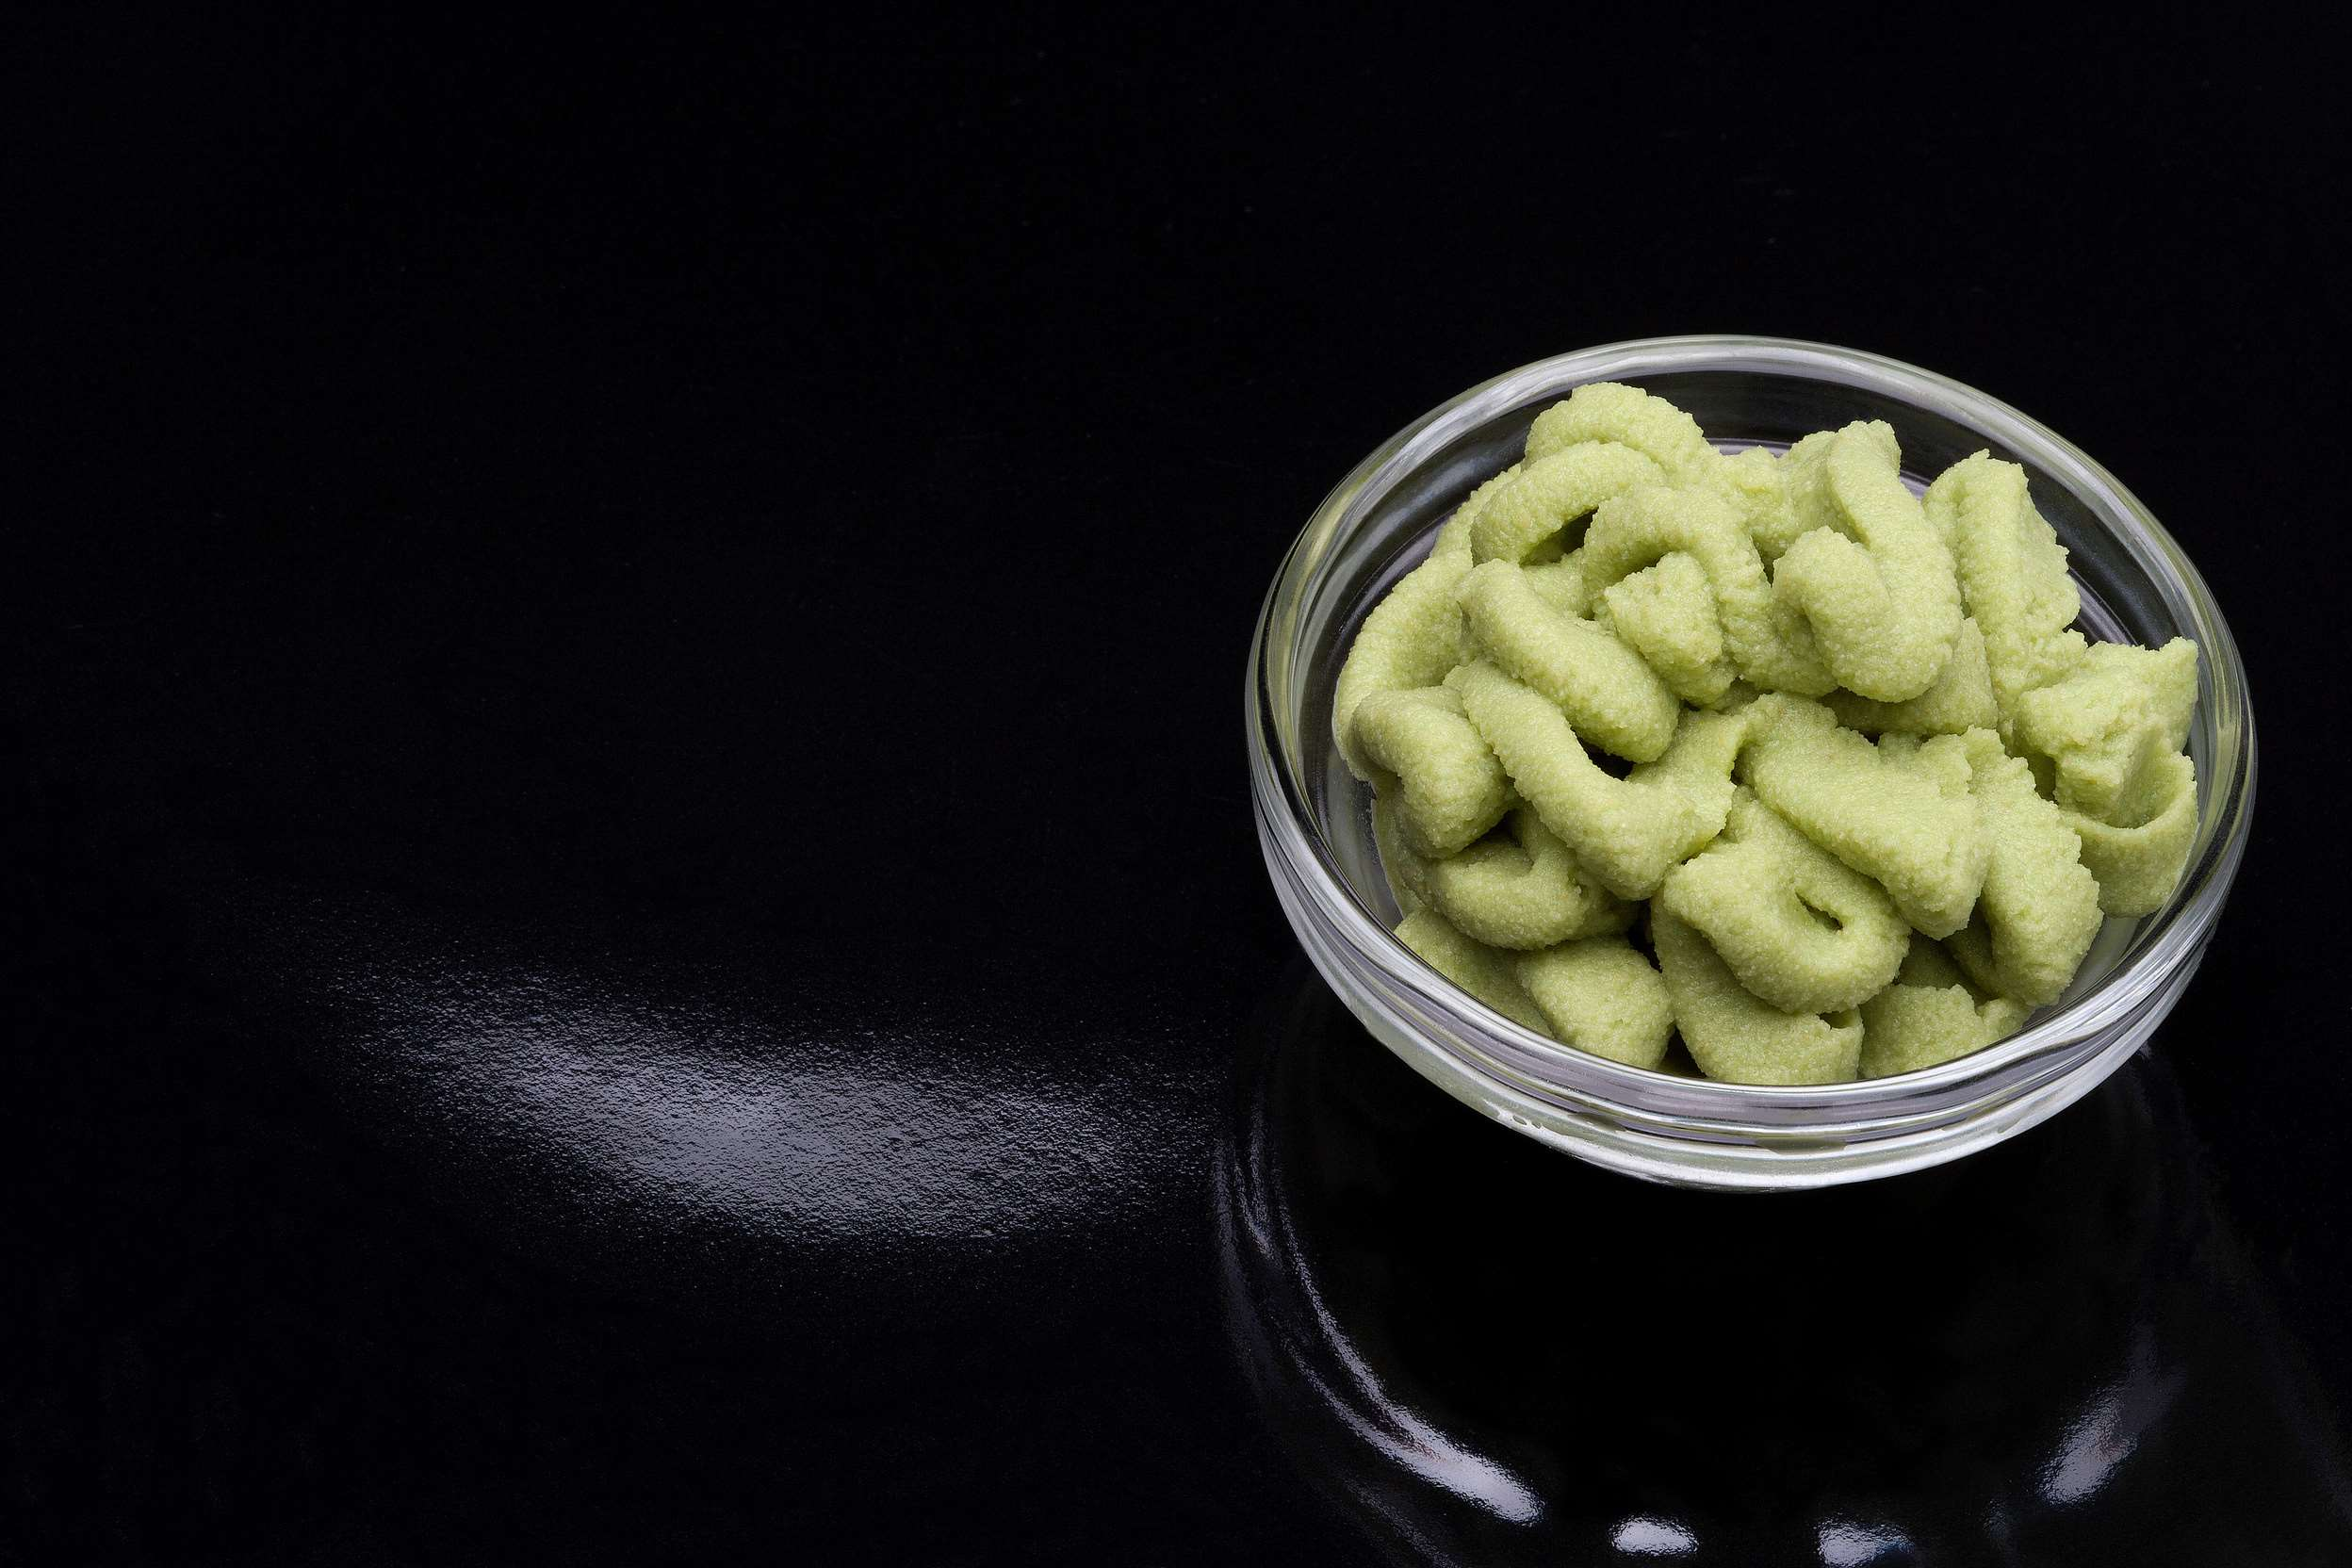

WASABI POWDER
MARKET REPORT
2024
Qualitative Analysis + Quantitative Analysis

Slide 2
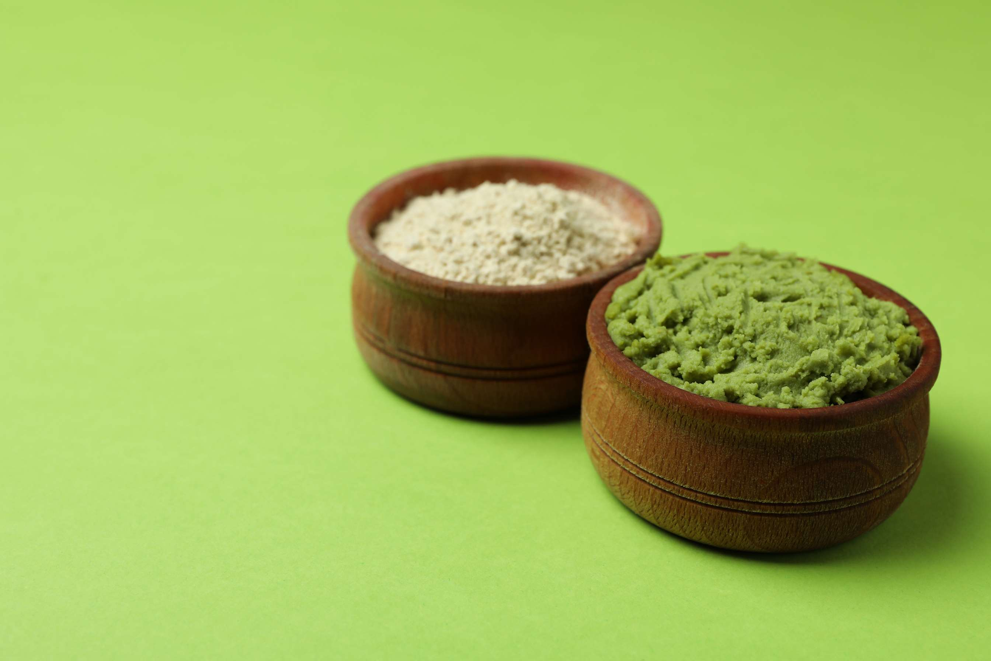
INTRODUCTION
The wasabi powder market refers to the industry segment involved in the production, distribution, and sales of powdered forms of the Japanese condiment known as wasabi. The Wasabi Powder Market caters to the demand for this pungent and flavorful condiment derived from the rhizome of the Wasabia japonica plant. Wasabi powder is a popular ingredient in Japanese cuisine, known for its distinctive taste and aroma, often used in sushi, sashimi, and other traditional dishes. Driven by the growing popularity of Asian cuisine worldwide, the market for wasabi powder has witnessed steady growth in recent years. Additionally, the increasing awareness of the health benefits associated with wasabi, such as its antimicrobial and anti-inflammatory properties, has further fueled market demand.

Slide 3
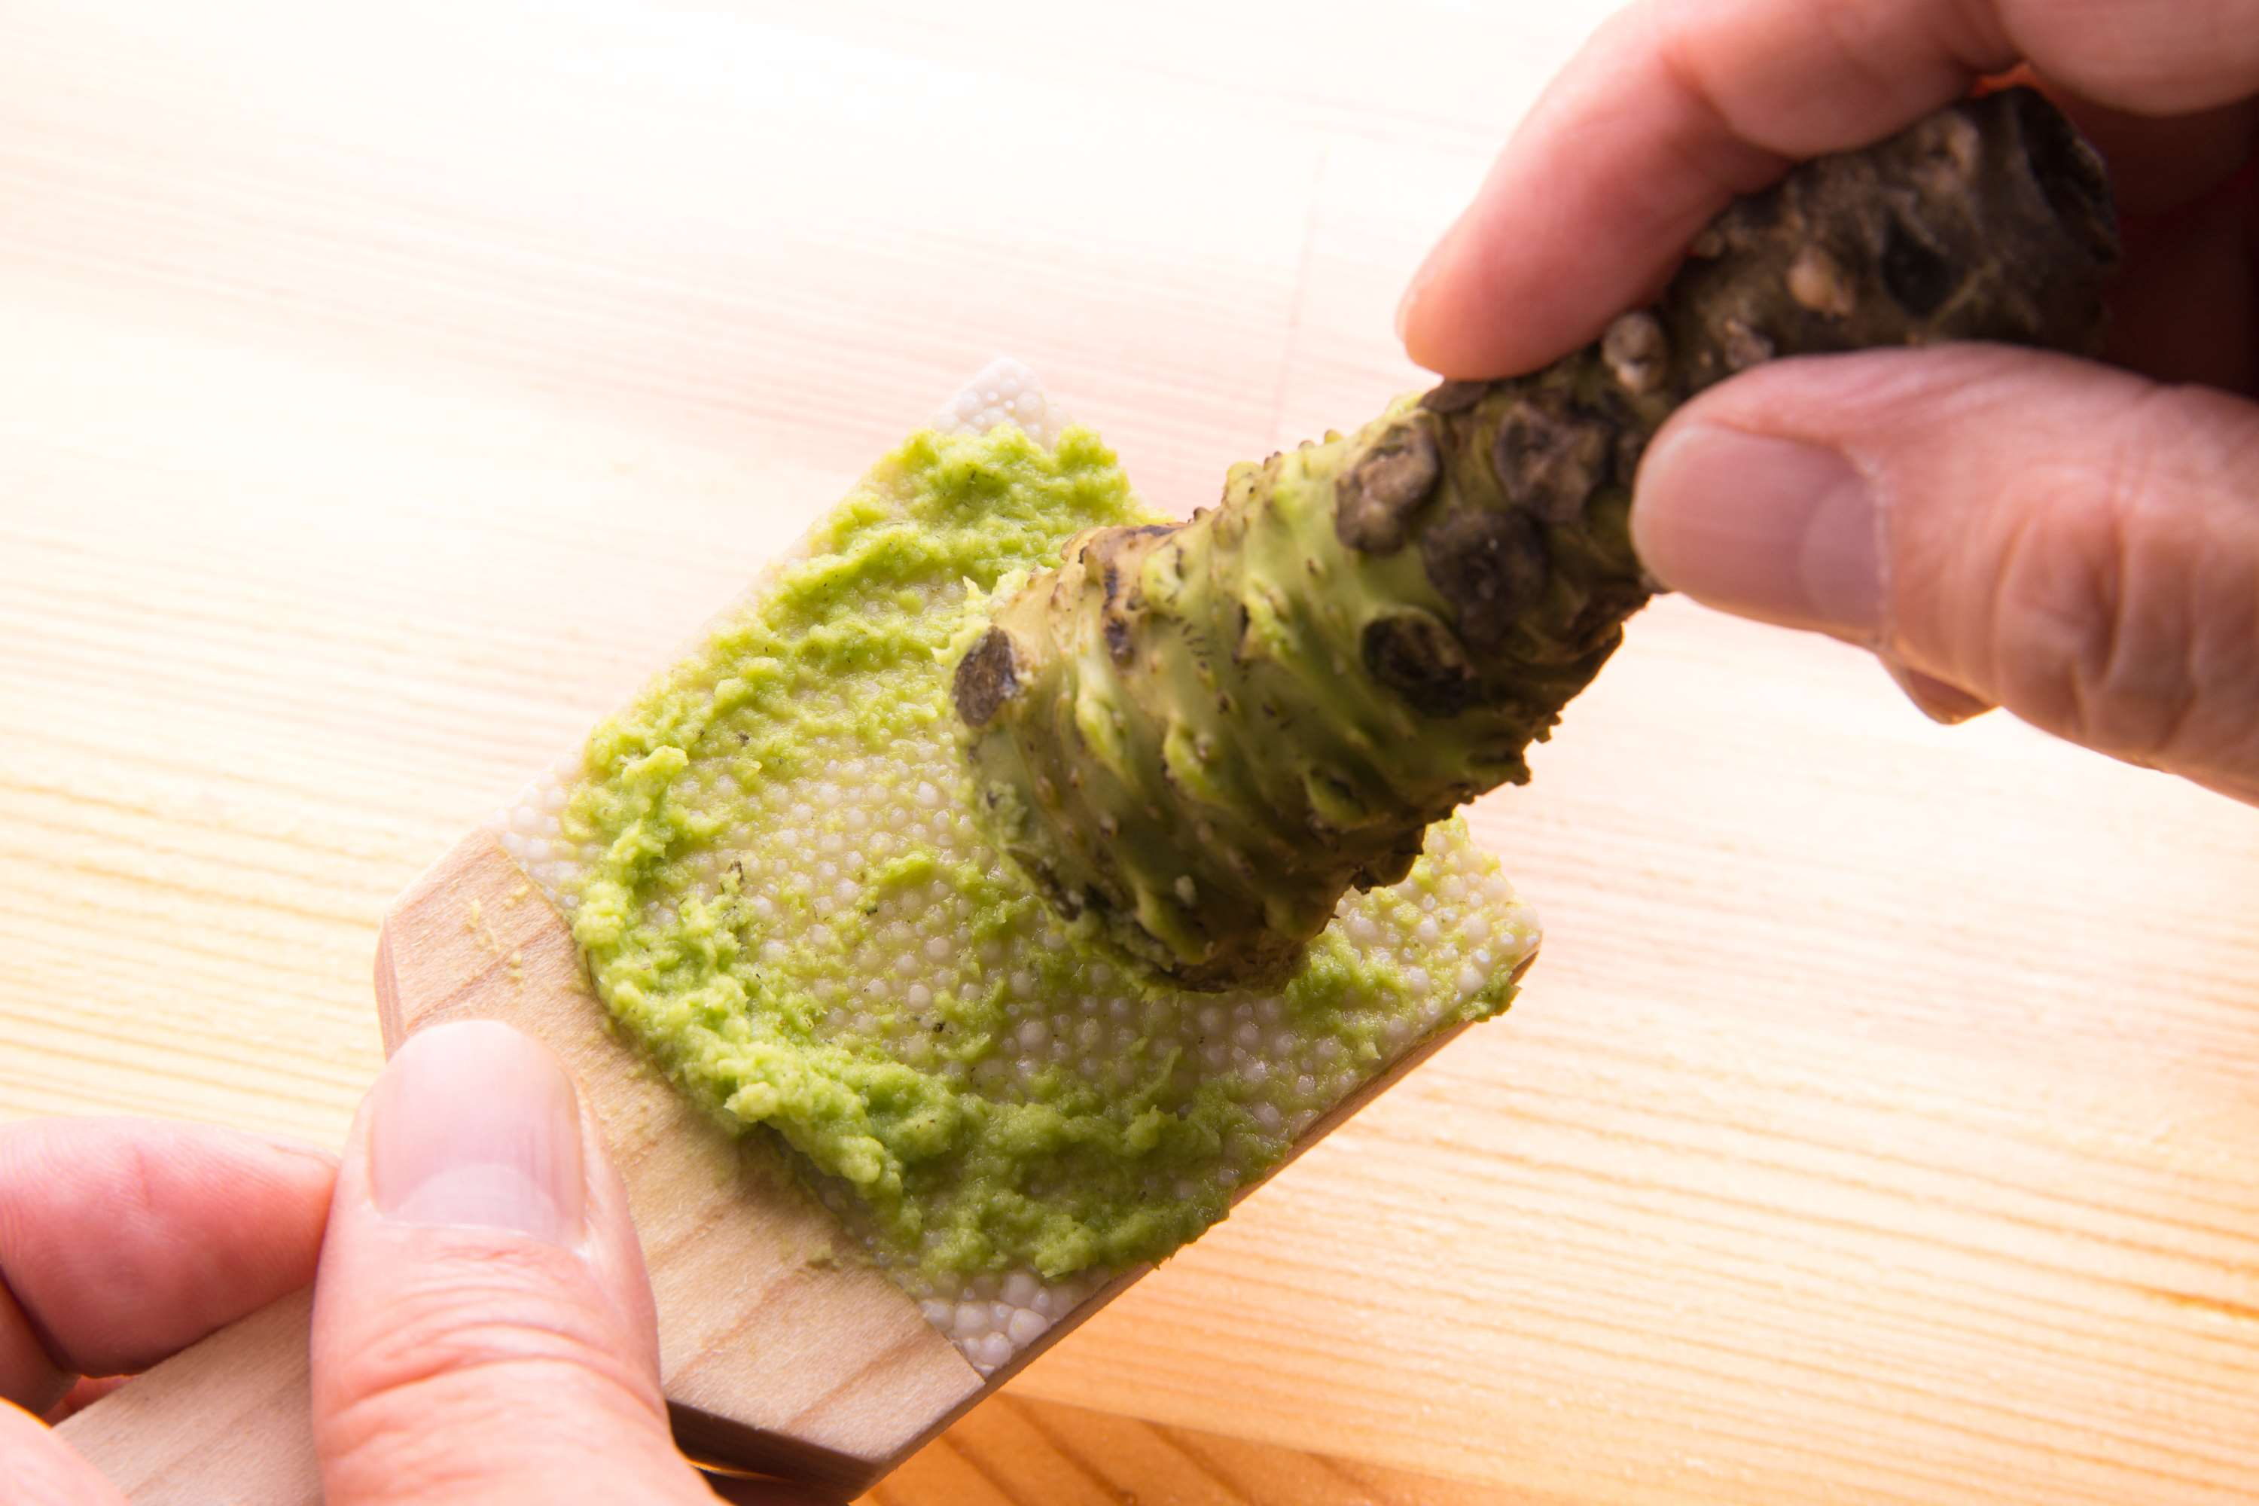

KEY INSIGHTS
MARKET SIZE
USD 518.2 million
2024
CAGR
6.00%
2024- 2031

Slide 4
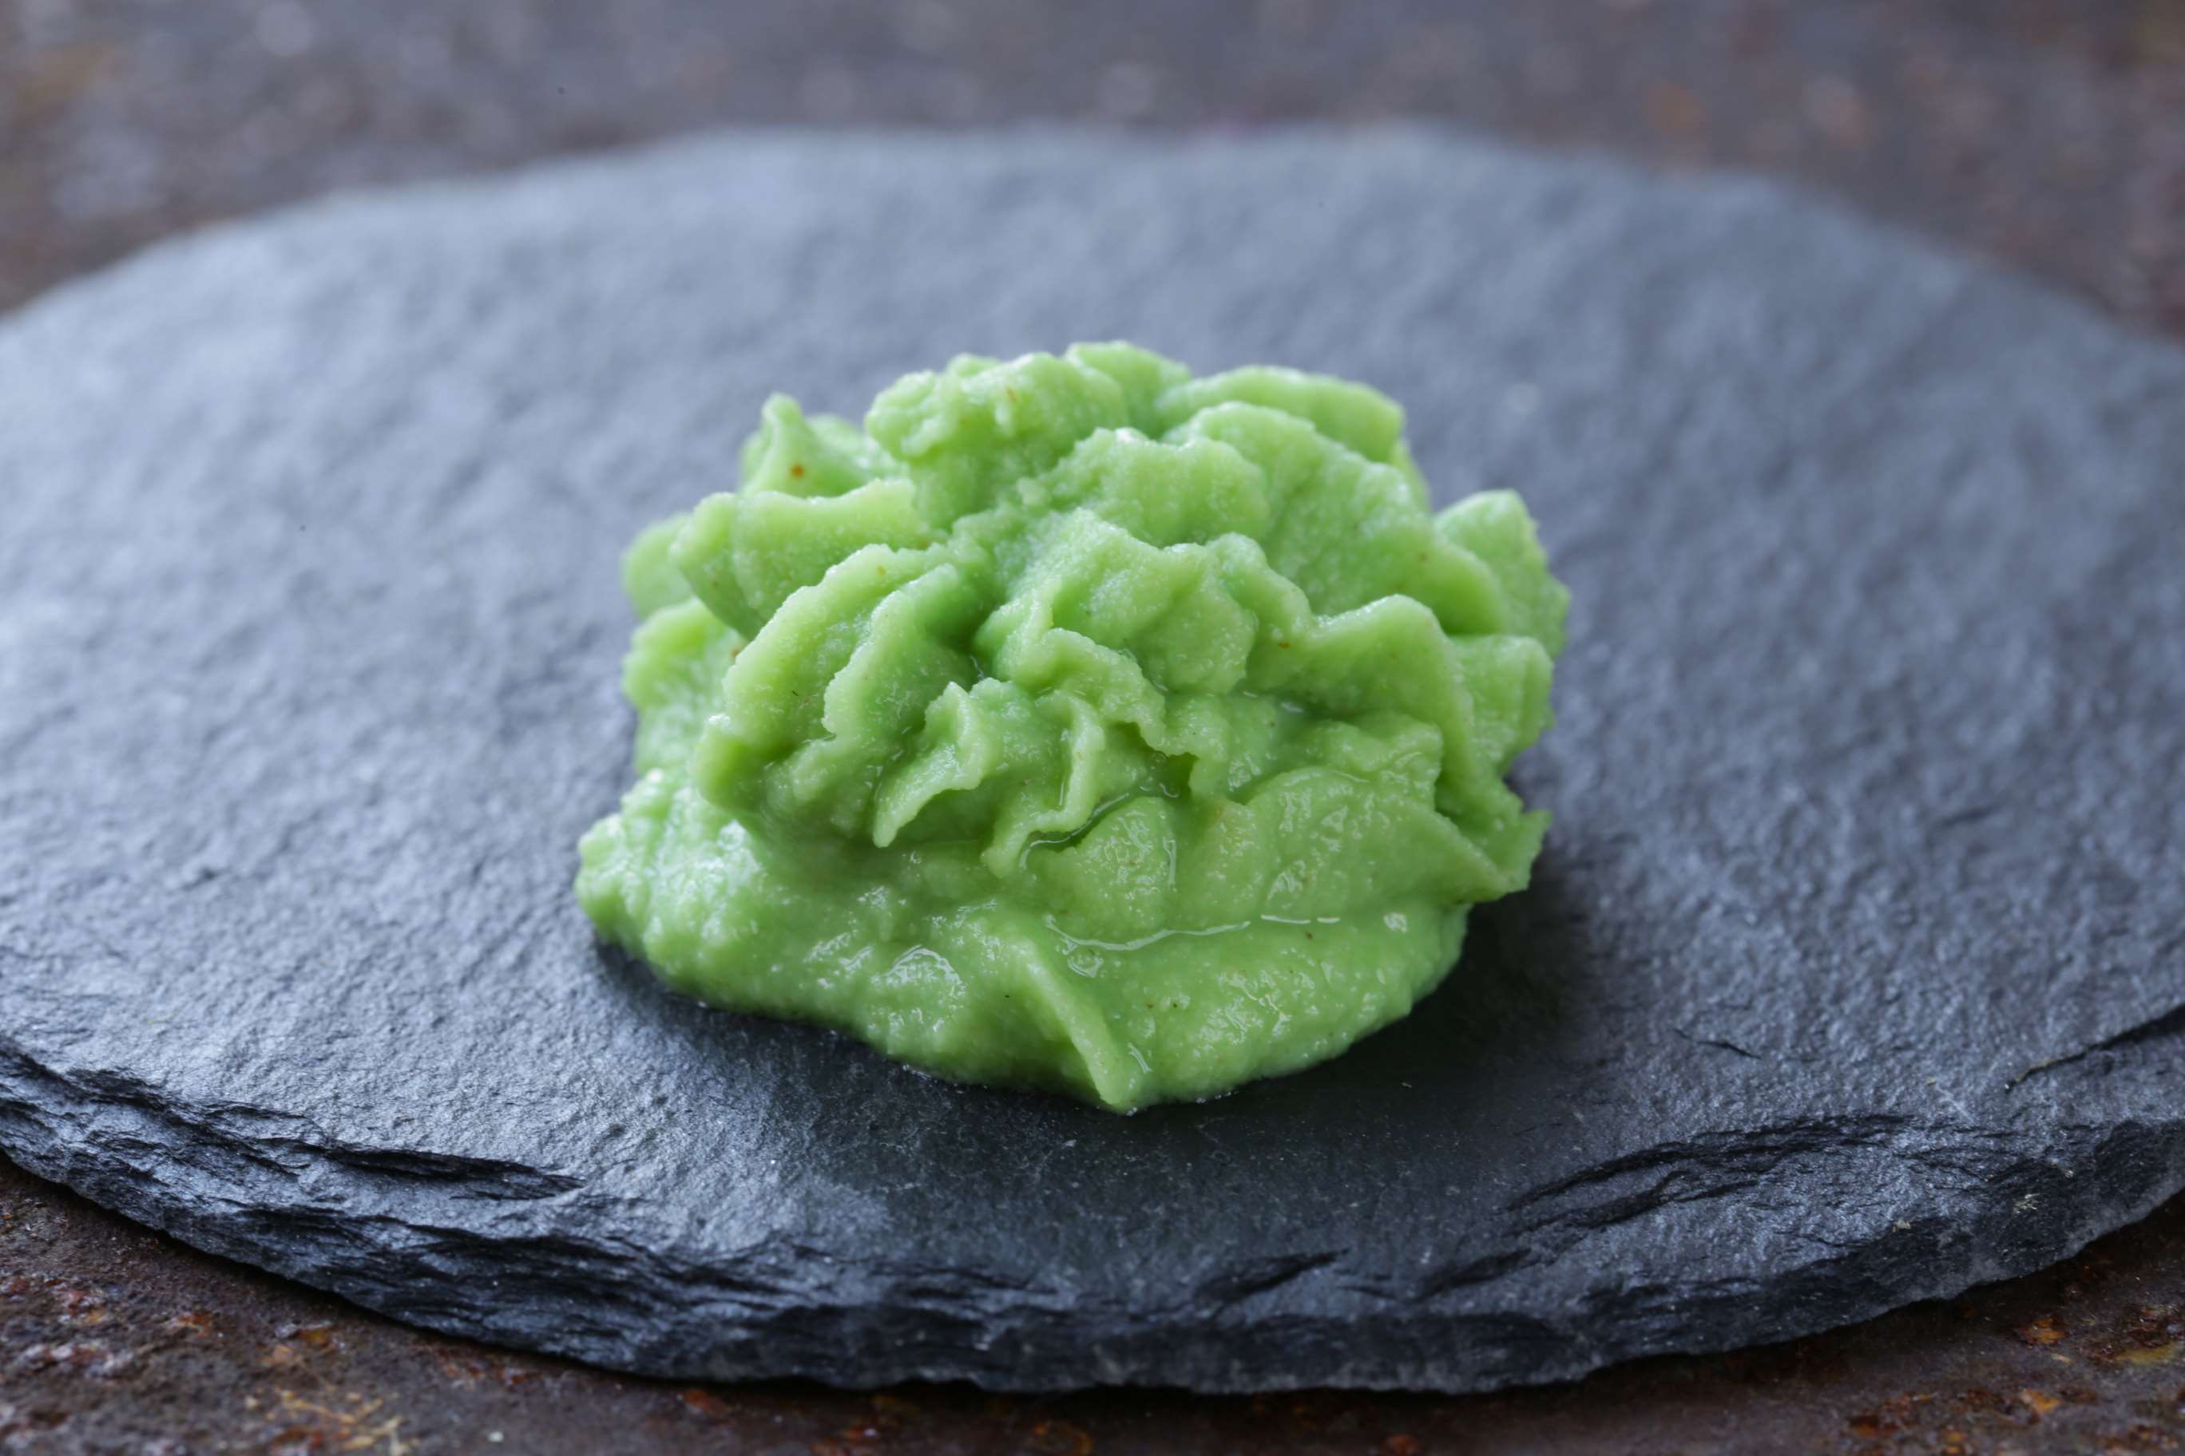
REVENUE MARKET SHARE BY SEGMENTS 2024
  Green Wasabi Powder dominates the market due to its traditional use in Japanese cuisine and its distinctive flavor and aroma.
  Yellow Wasabi Powder emerges as the fastest-growing segment in the Wasabi Powder Market.
Type Segment
  Food Service represents the largest segment in the Wasabi Powder Market, driven by the widespread use of wasabi powder in restaurants, sushi bars, and catering services.
  Retail emerges as the fastest-growing segment in the Wasabi Powder Market.
Application Segment

Slide 5

REGION ANALYSIS
NORTH AMERICA
Europe
Asia Pacific
Latin America
MIDDLE EAST AFRICA
40%
30%
23%
5%
2%
North America Wasabi Powder Market Revenue share for 2024 is 40%

Slide 6
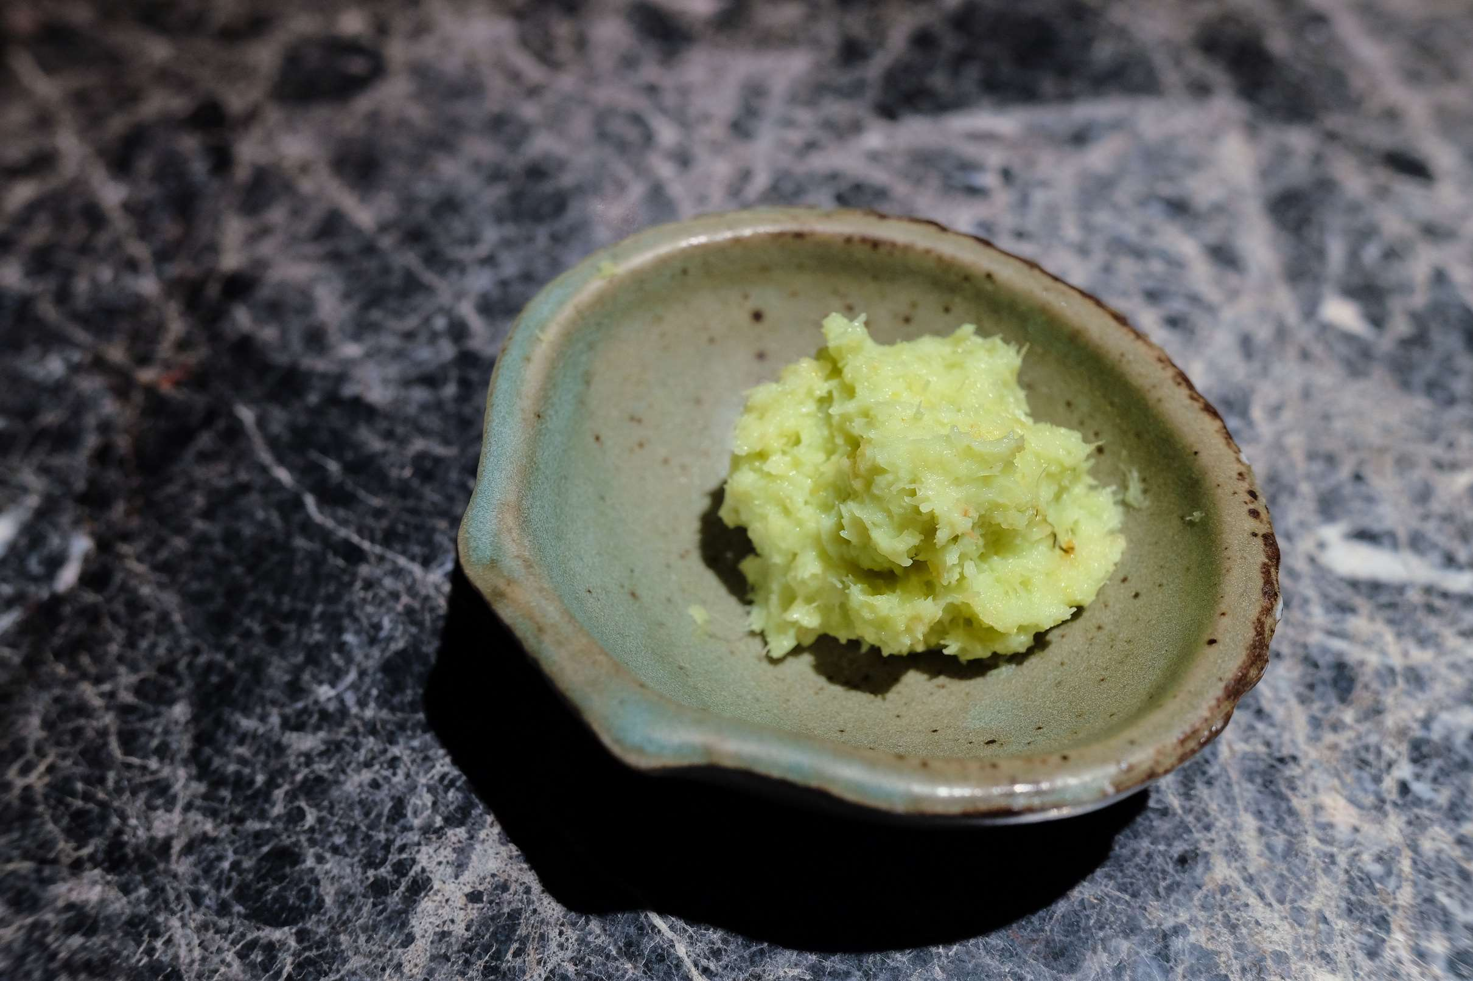
  Increasing Demand for Asian Cuisine Globally to Increase the Demand Globally
  Growing Awareness of Health Benefits to Propel Market Growth
Drivers
Restraints
Limited Cultivation Areas and Production Challenges

Slide 7
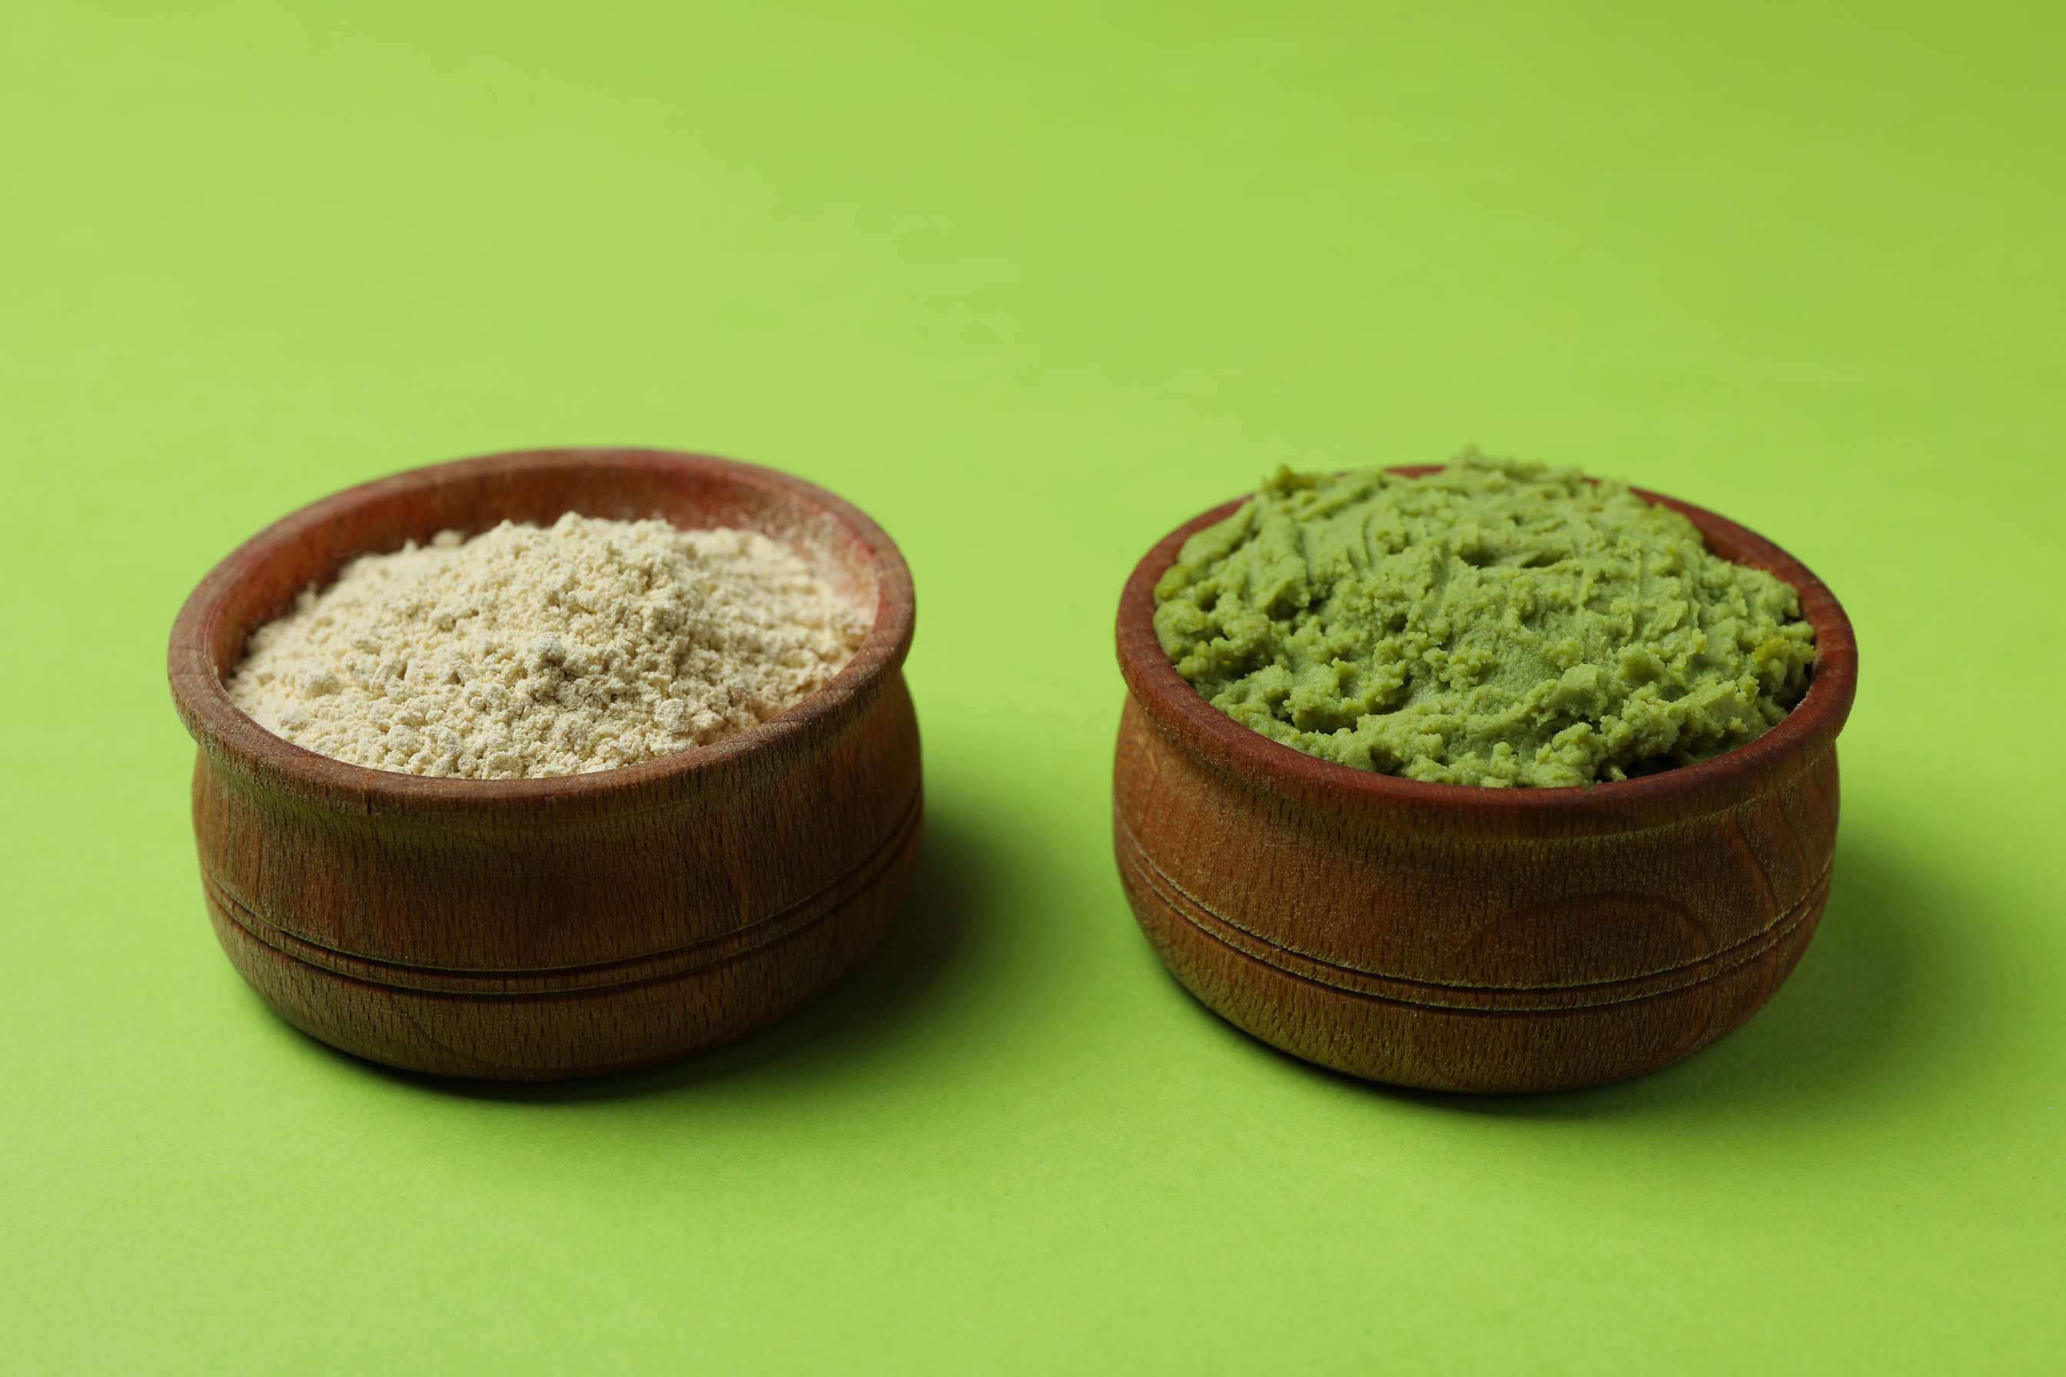
AUTHOR'S PERSPECTIVE
  The global Wasabi Powder Market will expand significantly by 6.00% CAGR between 2024 to 2031. Offline sales channels, including supermarkets, specialty food stores, and Asian grocery stores, dominate the Wasabi Powder Market.
  These channels offer consumers convenient access to a wide range of food products, including wasabi powder, and provide opportunities for product sampling and in-store promotions to drive sales. Green Wasabi Powder dominates the market due to its traditional use in Japanese cuisine and its distinctive flavor and aroma.
  It is widely preferred for its authenticity and is commonly used in sushi, sashimi, and other Asian dishes.

Slide 8







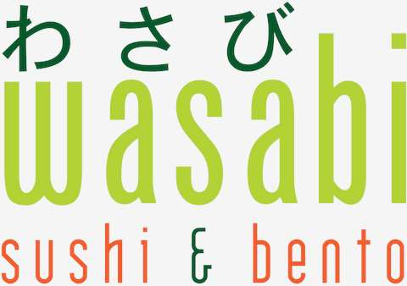

KEY PLAYERS

Slide 9


For Full Report
Contact us
COGNITIVE MARKET RESEARCH
Tel: +1 312-376-8303 | +44 020-8123-0732
India: (+91) 983-496-8611
sales@cognitivemarketresearch.com
Access the Full Report : https://tinyurl.com/4cazd2m9
Please visit our website:
https://www.cognitivemarketresearch.com

