Slide 1
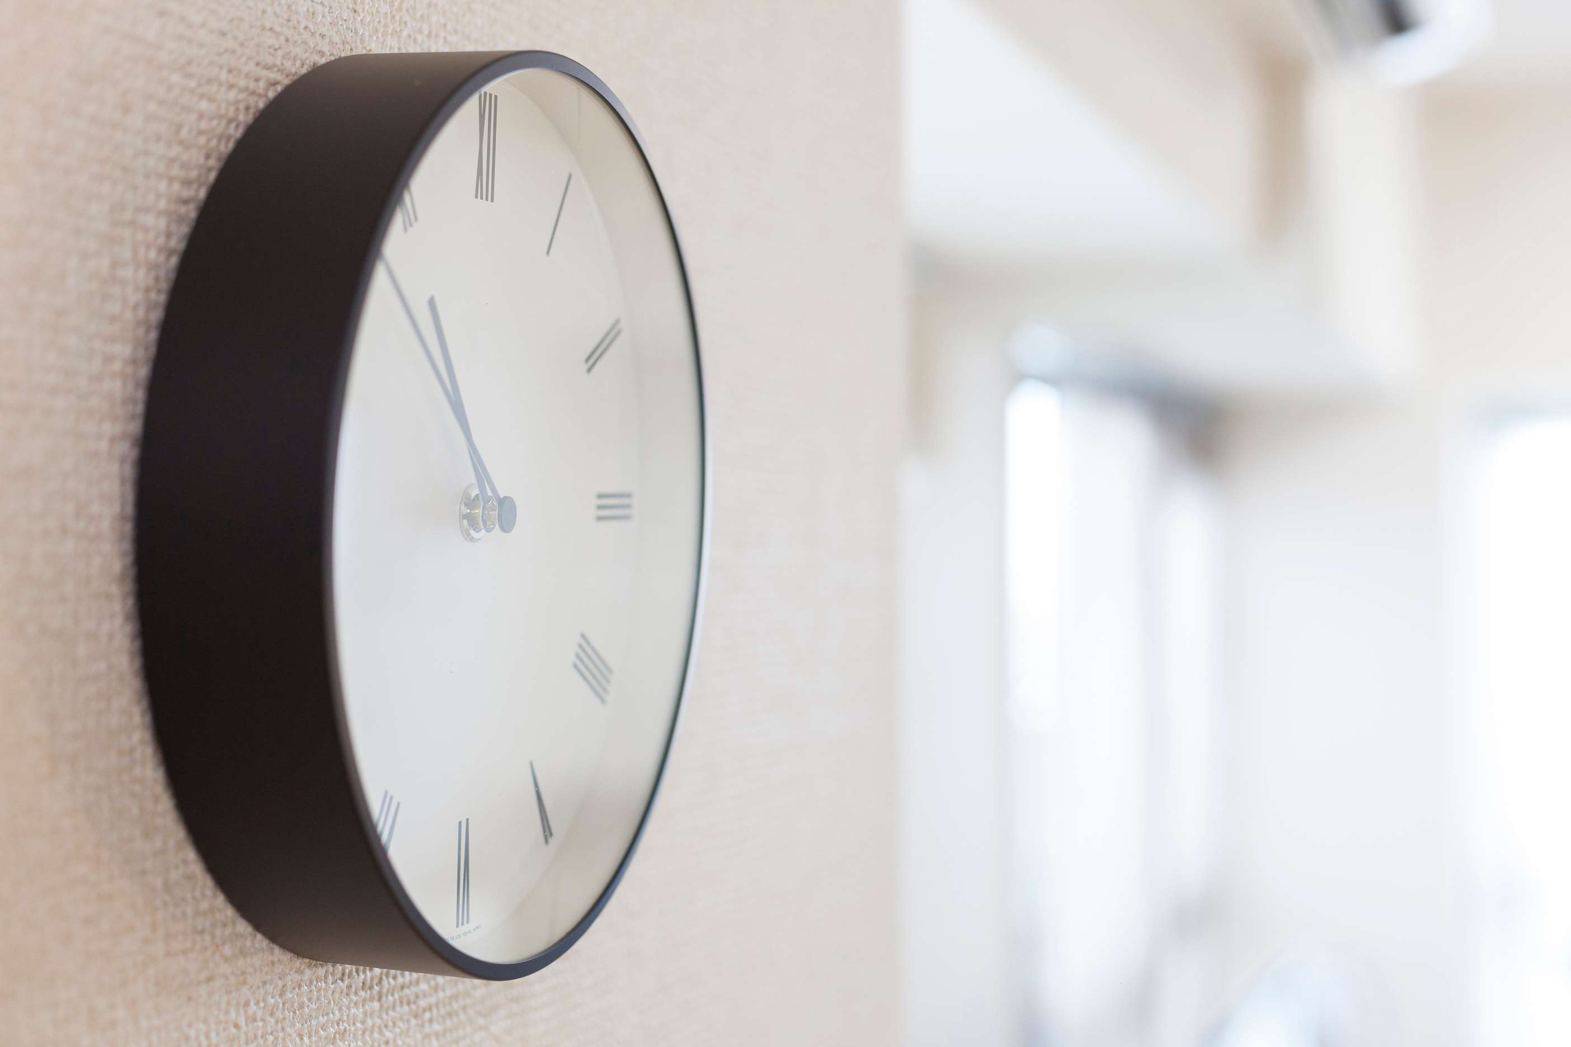
GLOBAL
WALL CLOCK
MARKET REPORT
2024
Global,Regional,CountryAnalysis

Slide 2
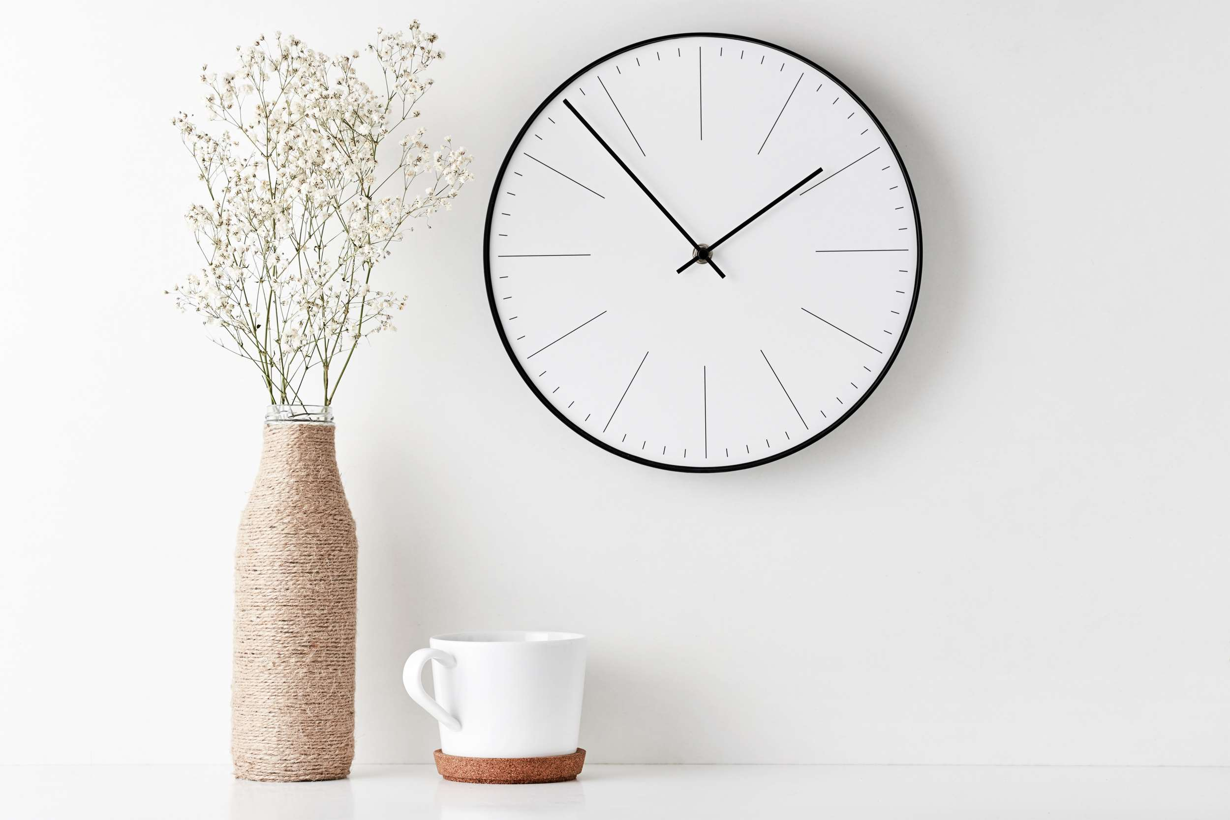
INTRODUCTION
Wall-hanging clocks are commonly used by people in their living rooms and halls. Growing renovation and remodeling activities have provided ease in the demand for such products. Growth factors of the Wall Clock Market are an increasing number of people in developing countries are entering into an organized sector, which has led to growing awareness about time; with advancements in technology, there is an increase in demand for digital wall clocks that have alarm features and other functionalities like wireless connectivity with smartphones. These strategies help key players capture a significant market share and remain competitive in the dynamic Wall Clock market.

Slide 3
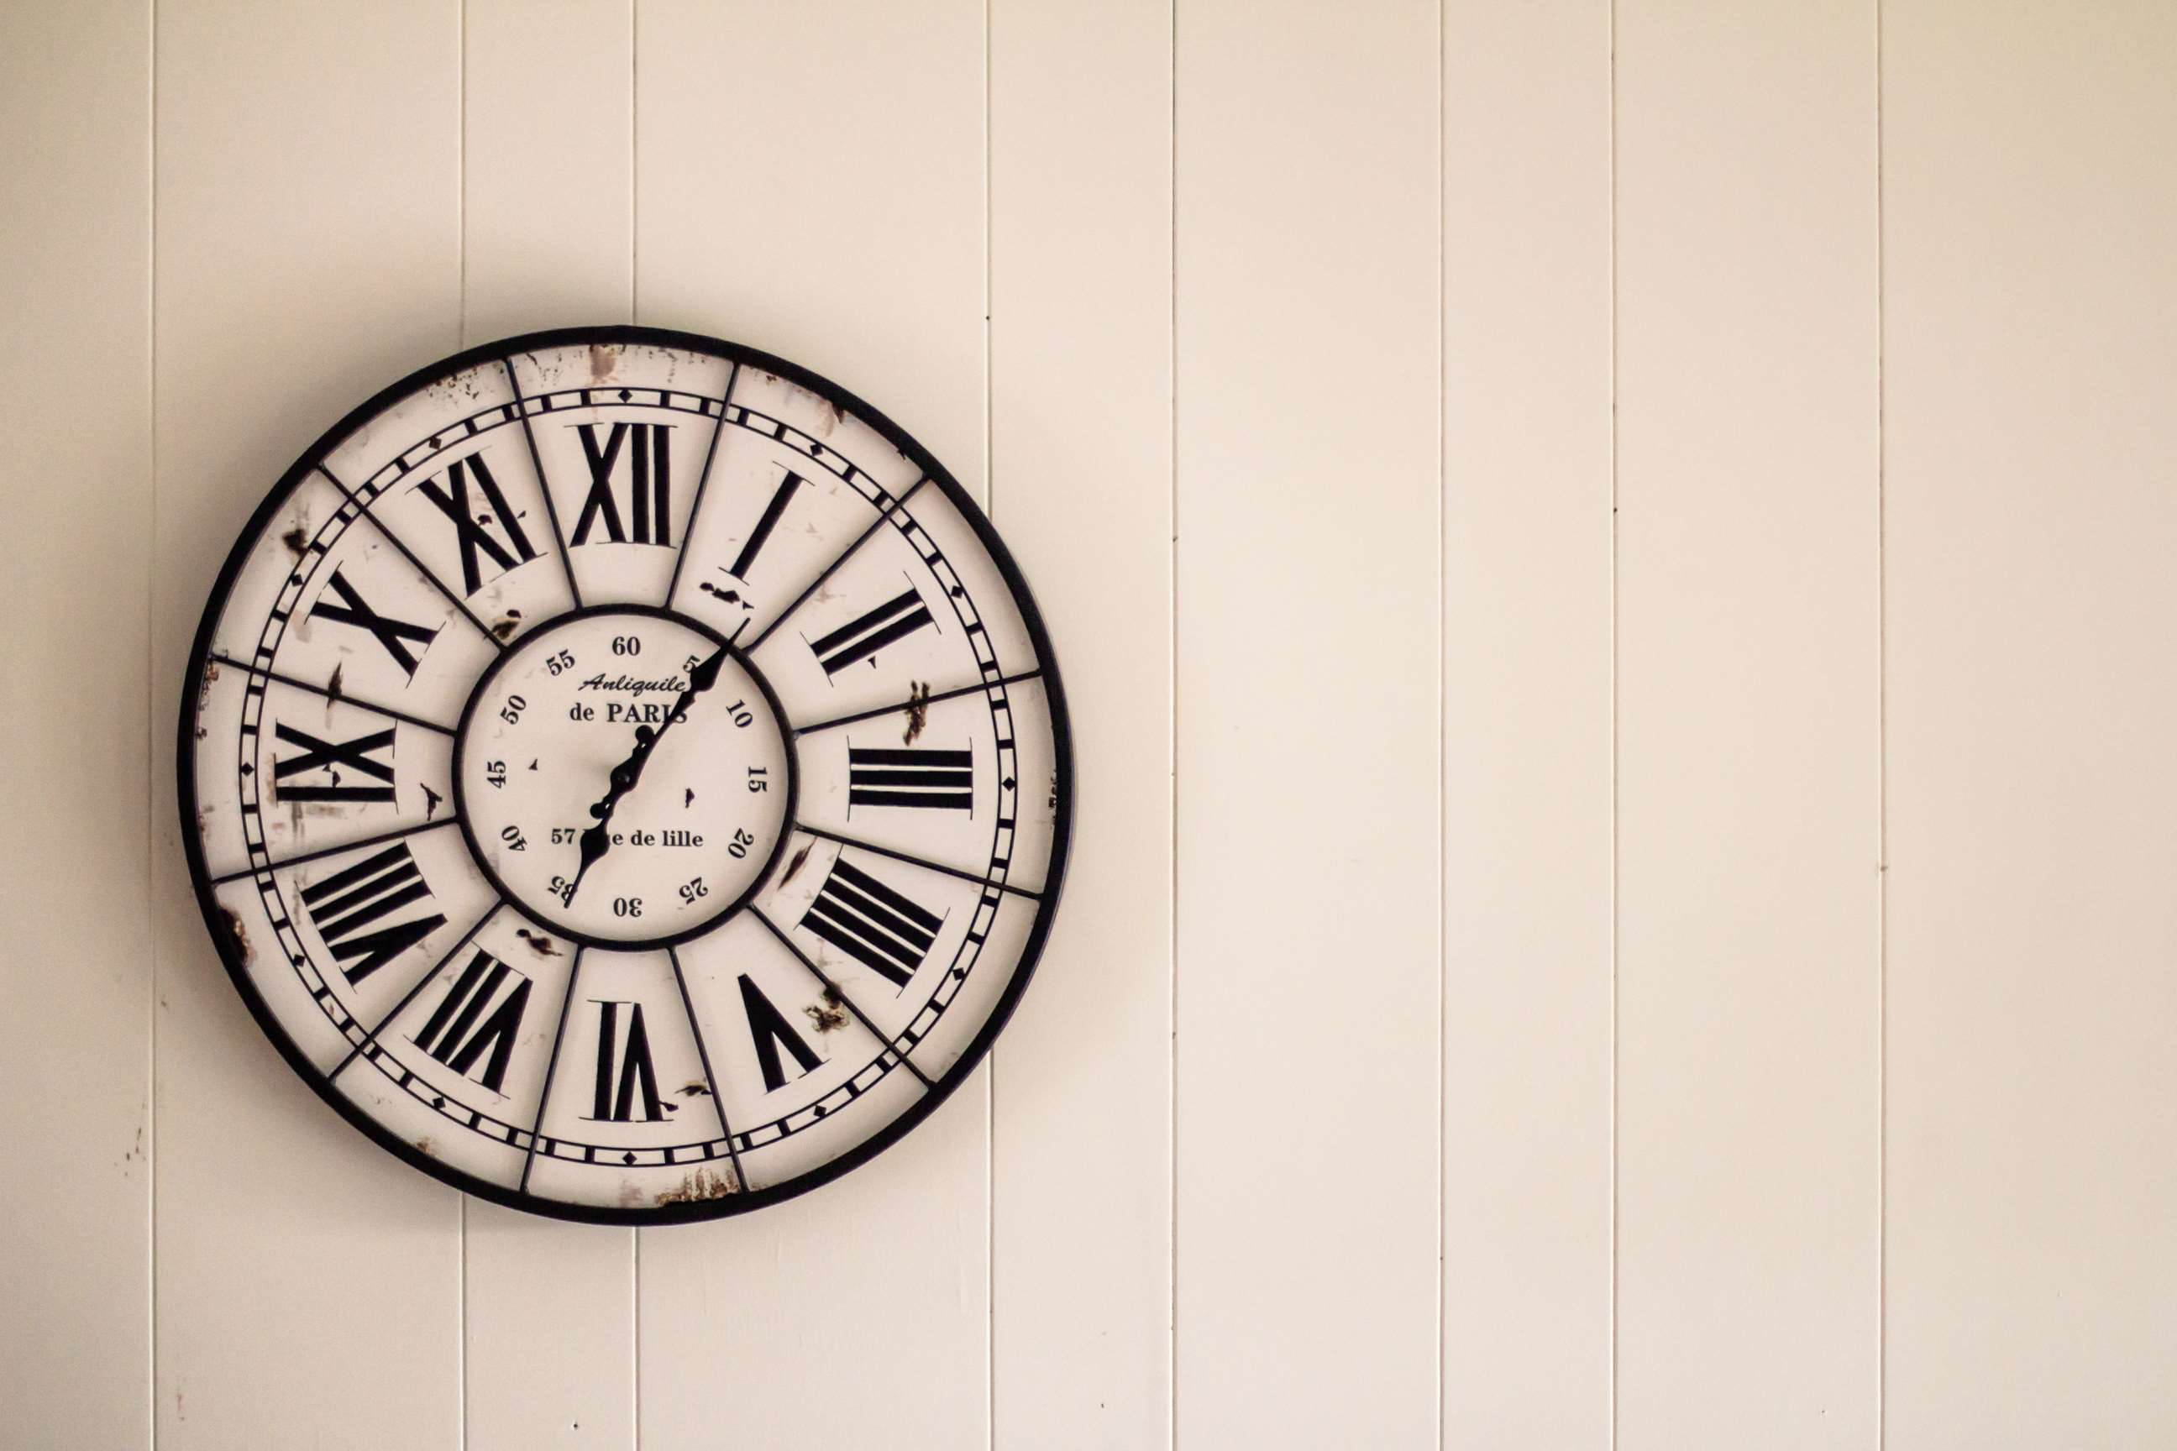

KEY INSIGHTS
CAGR
2.00%
2023- 2030

Slide 4
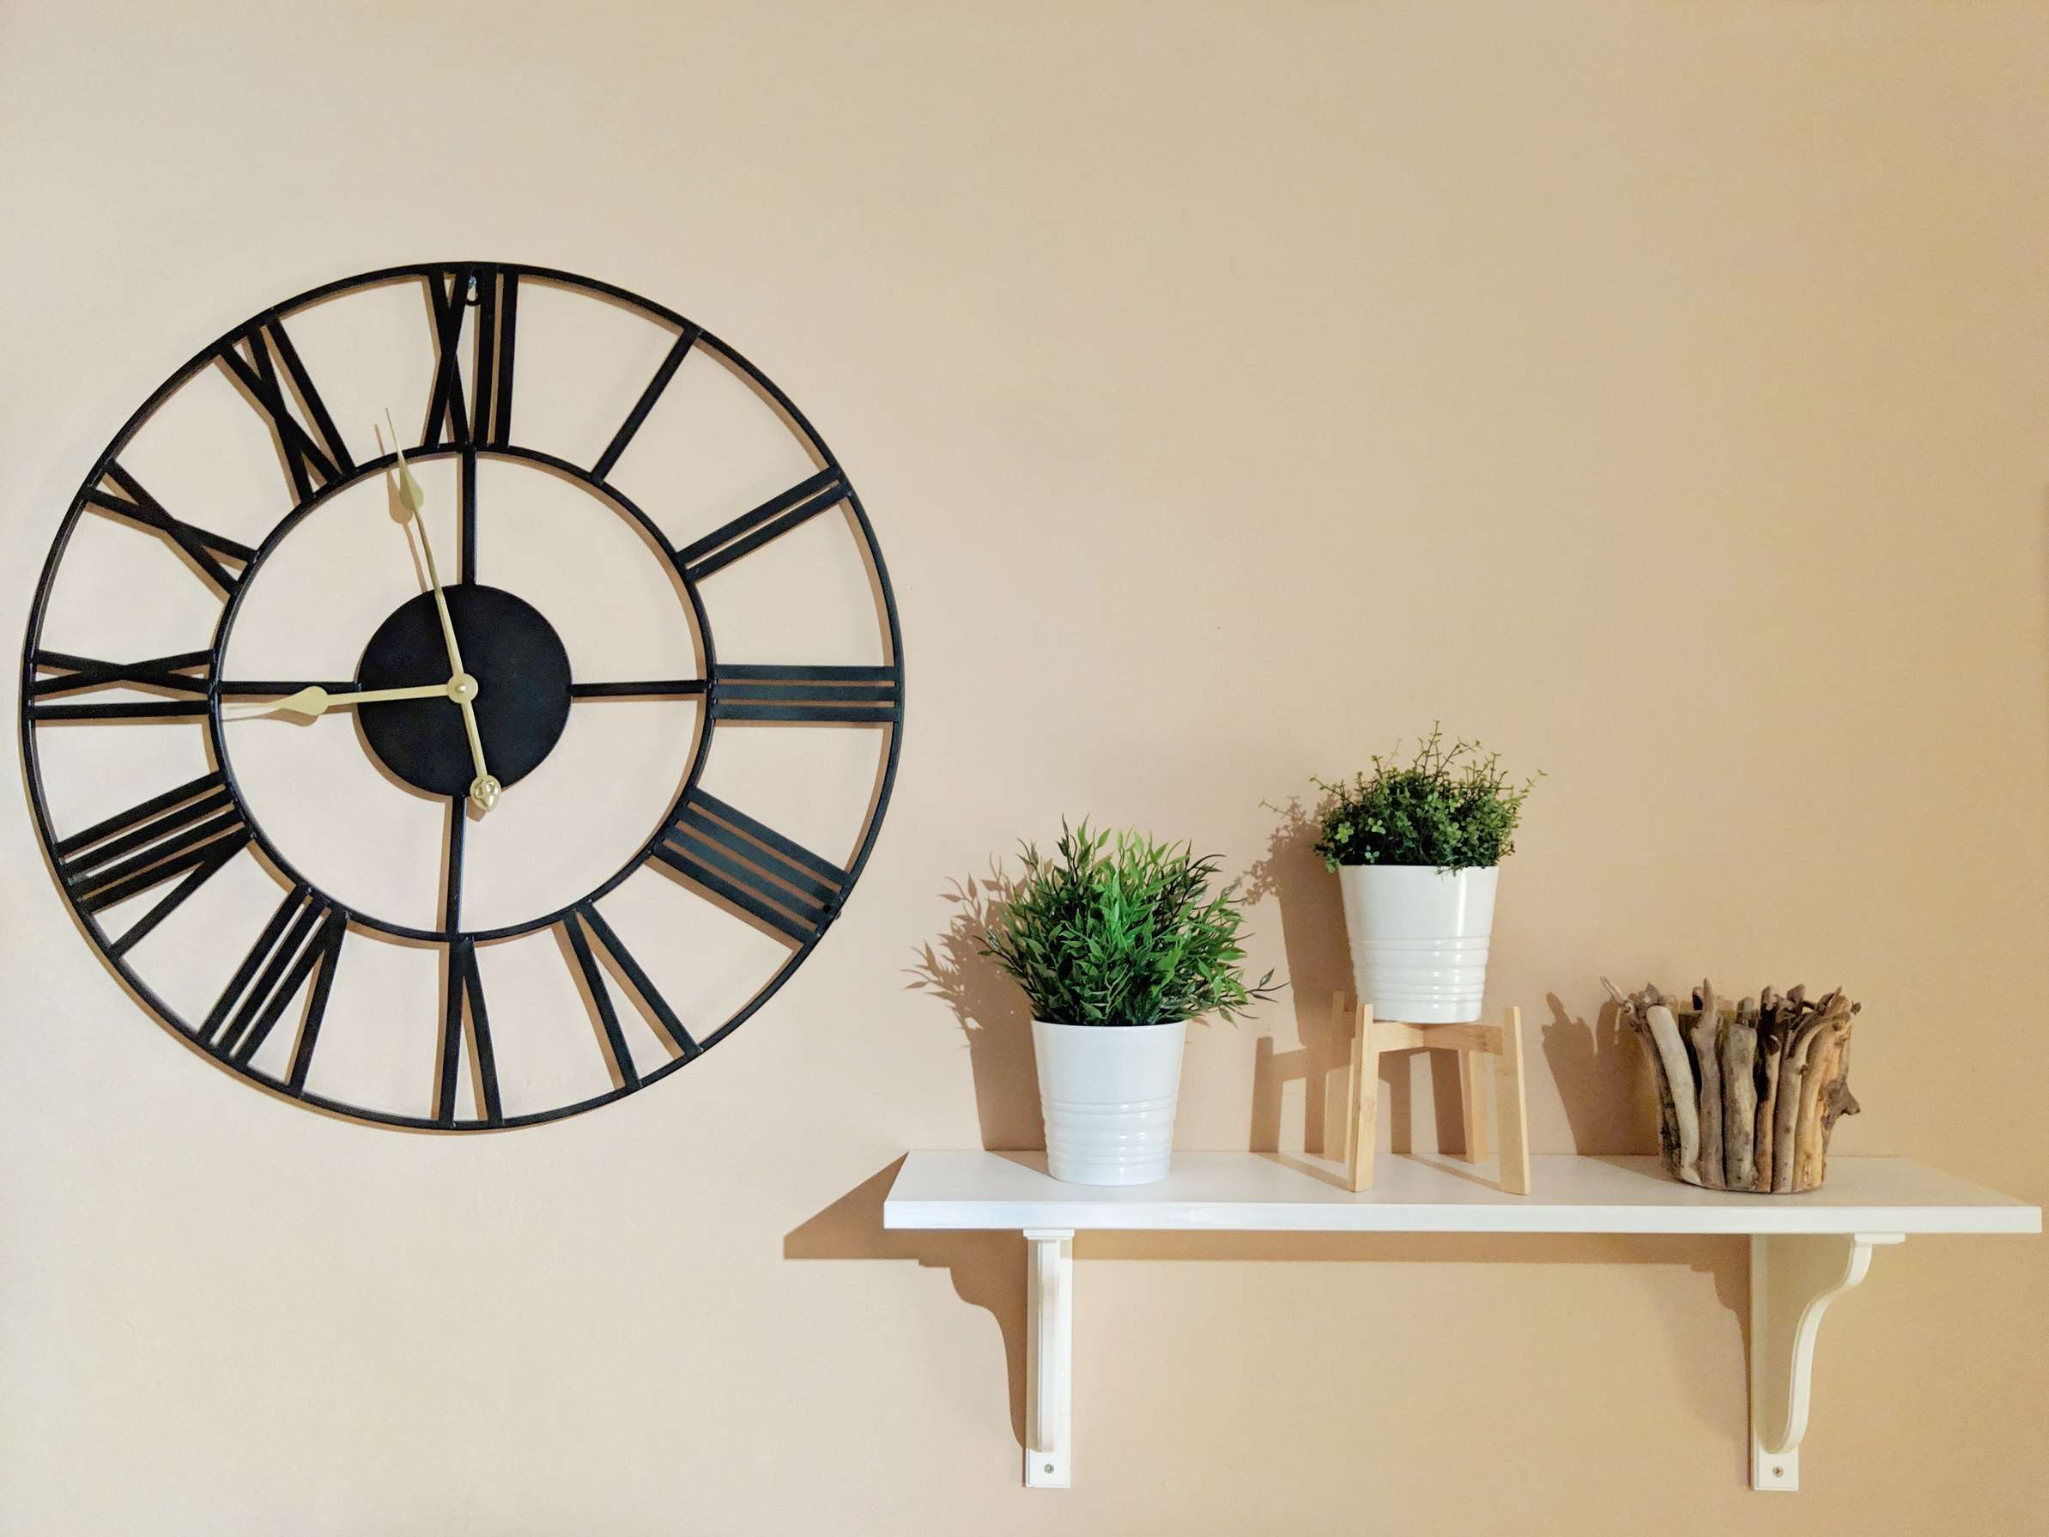
REVENUE MARKET SHARE BY SEGMENTS 2022
  Pointer Type
  Mechanical Type
  Digital Type
Type Segment
  Wood
  Metal
  Plastic
Material Segment
  Store
  Restaurant
  Family
Application Segment
  Antique
  Modern
  Stylish
Style Segment
  Offline
  Online
Distribution Channel

Slide 5

Global Wall Clock Market Revenue share for 2024
North America
28%

Slide 6
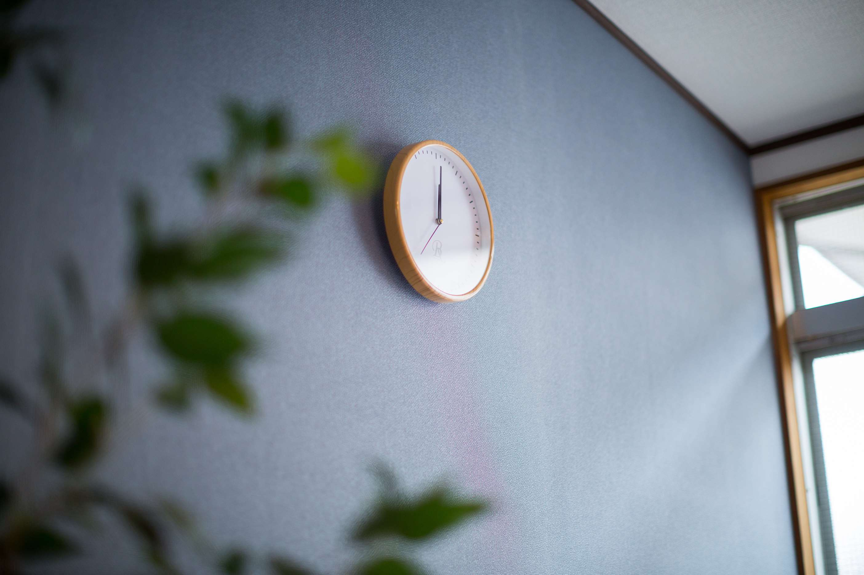
Technological Investment to Propel Market Growth
Drivers
Longer Product Life Cycle of the Wall Clocks is Anticipated to Restrain the Market Growth
Restraints

Slide 7

AUTHOR'S PERSPECTIVE
  The Global Wall Clock Market is witnessing significant growth in the near future.
  On the other hand, pointer-type wall clocks maintain a classic appeal, often featuring traditional clock hands to indicate time.
  Smart features such as wireless connectivity and integrated calendars are gaining popularity, enhancing the utility of wall clocks in family spaces.
  Consumers appreciate the ease of browsing through various wall clocks, comparing prices, and purchasing from the comfort of their homes.
  Plastic wall clocks are lightweight and easy to maintain, making them suitable for children's rooms, offices, or casual living spaces.

Slide 8












KEY PLAYERS

Slide 9


For Full Report
Contact us
COGNITIVE MARKET RESEARCH
Tel: +1 312-376-8303 | +44 020-8123-0732
India: (+91) 983-496-8611
sales@cognitivemarketresearch.com
Access the Full Report : https://tinyurl.com/3j2uyhec
Please visit our website:
https://www.cognitivemarketresearch.com

