Slide 1
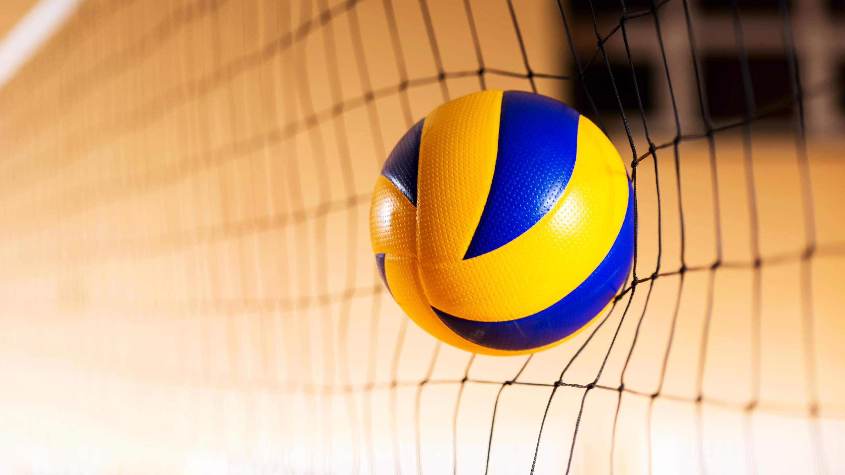
GLOBAL VOLLEYBALL MARKET REPORT 2024
Global,Regional,CountryAnalysis

Slide 2

INTRODUCTION
Volleyball is a kind of Inflatable ball used in team sports in which two teams of six players are separated by a net. The ball used in volleyball is made of sheepskin or artificial leather. The introduction of many new national and international leagues and tournaments and growth within the range of recreational players trying to find health edges related to sports activities. The increasing range of kids collaborating in sports activities is collectively one of the prime reasons driving the volleyball instrumentation market growth.

Slide 3
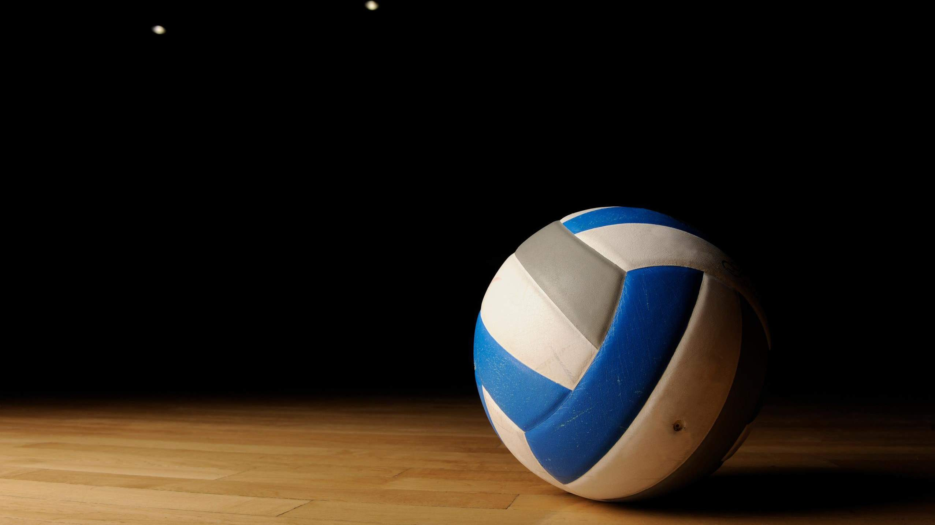

KEY INSIGHTS
MARKET SIZE
USD 0.415 billion
2022
20₋23
CAGR 7.20%
2030

Slide 4
REVENUE MARKET SHARE BY SEGMENTS 2022
PU Surface Volleyball
PVC Surface Volleyball
Rubber Surface Volleyball
Type Segment
Competition
Training
Recreational Activities
Application Segment

Slide 5

Global Volleyball Market Revenue share for 2022
Asia-Pacific 35%

Slide 6
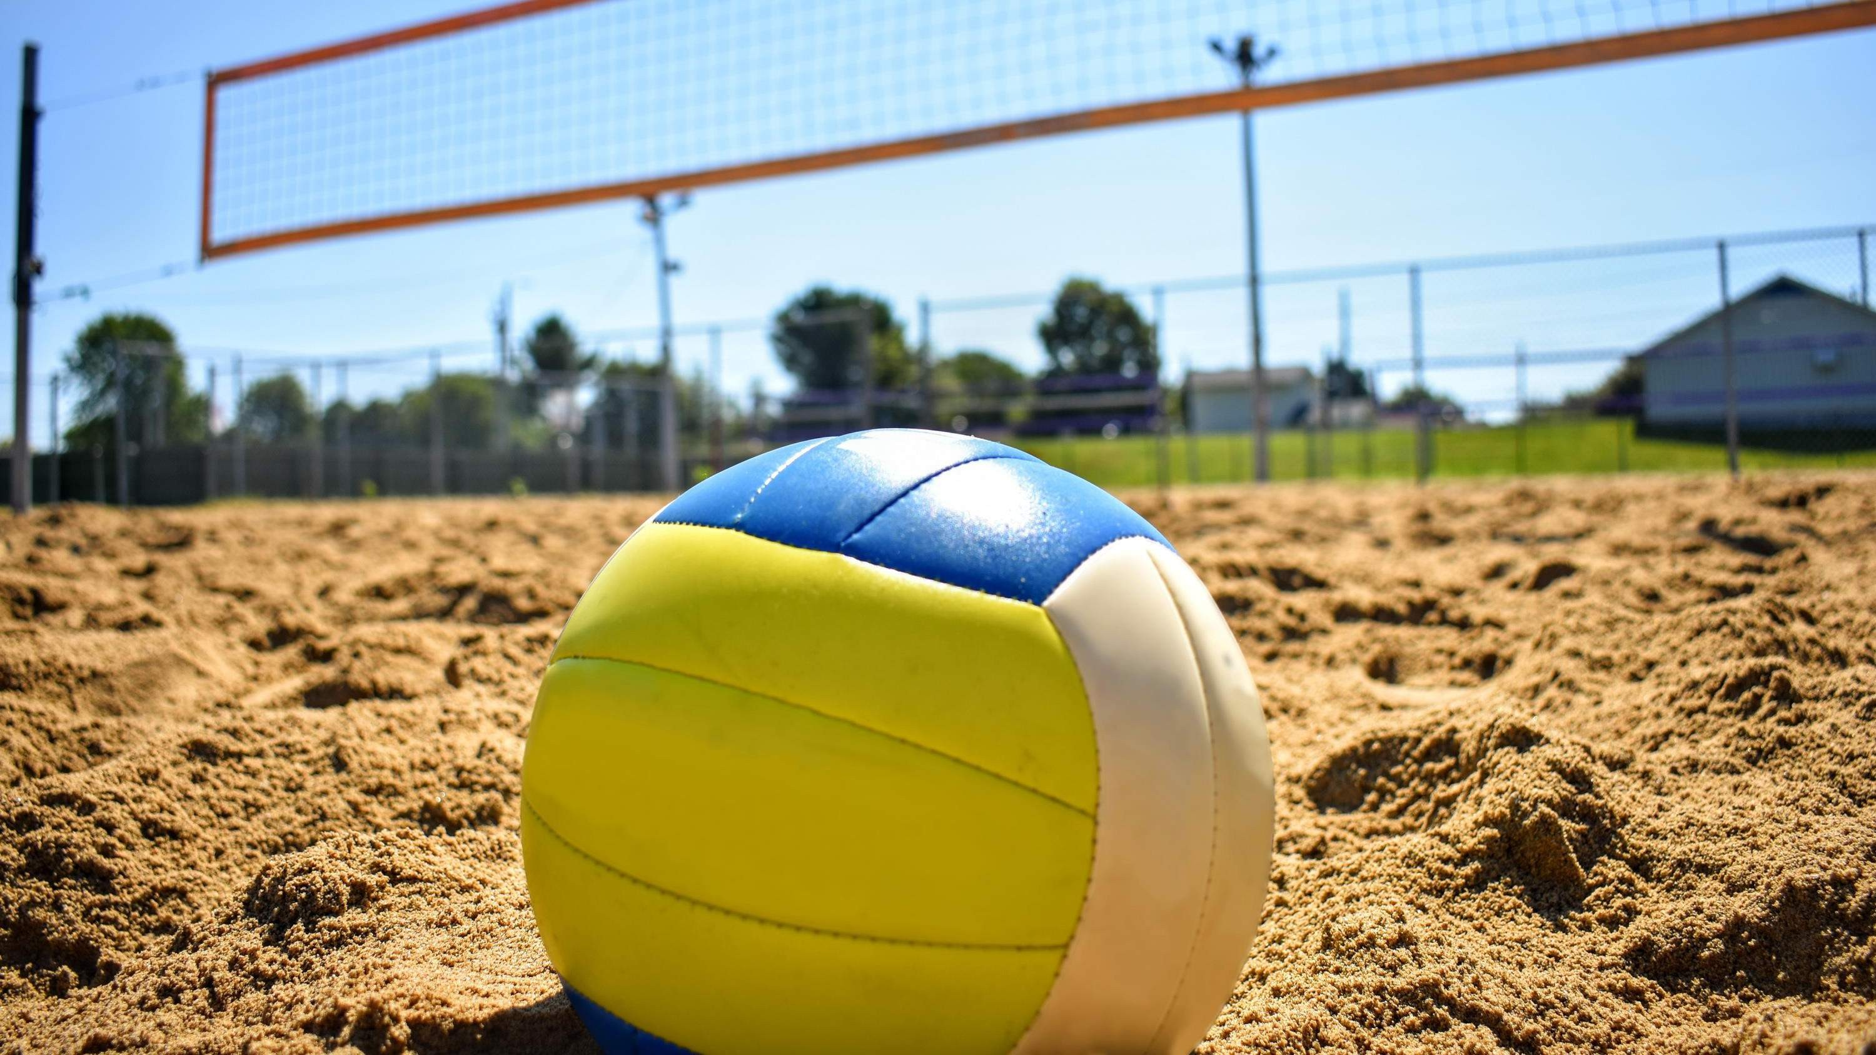





Slide 7
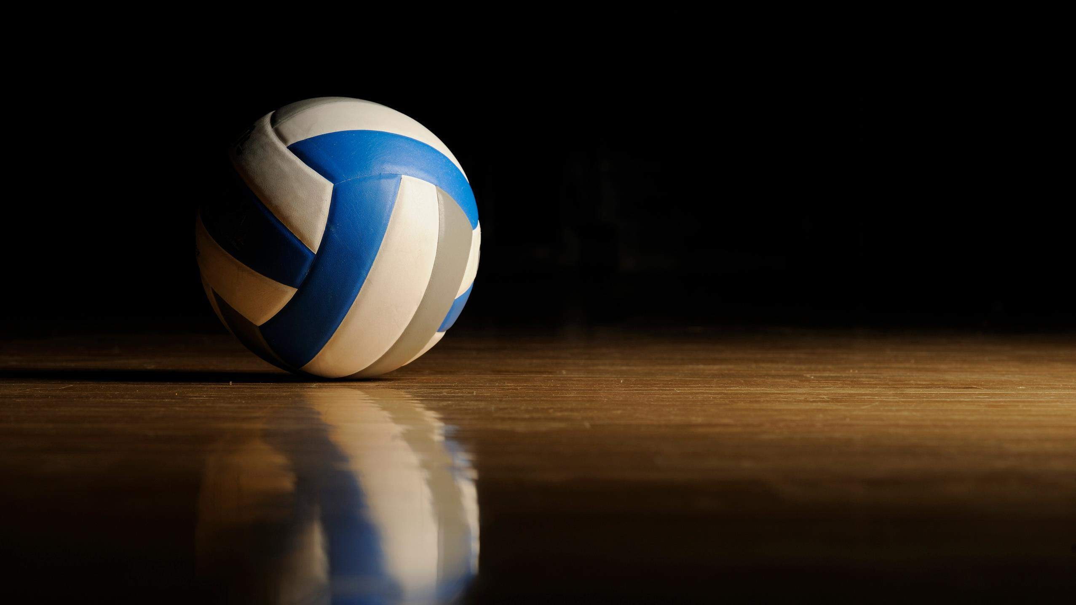
AUTHOR'S PERSPECTIVE
The Global Volleyball Market is witnessing significant growth in the near future.
PVC (polyvinyl chloride) surfaces offer a cost-effective alternative without compromising on performance, making them increasingly popular among recreational players, schools, and amateur leagues.
As volleyball gains traction among enthusiasts for casual play, social gatherings, and leisure activities, there is a surge in demand for volleyballs that strike a balance between quality and affordability.

Slide 8
KEY PLAYERS

Slide 9


Contact us
For Full Report
COGNITIVE MARKET RESEARCH
Tel: + 1 312 - 376 - 8303 | + 44 020 - 8123 - 0732
India: ( + 91 ) 983 - 496 - 8611
sales@ cognitivemarketresearch. com
Access the Full Report : http://tinyurl.com/2v6v8372
Please visit our website:
https://www.cognitivemarketresearch.com

