Slide 1
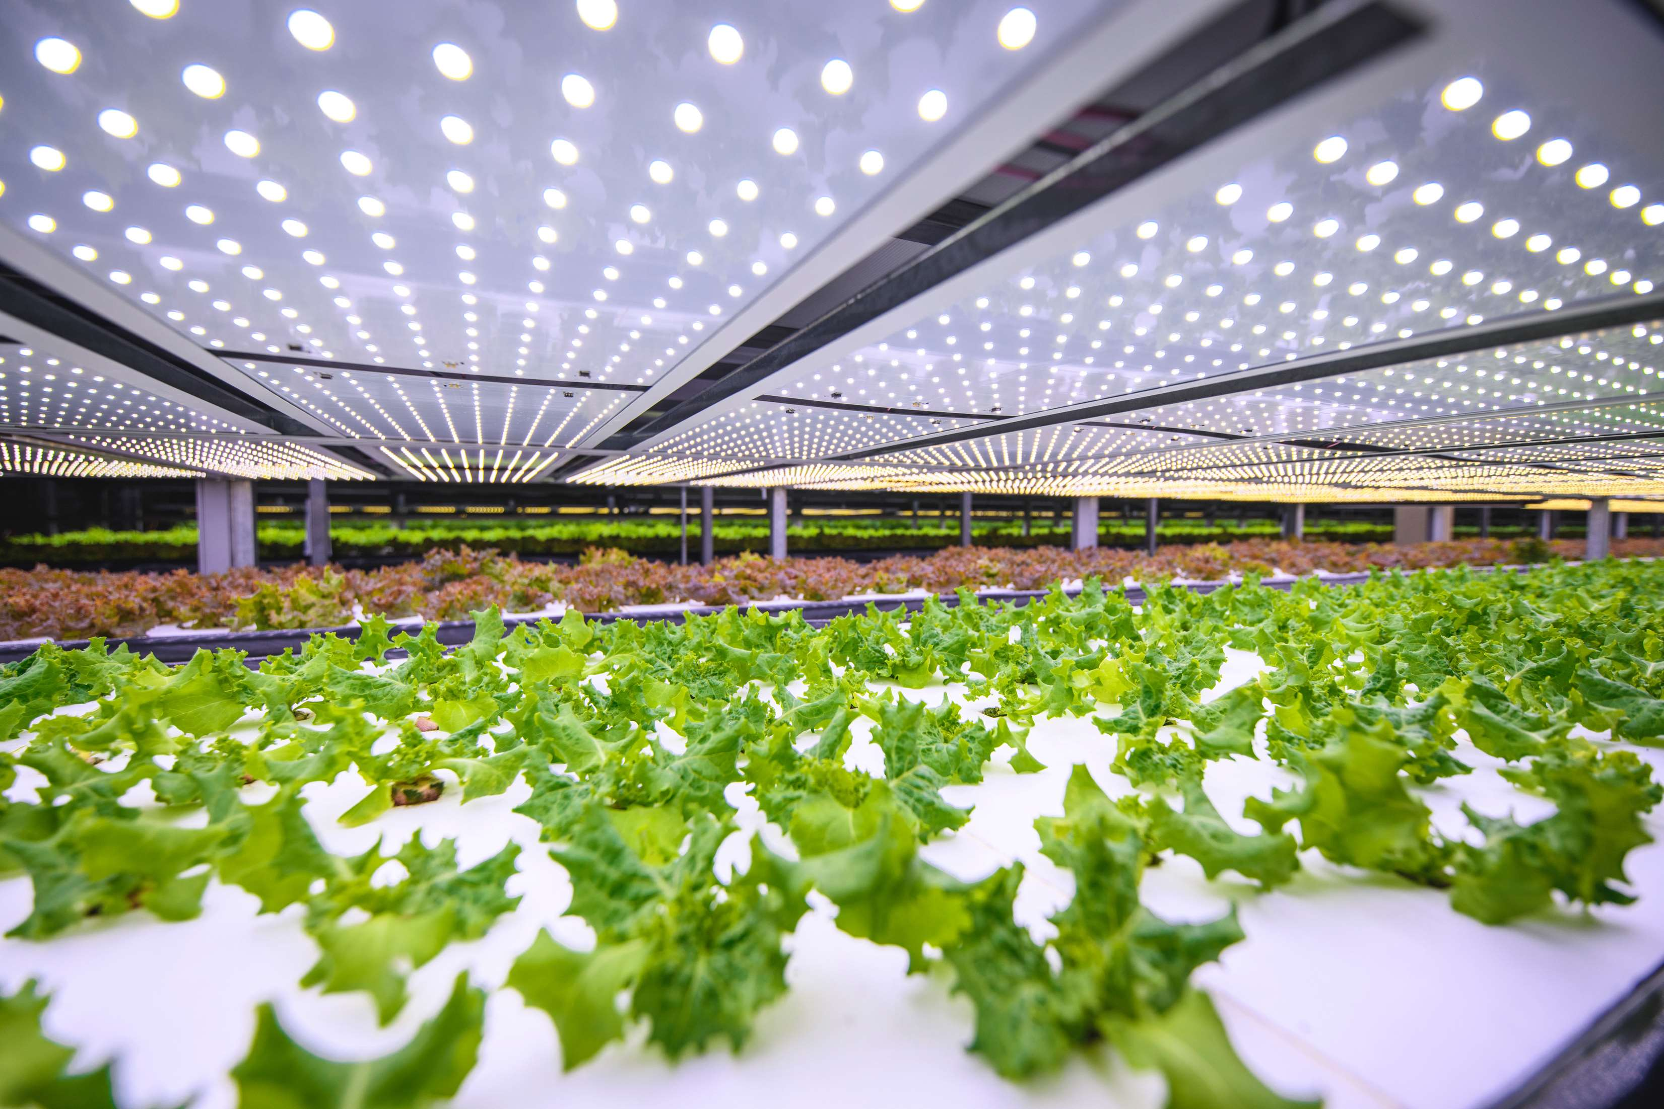
GLOBAL
VERTICAL FARMING
MARKET REPORT
2024
Global,Regional,CountryAnalysis

Slide 2
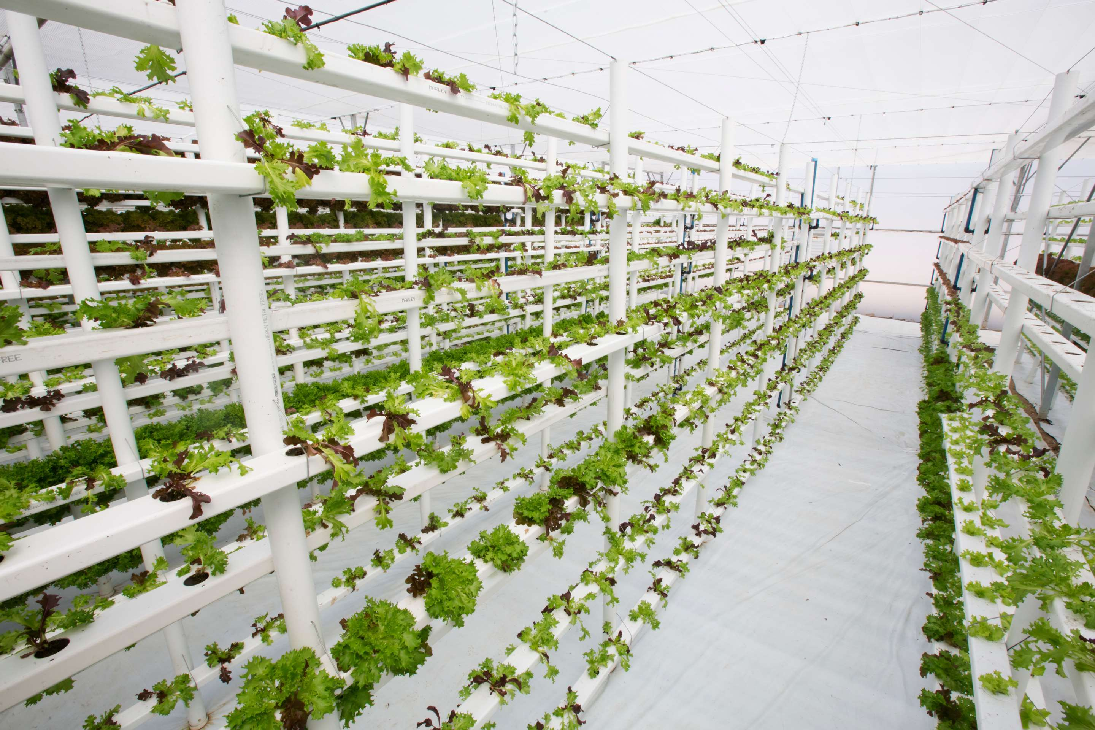
INTRODUCTION
Vertical farming is the way of growing crop in vertically stacked layers. It controlled-environment agriculture, to optimize plant growth, and soilless farming techniques such as aquaponics, hydroponics, and aeroponics. Some common choices of structures to house vertical farming systems include shipping containers, buildings, tunnels, and Others. The major advantage of utilizing vertical farming technologies is the increased crop yield that comes with a smaller unit area of land requirement.

Slide 3
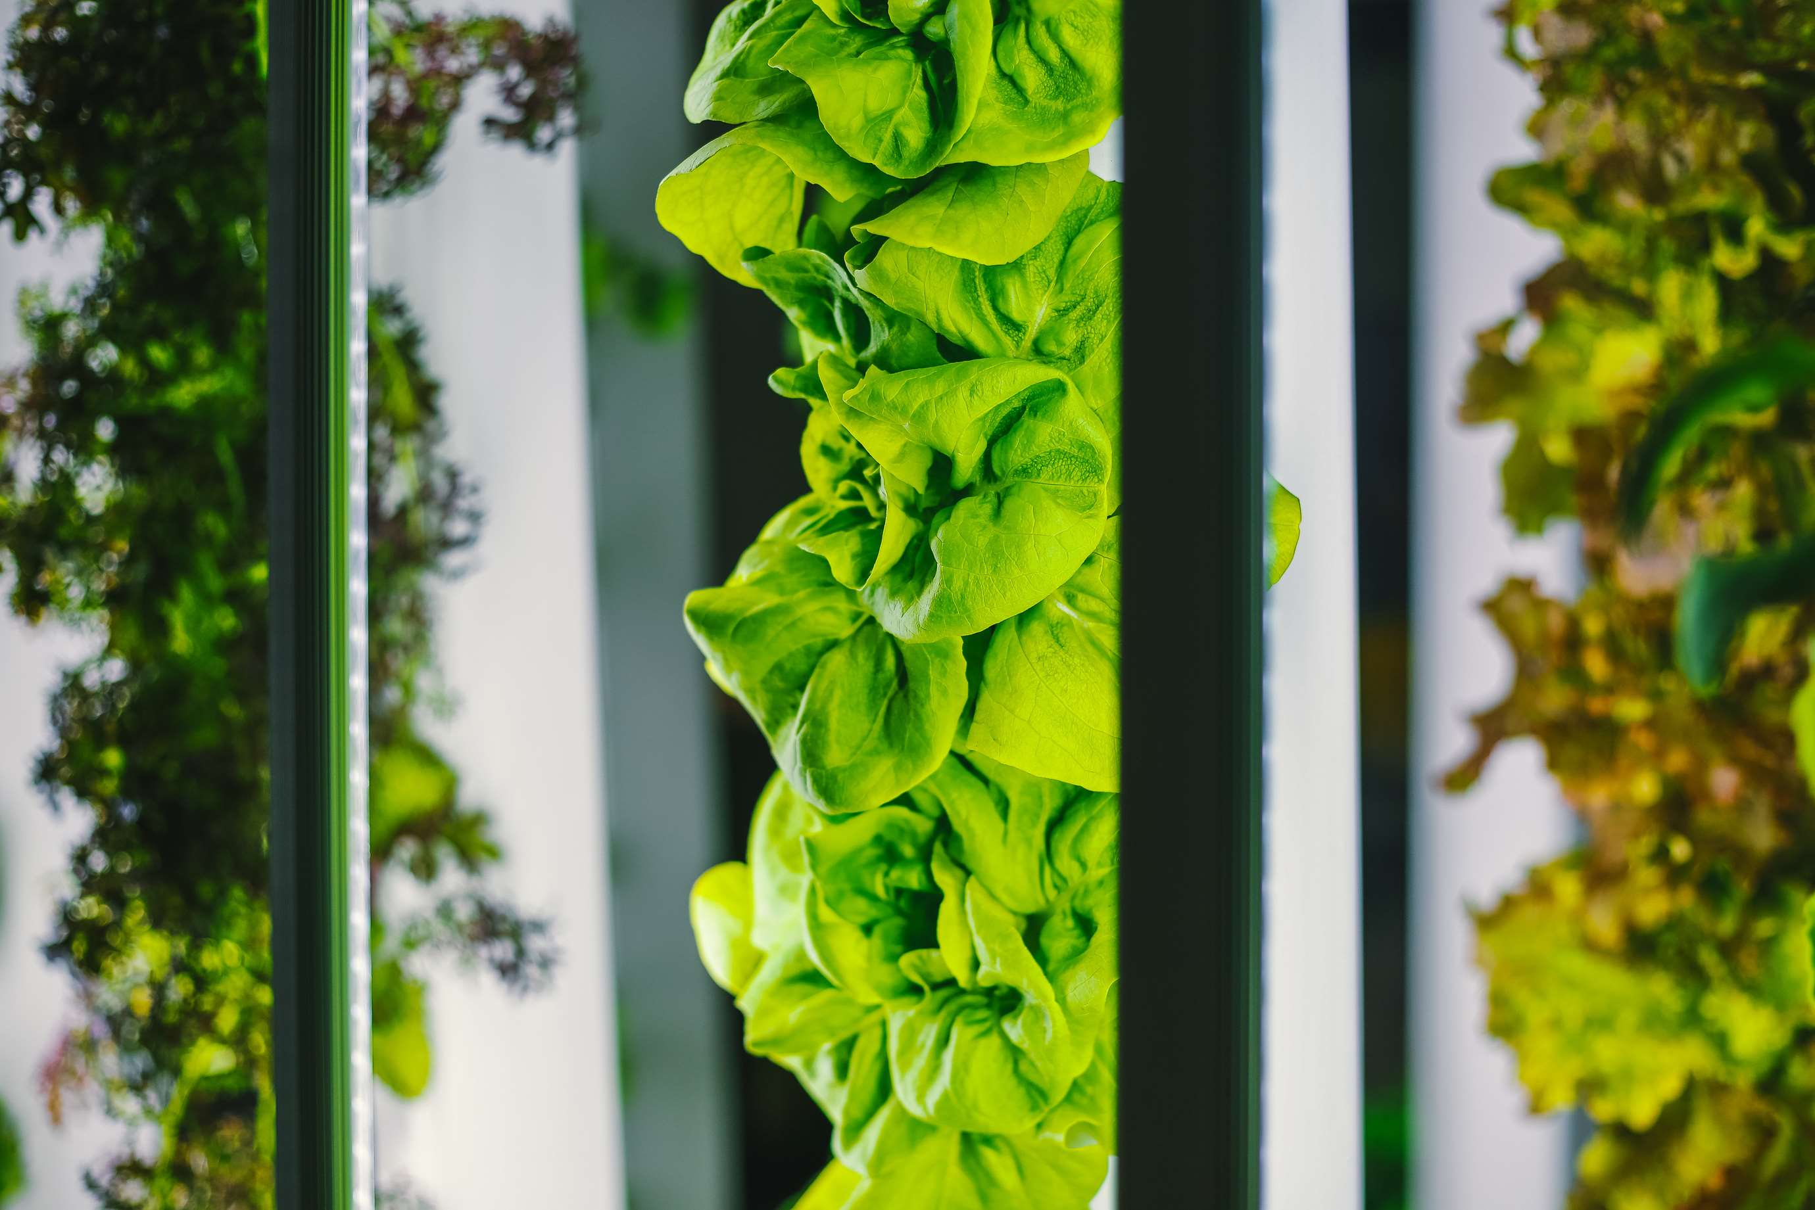

KEY INSIGHTS
MARKET SIZE
USD 4.67 billion
2023
FORECAST
USD 24.43 billion
2029
CAGR
27.89%
2023- 2030

Slide 4
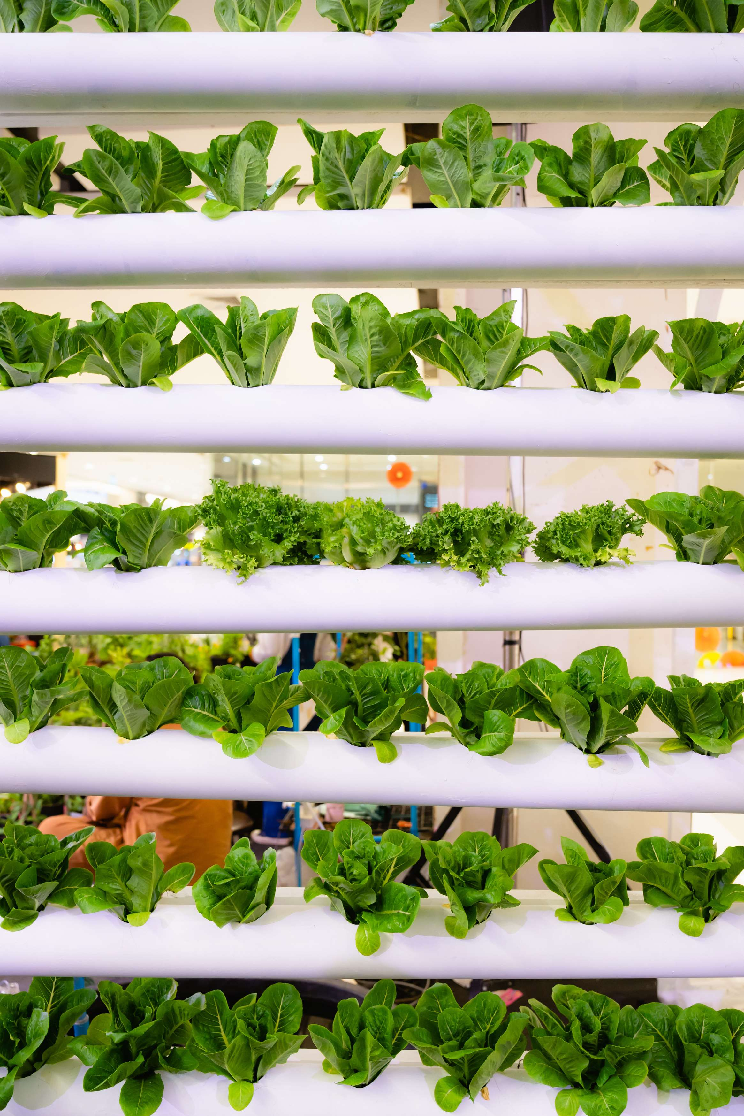
REVENUE MARKET SHARE BY SEGMENTS 2022
  Hydroponics
  Aeroponics
  Aquaponics
Growth mechnism
  Irrigation Component
  Sensor
  Climate Control
  Building Material
Component Segment
  Building-based vertical farm
  Shipping container-based vertical farm
Structure Segment

Slide 5

Global Vertical Farming Market Revenue share for 2022
North America

Slide 6
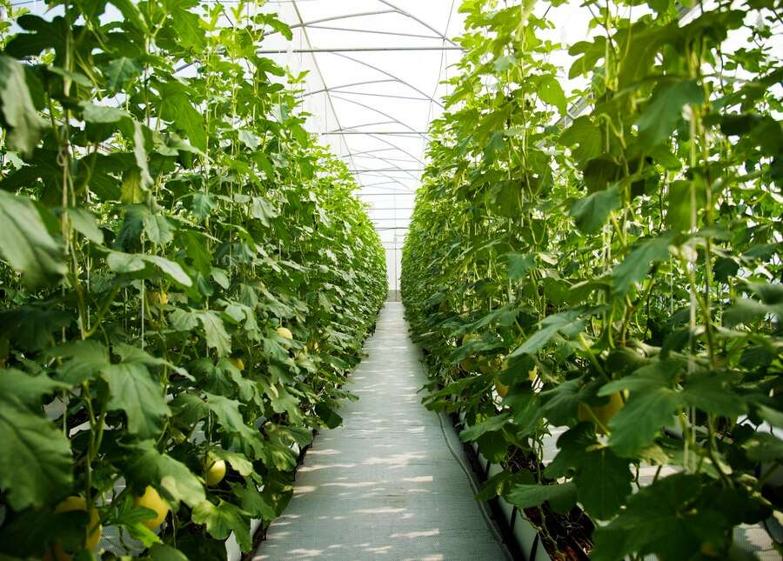
Growing Water Crisis and Declining Arable Land to Drive the Market Growth
Drivers
The High Cost of Initial Investment to Challenge Market Potential
Restraints

Slide 7
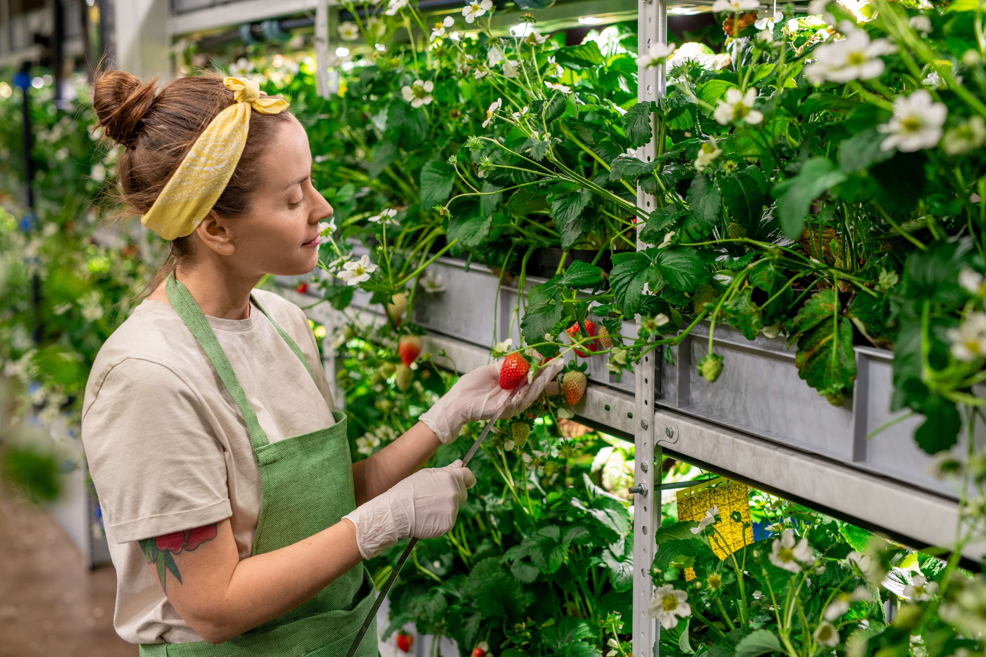
AUTHOR'S PERSPECTIVE
  The Global Vertical Farming Market is witnessing significant growth in the near future.
  In 2023, the Hydroponics segment accounted for noticeable share of global Vertical Farming Market and is projected to experience significant growth in the near future.
  The Hydroponics segment is expected to expand at the significant CAGR retaining position throughout the forecast period.

Slide 8
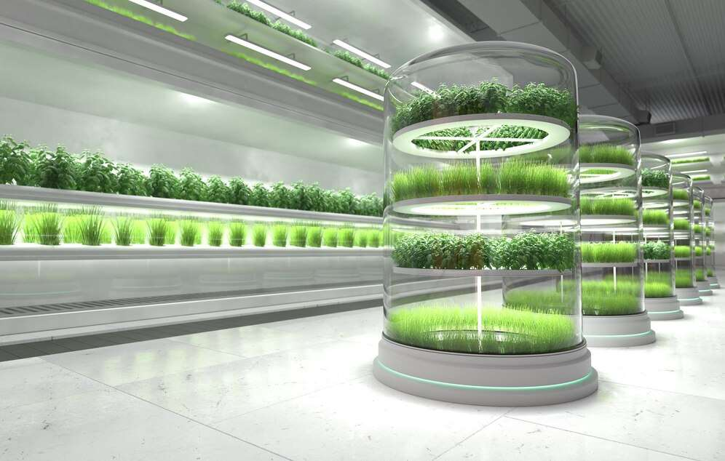
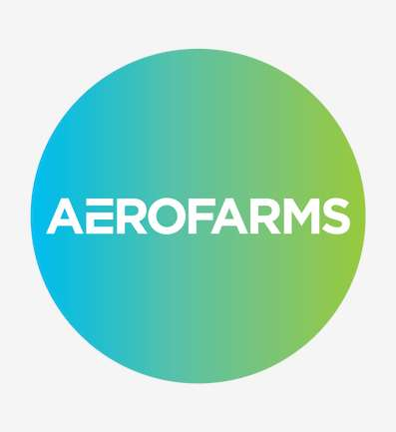
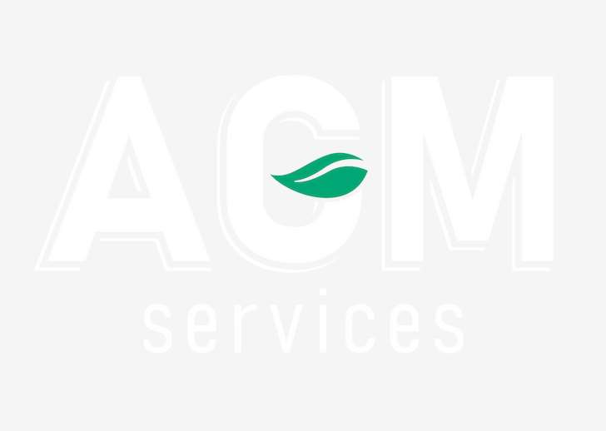
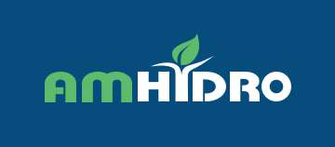

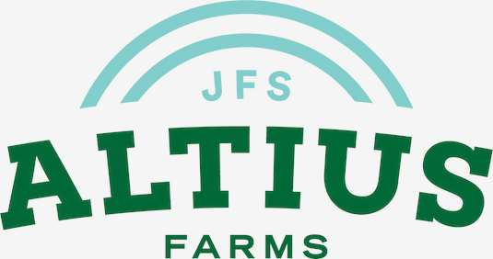
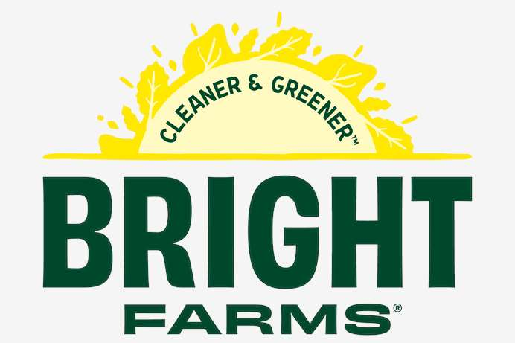
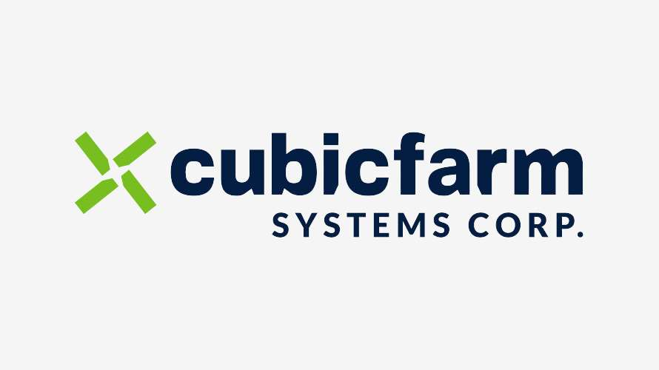


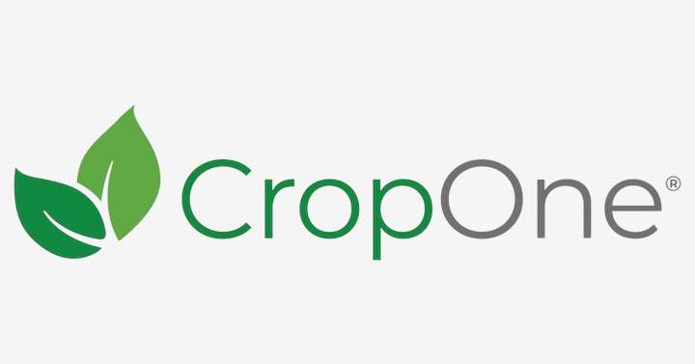


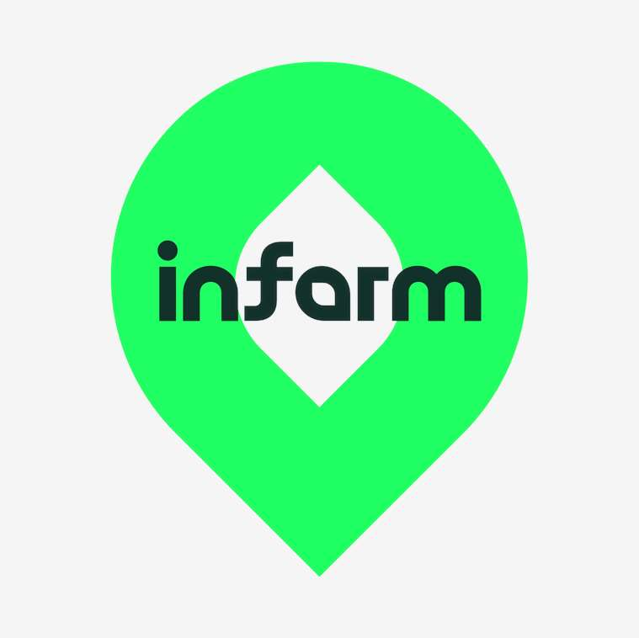



KEY PLAYERS

Slide 9


For Full Report
Contact us
COGNITIVE MARKET RESEARCH
Tel: +1 312-376-8303 | +44 020-8123-0732
India: (+91) 983-496-8611
sales@cognitivemarketresearch.com
Access the Full Report : https://tinyurl.com/37awhukh
Please visit our website:
https://www.cognitivemarketresearch.com

