Slide 1
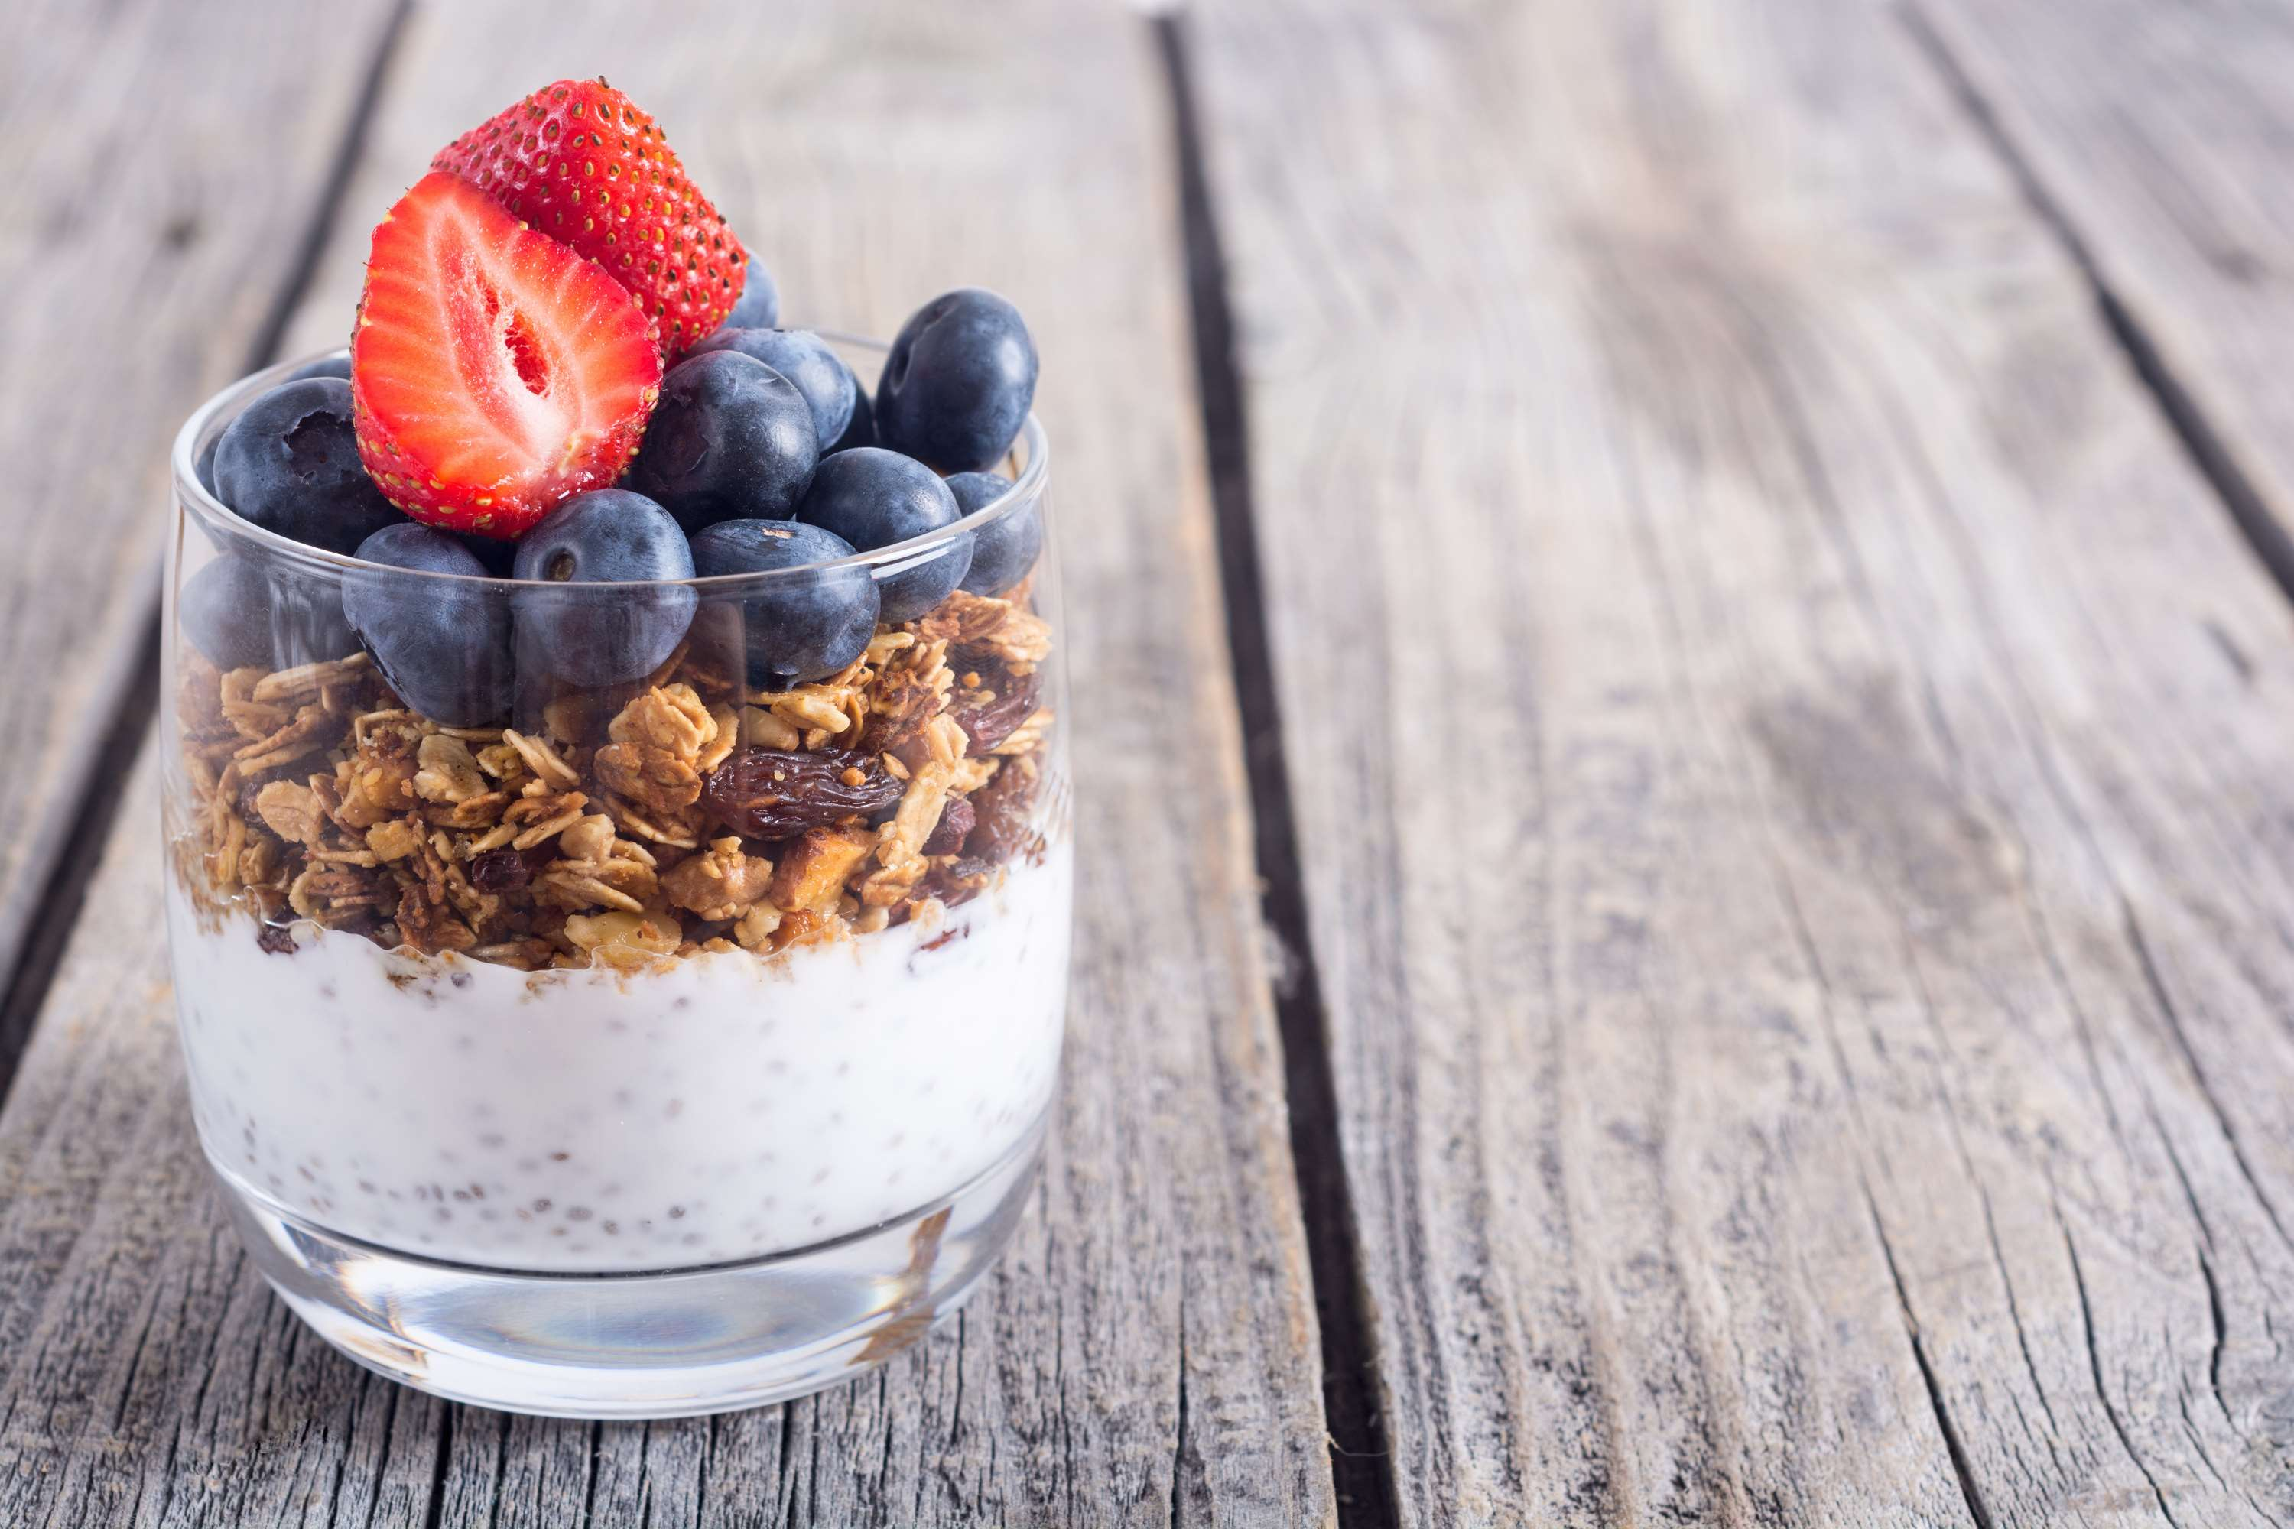
GLOBAL
VEGAN YOGURT
MARKET REPORT 2024
Global,Regional,CountryAnalysis

Slide 2
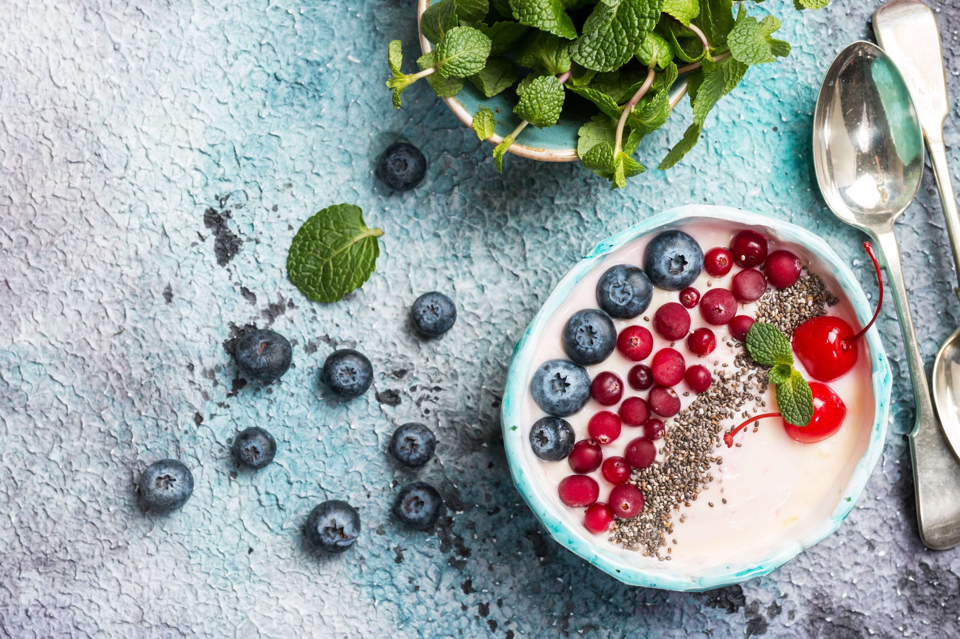
INTRODUCTION
Vegan yogurt is a dairy-free and plant-based alternative to traditional yogurt. Vegan yogurt is rich in vitamins, minerals, and probiotics which makes it a healthy food choice. It is also a good source of protein and calcium. Vegan yogurt is available in different flavors such as vanilla, strawberry, chocolate, and others.

Slide 3


KEY INSIGHTS
MARKET SIZE
USD 2.45 Billion
2022
CAGR
19.87 %
2023- 2030

Slide 4

REVENUE MARKET SHARE BY SEGMENTS 2022
  Soy
  Almond
  Oats
  Coconut
By Product
  Frozen Dessert
  Food
  Beverages
Application segment
  Vanilla
  Strawberry
  Mixed Berry
  Raspberry
Flavor Segment

Slide 5

Europe
Global Vegan Yogurt Market Revenue share for 2022

Slide 6
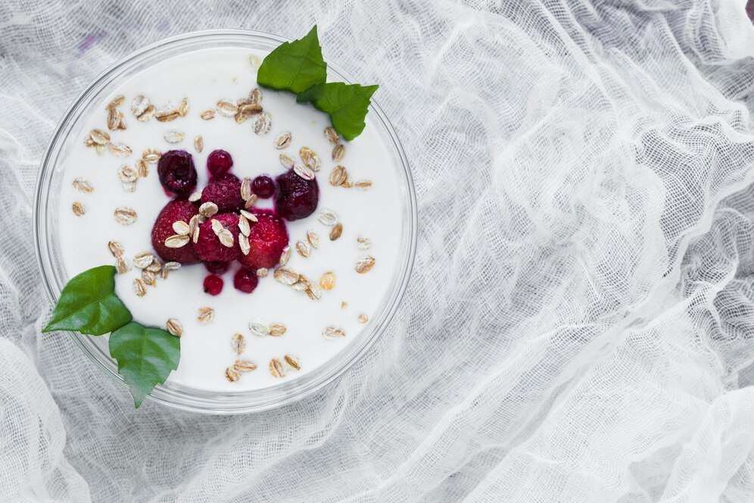
Increasing health consciousness among people and the growing preference for plant-based food products are forecasted to dominate
Drivers
Limited texture and taste options compared to traditional yogurt may restrain the widespread acceptance of vegan yogurt.
Restraints

Slide 7
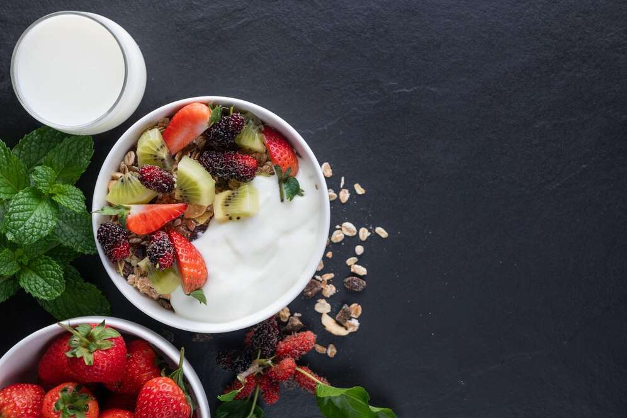
AUTHOR'S PERSPECTIVE
  The Global Vegan Yogurt Market is witnessing significant growth in the near future.
  In 2023, the Soy segment accounted for noticeable share of global Vegan Yogurt Market and is projected to experience significant growth in the near future.
  The Frozen Dessert segment is expected to expand at the significant CAGR retaining position throughout the forecast period.

Slide 8




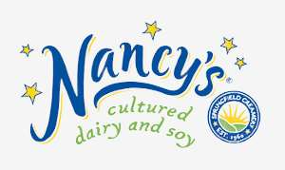



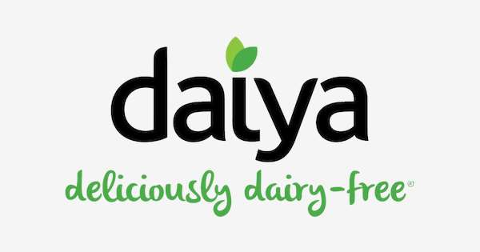

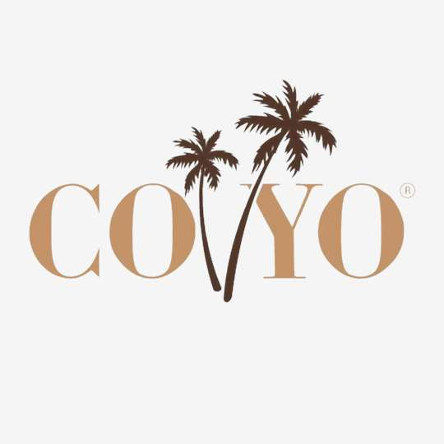
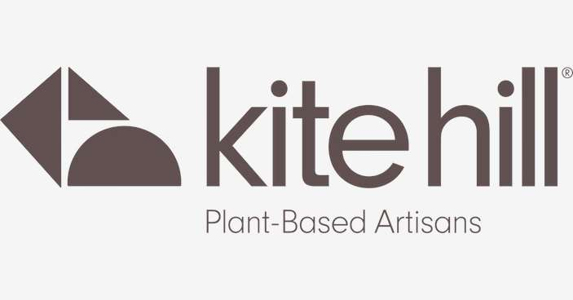
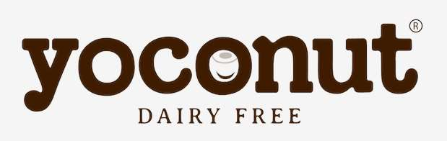

KEY PLAYERS

Slide 9


For Full Report
Contact us
COGNITIVE MARKET RESEARCH
Tel: +1 312-376-8303 | +44 020-8123-0732
India: (+91) 983-496-8611
sales@cognitivemarketresearch.com
Access the Full Report : https://tinyurl.com/4mpybxta
Please visit our website:
https://www.cognitivemarketresearch.com

