Slide 1
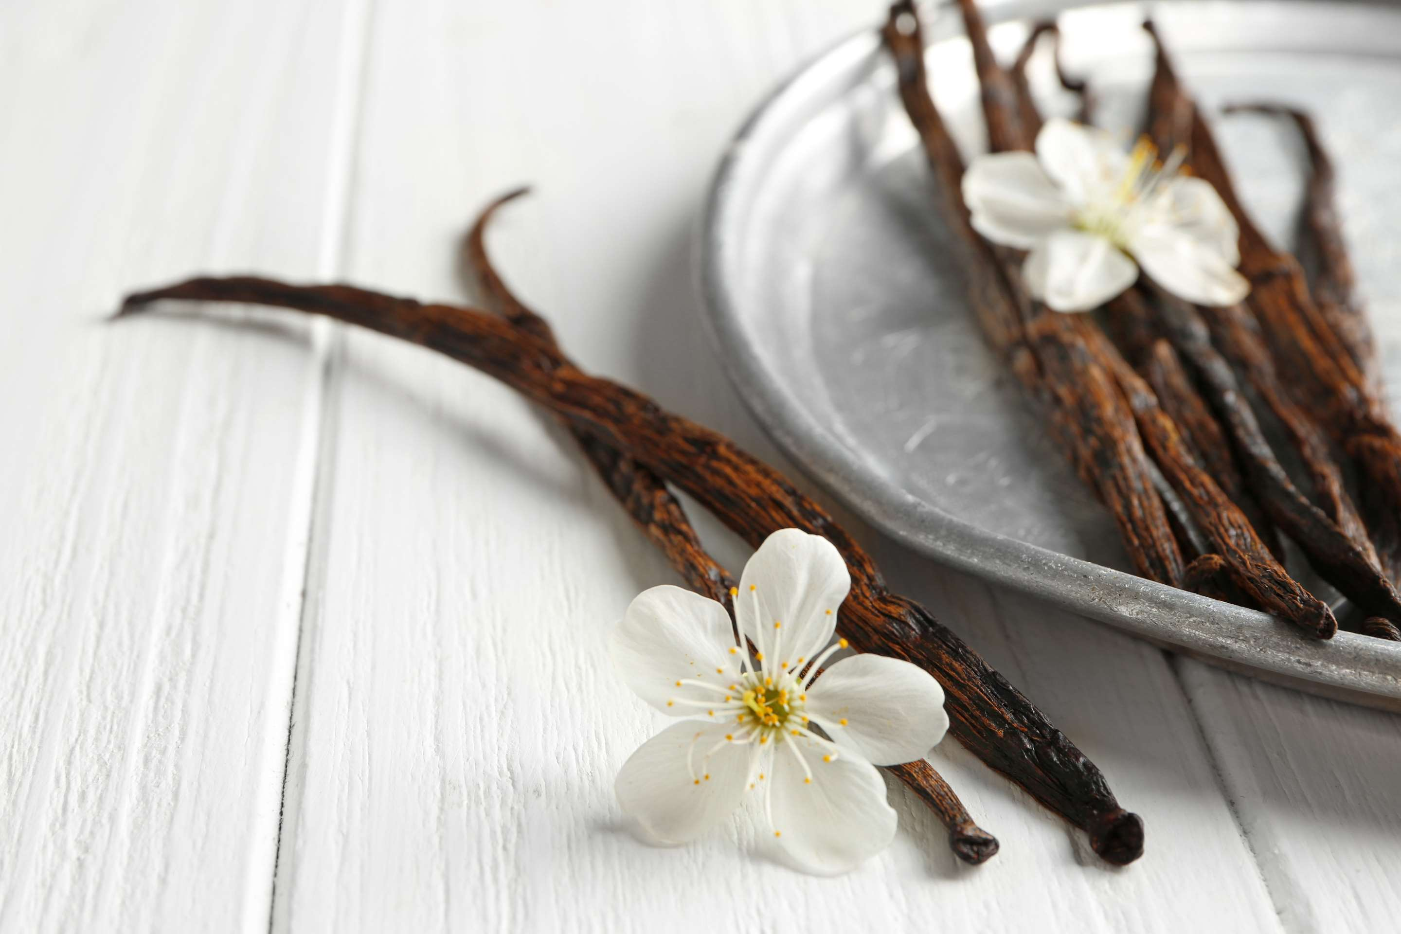

VANILLA POWDER
MARKET REPORT
2024
Qualitative Analysis + Quantitative Analysis

Slide 2

INTRODUCTION
Vanilla powder is a fine, dry substance made from grinding vanilla beans into a powdered form. It is prized for its concentrated flavor and aroma, commonly used as a natural flavoring agent in various culinary applications. The market for vanilla powder is characterized by a growing demand for natural flavorings and ingredients, driven by consumer preferences for clean-label products and increasing awareness of health and wellness. Vanilla powder, derived from vanilla beans, offers a convenient and versatile alternative to vanilla extract, with applications ranging from baking and confectionery to beverages and Savory dishes.

Slide 3


KEY INSIGHTS
CAGR
5.00%
2024- 2031

Slide 4
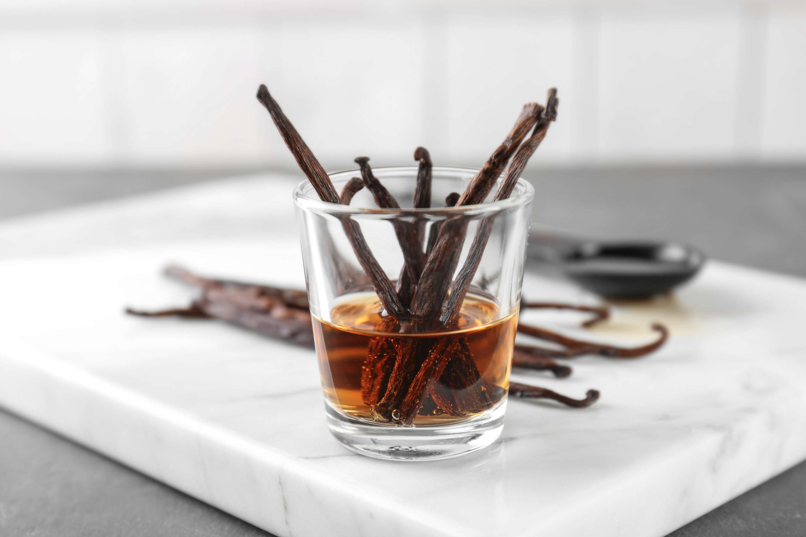
REVENUE MARKET SHARE BY SEGMENTS 2024
  Vanilla-infused Maltodextrin
  Dextrose
  Finely Ground Sucrose
  Pure Ground Dried Vanilla Beans
  Plastic Jar
  Bags
  Packet
  Others
Type Segment
Packaging Type Segment
  Baked Goods
  Beverages
  Candies
  Others
  Online Channels
  Hypermarkets
  Supermarkets
  Convenience Stores
  Specialty Stores
Application Segment
Distribution channel

Slide 5

REGION ANALYSIS
NORTH AMERICA
Europe
Asia Pacific
Latin America
MIDDLE EAST AFRICA
40%
30%
23%
5%
2%

Slide 6
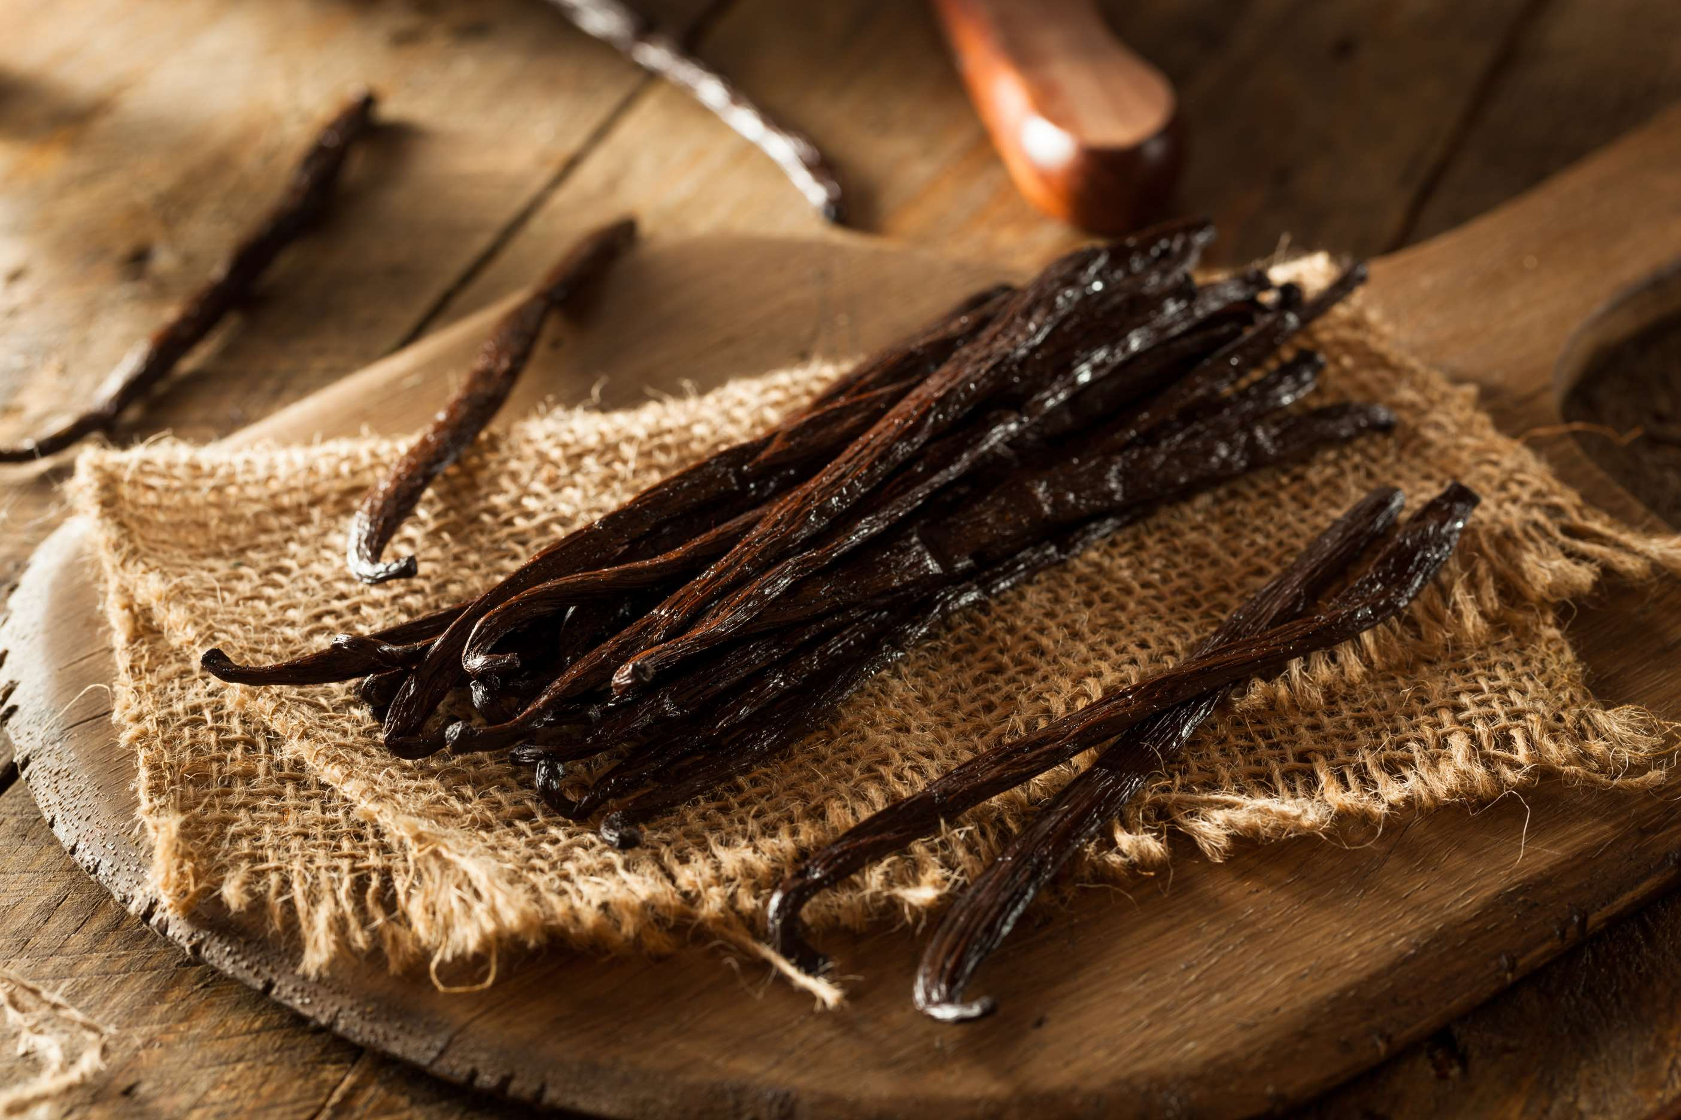
  Rising Consumer Preference for the Natural and Organic Ingredients to Drive the Market
  Expansion of the Food and Beverage Industry in Developing Markets to Propel Market Growth
Drivers
Restraints
High Cost of Vanilla to Limit the Sales

Slide 7
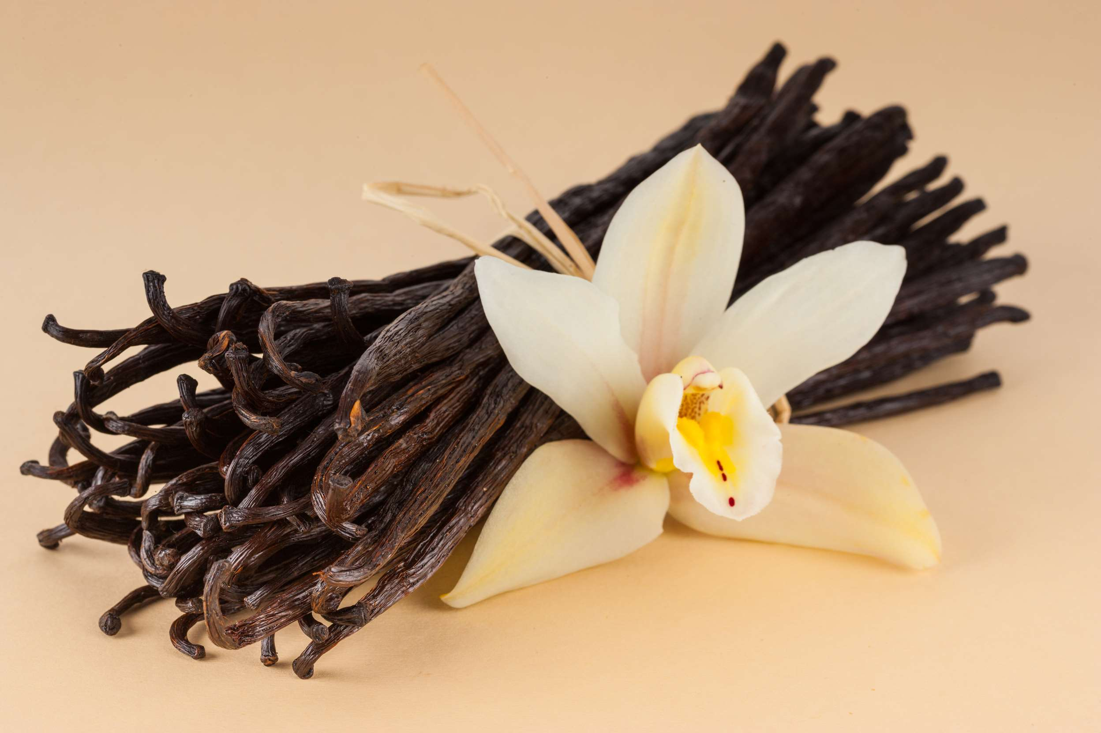
AUTHOR'S PERSPECTIVE
  The global Vanilla Powder market will expand significantly by 5.00% CAGR between 2024 to 2031.
  Pure ground dried vanilla beans, due to their high quality and authenticity, play a crucial role in driving the market for vanilla powder.
  These beans serve as the primary source of flavor and aroma in vanilla powder production, ensuring a rich and natural taste that appeals to consumers.
  Baked goods drive the market for vanilla powder due to their widespread use of this ingredient in recipes.
  Vanilla powder adds a distinct flavor and aroma to baked goods, enhancing their taste profile and making them more appealing to consumers.

Slide 8
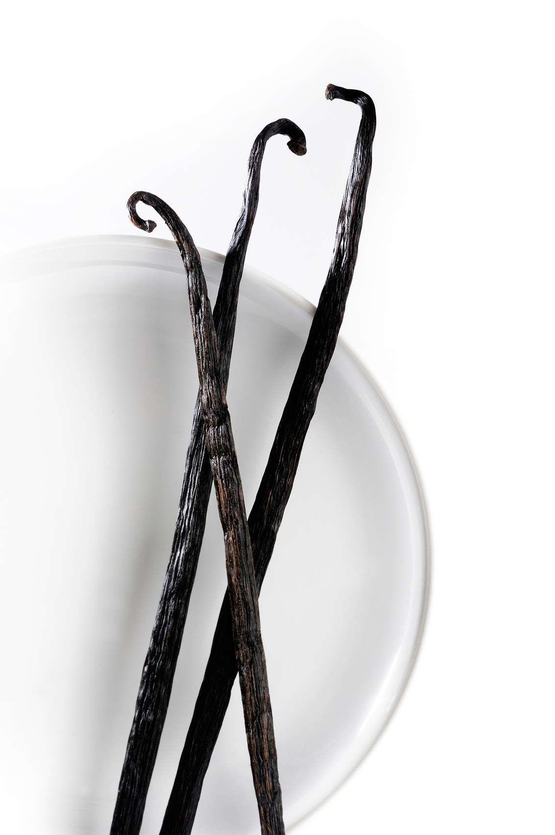



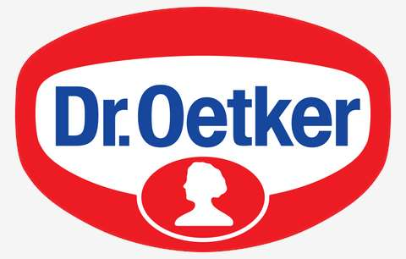






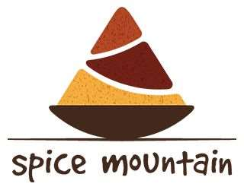

KEY PLAYERS

Slide 9


For Full Report
Contact us
COGNITIVE MARKET RESEARCH
Tel: +1 312-376-8303 | +44 020-8123-0732
India: (+91) 983-496-8611
sales@cognitivemarketresearch.com
Access the Full Report : https://tinyurl.com/49bamd7e
Please visit our website:
https://www.cognitivemarketresearch.com

