Slide 1

GLOBAL URINARY TRACT
INFECTION TESTING
MARKET REPORT 2024

Slide 2

INTRODUCTION
Urinary tract infection (UTI) is a frequent bacterial infection in the urinary tract that affects approximately 40% of women in the United States at some stage in their lives.

Slide 3

KEY INSIGHTS
MARKET SIZE (2022)
$600.92 MN
FORECAST (2030)
$964.91 MN
CAGR (2022-2030)
6.6%

Slide 4

TEST TYPE
URINALYSIS:68.4
REVENUE MARKET SHARE BY SEGMENTS 2022
END USER
HOSPITALS:44.7
GENDER
WOMEN:63.7%
%
%
INFECTION TYPE
CYSTITIS:36.5%
TEST KITS LABORATORY TEST KITS:75.3%

Slide 5
GLOBAL URINARY TRACT INFECTION TESTING MARKET REVENUE SHARE FOR 2022
NORTH AMERICA 34.1%

Slide 6
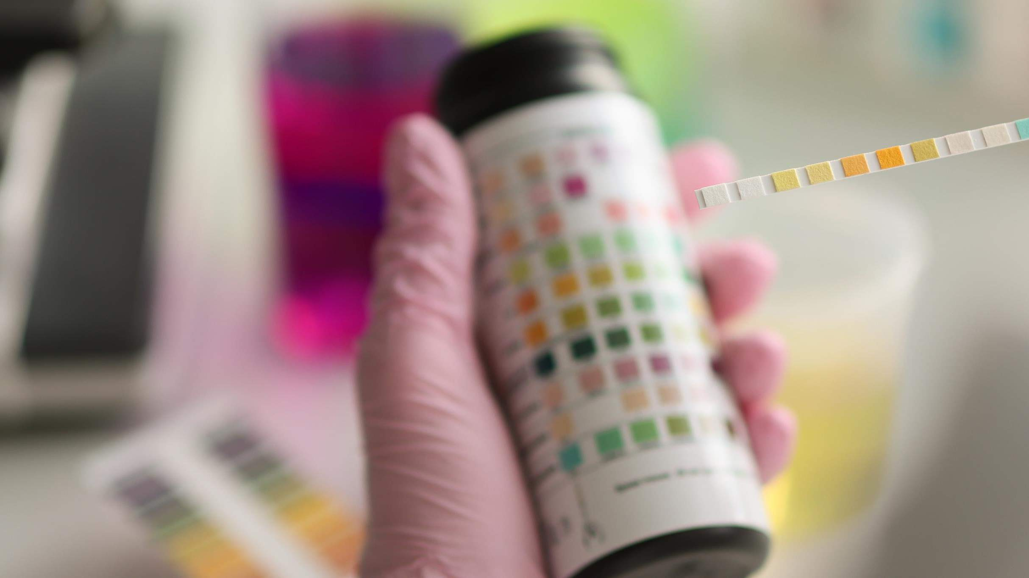
DRIVERS
Rise in the prevalence of urinary tract infection
RESTRAINT S
Errors of false negative or false positive results in UTI testing may hinder the growth of market

Slide 7

AUTHOR'S PERSPECTIVE
Emerging technologies in UTI Testing, such as microfluidics, biosensors, real-time microscopy systems, and sequence-based diagnostics are showing profitable potential in delivering rapid results.

Slide 8
KEY PLAYERS

Slide 9


Contact us
For Full Report
COGNITIVE MARKET RESEARCH
Tel: + 1 312 - 376 - 8303 | + 44 020 - 8123 - 0732
India: ( + 91 ) 983 - 496 - 8611
sales@ cognitivemarketresearch. com
Access the Full Report : https://shorturl.at/bAJY5
Please visit our website:
https://www.cognitivemarketresearch.com

