Slide 1

GLOBAL
UMBRELLAS
MARKET REPORT
2024
Global,Regional,CountryAnalysis

Slide 2

INTRODUCTION
The umbrella market is experiencing growth due to a combination of factors. Changing weather patterns and the need for protection against sun and rain have increased demand for umbrellas. Additionally, innovative designs, materials, and features are making umbrellas more attractive to consumers. The fashion industry's influence has also contributed to umbrella market growth, as they are increasingly viewed as stylish accessories. Overall, the utility and style of umbrellas, along with the impact of weather-related events, drive their market expansion.

Slide 3


KEY INSIGHTS
MARKET SIZE
USD 7.0 billion
2023
CAGR
2.2%
2023- 2030

Slide 4

REVENUE MARKET SHARE BY SEGMENTS 2022
  Straight
  Folding
  Reverse
  Automatic
  Golf
  Adult
  Kids
Product Segment
End Use Segment
  Residential
  Commercial
  Online
  Offline
Application Segment
Distribution Channel

Slide 5

Global Umbrellas Market Revenue share for 2024
Asia Pacific

Slide 6

Increasing Tourism and Travel to Propel Market Growth
Drivers
Seasonal Demand Hinder Market Growth
Restraints

Slide 7

AUTHOR'S PERSPECTIVE
  The Global Umbrellas Market is witnessing significant growth in the near future.
  Straight umbrellas are versatile, appealing to a broad consumer base as essential, reliable accessories.
  Their automatic mechanism, compact size, and stylish designs are driving their popularity, especially among urban dwellers and those looking for practical and fashionable umbrella options.
  Restaurants, cafes, and hotels are using umbrellas for outdoor dining and customer comfort, especially in response to social distancing requirements.
  Kid-friendly and colorful umbrella options are gaining popularity as they appeal to both children and their caregivers.

Slide 8





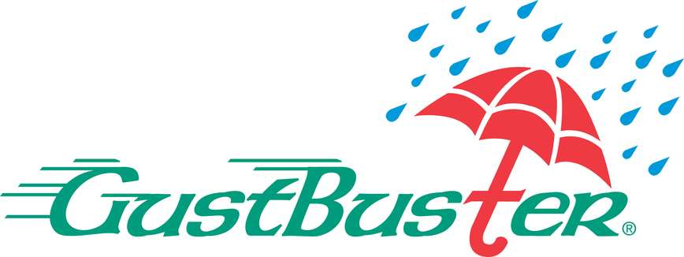

KEY PLAYERS

Slide 9


For Full Report
Contact us
COGNITIVE MARKET RESEARCH
Tel: +1 312-376-8303 | +44 020-8123-0732
India: (+91) 983-496-8611
sales@cognitivemarketresearch.com
Access the Full Report : https://tinyurl.com/25maaxbk
Please visit our website:
https://www.cognitivemarketresearch.com

