Slide 1

GLOBAL
TREADMILL
MARKET REPORT
2024
Global,Regional,CountryAnalysis

Slide 2
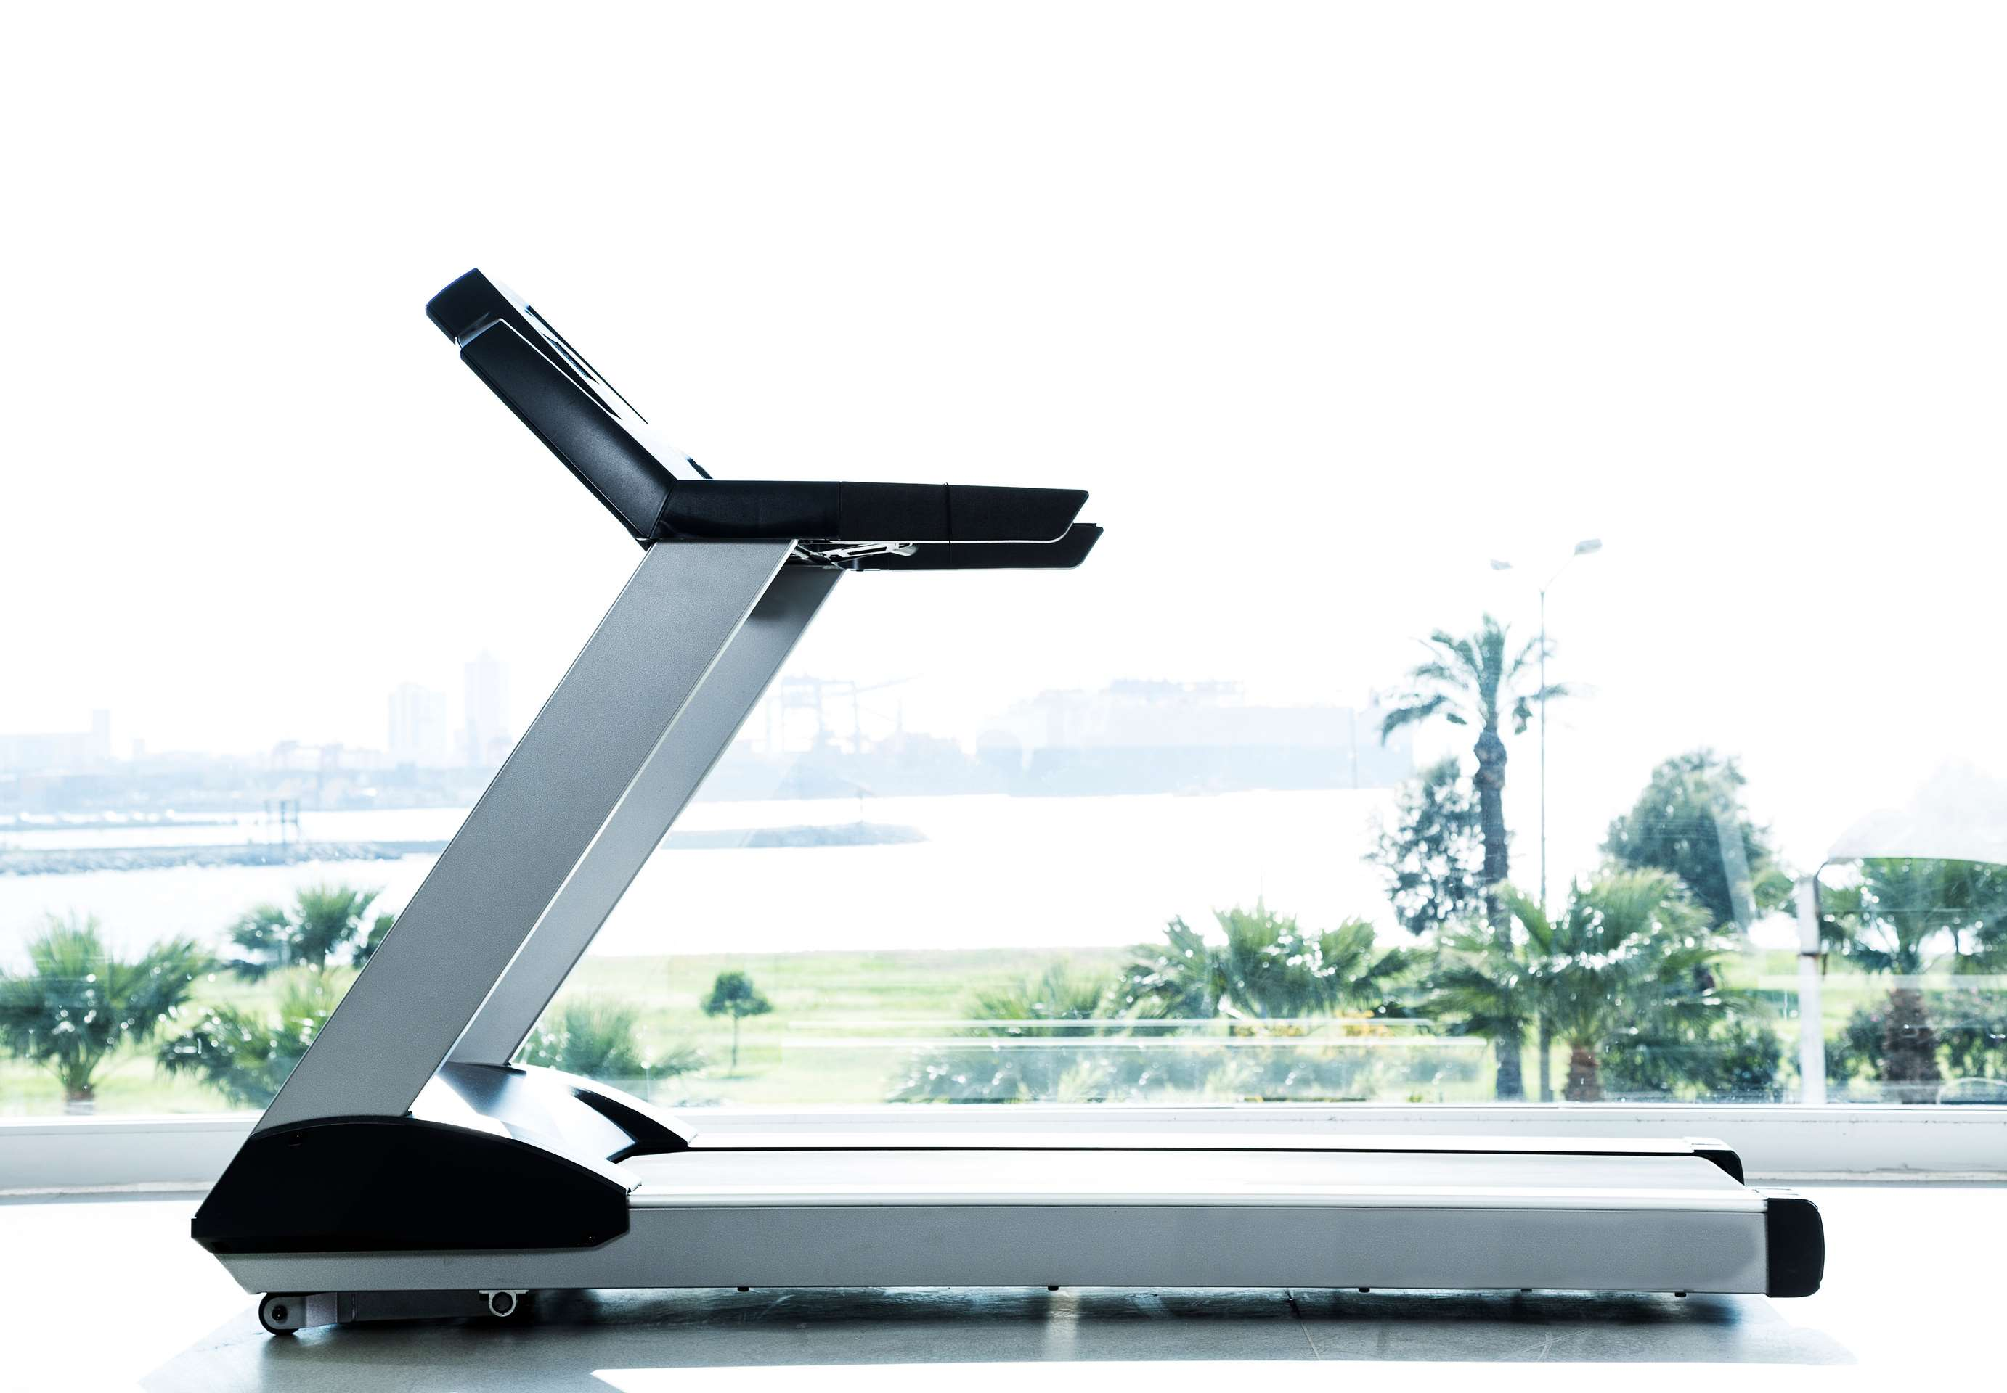
INTRODUCTION
The treadmill market represents a dynamic segment within the fitness equipment industry, offering consumers a versatile and convenient solution for indoor cardiovascular exercise. Treadmills are popular for their accessibility, allowing users to walk, jog, or run at their own pace regardless of weather conditions or time constraints. With various features such as adjustable speed, incline settings, and built-in workout programs, treadmills cater to users of all fitness levels and goals. The market encompasses a wide range of treadmills, including manual and motorized models, designed for home use, commercial fitness facilities, and rehabilitation centres.

Slide 3


KEY INSIGHTS
MARKET SIZE
USD 1566.08 million
2024
CAGR
3.5%%
2024- 2031

Slide 4

REVENUE MARKET SHARE BY SEGMENTS 2022
  Manual
  Electronic
Type Segment

Slide 5

Global Treadmill Market Revenue share for 2024
North America
30%

Slide 6

Increasing Health Awareness to Increase the Demand Globally
Drivers
Convenience and Accessibility to Propel Market Growth
Restraints

Slide 7

AUTHOR'S PERSPECTIVE
  The global Treadmill Market will expand significantly by 5.30% CAGR between 2024 to 2031.
  The Manual segment is set to rise. Manual treadmills typically feature a basic design without motors, making them more budget-friendly compared to their motorized counterparts. This affordability appeals to cost-conscious consumers who seek an effective yet economical way to incorporate cardiovascular exercise into their routines.
  Rising awareness of the importance of physical fitness and the benefits of regular exercise drives demand for home fitness equipment like treadmills

Slide 8
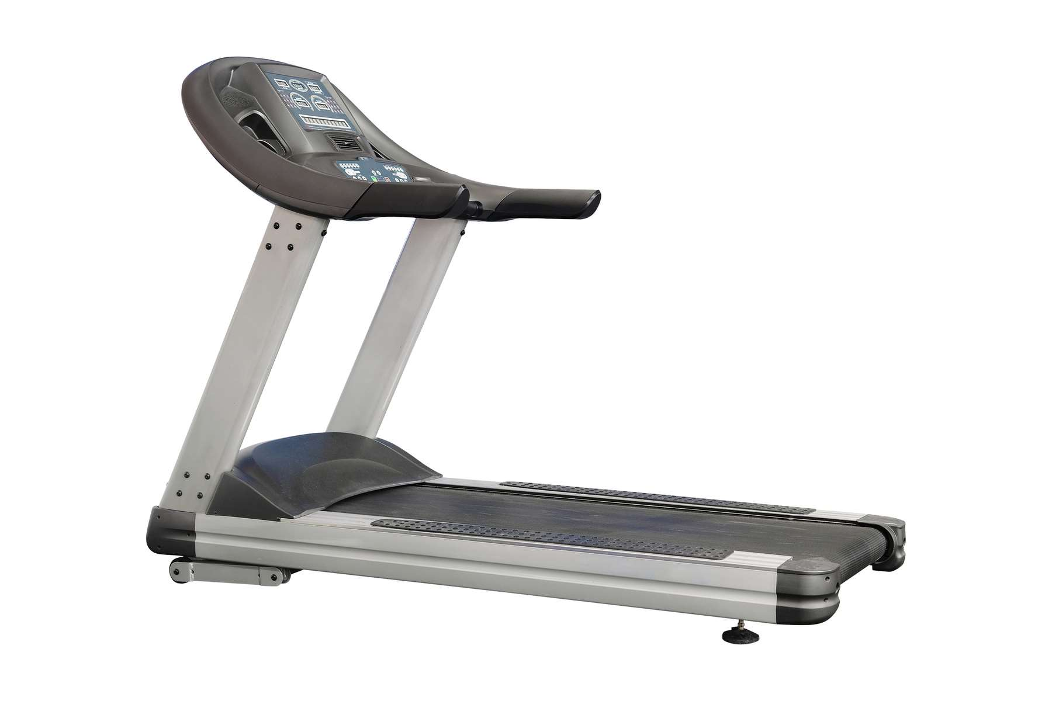








KEY PLAYERS

Slide 9


For Full Report
Contact us
COGNITIVE MARKET RESEARCH
Tel: +1 312-376-8303 | +44 020-8123-0732
India: (+91) 983-496-8611
sales@cognitivemarketresearch.com
Access the Full Report : https://tinyurl.com/yc7vfkc5
Please visit our website:
https://www.cognitivemarketresearch.com

