Slide 1
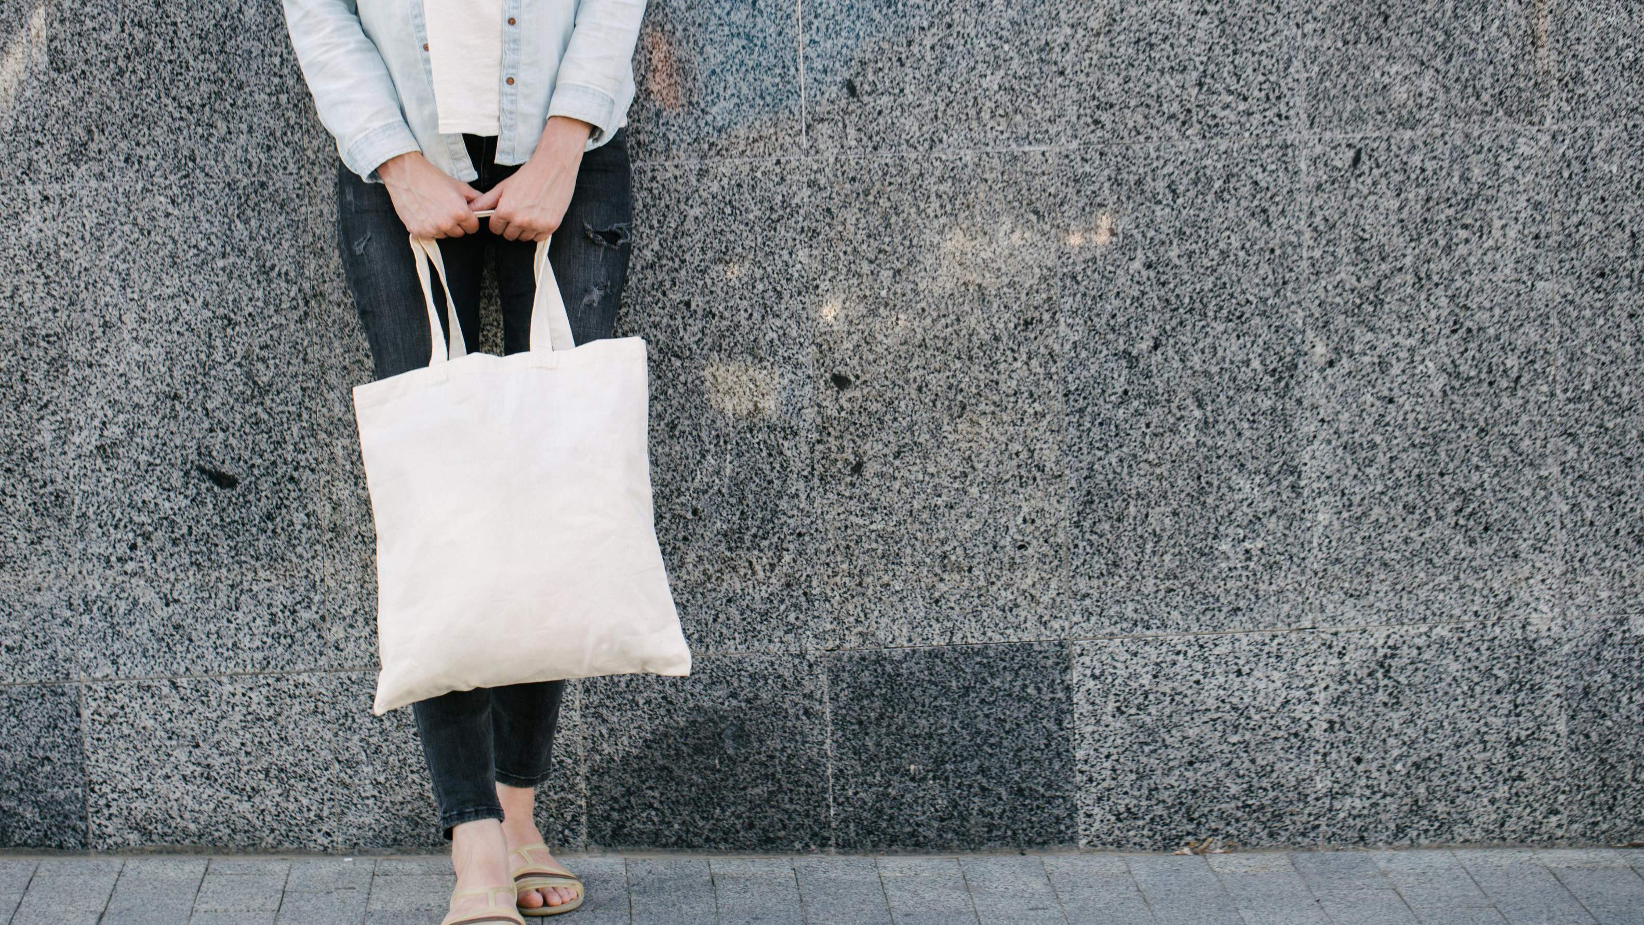
GLOBAL
Tote Bags
MARKET REPORT 2024
Global,Regional,CountryAnalysis

Slide 2
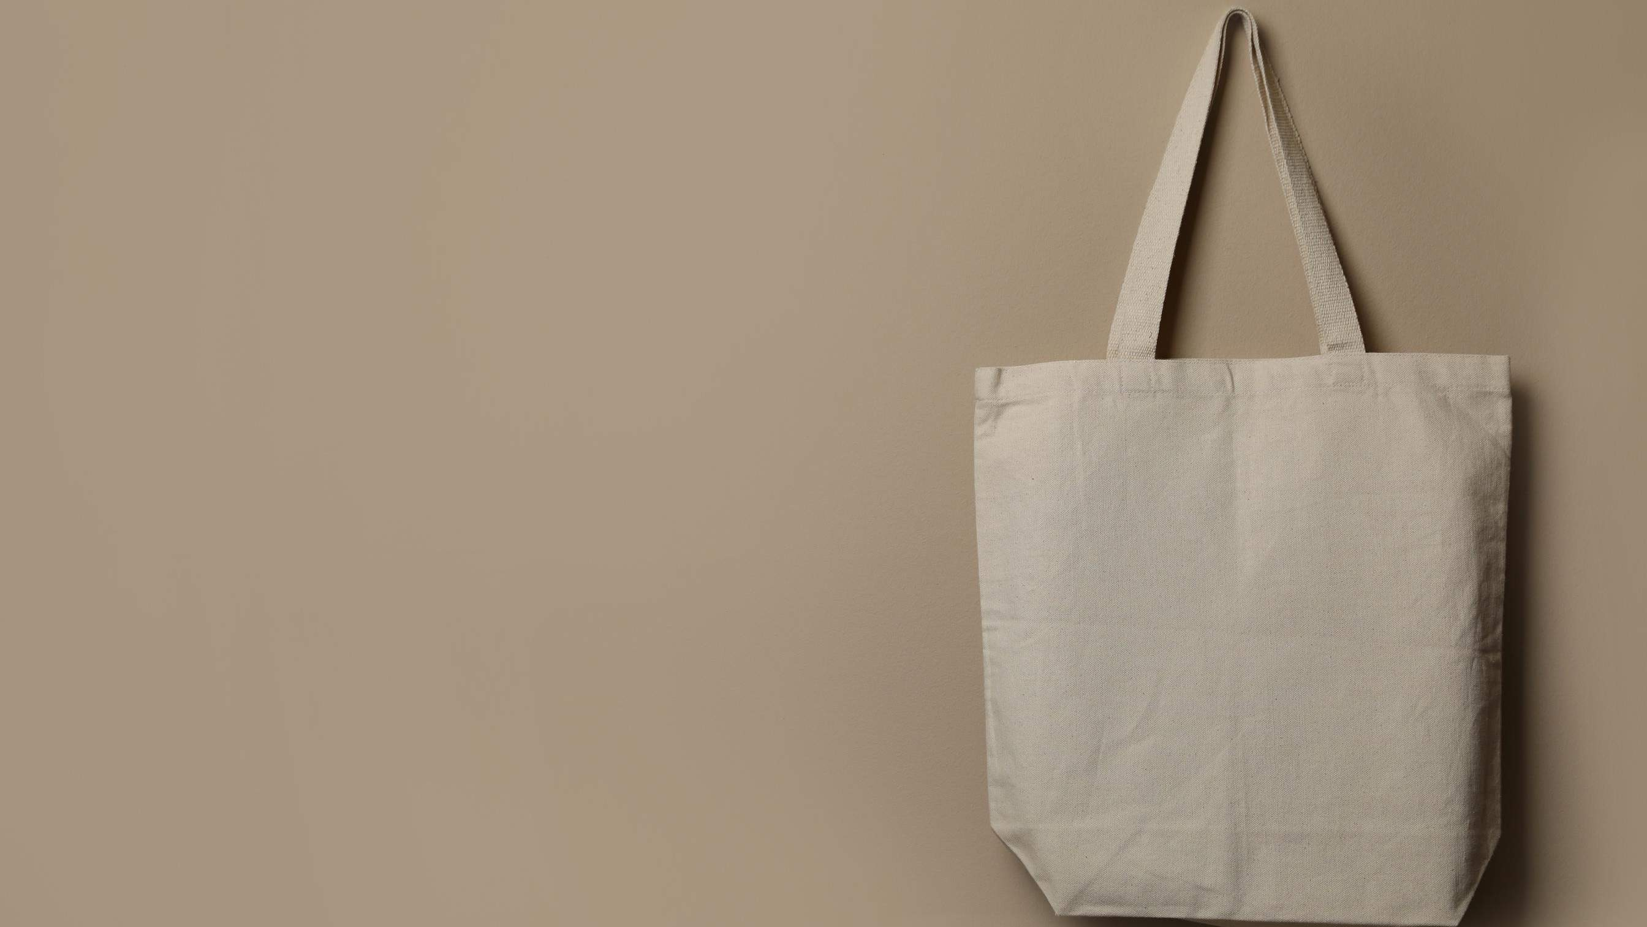
INTRODUCTION
Spending on personal items like tote bags has increased as a result of consumers' growing fashion consciousness. Totes are one of those fashion items whose demand fluctuates quickly based on shifting consumer tastes and style trends. Since tote bags constitute the product's secondary packing, packaging is an important part of the product. Thus, the market's expansion has benefited from the expansion of the packaging sector. Additionally, employing sustainable materials to make tote bags is becoming more and more popular, which will further boost market growth.

Slide 3
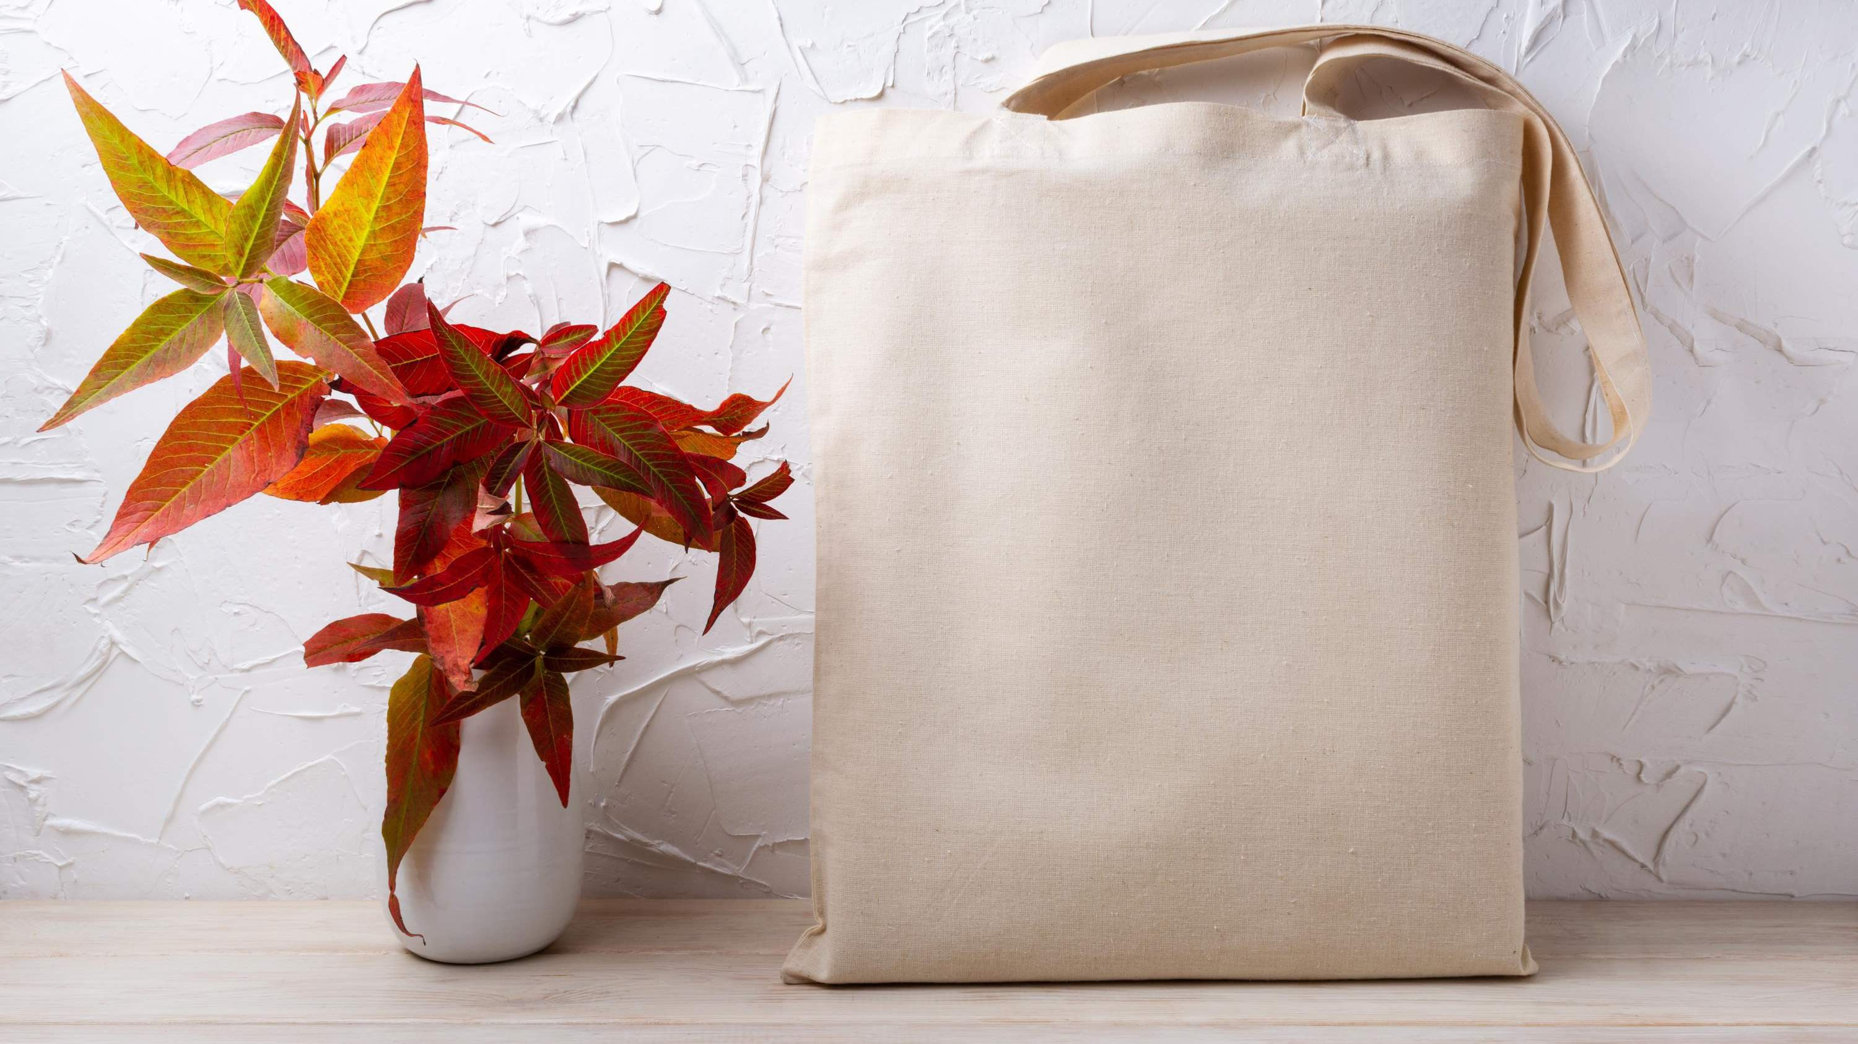

KEY INSIGHTS
MARKET SIZE
USD 2.6 billion
2023
20₋23
CAGR 5%
2030

Slide 4
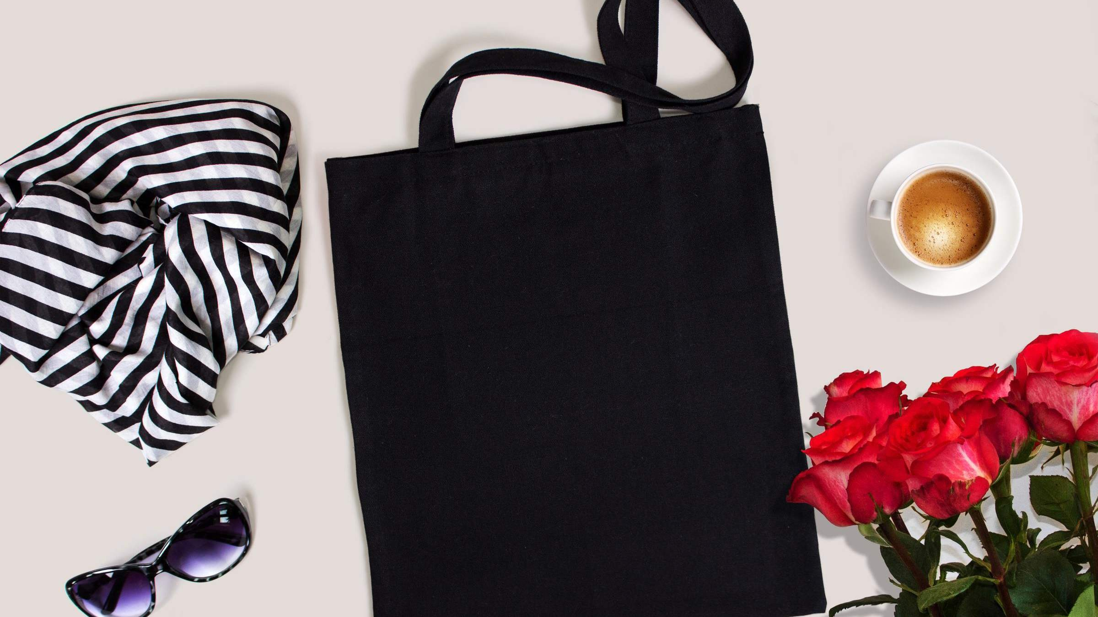
REVENUE MARKET SHARE BY SEGMENTS 2022
Leather
Faux Leather
Nylon
Jute
Cloth
Fabric Segment
Shopping
Casual Every Day
Laptop
Business and Travel
Personalized
Application Segment
Printed
Textured
Solid
Pattern Segment

Slide 5
Global Tote Bags Market Revenue share for 2022
North America 40%

Slide 6
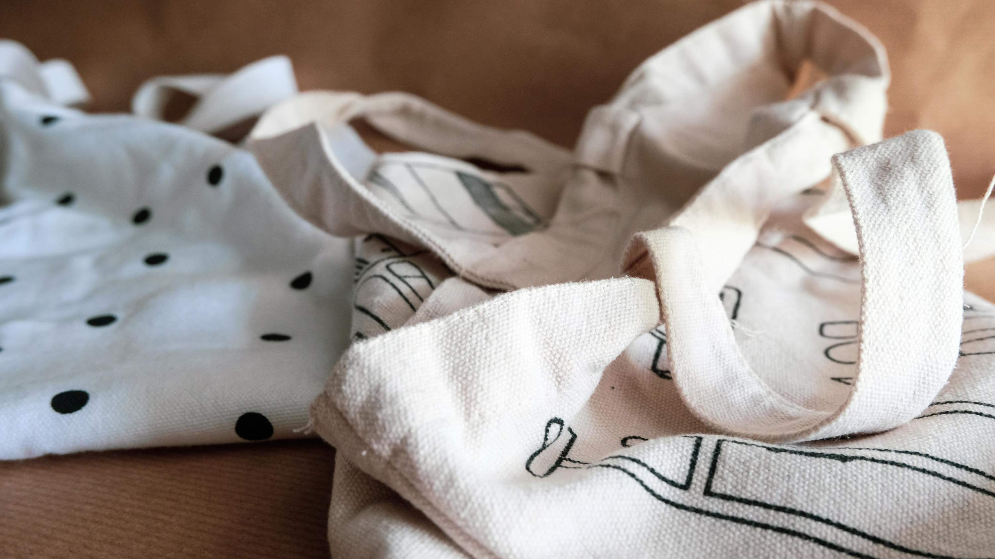



Slide 7
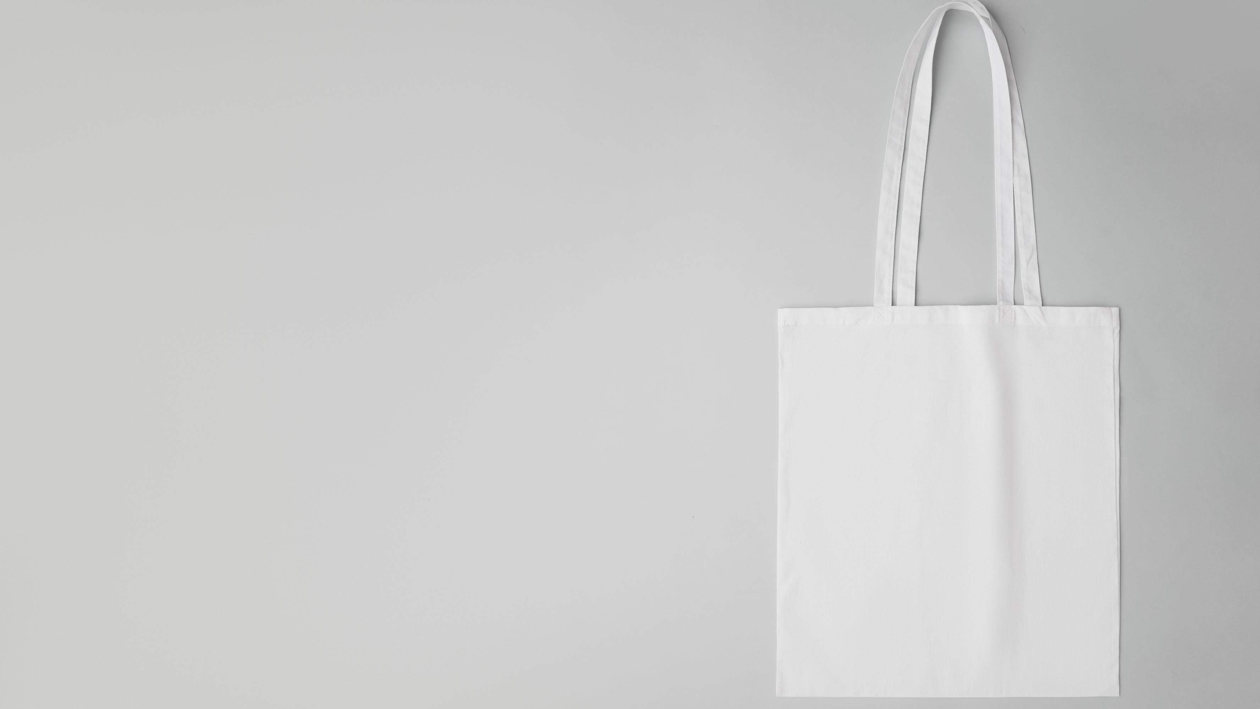
AUTHOR'S PERSPECTIVE
The Global Tote Bags Market is witnessing significant growth in the near future.
Cloth is the fastest-growing category over the forecast period; among its many benefits are its
durability, moisture resistance, and low weight. Its qualities are reusable, and it requires very little seepage.
Malls and coffee shops have rebounded tremendously after the COVID-19 pandemic, and as
people's attention has shifted to shopping and travel, this takeout has suddenly increased.
This bag's enormous size allows it to hold a laptop in
addition to other essentials. Women are thus anticipated to like this wide, versatile tote bag above other bags.

Slide 8
KEY PLAYERS

Slide 9


Contact us
For Full Report
COGNITIVE MARKET RESEARCH
Tel: + 1 312 - 376 - 8303 | + 44 020 - 8123 - 0732
India: ( + 91 ) 983 - 496 - 8611
sales@ cognitivemarketresearch. com
Access the Full Report : http://tinyurl.com/ctj724m2
Please visit our website:
https://www.cognitivemarketresearch.com

