Slide 1

GLOBAL
TOMATO POWDER
MARKET REPORT
2024
Global,Regional,CountryAnalysis

Slide 2
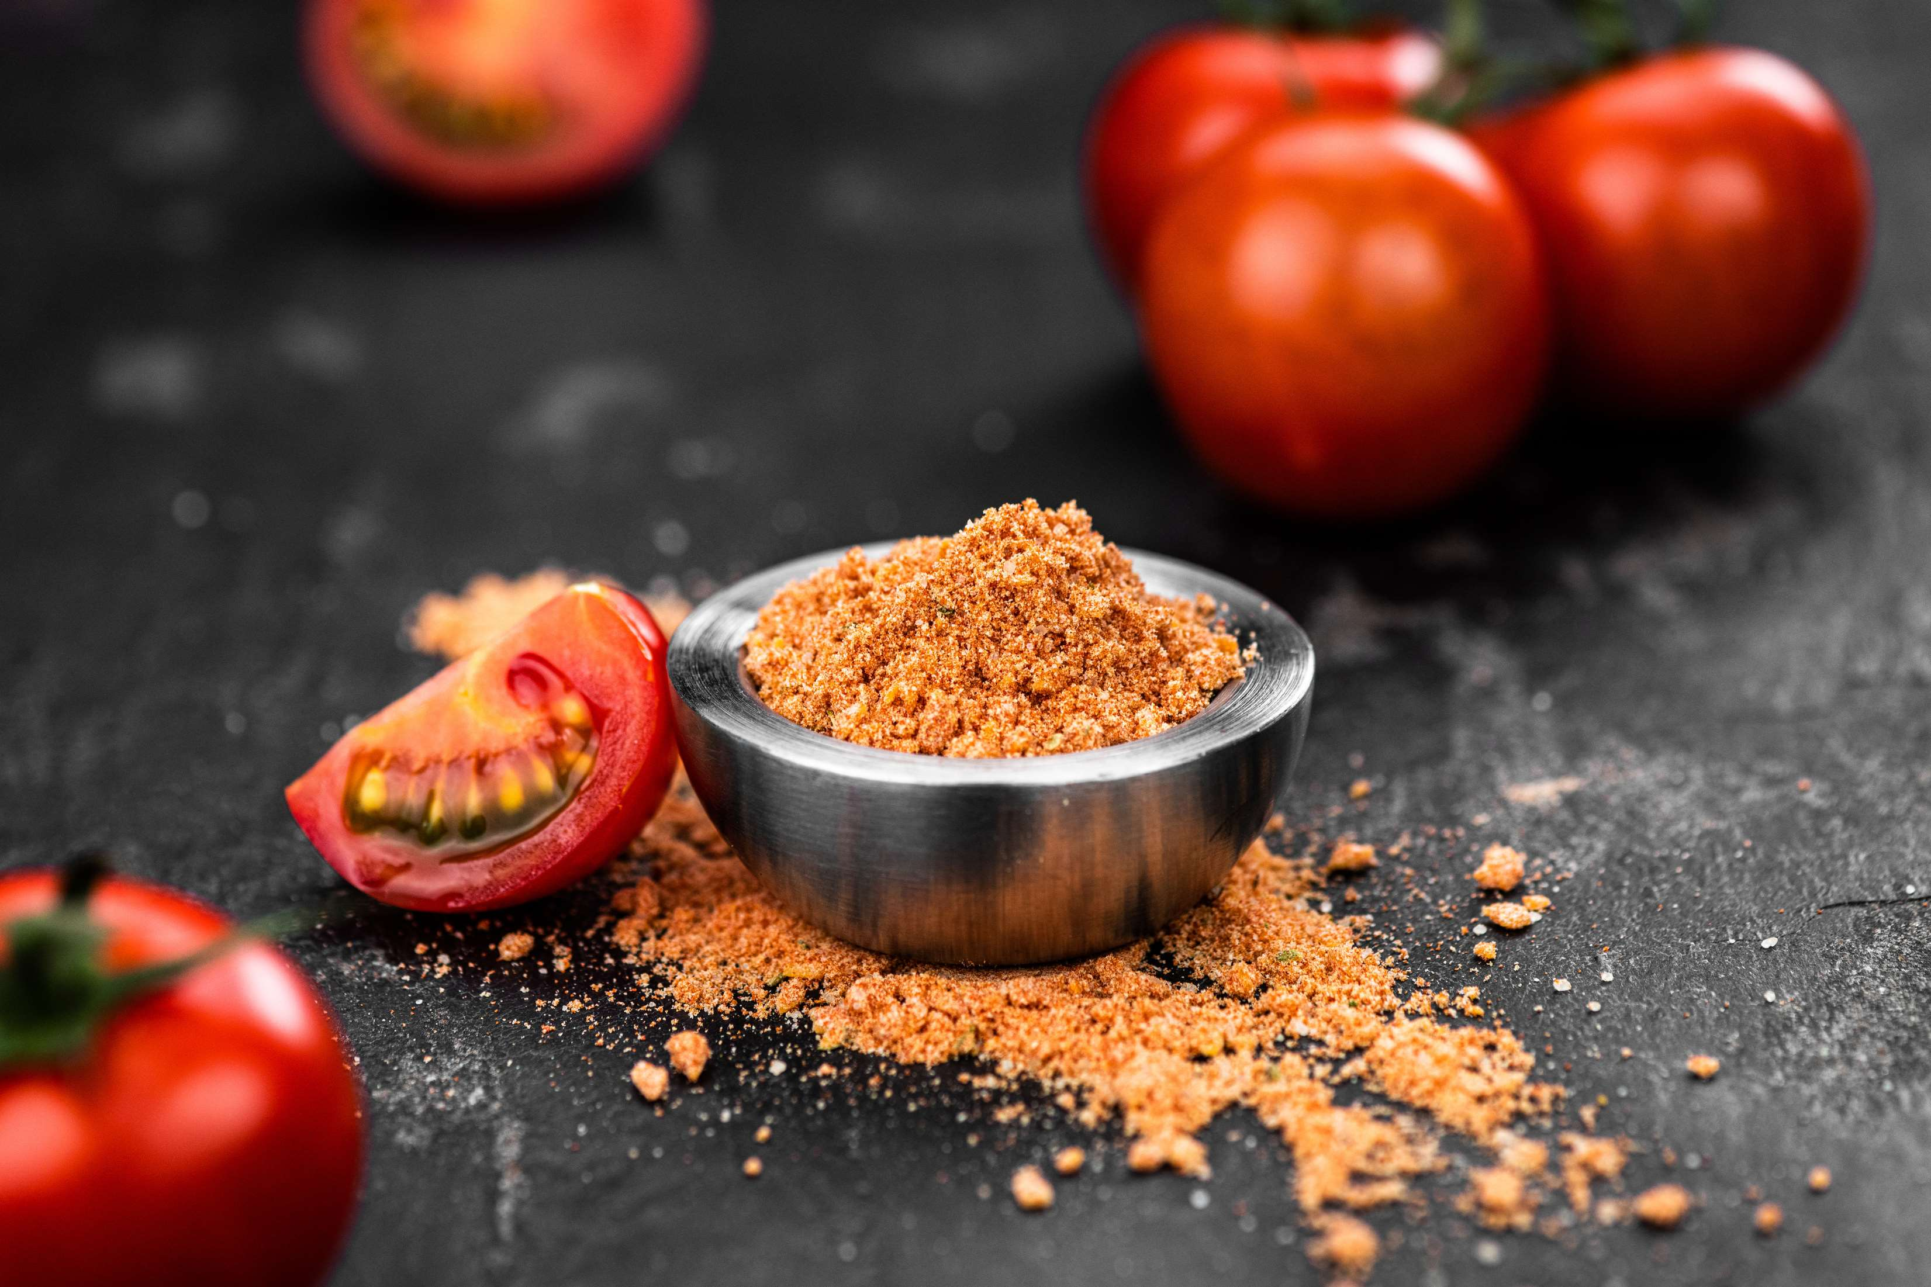
INTRODUCTION
The demand for fast food products is growing globally due to the rising working population, particularly among women, and the growing number of teenagers and young adults with strong purchasing power. One of the key components in fast food products is tomato powder. These items are increasingly using tomato powder as a flavoring and taste-enhancing component. Over the past ten years, changes in the way people eat have increased the amount of fast food consumed per person, including pizza, sandwiches, burgers, hotdogs, and other items. Tomato powder is utilized as a vital ingredient for flavor enhancement in various types of food products. The market for tomato powder is experiencing increased demand due to rising demand for non-GMO products. Non-GMO tomato powder is available from important manufacturers like Harmony House Foods, satisfying consumer demand for unmodified ingredients.

Slide 3


KEY INSIGHTS
MARKET SIZE
USD 1900 million
2023
CAGR
4.2%
2023- 2030

Slide 4

REVENUE MARKET SHARE BY SEGMENTS 2022
  Spray Dried
  Freeze Dried
  Bulk-sun Dried
  Cold-break
  Hot-break
Type Segment
Extraction Method
  Soup Mixes
  Seasoning and Savories
  Snack Foods
  Curries Gravies
  Baby Food
Application Segment
  Organic
  Conventional
Nature Segment

Slide 5

Global Tomato Powder Market Revenue share for 2024
Asia-Pacific

Slide 6
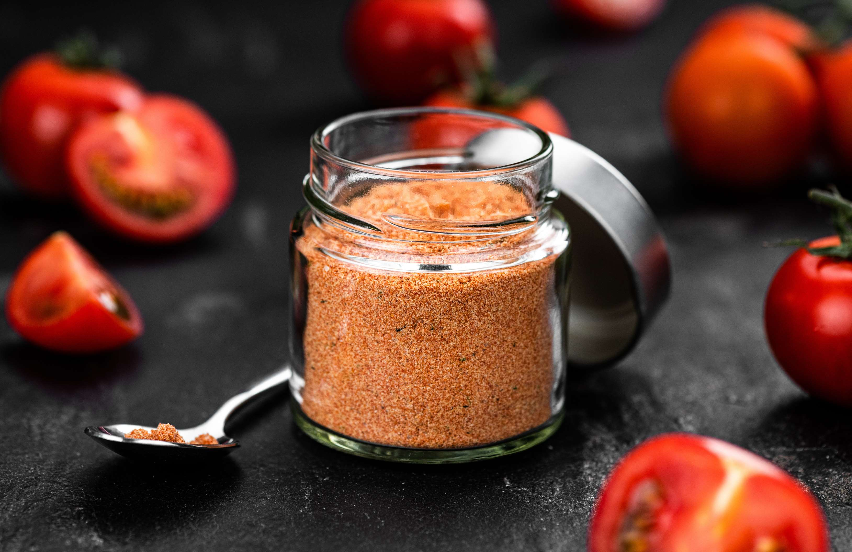
Growth of the Tomato Powder Market Would be Aided by Rising Consumer Demand for Convenient and Shelf-Stable Goods
Drivers
Quality Issues with the Powder Could Slow the Market's Expansion for Tomato Powder
Restraints

Slide 7
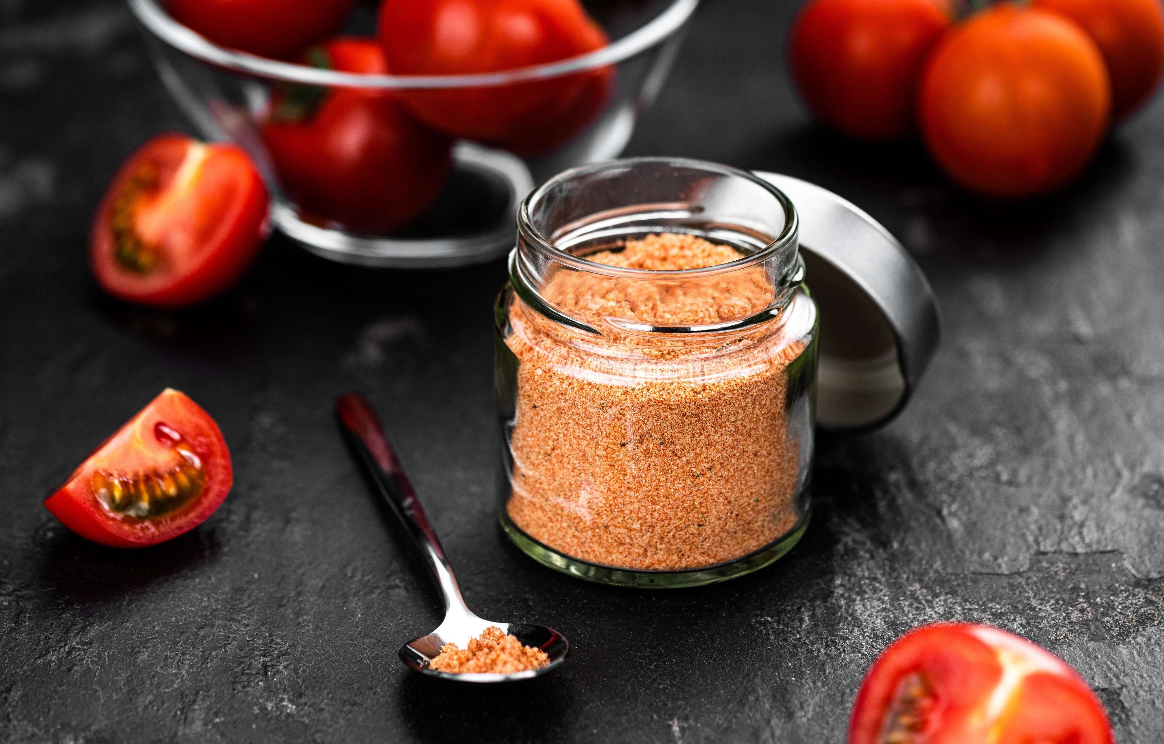
AUTHOR'S PERSPECTIVE
  The Global Tomato Powder Market is witnessing significant growth in the near future.
  Typically, freeze-dried tomato powder is bright red and tastes strongly of fresh tomatoes.
  Tomato powder is a useful option for soup manufacturers because it improves the flavour, aroma, and thickness of soups. It also helps with simpler storage and longer shelf life.

Slide 8










KEY PLAYERS

Slide 9


For Full Report
Contact us
COGNITIVE MARKET RESEARCH
Tel: +1 312-376-8303 | +44 020-8123-0732
India: (+91) 983-496-8611
sales@cognitivemarketresearch.com
Access the Full Report : https://tinyurl.com/4huh6efm
Please visit our website:
https://www.cognitivemarketresearch.com

