Slide 1

GLOBAL
Tomato Ketchup
MARKET REPORT 2024
Global,Regional,CountryAnalysis

Slide 2

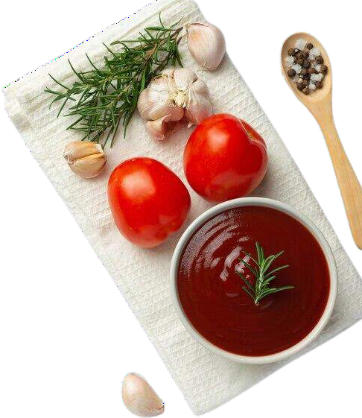
INTRODUCTION
The increasing consumer demand for convenience food, the rapid globalization of cuisines, growing brand loyalty and strategic marketing initiatives, recent technological advancements in supply chain management, and growing expenditure capacities of consumers are some of the major factors propelling the market. These strategies help key players capture a significant market share and remain competitive in the dynamic Tomato Ketchup market.

Slide 3


KEY INSIGHTS
MARKET SIZE
USD 21.2 billion
2023
20₋23
CAGR 3.00%
2030

Slide 4

REVENUE MARKET SHARE BY SEGMENTS 2022
Flavored
Regular
Type Segment
Application Segment
Household
Commercial
Packaging Segment
Pouch
Bottle
Supermarkets and Hypermarkets
Convenience Stores
Distribution Channel

Slide 5
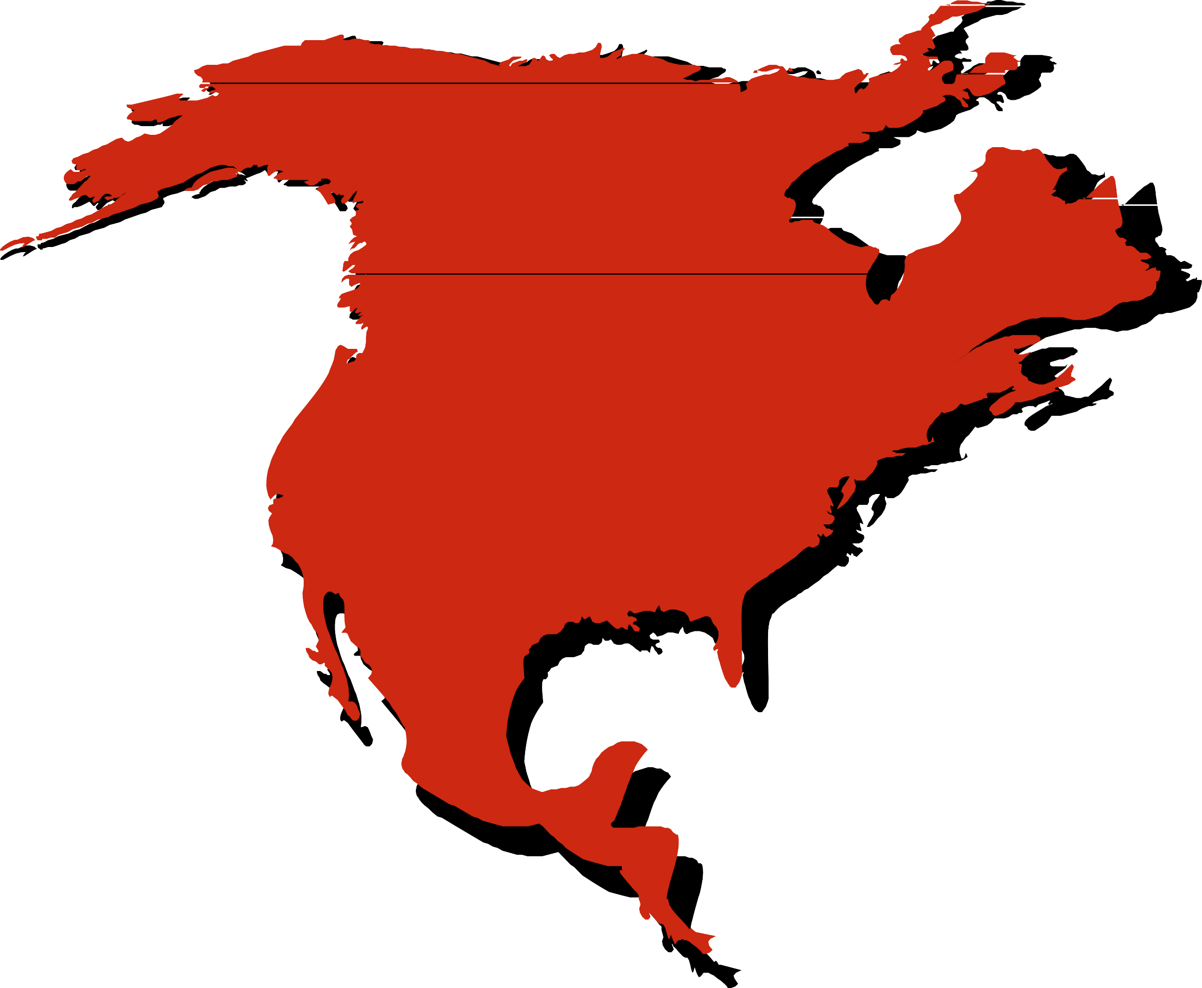
Global Tomato Ketchup Market Revenue share for 2022
North America 36%

Slide 6
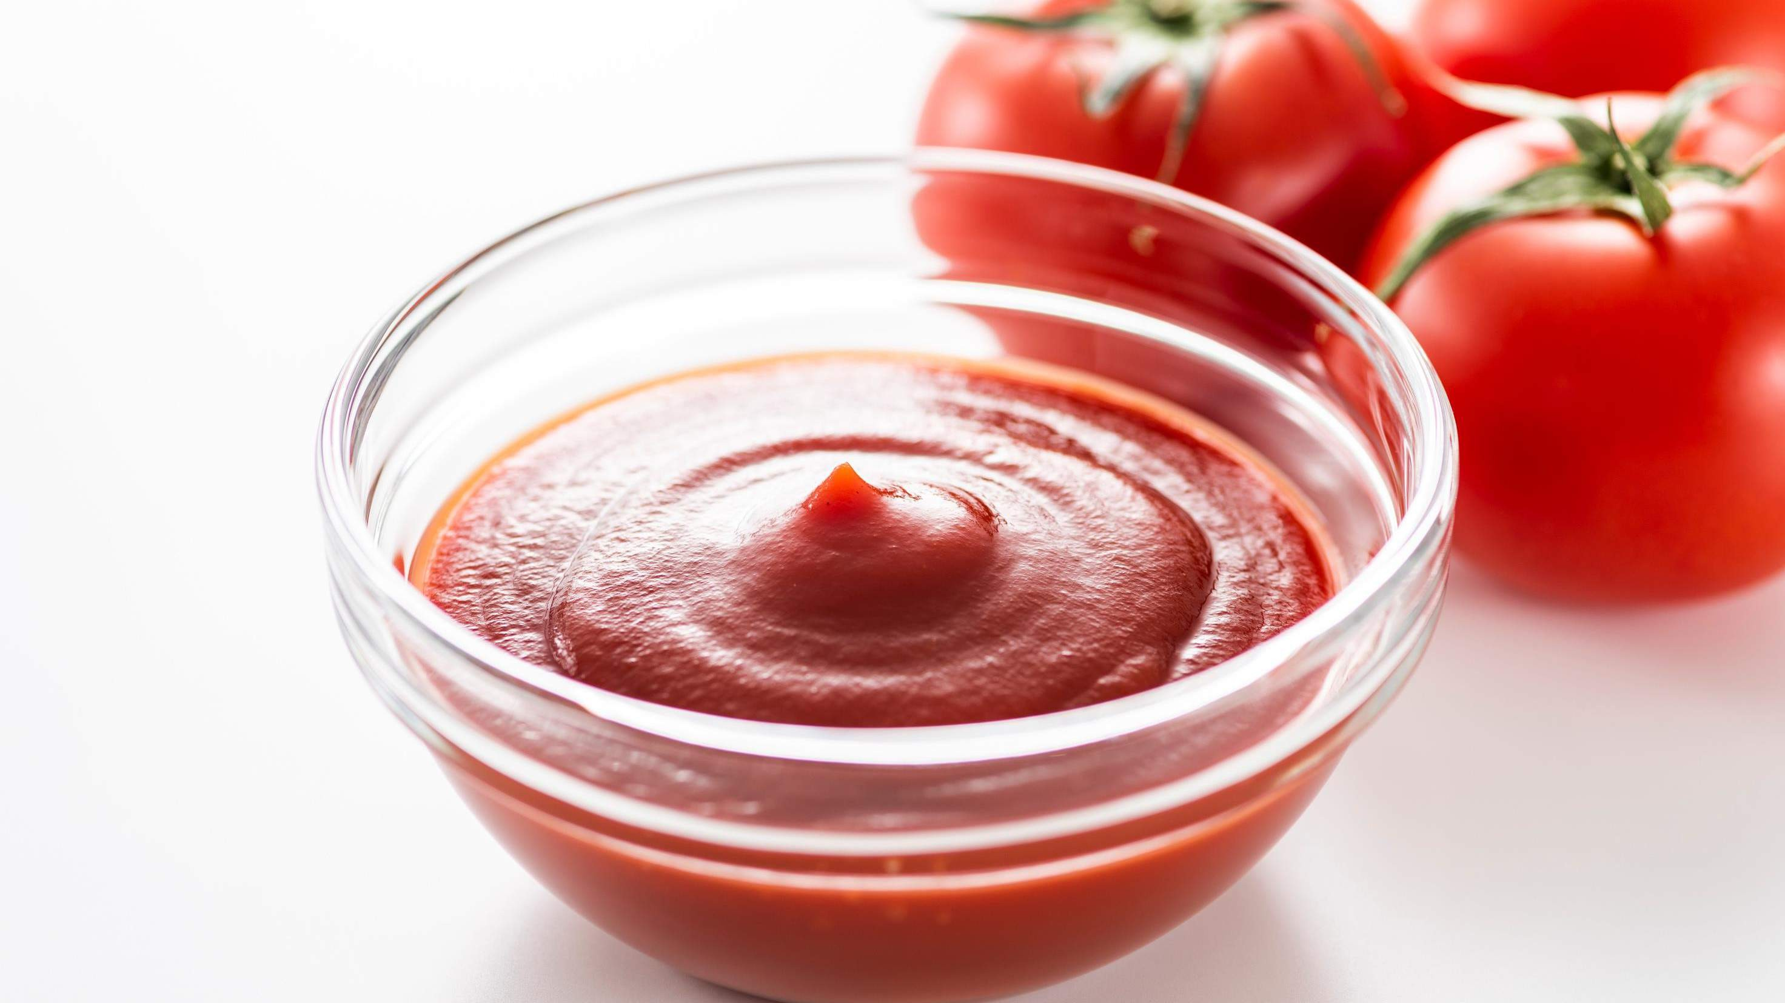




Slide 7

AUTHOR'S PERSPECTIVE
The Global Tomato Ketchup Market is witnessing significant growth in the near future.
Regular ketchup is a staple in households worldwide and is commonly used as a dip, topping, or ingredient in various recipes. It appeals to a wide demographic, including children and those who prefer a classic, familiar taste.
The household segment involves individual consumers who purchase tomato ketchup for personal use at home.
Glass bottles, in particular, are associated with premium quality and are preferred by consumers looking for a higher-end product.
The convenience of online shopping, coupled with the increasing prevalence of e-commerce platforms, has driven significant growth in this channel.
The commercial segment encompasses the usage of tomato
ketchup in the food service industry, which includes restaurants, fast-food chains, hotels, caterers, and other establishments where food is prepared and served to customers.

Slide 8

KEY PLAYERS

Slide 9


Contact us
For Full Report
COGNITIVE MARKET RESEARCH
Tel: + 1 312 - 376 - 8303 | + 44 020 - 8123 - 0732
India: ( + 91 ) 983 - 496 - 8611
sales@ cognitivemarketresearch. com
Access the Full Report : http://tinyurl.com/39x5b32n
Please visit our website:
https://www.cognitivemarketresearch.com

