Slide 1
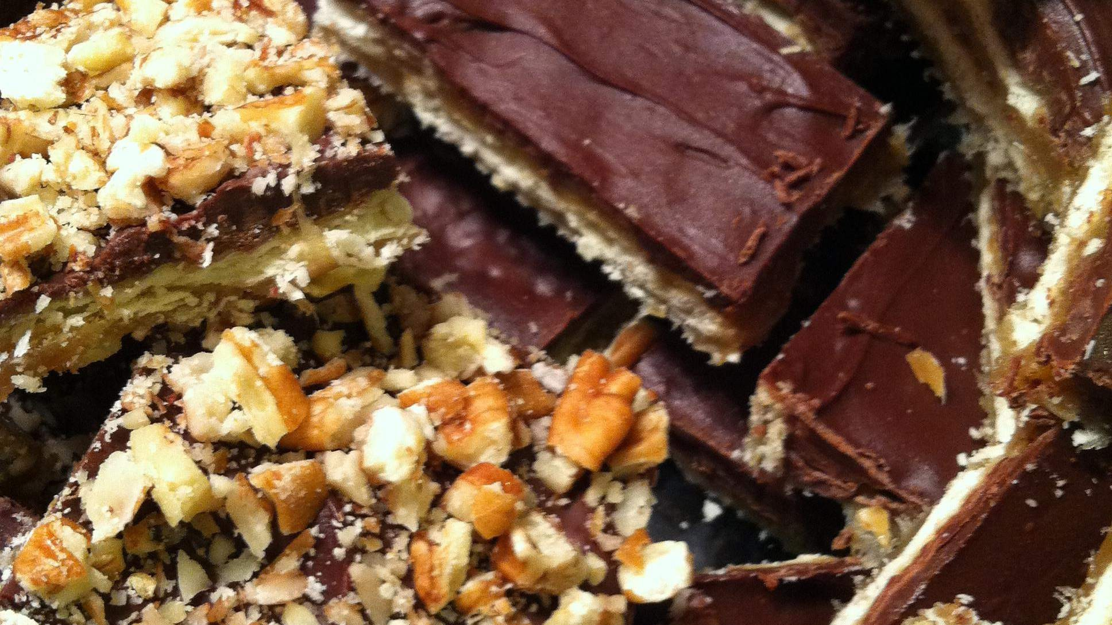
GLOBAL
TOFFEE
MARKET REPORT 2024
Global,Regional,CountryAnalysis

Slide 2
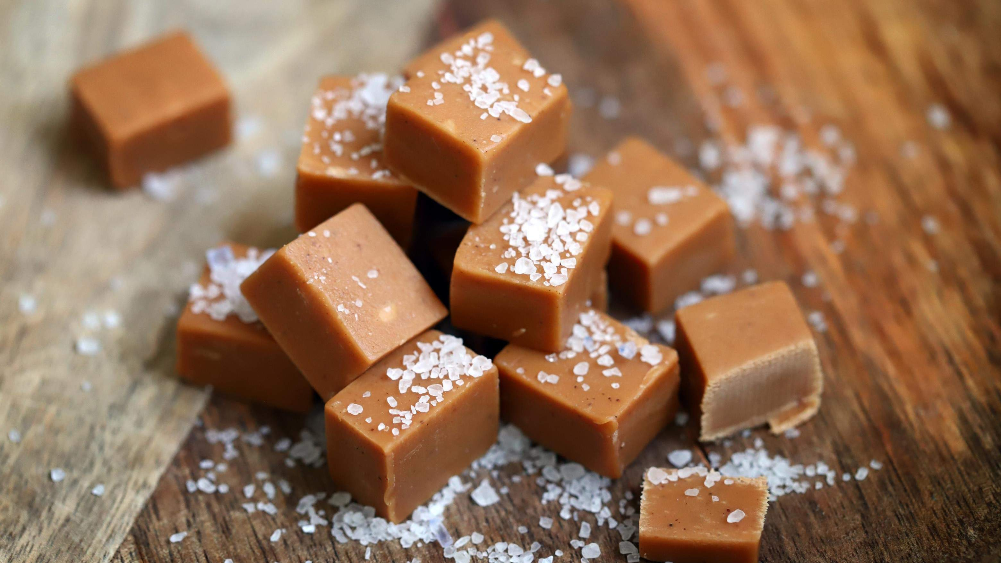
INTRODUCTION
Toffee is a sweet treat produced by caramelizing sugar or molasses (or both) together with butter and sometimes flour. The concoction is heated until it reaches a particular temperature, resulting in a delightful, chewy, and sometimes sticky confection. Toffee can possess a soft and chewy texture or be hard and brittle, depending on the ingredients used and the cooking method employed. The expansion of the toffee industry is driven by the increasing desire for sugar-free candies and the availability of numerous flavor options.

Slide 3
KEY INSIGHTS
20₋23
CAGR 4.00%
2030

Slide 4
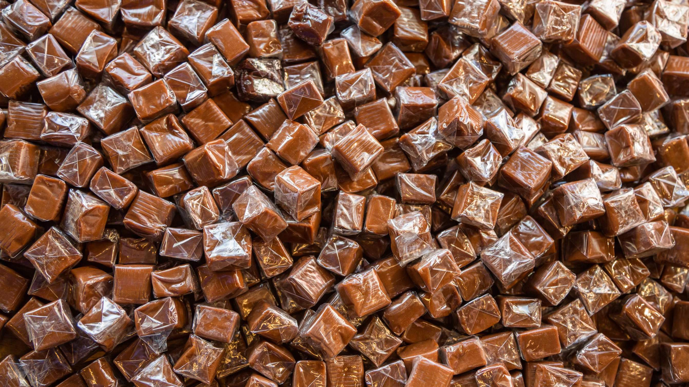
REVENUE MARKET SHARE BY SEGMENTS 2022
Salty Water Toffee
Milk Toffee
Peanut Toffe
Type Segment
Application Segment
Online Sale
Offline Sale

Slide 5
Global Toffee Market Revenue share for 2022
Asia Pacific

Slide 6
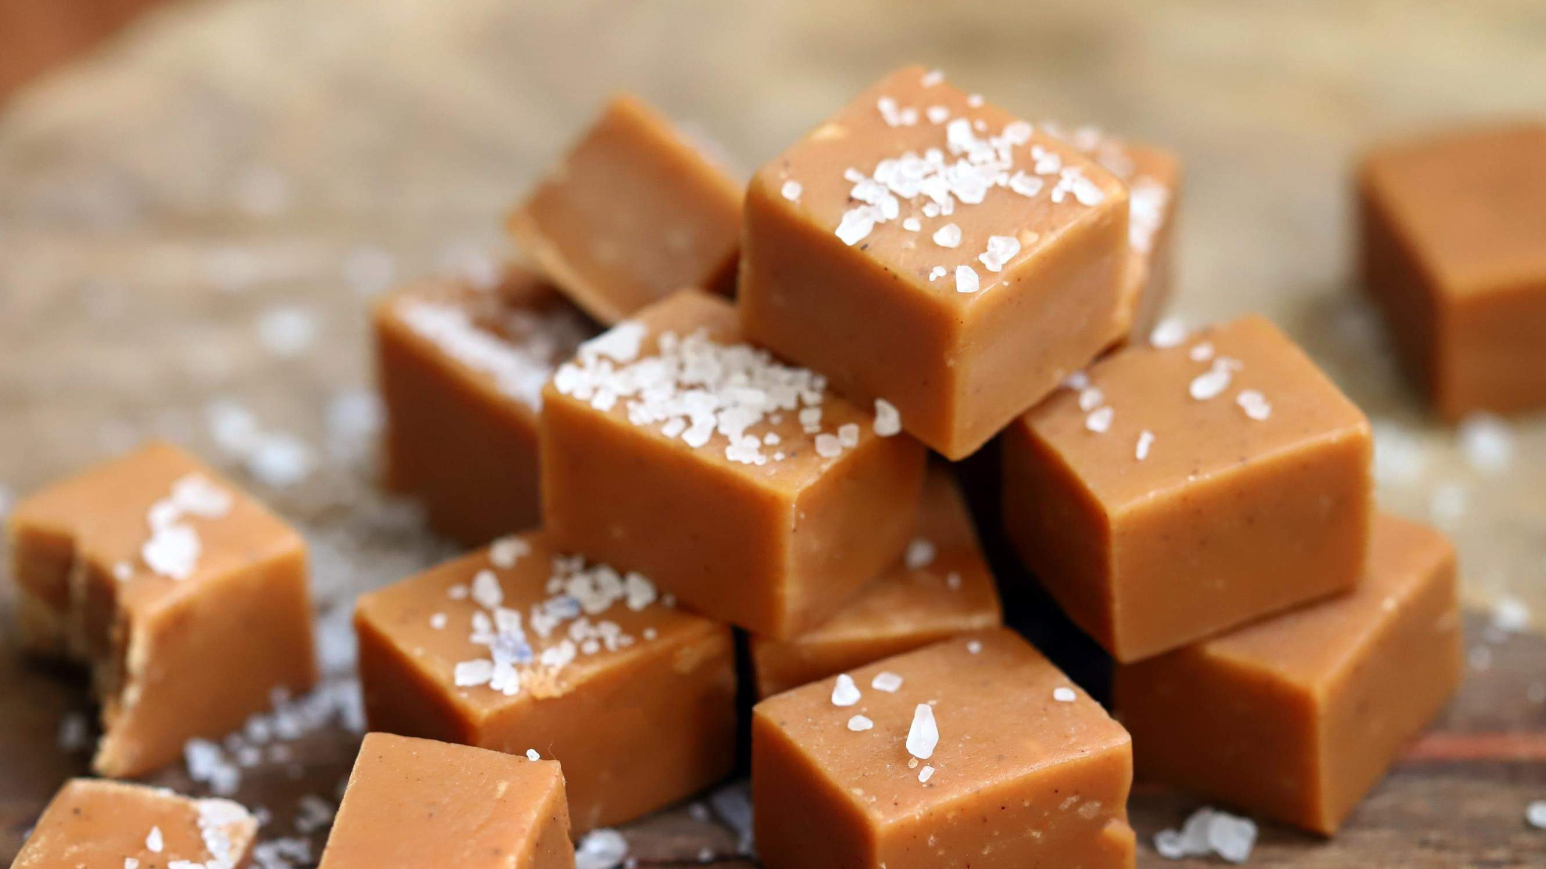




Slide 7
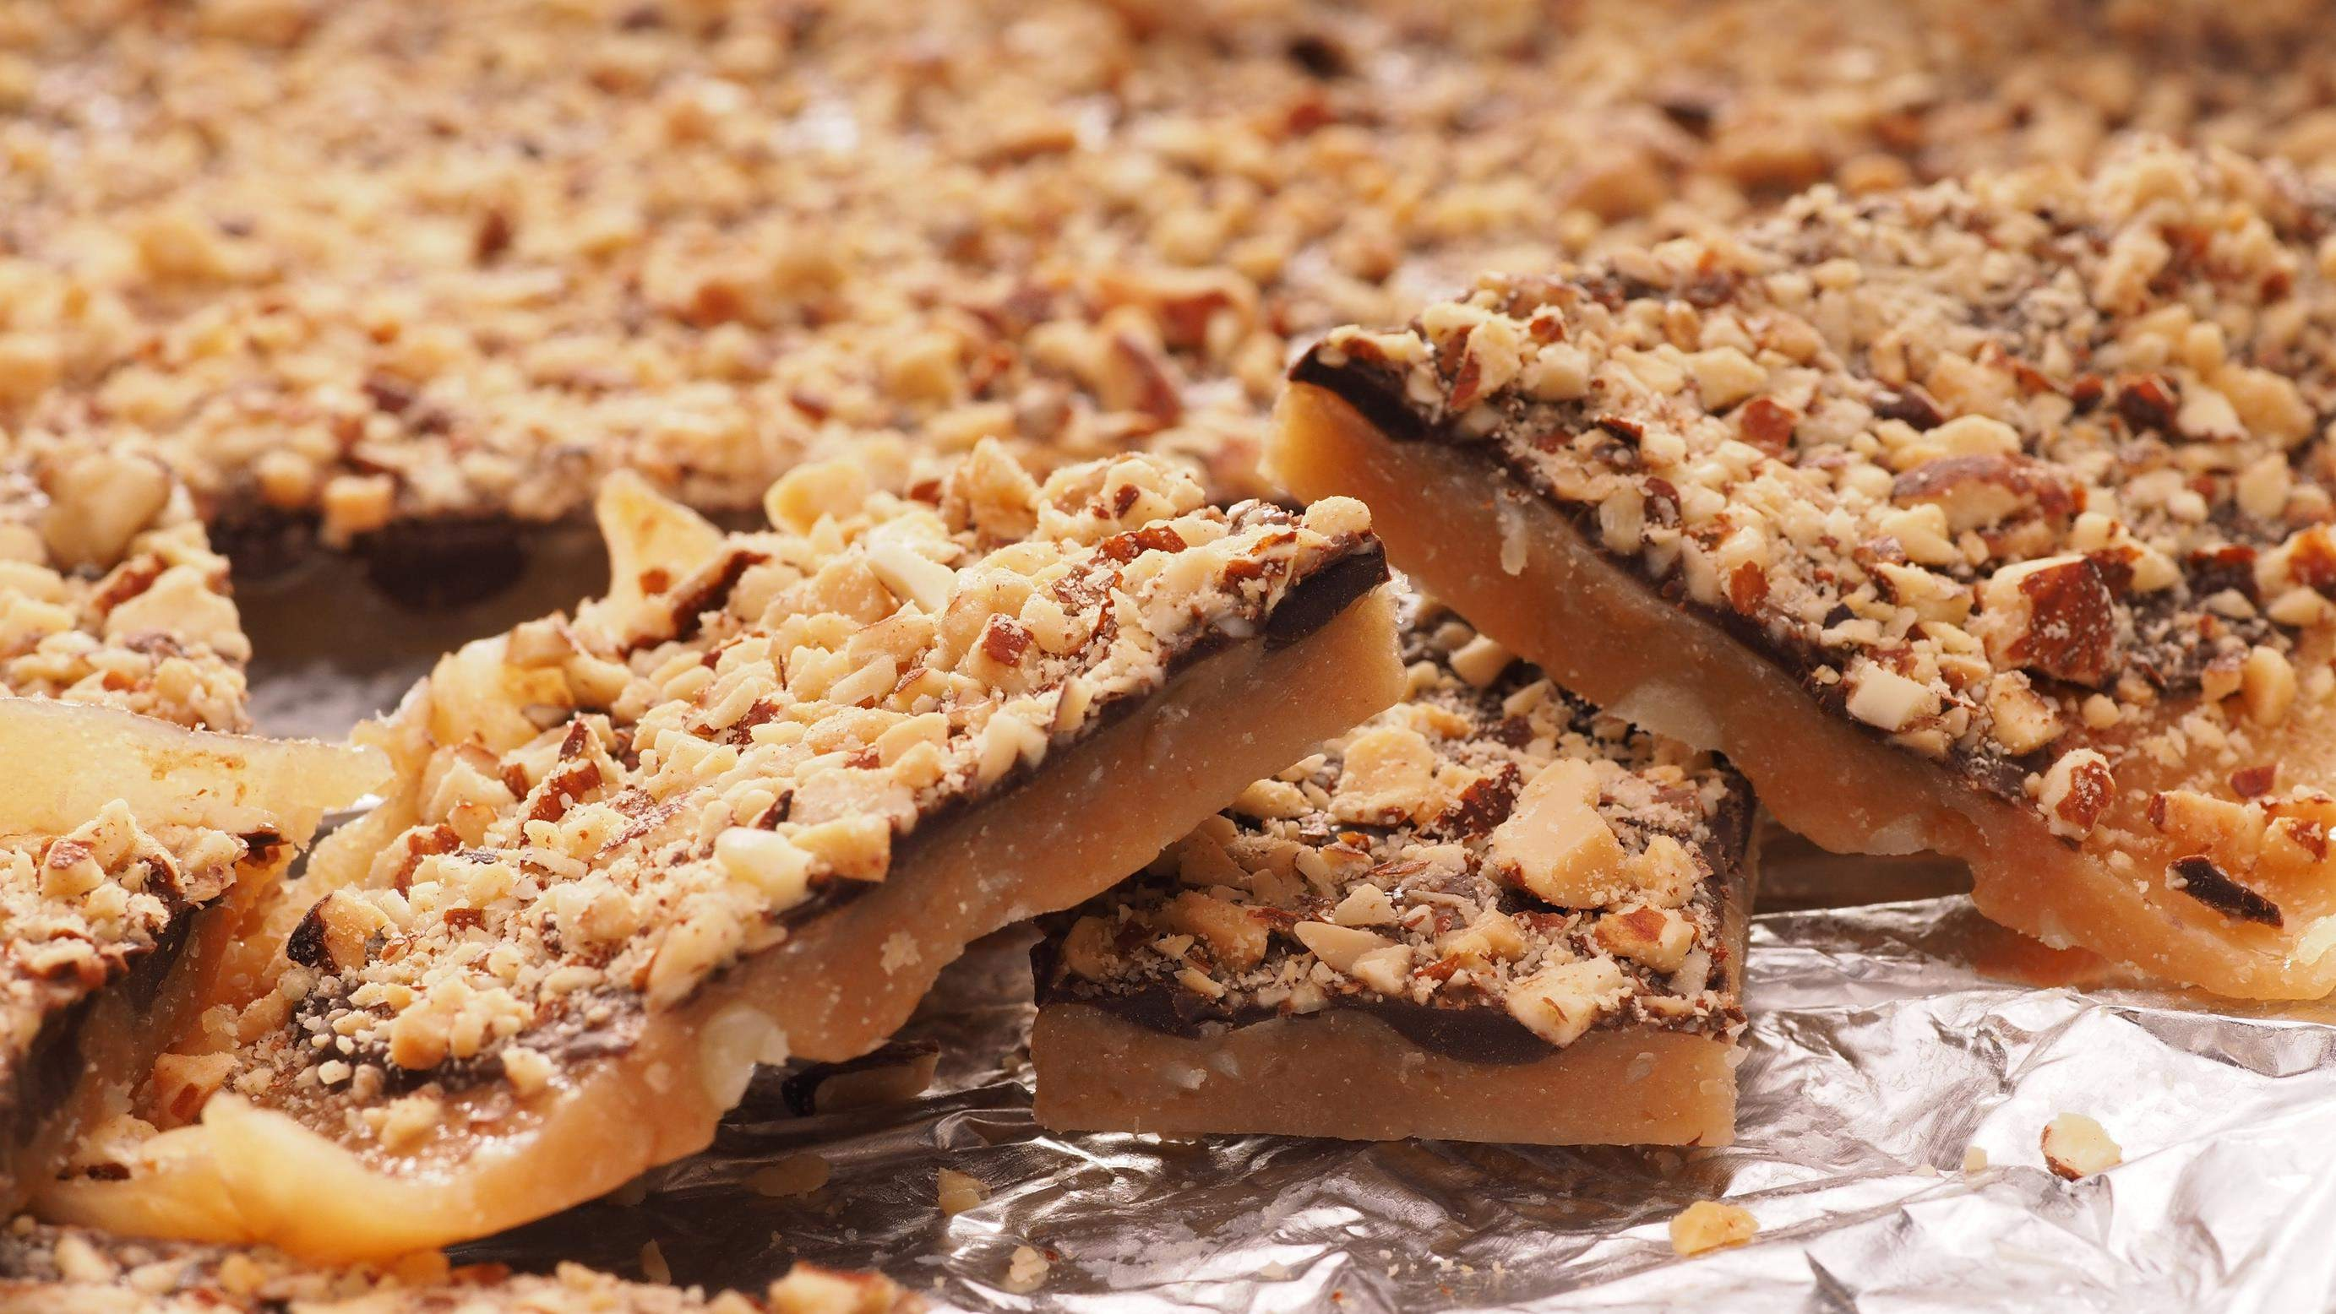
AUTHOR'S PERSPECTIVE
The Global Toffee Market is witnessing significant growth in the near future.
Peanut toffees have emerged as the fastest-growing category in the toffee market due to the growing emphasis on healthier snack options.
As health-conscious consumers continue to seek balanced and wholesome snack choices, the peanut toffee segment is experiencing rapid growth, making it the fastest-growing category in the toffee market
Online platforms offer the advantage of detailed product descriptions, customer reviews, and competitive pricing, allowing consumers to make informed choices. Moreover, the increasing digitalization, secure payment options, and efficient delivery services have enhanced the online shopping experience.

Slide 8










KEY PLAYERS

Slide 9


Contact us
For Full Report
COGNITIVE MARKET RESEARCH
Tel: + 1 312 - 376 - 8303 | + 44 020 - 8123 - 0732
India: ( + 91 ) 983 - 496 - 8611
sales@ cognitivemarketresearch. com
Access the Full Report : http://tinyurl.com/yzhaveck
Please visit our website:
https://www.cognitivemarketresearch.com

