Slide 1

GLOBAL
TENNIS BALLS
MARKET REPORT
2024
Global,Regional,CountryAnalysis

Slide 2

INTRODUCTION
A tennis ball is specially designed for tennis sport, which is around 6.7 cm in diameter. Tennis balls are found mostly in yellow color at major sports events, however, in a recreational activity they can be virtual of any color. A tennis ball is covered in a fibrous felt which modifies its aerodynamic features and it has a white curvilinear oval covering it. The growth of the Tennis Ball Market is attributed to the growing demand for Tennis Balls due to the increasing tennis match & training, fitness & recreation activities around the world. These strategies help key players capture a significant market share and remain competitive in the dynamic Tennis Balls market.

Slide 3


KEY INSIGHTS
MARKET SIZE
USD 1420.5 million
2023
CAGR
5.60%
2023- 2030

Slide 4

REVENUE MARKET SHARE BY SEGMENTS 2022
  Beginner's Balls
  Real Tennis Balls
  Regular Duty Balls
  Extra Duty Balls
Product Segment
  High-Pressure Balls
  Low-Pressure Balls
  Pressure-Less Balls
Type Segment
Distribution Channel
  Online
  Offline

Slide 5

Global Tennis Balls Market Revenue share for 2024
North America
40%

Slide 6
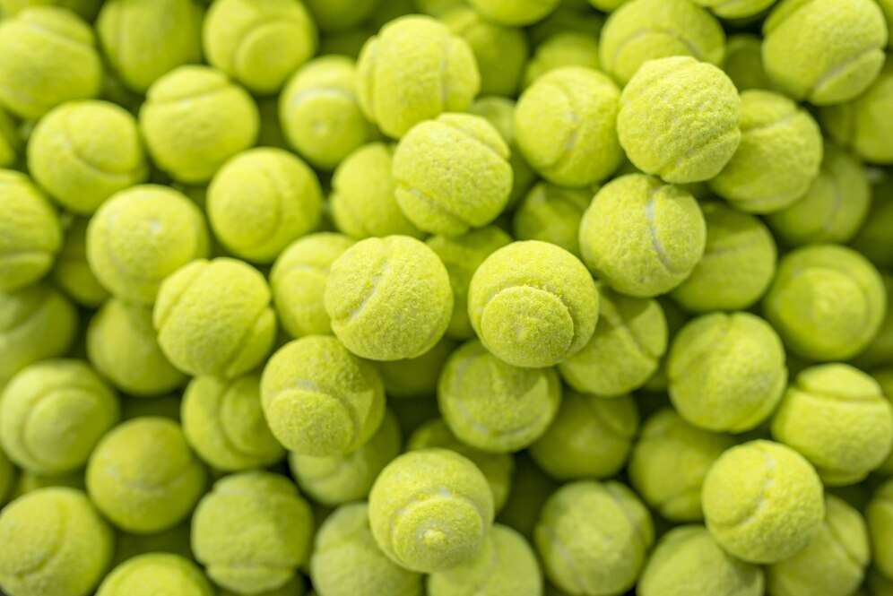
Global Tennis Tournaments and Professional Events to Propel Market Growth
Drivers
Supply Chain Disruptions and Raw Material Shortages to Restrict Market Growth
Restraints

Slide 7

AUTHOR'S PERSPECTIVE
  The global Tennis Balls market will expand significantly by 5.60% CAGR between 2023 and 2030.
  The demand for Tennis Balls is rising due to the increasing tennis match & training, fitness & recreation activities.
  Demand for pressure-less balls remains higher in the Tennis Balls market.
  North American Tennis Balls will continue to lead, whereas the Asia Pacific Tennis Balls market will experience the most substantial growth until 2030.

Slide 8








KEY PLAYERS

Slide 9


For Full Report
Contact us
COGNITIVE MARKET RESEARCH
Tel: +1 312-376-8303 | +44 020-8123-0732
India: (+91) 983-496-8611
sales@cognitivemarketresearch.com
Access the Full Report : http://tinyurl.com/bdww6e5y
Please visit our website:
https://www.cognitivemarketresearch.com

