Slide 1
GLOBAL TELEMEDICINE MARKET REPORT 2024

Slide 2

WHAT IS TELEMEDICINE
Telemedicine has made healthcare accessible to remote locations by using electronic communication to exchange medical information. It has become an integrated part of hospitals, private doctor offices, and even consumer residences and workplaces.

Slide 3

KEY INSIGHTS
MARKET SIZE
$76.59 Bn (2022)
MARKET FORECAST
$396.14 Bn (2029)
24.8% ^{CAGR}-2029)
(2022

Slide 4

REVENUE MARKET SHARE BY SEGMENTS
2022
COMPONENT
Software & Services:71.3%
SERVICE TYPE
Tele-consulting:49.2%
DELIVERY TYPE
On-premise:56.1%
APPLICATION
Telecardiology:24.1%

Slide 5

GLOBAL TELEMEDICINE MARKET REVENUE SHARE FOR 2022
North America 35.1%
North America shows highest market share in telemedicine market and will grow significantly in coming years. This is attributed due to high adoption of digitalization in healthcare sector. Furthermore, geriatric population in the U.S. is surging which stimulates need for better analysis of health conditions to elderly patients. Changing lifestyle and obesity problems in North America is driving chronic illness. Hence, demand for telemedicine is continuously rising in North America.

Slide 6

DRIVERS
GROWING ADOPTION OF SMART DEVICES COUPLED WITH RISING INTERNET CONNECTIVITY
RESTRAINTS
REGIONAL REGULATORY DISPARITIES

Slide 7
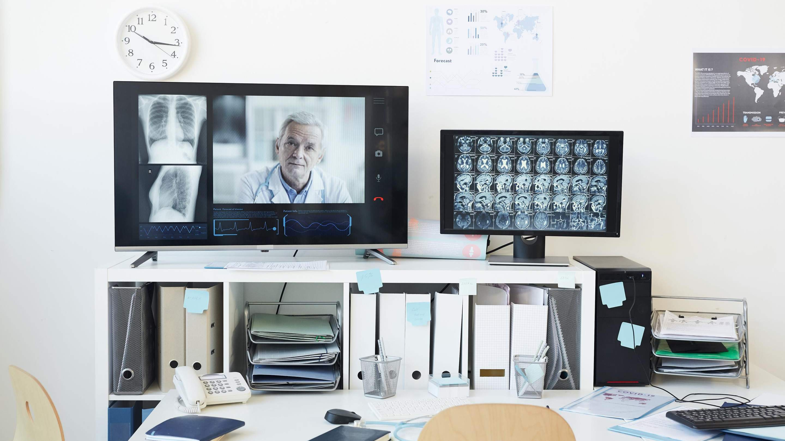
AUTHOR'S PERSPECTIVE
Software & Services was the largest segment with 71.25% share of total revenue generated in 2022.
In terms of revenue, On-premise was the leading segment with 56.14% share of total Telemedicine market.
In terms of revenue, Telecardiology was the leading segment with 24.08%
share of total Telemedicine market.
In terms of revenue, The Tele-consulting was the leading segment with 49.15% share of total Telemedicine market.
North America was the dominated region with 35.10% of total revenue market share in 2021.

Slide 8
KEY PLAYERS

Slide 9


Contact
For Full Report
us
COGNITIVE MARKET RESEARCH
Tel: + 1 312 - 376 - 8303 | + 44 020 - 8123 - 0732
India: ( + 91 ) 983 - 496 - 8611
sales@ cognitivemarketresearch. com
Access the Full Report : https://shorturl.at/oSVZ6
Please visit our website:
https://www.cognitivemarketresearch.com

