Slide 1
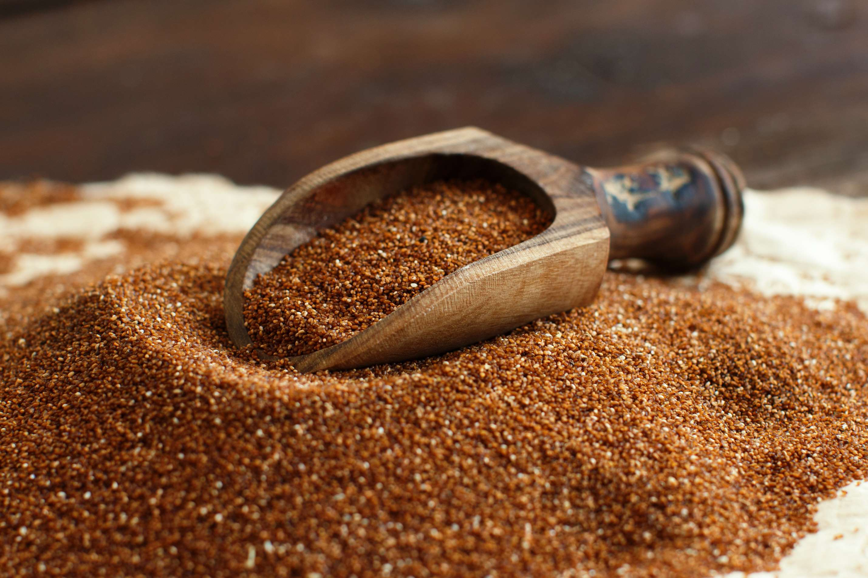
GLOBAL
TEFF
MARKET REPORT
2024
Global,Regional,CountryAnalysis

Slide 2
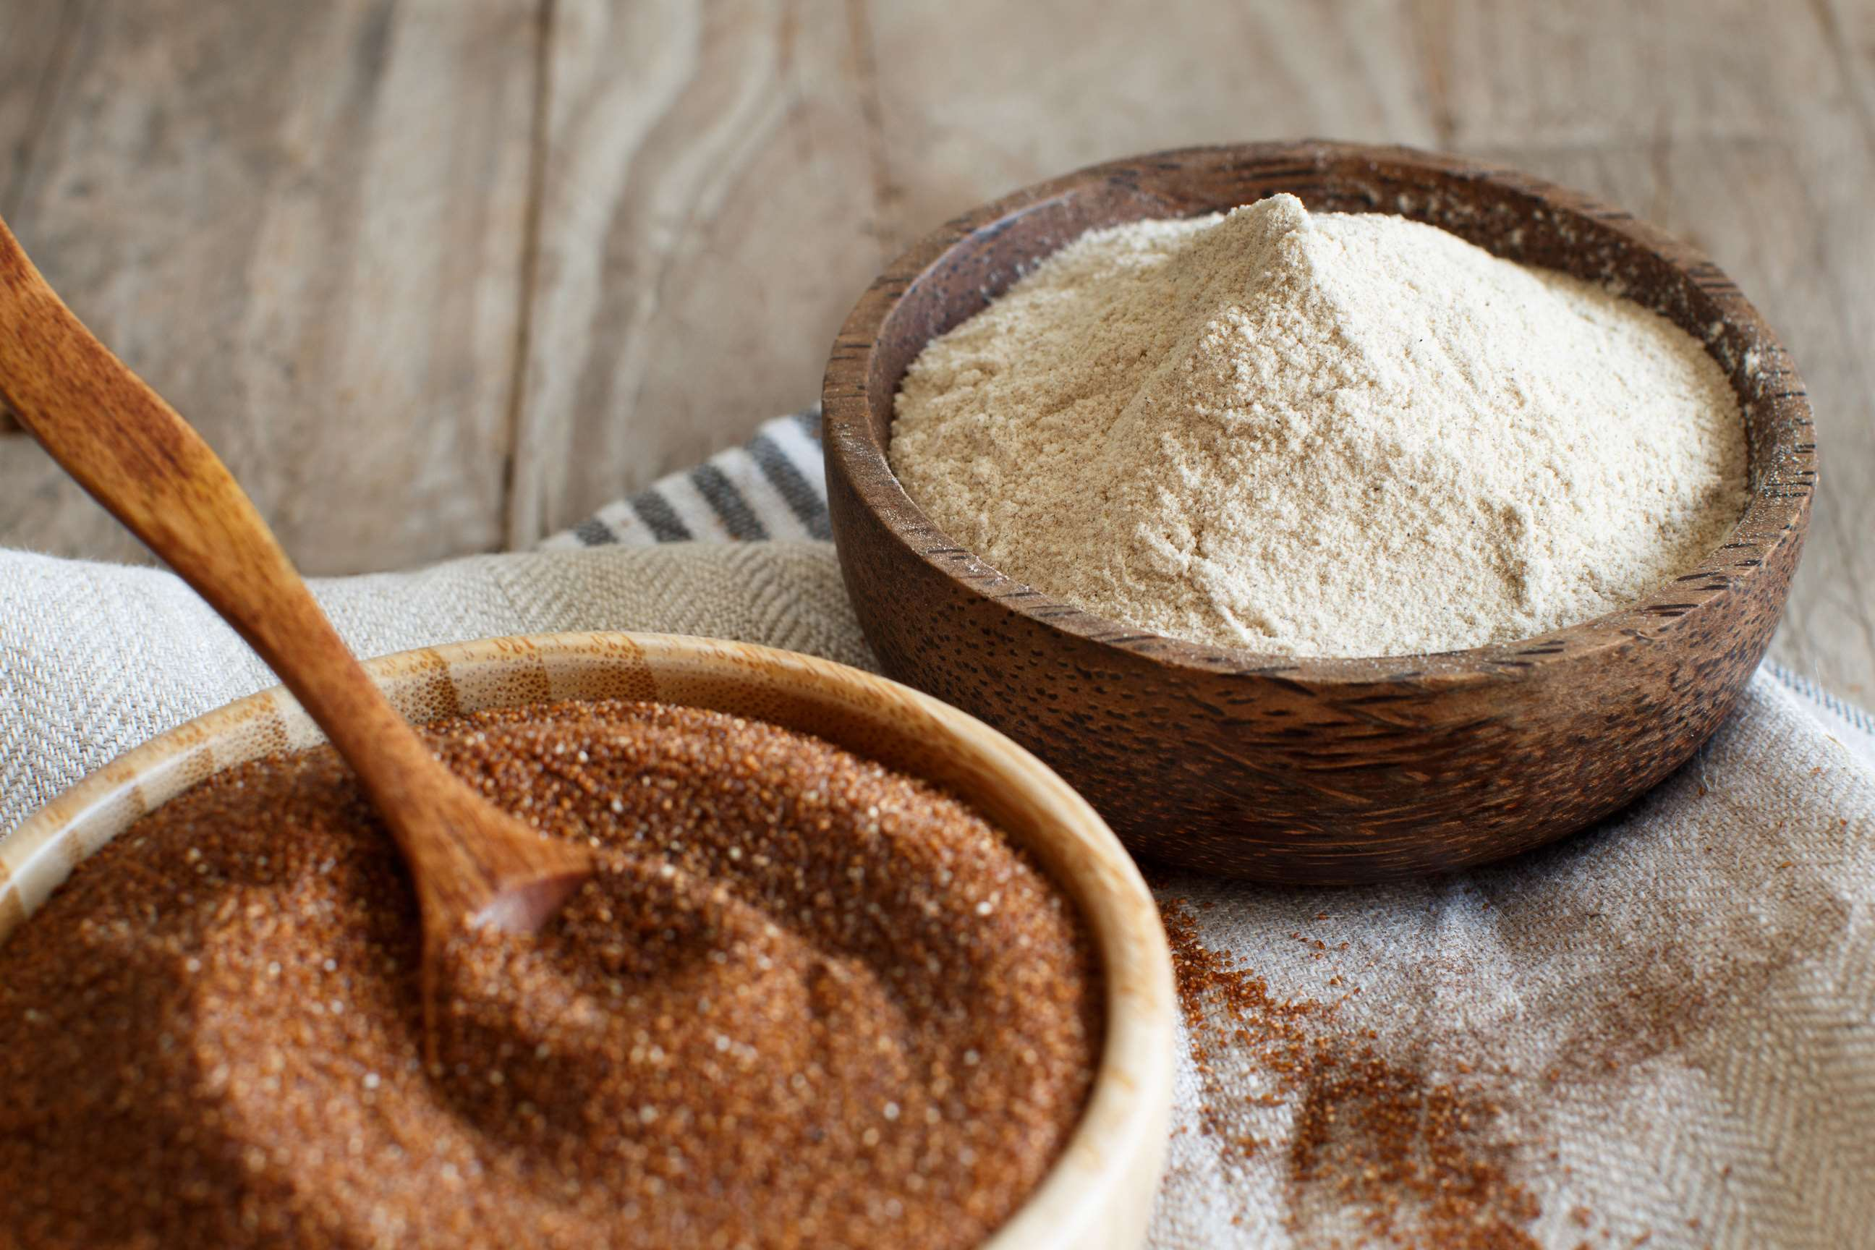
INTRODUCTION
Teff (Eragrostis tef) is a type of grain that belongs to the true grasses family (Poaceae) and is similar to millet. The grains come in ivory (‘white teff’) or reddish brown (‘brown teff’) colors and are very small, measuring 0.5-1 mm. A mere one gram can hold about 3,000 teff grains. Due to its diminutive size, teff is processed and consumed as a whole grain. The market for teff is experiencing growth, primarily due to the rising demand for gluten-free products, the increasing popularity of teff-based items, and the expansion of teff cultivation.

Slide 3
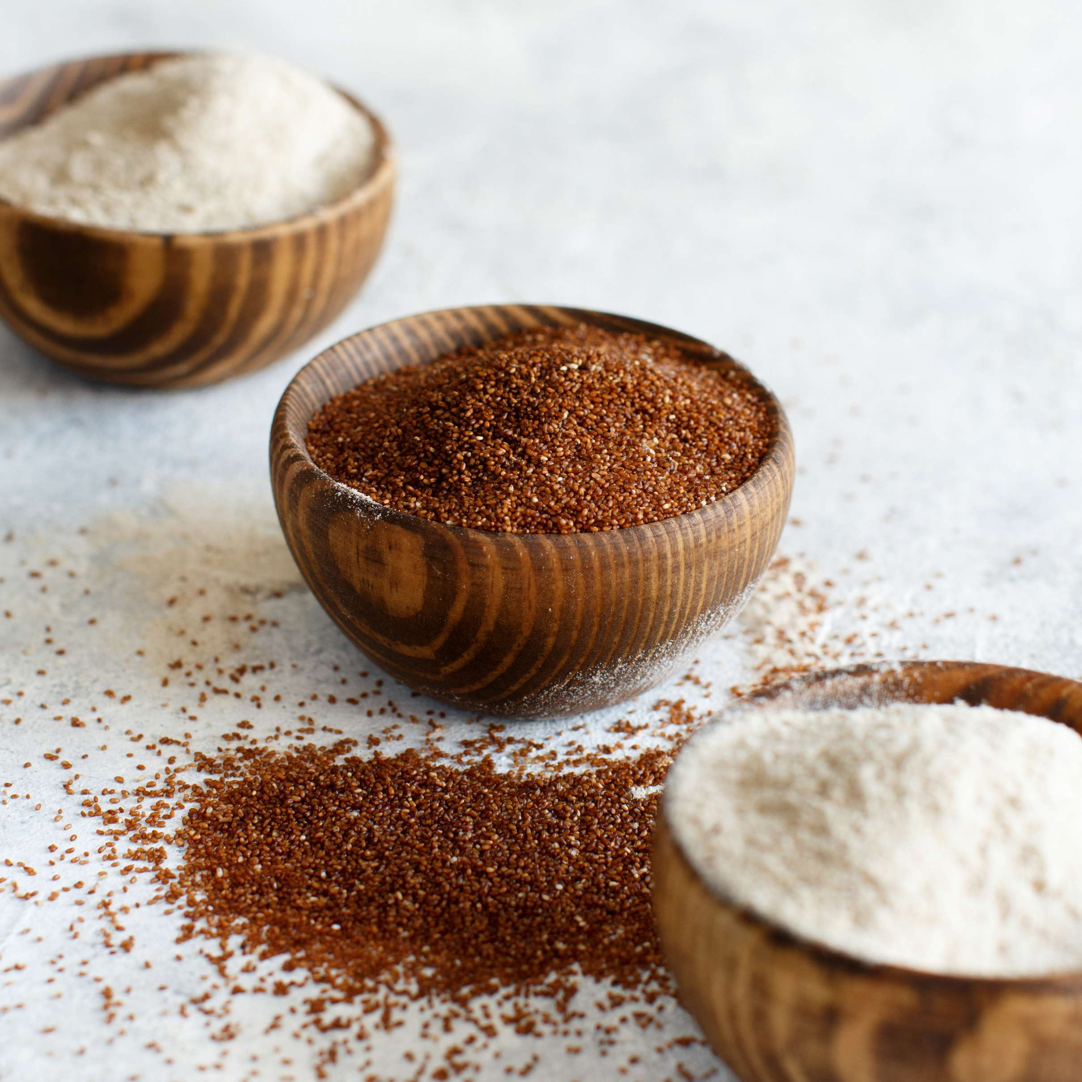

KEY INSIGHTS
CAGR
15.63%
2023- 2030

Slide 4
REVENUE MARKET SHARE BY SEGMENTS 2022
  Conventional Teff
  Organic Teff
Type Segment
  Bakery
  Cereals
  Beverages
  Snacks
Application Segment

Slide 5
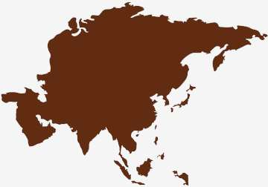
Global Teff Market Revenue share for 2024
Asia Pacific
35%

Slide 6

Diverse Culinary Applications to Propel Market Growth
Drivers
Energy Consumption Concerns to Restrict Market Growth
Restraints

Slide 7
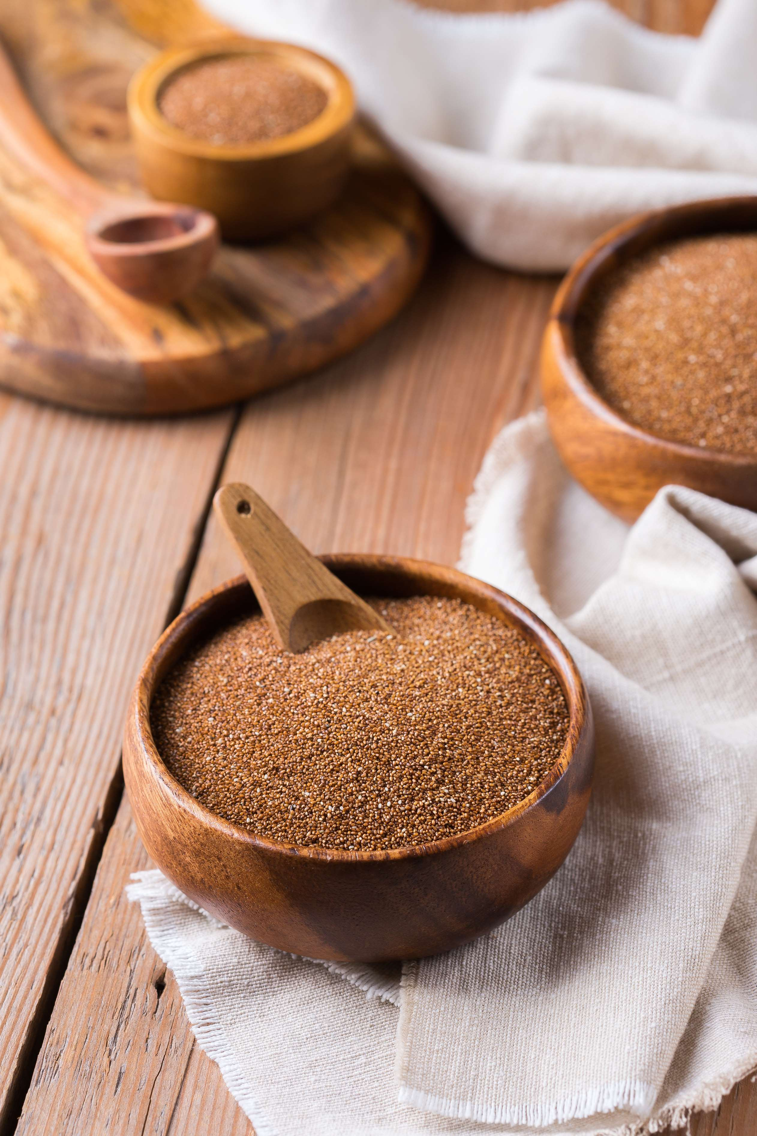
AUTHOR'S PERSPECTIVE
  The Global Teff Market is witnessing significant growth in the near future.
  Conventional Teff often benefits from larger-scale farming operations, well-established supply chains, and lower production costs, making it more accessible and affordable for a broader consumer base.
  Organic Teff, cultivated without synthetic pesticides or fertilizers, appeals to consumers seeking healthier and environmentally conscious choices.
  Snacks represent the fastest-growing category in the Teff market.
  Teff's versatility allows its incorporation into snacks like energy bars, chips, and granola mixes.

Slide 8
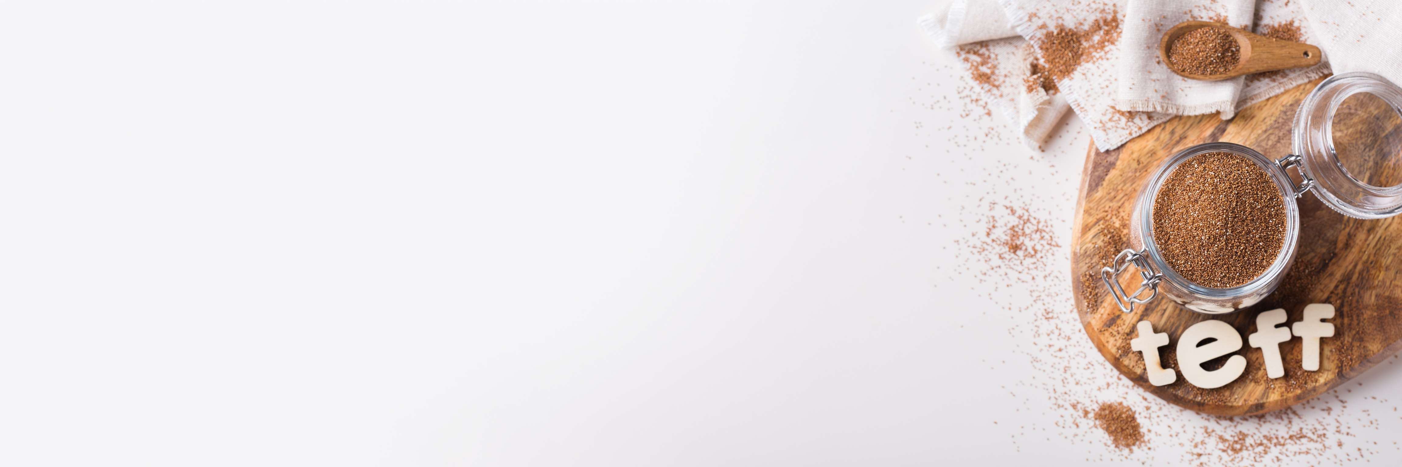








KEY PLAYERS

Slide 9


For Full Report
Contact us
COGNITIVE MARKET RESEARCH
Tel: +1 312-376-8303 | +44 020-8123-0732
India: (+91) 983-496-8611
sales@cognitivemarketresearch.com
Access the Full Report : http://tinyurl.com/zkmakwpk
Please visit our website:
https://www.cognitivemarketresearch.com

