Slide 1
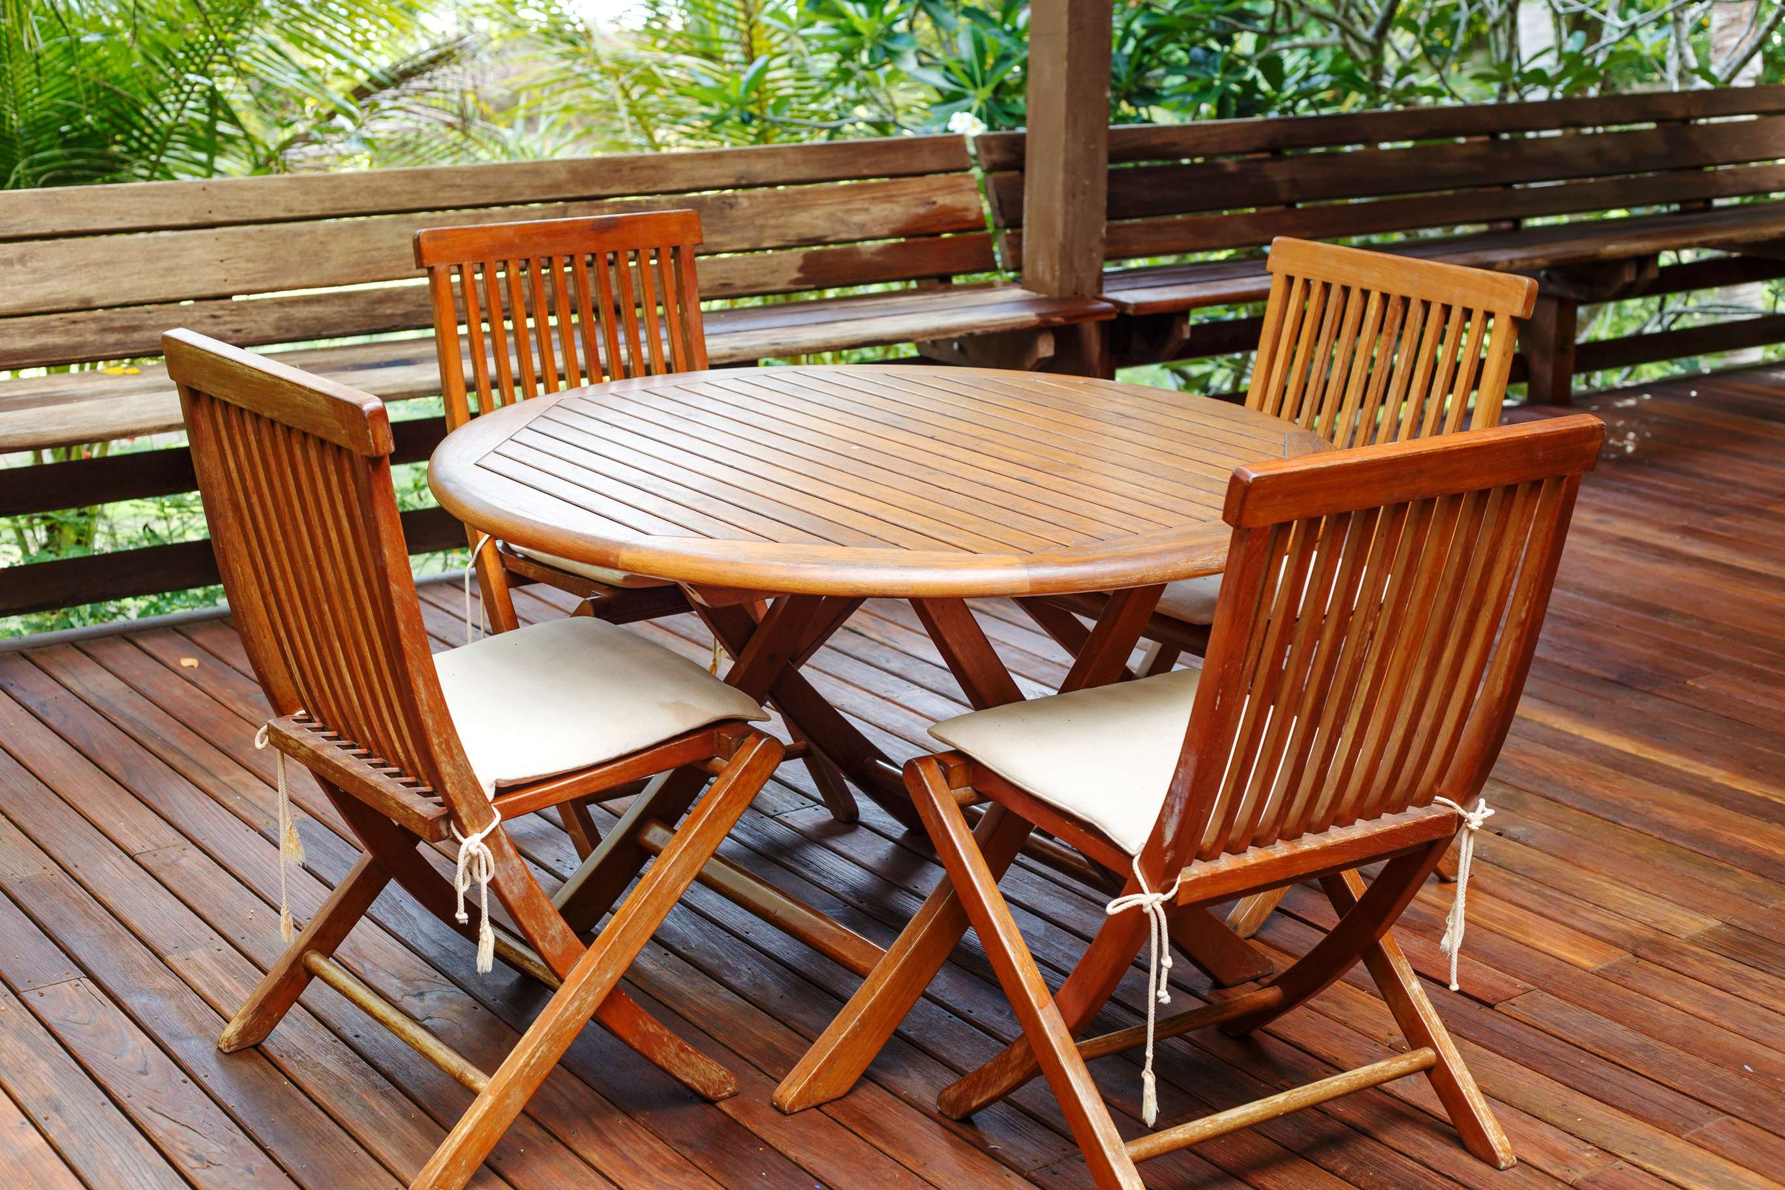
GLOBAL
TEAK FURNITURE
MARKET REPORT
2024
Global,Regional,CountryAnalysis

Slide 2
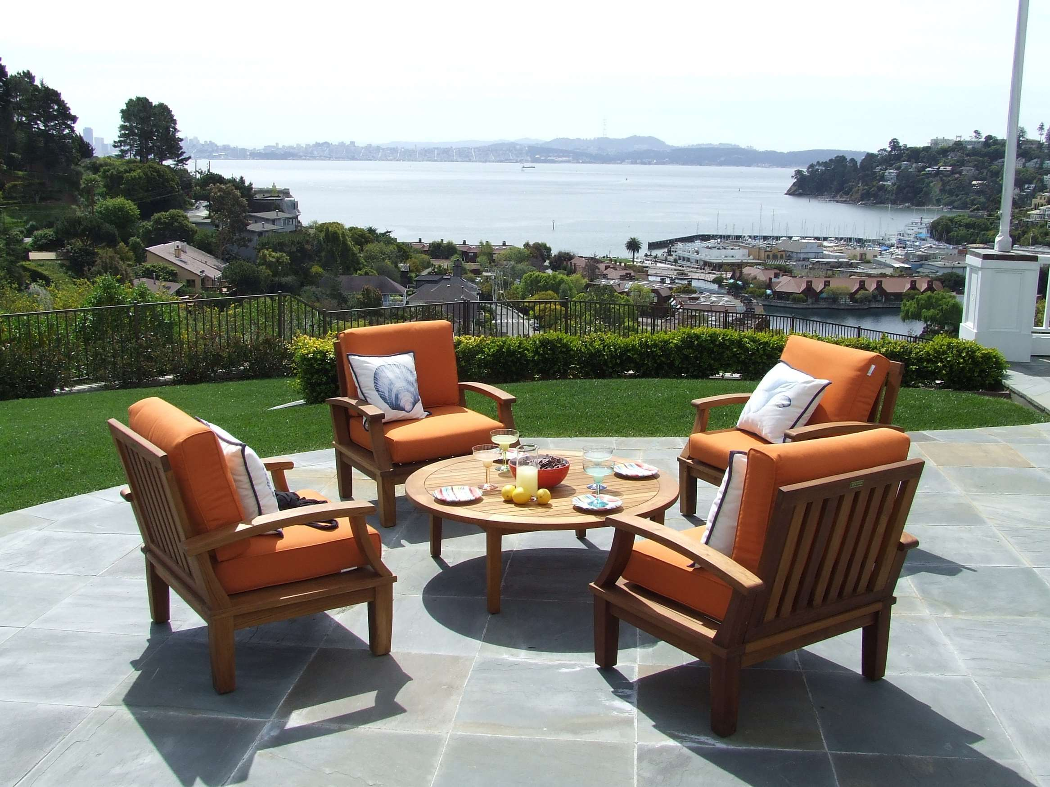
INTRODUCTION
The durability and longevity, low maintenance, aesthetic appeal of furniture, growing environmental awareness, increasing trend of creating outdoor living spaces, growth in tourism and hospitality, higher disposable income, rise in customization options, ease of purchasing teak furniture online, growth of high-quality, comfortable furniture in regions with an aging population, rising interest in home improvement, and growth in architectural and interior designs.

Slide 3


KEY INSIGHTS
MARKET SIZE
USD 58.9 billion
2023
CAGR
6.2%
2023- 2030

Slide 4
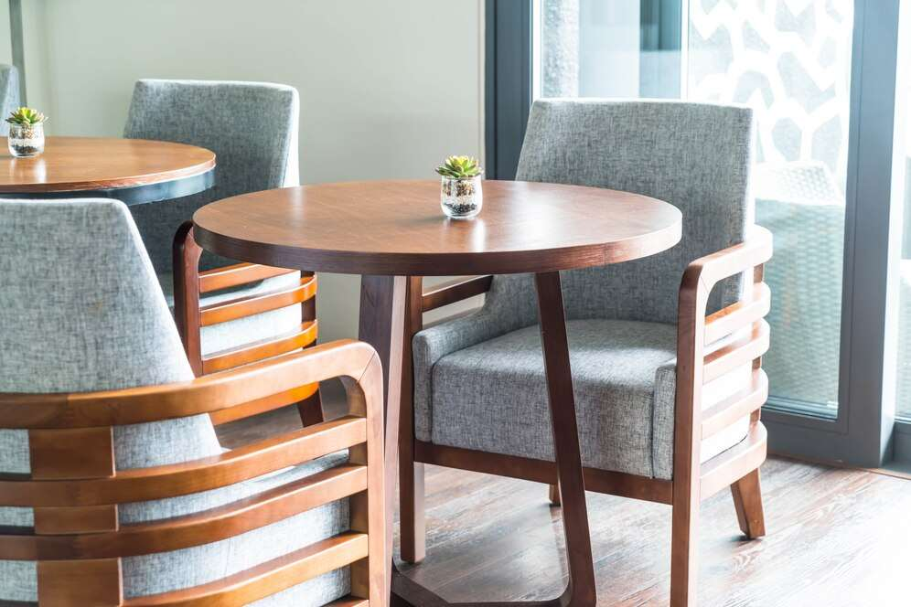
REVENUE MARKET SHARE BY SEGMENTS 2022
  Indoor Teak Furniture
  Outdoor Teak Furniture
  Online Stores
  Departmental Stores
  Independent Furniture Retailers
  Factory Outlets
Type Segment
Distribution Channel
  Bed & Bedside Tables
  Sofa Sets
  Storage Wardrobes & Drawers
  Bookcases
  Cabinets
  Chest
  TV Stand
  Shelves & Storage
  Sideboards
Product Type Segment
  Residential
  Commercial
End Use Segment

Slide 5

Global Teak Furniture Market Revenue share for 2024
Asia Pacific
40%

Slide 6
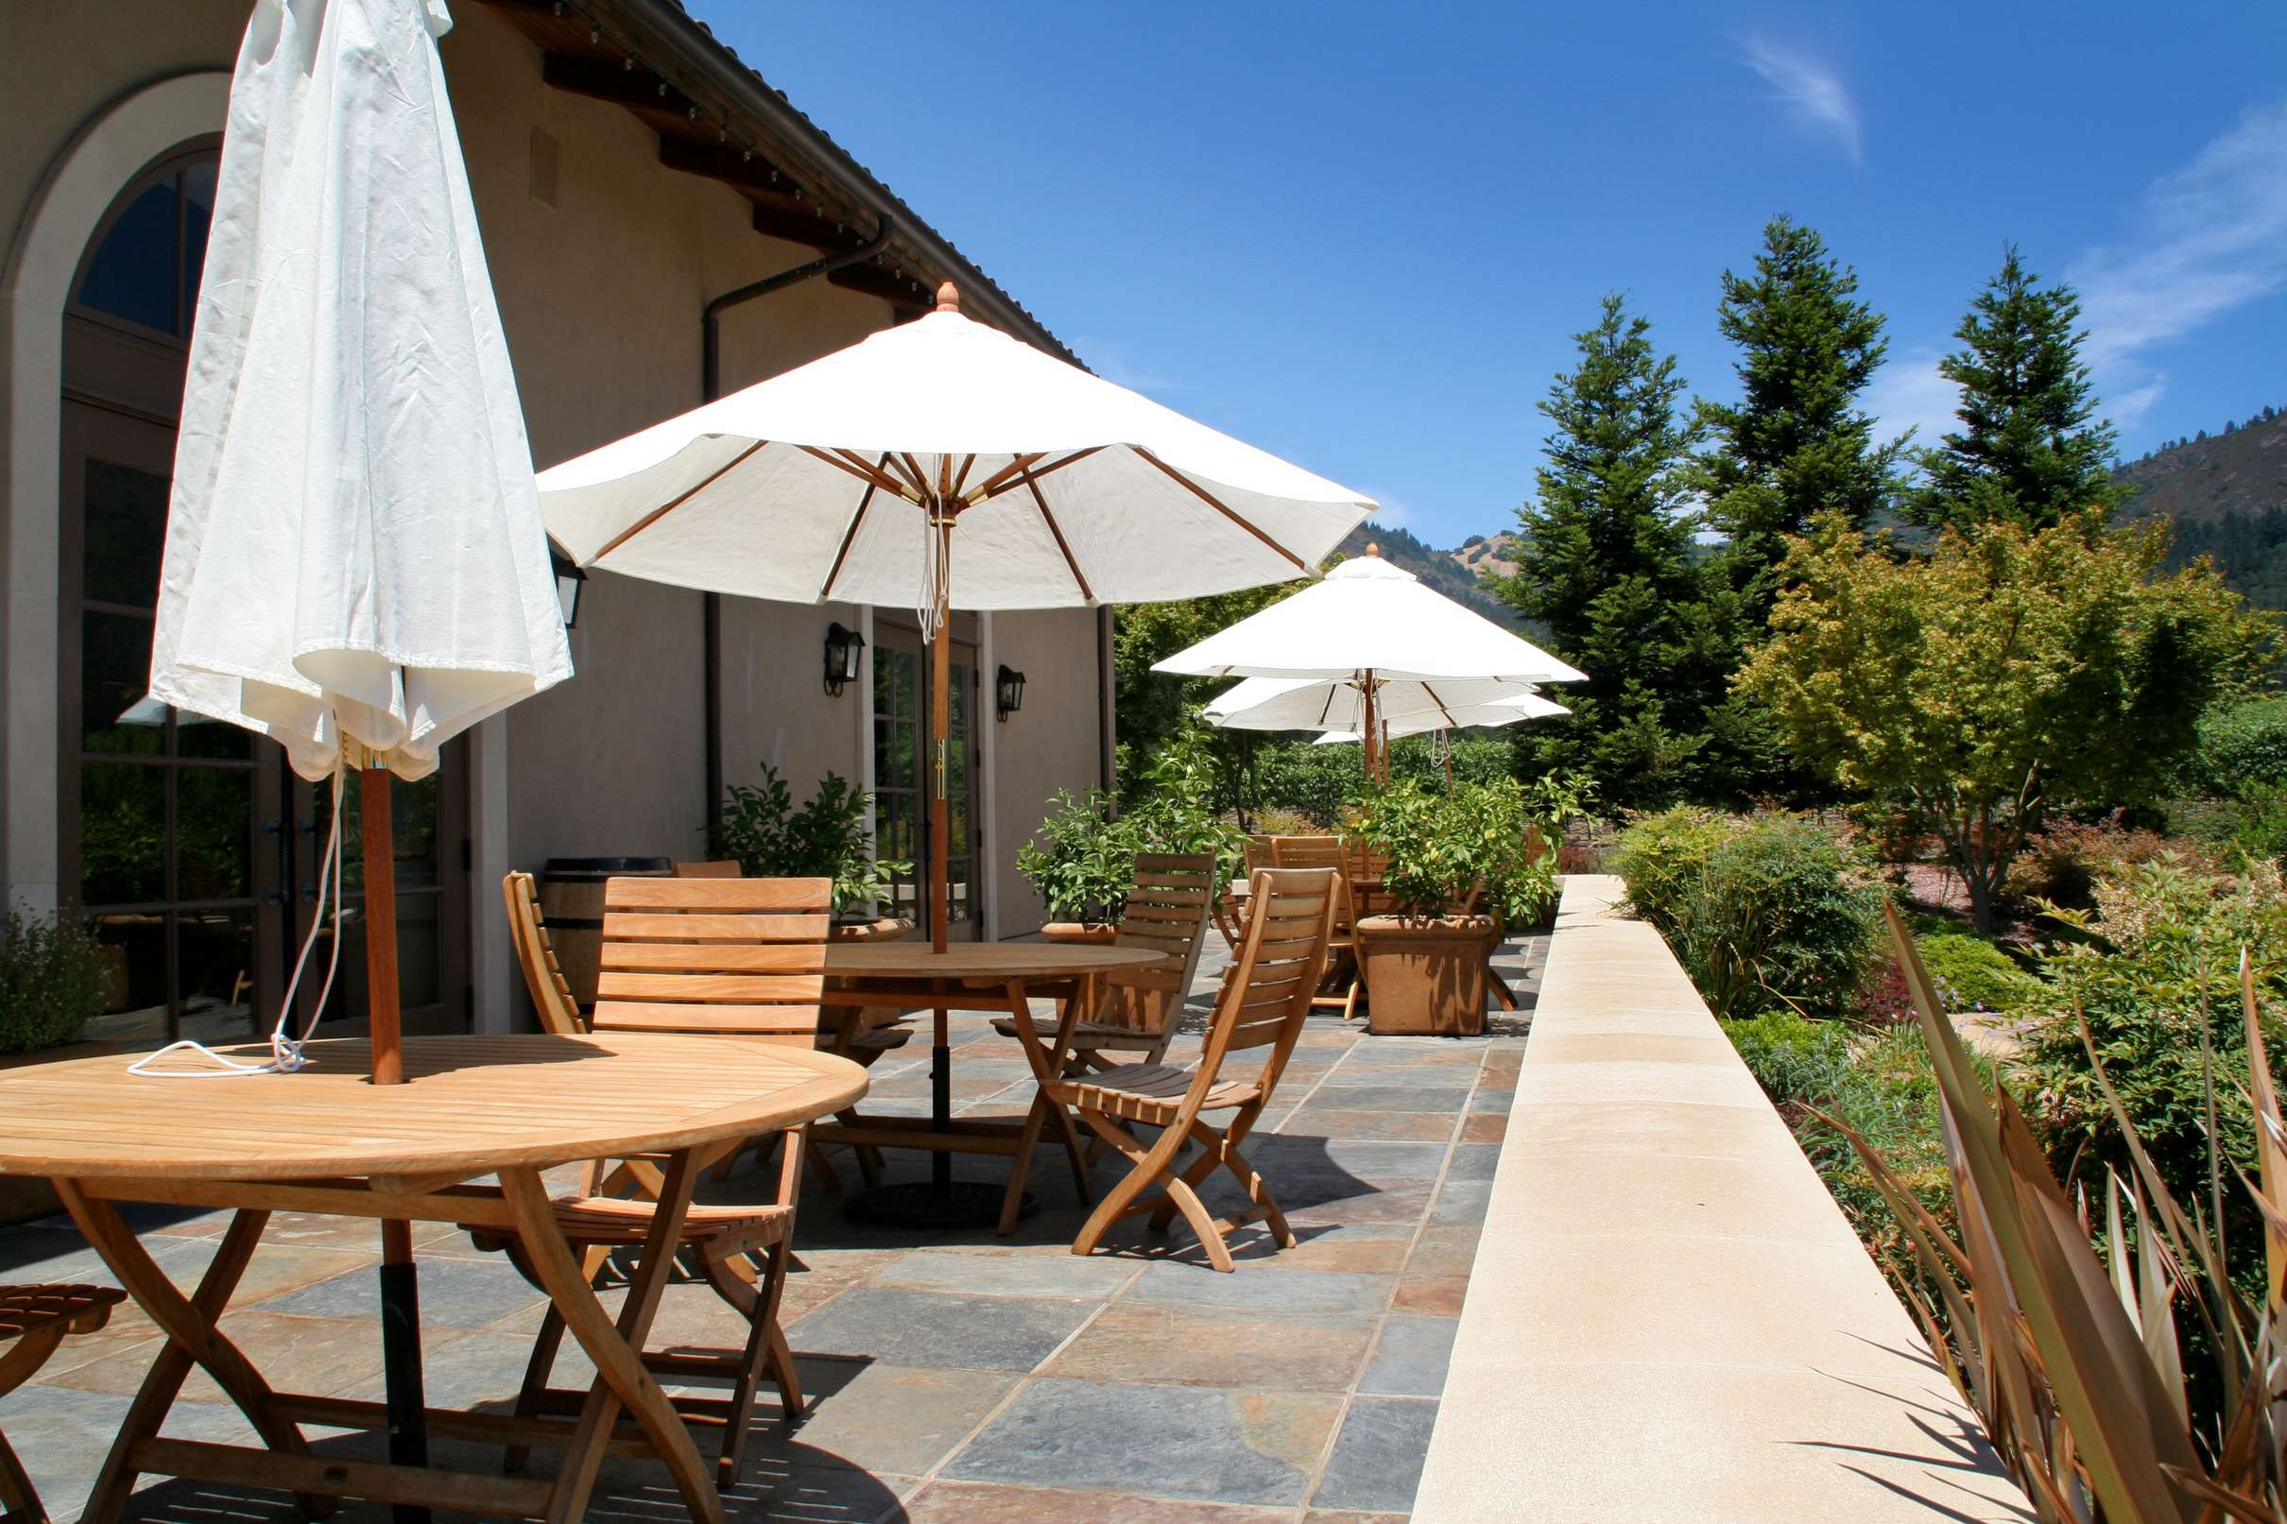
Rising Consumer Demand for Furniture to Propel Market Growth
Drivers
High Price of Furniture to Hinder Market Growth
Restraints

Slide 7
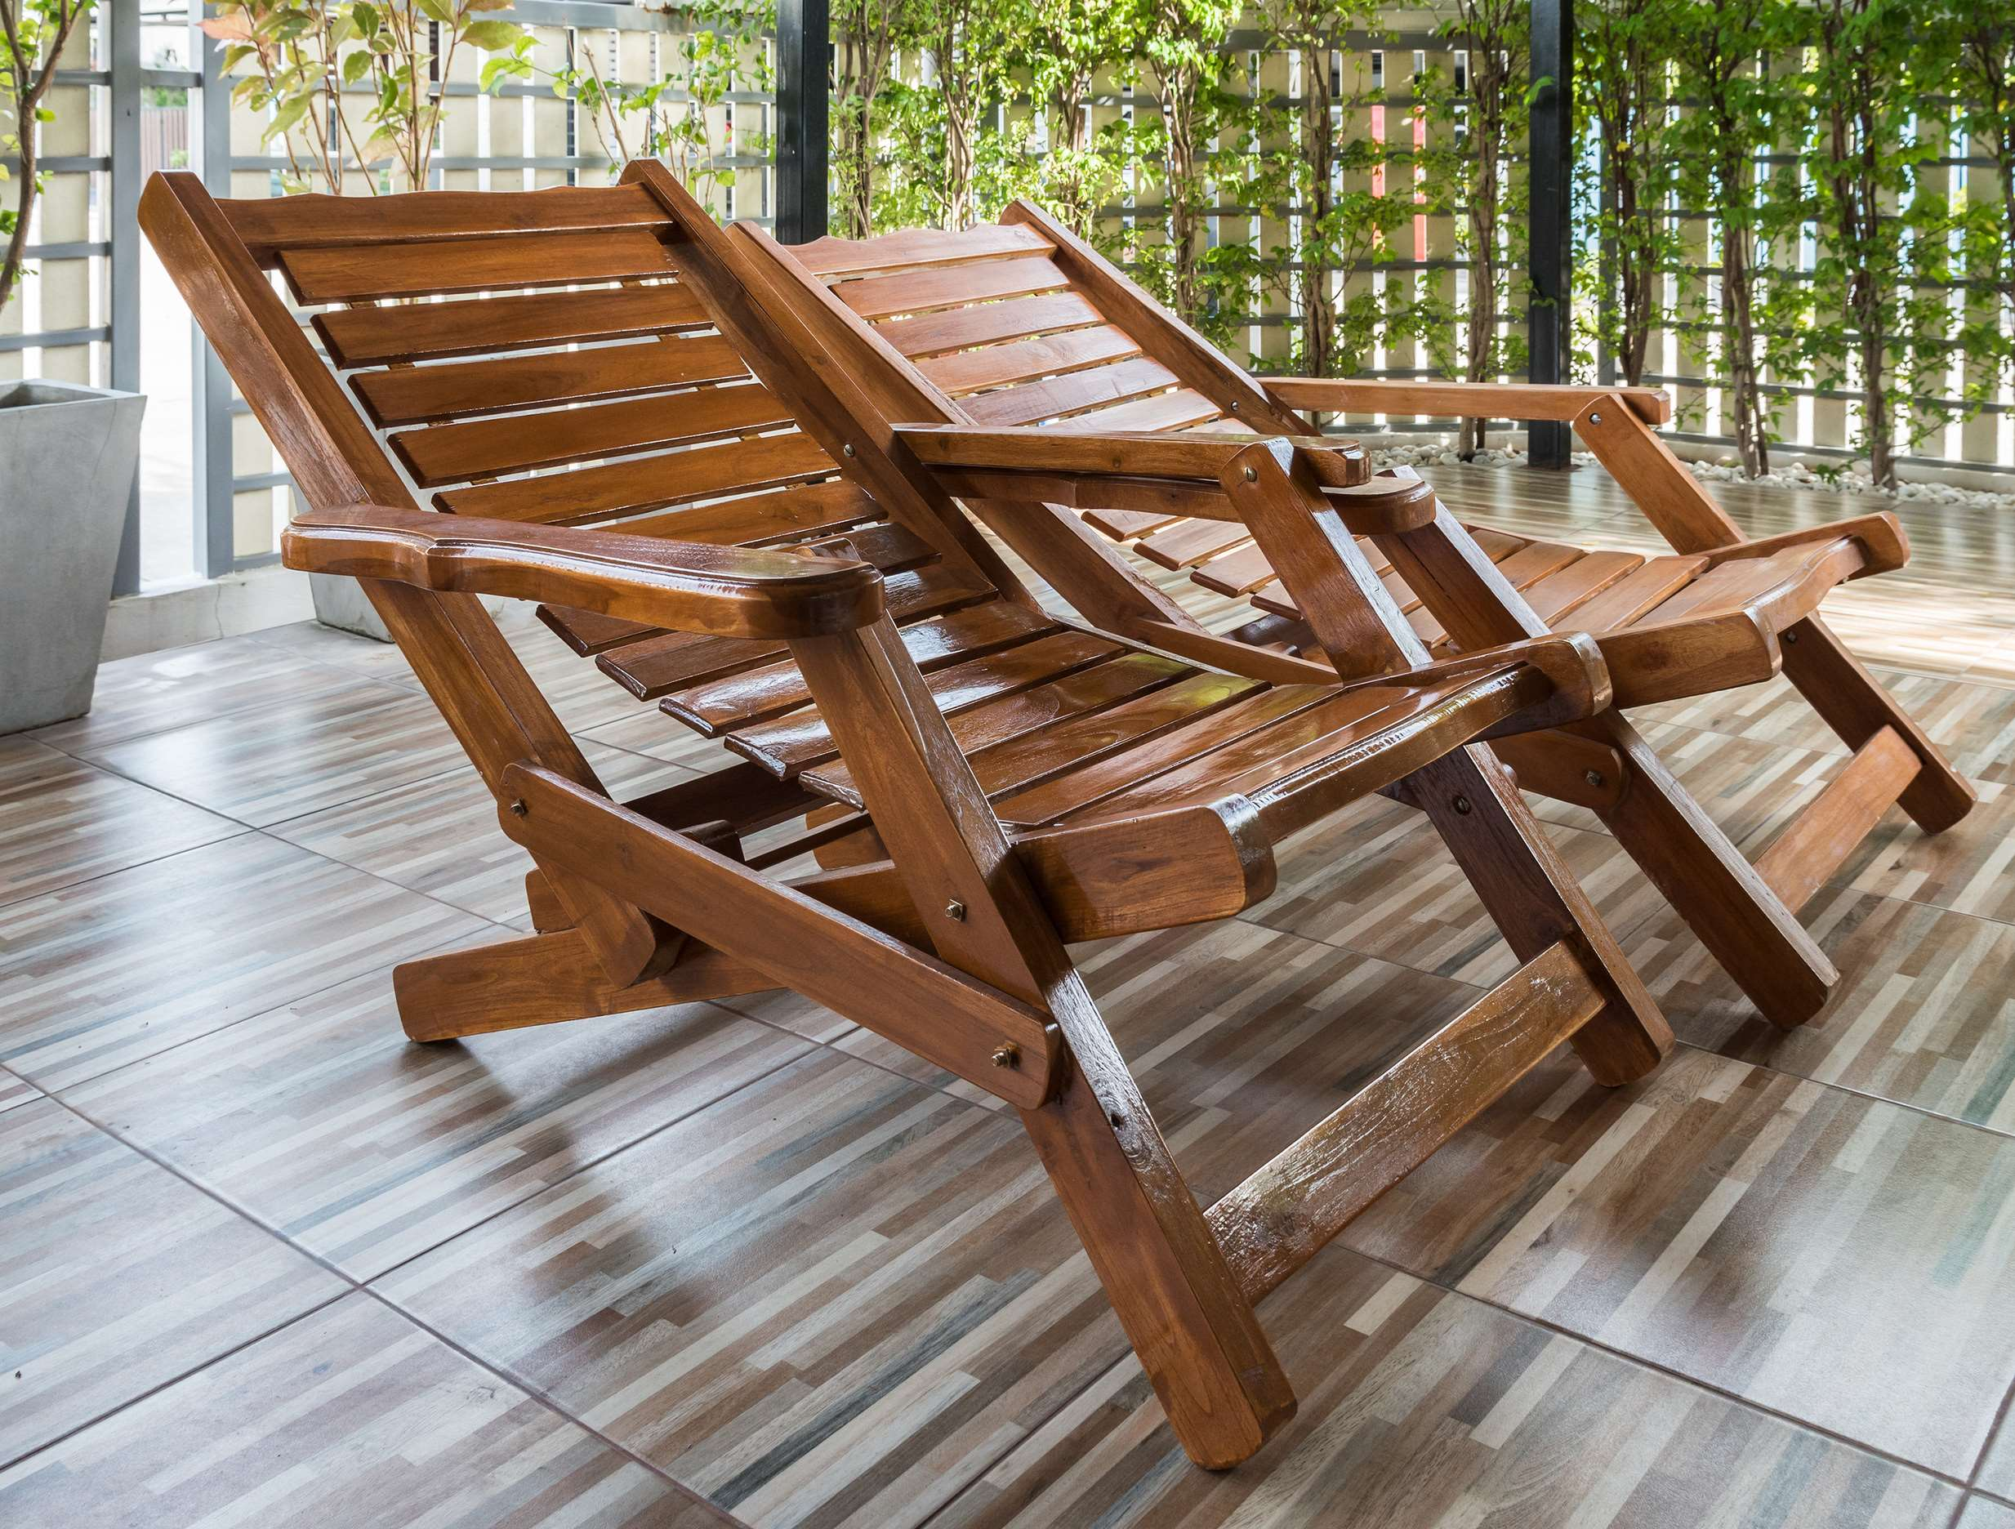
AUTHOR'S PERSPECTIVE
  The Global Teak Furniture Market is witnessing significant growth in the near future.
  It often includes teak dining sets, teak beds, teak cabinets, and teak coffee tables, catering to customers seeking a combination of functionality and style for their indoor living spaces.
  Teak sofa sets are long-lasting and exude a classic and stylish appearance, making them suitable for both traditional and modern decor settings.
  Teak furniture is favored by homeowners for its durability, timeless aesthetic, and resistance to weathering.
  Teak chairs, tables, wardrobes, and outdoor furniture are popular among homeowners looking for quality and longevity.

Slide 8
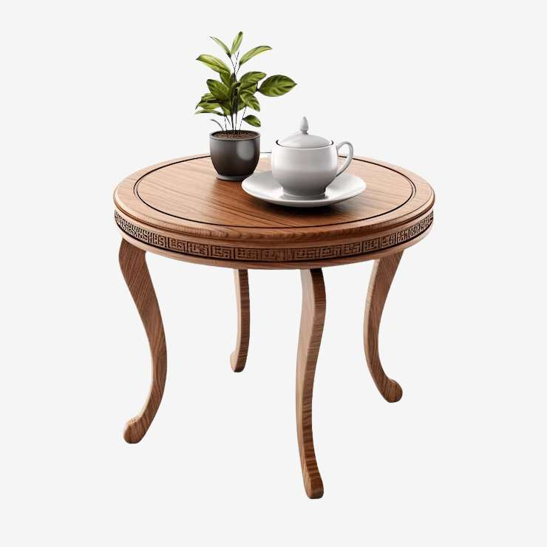










KEY PLAYERS

Slide 9


For Full Report
Contact us
COGNITIVE MARKET RESEARCH
Tel: +1 312-376-8303 | +44 020-8123-0732
India: (+91) 983-496-8611
sales@cognitivemarketresearch.com
Access the Full Report : https://tinyurl.com/2s4k6ev2
Please visit our website:
https://www.cognitivemarketresearch.com

