Slide 1
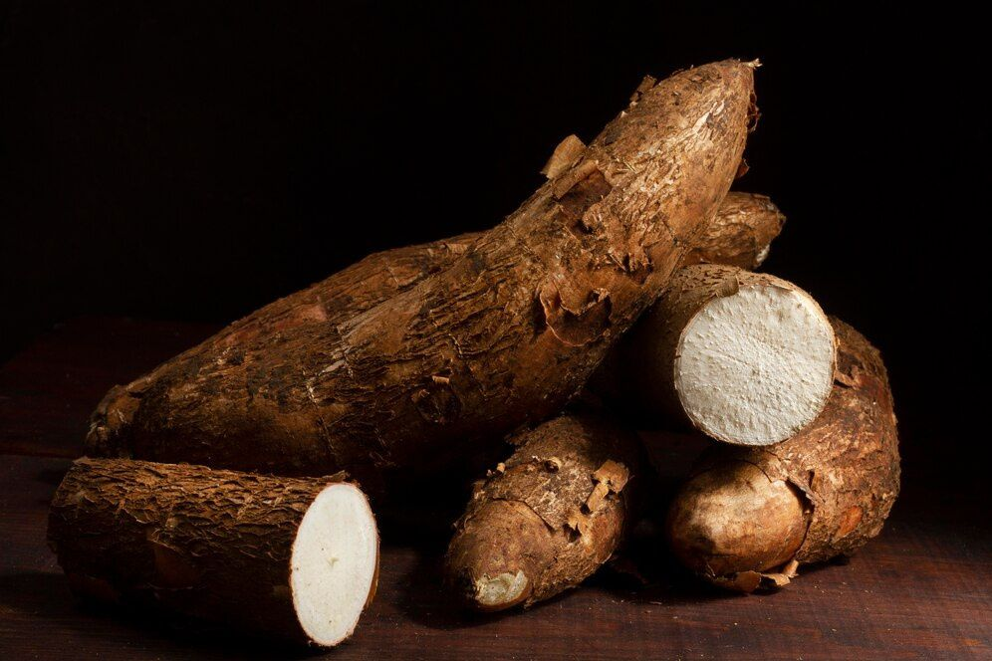
GLOBAL
TAPIOCA
MARKET REPORT
2024
Global,Regional,CountryAnalysis

Slide 2
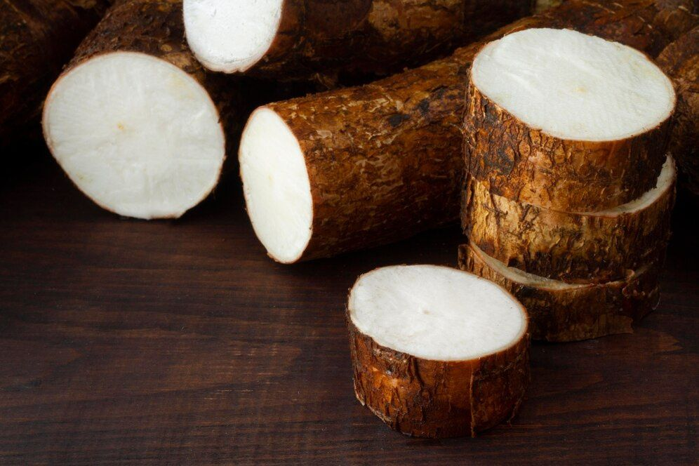
INTRODUCTION
Tapioca is a starch extracted from the cassava root which is native to South America. It is consumed as a staple food in some of the countries such as Africa, South America and Asia. and widely used for industrial and commercial and residential applications. It is gluten-free product with limited nutritional value such as high in carbohydrate content but low in protein and mineral value used a s a wheat substitute in baking or cooking. The are some properties of modified or tapioca starch such as low-cost, tapioca retains its thickening capacity.

Slide 3


KEY INSIGHTS
FORECAST
$9,915.89 Million
2027
2023-
2030
CAGR
4.64%

Slide 4
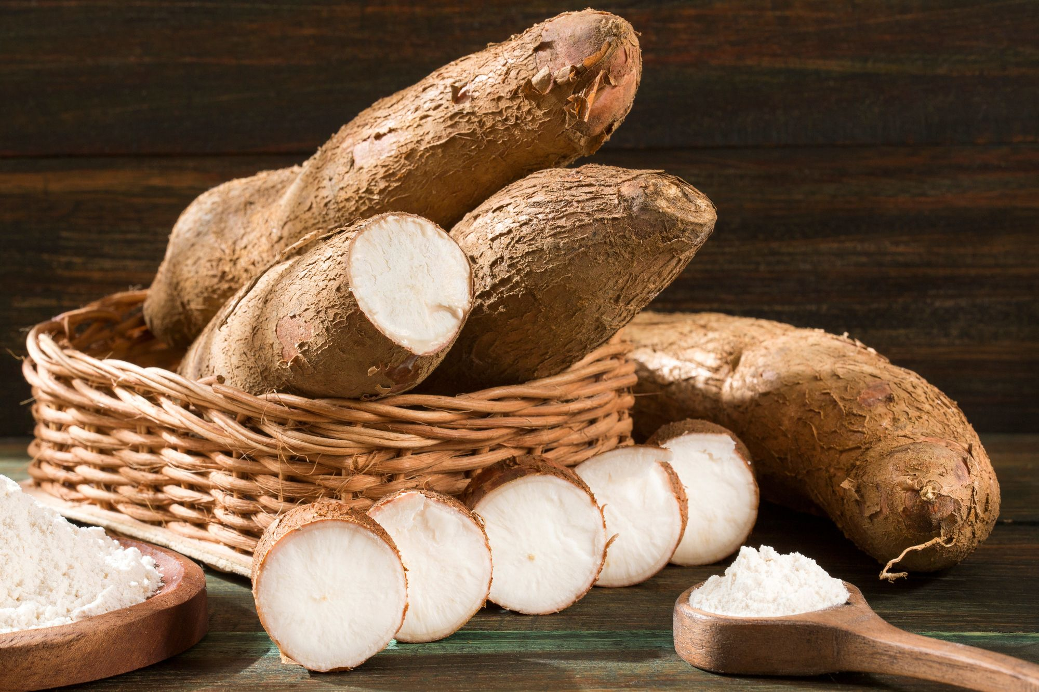
REVENUE MARKET SHARE BY SEGMENTS 2022
Type analysis
Tapioca Flour
USD 3,507.11 Million
by application
Food and Beverage
USD 5,227.10 Million
Type analysis
Tapioca Flour
USD 3,507.11 Million

Slide 5

GLOBAL TAPIOCA MARKET REVENUE SHARE FOR 2022
Asia Pacific
USD 3,961.40 Million

Slide 6
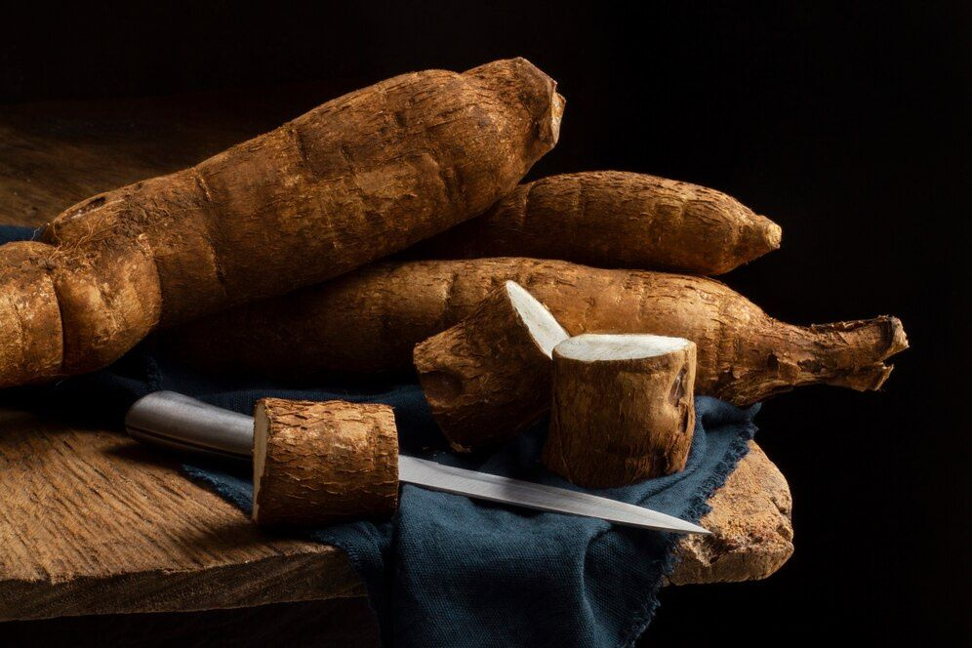
Rising demand for the food & beverages industry
Drivers
Rapid changing product prices and supply shortages due to Coronavirus (COVID-19)
Trends

Slide 7
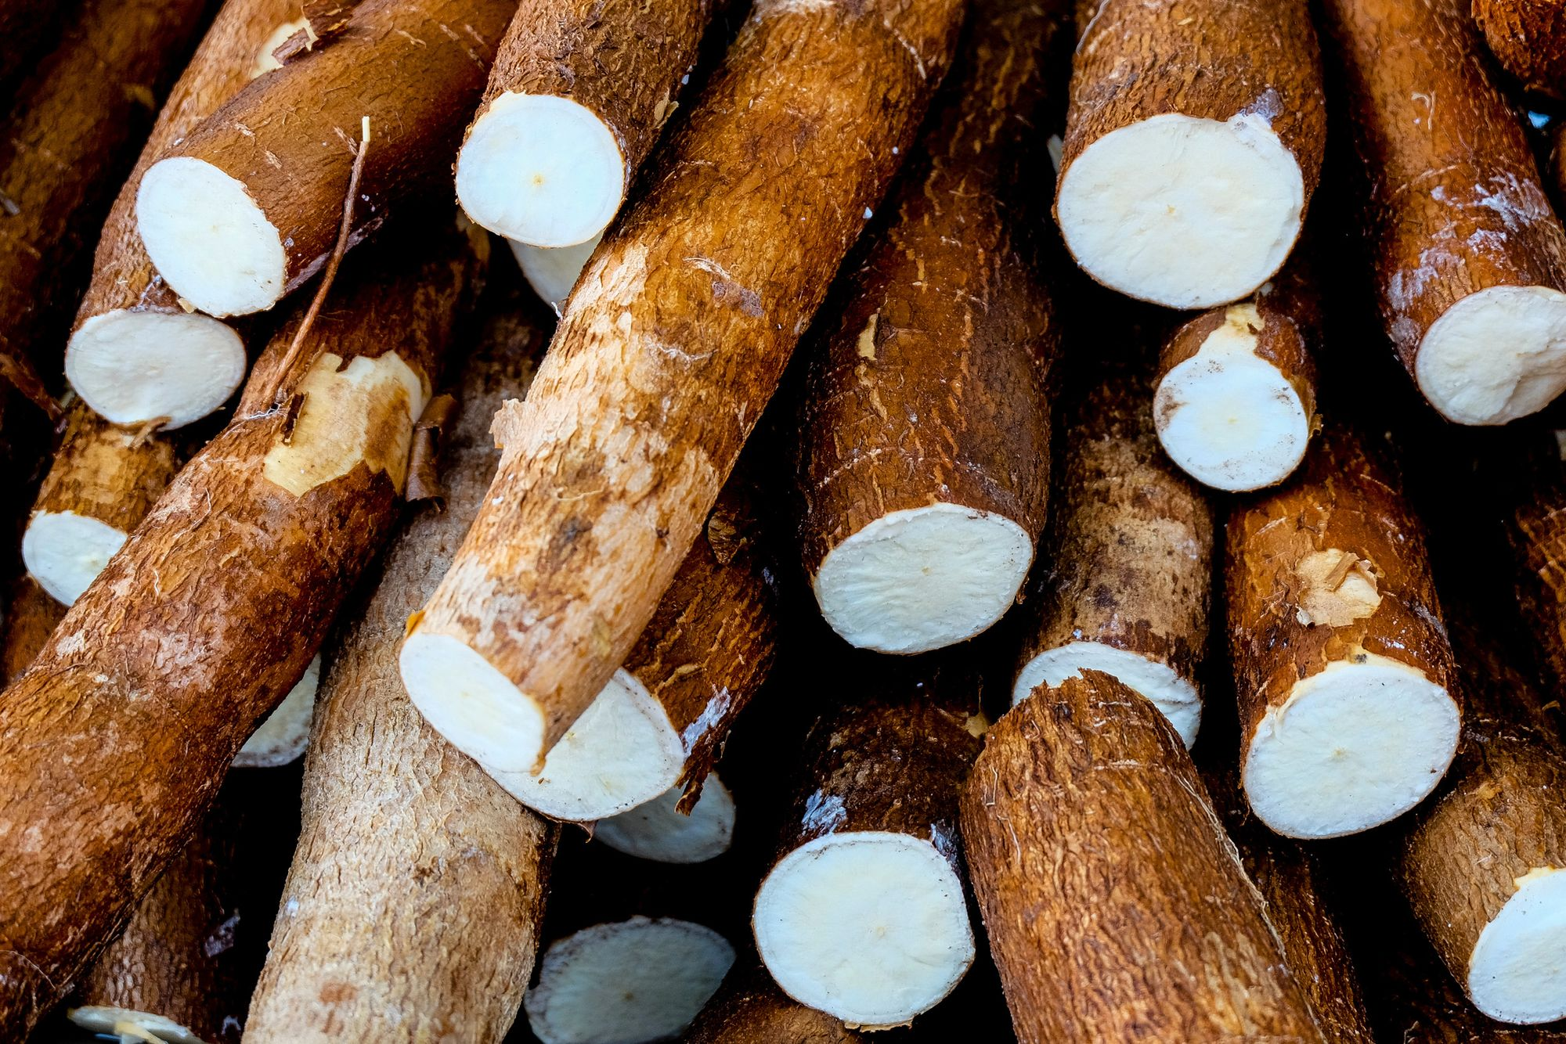
AUTHOR'S PERSPECTIVE
  The Global Tapioca Market revenue in 2015: USD 5,893.56 Million
  Tapioca flour accounted for largest share of total revenue generated in 2019
  Food and Beverage held share of Tapioca market in 2019
  Offline held maximum share in year 2019.

Slide 8
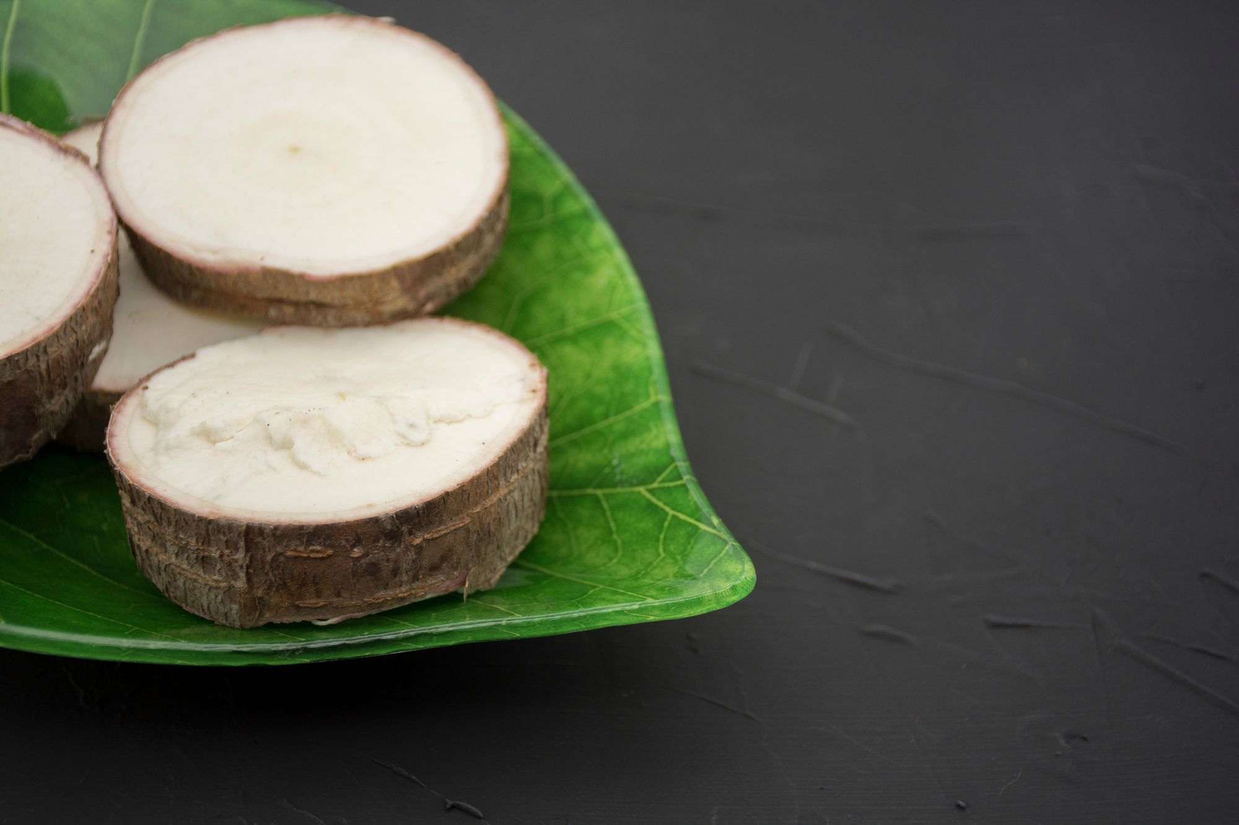









KEY PLAYERS

Slide 9


Contact us
For Full Report
COGNITIVE MARKET RESEARCH
Tel: +1 312-376-8303 | +44 020-8123-0732
India: (+91) 983-496-8611
sales@cognitivemarketresearch.com
Access the Full Report : https://tinyurl.com/5n6uetxs
Please visit our website:
https://www.cognitivemarketresearch.com

