Slide 1
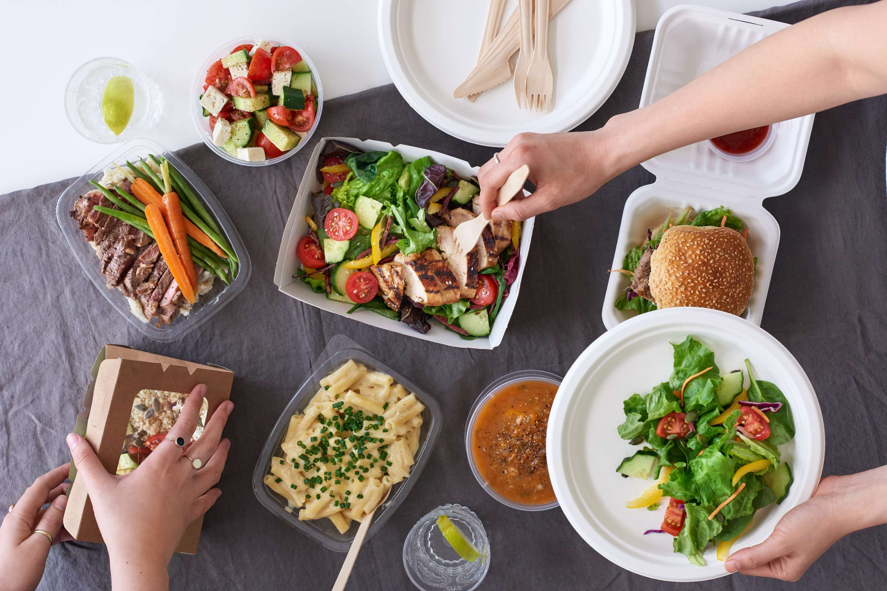
GLOBAL
TAKEAWAY FOOD
MARKET REPORT
2024
Global,Regional,CountryAnalysis

Slide 2

INTRODUCTION
The takeaway food market has emerged as a dynamic and integral component of the global food service industry, transforming the way consumers access and enjoy a diverse array of culinary offerings. Defined by the convenience of ordering prepared meals for off-site consumption, this market has experienced unprecedented growth, driven by shifting consumer lifestyles, technological advancements, and external factors such as the COVID-19 pandemic. The fundamental allure of takeaway food lies in its ability to cater to the increasing demand for on-the-go dining solutions, providing a quick and accessible alternative for individuals with busy schedules and changing priorities.

Slide 3
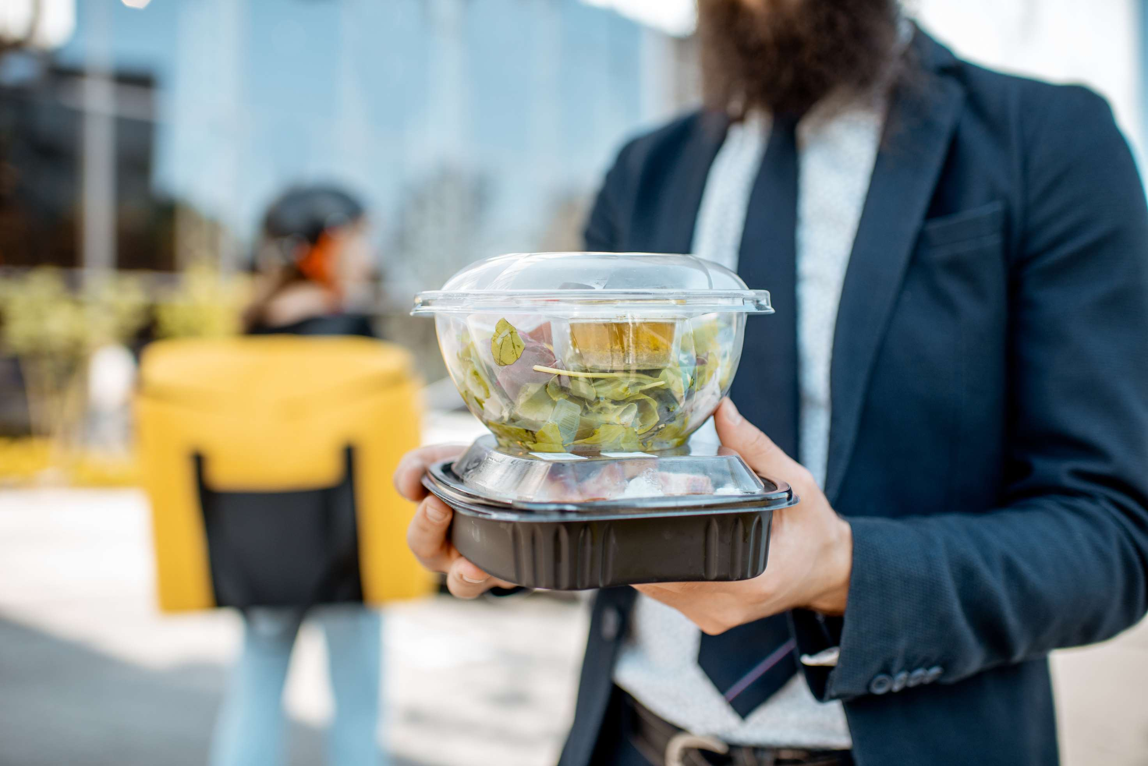

KEY INSIGHTS
MARKET SIZE
USD 511421.2 million
2024
CAGR
7.20
2024- 2031

Slide 4

REVENUE MARKET SHARE BY SEGMENTS 2022
  Vegetarian
  Non-Vegetarian
Type Segment
  Fast Food Chains
  Independent Restaurants
  Cloud Kitchens
  Coffee Houses & Cafes
Restaurant Type Segment
  Online
  Offline
Order Type Segment

Slide 5

Global Takeaway Food Market Revenue share for 2024
North America
40%

Slide 6
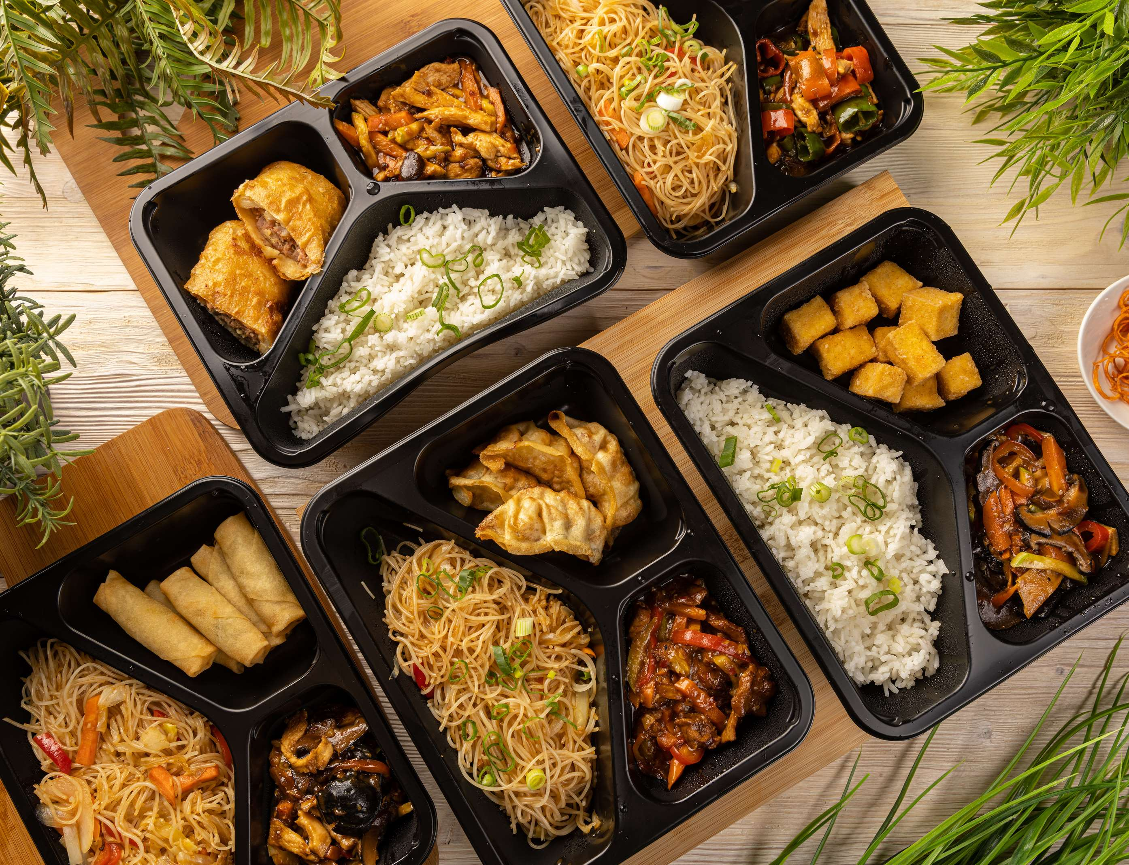
  Changing Consumer Lifestyles to Increase the Demand Globally
  Innovations in Packaging to Propel Market Growth
Drivers
Competition and Price Sensitivity to Limit the Sales
Restraints

Slide 7
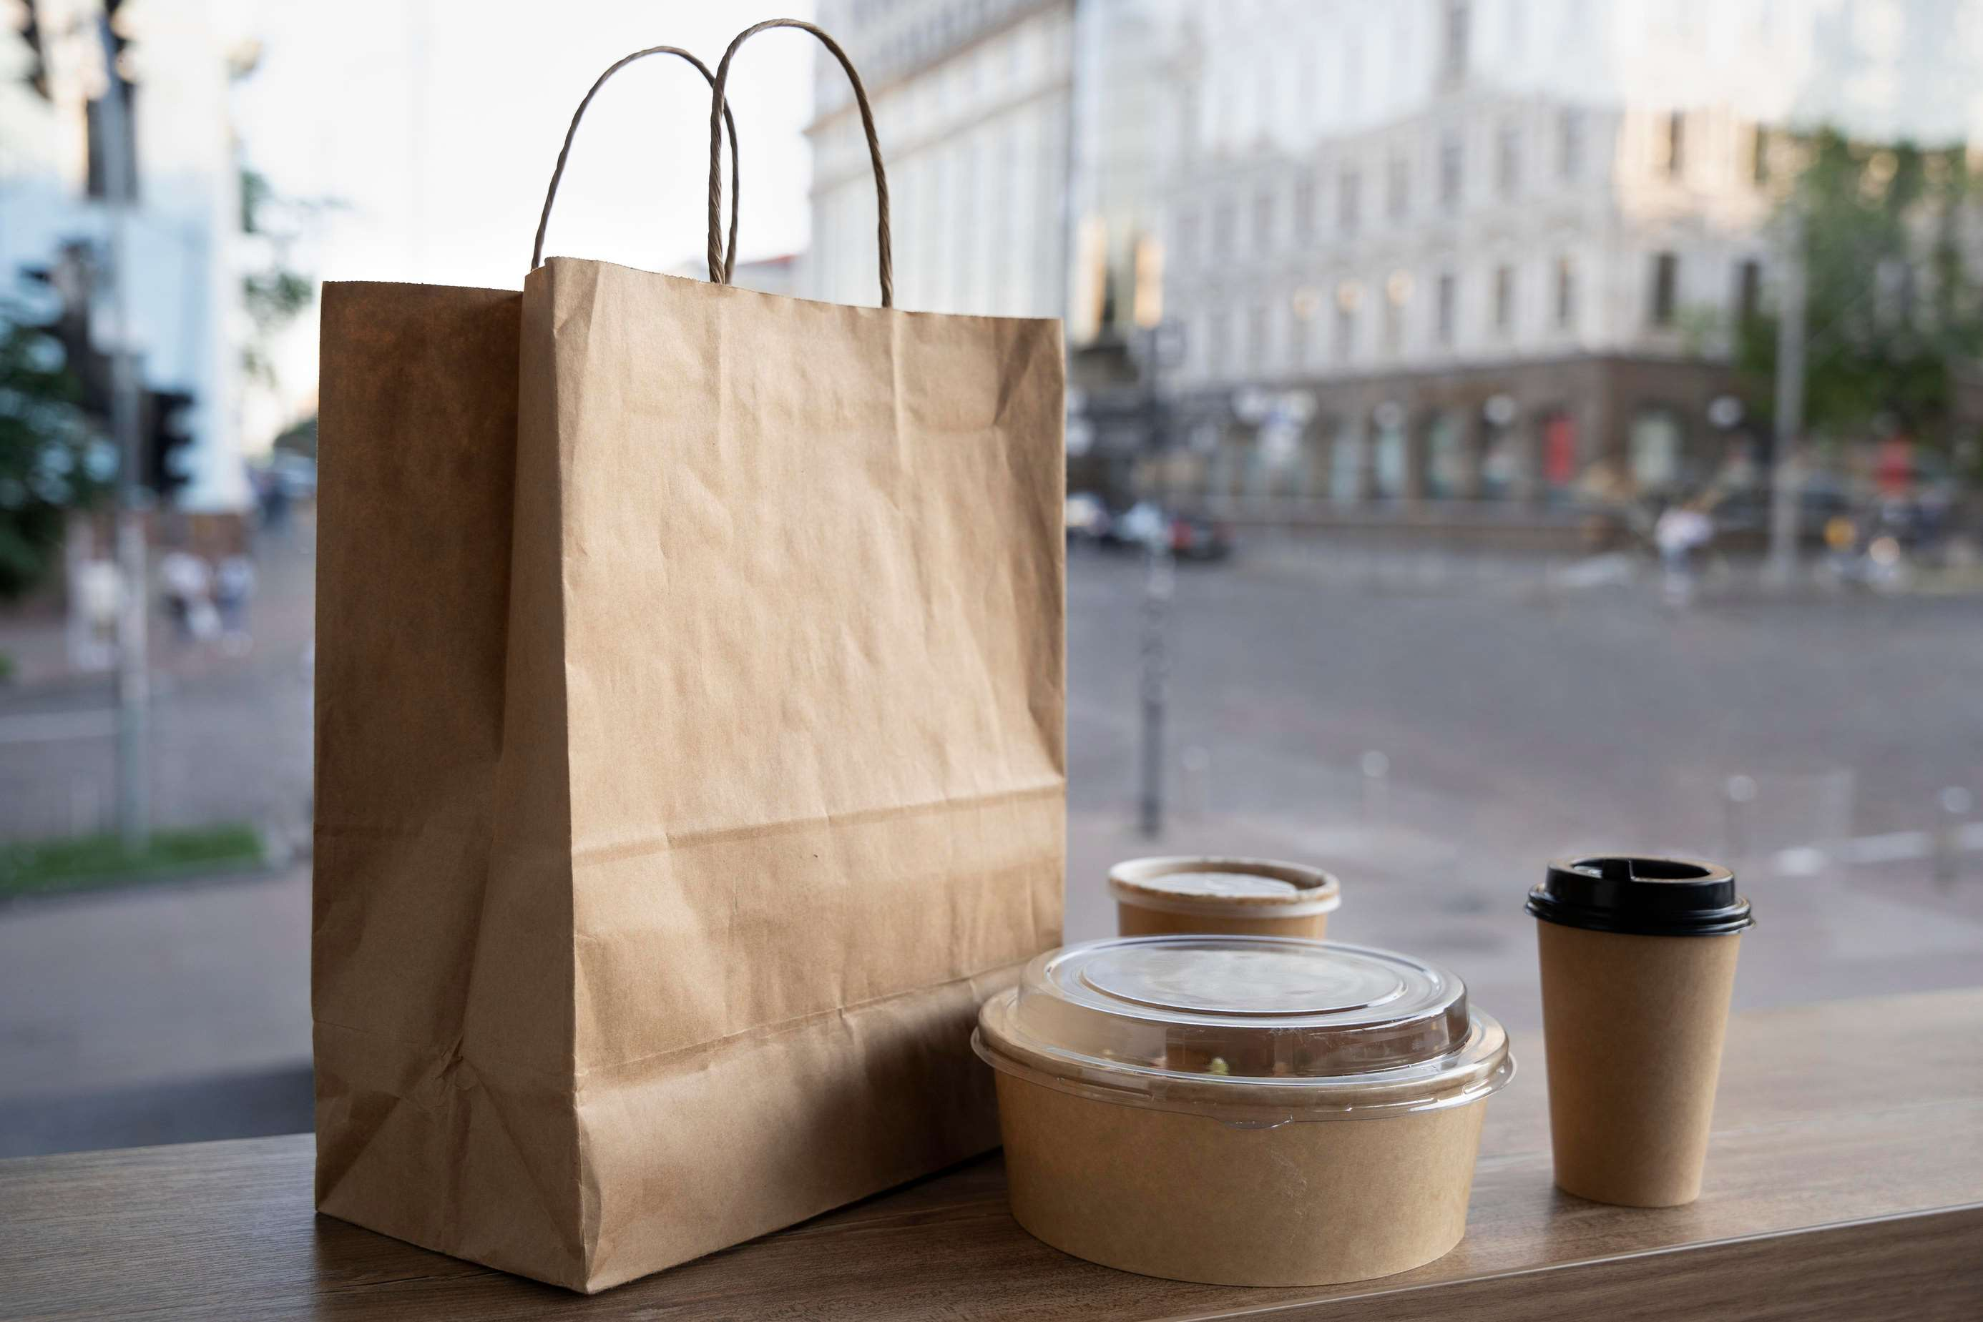
AUTHOR'S PERSPECTIVE
  The global Takeaway Food market will expand significantly by 7.20% CAGR between 2024 to 2031.
  The Vegetarian segment is set to rise as consumers increasingly prioritize health, sustainability, and ethical considerations in their dietary choices.
  Convenience, timesaving, and changing consumer lifestyles are propelling the robust growth of the takeaway food market. With modern life characterized by busy schedules and a premium placed on efficiency, consumers increasingly turn to convenient dining solutions.

Slide 8






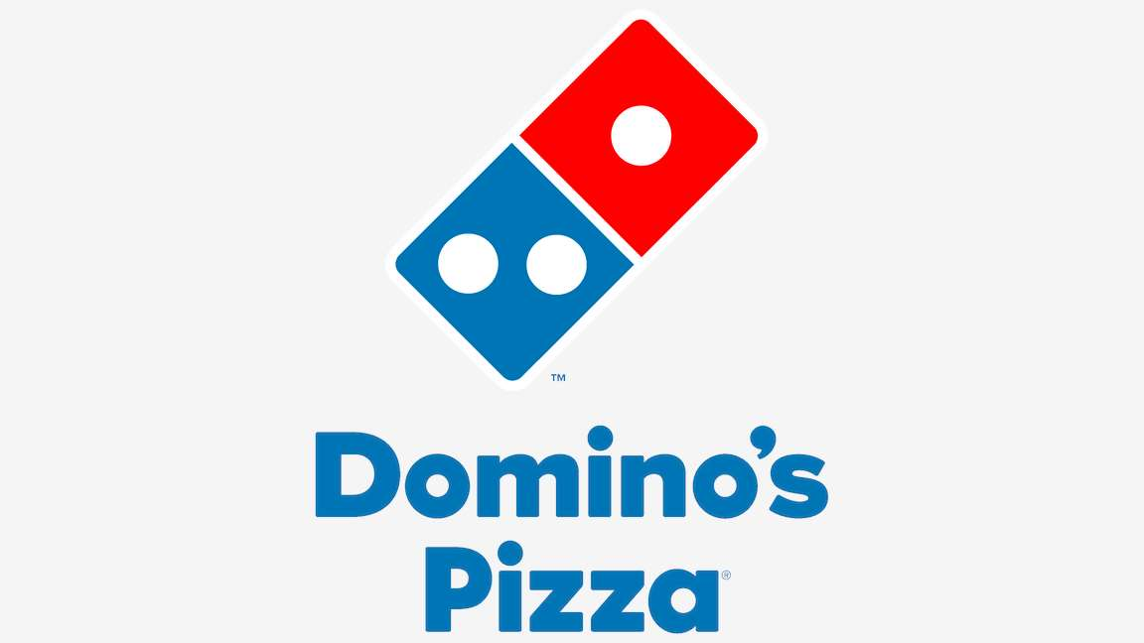


KEY PLAYERS

Slide 9


For Full Report
Contact us
COGNITIVE MARKET RESEARCH
Tel: +1 312-376-8303 | +44 020-8123-0732
India: (+91) 983-496-8611
sales@cognitivemarketresearch.com
Access the Full Report : https://tinyurl.com/7x5upwcf
Please visit our website:
https://www.cognitivemarketresearch.com

