Slide 1

GLOBAL
TAKE OUT FRIED CHICKEN MARKET REPORT 2024
Global,Regional,CountryAnalysis

Slide 2

INTRODUCTION
Numerous factors impact the market for take-out fried chicken. First, demand has increased due to changing consumer lives and a growing desire for quick meal options. Consumer access to fried chicken has also been facilitated by the growth of online ordering platforms and food delivery services. The COVID-19 epidemic hastened this tendency even more since more people are turning to comfort food cooked at home. Additionally, a wider range of customers are drawn in by the variety of flavors and customization options available in fried chicken offers, which adapt to changing tastes. Some brands are investigating eco-friendly methods as sustainability gets traction, which is helping the market expand. Ultimately, in this dynamic economy, competitive pricing and promotional tactics continue to be essential drivers.

Slide 3
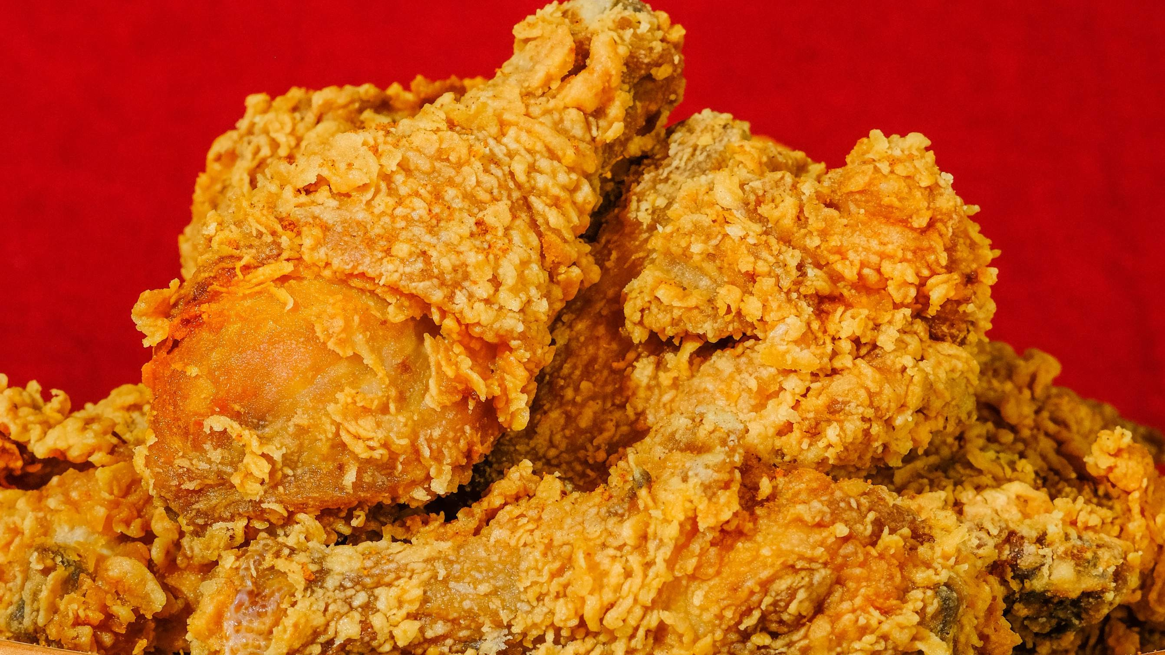

KEY INSIGHTS
MARKET SIZE
USD 6.8 billion
2022
20₋23
CAGR 6.0%
2030

Slide 4
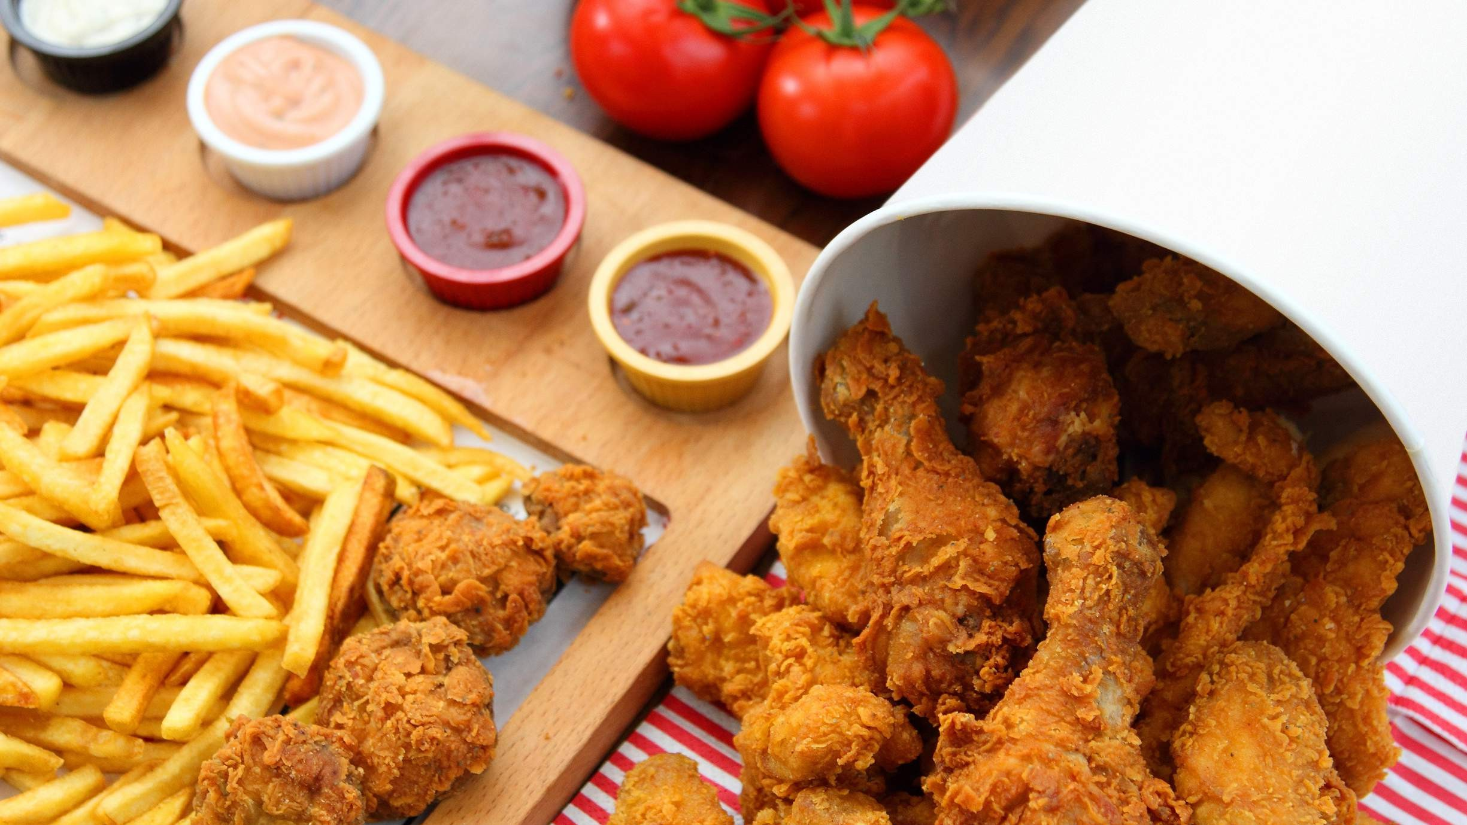
REVENUE MARKET SHARE BY SEGMENTS 2022
Chicken Breast Chicken Wings Chicken Legs Whole Chicken
Households Commercial Facilities Institutional
End Users Segment
Type Segment
Grown-ups Children Elderly Man
Delivery Drive-Thru Pick-Up
Application Segment
Service Type

Slide 5
Global Take out Fried Chicken Market Revenue share for 2022
North America 40%

Slide 6

Expansion of Food Delivery Services and Online Ordering Platforms to Provide Market Growth
Drivers
Evolving Health Consciousness to Hinder Market Growth
Restraints

Slide 7

AUTHOR'S PERSPECTIVE
The Global Take out Fried Chicken Market is witnessing significant growth in the near future.
Chicken wings stand out for their practicality, versatility, and capacity to satisfy a wide range of palates.
Children find fried chicken to be naturally appealing due to its crispy exterior and delicious flavor.
First of all, fried chicken takeout is a convenient option for a quick workplace meal or during lunch breaks for a lot of professionals and employees.

Slide 8
KEY PLAYERS

Slide 9


Contact us
For Full Report
COGNITIVE MARKET RESEARCH
Tel: + 1 312 - 376 - 8303 | + 44 020 - 8123 - 0732
India: ( + 91 ) 983 - 496 - 8611
sales@ cognitivemarketresearch. com
Access the Full Report : http://tinyurl.com/bdkcc5k6
Please visit our website:
https://www.cognitivemarketresearch.com

