Slide 1
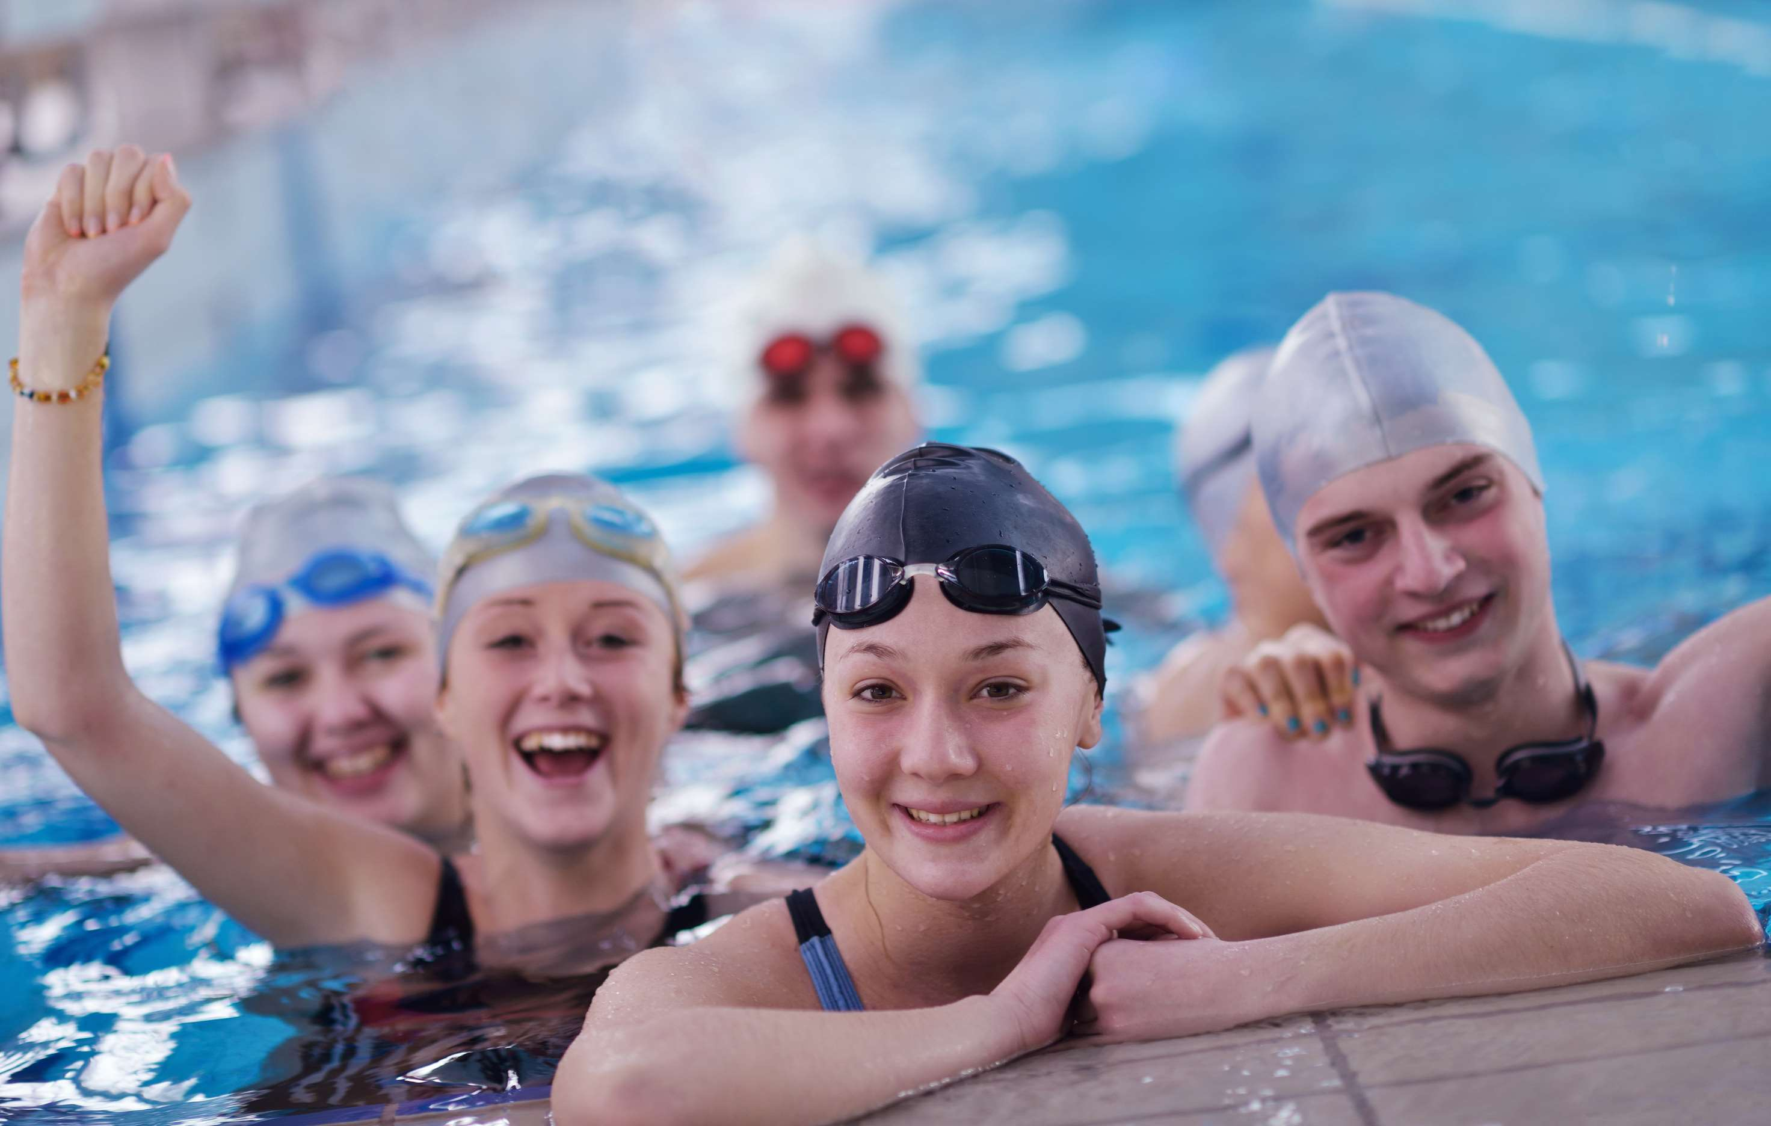
GLOBAL
SWIM CAPS
MARKET REPORT
2024
Global,Regional,CountryAnalysis

Slide 2
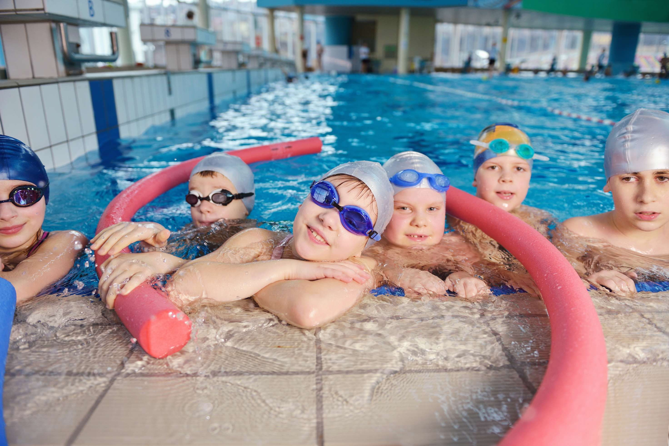
INTRODUCTION
The swimming cap market offers a range of innovative solutions for hair protection while swimming. These caps are designed to shield hair from chlorine, saltwater, and UV rays, preventing damage and discoloration. They come in various materials, sizes, and styles, catering to diverse preferences and hair types. Whether it's a latex cap for minimal water exposure or a silicone cap for a snug fit, these products ensure that your hair stays healthy and vibrant during aquatic activities.

Slide 3


KEY INSIGHTS
CAGR
5.80%
2023- 2030

Slide 4
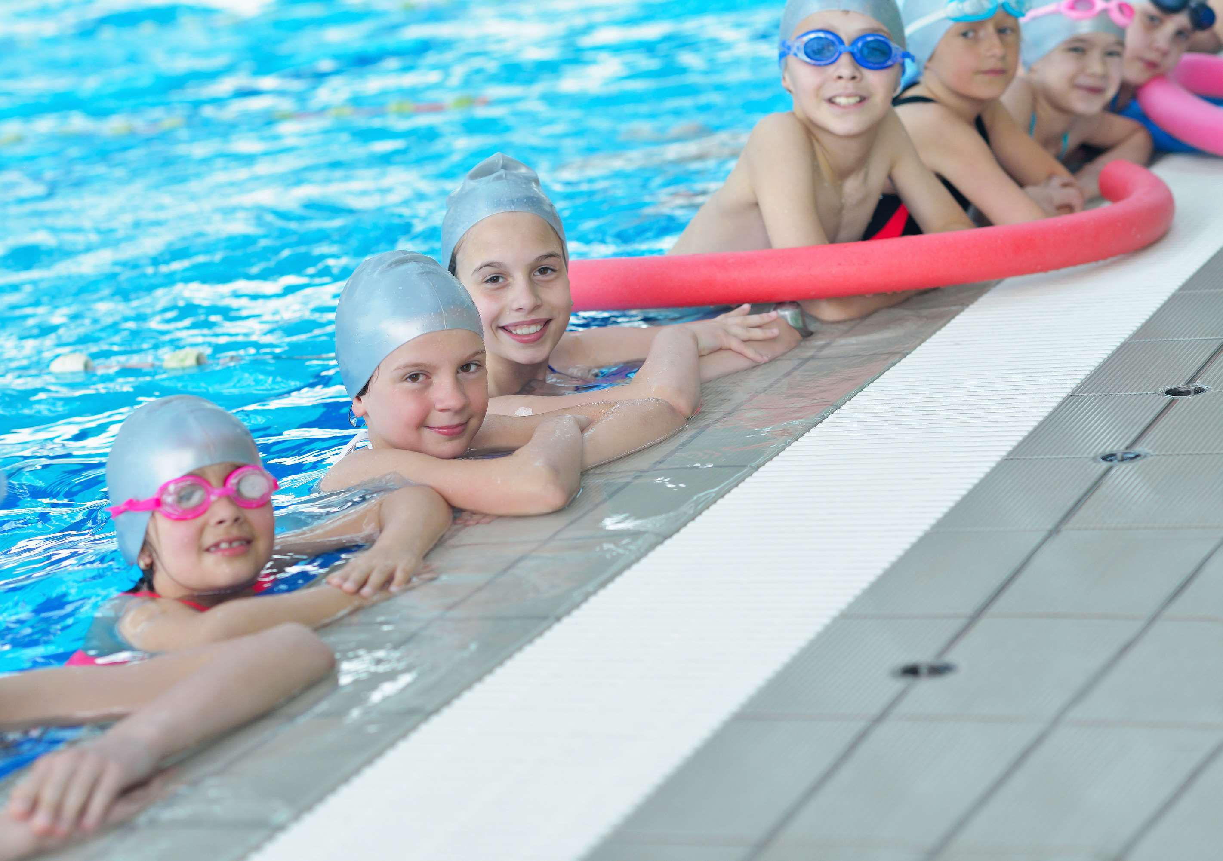
REVENUE MARKET SHARE BY SEGMENTS 2022
  Silicone Swim Caps
  Rubber Swim Caps
  Other Swim Caps
  Male
  Female
Type Segment
Gender Segment
  Individuals
  Swim Clubs
  Educational Institutions
  Training
  Competition
  Leisure
End-User Segment
Application Segment

Slide 5
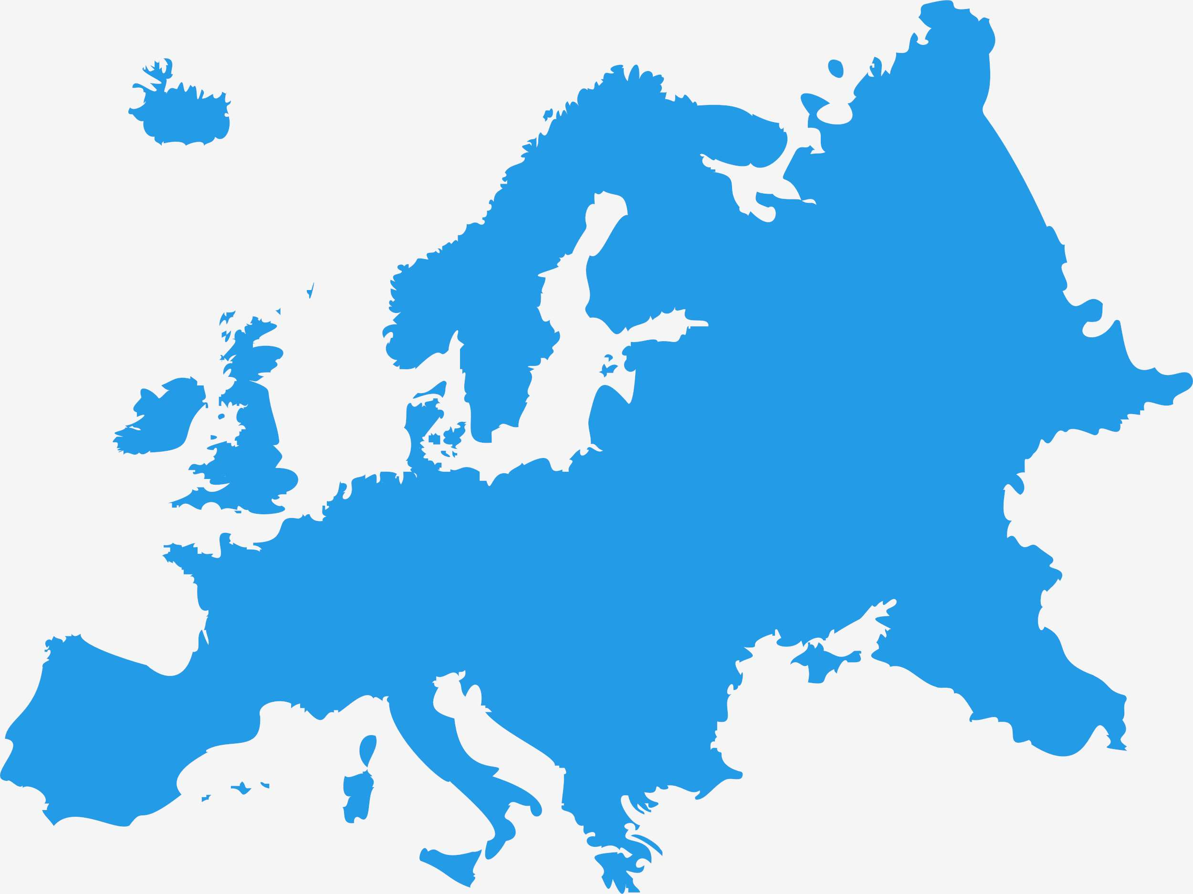
Global Swim Caps Market Revenue share for 2024
Europe
38%

Slide 6
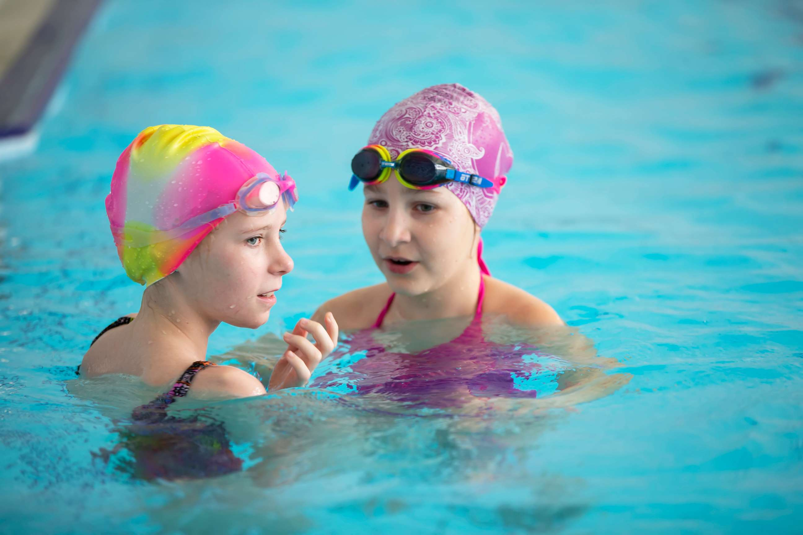
Surge in Demand for Swimming Caps among Youngsters to Propel Market Growth
Drivers
Competition from Alternative Products to Restrict Market Growth
Restraints

Slide 7
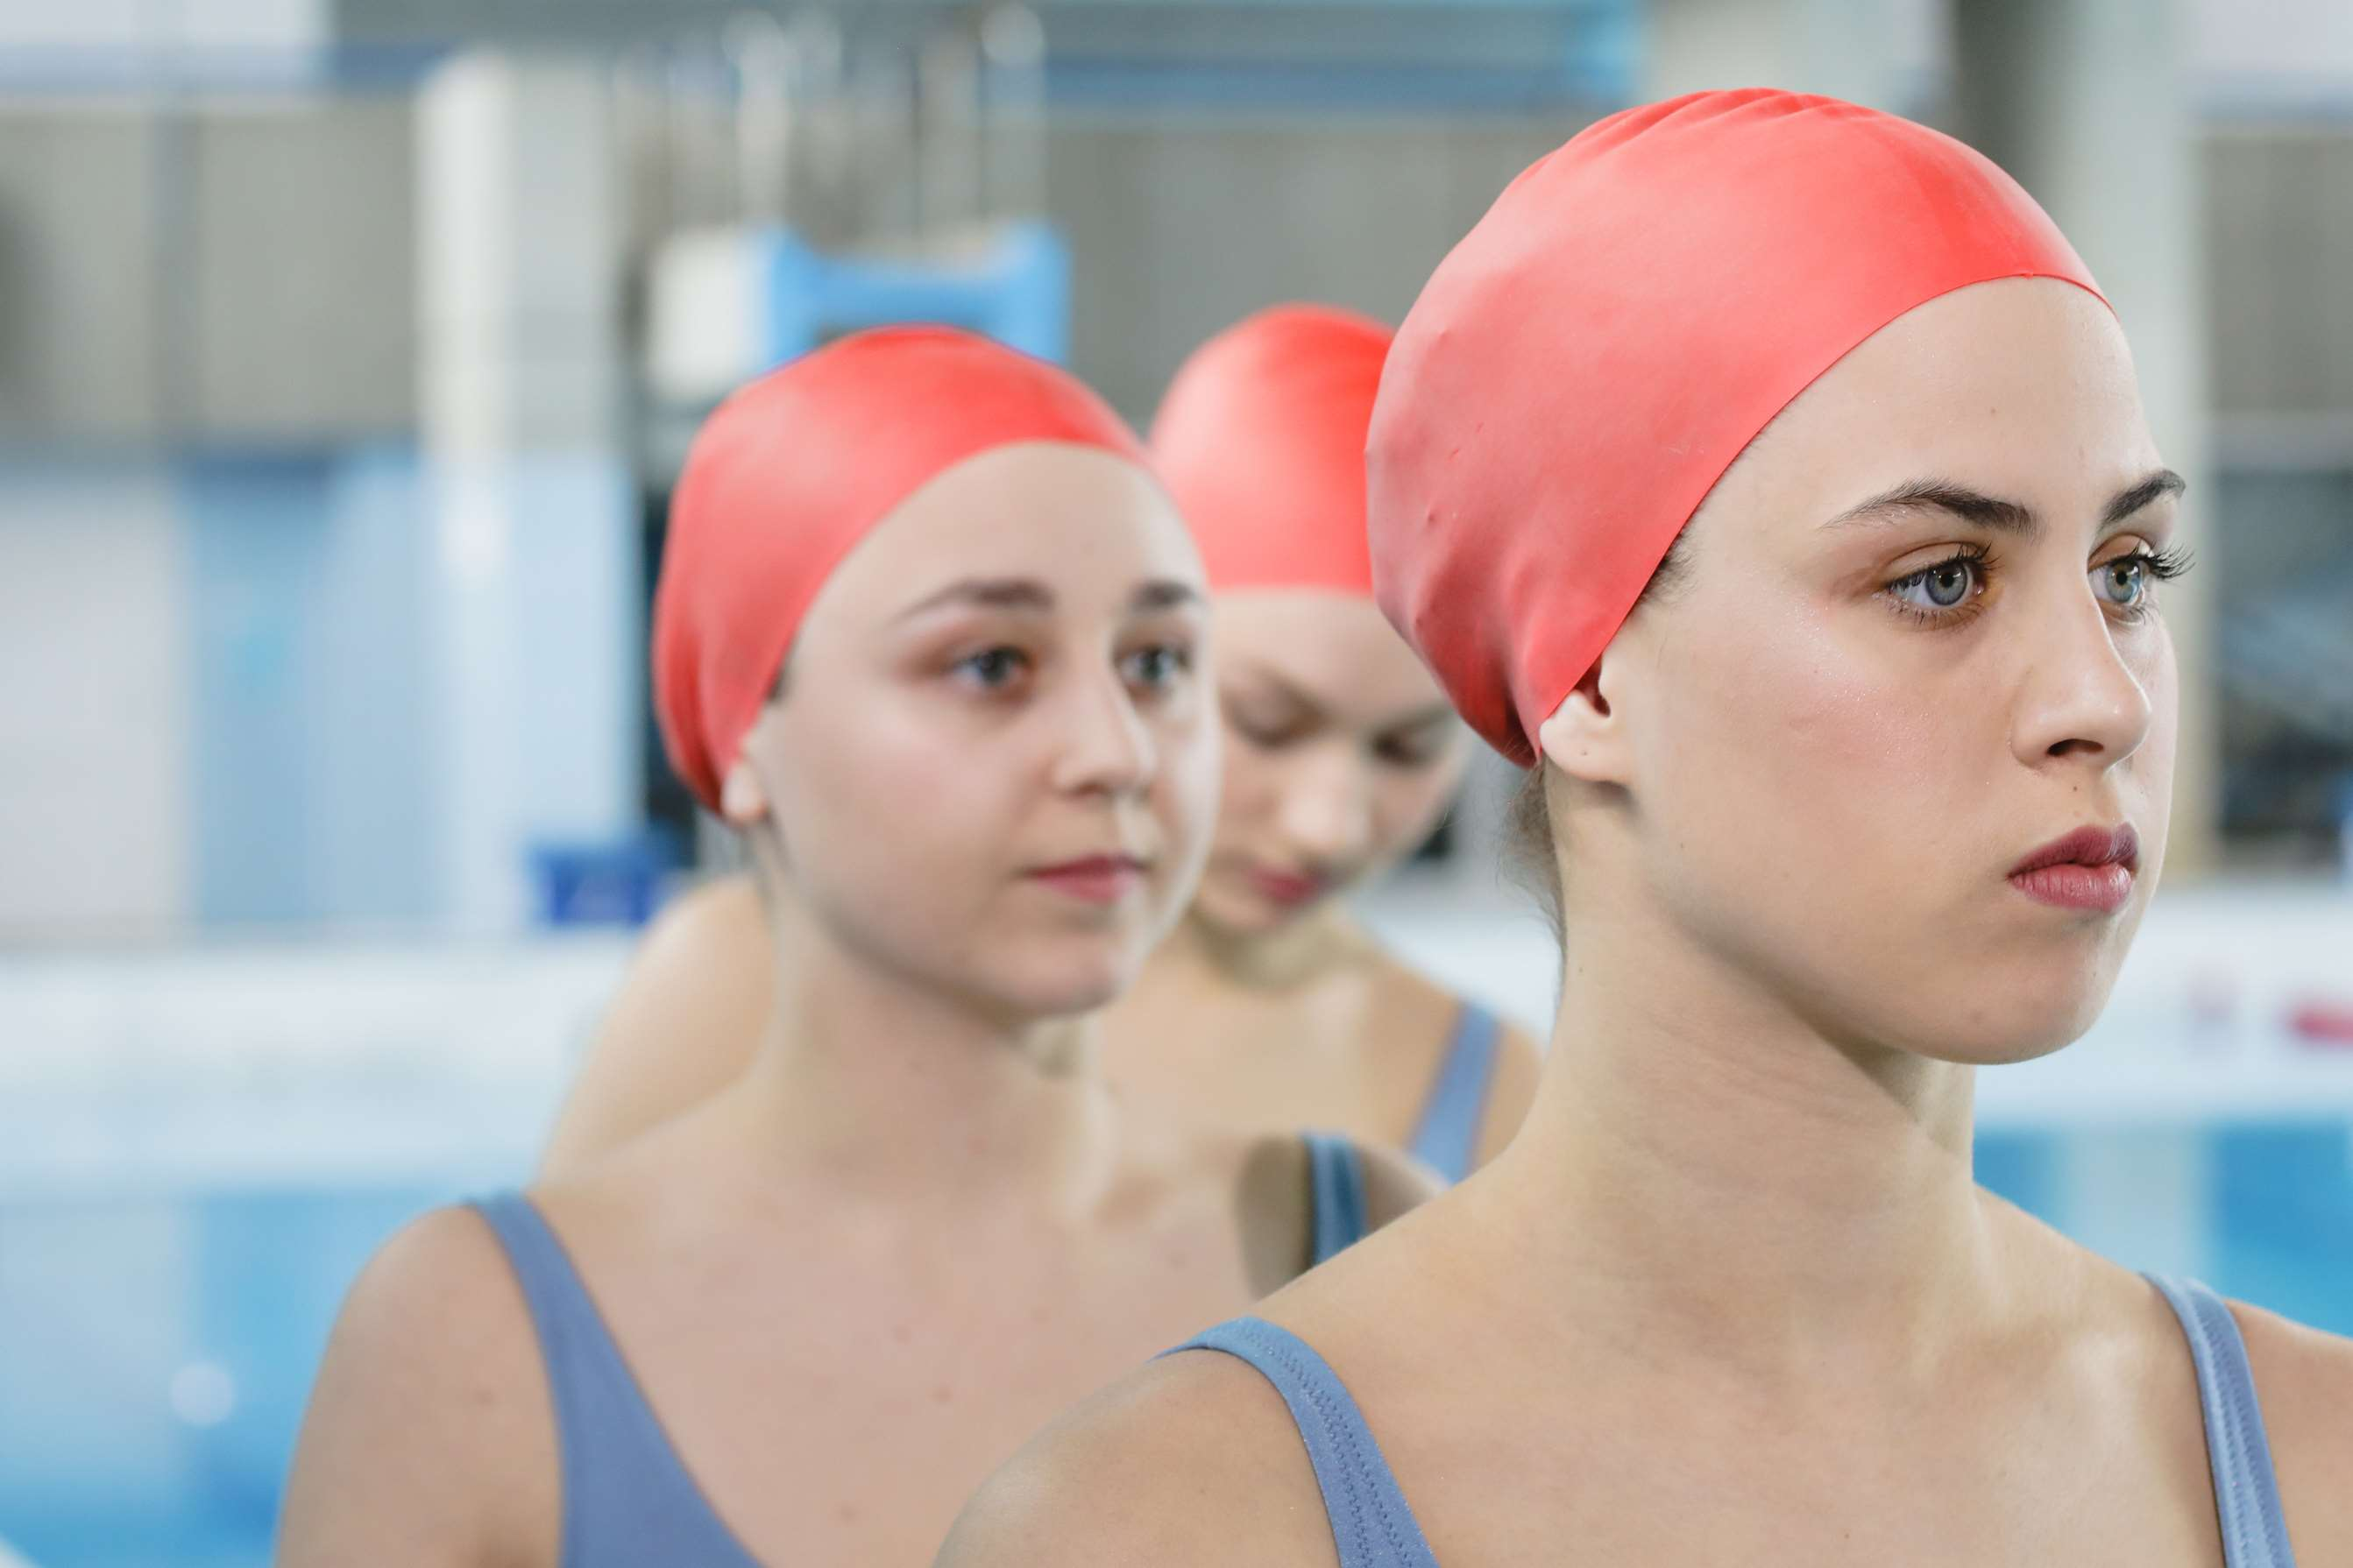
AUTHOR'S PERSPECTIVE
  The Global Swim Caps Market is witnessing significant growth in the near future.
  Swimmers of all groups, from recreational to competitive, trust rubber swim caps to streamline their performance and keep their hair dry.
  The swim caps market has grown to accommodate diverse preferences, offering various designs, materials, and sizes to cater to competitive swimmers' needs.
  Local sports stores, swim shops, and department stores are common offline venues where customers can explore a range of swim cap options, providing a tangible shopping experience that complements the online market.
  Males are the fastest-growing category due to the growing needs of men involved in aquatic activities, providing various headgear options designed for swimming.

Slide 8
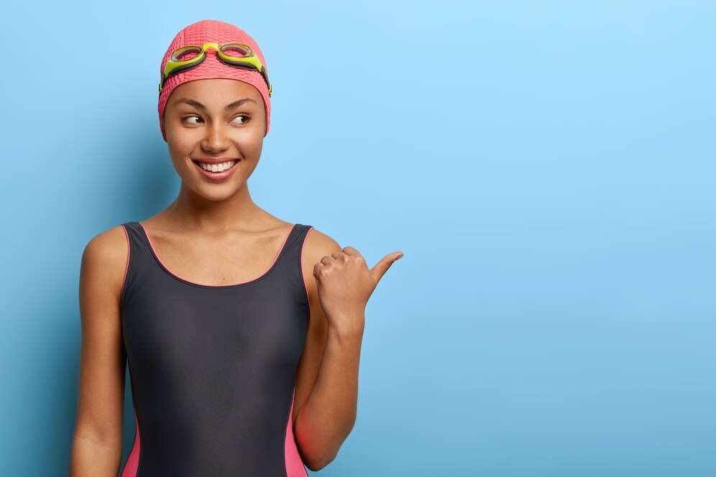

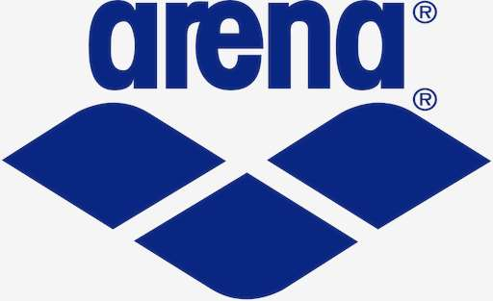

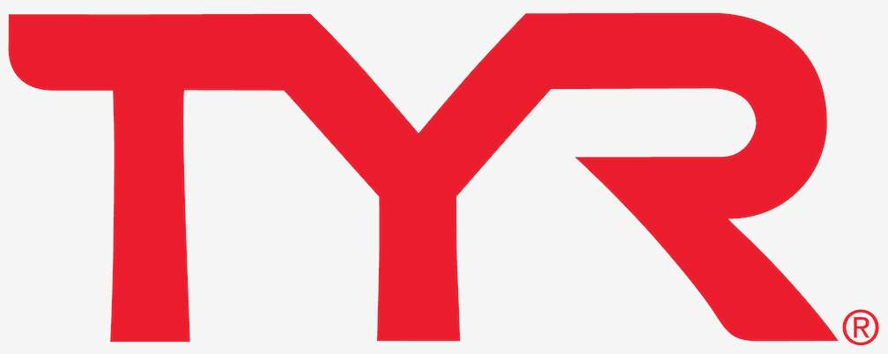
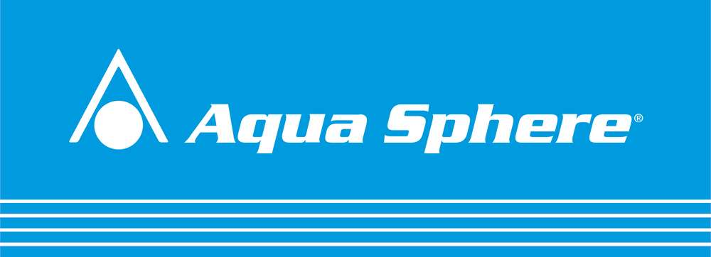
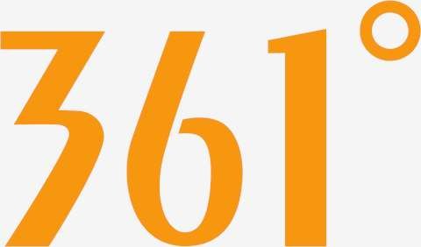
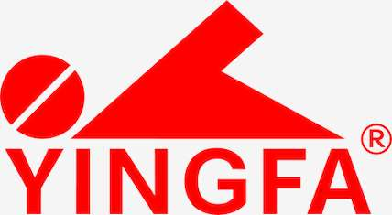


KEY PLAYERS

Slide 9


For Full Report
Contact us
COGNITIVE MARKET RESEARCH
Tel: +1 312-376-8303 | +44 020-8123-0732
India: (+91) 983-496-8611
sales@cognitivemarketresearch.com
Access the Full Report : https://tinyurl.com/tnj2zxjr
Please visit our website:
https://www.cognitivemarketresearch.com

