Slide 1
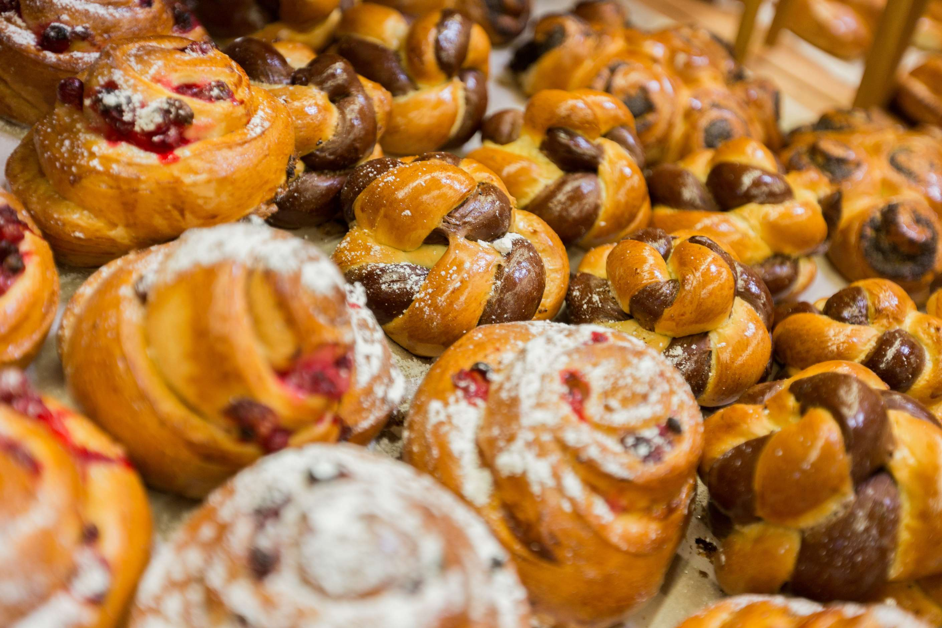
GLOBAL
SWEET BAKED GOODS
MARKET REPORT
2024
Global,Regional,CountryAnalysis

Slide 2
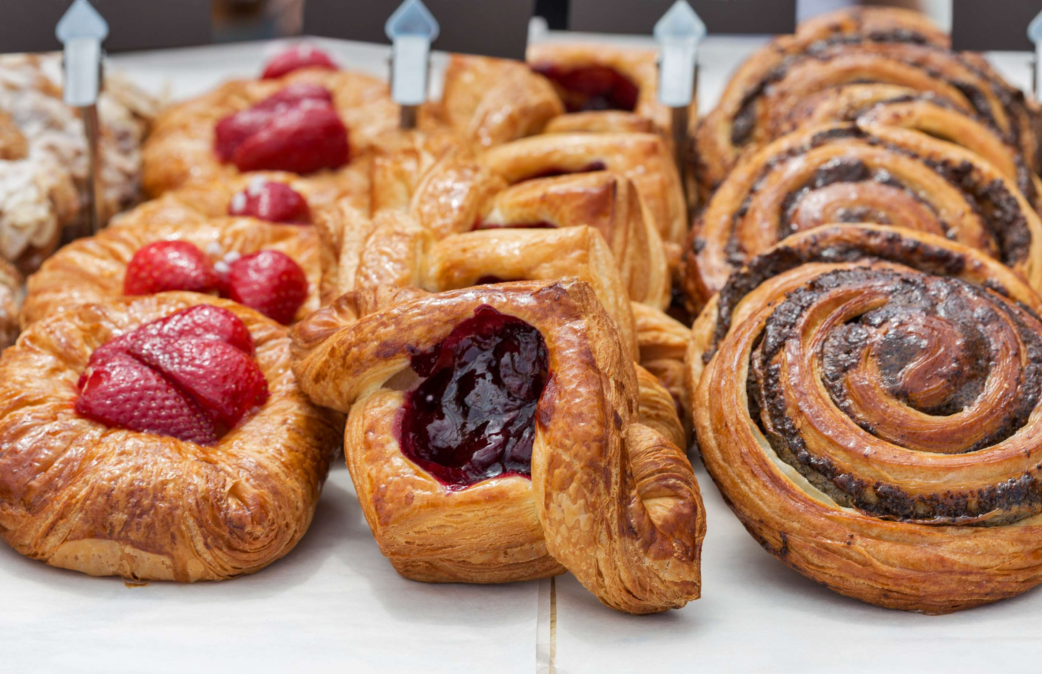
INTRODUCTION
The sweet baked goods market encompasses a variety of confectionery items such as cakes, pastries, cookies, and desserts, enjoyed for their indulgent flavors and textures worldwide. The sweet baked goods market encompasses various products, including cakes, cookies, pastries, and desserts, catering to diverse consumer preferences and occasions. Key players employ various strategies such as product innovation, marketing campaigns emphasizing taste and quality, expansion of distribution networks through online platforms and partnerships with retailers, and investments in R&D to develop healthier and premium offerings. Additionally, strategic acquisitions and collaborations help companies to diversify their product portfolios and expand their market reach.

Slide 3
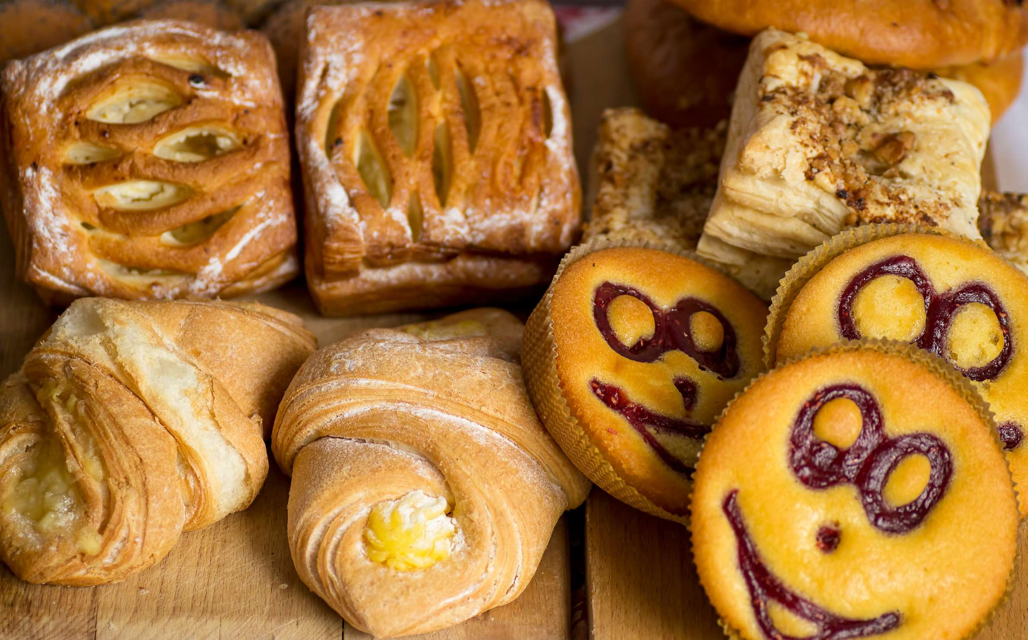

KEY INSIGHTS
CAGR
9.0%
2023- 2030

Slide 4
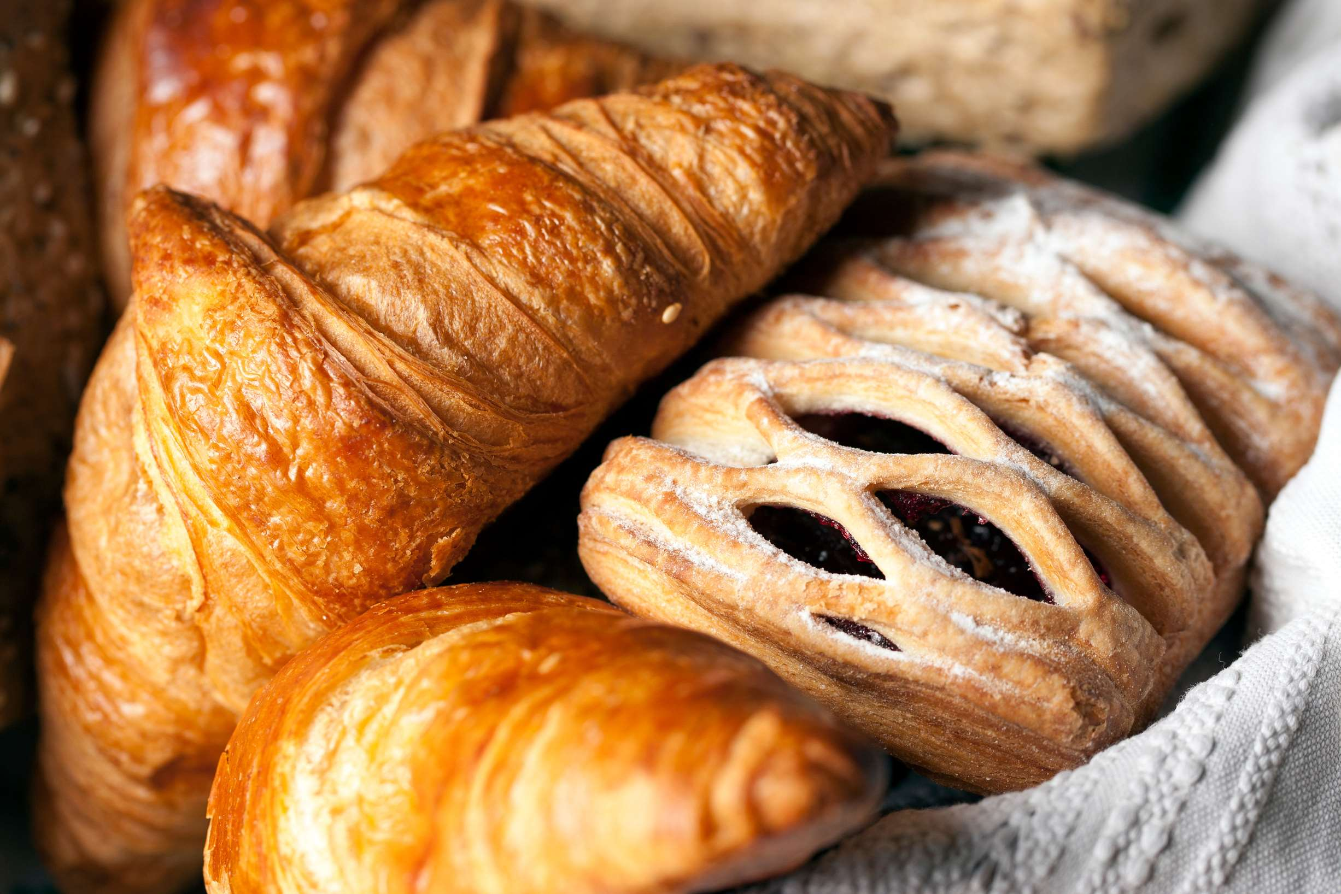
REVENUE MARKET SHARE BY SEGMENTS 2022
  Doughnuts
  Muffins
  Pastry/Danish/Coffee Cake
  Cookies
  Brownies
  Cakes
  Pies
  Biscuits
  Supermarkets/Hypermarkets
  Convenience Stores
  Bakeries
  Online Retail
Type Segment
Distribution Channel
  Kids
  Adult
  Pregnant Woman
  The Old
  Daily Consumption
  Seasonal
  Celebration
  Gifting
Application Segment
Occasion Segment

Slide 5
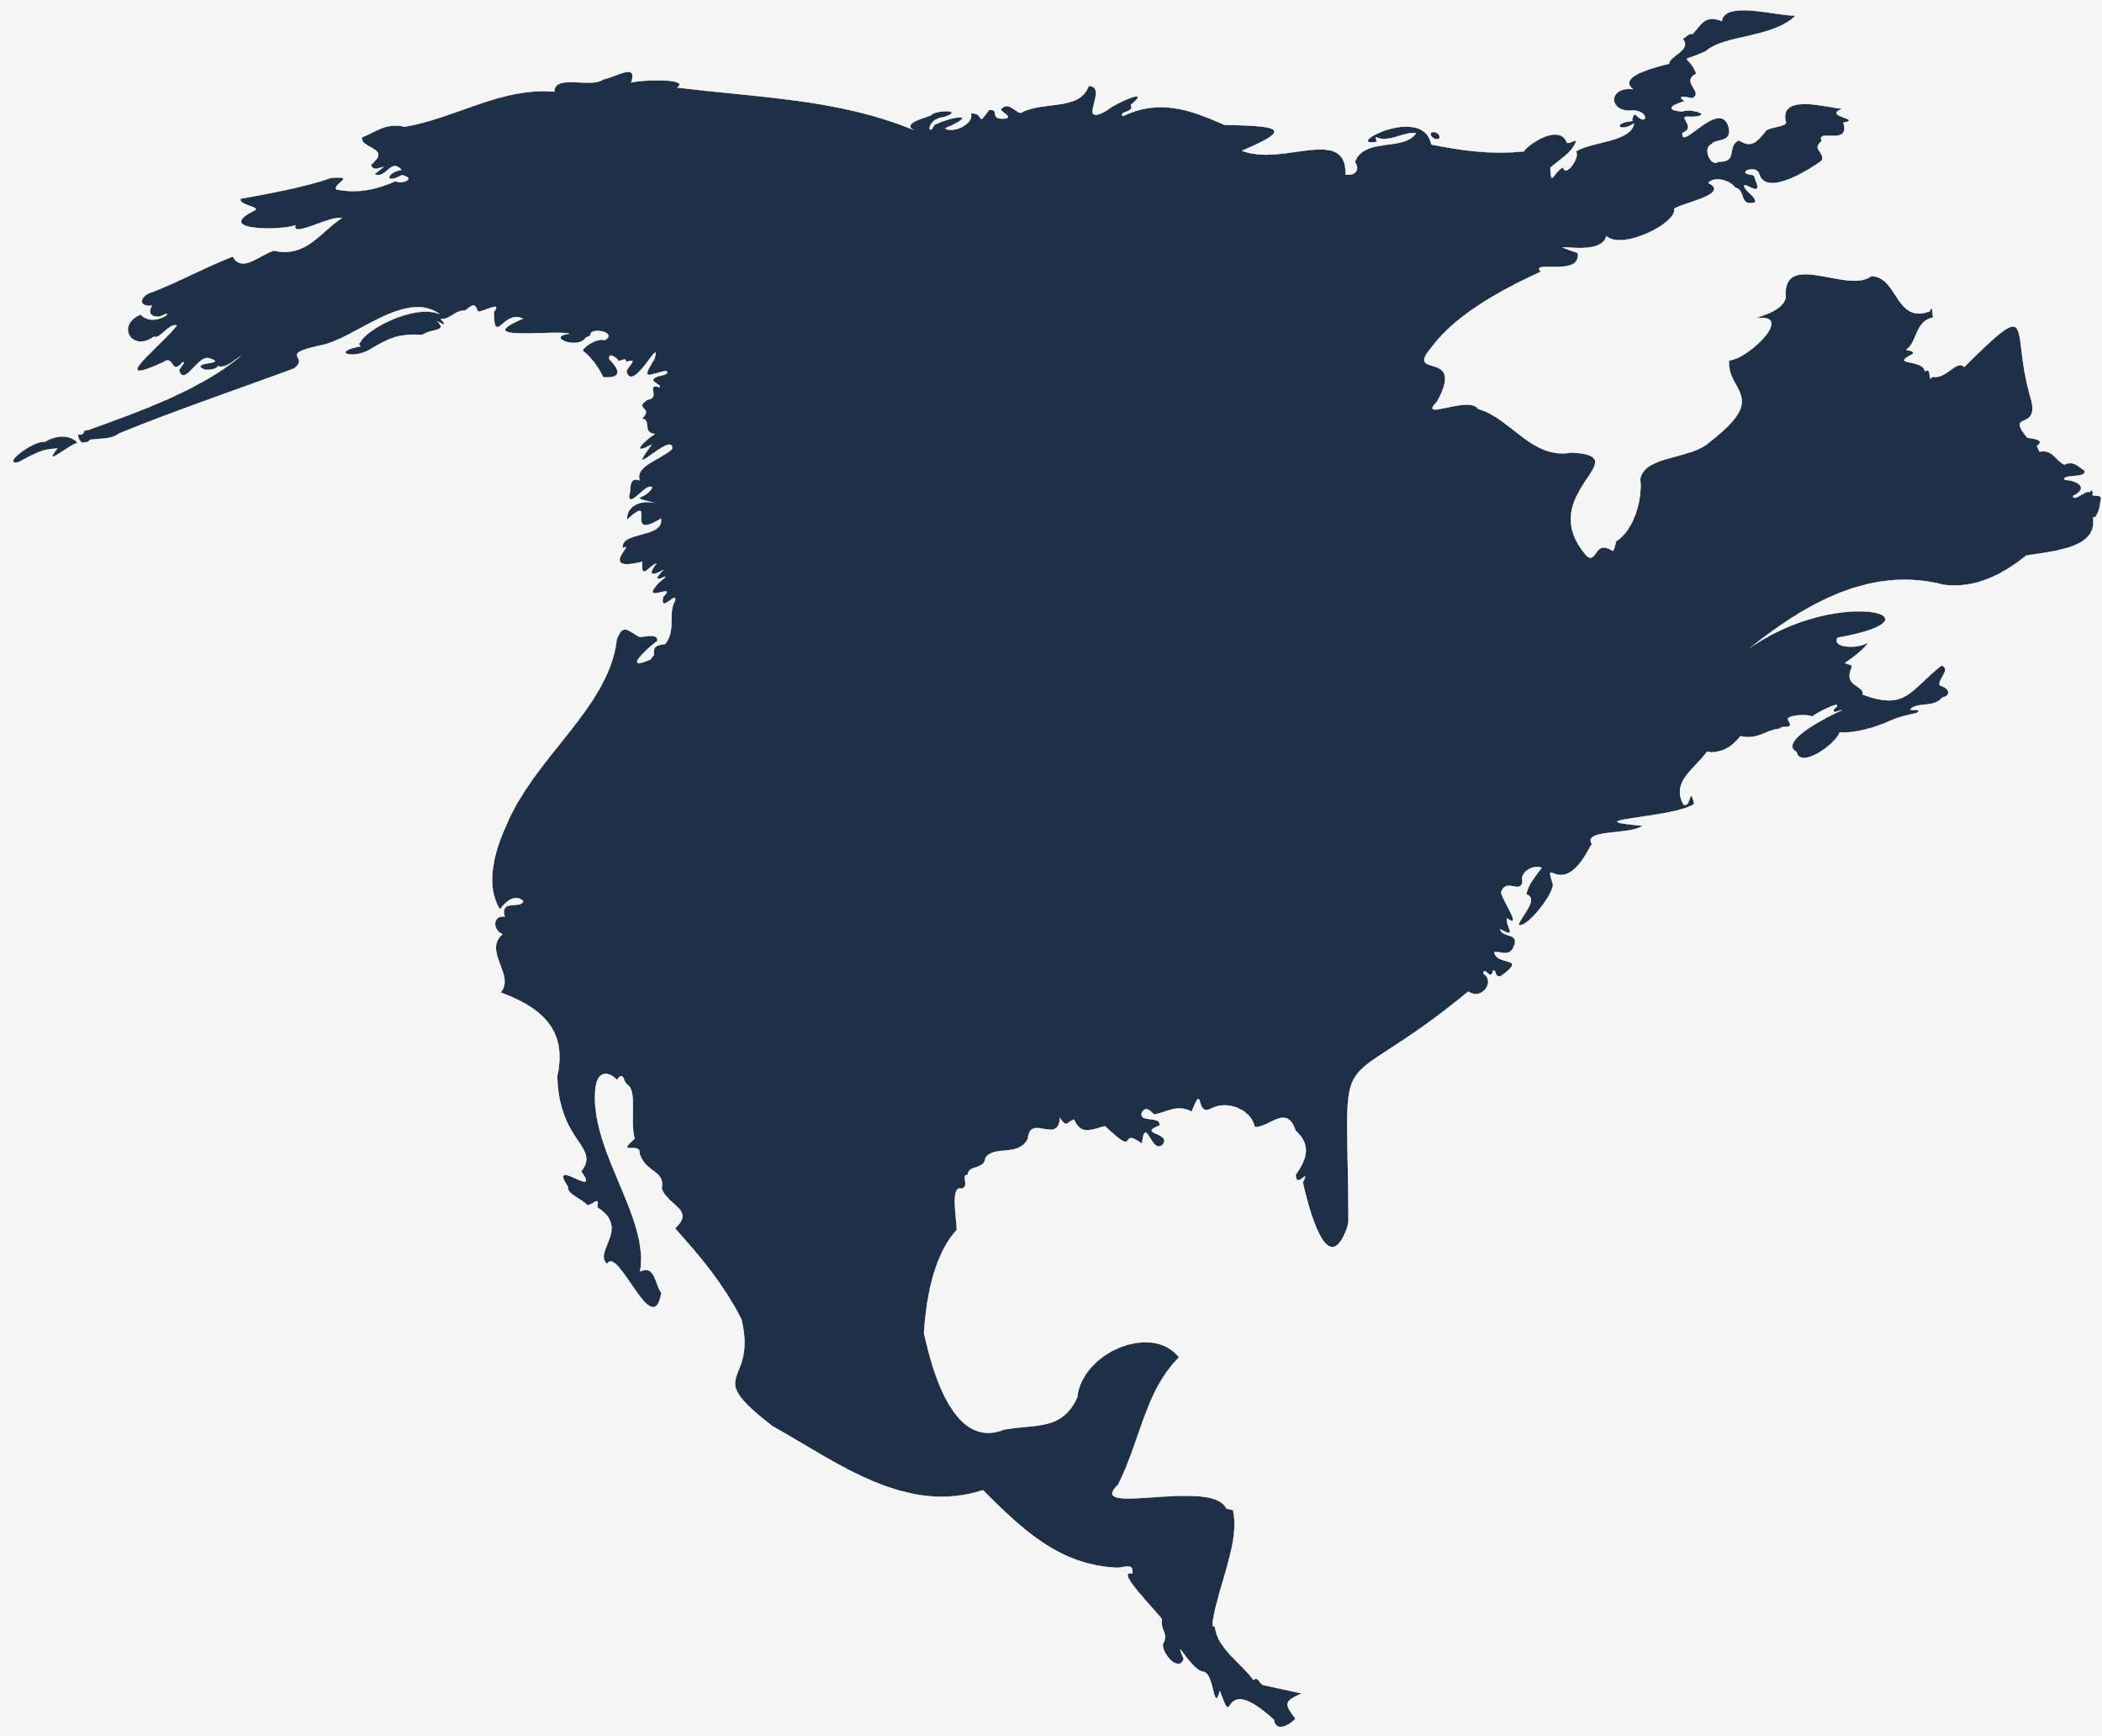
Global Sweet Baked Goods Market Revenue share for 2024
North America
40%

Slide 6
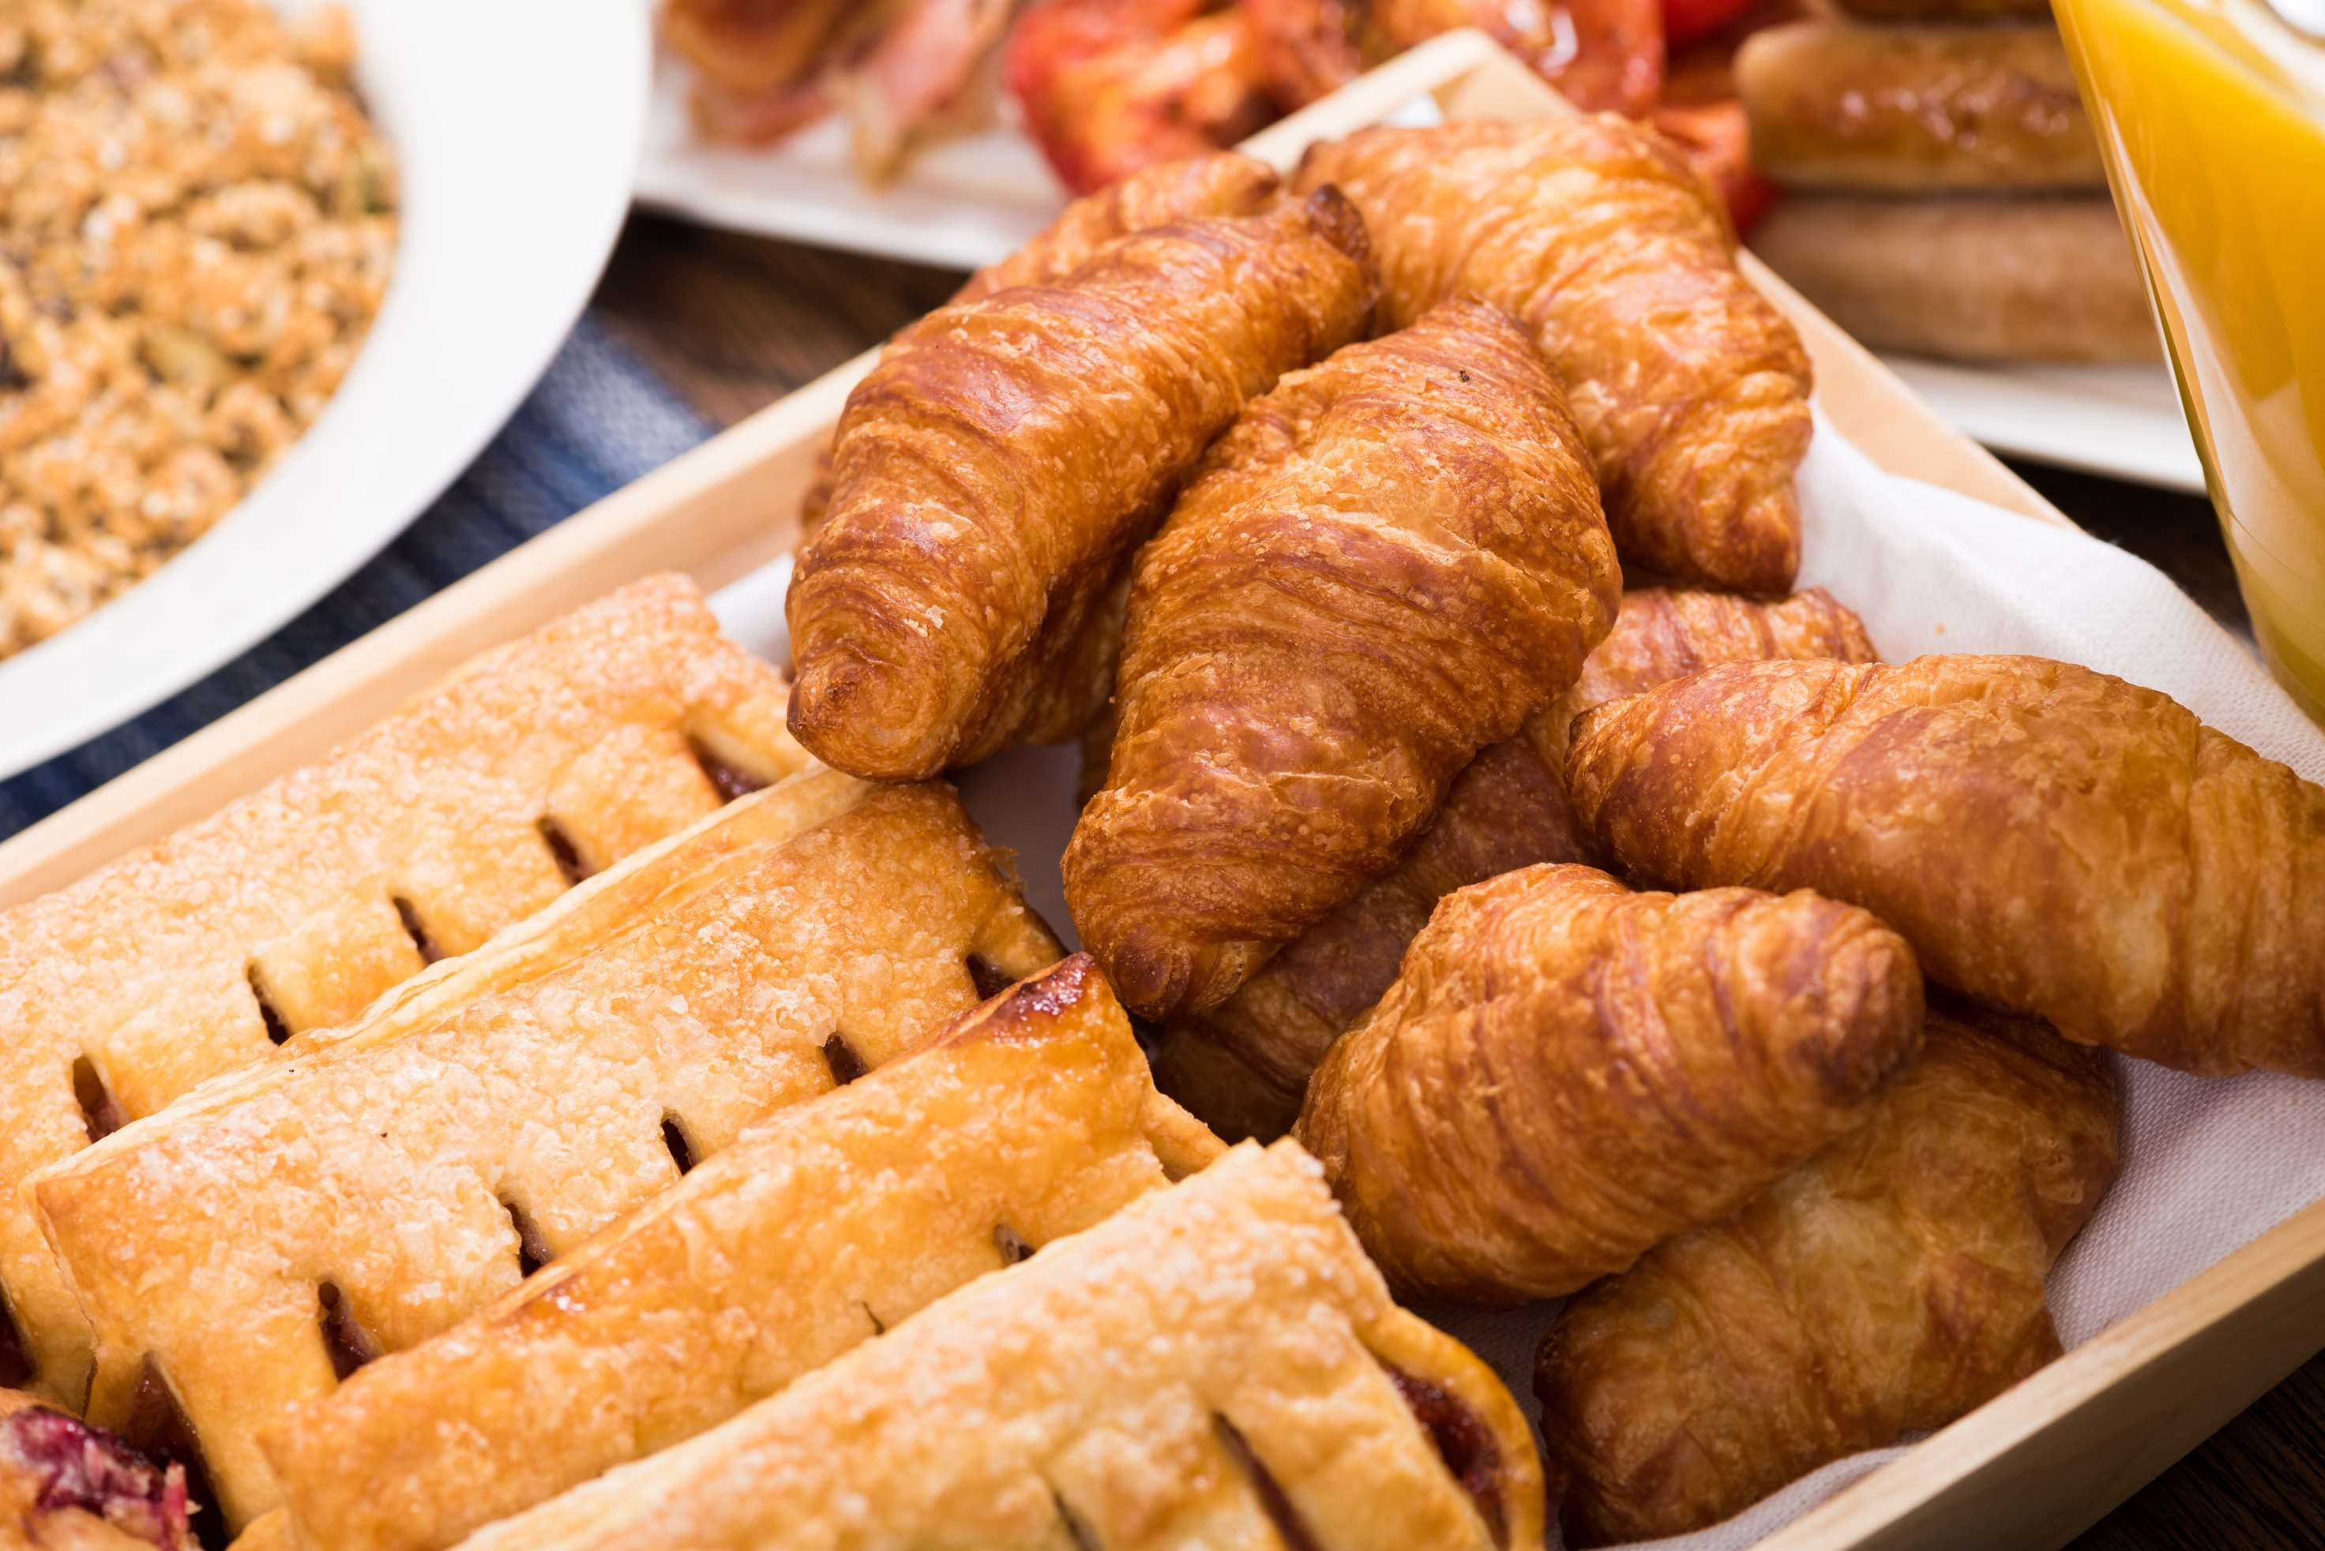
Changing Consumer Preferences to Provide Viable Market Output
Drivers
Health Issues due to Excess Consumption of Trans-Fatty Acids to Restrict Market Growth
Restraints

Slide 7
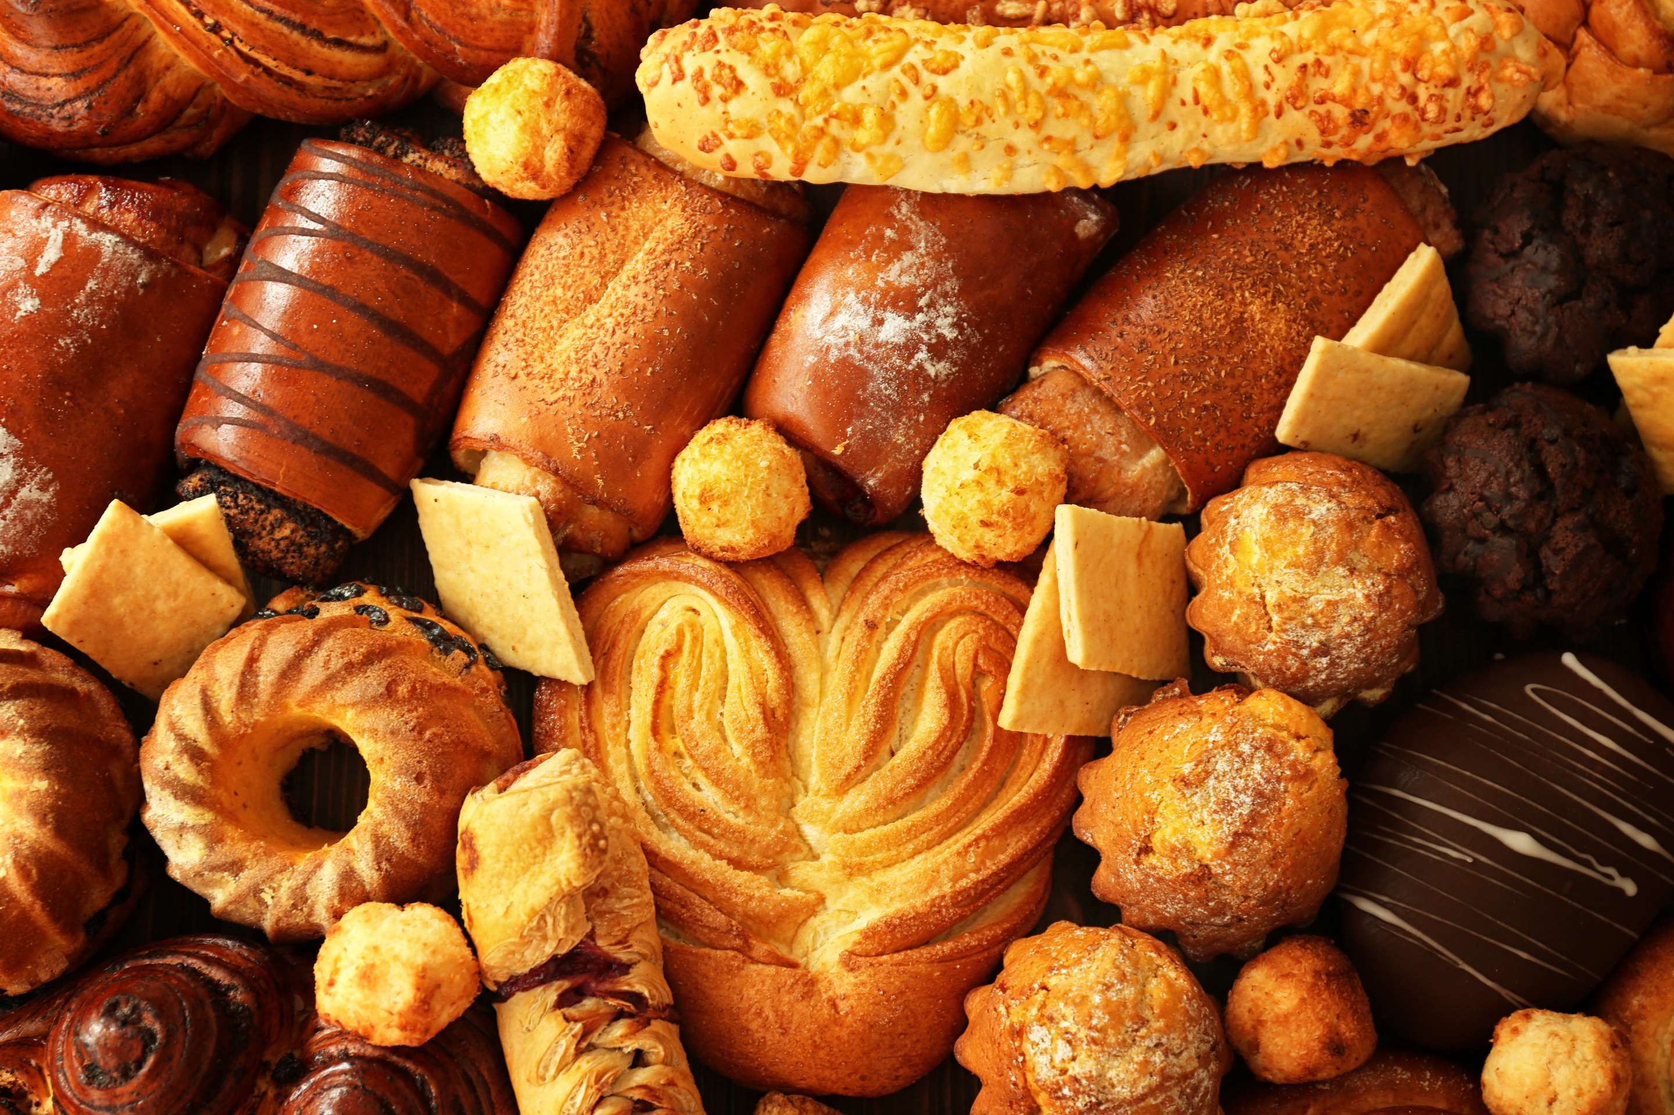
AUTHOR'S PERSPECTIVE
  The global sweet baked goods market will expand significantly by 9.0% CAGR between 2024 to 2031.
  The bakeries segment is set to rise due to the proliferation of bakeries offering artisanal and specialty products, attracting consumers seeking unique and high-quality treats. Bakeries are pivotal in shaping consumer preferences, driving innovation, and creating experiential consumption opportunities within the market.
  The sweet baked goods market is driven by evolving consumer preferences for indulgent yet convenient snacks and innovative product offerings to meet changing tastes. Additionally, urbanization, rising disposable incomes, and effective marketing strategies contribute to market growth and competitiveness

Slide 8











KEY PLAYERS

Slide 9


For Full Report
Contact us
COGNITIVE MARKET RESEARCH
Tel: +1 312-376-8303 | +44 020-8123-0732
India: (+91) 983-496-8611
sales@cognitivemarketresearch.com
Access the Full Report : https://tinyurl.com/ycyp27km
Please visit our website:
https://www.cognitivemarketresearch.com

