Slide 1
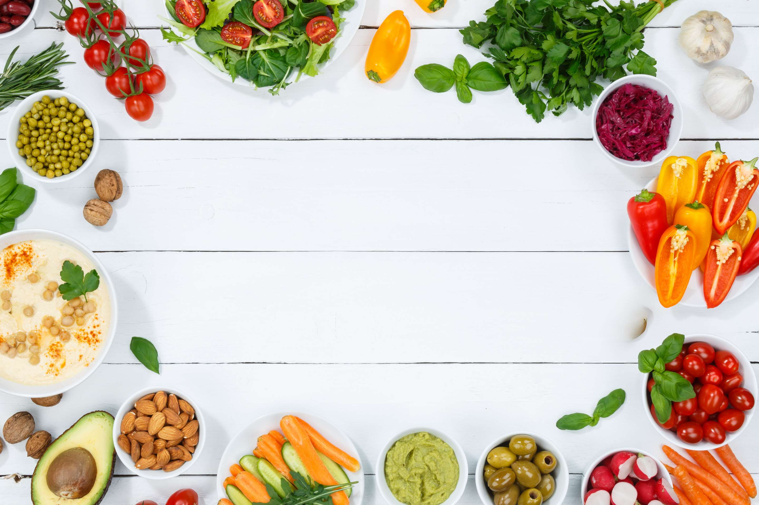
GLOBAL
SUPERFOODS
MARKET REPORT
2024
Global,Regional,CountryAnalysis

Slide 2
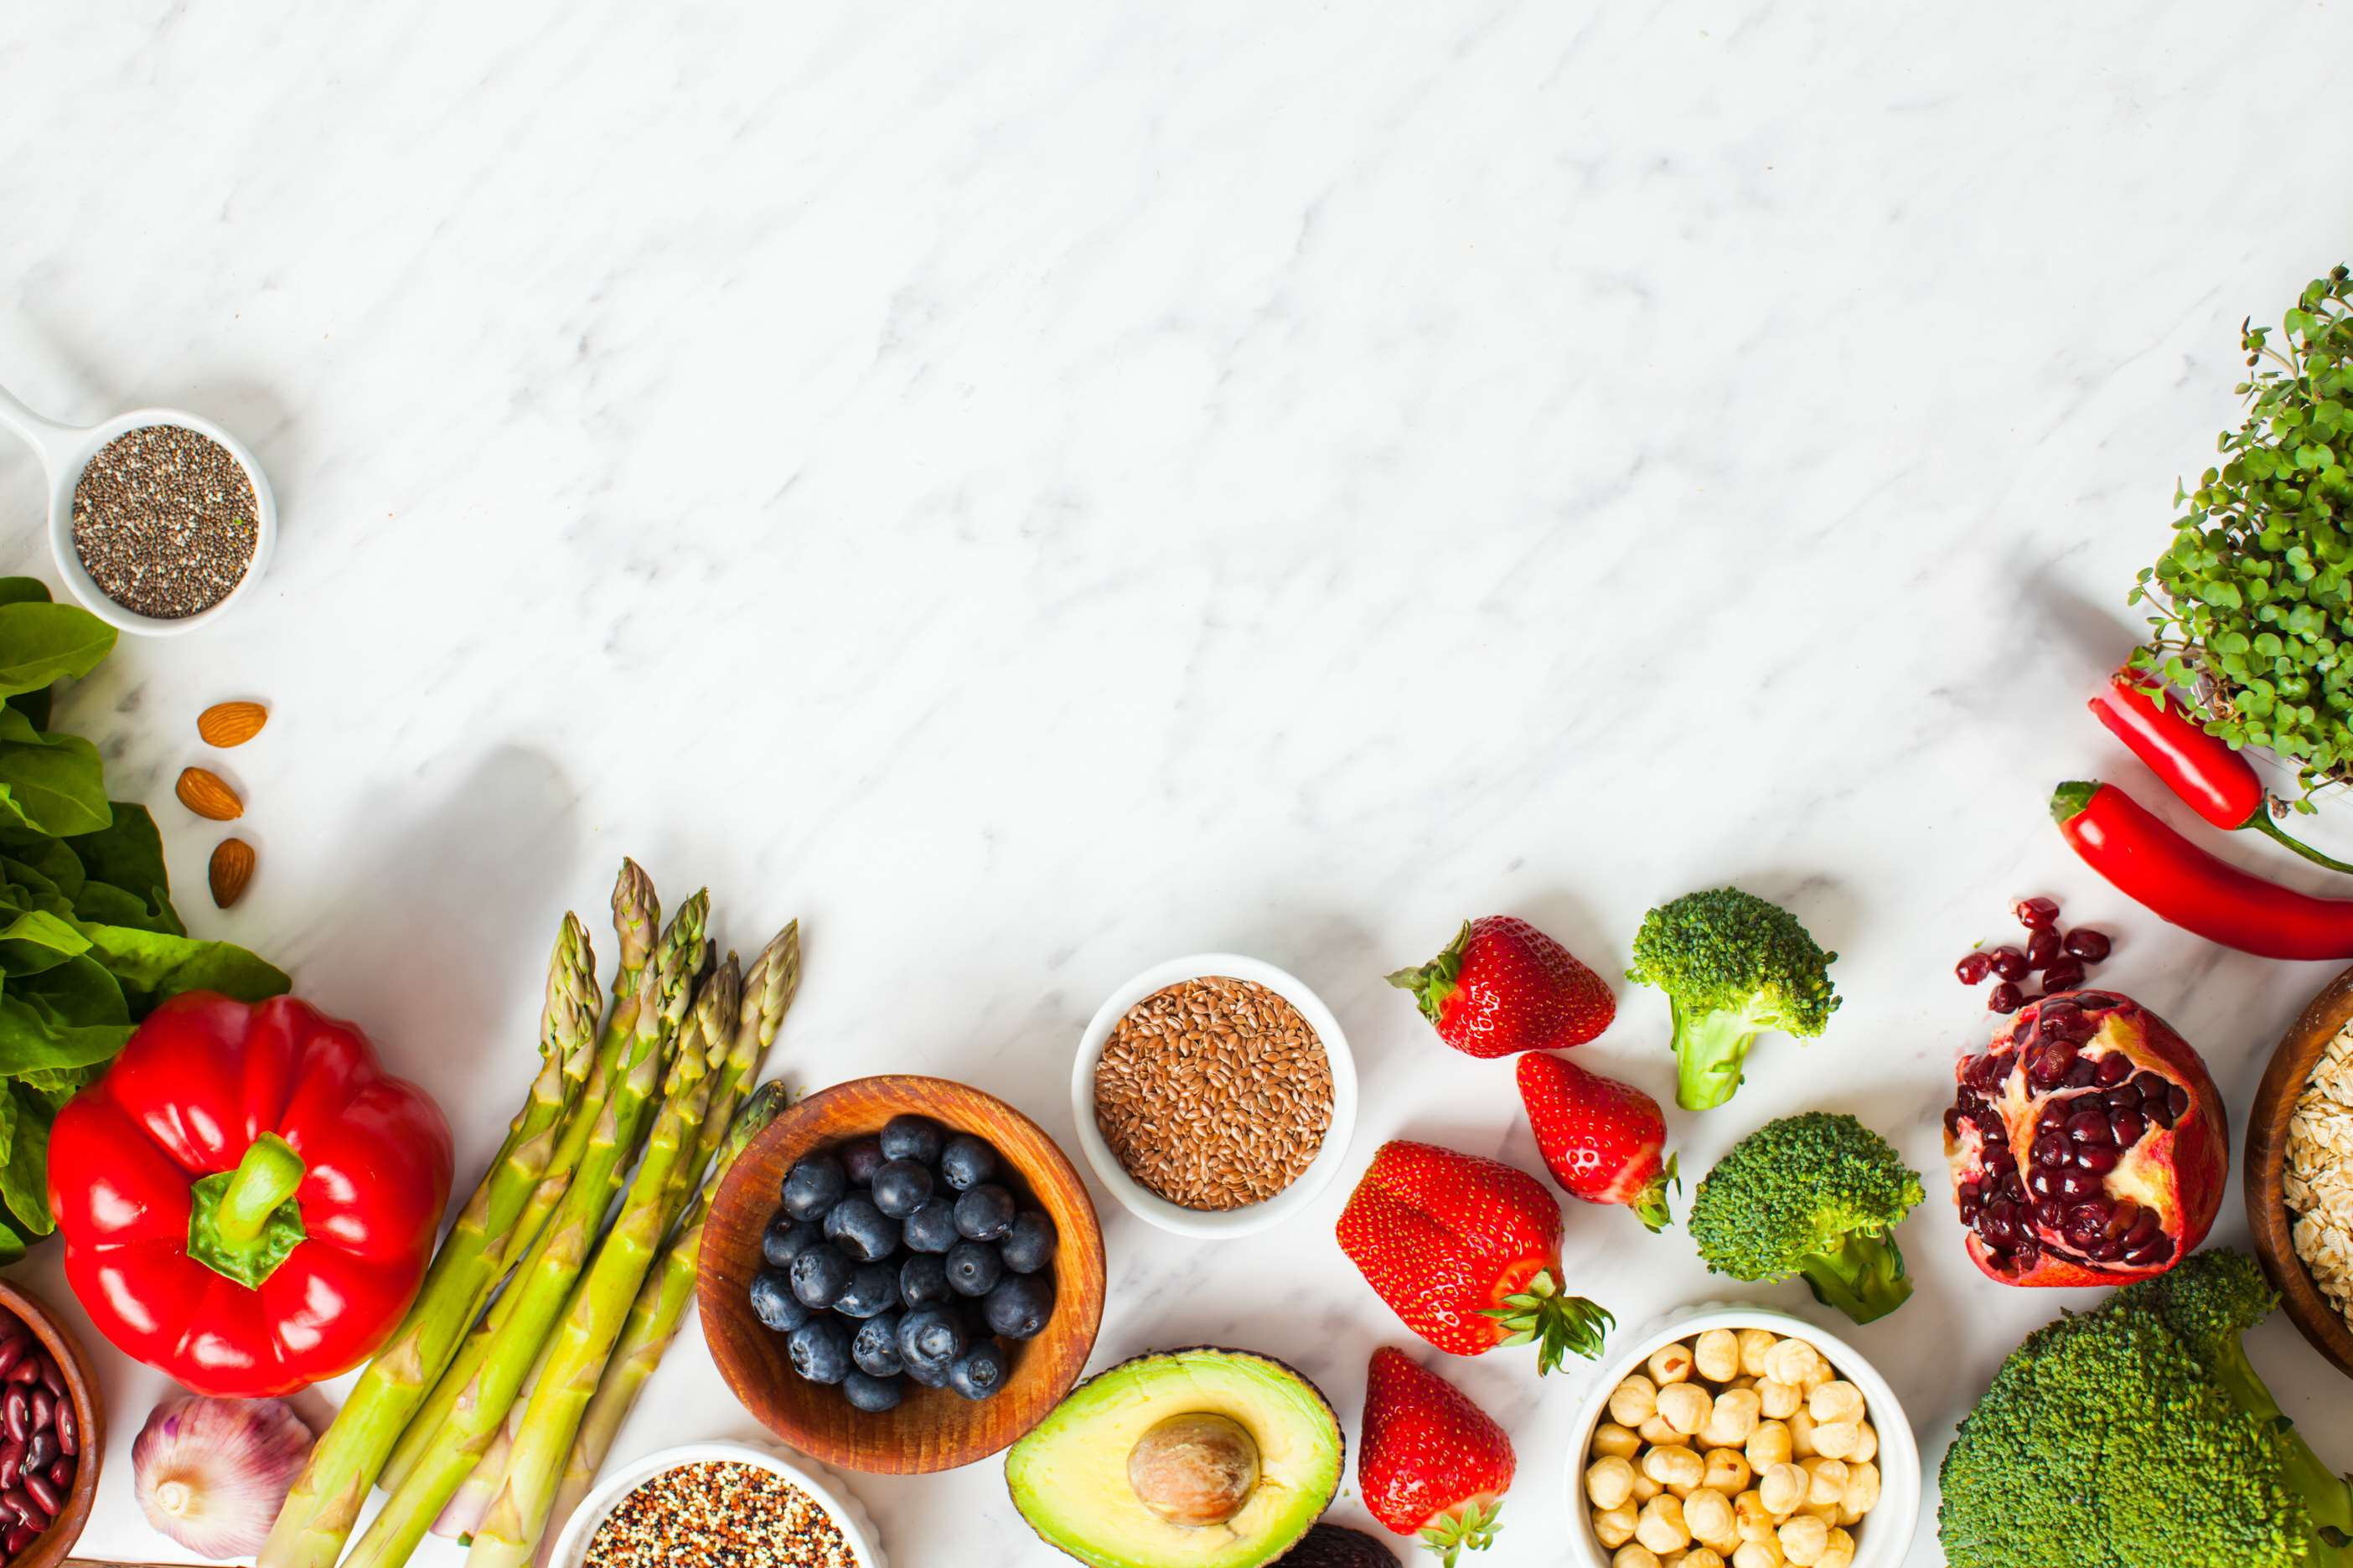
INTRODUCTION
The increasing health consciousness, rising demand for functional foods, high nutrient density, growth in vegan and plant-based diets, rise in the aging population, power of social media in promoting trends, increased availability in grocery stores, a boom in the health and wellness industry, popularity in various regions, ongoing scientific researches, consumer desire for natural and organic products, popularity among athletes and fitness enthusiasts, rising innovation in the food industry, and rising concern about ethical and environmental aspects of food production.

Slide 3
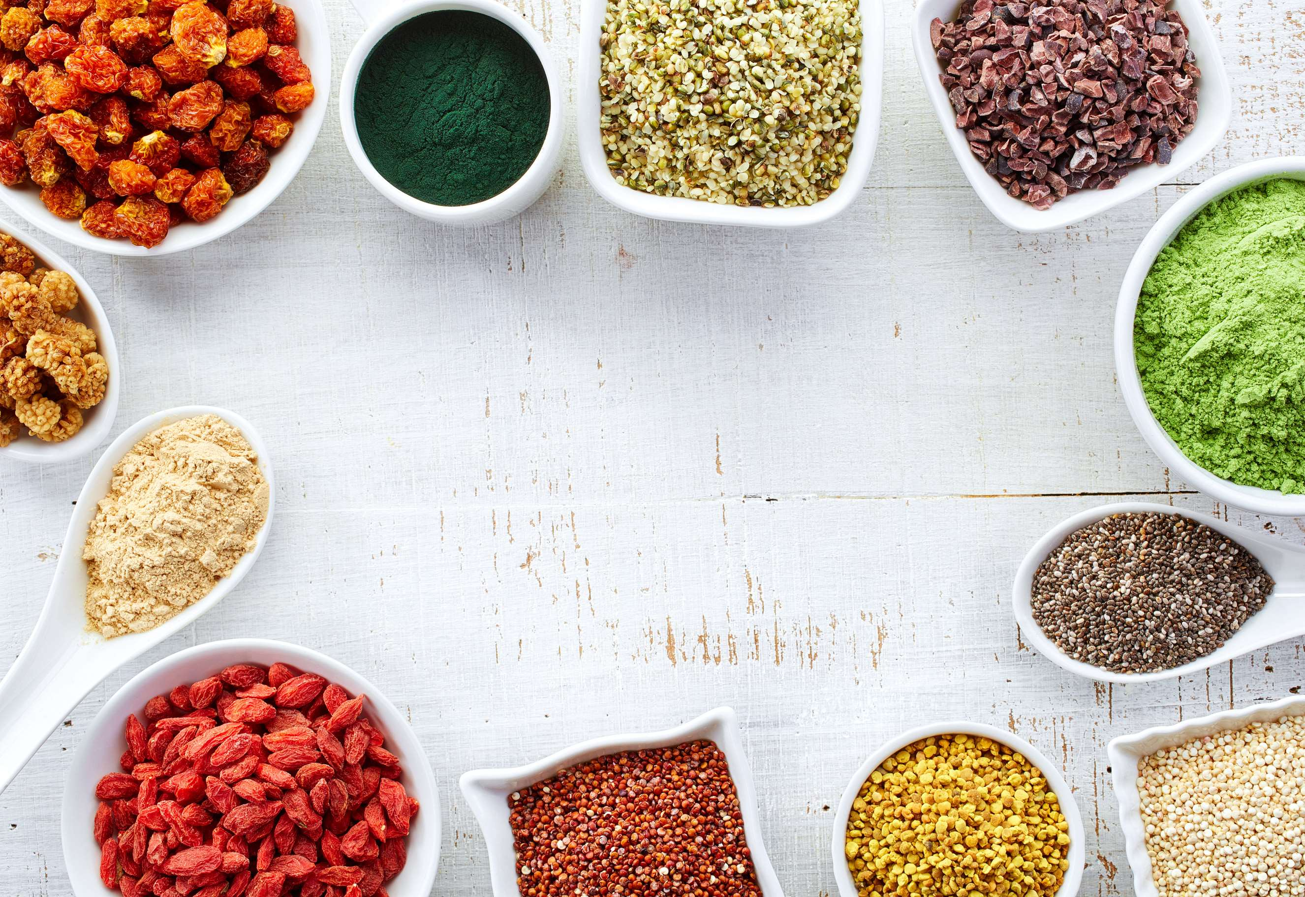

KEY INSIGHTS
MARKET SIZE
USD 162.5 billion
2023
CAGR
10.50%
2023- 2030

Slide 4
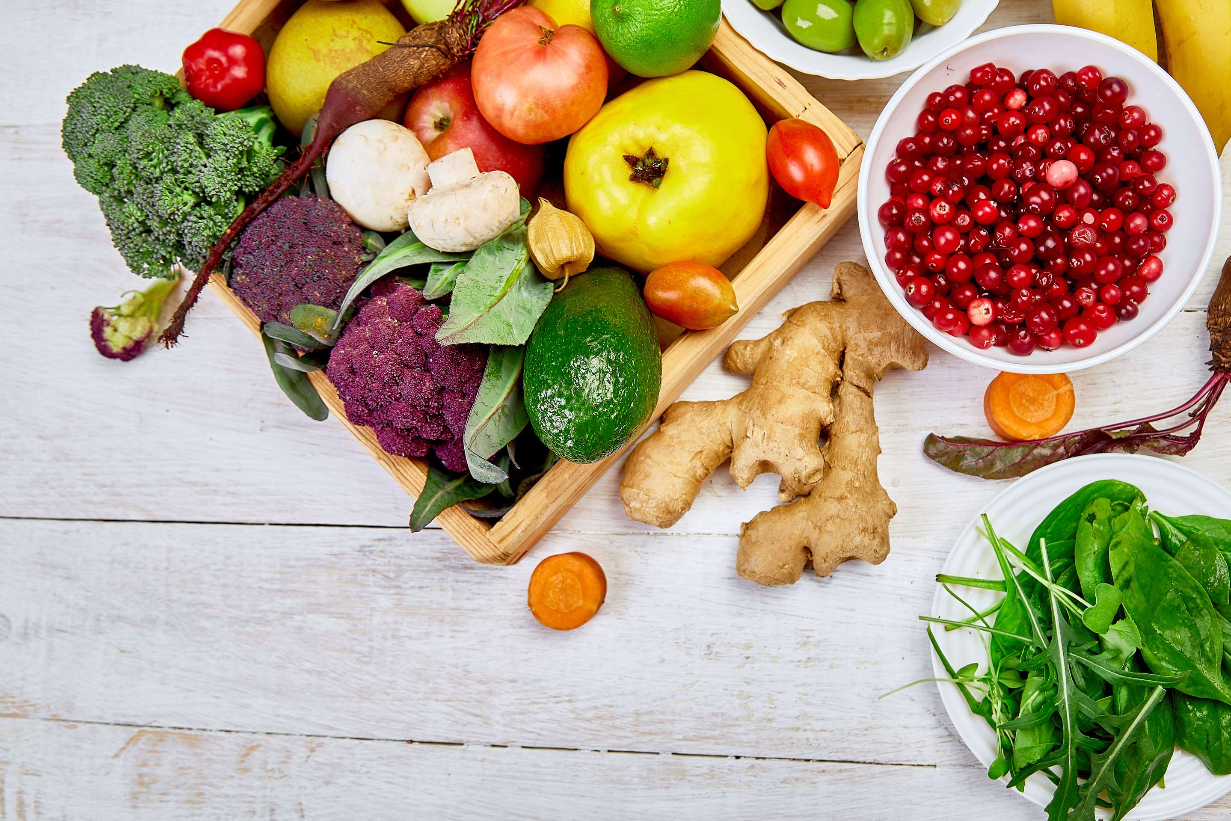
REVENUE MARKET SHARE BY SEGMENTS 2022
  Vegetables
  Fruits
  Grain and Seeds
By Product
  Beverages
  Convenience or ready-to-eat and ready-to-drink foods
Application segment
  Hypermarkets/Supermarkets
  Online Channels
  Traditional Grocery Stores
Distribution Channel

Slide 5
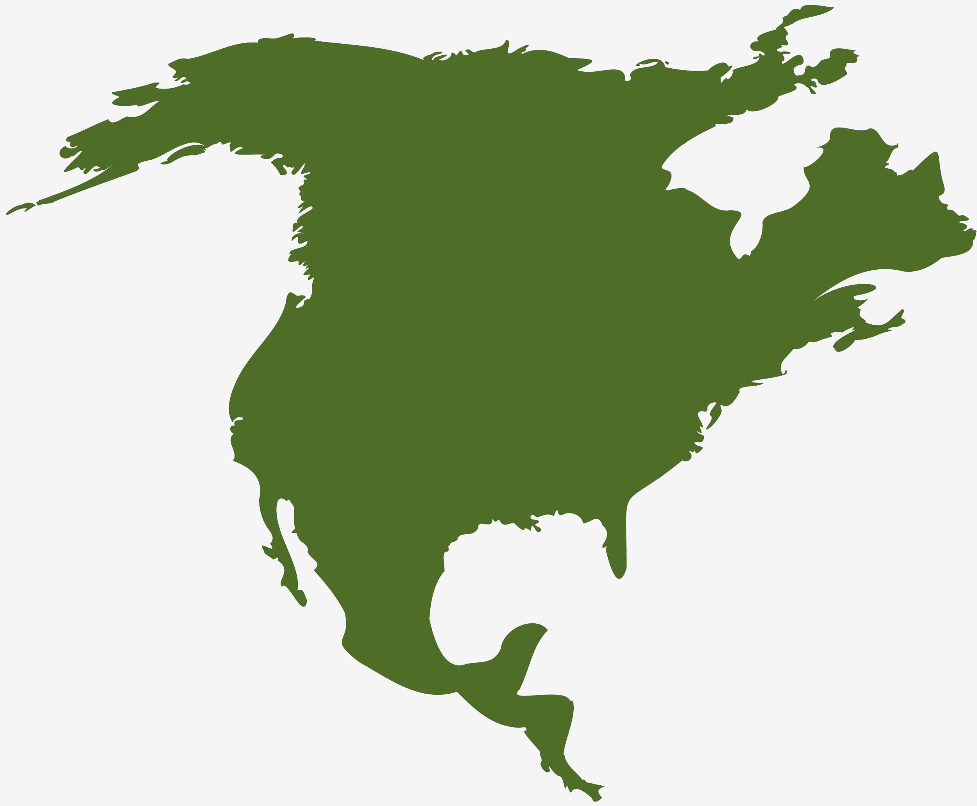
Global Superfoods Market Revenue share for 2022
North America
37%

Slide 6
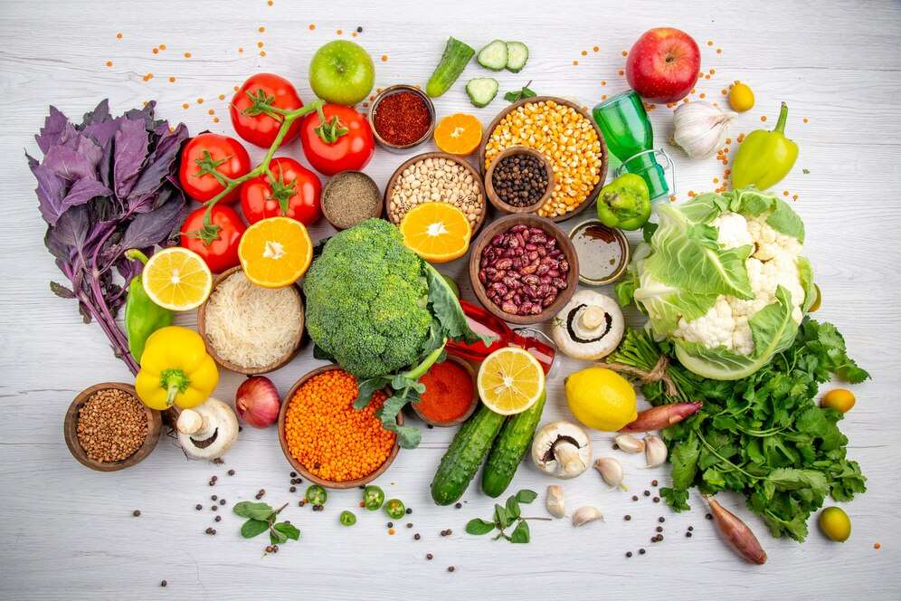
Various Strategies Adopted by Key Players to Propel Market Growth
Drivers
Restraints
High Prices of Products Hinder Market Growth

Slide 7
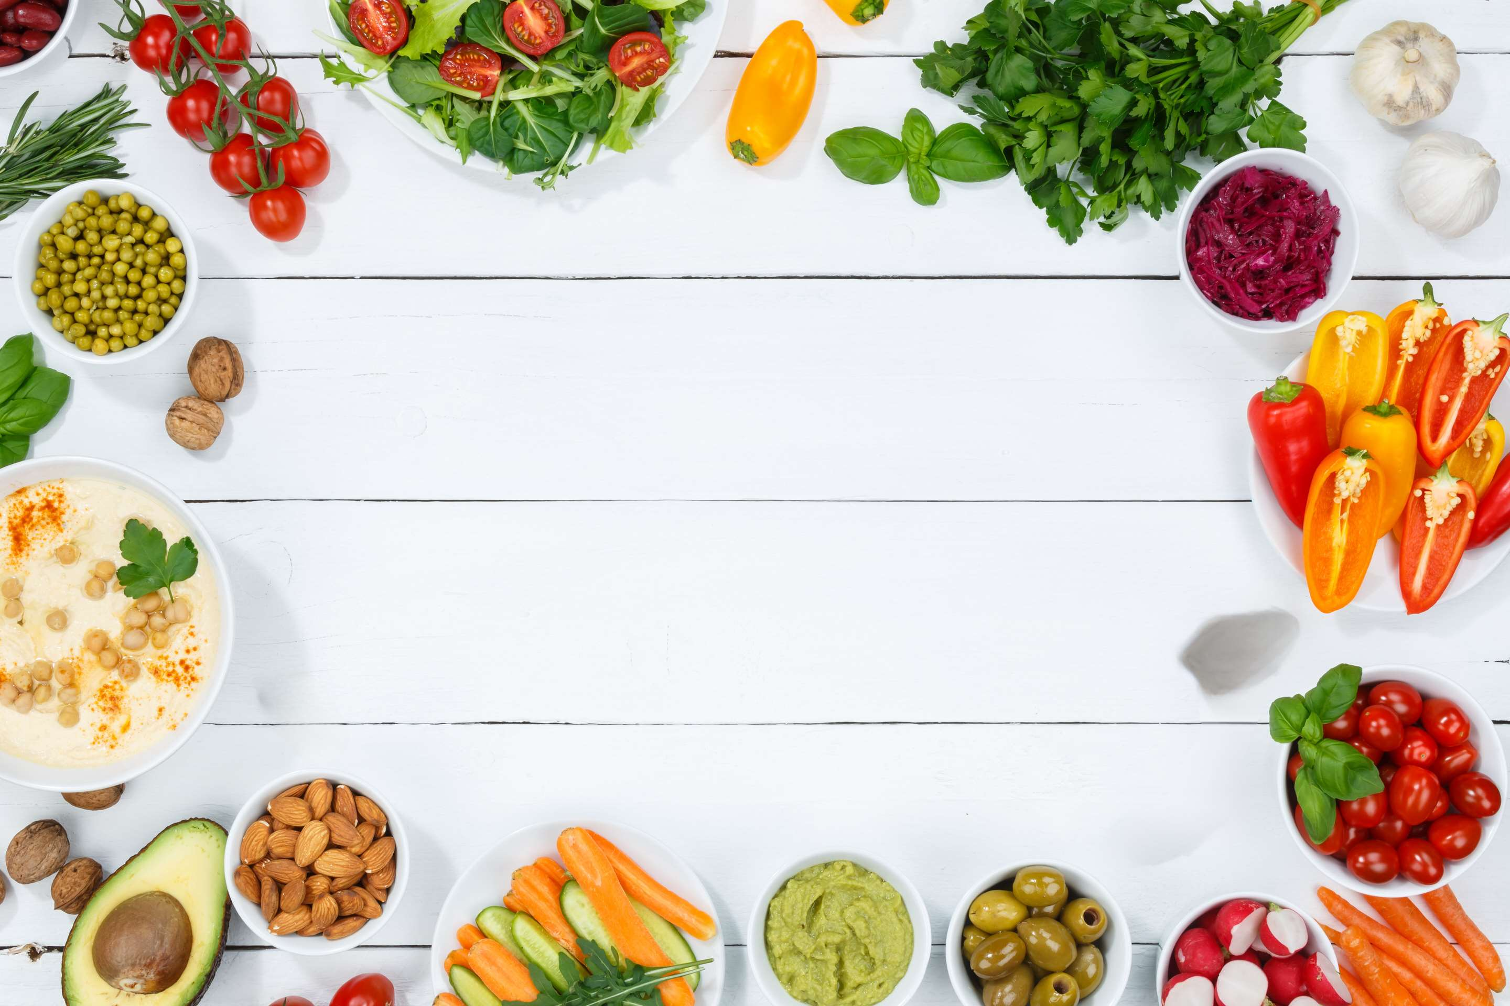
AUTHOR'S PERSPECTIVE
  The Global Superfoods Market is witnessing significant growth in the near future.
  Superfood fruits include blueberries, acai berries, goji berries, and pomegranates, renowned for their antioxidant content and potential health benefits.
  Grains & seeds are the second-most used product. Quinoa, chia, flax, and hemp seeds are among the popular choices.
  Superfood ingredients like quinoa, cocoa, and nuts are added to cookies, granola bars, and chocolates, providing consumers with a guilt-free indulgence option.

Slide 8











KEY PLAYERS

Slide 9


For Full Report
Contact us
COGNITIVE MARKET RESEARCH
Tel: +1 312-376-8303 | +44 020-8123-0732
India: (+91) 983-496-8611
sales@cognitivemarketresearch.com
Access the Full Report : https://tinyurl.com/y8c2kb3y
Please visit our website:
https://www.cognitivemarketresearch.com

