Slide 1
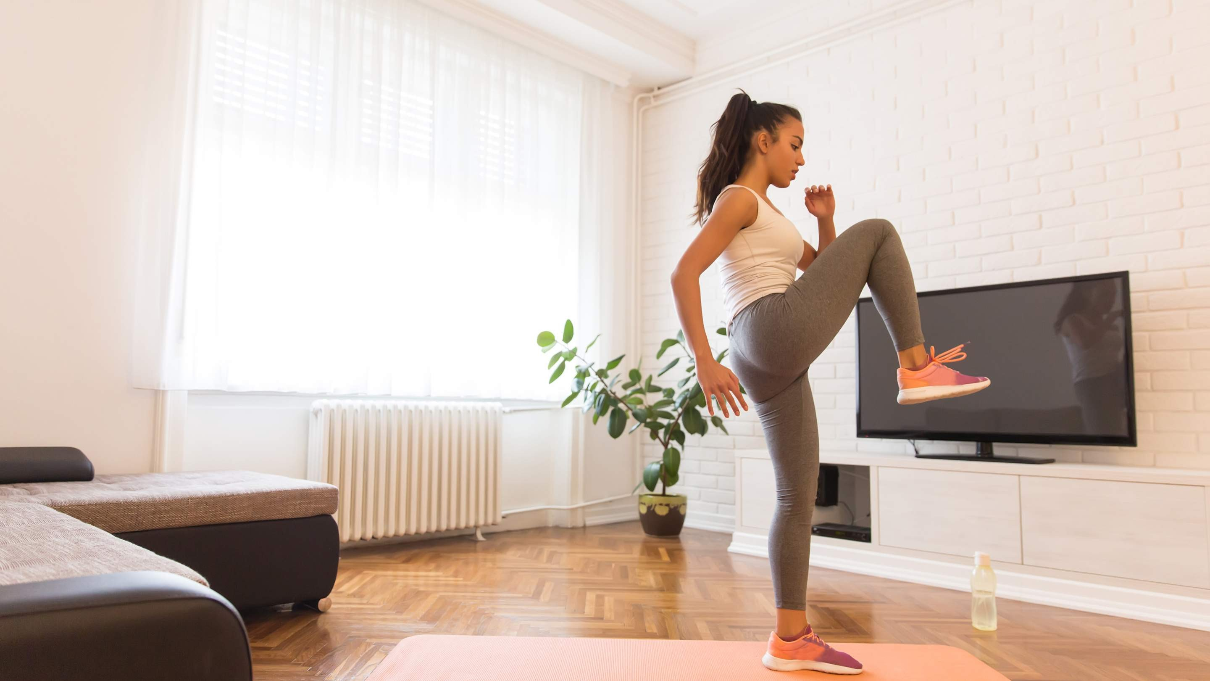
GLOBAL
SPORTSWEAR
MARKET REPORT 2024
Global,Regional,CountryAnalysis

Slide 2
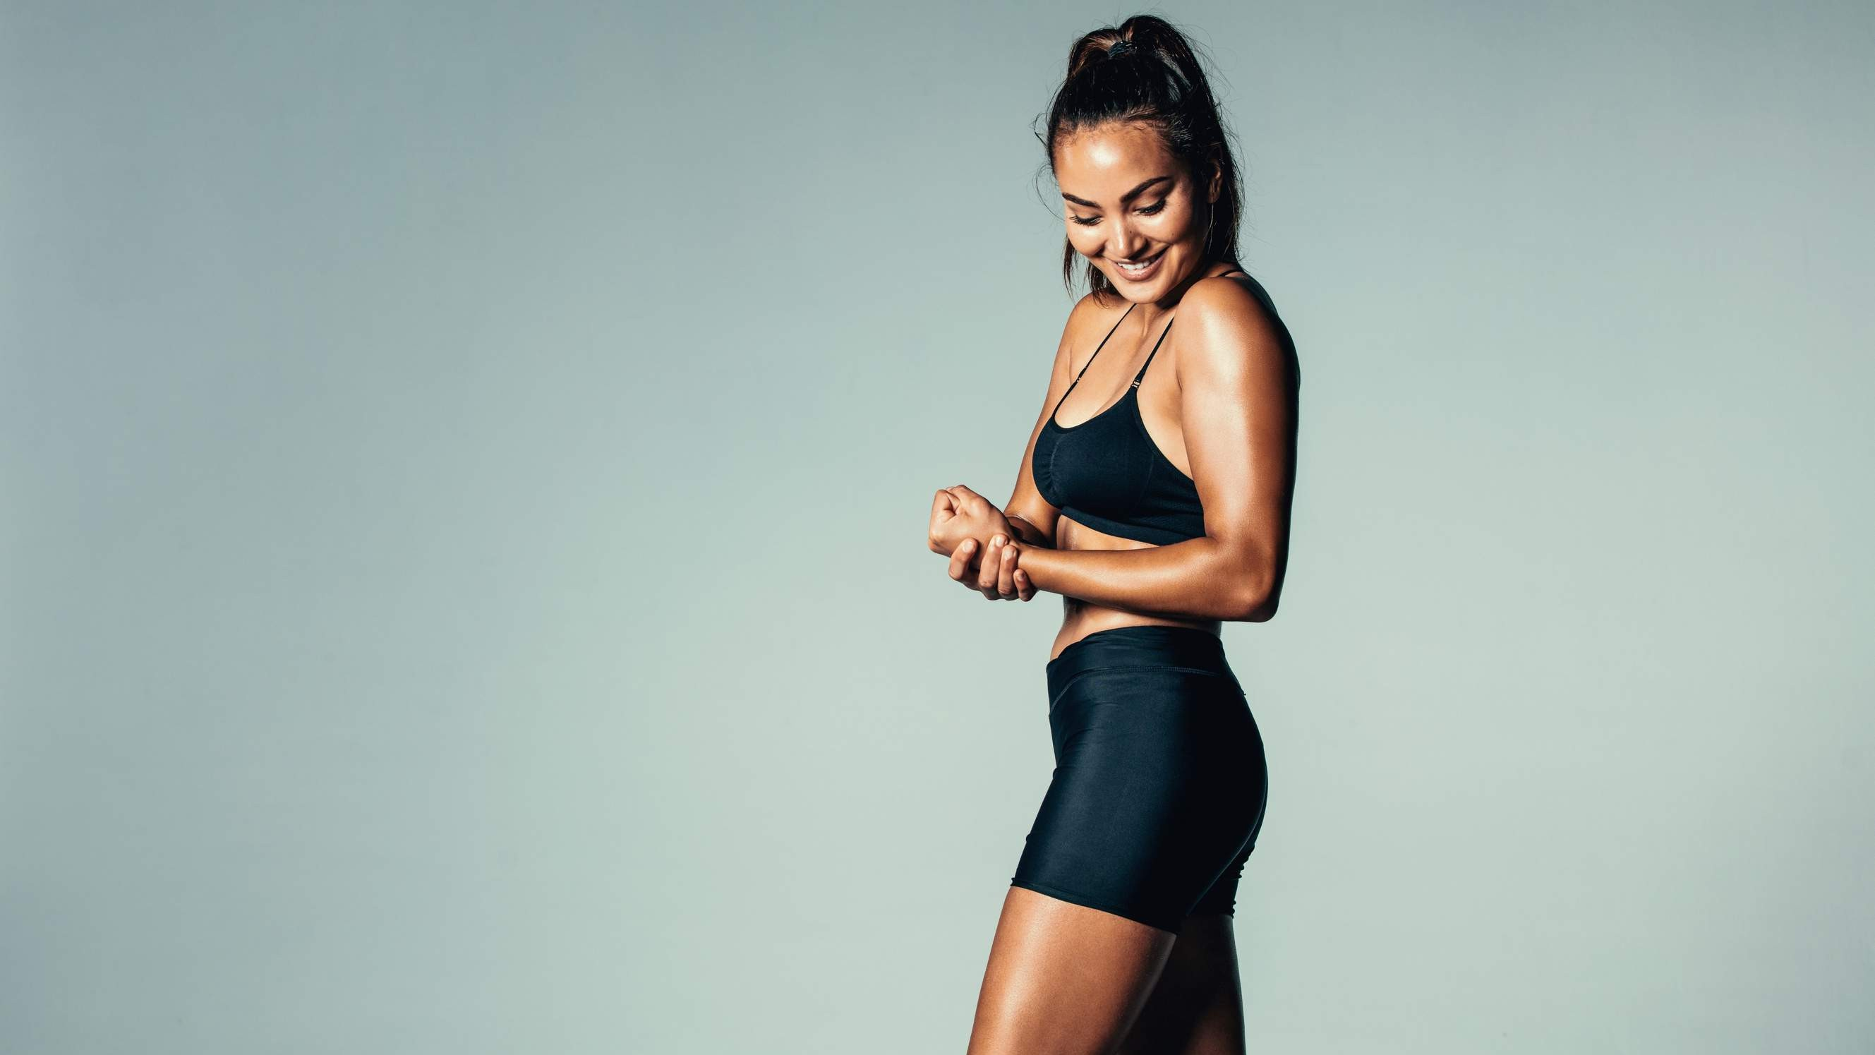
INTRODUCTION
Sportswear pertains to attire, shoes, and additional items that are explicitly crafted for athletic endeavors and physical exertion.
These articles of clothing are meticulously designed to offer ease, adaptability, and ventilation, empowering individuals to participate in a wide array of sports and fitness pursuits with enhanced efficacy. The market is projected to experience growth due to the escalating consciousness surrounding the importance of leading a healthy lifestyle and the multitude of health advantages associated with engaging in activities like swimming, yoga, running, and aerobics.

Slide 3
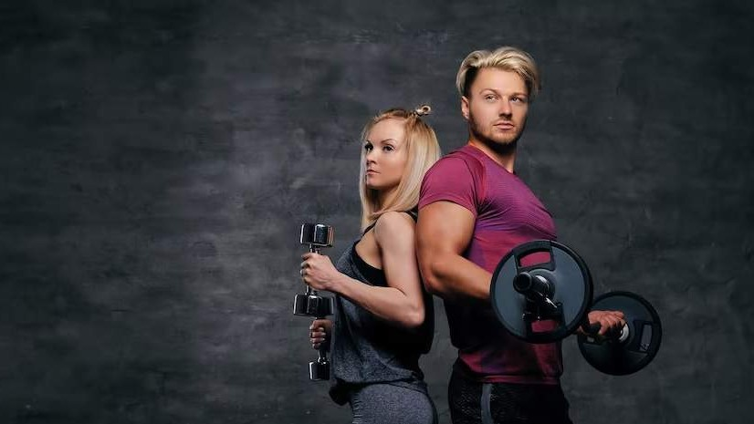

KEY INSIGHTS
MARKET SIZE
USD 180.5 billion
2023
20₋23
CAGR 7.00%
2030

Slide 4
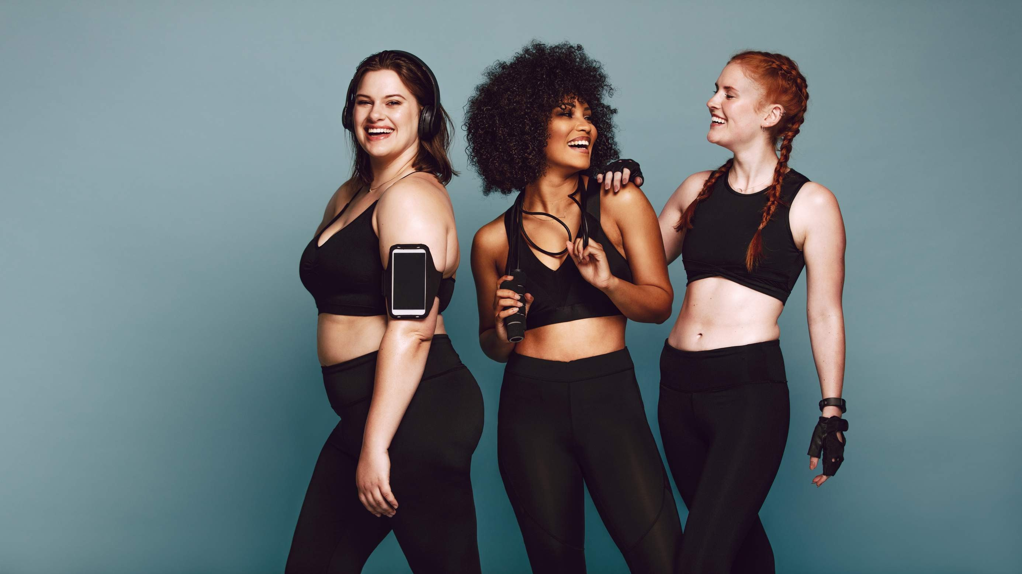




REVENUE MARKET SHARE BY SEGMENTS 2022
Shoes Clothes
Type Segment
Men Women Kids
End Use Segment
Online Retail
Distribution Channel

Slide 5
Global Sportswear Market Revenue share for 2022
North America 45%

Slide 6
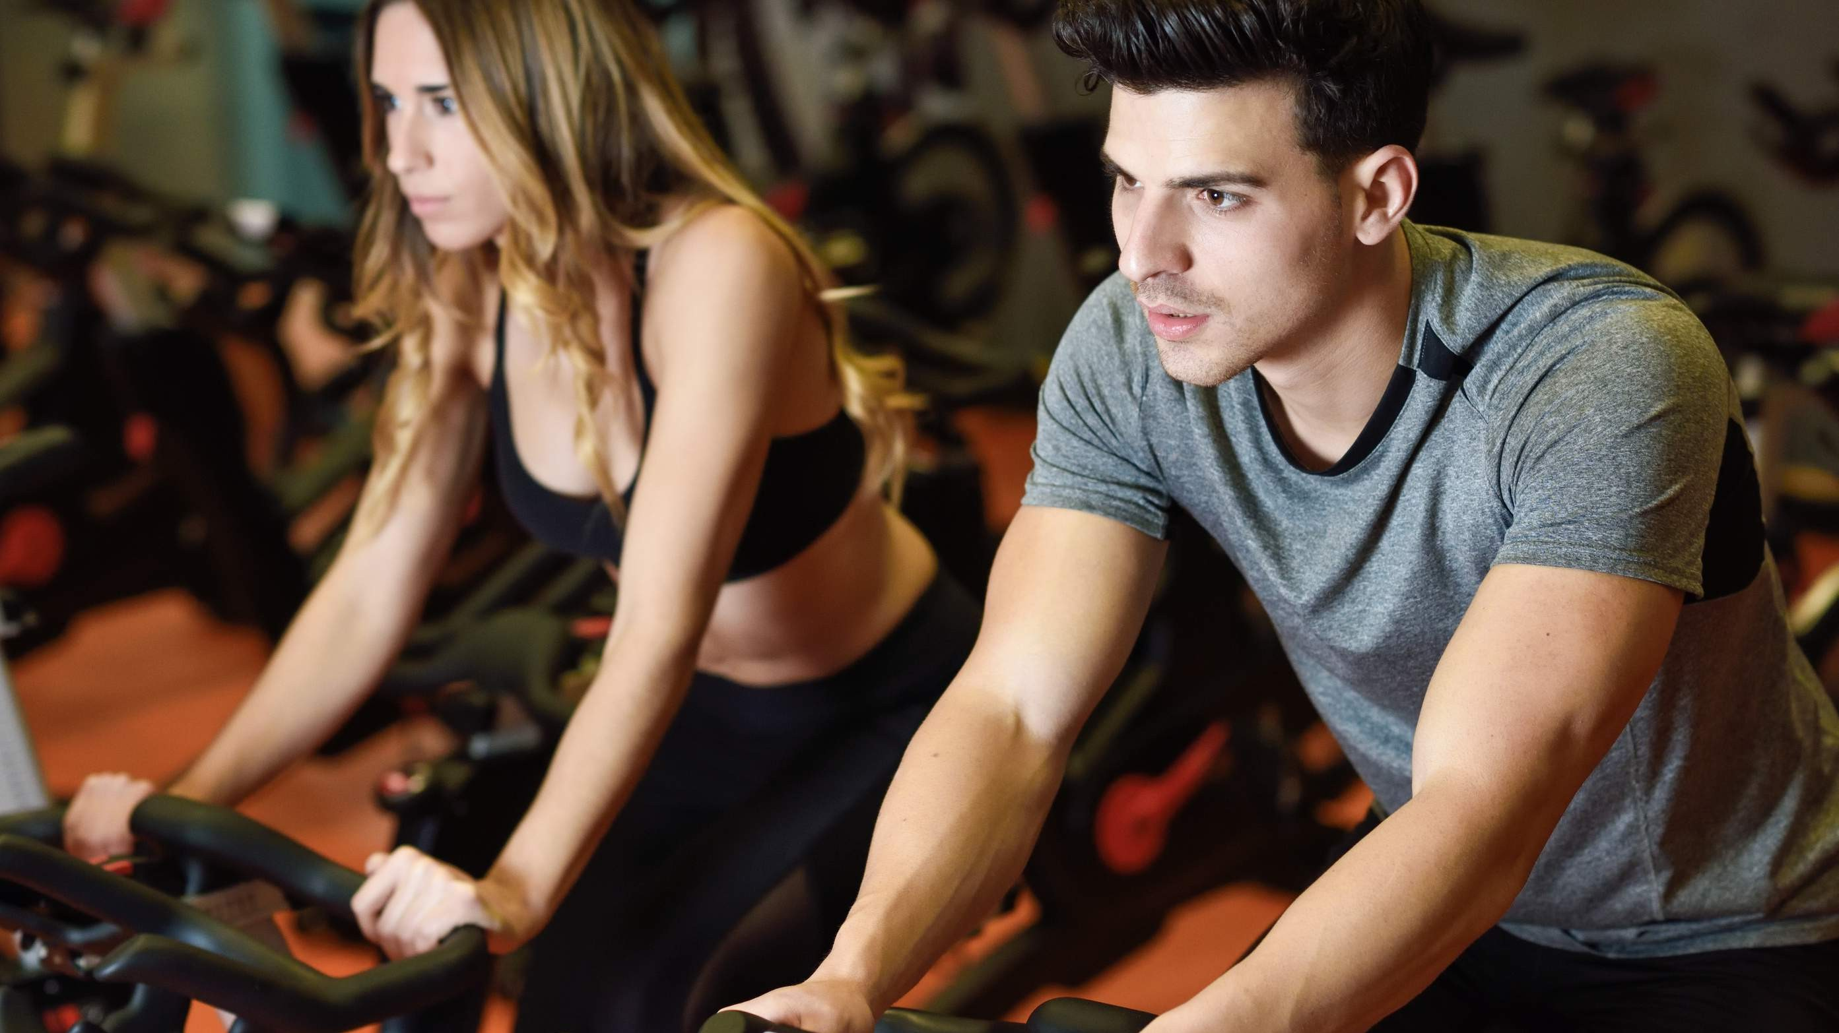
Rising Health and Fitness Consciousness to Propel Market Growth
Drivers
Supply Chain Disruptionsto Hinder Market Growth
Restraints

Slide 7

AUTHOR'S PERSPECTIVE
The Global Sportswear Market is witnessing significant growth in the near future.
Sportswear apparel, including activewear,
jerseys, leggings, and other clothing items, is prominent due to its versatility and widespread demand.
Parents, recognizing the importance of an
active lifestyle, invest in high-quality sportswear for their children, ensuring comfort, flexibility, and durability during various physical activities.
The in-store experience allows customers to
assess the products' quality, fit, and comfort in person, which is especially crucial for sportswear where proper fit and functionality are essential.

Slide 8
KEY PLAYERS

Slide 9


Contact us
For Full Report
COGNITIVE MARKET RESEARCH
Tel: + 1 312 - 376 - 8303 | + 44 020 - 8123 - 0732
India: ( + 91 ) 983 - 496 - 8611
sales@ cognitivemarketresearch. com
Access the Full Report : http://tinyurl.com/yzas96a5
Please visit our website:
https://www.cognitivemarketresearch.com

