Slide 1
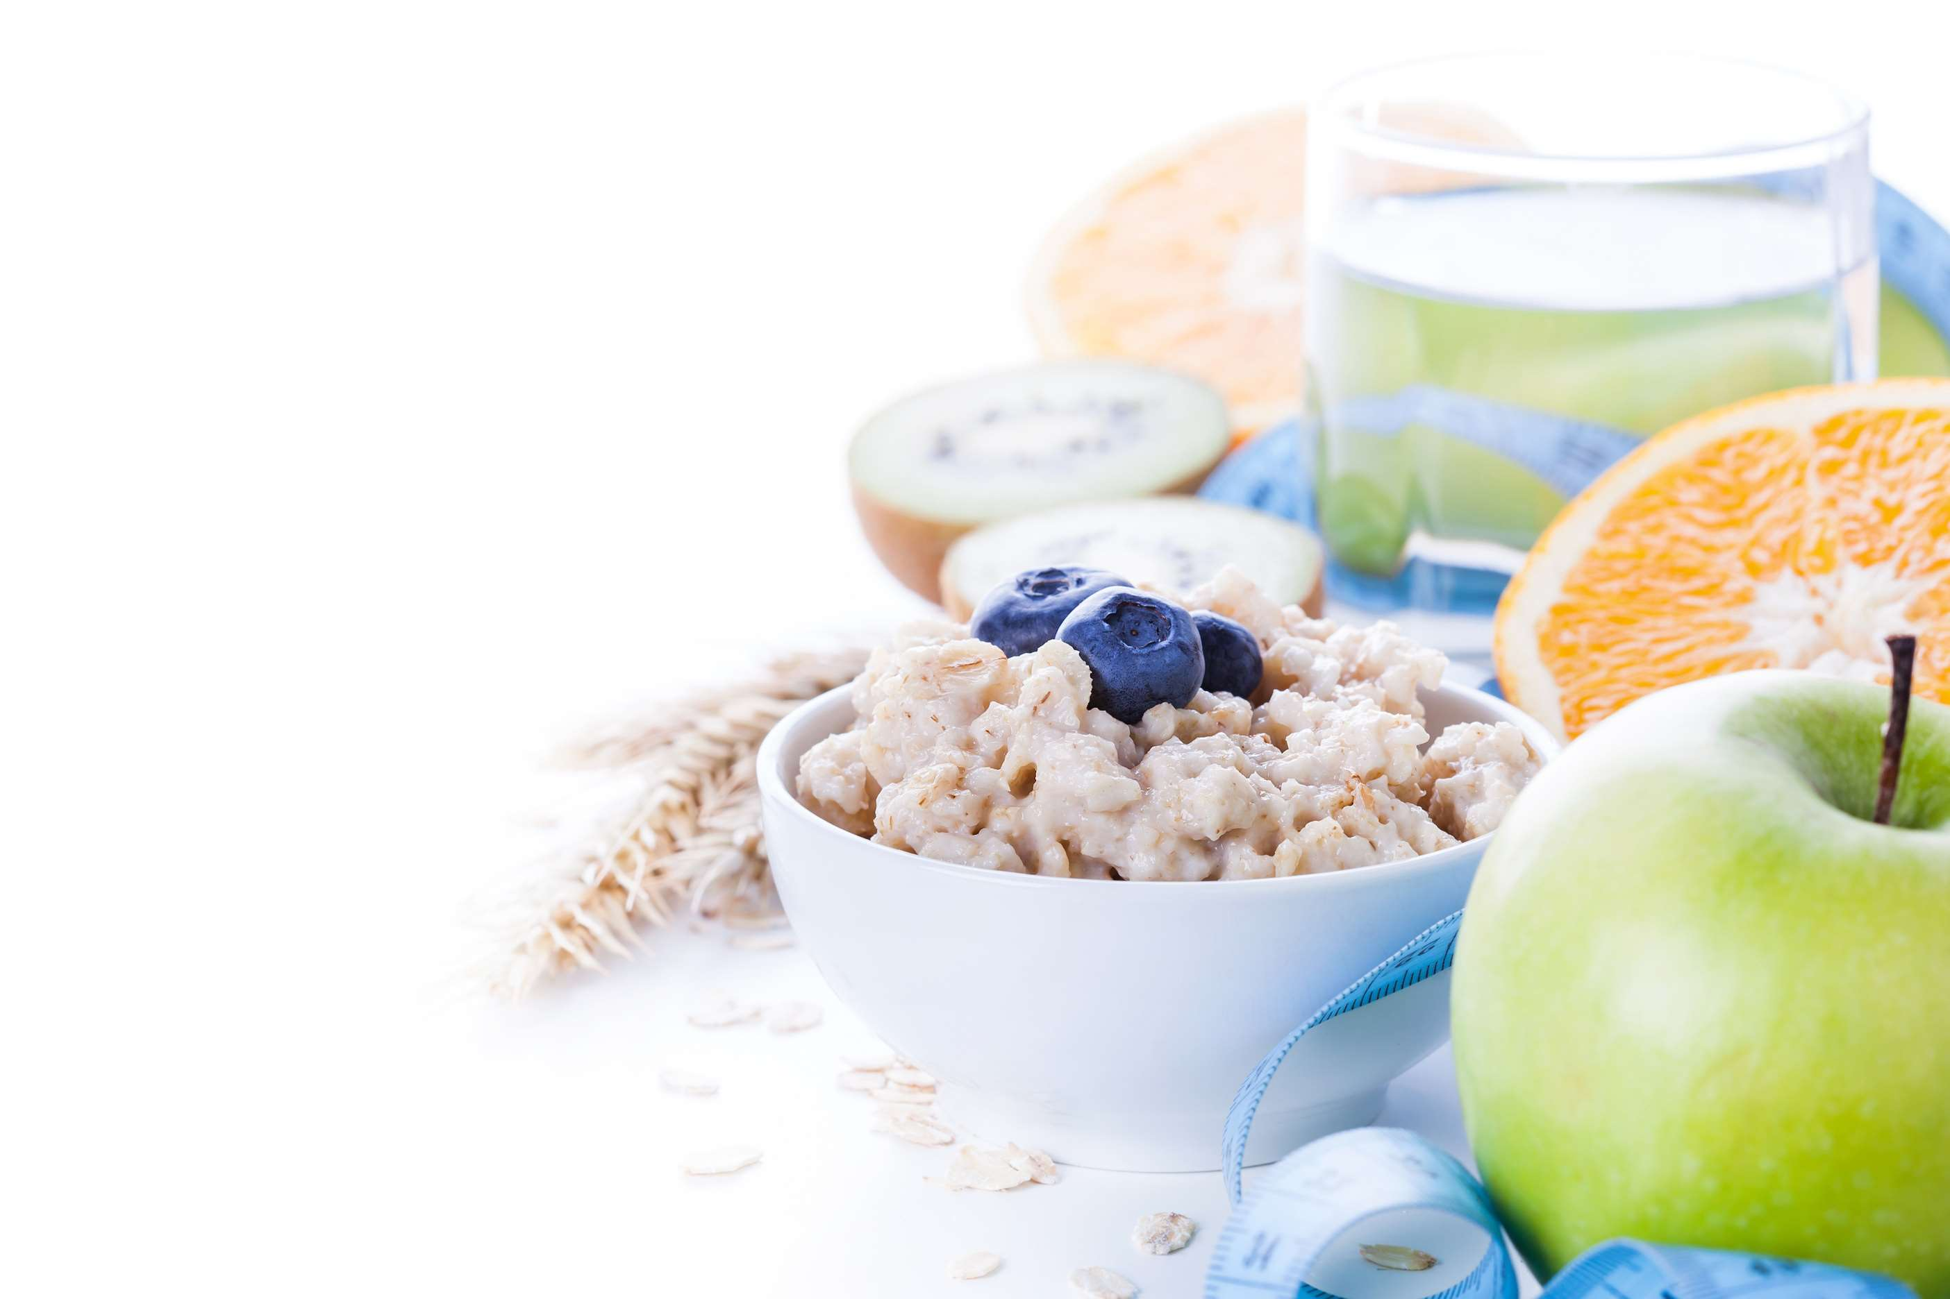
GLOBAL
SPORTS NUTRITION
MARKET REPORT
2024
Global,Regional,CountryAnalysis

Slide 2
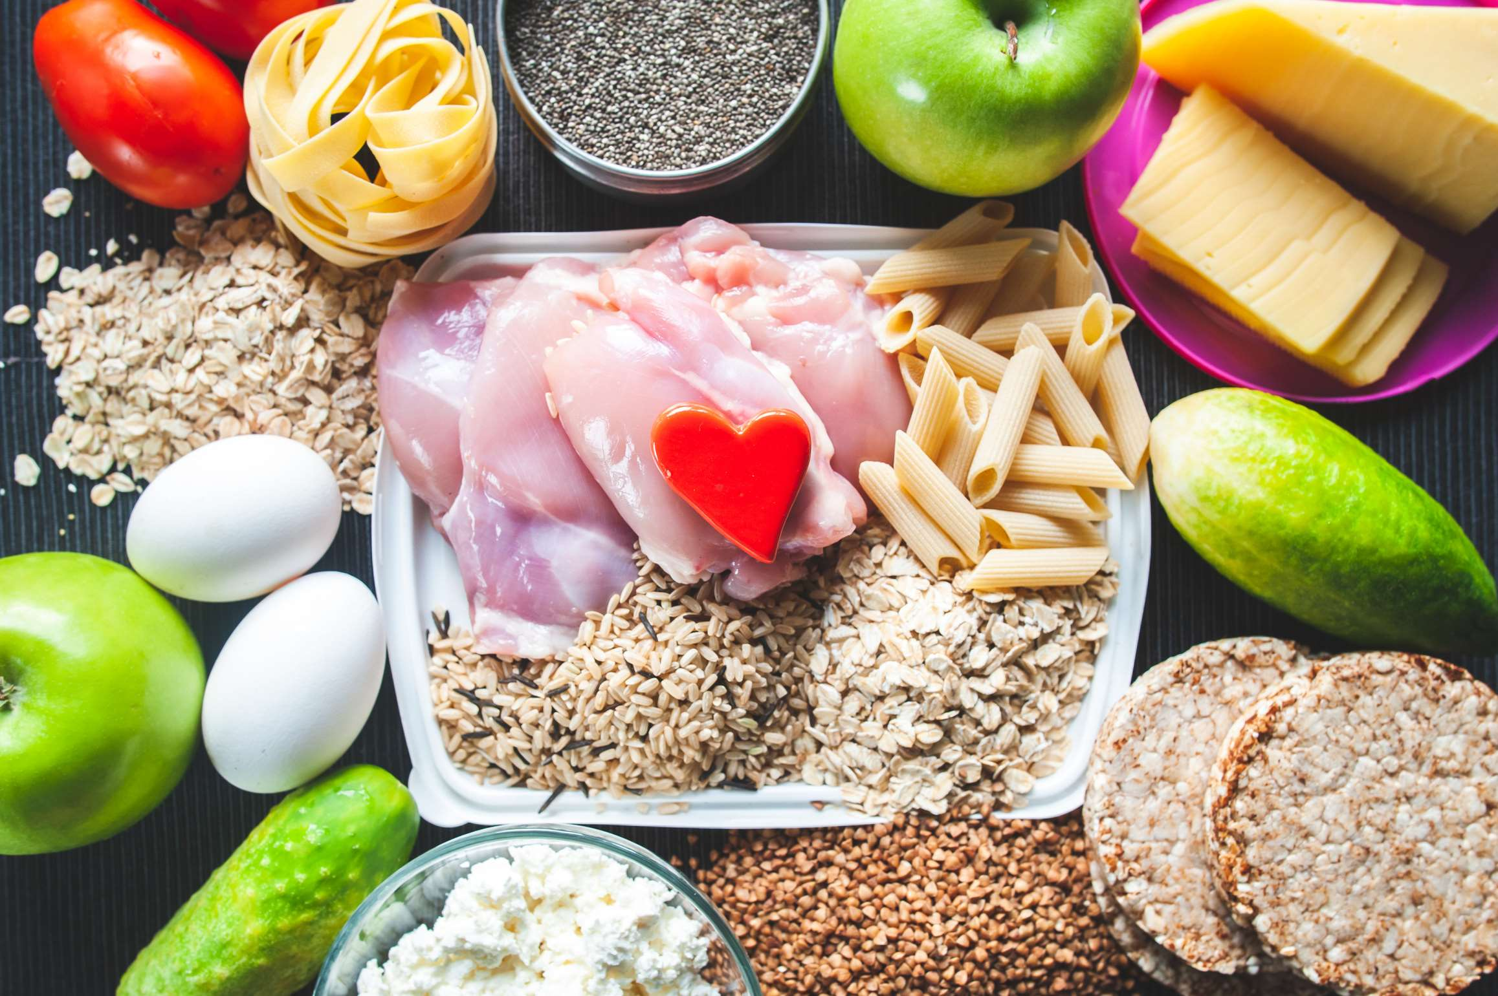
INTRODUCTION
The sports nutrition market includes various goods intended to improve sports performance, aid in recovery, and advance general health among people who exercise. Supplements, including protein powders, energy bars, pre-workout mixes, amino acids, and vitamins designed to satisfy the dietary requirements of athletes and fitness enthusiasts, are commonly found in these items. The market serves many consumers who want to maximize their training results and maintain a healthy lifestyle, from casual gym attendees to elite athletes. Growing health consciousness, increased engagement in sports and fitness activities, and the spread of specialized diet plans are major factors propelling market expansion. Improvements further aid the market's growth in product formulas, practical packaging, and a growing number of distribution channels, including online retail platforms.

Slide 3
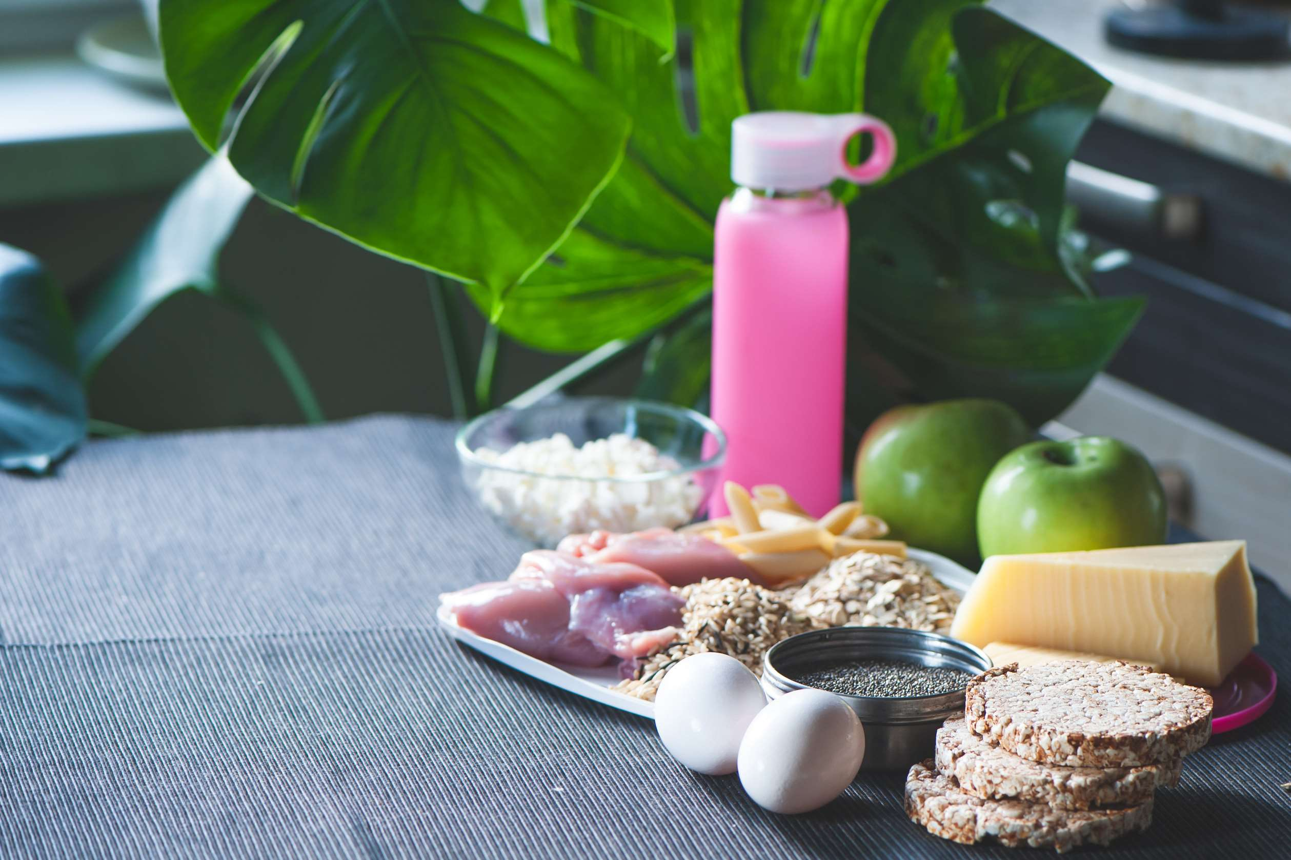

KEY INSIGHTS
MARKET SIZE
USD 45121.2 million
2024
CAGR
8.0%
2024- 2031

Slide 4
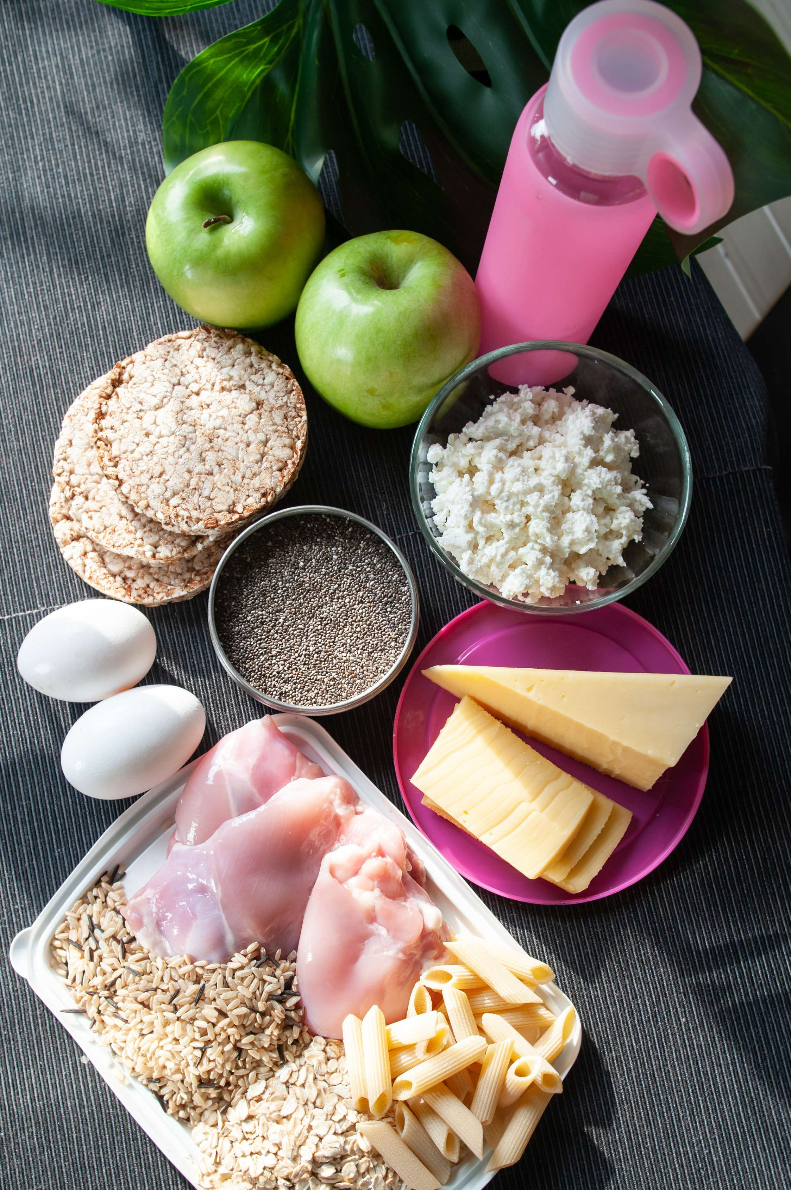
REVENUE MARKET SHARE BY SEGMENTS 2022
  Sports Supplements
  Sports Drinks
  Sports Foods
  Meal Replacement Products
  Weight Loss Product
  Children
  Adult
  Geriatric
Type Segment
Consumer Group Segment
  Athletes
  Fitness Enthusiasts
  Bodybuilders
  Lifestyle Users
  Pre-workout
  Post-workout
Application Segment
End-user Segment
  Tablets
  Capsules
  Powder
  Softgels
  Liquid
  Gummies
  Brick And Mortar
  E-commerce
Formulation Segment
Sales Channel

Slide 5


Global Sports Nutrition Market Revenue share for 2024
North America
40%

Slide 6
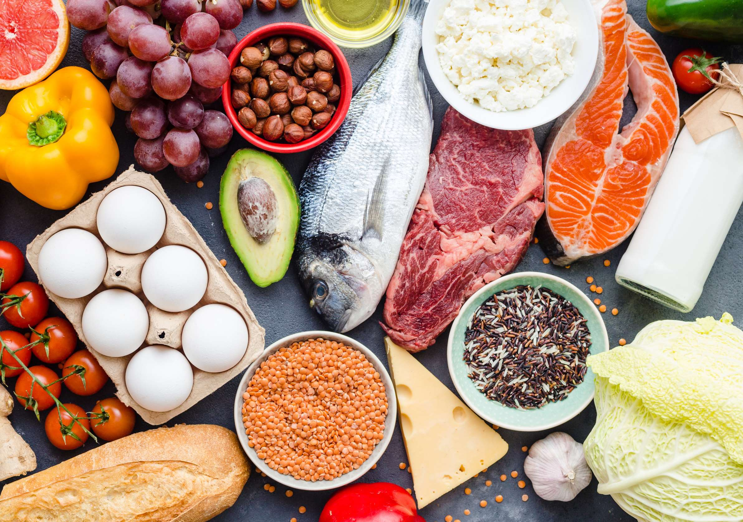
Increasing Participation in Sports and Fitness Activities to Propel Market Growth
Drivers
Price Sensitivity to Limit the Sales
Restraints

Slide 7

AUTHOR'S PERSPECTIVE
  People are increasingly inclined to spend money on goods that can enhance their health and well-being as their disposable earnings rise.
  The market for high-end sports nutrition products is being driven by this.
  Sports nutrition products are becoming more and more well-known thanks in large part to social media and influencer marketing.
  These items are becoming more in demand as a result of fitness gurus marketing them to their sizable fan bases.
  The Tablets held the highest Sports Nutrition market revenue share in 2024.

Slide 8
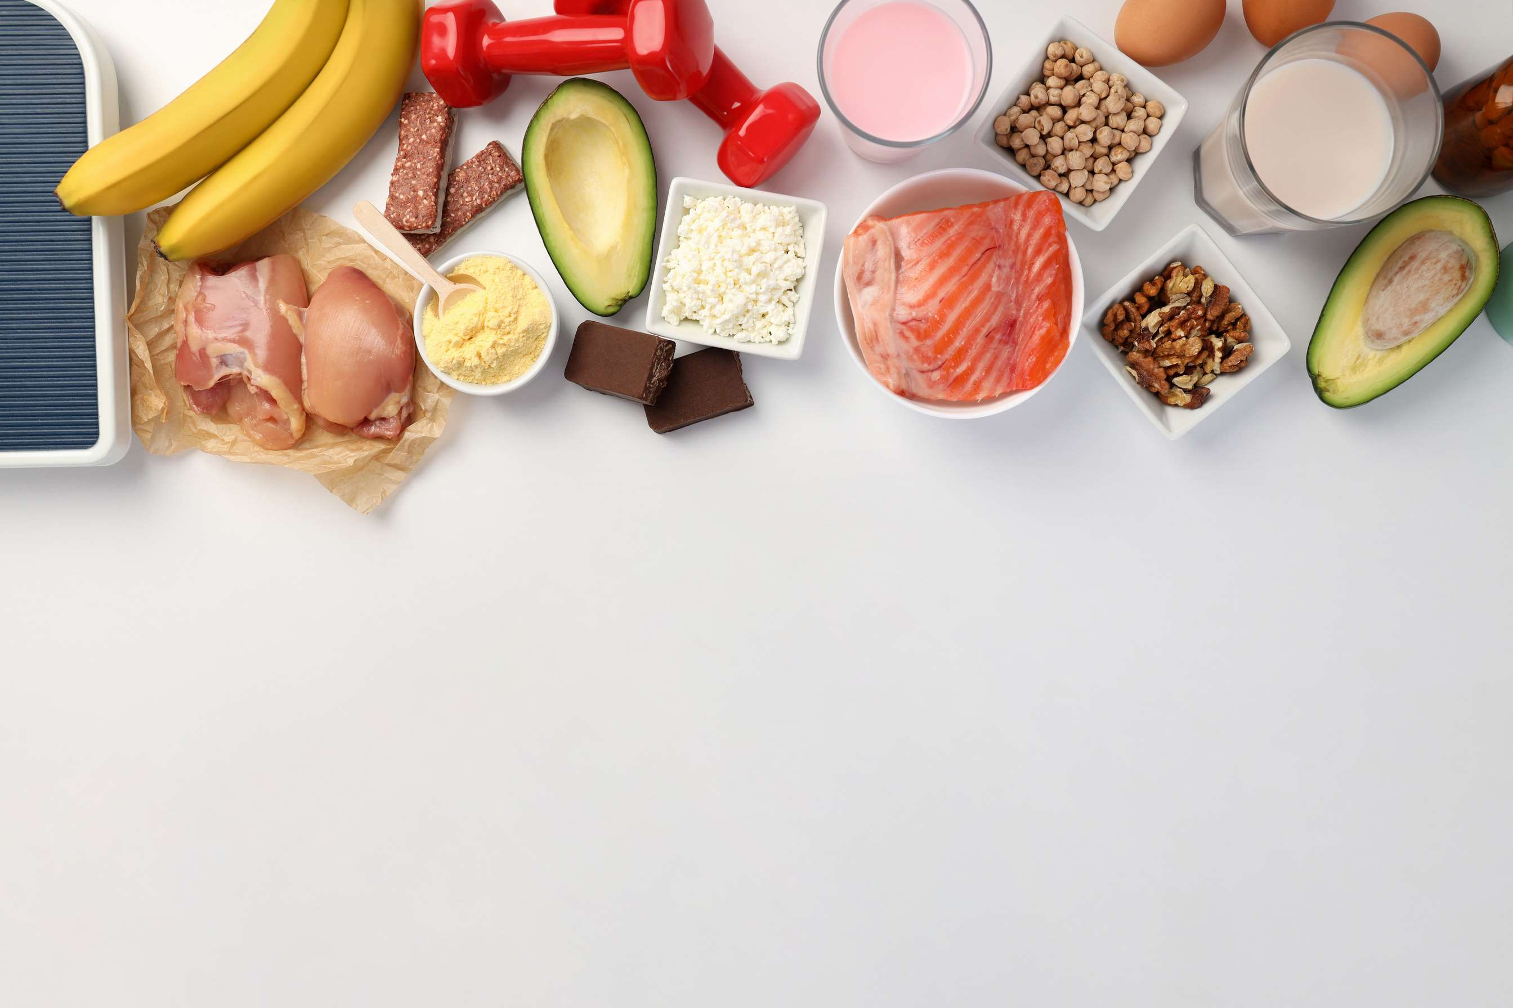
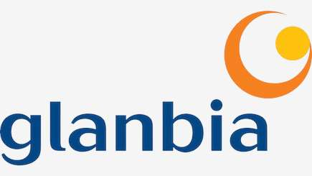
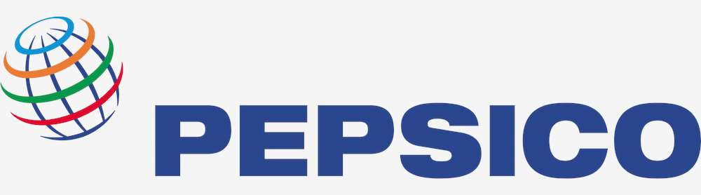
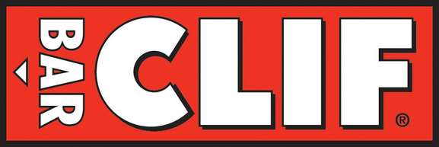
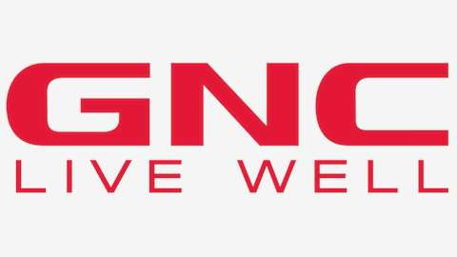
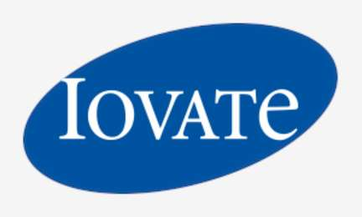
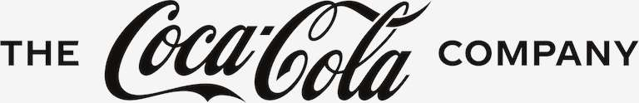
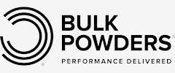
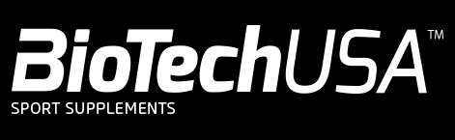

KEY PLAYERS

Slide 9

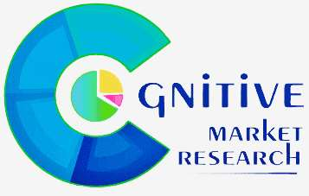
For Full Report
Contact us
COGNITIVE MARKET RESEARCH
Tel: +1 312-376-8303 | +44 020-8123-0732
India: (+91) 983-496-8611
sales@cognitivemarketresearch.com
Access the Full Report : https://tinyurl.com/y2xbtkdv
Please visit our website:
https://www.cognitivemarketresearch.com

