Slide 1
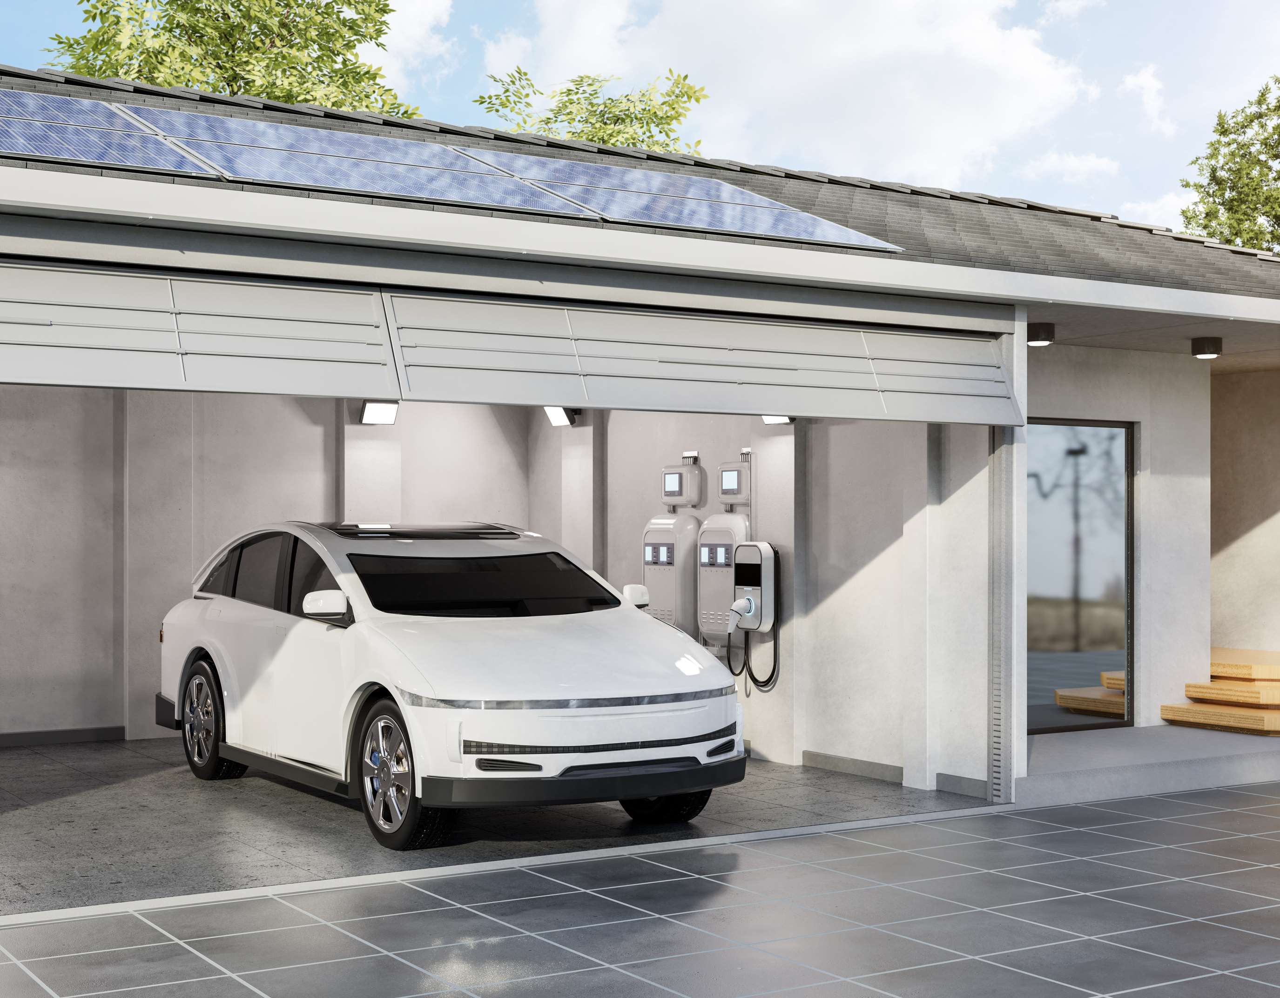
SOLAR POWERED CAR
MARKET REPORT

Slide 2
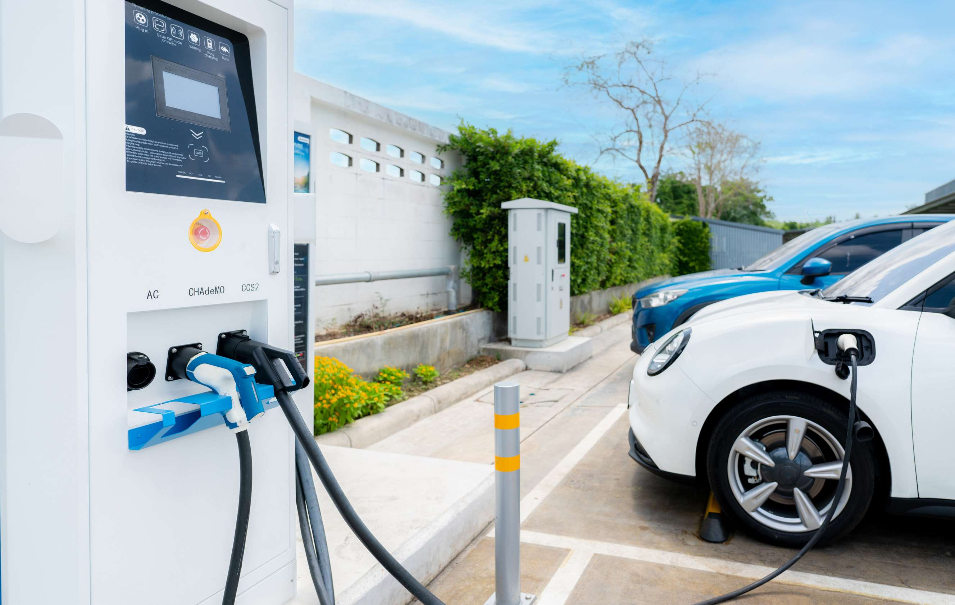
INTRODUCTION
Solar-powered car is an electric vehicle that uses integrated solar panels in order to generate electric energy. The solar panel's photovoltaic cells convert solar energy into electric energy, which is subsequently stored in the car's battery. The demand for this solar-powered car is being fuelled by falling battery prices, sophisticated manufacturing techniques for solar panel integration, and the rising use of environmentally friendly cars.

Slide 3
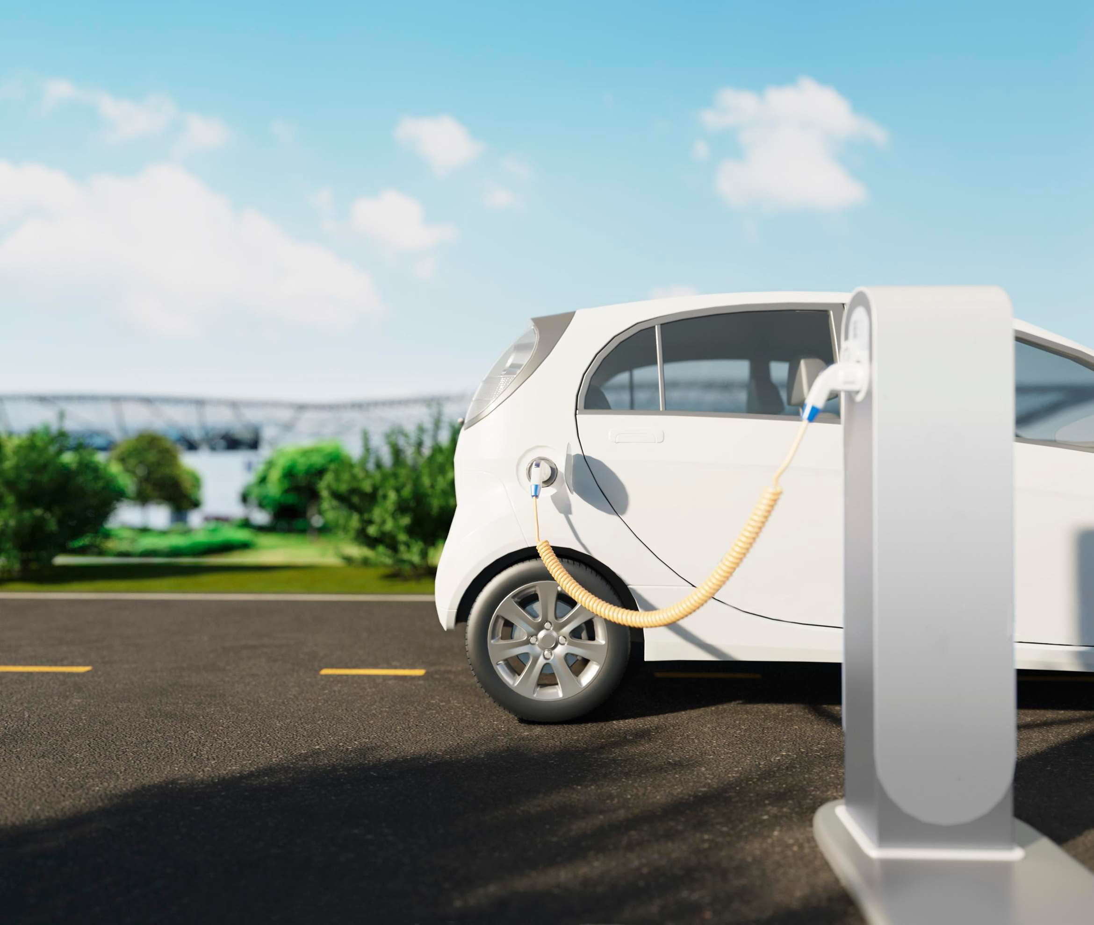
KEY INSIGHTS
MARKET SIZE
2022
1,034.6 Million
FORECAST
2030
5,990.5 Million
CAGR
2023-
2030
24.5%

Slide 4
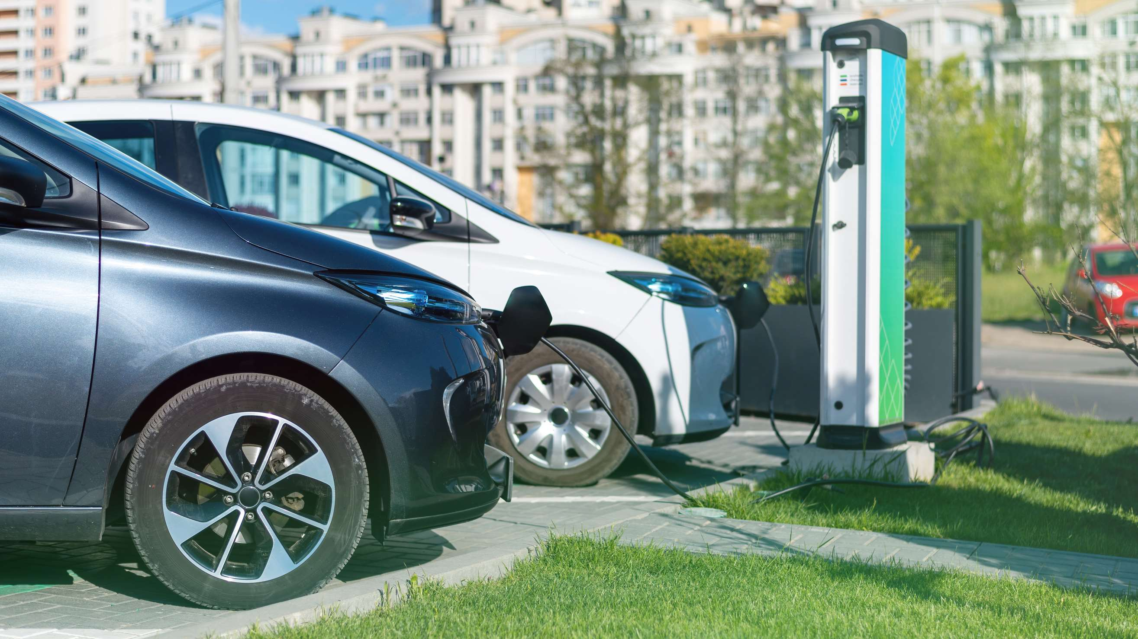

REVENUE MARKET SHARE BY SEGMENTS 2022
Passenger cars: 67.2%
Car
Type
Battery car:
58.2%
Propulsion
Lithium-ion:
34.2%
Battery
type

Slide 5

GLOBAL SOLAR POWERED CAR MARKET REVENUE SHARE FOR 2022
Asia Pacific Regional Share
32.5%

Slide 6
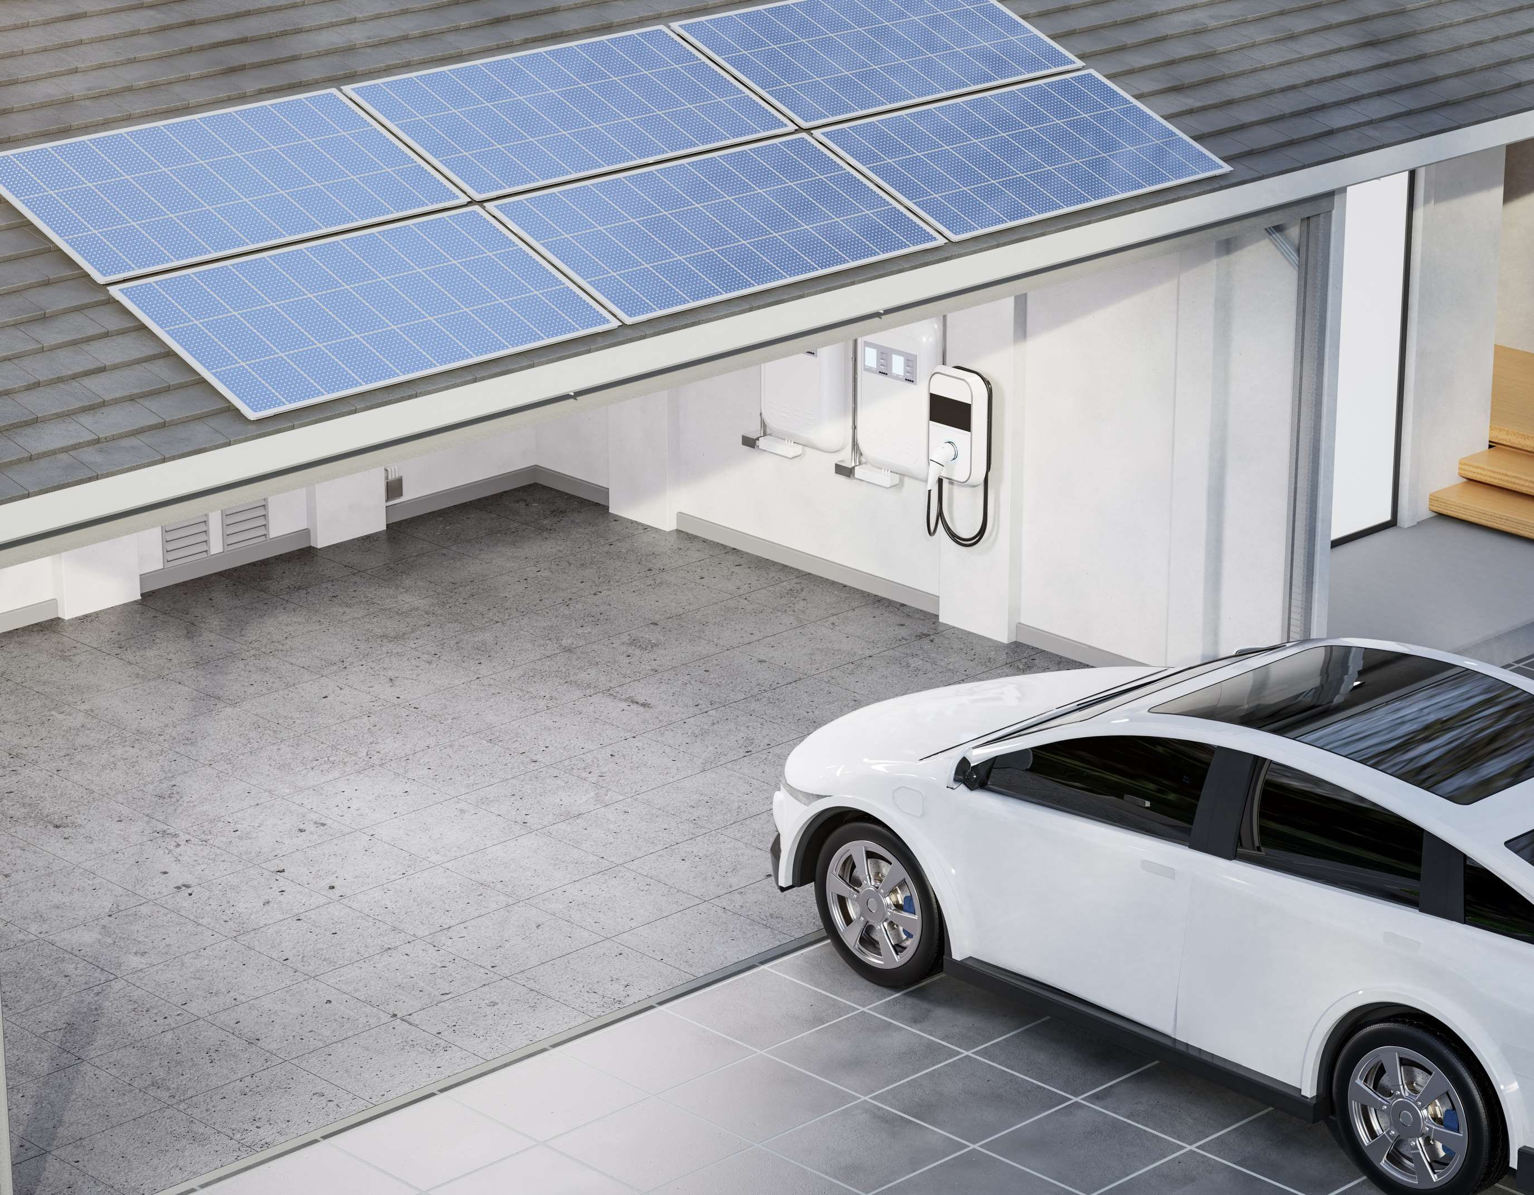
DRIVERS
  Rising solar energy projects in developed and developing regions and increasing demand for clean energy in transportation
  Increasing the use of solar-powered cars because it is more cost-effective than electric cars
RESTRAINTS
As compared to conventional cars, solar-powered cars are not as fast or powerful.

Slide 7
Author's Perspective
The market for solar-powered cars is expected to grow significantly in the coming years due to the increasing demand for environmentally friendly transportation options and the decreasing cost of solar energy technology.

Slide 8
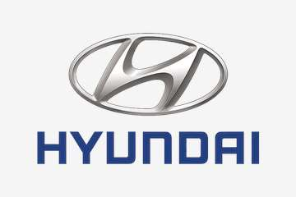



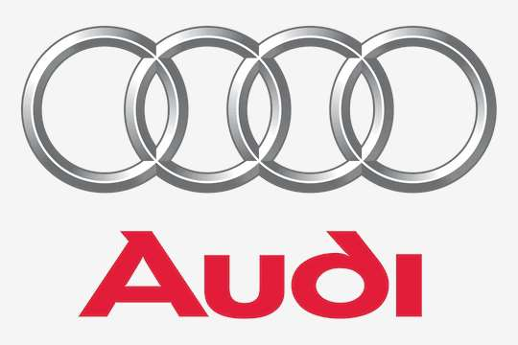

KEY PLAYERS

Slide 9


For Full Report
Contact us
COGNITIVE MARKET RESEARCH
Tel: +1 312-376-8303 | +44 020-8123-0732
India: (+91) 983-496-8611
sales@cognitivemarketresearch.com
Access the Full Report : https://shorturl.at/cjmW4
Please visit our website:
https://www.cognitivemarketresearch.com

