Slide 1
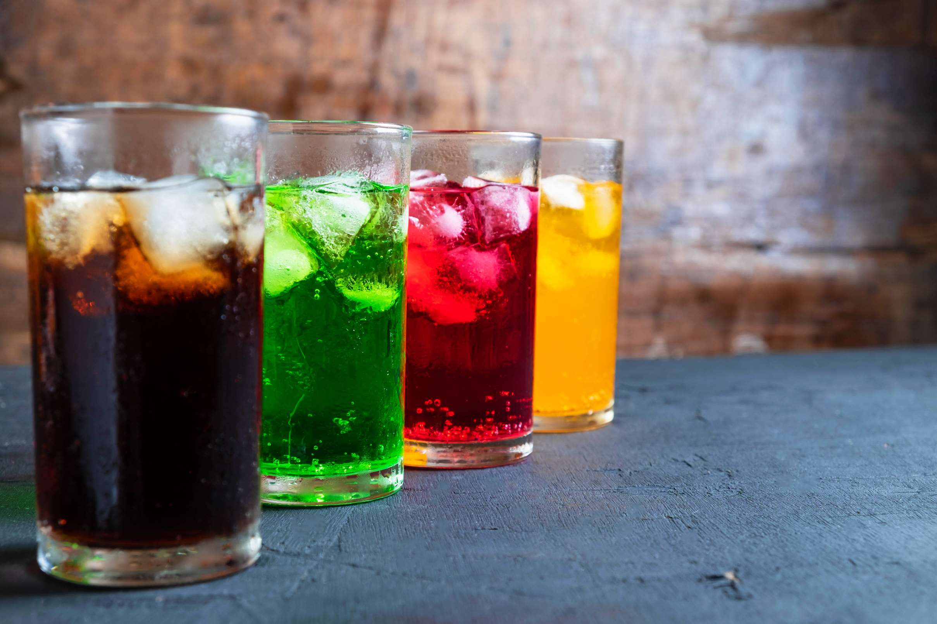
GLOBAL
SOFT DRINKS CONCENTRATE
MARKET REPORT
2024
Global,Regional,CountryAnalysis

Slide 2
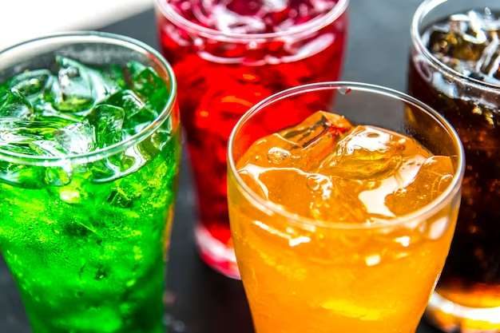
INTRODUCTION
Soft drink concentrates are liquids that contain carbonated or purified water, sweeteners, sweetening agents, and synthetic flavoring components. The rise in demand for ready-to-drink (RTD) beverages is driving the entire market. Sweeteners can be sugar, corn syrup with fructose, fruit juice, or sugar replacements, which can be artificial or natural. The soft drink concentrate business is expanding rapidly due to its ease of use and variety. As a result, the soft drink concentrates business in established markets is maturing. Additionally, rising customer interest in such beverages has boosted the market. In addition, the market's growth potential is dependent on R&D and chances to produce new flavors of concentrates.

Slide 3
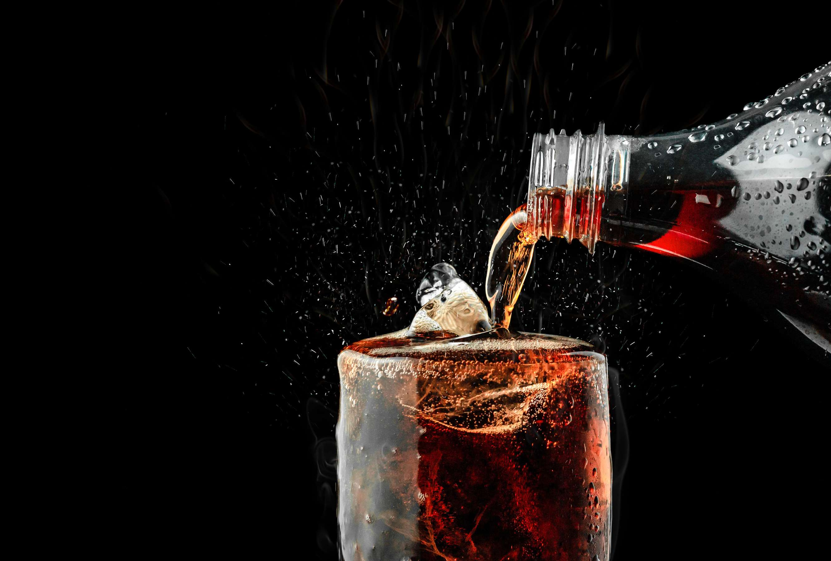

KEY INSIGHTS
MARKET SIZE
USD 35.8 billion
2023
CAGR
4.80%
2023- 2030

Slide 4
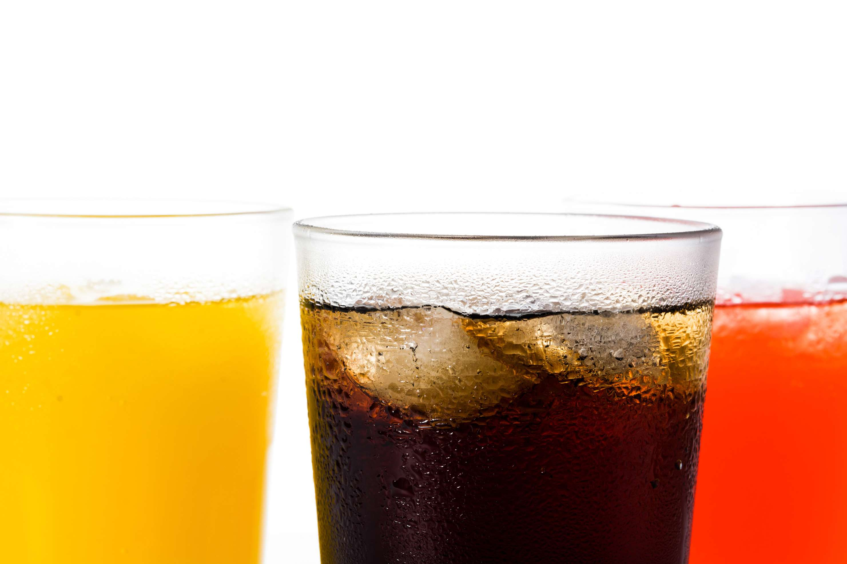
REVENUE MARKET SHARE BY SEGMENTS 2022
  Non-Carbonated
  Carbonated
Type Segment
  Cola
  Non-Cola
  Orange
  Mixed
  Pineapple
  Kiwi
  Litchi
  Apple
  Grape
  Grapefruit
  Peach
  Mango
  Drinking Places
  Mass Merchandise
  The Fountain Machine
  Private Clubs
  Food ServicS
Flavours Segment
End-User Segment
  Supermarkets/Hypermarkets
  Convenience Stores
  Online Retail Stores
Distribution Channel

Slide 5

Global Soft Drinks Concentrate Market Revenue share for 2024
North America
40%

Slide 6
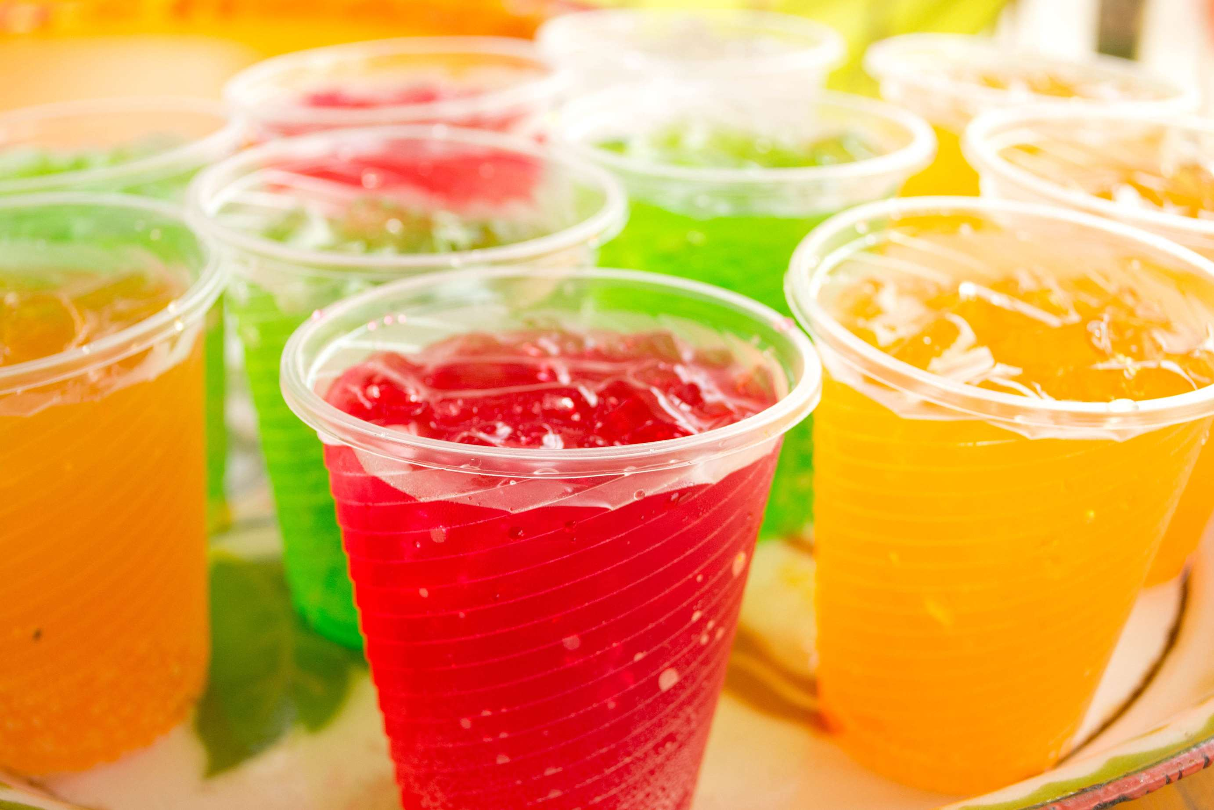
Increasing Demand for Craft Soft Drinks to Propel Market Growth
Drivers
Increase in Obesity into Restrict Market Growth
Restraints

Slide 7
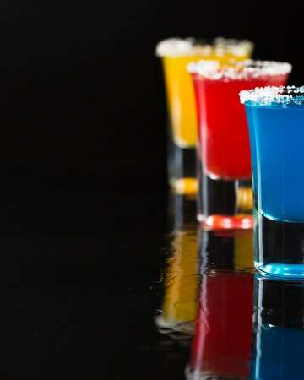
AUTHOR'S PERSPECTIVE
  The Global Soft Drinks Concentrate Market is witnessing significant growth in the near future.
  Non-fizzy beverages come in a wide range of tastes, including fruit-based and herbal infusions, and are appealing to consumers looking for alternatives to sugary or carbonated beverages.
  Soft drink concentrates are making their way onto menus, providing customers with a personalized and tasty option.
  Supermarkets and hypermarkets are important in influencing consumer decisions through clever product placement and promotions increasing the visibility of soft drink concentrates.

Slide 8
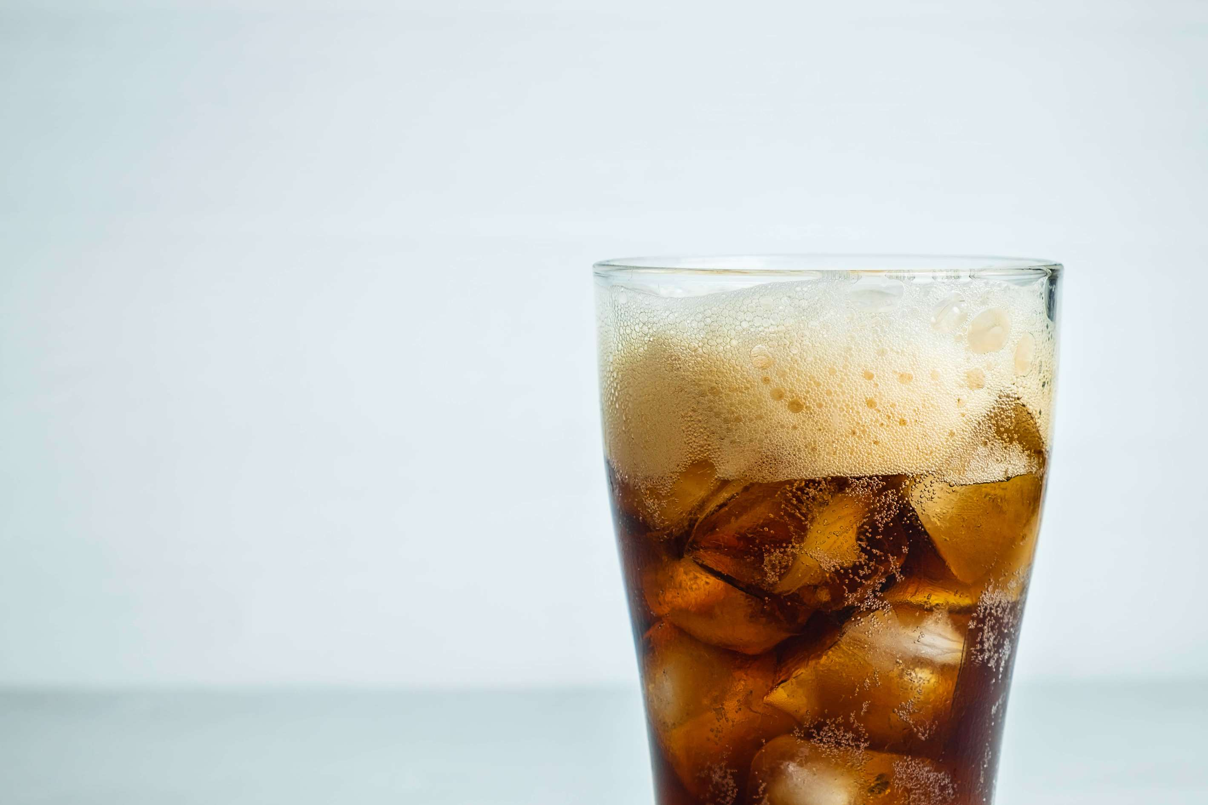




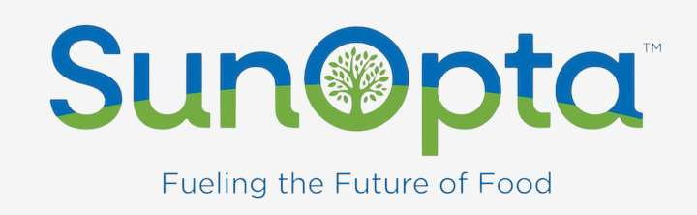
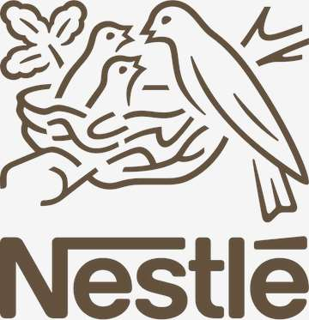

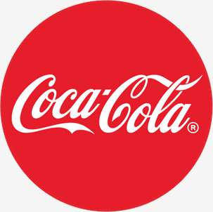


KEY PLAYERS

Slide 9


For Full Report
Contact us
COGNITIVE MARKET RESEARCH
Tel: +1 312-376-8303 | +44 020-8123-0732
India: (+91) 983-496-8611
sales@cognitivemarketresearch.com
Access the Full Report : http://tinyurl.com/mw42sykz
Please visit our website:
https://www.cognitivemarketresearch.com

