Slide 1
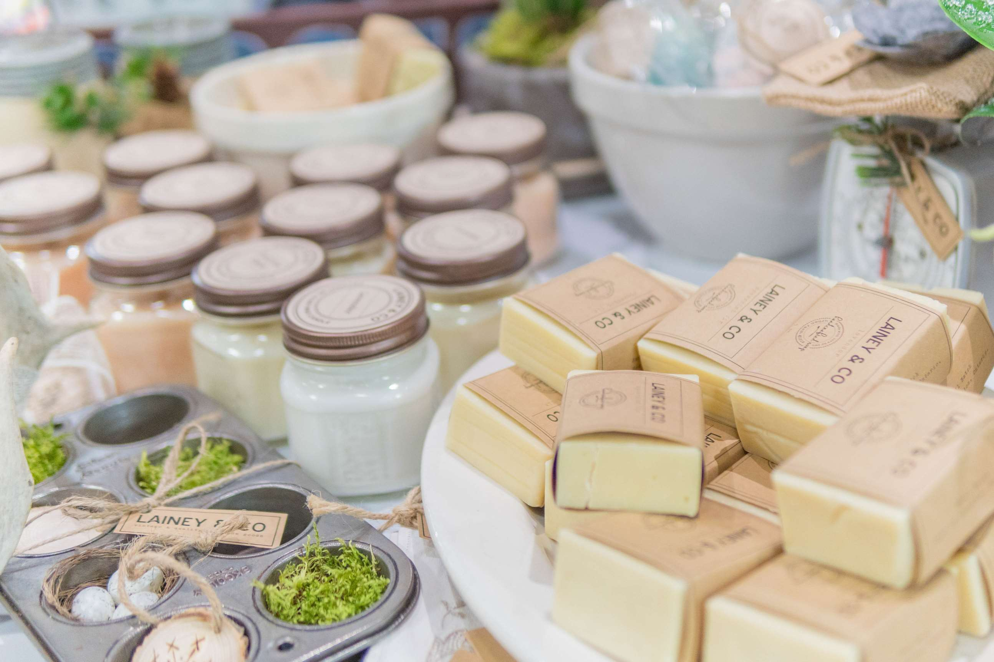
GLOBAL
SOAP
MARKET REPORT
2024
Global,Regional,CountryAnalysis

Slide 2

INTRODUCTION
Soap is a cleaning agent used to remove dirt, oil, and other impurities from the skin and other surfaces. Soap is made by combining fats or oils with an alkali, such as sodium hydroxide, to create a chemical reaction called saponification. Every individual uses soap for personal care, dishwashing, or clothes, as specific soaps are available for specific purposes. Soaps are evolving and innovating with increasing desires and customer requirements, including different fragrances, cost margins, organic products, etc.

Slide 3


KEY INSIGHTS
MARKET SIZE
USD 17260.48 million
2024
CAGR
4.2%
2024- 2031

Slide 4
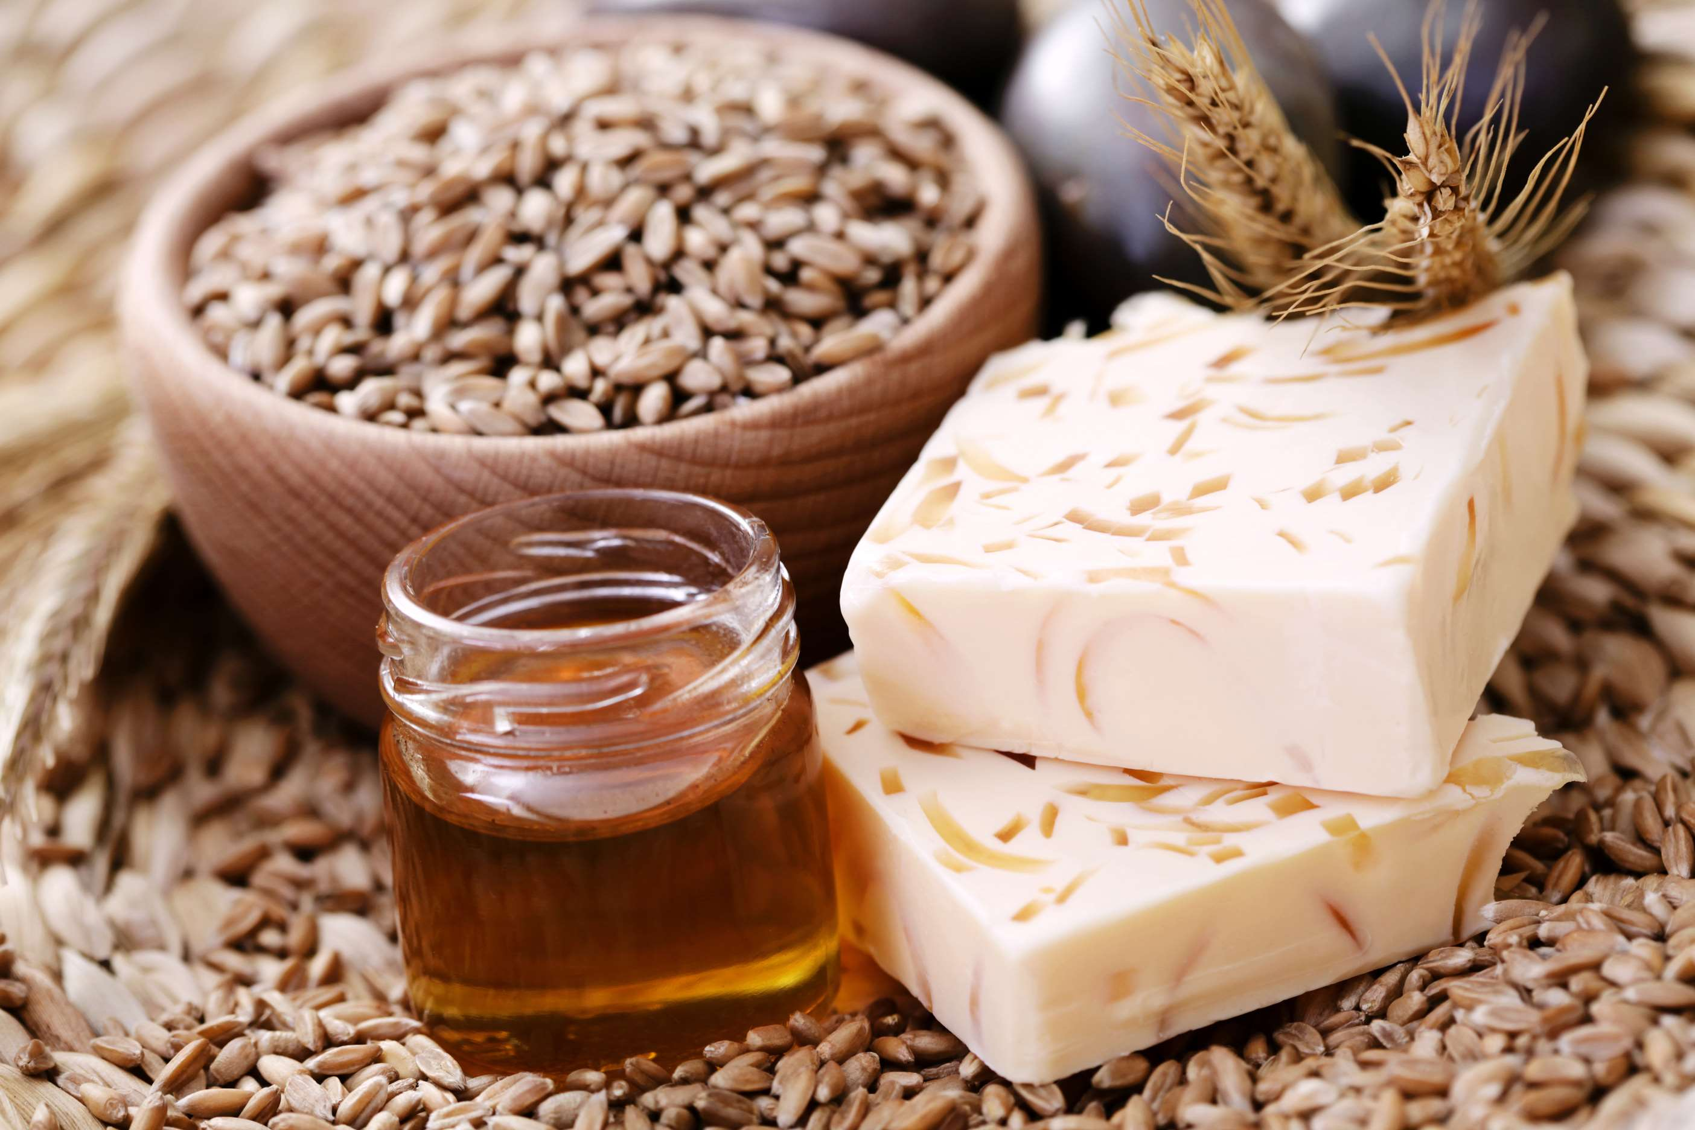
REVENUE MARKET SHARE BY SEGMENTS 2022
  Bath & Body Soaps
  Kitchen Soaps
  Laundry Soaps
  Solid
  Liquid
Type Segment
Form Segment
  Supermarkets
  Pharmacies
  Online Channel
  Household
  Commercial
Application Segment
Distribution Channel

Slide 5

Global Soap Market Revenue share for 2024
North America
40%

Slide 6
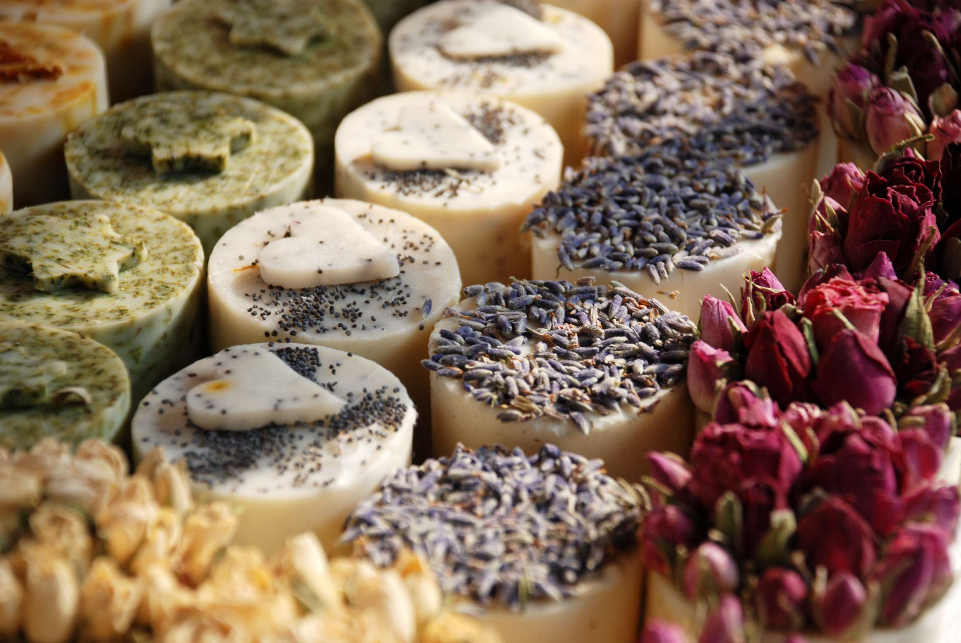
Increase in Product Innovations to Propel Market Growth
Drivers
Increasing Availability of Alternative Products to Limit the Sales
Restraints

Slide 7

AUTHOR'S PERSPECTIVE
  The bath & body soap segment is set to diverse cleansing products designed for personal hygiene and skincare, with formulations catering to different skin types and preferences. Bath & body soaps contribute significantly to the overall soap market, meeting various consumer needs.
  Increased hygiene awareness, changing consumer lifestyles, and a rising focus on natural and organic ingredients. Additionally, the COVID-19 pandemic has further accentuated the importance of hand hygiene, fueling the demand for various soap products across the globe.
  The household held the highest Soap market revenue share in 2024.

Slide 8




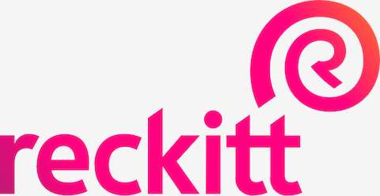


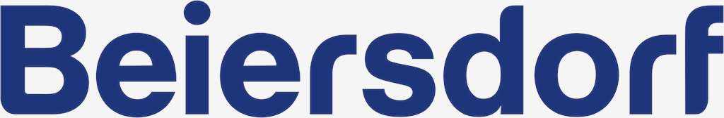
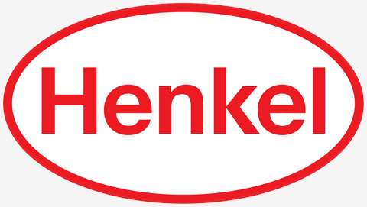


KEY PLAYERS

Slide 9


For Full Report
Contact us
COGNITIVE MARKET RESEARCH
Tel: +1 312-376-8303 | +44 020-8123-0732
India: (+91) 983-496-8611
sales@cognitivemarketresearch.com
Access the Full Report : https://tinyurl.com/39znm9jh
Please visit our website:
https://www.cognitivemarketresearch.com

