Slide 1
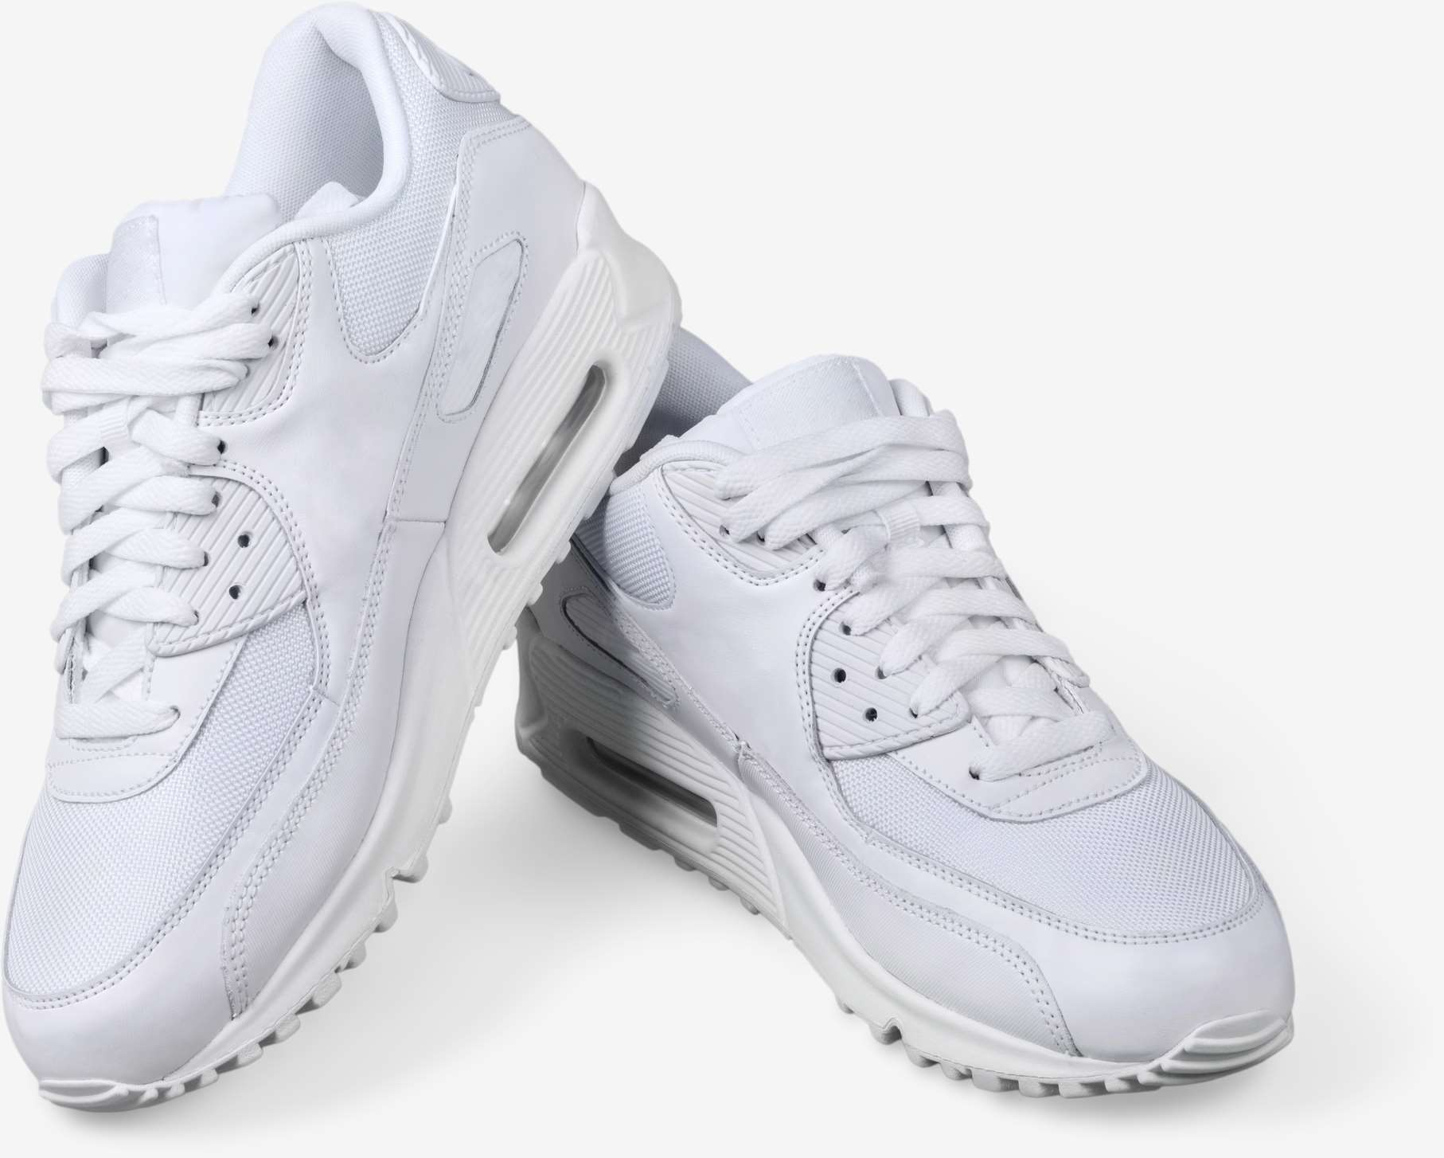
GLOBAL
SNEAKER
MARKET REPORT
2024
Global,Regional,CountryAnalysis

Slide 2
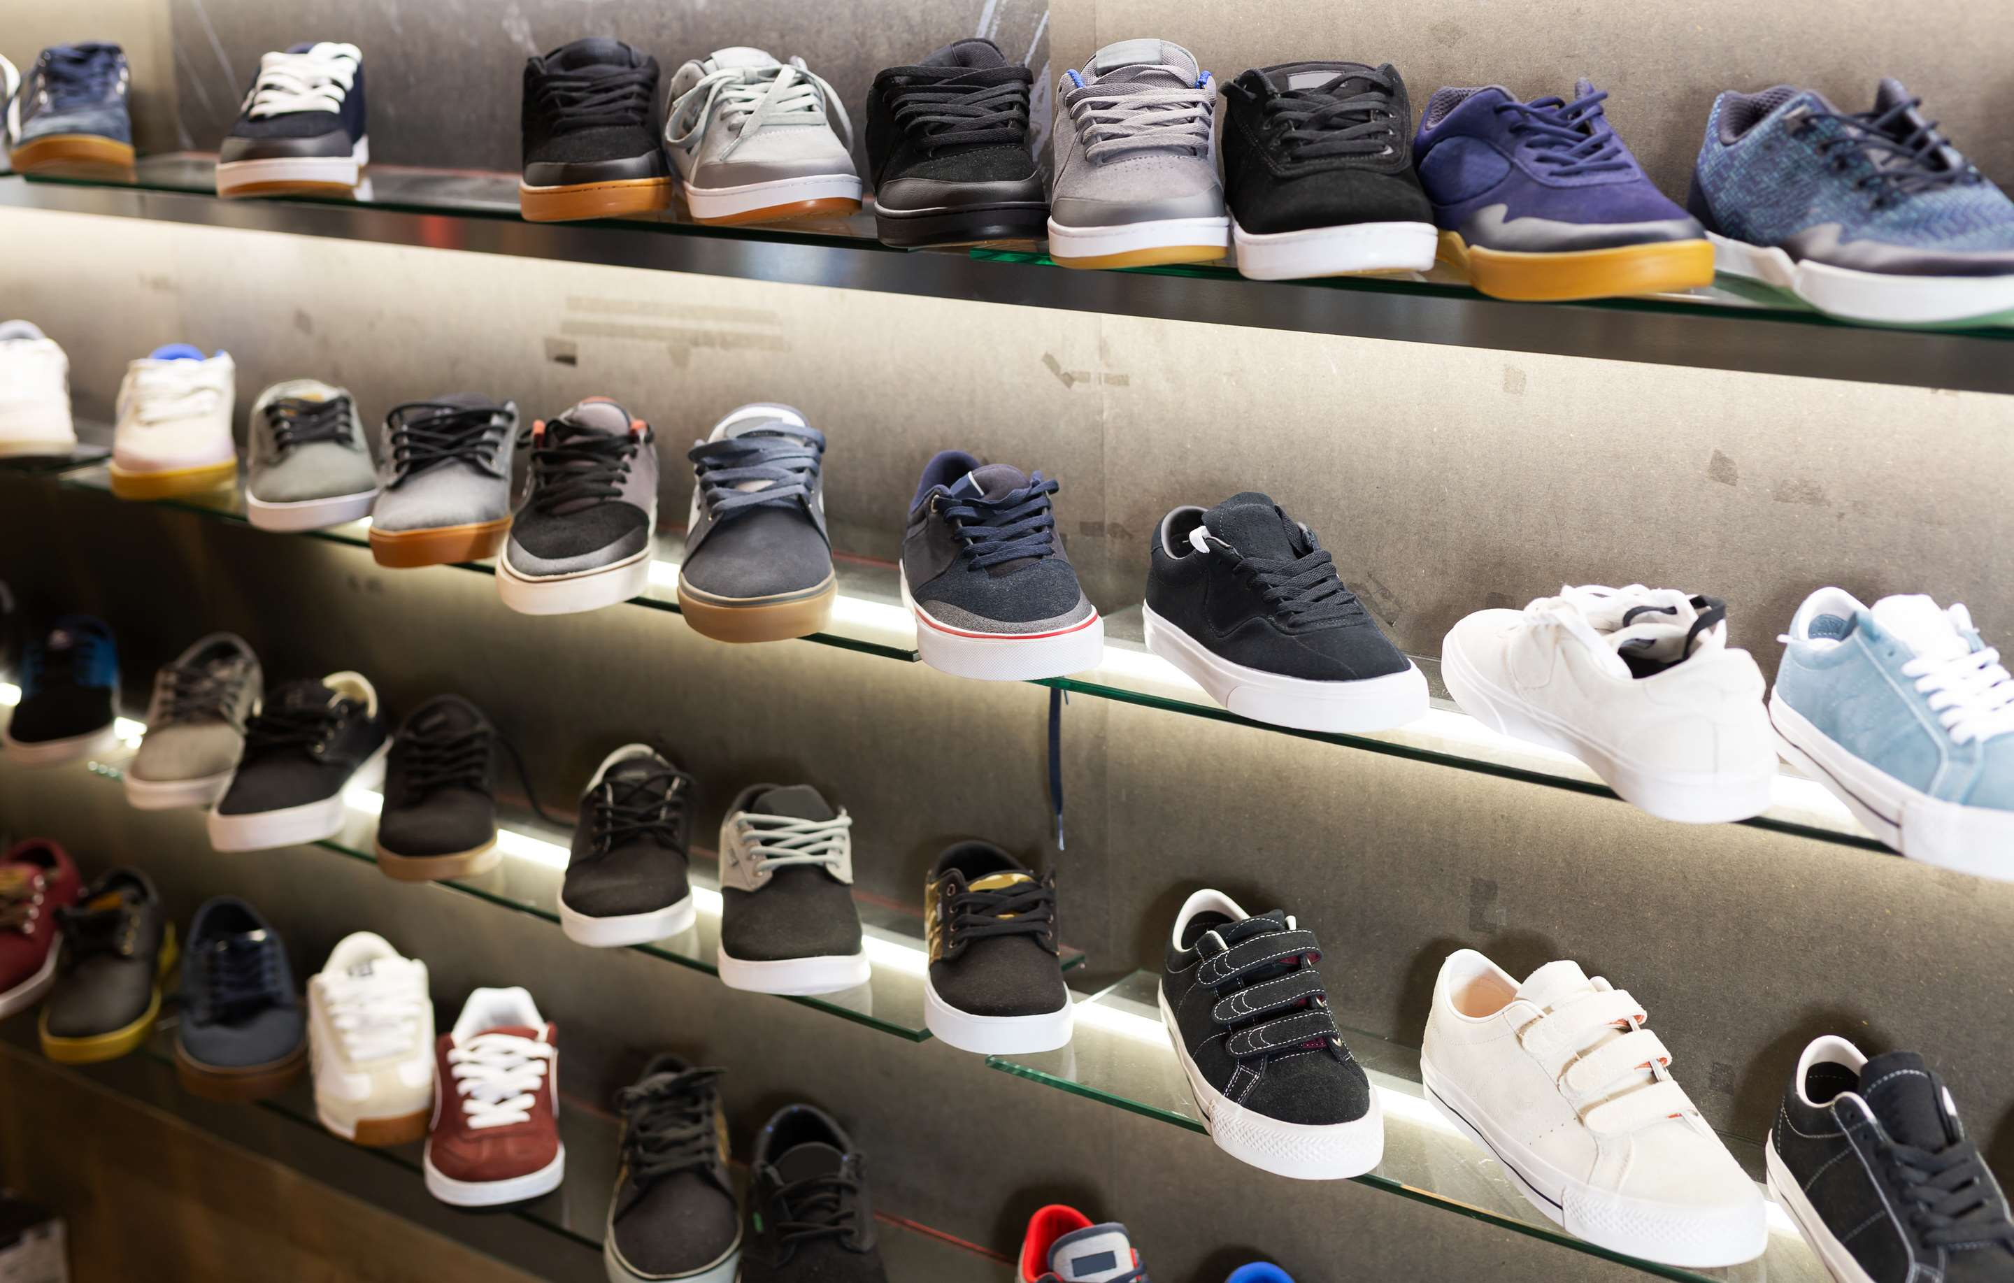
INTRODUCTION
A sneaker, also referred to as a trainer, tennis shoe, or athletic shoe, is a specific kind of footwear primarily created for sports and other physical endeavors. Sneakers are distinguished by their rubber soles, which are both comfortable and flexible, providing cushioning and support to the wearer's feet. The upper part of sneakers is typically constructed from breathable materials such as leather, canvas, or synthetic fibers, allowing proper ventilation and reducing moisture within the shoe. The industry's growth is propelled by the increasing preference for fashionable, branded, and high-fashion sneakers across all age groups, as well as an upsurge in disposable income, which drives the demand for more comfortable and innovative sneakers.

Slide 3


KEY INSIGHTS
MARKET SIZE
USD 79.2 billion
2023
CAGR
5.50%
2023- 2030

Slide 4

REVENUE MARKET SHARE BY SEGMENTS 2022
  Adult Sneaker
  Children Sneaker
Type Segment
  Competition
  Amateur Sports
  Lifestyle
Application Segment

Slide 5

Global Sneaker Market Revenue share for 2024
Asia Pacific
35%

Slide 6
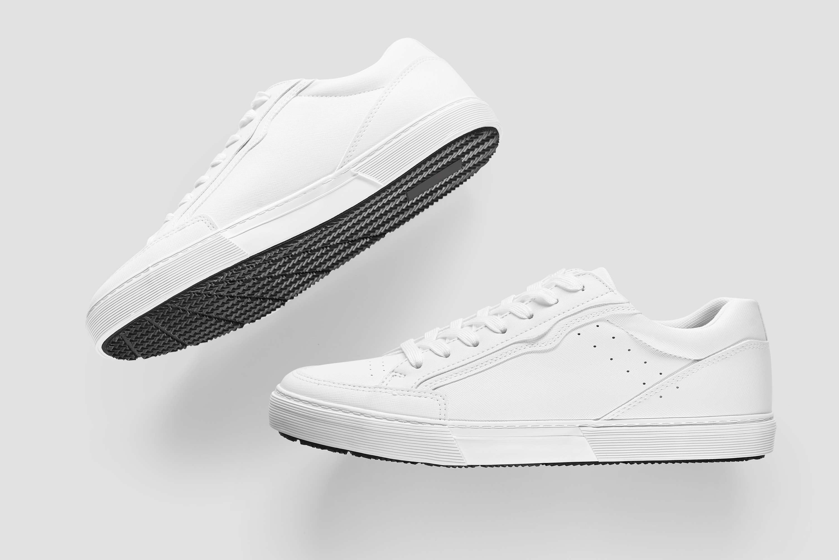
Technological Advancements and Innovation to Propel Market Growth
Drivers
Counterfeit and Imitation Products to Hinder Market Growth
Restraints

Slide 7

AUTHOR'S PERSPECTIVE
  The Global Sneaker Market is witnessing significant growth in the near future.
  Adults, particularly young adults and working professionals are more actively engaged in sports, fitness activities, and urban lifestyles, where sneakers are the preferred choice of footwear.
  Adult consumers often seek sneakers that not only provide comfort and performance but also reflect their individual style and identity.
  Athletes, sports enthusiasts, and fitness professionals seek specialized sneakers designed to enhance their performance, provide superior grip, support, and durability during competitive sports activities.

Slide 8











KEY PLAYERS

Slide 9


For Full Report
Contact us
COGNITIVE MARKET RESEARCH
Tel: +1 312-376-8303 | +44 020-8123-0732
India: (+91) 983-496-8611
sales@cognitivemarketresearch.com
Access the Full Report : https://tinyurl.com/3tp56f3e
Please visit our website:
https://www.cognitivemarketresearch.com

