Slide 1


SMART PACKAGING MARKET REPORT

Slide 2
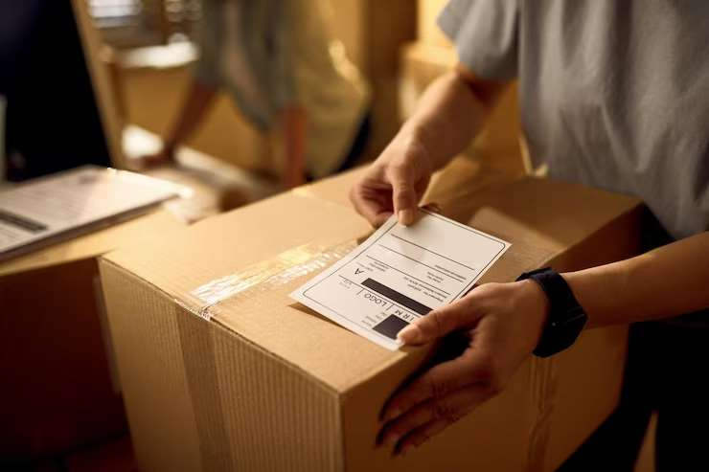

INTRODUCTION
Smart packaging has several technologies integrated into such as radio frequency identification and biosensors. It provides more than simply fundamental branding and protection. It is a collection of advanced packaging methods and integration of many creative technological methods are suitable in packaging of contents that are sensitive in nature and demand improved traceability.

Slide 3
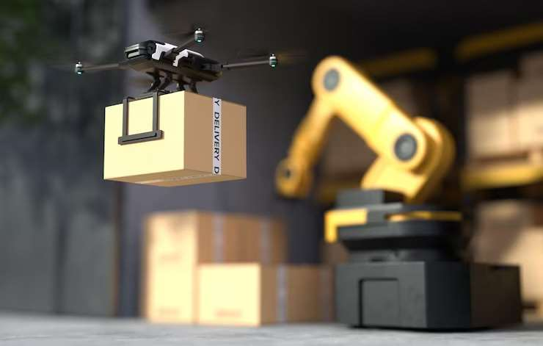

MARKET SIZE
2022
41.34 Billion
FORECAST
2030
65.14 billion
KEY INSIGHTS
CAGR
2023-2030
5.8%

Slide 4
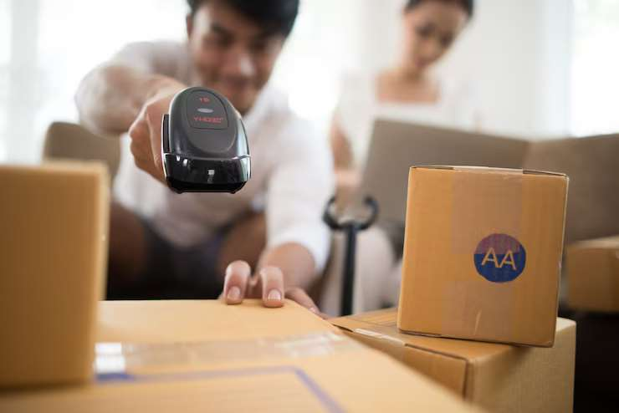
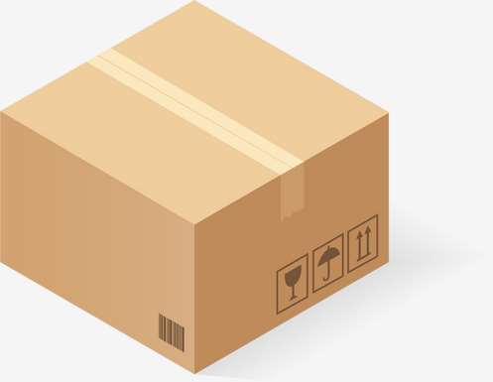


REVENUE MARKET SHARE BY SEGMENTS 2022
Modified atmosphere packaging : Technology Share : 39.4%
Plastic:
Material Share:
38. 6%
Application: food &amp;
beverages Share :
29.8%

Slide 5
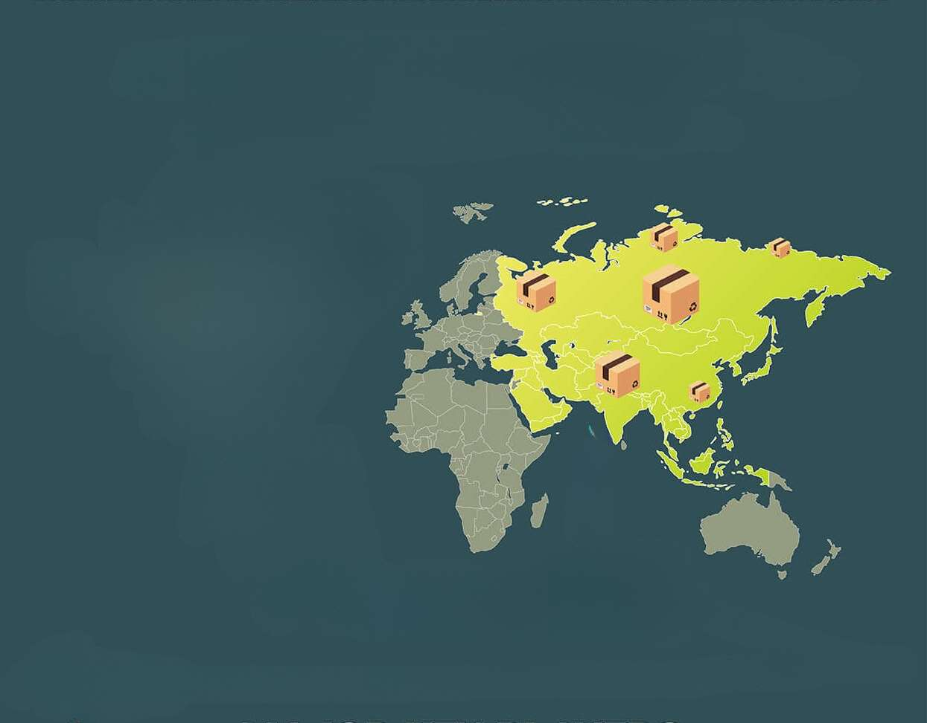
GLOBAL SMART PACKAGING MARKET REVENUE SHARE FOR
2022
Asia Pacific Regional Share
43.5%

Slide 6
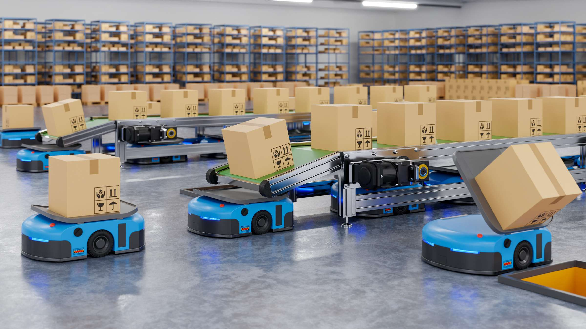
  Rising demand for advanced packaging solutions from the pharmaceutical and food & beverage sector
  Rising concern for food wastage reduction among consumers and increasing demand for smart &amp; functional packaging
Drivers
The cost of smart packaging increases because of technologically features such as installed sensors and RFID, and others.
Restraints

Slide 7
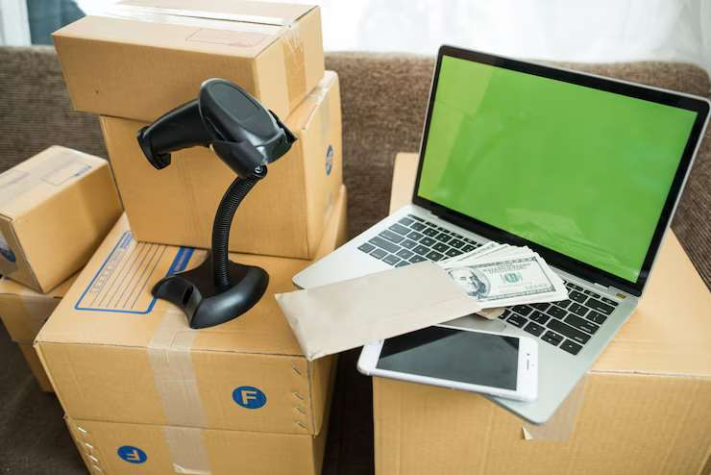
AUTHOR'S PERSPECTIVE
  The intelligent packaging segment is expected to contribute significant CAGR in global market, owing to it uses embedded sensors to monitor product temperature or humidity levels.
  The modified atmosphere packaging (MAP) segment is expected to largest revenue share in the global market.
  The food & beverages segment accounts for higher revenue share in the market, due to their flexible, durable, and lightweight properties.
  The plastic segment among the material segments accounted for higher revenue share during the study as compared to other material segments.

Slide 8
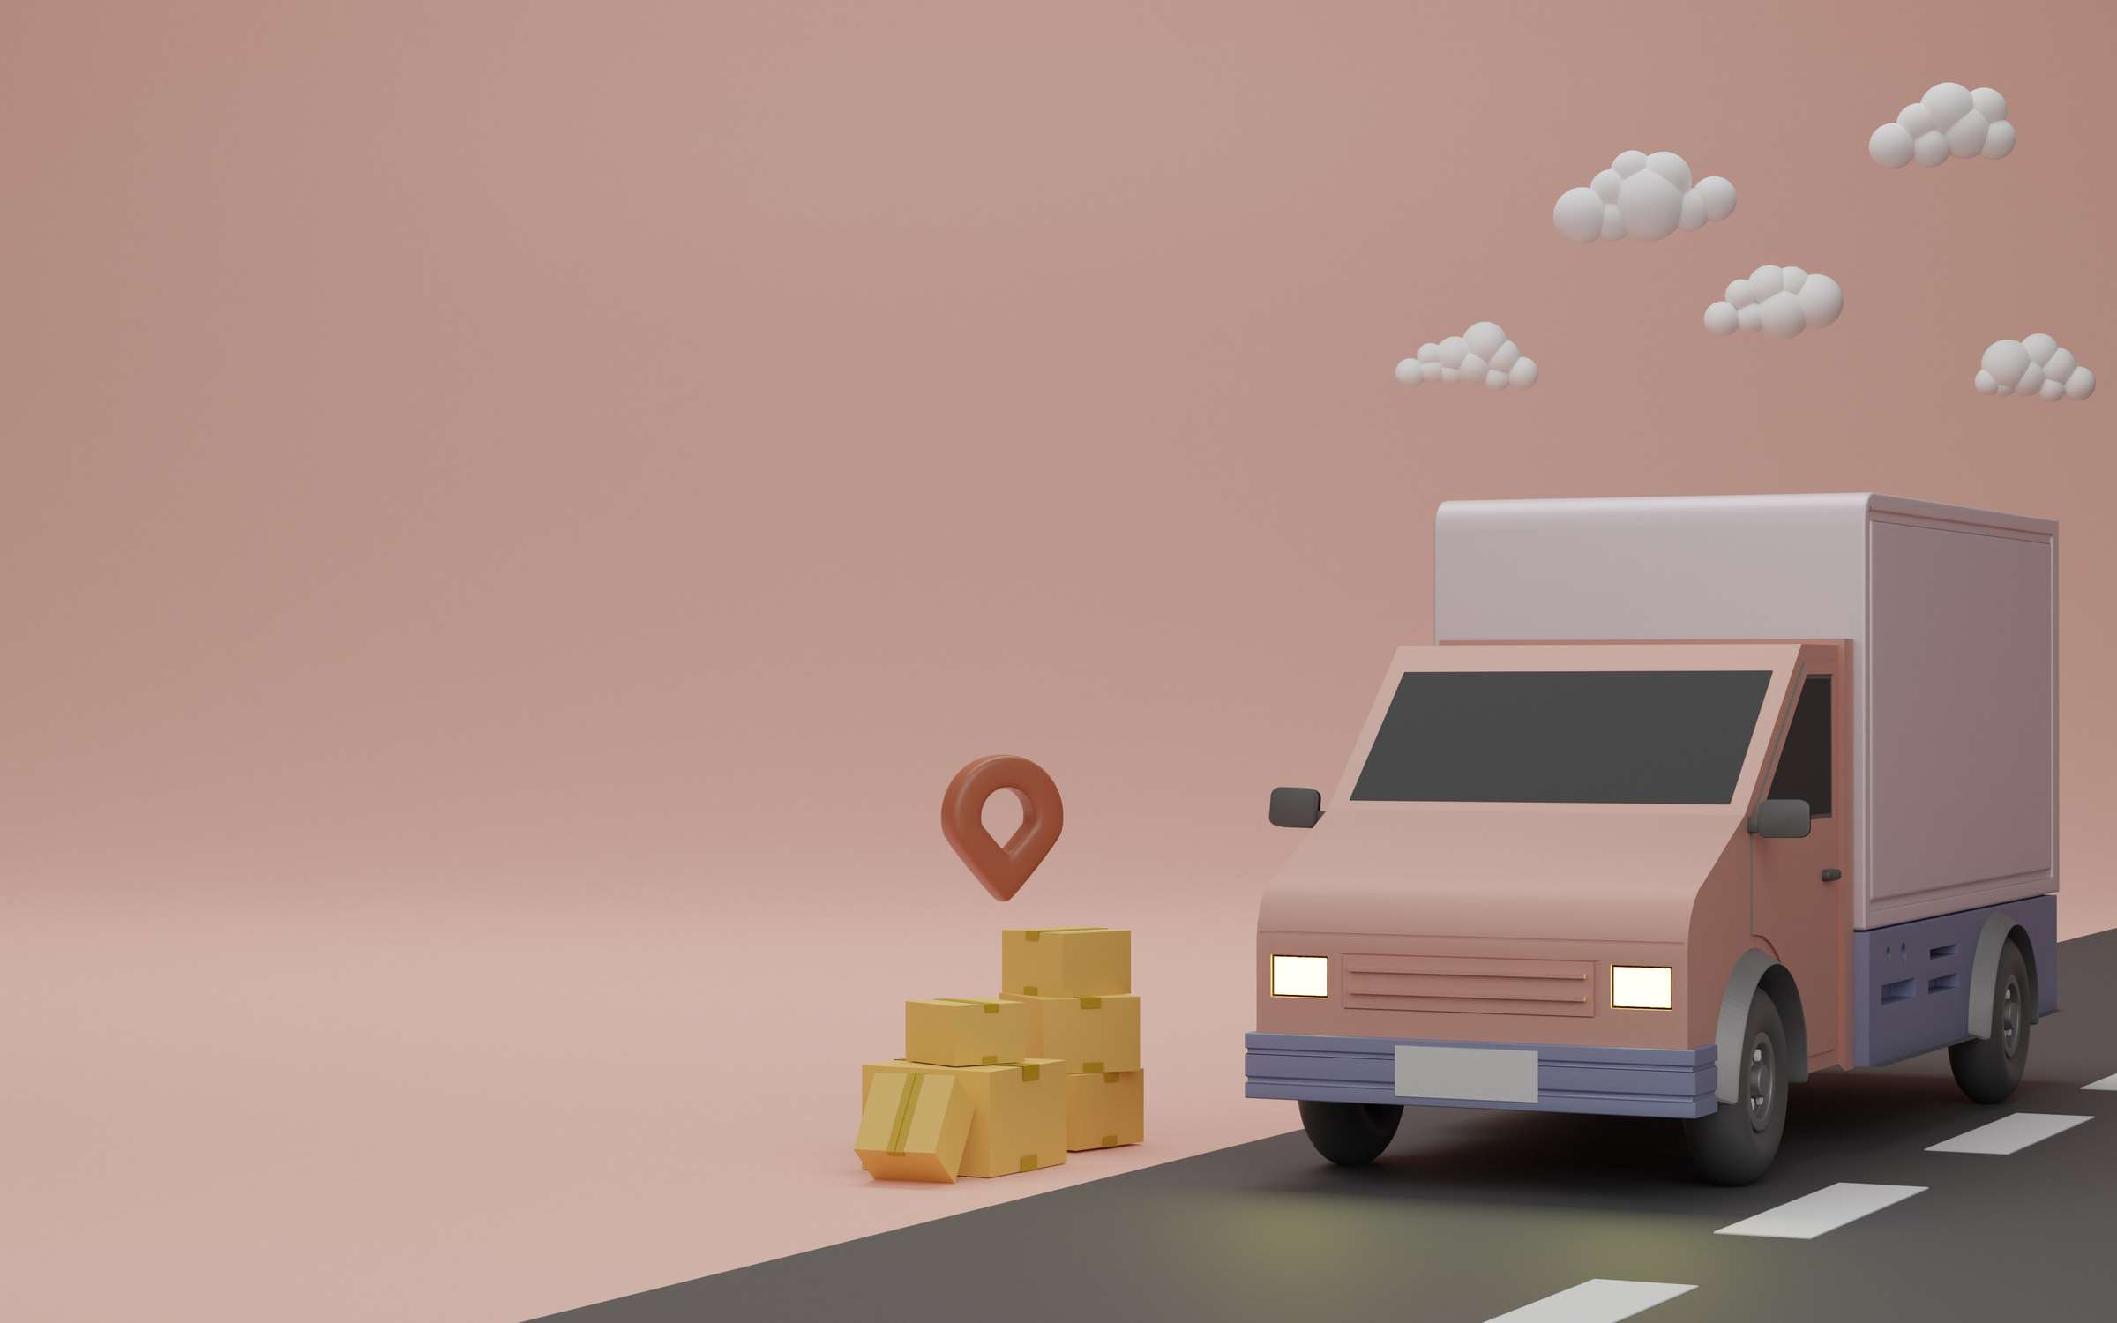

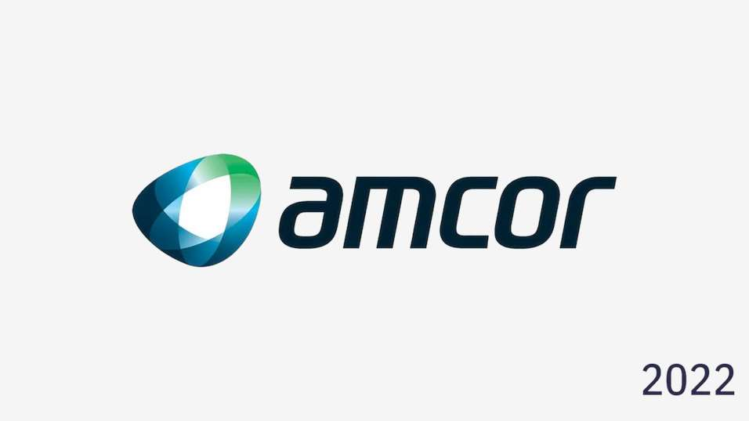

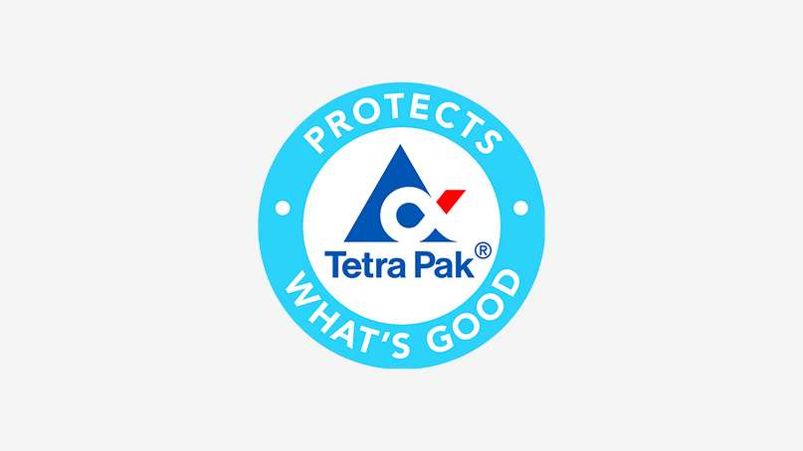
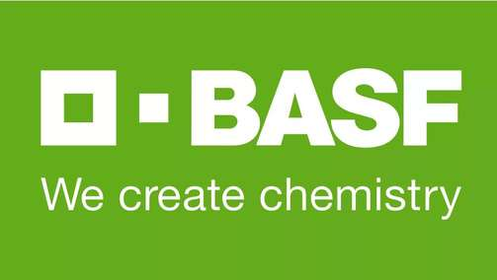



KEY PLAYERS

Slide 9


For Full Report
Contact us
COGNITIVE MARKET RESEARCH
Tel: +1 312-376-8303 | +44 020-8123-0732
India: (+91) 983-496-8611
sales@cognitivemarketresearch.com
Access the Full Report : https://shorturl.at/lnvzN
Please visit our website:
https://www.cognitivemarketresearch.com

