Slide 1


SHREDDED AND DESICCATED COCONUT
MARKET REPORT
2024
Qualitative Analysis + Quantitative Analysis

Slide 2
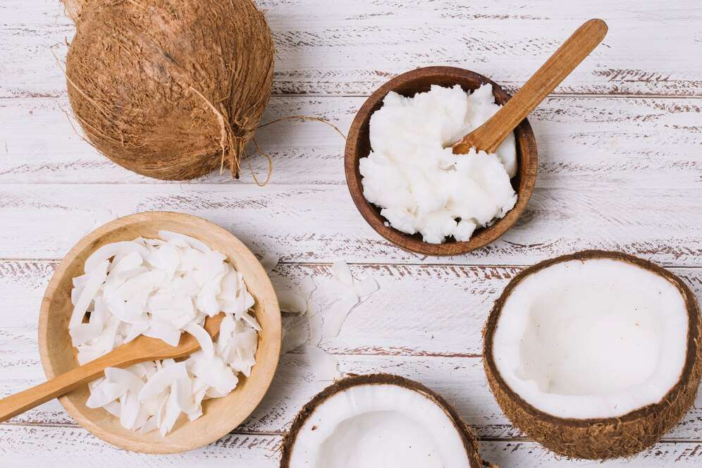
INTRODUCTION
The production, distribution, and sale of coconut meat that has been dried or shredded to eliminate moisture content and lengthen its shelf life are all included in the shredded and desiccated coconut market. Shredded and desiccated coconut is widely used in cooking applications to enhance various foods' taste, texture, and nutritional content, including baked products, sweets, savory entrees, and drinks. It is a well-liked component for food manufacturers and customers due to its inherent sweetness and adaptability. The market for shredded and desiccated coconut is expanding due to the growing demand for natural and healthful ingredients. This market serves both the growing needs of the food sector and the changing tastes of health-conscious consumers.

Slide 3
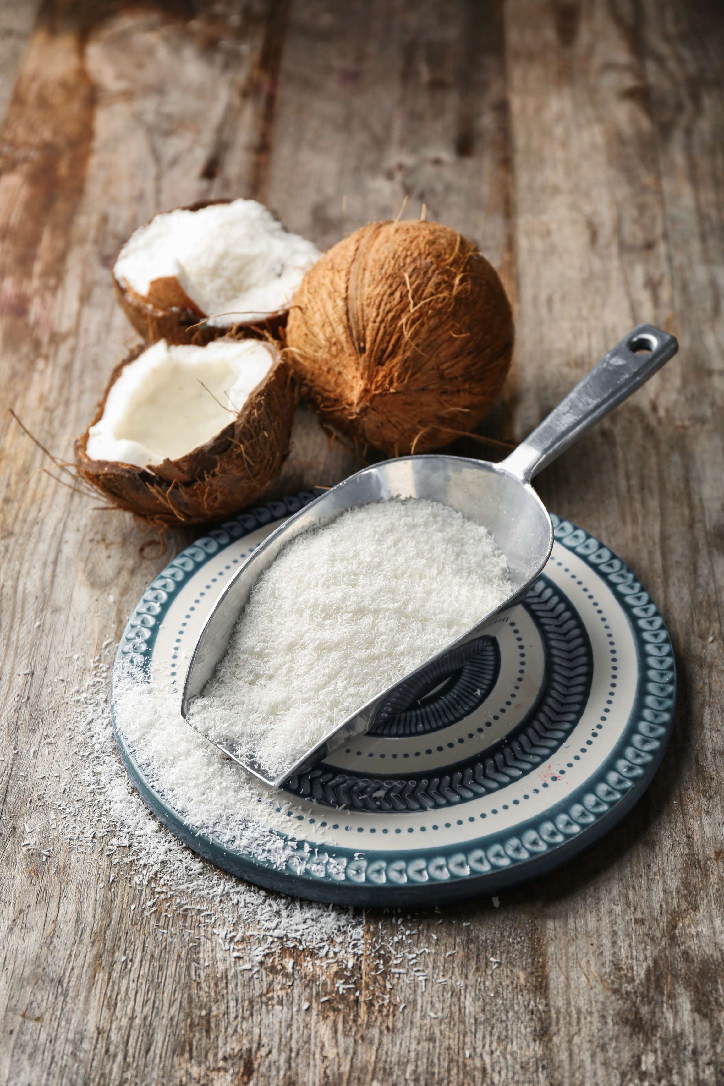

KEY INSIGHTS
MARKET SIZE
USD 5615.2 million
2024
CAGR
5.50%
2024- 2031

Slide 4
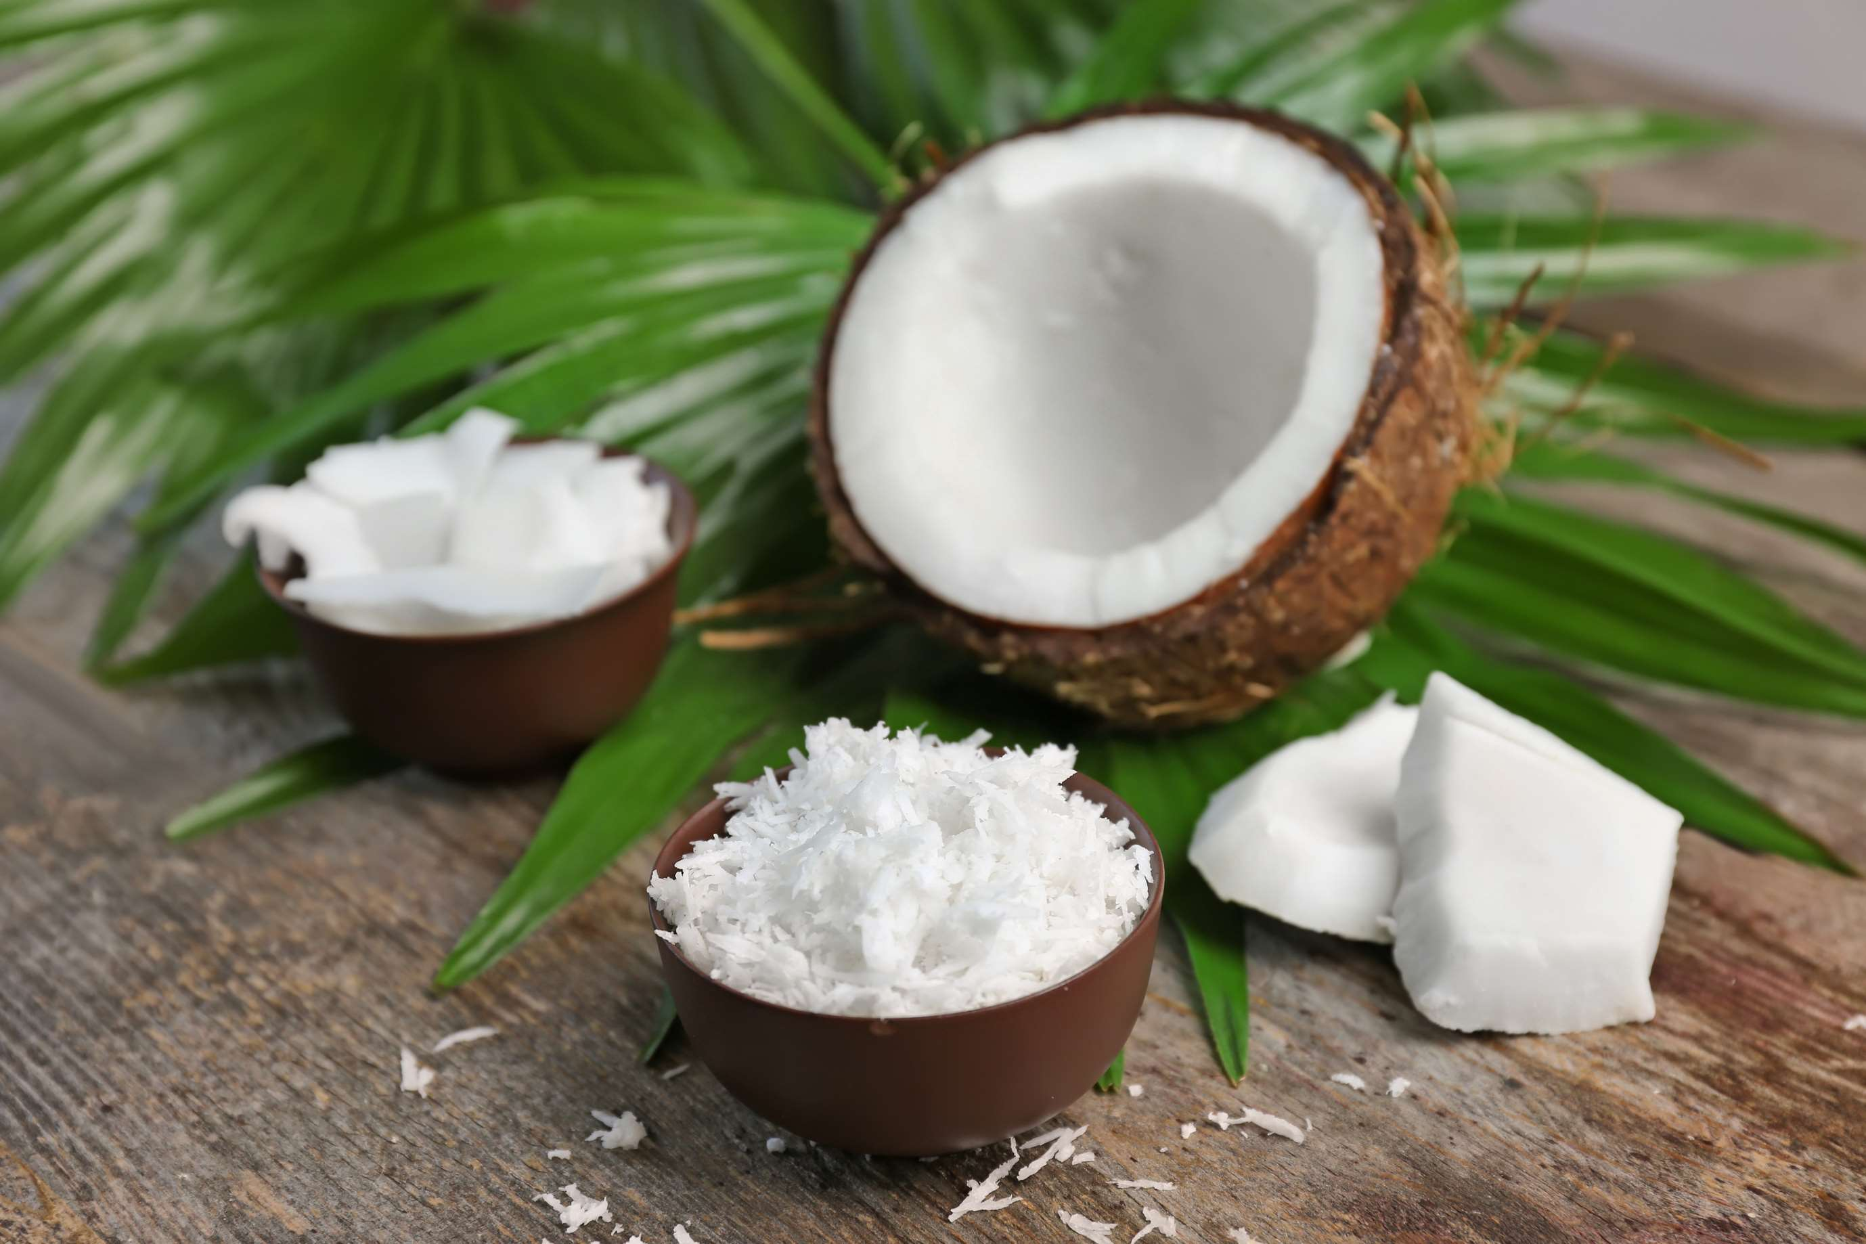
REVENUE MARKET SHARE BY SEGMENTS 2024
  Powder
  Granular
  Flakes
  Chips
  Shreds
Form Segment
  Direct
  Indirect
  Hypermarkets/Supermarket
  Convenience Stores
  Specialty Stores
  Independent Retailers
Distribution Channel
  Bakery
  Confectionery
  Dairy Products
  Frozen Dessert
Application Segment

Slide 5

North America
40%
North America Shredded and Desiccated Coconut Market Revenue share for 2024 is 40%

Slide 6
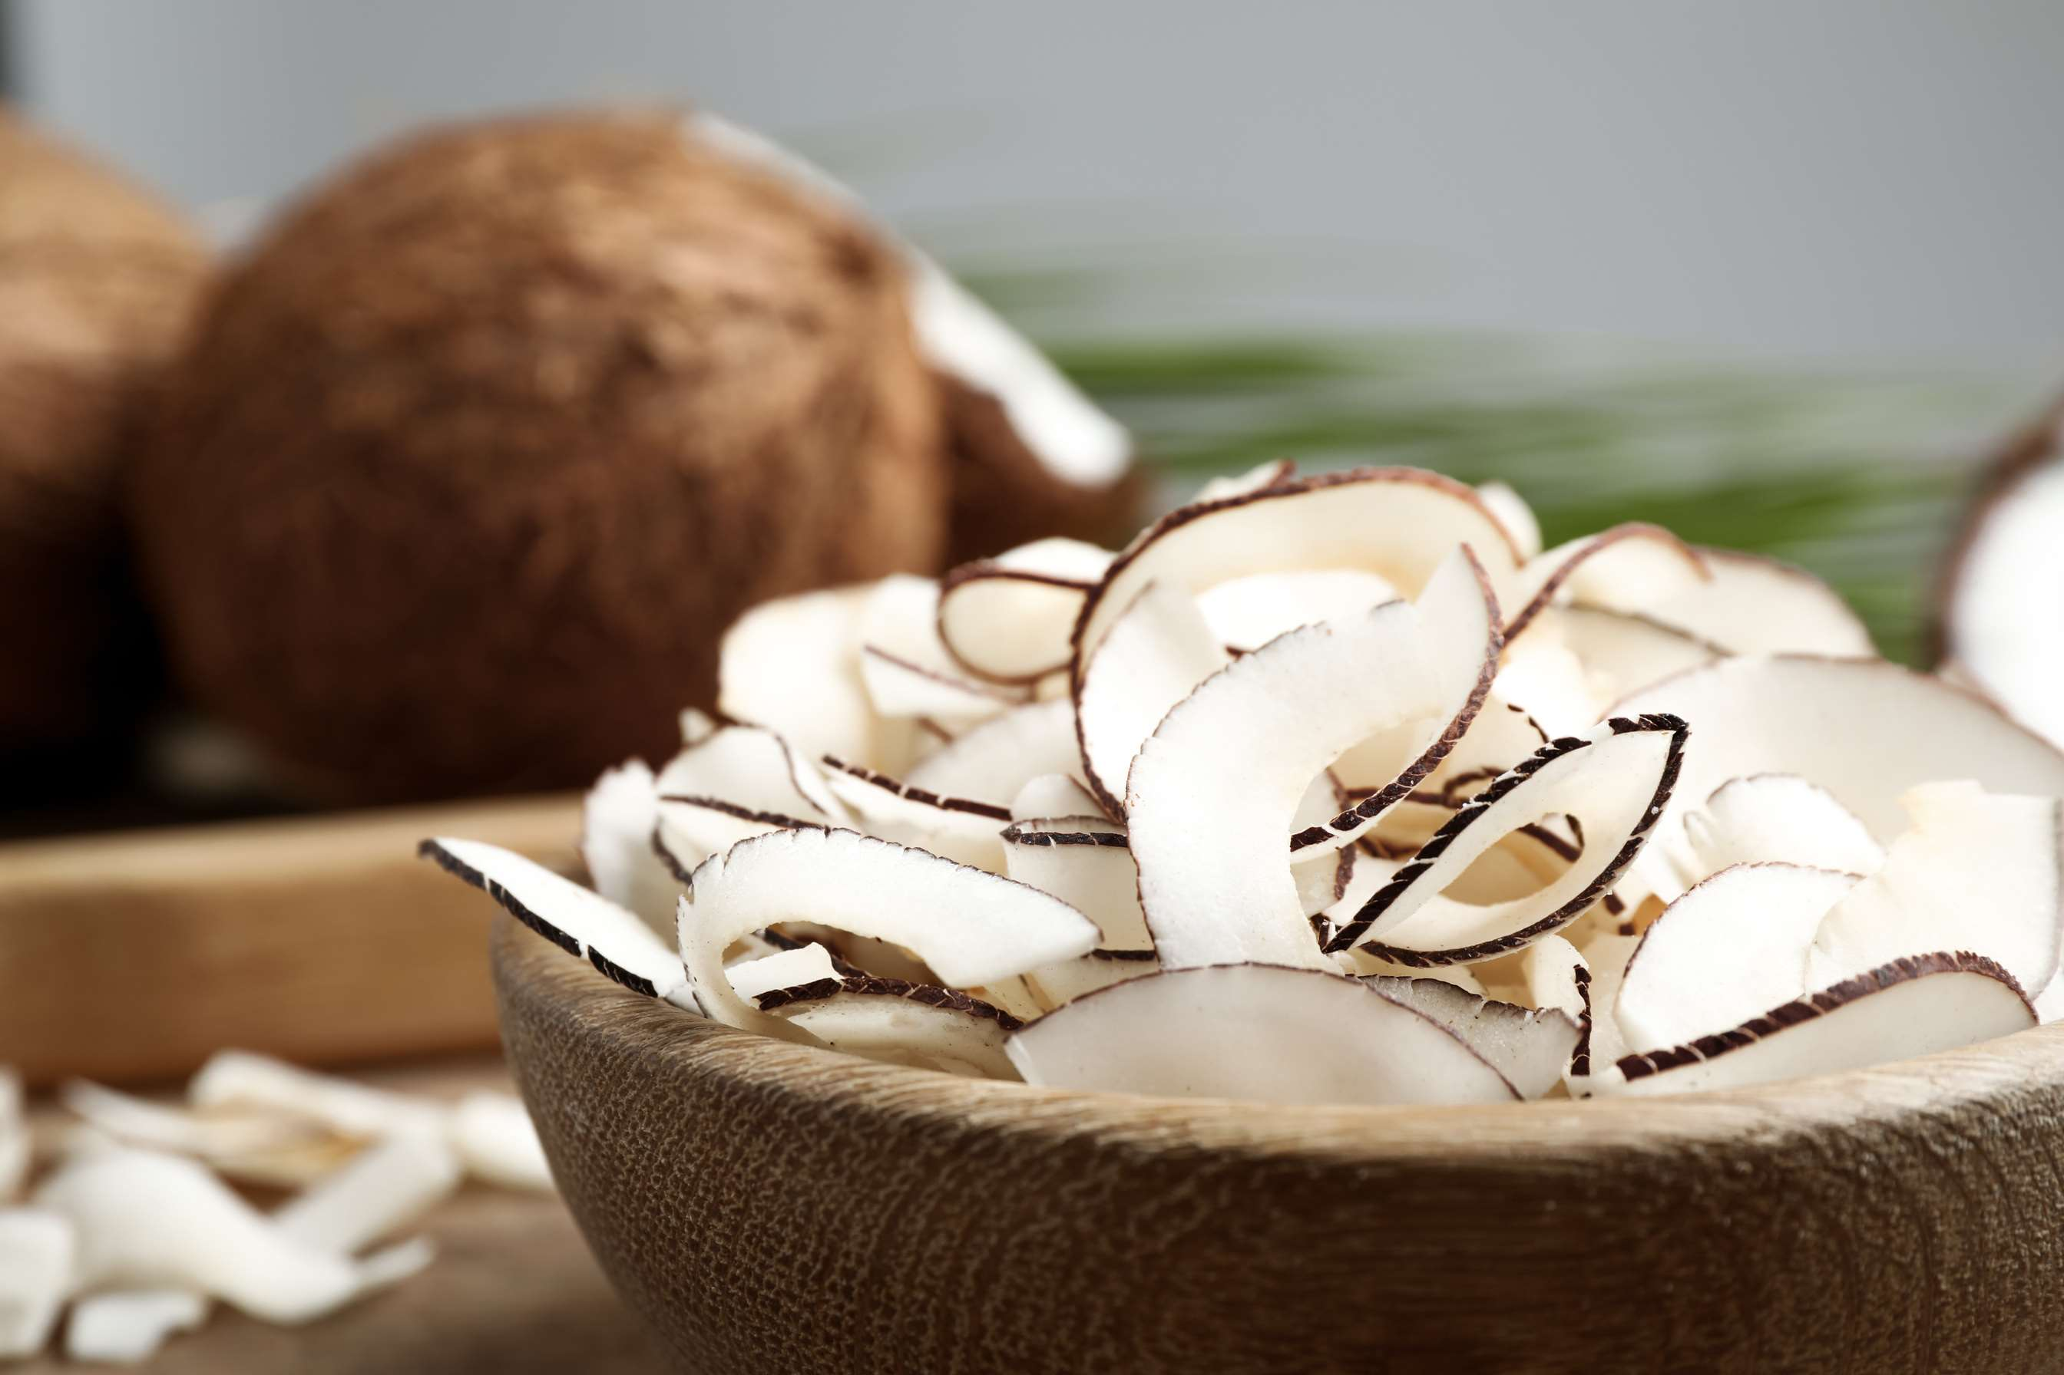
  Rising Popularity of Healthy and Convenient Ingredients to Increase the Demand Globally
  Growth of Bakery and Confectionery Industry to Propel Market Growth
Drivers
Fluctuations in Coconut Prices to Limit the Sales
Restraints

Slide 7
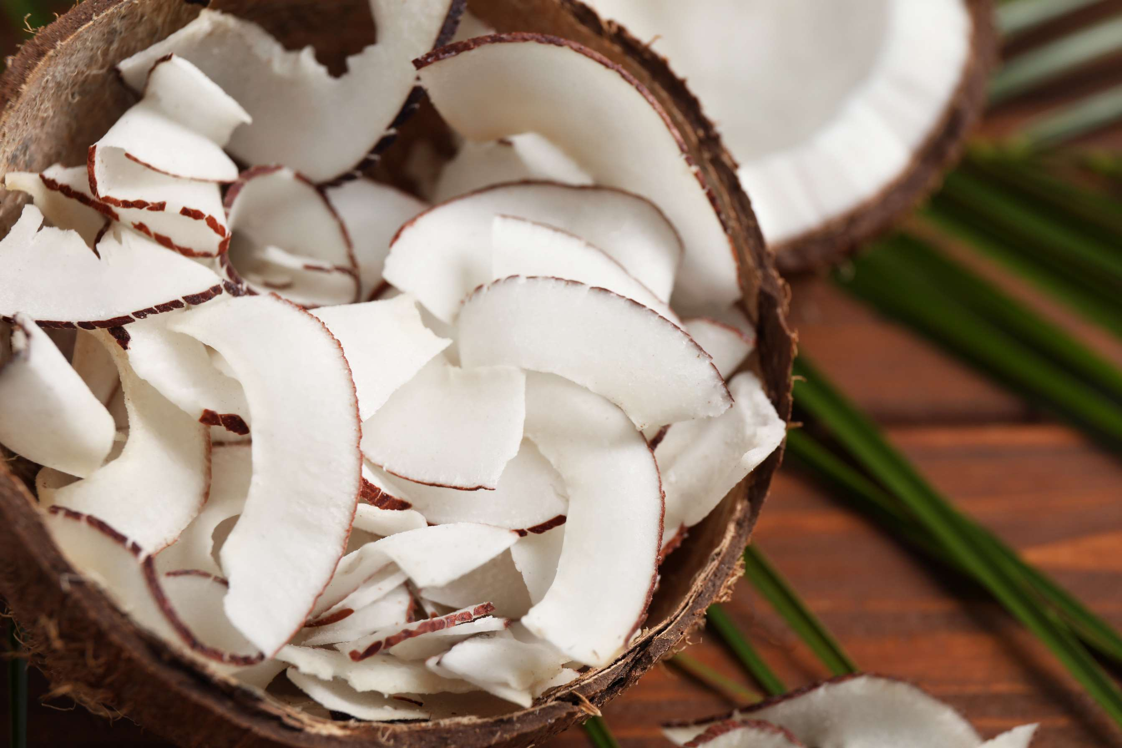
AUTHOR'S PERSPECTIVE
  The global Shredded and Desiccated Coconut market will expand significantly by 5.50% CAGR between 2024 to 2031.
  A good source of fiber, medium-chain triglycerides, and a few important minerals is desiccated coconut. This is consistent with consumers' increasing interest in health-promoting functional foods.
  Growing discretionary income causes consumers to spend more on packaged and convenience goods, many of which include dried or shredded coconut. This is especially true in developing nations.

Slide 8

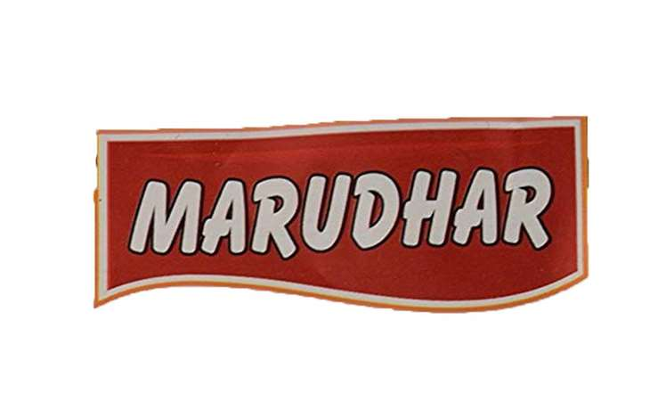
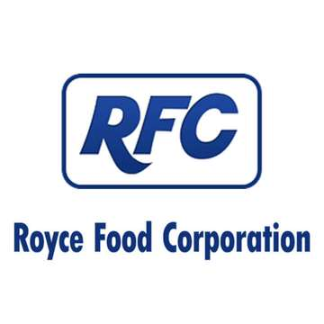
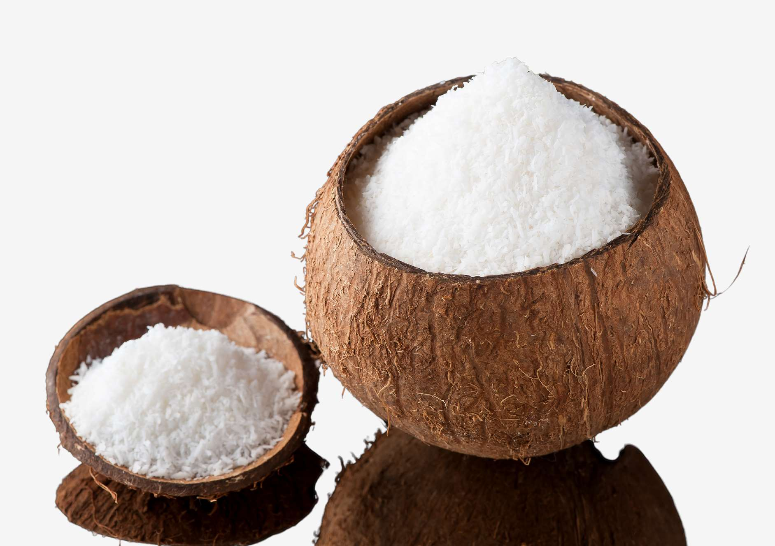







KEY PLAYERS

Slide 9


For Full Report
Contact us
COGNITIVE MARKET RESEARCH
Tel: +1 312-376-8303 | +44 020-8123-0732
India: (+91) 983-496-8611
sales@cognitivemarketresearch.com
Access the Full Report : https://tinyurl.com/29na3b5t
Please visit our website:
https://www.cognitivemarketresearch.com

