Slide 1


GLOBAL
SHAKER BOTTLE
MARKET REPORT
2024
Global,Regional,CountryAnalysis

Slide 2
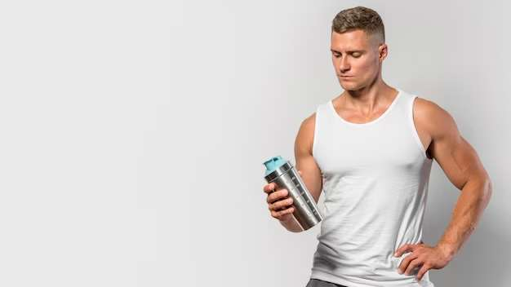
INTRODUCTION
Shaker bottles are specifically crafted containers for storing beverages that do not contain carbonation. These bottles are designed with a tightly fitting lid to prevent any leakage of liquids. Additionally, they are equipped with a mechanism that enables effortless mixing of the contents. The rising demand for these bottles can be attributed to the growing awareness of health and fitness and the increasing popularity of sports management.

Slide 3


KEY INSIGHTS
MARKET SIZE
USD 2.5 billion
2023
CAGR
6.80%
2023- 2030

Slide 4
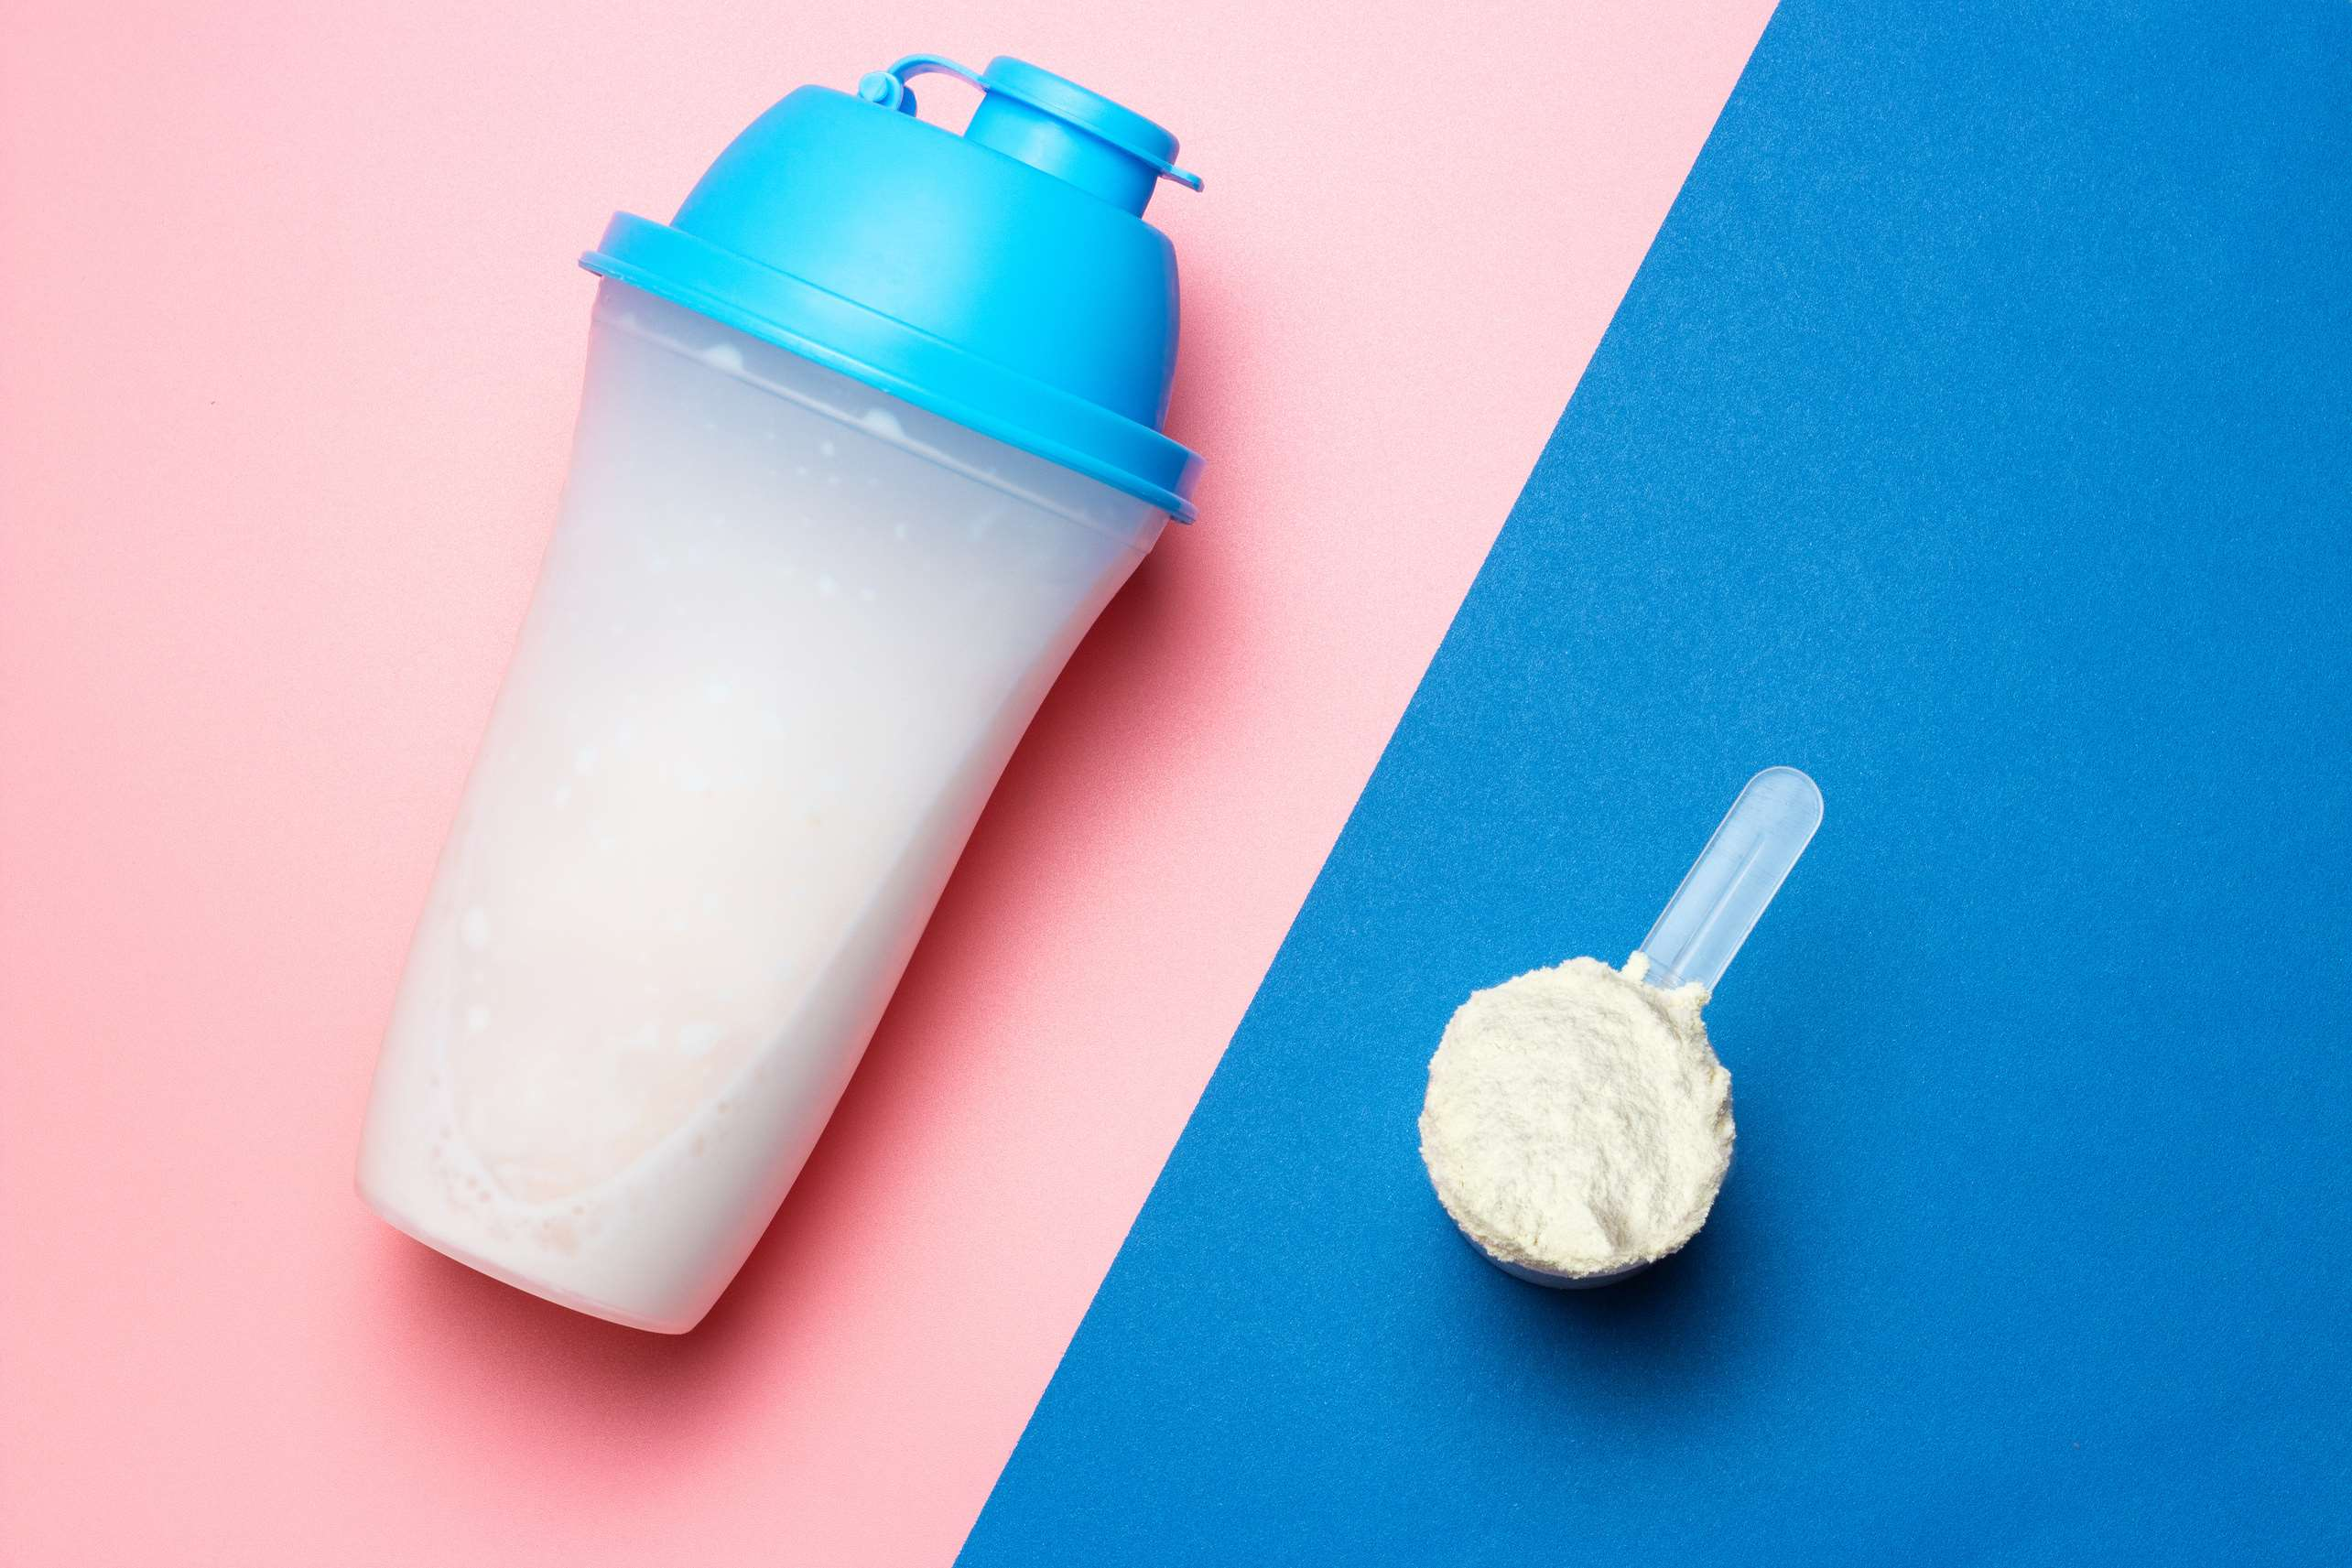
REVENUE MARKET SHARE BY SEGMENTS 2022
  Plastic Made
  Stainless Steel Made
Type Segment
Application Segment
  Protein Mixing
  Other Supplement Drinks

Slide 5

Global Shaker Bottle Market Revenue share for 2022
North America
30%

Slide 6
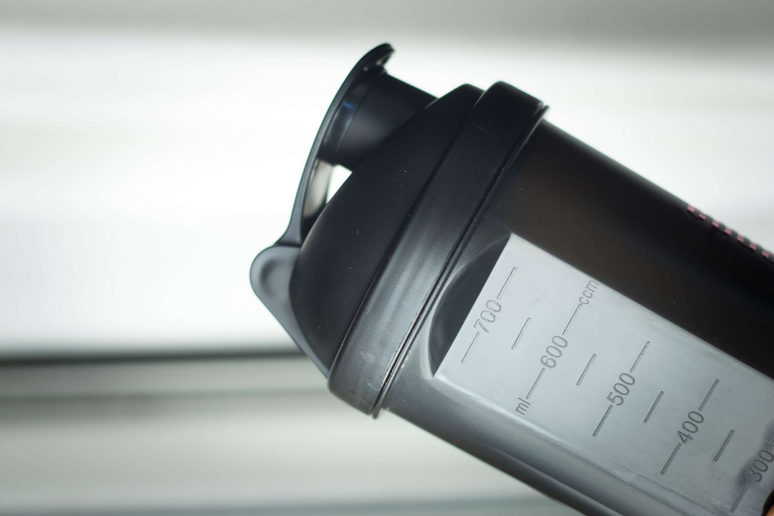
E-commerce Expansion and Customization to Propel Market Growth
Drivers
Increasing Environmental Concerns and Sustainability Challengesto Hinder Market Growth
Restraints

Slide 7
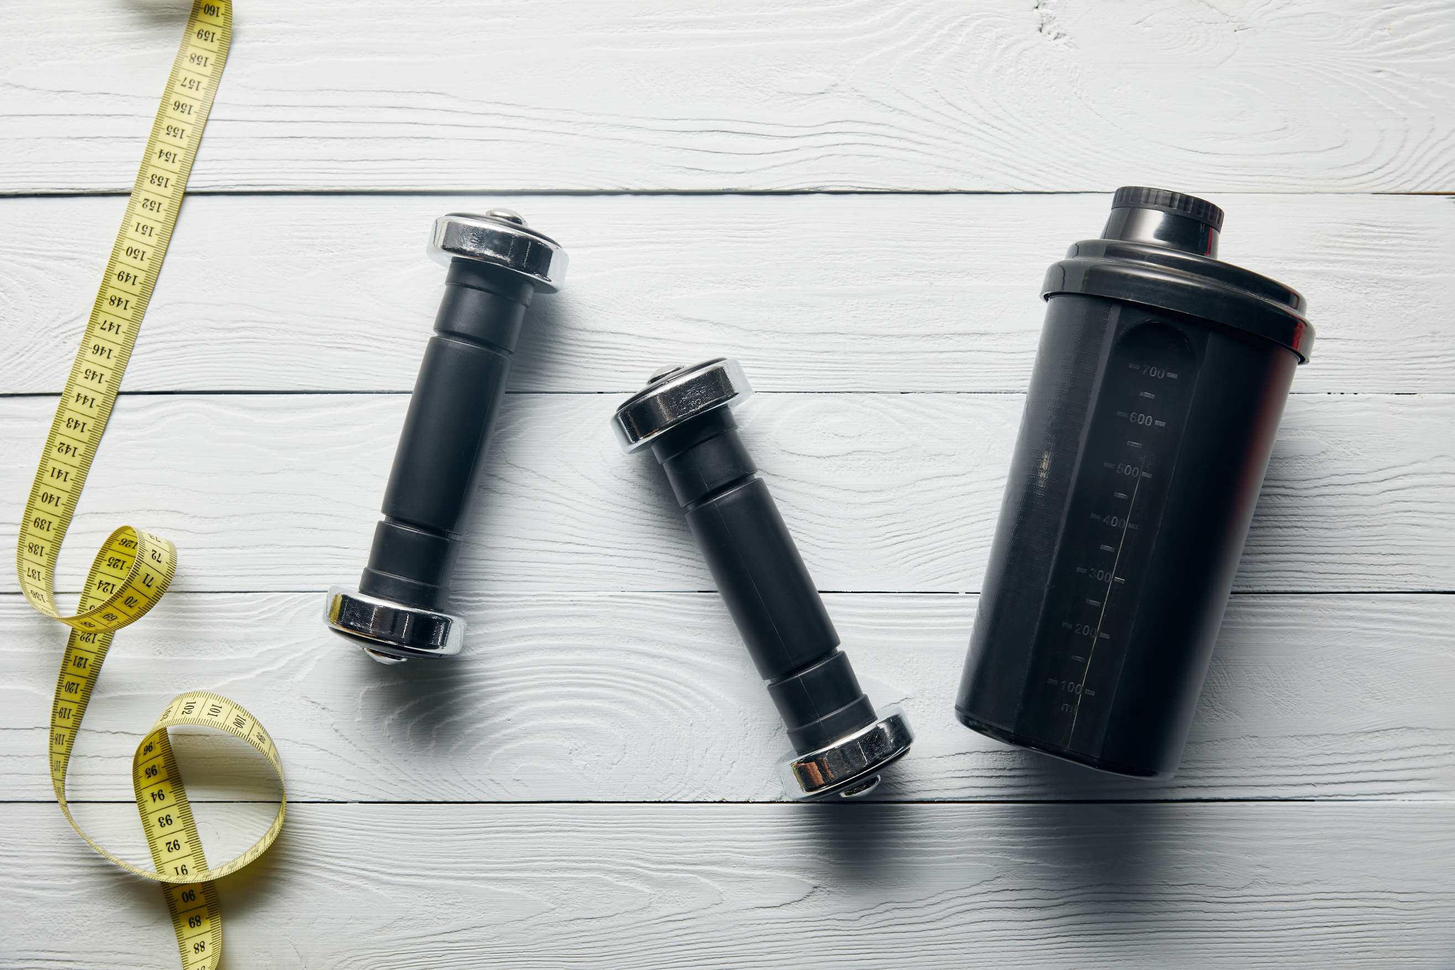
AUTHOR'S PERSPECTIVE
  The Global Shaker Bottle Market is witnessing significant growth in the near future.
  Stainless steel shaker bottles are witnessing a surge in demand due to their superior durability, non-toxic properties, and excellent insulation capabilities.
  This category encompasses various beverages such as meal replacement shakes, pre-workout supplements, energy drinks, and hydration formulas.
  In 2023, the Plastic Made segment accounted for noticeable share of global Shaker Bottle Market and is projected to experience significant growth in the near future.
  The Protein Mixing segment is expected to expand at the significant CAGR retaining position throughout the forecast period.

Slide 8
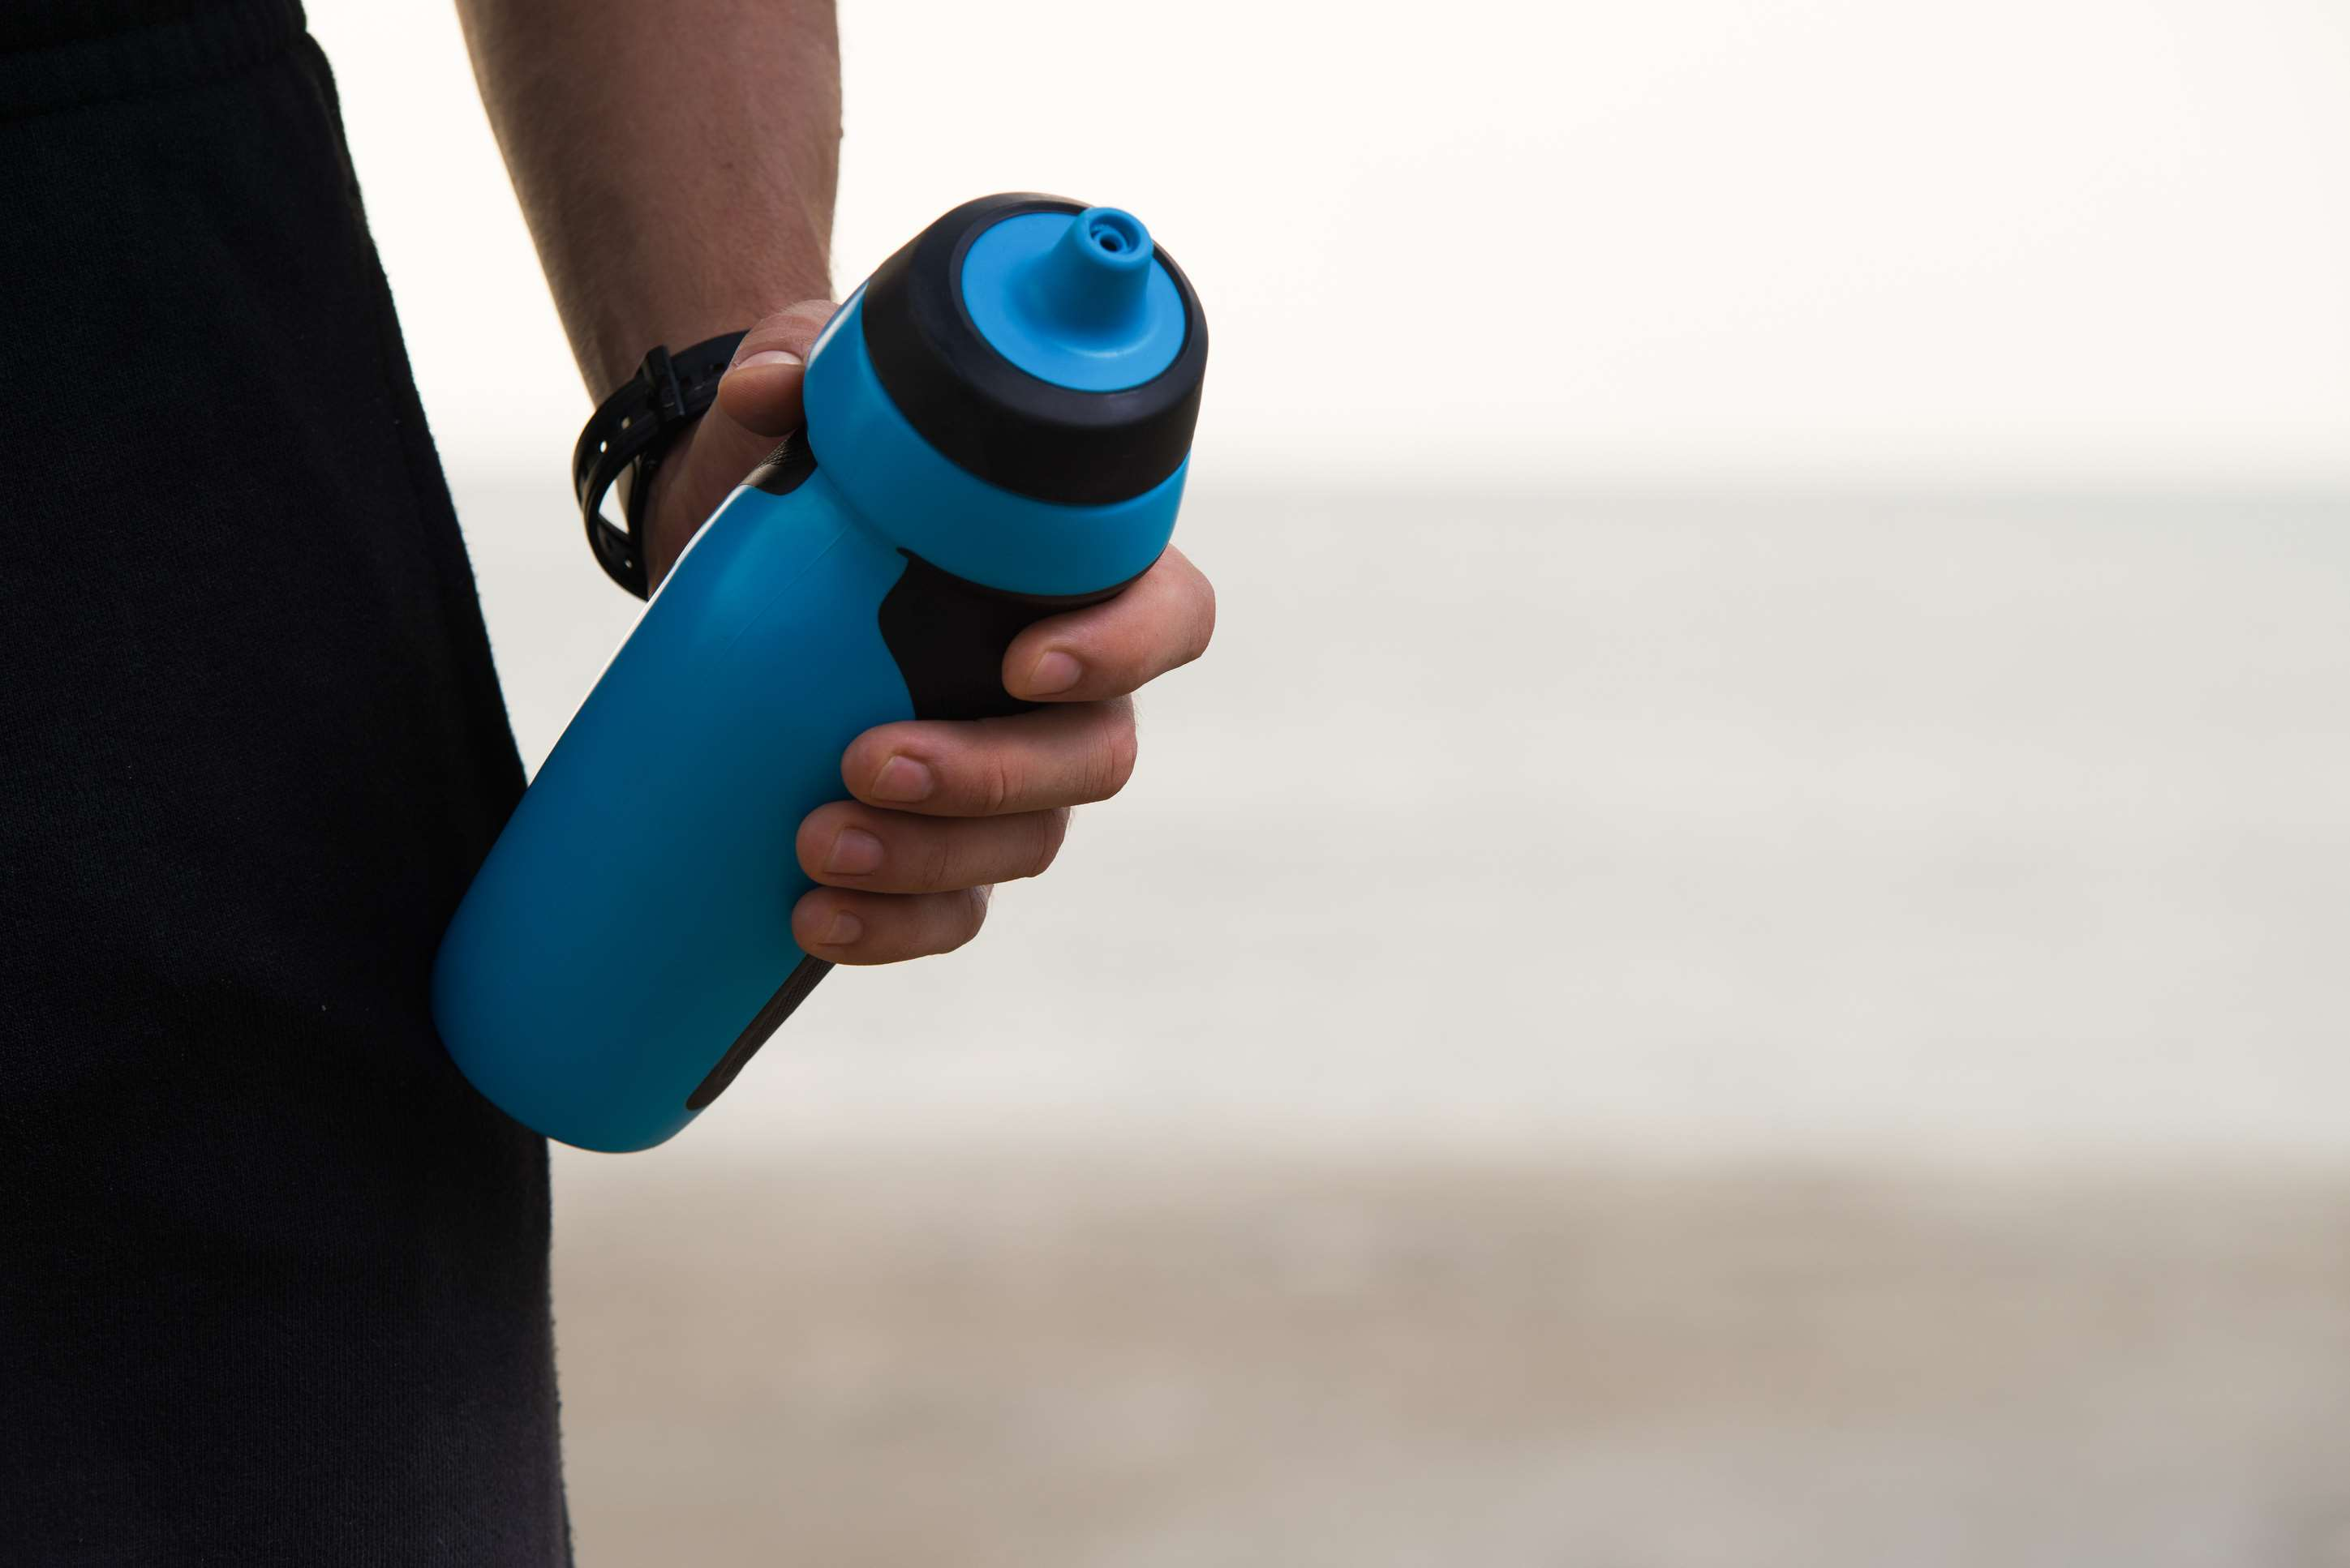
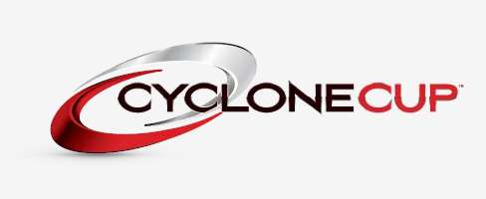

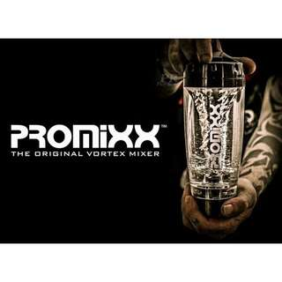
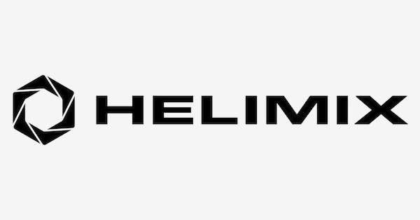

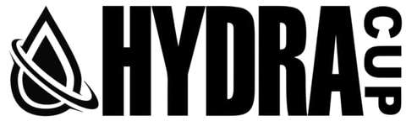
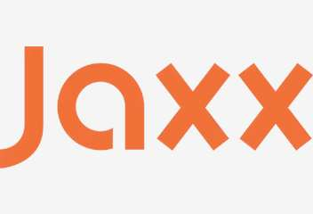

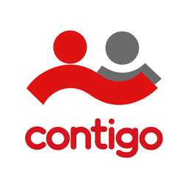
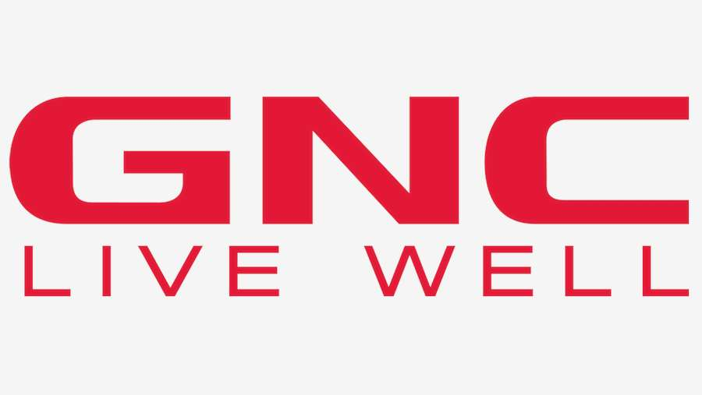
KEY PLAYERS

Slide 9


For Full Report
Contact us
COGNITIVE MARKET RESEARCH
Tel: +1 312-376-8303 | +44 020-8123-0732
India: (+91) 983-496-8611
sales@cognitivemarketresearch.com
Access the Full Report : http://tinyurl.com/2wnthvje
Please visit our website:
https://www.cognitivemarketresearch.com

