Slide 1

GLOBAL
SEED TESTING SERVICES
MARKET REPORT
2024
Global,Regional,CountryAnalysis

Slide 2
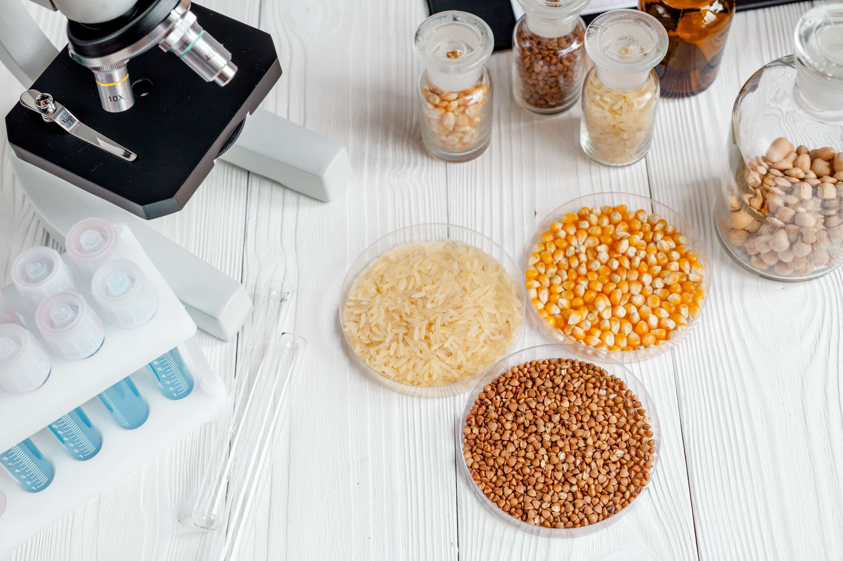
INTRODUCTION
The requirement for international seed certifications for domestic and international trade is expanding the market for seed testing services. To increase agricultural productivity, seed quality identification is essential. Information on biological conditions and general seed health is available through seed certification. For instance, international seed trading often necessitates Orange certification for seed, which follows ISTA guidelines.

Slide 3


KEY INSIGHTS
MARKET SIZE
USD 0.8 billion
2023
CAGR
6.50%
2023- 2030

Slide 4
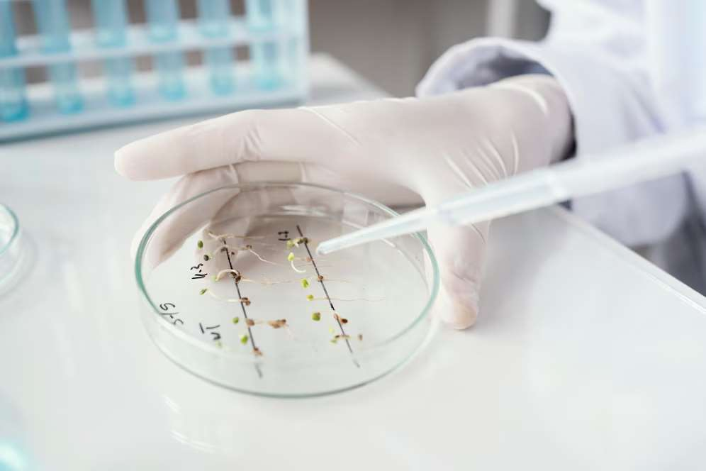
REVENUE MARKET SHARE BY SEGMENTS 2022
  Purity Test
  Water Test
  Dynamic Test
  Germination Test
  Vigor Test
  Pathogen Test
  GMO Test
  Trait Test
Type Segment
  Seed Manufacturer
  Farmers
  Agricultural Consultant
  Research Institutions
  Government Agencies
  Seed Distributors
Application Segment

Slide 5

Global Seed Testing Services Market Revenue share for 2024
North America
37.6%

Slide 6
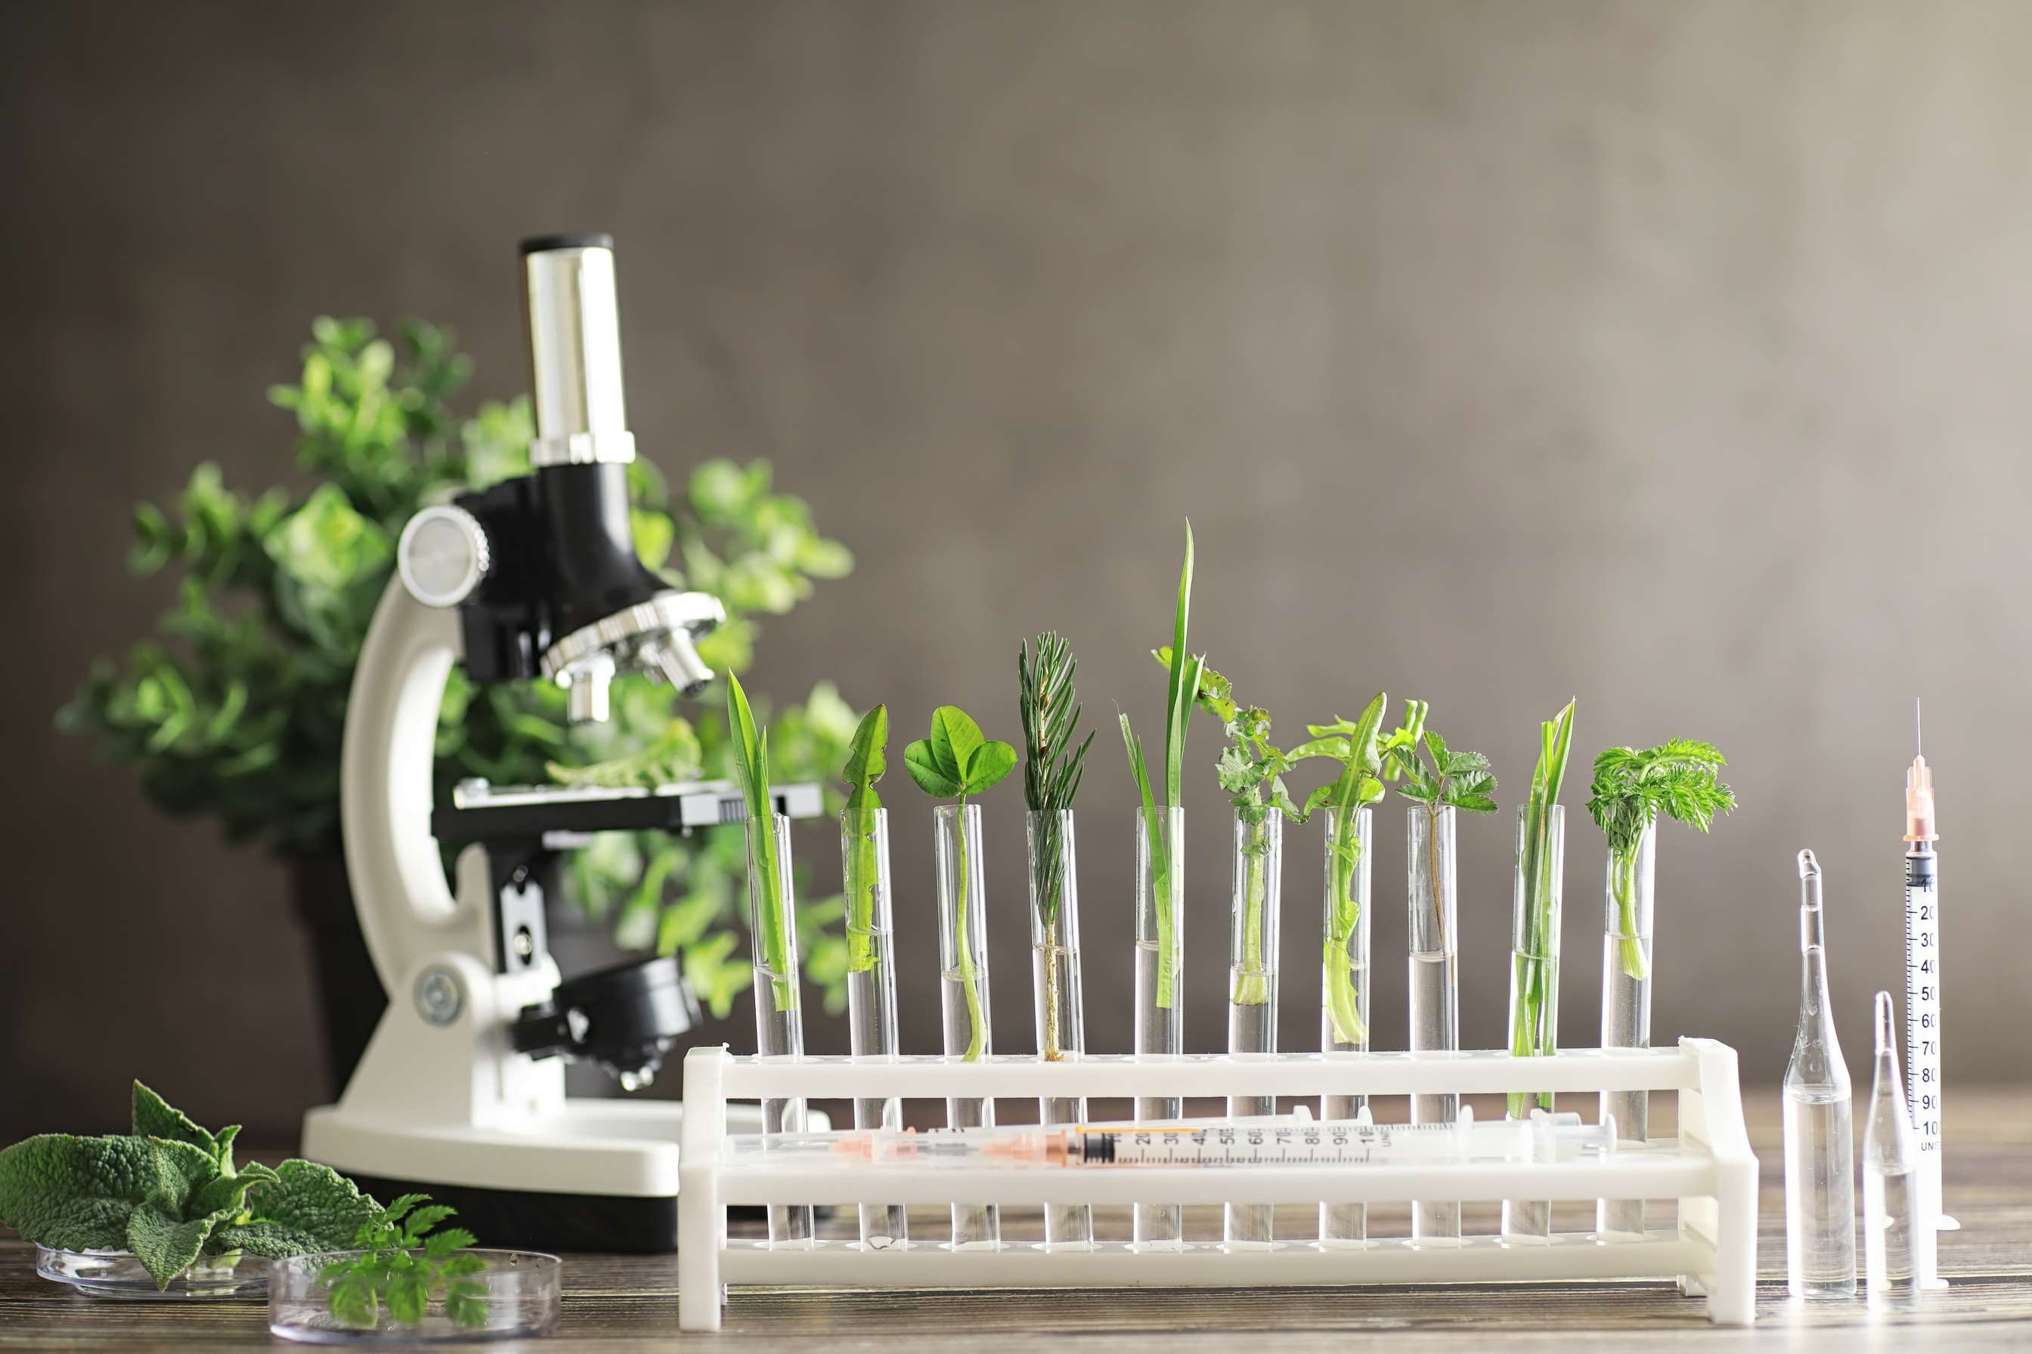
Improved Crop Production Using Advanced Techniques to Provide Viable Market Output
Drivers
High Cost and Lack of Awareness to Hinder Market Growth
Restraints

Slide 7

AUTHOR'S PERSPECTIVE
  The Global Seed Testing Services Market is witnessing significant growth in the near future.
  Purity testing of seeds ensures that seed lots are of high quality and that the Federal Seed Act's requirements for seed labeling are met.
  While the purity test rules the market, a water test is still necessary for some seed testing services, and one can check the moisture level of seeds with the water test. Insufficient germination and poor yields might result from seeds that are too moist
  The Agricultural consultant is the second-most popular product. Leading market corporations are focusing on acquisitions and bolstering their R&D divisions.

Slide 8









KEY PLAYERS

Slide 9


For Full Report
Contact us
COGNITIVE MARKET RESEARCH
Tel: +1 312-376-8303 | +44 020-8123-0732
India: (+91) 983-496-8611
sales@cognitivemarketresearch.com
Access the Full Report : https://tinyurl.com/27xw7jss
Please visit our website:
https://www.cognitivemarketresearch.com

