Slide 1


SEED POTATOES
MARKET REPORT
2024
Qualitative Analysis + Quantitative Analysis

Slide 2
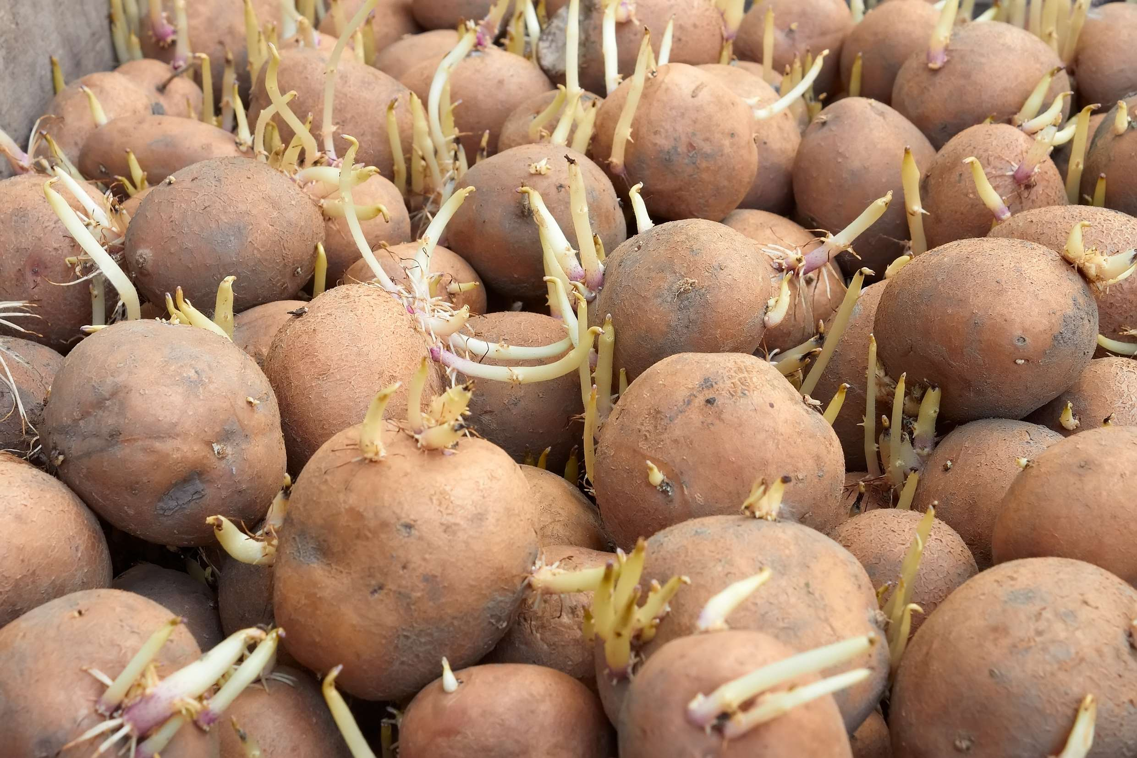
INTRODUCTION
The global potato industry, one of the most important food industries globally, includes a sizeable portion of the seed potato market. In the potato value chain, seed potatoes are essential since they are used to plant and grow potato crops. They are crucial for preserving crop quality and yield because they are the source of new potato plants. For instance, according to the International Potato Centre, in terms of human consumption, potatoes are the third-most significant food crop in the world, behind rice and wheat.

Slide 3


KEY INSIGHTS
MARKET SIZE
$13.863.18 Million
2024
FORECAST
$16,558.05 Million
2030
CAGR
2.97%
2024- 2031

Slide 4
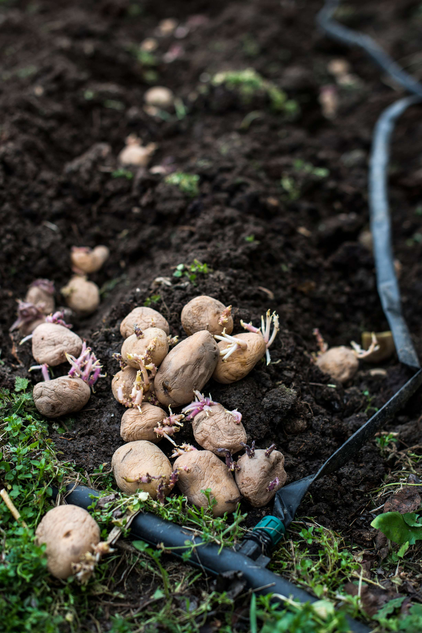
REVENUE MARKET SHARE BY SEGMENTS 2024
  Conventional Seed Potatoes
  Micro-propagation Seed Potatoes
  Retail Chain
  Direct to Farmers
  Others
Distribution Channel
By Product Type
  Certified Seed Potatoes
  Non-certified Seed Potatoes
  Factory Planting
  Farmer Planting
  Others
Regulation Segment
by Application

Slide 5

North America
40%
North America Seed Potatoes Market Revenue share for 2024 is 40%

Slide 6
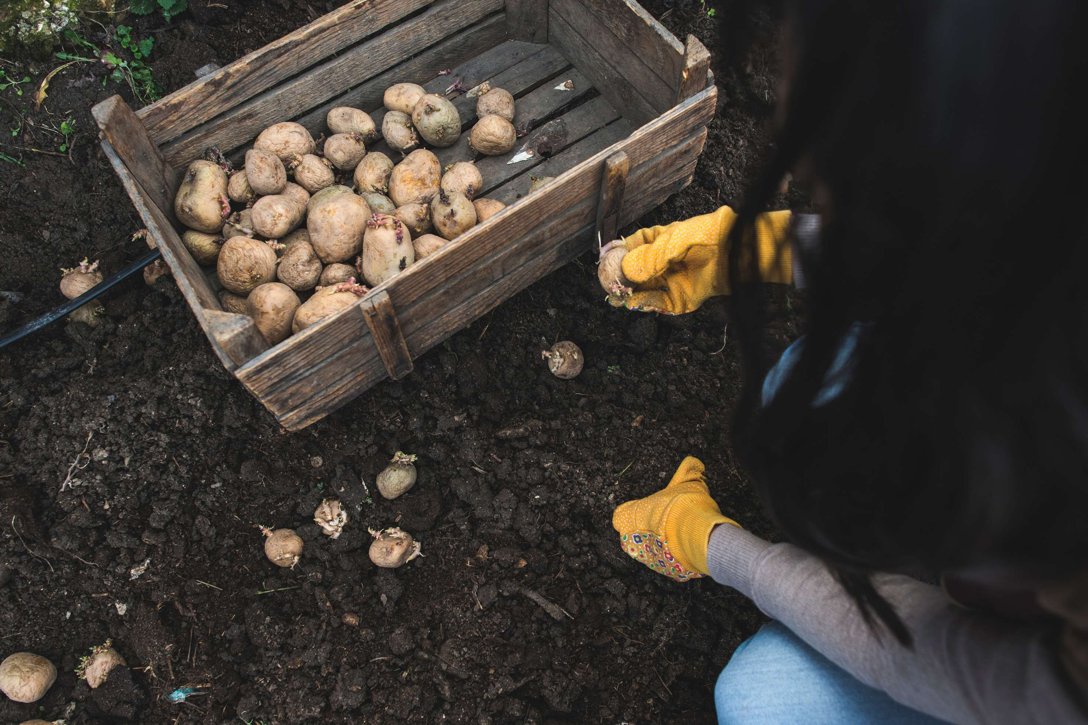
  Growing Potato Consumption and Production Favours the Growth of the Seed Potato Market
  Increasing Technological Advancements in Production of Seed Potato Varieties Drives the Market Growth
Drivers
Higher Investment Requirements for Seed Potato Production is Likely to Restrain the Market Growth.
Restraints

Slide 7

AUTHOR'S PERSPECTIVE
  The Global Seed Potatoes Market is witnessing significant growth in the near future.
  Conventional potato seed production systems involve successive multiplication of nucleus seed tubers through super-elite, elite, and certified seed stages.
  Factory planting of potatoes can improve the efficiency, quality, and yield of potato production, as well as reduce labor costs and environmental impact.
  Retail chain distribution refers to the process of getting goods from manufacturers and producers to consumers through a network of intermediaries such as wholesalers, distributors, and retailers.

Slide 8





KEY PLAYERS

Slide 9


For Full Report
Contact us
COGNITIVE MARKET RESEARCH
Tel: +1 312-376-8303 | +44 020-8123-0732
India: (+91) 983-496-8611
sales@cognitivemarketresearch.com
Access the Full Report : https://tinyurl.com/2k6asu72
Please visit our website:
https://www.cognitivemarketresearch.com

