Slide 1
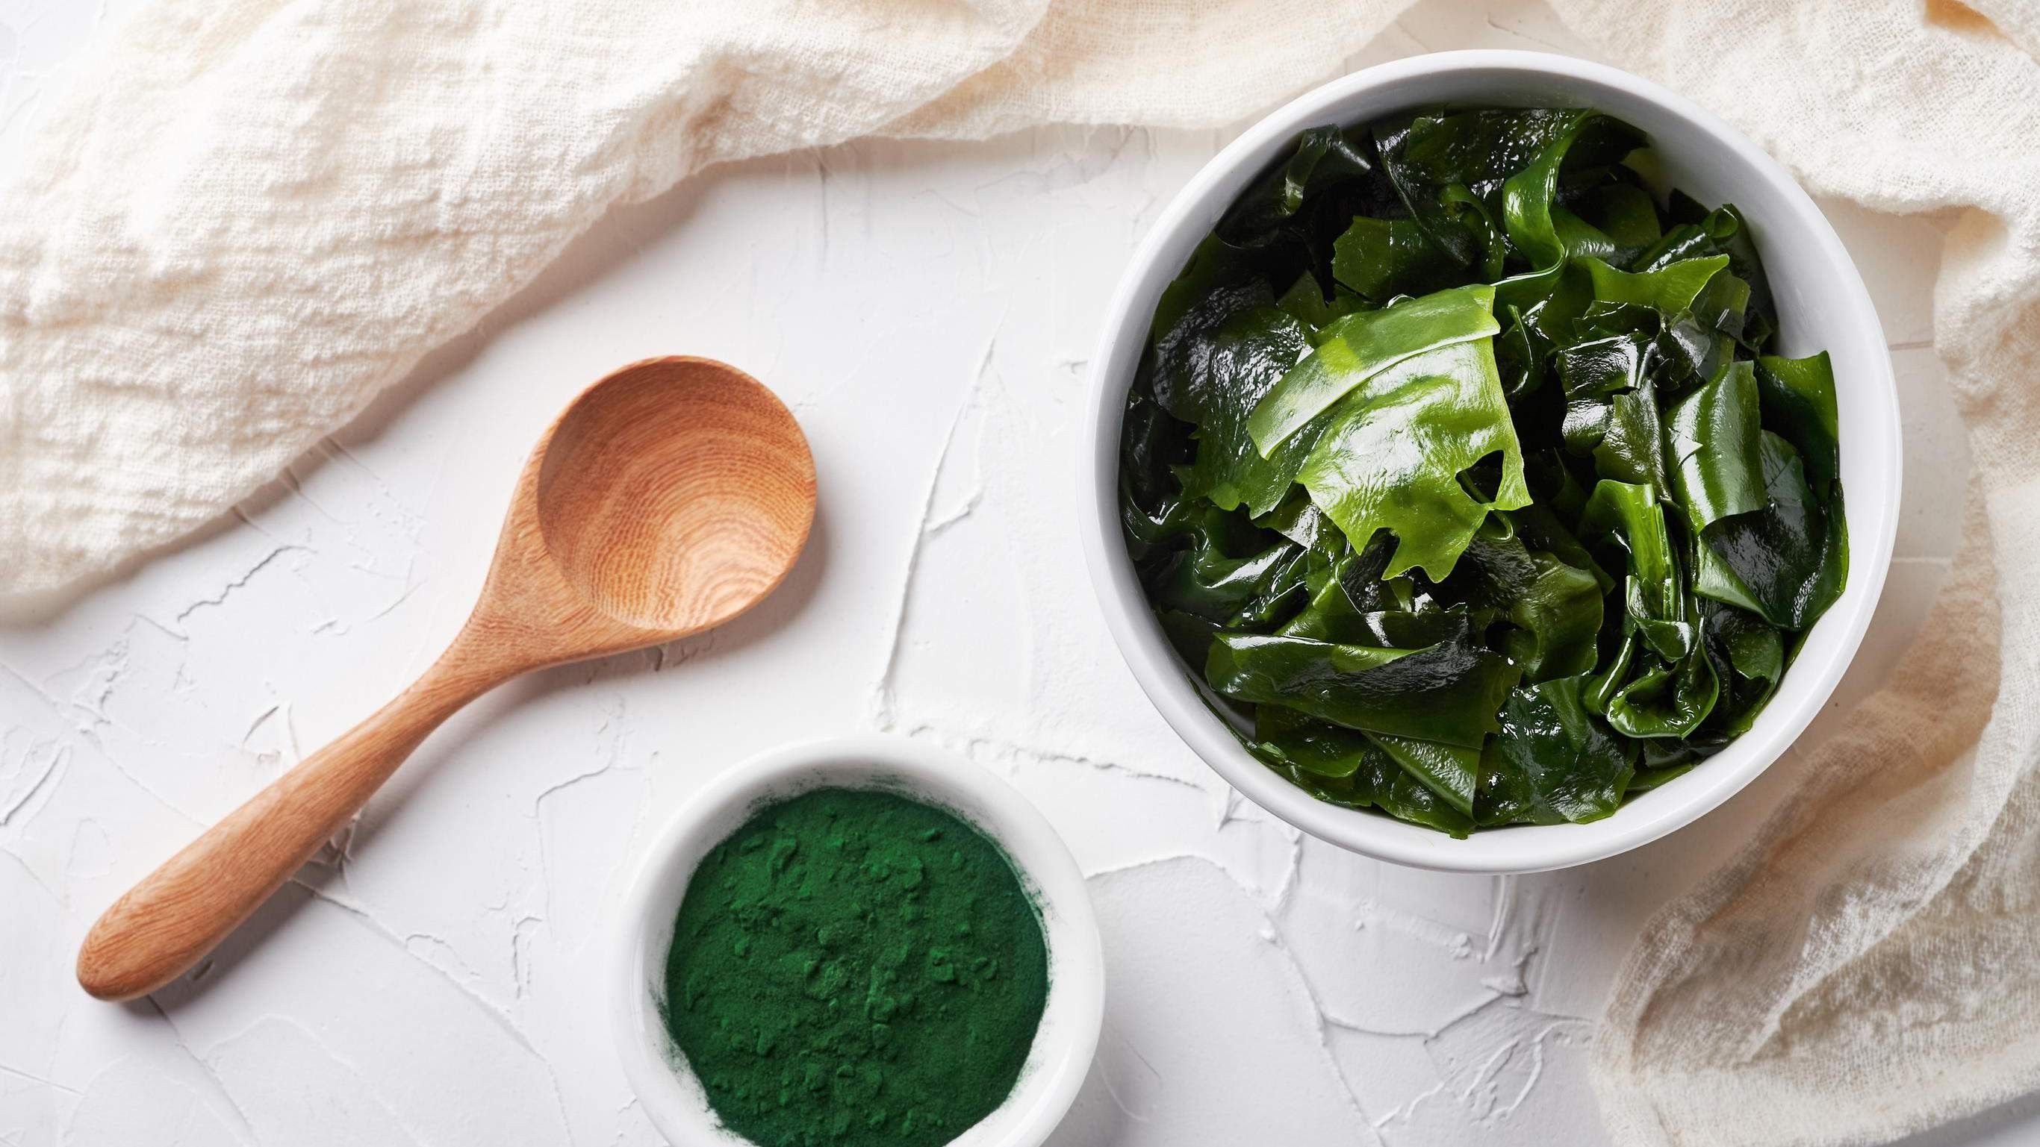
GLOBAL
Seaweeds
MARKET REPORT 2024
Global,Regional,CountryAnalysis

Slide 2
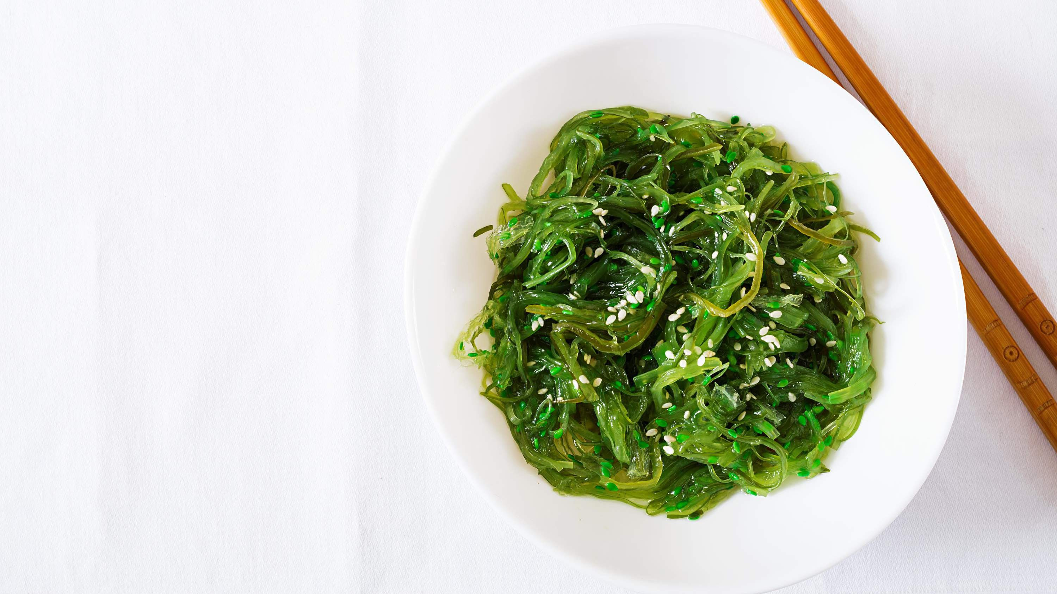
INTRODUCTION
Increased usage of seaweed for hydrocolloids, its high nutritional value and health advantages, and the growing demand for it in end-use sectors like animal feed, personal care, pharmaceuticals, and agriculture. Extracts of seaweed are used as fertilizer by farmers because of their high quality.
Extracts of seaweed leaves have been proven to increase agricultural yield through unique processes. As more farmers become familiar with using seaweeds in crop production, they begin to see other benefits, such as enhanced plant root systems. The microbiology, structure, and water- holding capacity of soil are all boosted by the addition of seaweeds. During the forecast period, product demand is anticipated to be driven by these reasons.

Slide 3
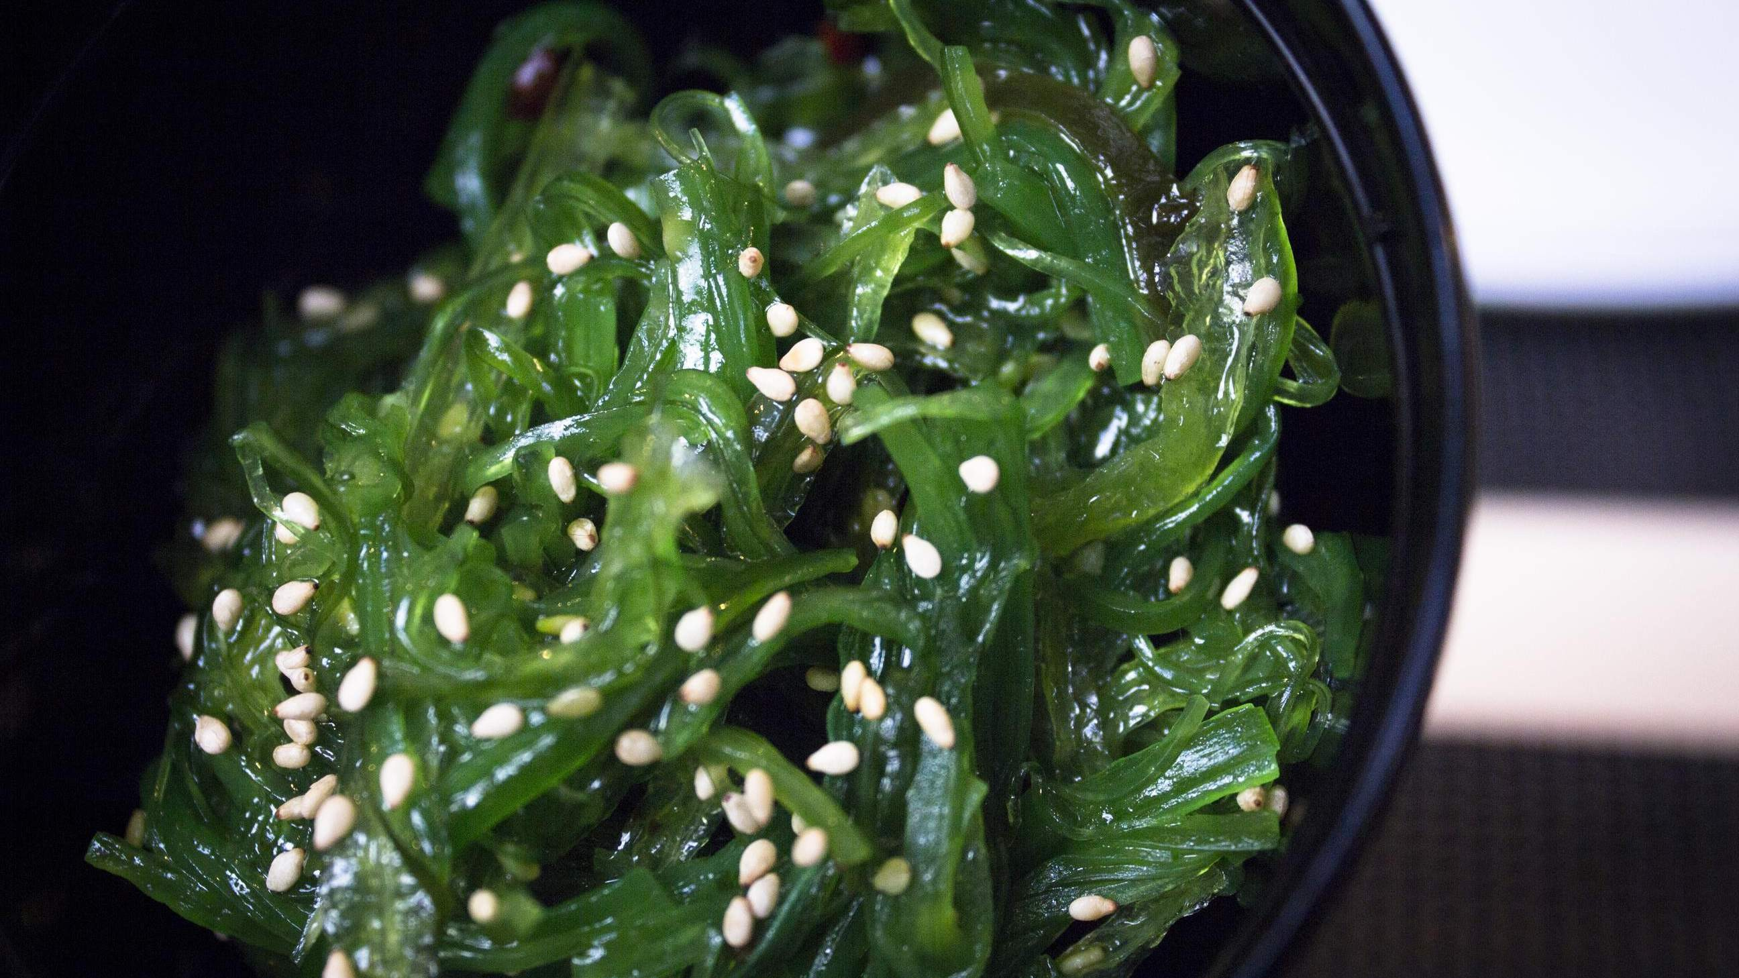

KEY INSIGHTS
MARKET SIZE
USD 6.8 billion
2023
20₋23
CAGR 9.20%
2030

Slide 4
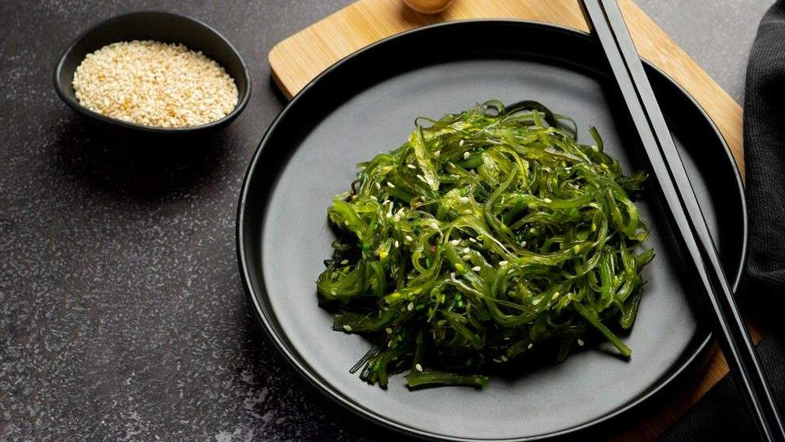
REVENUE MARKET SHARE BY SEGMENTS 2022
Red Seaweed
Brown Seaweed
Green Seaweed
Type Segment
Food & Beverages
Agricultural Fertilizers
Animal Feed Additives
Pharmaceuticals
Cosmetics & Personal Care
End-Use Segment
Flakes
Powder
Liquid
Seaweeds Service Segment

Slide 5
Global Seaweeds Market Revenue share for 2022
Asia-Pacific

Slide 6
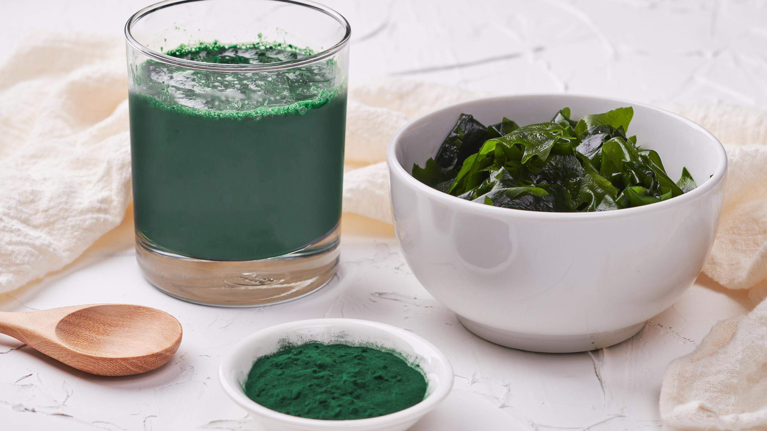



Slide 7
AUTHOR'S PERSPECTIVE
The Global Seaweeds Market is witnessing significant growth in the near future.
Brown seaweed's high demand from many sectors, including agriculture,
animal feed, and food & beverage, bodes well for the market's expansion
throughout the projection period.
The seaweed for cosmetic & personal care offering ranks second most popular segment due to the rapidly increased demand for antioxidant-rich cosmetic items such as body lotions, moisturizing soaps, shampoos, and creams.

Slide 8

KEY PLAYERS

Slide 9


Contact us
For Full Report
COGNITIVE MARKET RESEARCH
Tel: + 1 312 - 376 - 8303 | + 44 020 - 8123 - 0732
India: ( + 91 ) 983 - 496 - 8611
sales@ cognitivemarketresearch. com
Access the Full Report : http://tinyurl.com/3t7pxx6p
Please visit our website:
https://www.cognitivemarketresearch.com

