Slide 1
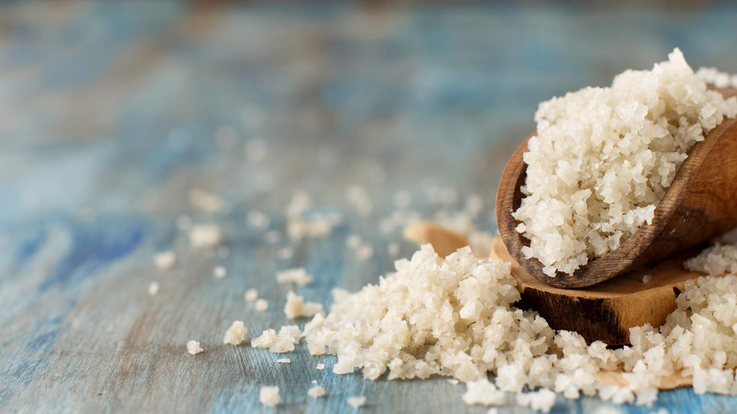
GLOBAL SEA SALT
MARKET REPORT
2024
Global,Regional,CountryAnalysis

Slide 2
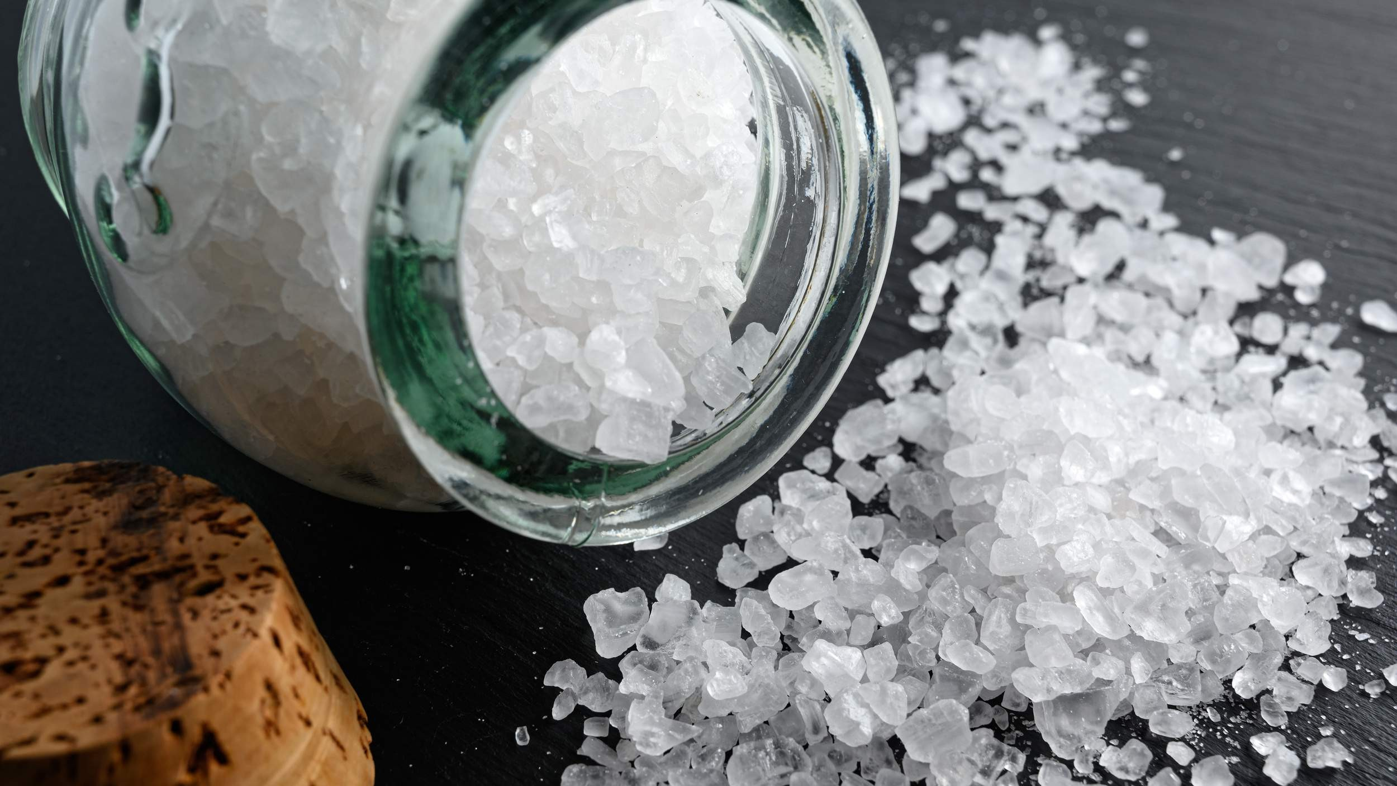
INTRODUCTION
Sea salt is salt produced by evaporating seawater. It's sometimes called solar salt, bay salt, or salt. Because sea salt is less processed than refined salt, it retains moisture and important minerals such as potassium, calcium, chloride, iron, magnesium, sodium, and zinc. It has a dark colour on top of refined salt. The quality and mineral combination offered by sea salt is also affected by the climate and geographical location in the place. The Atlantic Ocean, North Sea, and Mediterranean Sea are the most prevalent locations for sea salt extraction. It is used in cooking to improve flavour, season meat, pasta, fish, and grilled vegetables, and preserve items like pickles and canned foods. Furthermore, sea salt has anti-inflammatory properties that calm the skin, aid in eliminating bacteria that cause bad breath, and aid in treating dandruff. As a result, it is utilized in cosmetic goods like face and body scrubs and bath soap.

Slide 3


KEY INSIGHTS
MARKET SIZE
USD 18.5 billion
2023
CAGR 3.60%
2023
-
2030

Slide 4
REVENUE MARKET SHARE BY SEGMENTS 2022
Refined
Un-Refined
Type Segment
Bags or Pouches Drums and Sacks Shakers
Glass Jars
Packaging Segment
Regenerating Water Agent
De-Icing Agent Detoxifying Agent Anti-Oxidant Agent
Application Segment
B2B
Food Industry Agriculture Cosmetics Animal Feed
End-User Segment
Online Sales Offline Sales
Distribution Channel

Slide 5
Global Sea Salt Market Revenue share for 2022
North America 38%

Slide 6
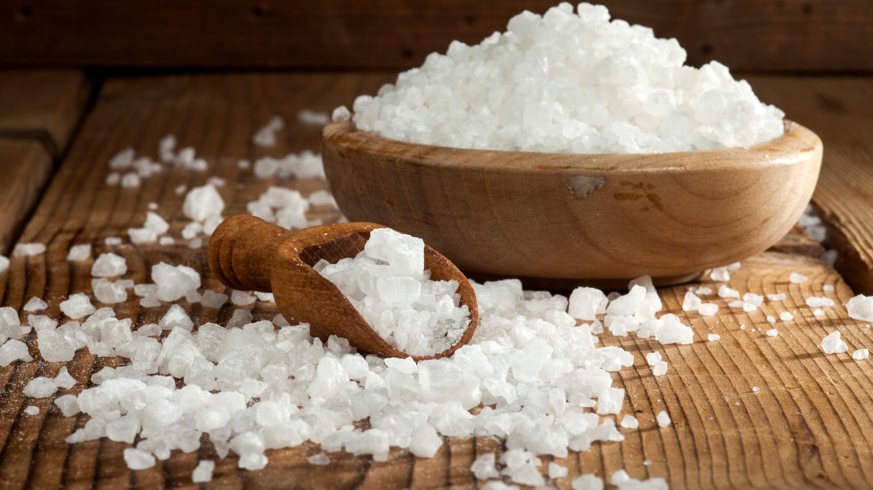
Multi-applicative Application of Sea Salt to Propel Market Growth
Drivers
Sea Water Pollution to Restrict Market Growth
Restraints

Slide 7
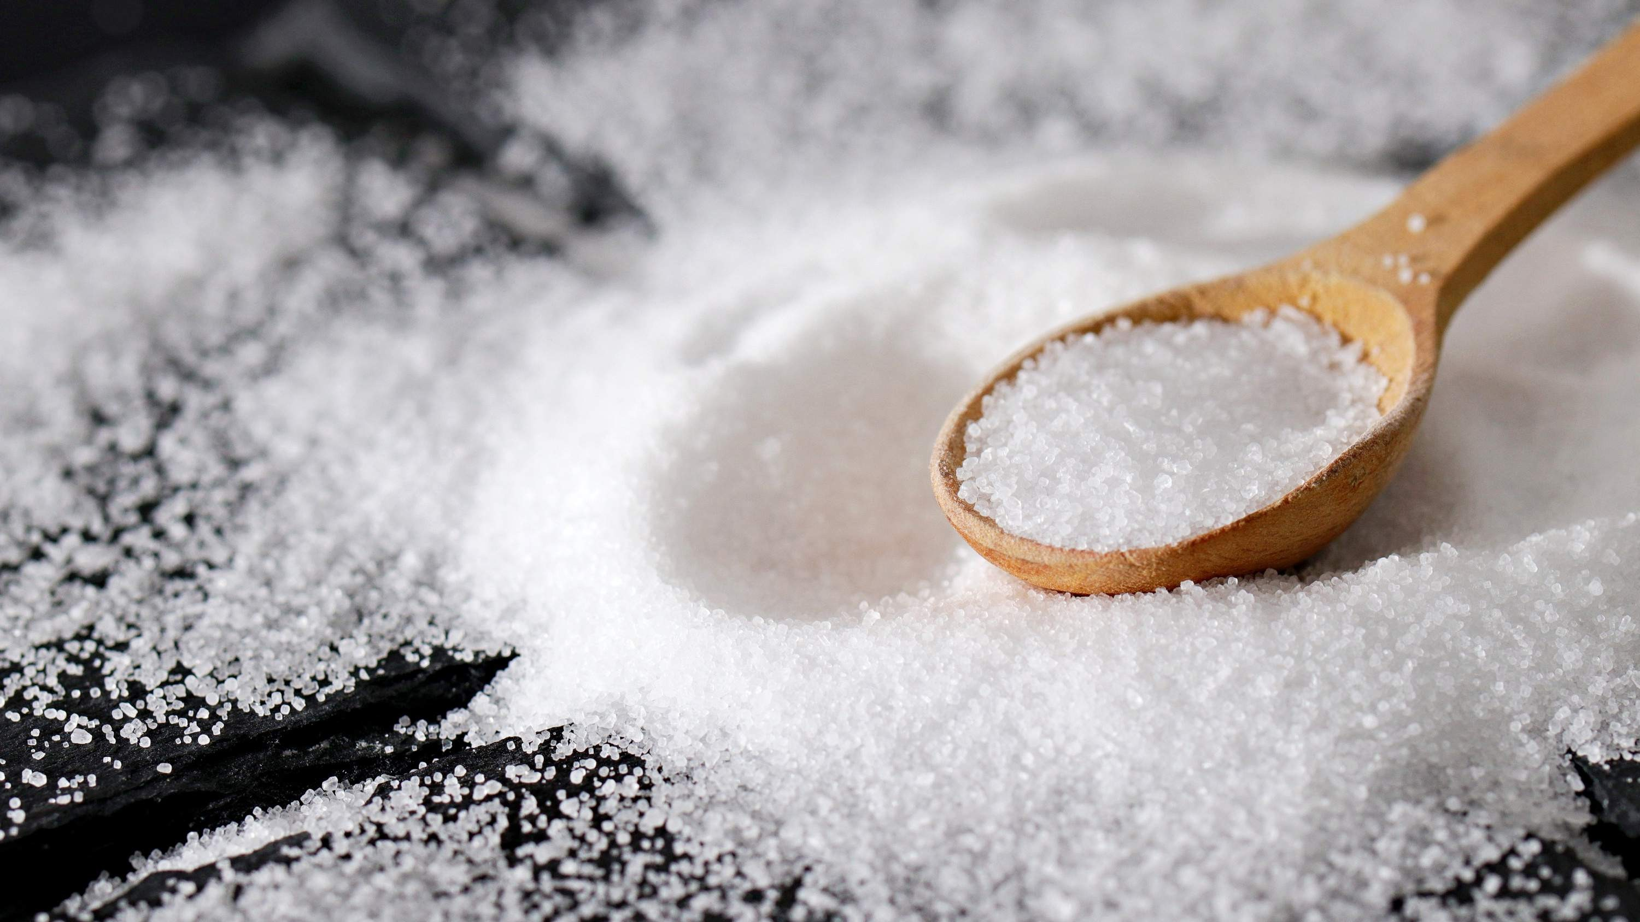
AUTHOR'S PERSPECTIVE
The Global Sea Salt Market is witnessing significant growth in the near future. Unrefined sea salt is gaining popularity among consumers looking for less processed and more nutritious options due to its natural and mineral-rich composition.
Sea salt, which uses the natural qualities of salt to lower freezing temperatures, is an effective and environmentally friendly solution for de-icing roads and surfaces.
Traditional retail venues such as supermarkets, speciality stores, and local markets are critical in broadening the market reach of sea salt goods.
The B2C is the fastest-growing category over the forecast period. Direct connection with end users, made possible by internet platforms, speciality stores, and supermarkets, improves market exposure and accessibility.

Slide 8
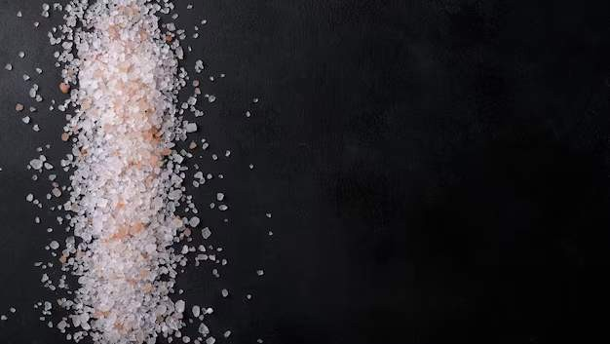
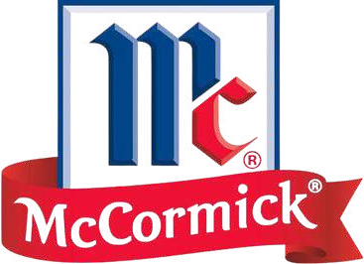







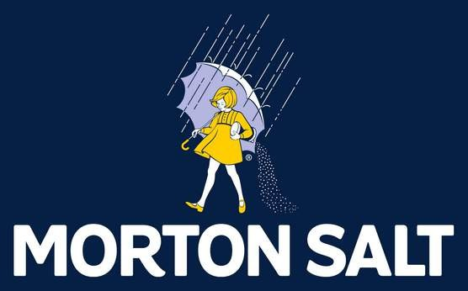
KEY PLAYERS

Slide 9


Contact us
For Full Report
COGNITIVE MARKET RESEARCH
Tel: + 1 312 - 376 - 8303 | + 44 020 - 8123 - 0732
India: ( + 91 ) 983 - 496 - 8611
sales@ cognitivemarketresearch. com
Access the Full Report : http://tinyurl.com/58aynyjw
Please visit our website:
https://www.cognitivemarketresearch.com

