Slide 1
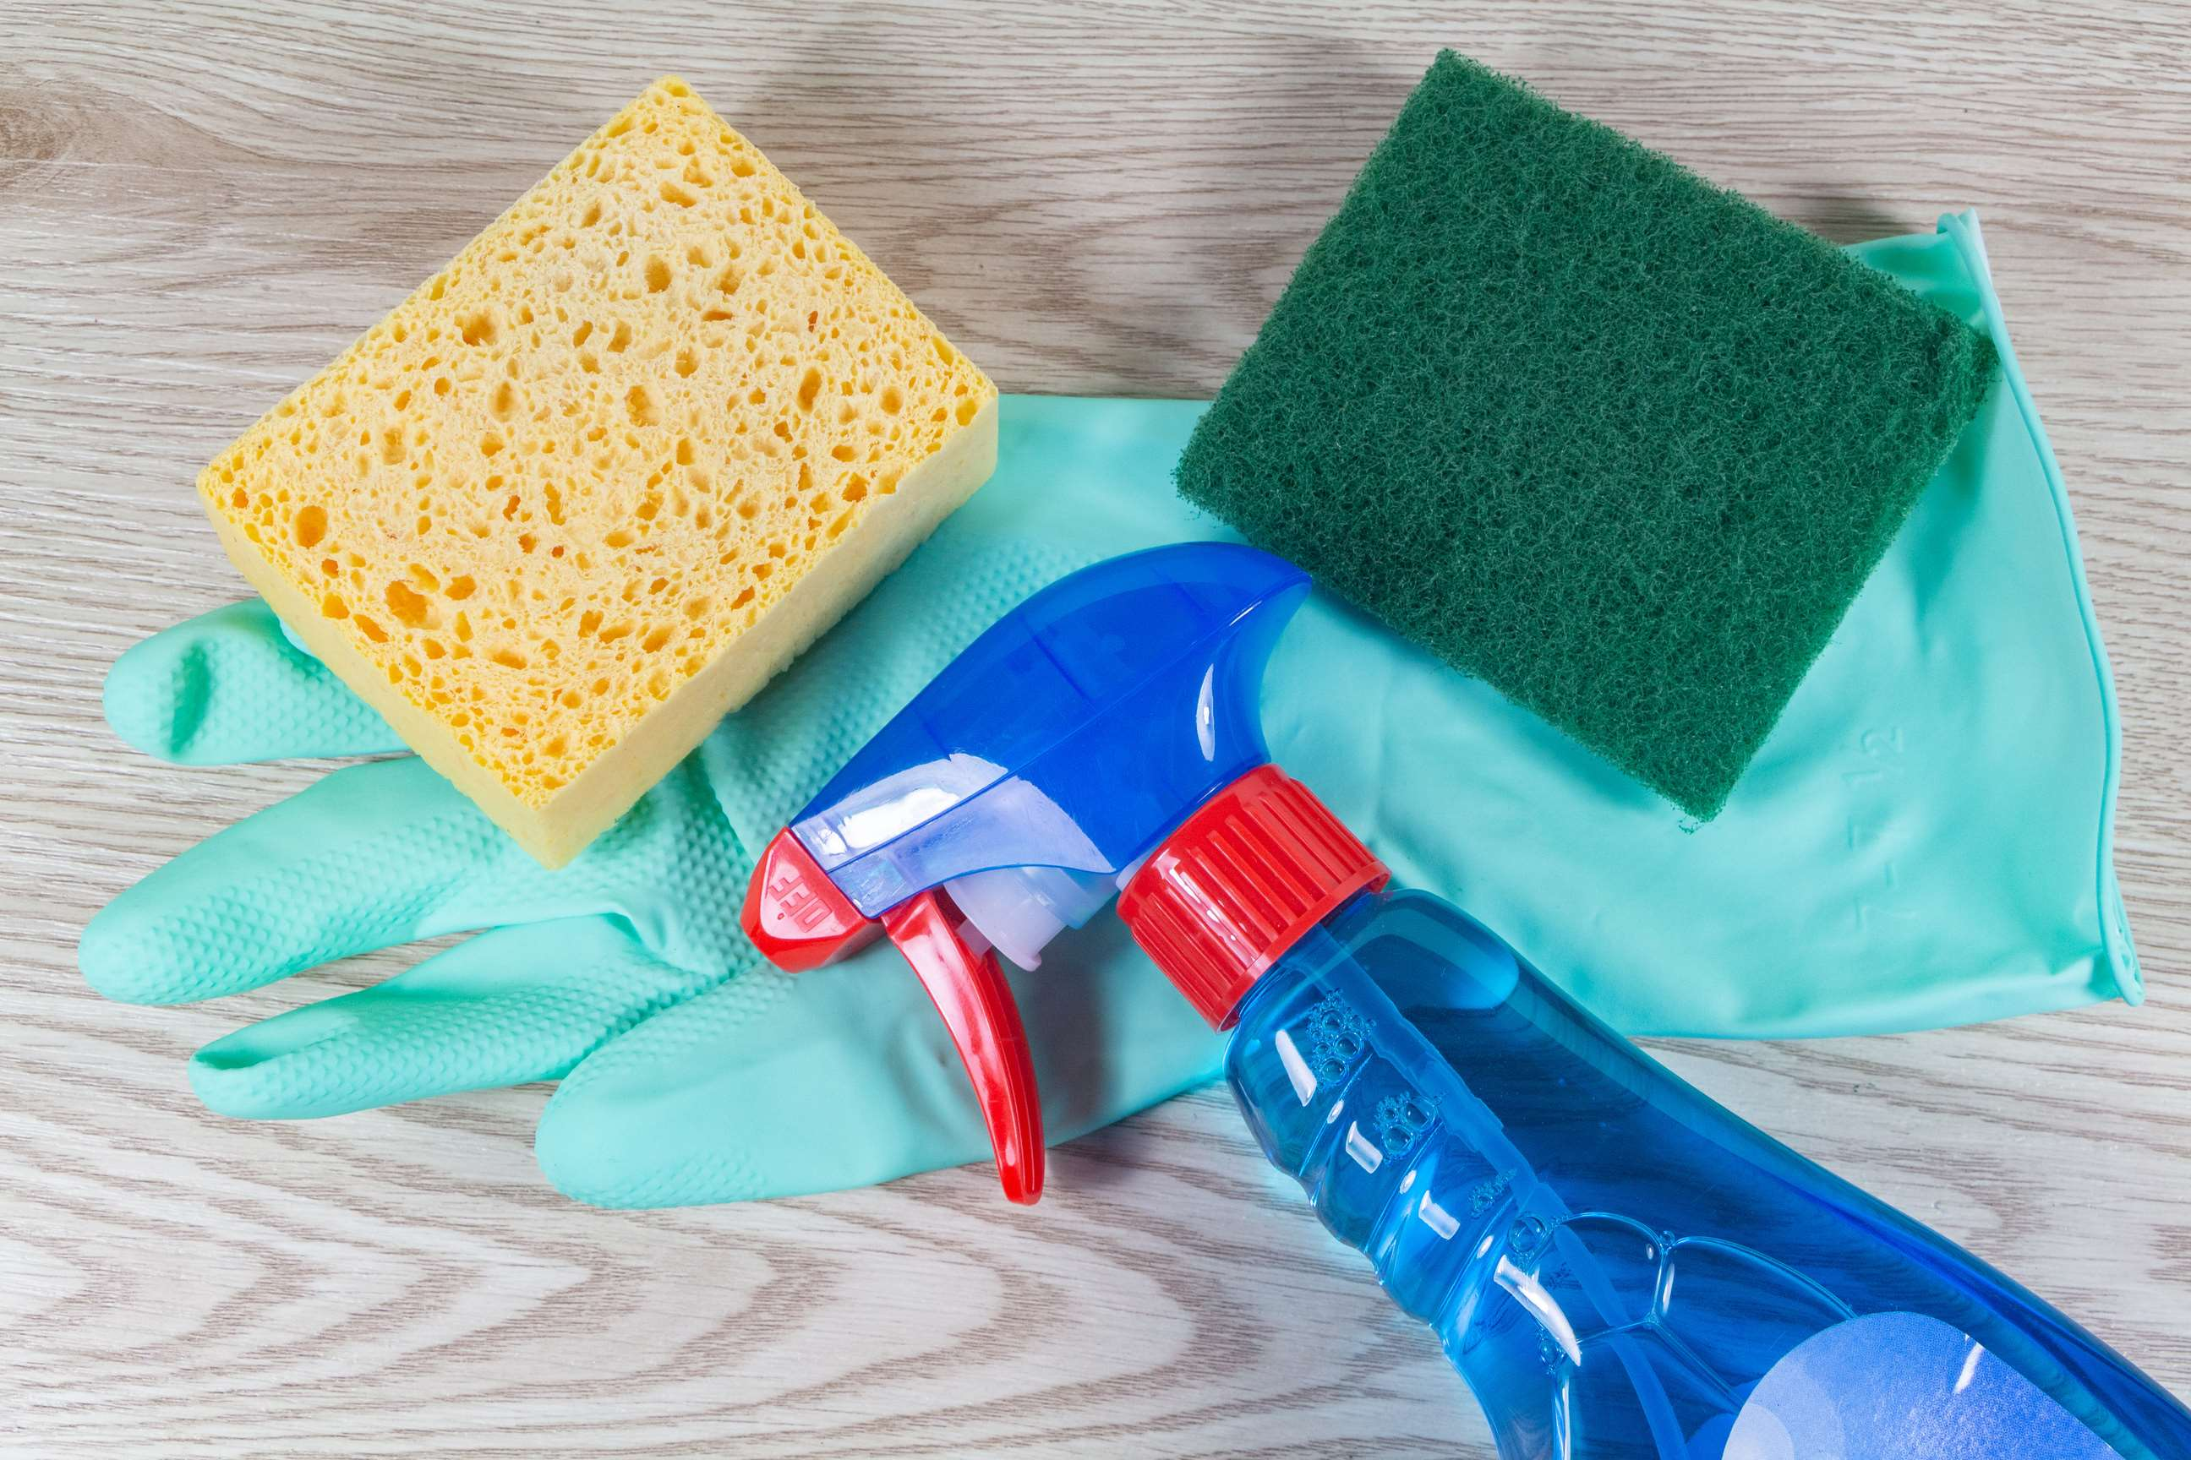
GLOBAL
SCRUB SPONGE
MARKET REPORT 2024
Global,Regional,CountryAnalysis

Slide 2

INTRODUCTION
A scrub sponge is a cleaning aid made of soft, porous material. The main purpose of a sponge is scrubbing to remove food and debris, and dirt from kitchen utensils and other surfaces. Most often, sponges are used to remove caked-on food from dishes, pans, and utensils.

Slide 3
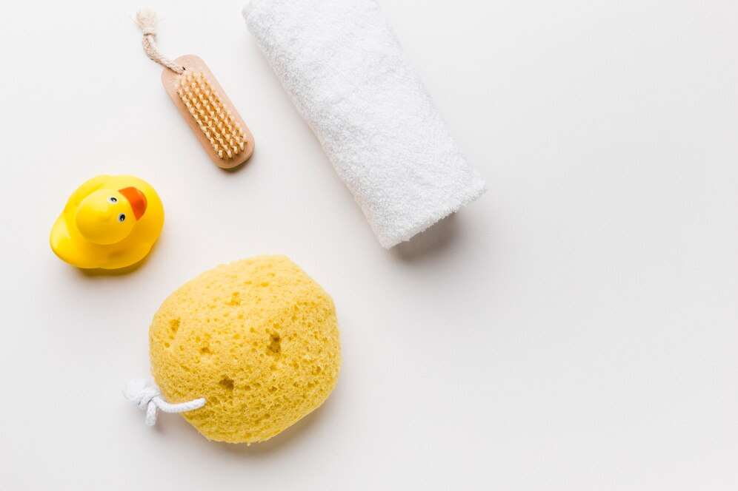

KEY INSIGHTS
MARKET SIZE
700 Million
2022
FORECAST
990 Million
2028
CAGR
3.6%
2023- 2030

Slide 4
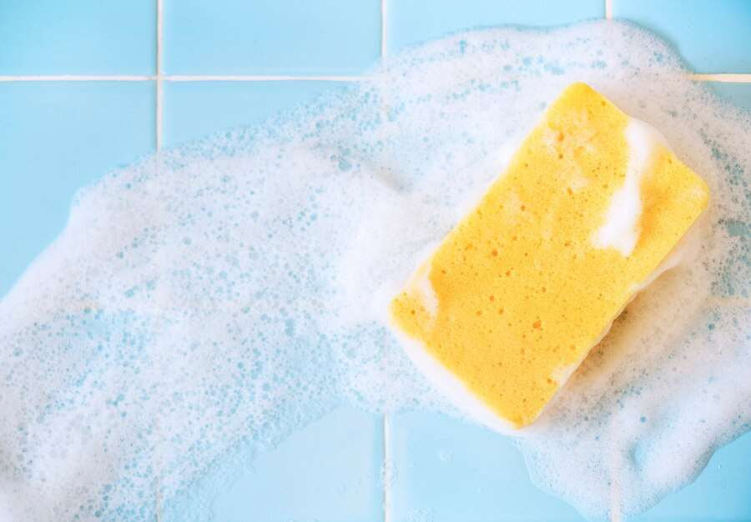
REVENUE MARKET SHARE BY SEGMENTS 2022
Type Segment
Normal
35.46%
Raw Material
Polyester
36.87%

Slide 5

Global Scrub Sponge Market Revenue share for 2022
Asia Pacific
34.78%

Slide 6
Increasing demand for home cleaning and hygiene products and the rising number of hotels and restaurants are the key driving factors for the growth of the sponge scrub market.
Drivers
The growing awareness about environmental pollution and the need to reduce waste is leading to an increase in demand for biodegradable scrub sponges.
Restraints

Slide 7
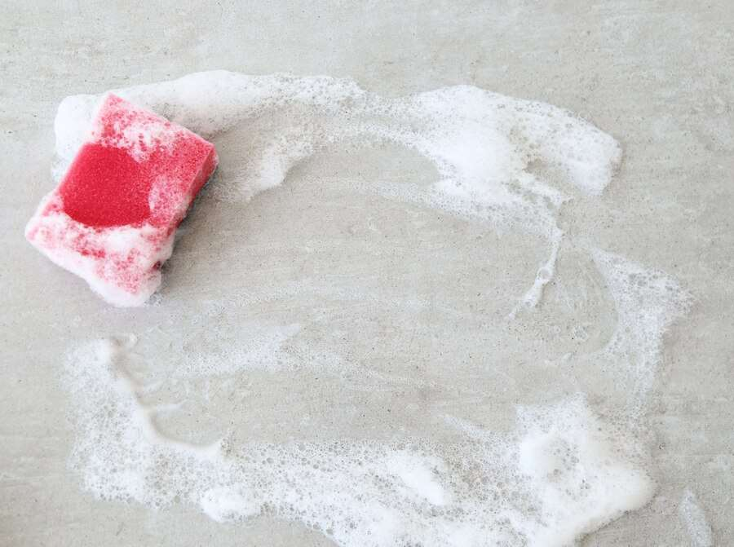
AUTHOR'S PERSPECTIVE
  The Global Scrub Sponge Market is witnessing significant growth in the near future.
  In 2023, the Normal segment accounted for noticeable share of global Scrub Sponge Market and is projected to experience significant growth in the near future.
  The Household segment is expected to expand at the significant CAGR retaining position throughout the forecast period.
  Some of the key companies 3M (Scotch Brite), Unilever and others are focusing on its strategy building model to strengthen its product portfolio and expand its business in the global market.

Slide 8
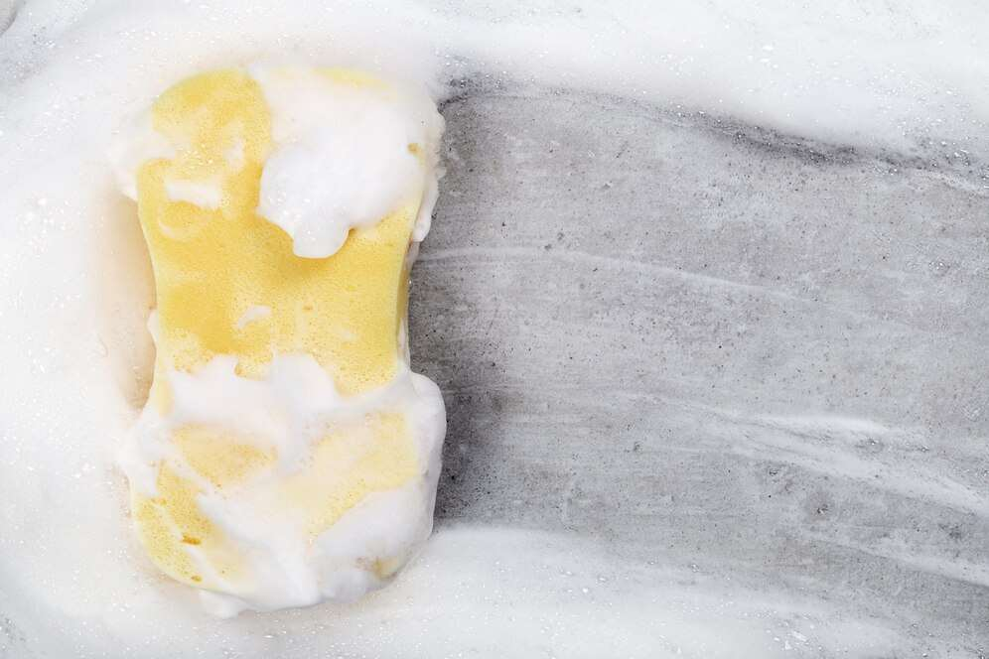
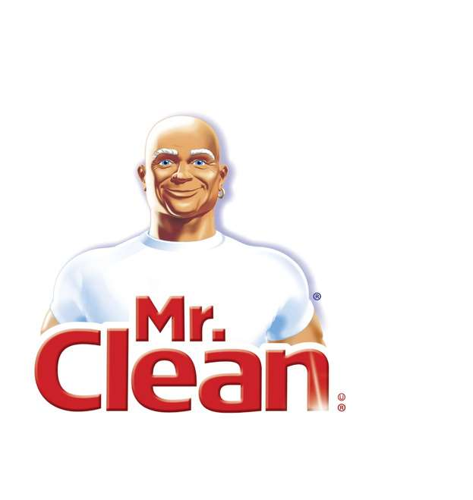
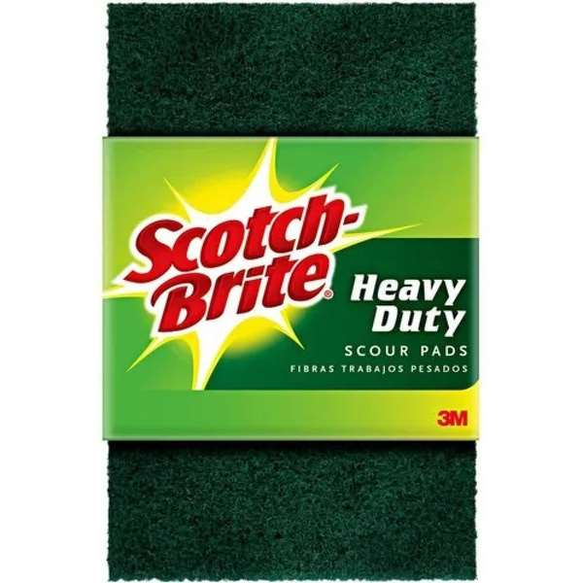
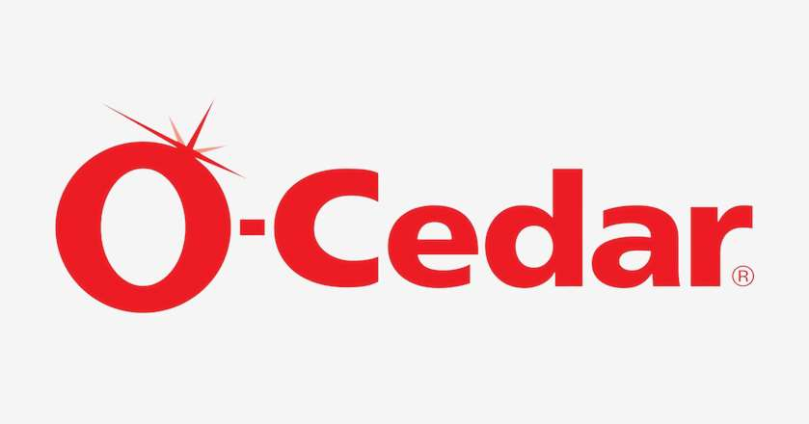
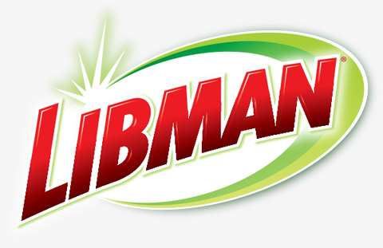


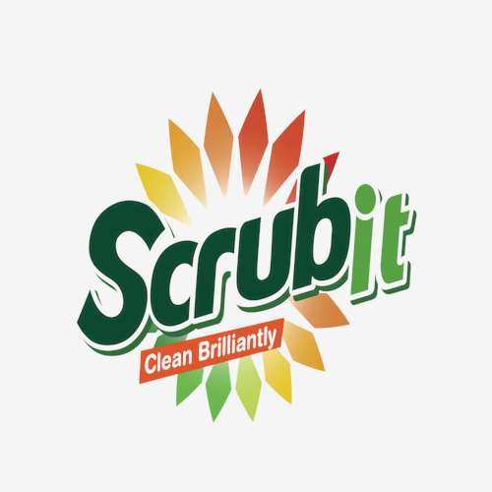


KEY PLAYERS

Slide 9


For Full Report
Contact us
COGNITIVE MARKET RESEARCH
Tel: +1 312-376-8303 | +44 020-8123-0732
India: (+91) 983-496-8611
sales@cognitivemarketresearch.com
Access the Full Report : https://tinyurl.com/ycz3knn9
Please visit our website:
https://www.cognitivemarketresearch.com

