Slide 1

GLOBAL
Sandwich
MARKET REPORT
2024
Global,Regional,CountryAnalysis

Slide 2
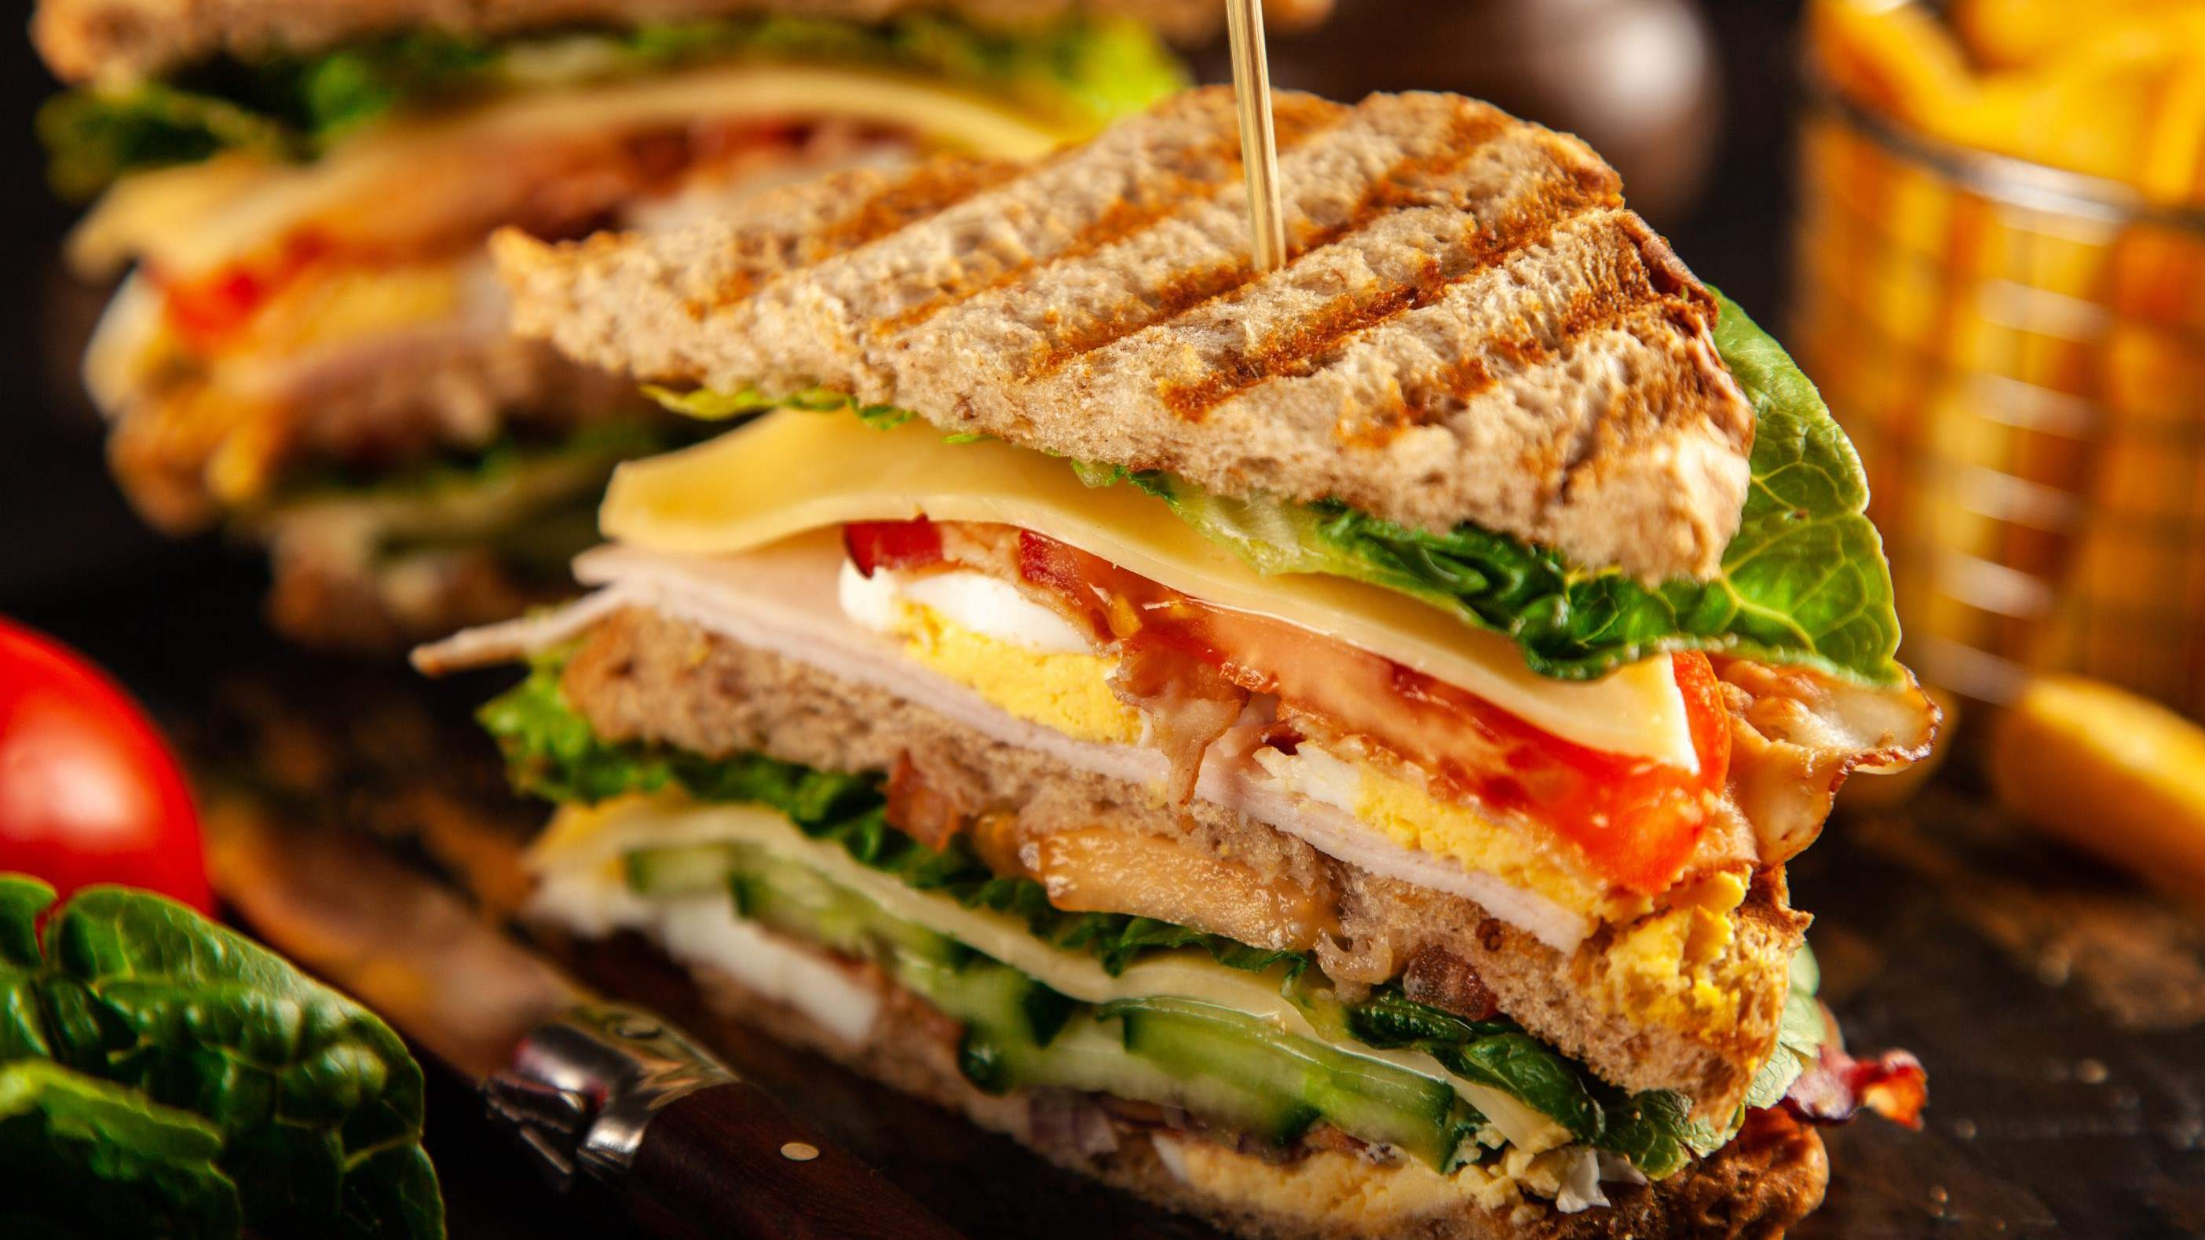
INTRODUCTION
The changes in consumer lifestyles, rising health awareness among consumers, creation of new and innovative sandwich recipes by chefs, a wide range of bread options, popularity of international cuisine, increasing number of individuals adopting vegan and vegetarian diets, growth of the food service industry, rise in e-commerce and delivery services, effective marketing campaigns, promotions, and collaborations with influencers or celebrities, regions have their sandwich preferences and tastes, convenient and eco-friendly packaging options, advanced food processing technologies and food safety regulations are the main factors driving the growth of Sandwich market.

Slide 3
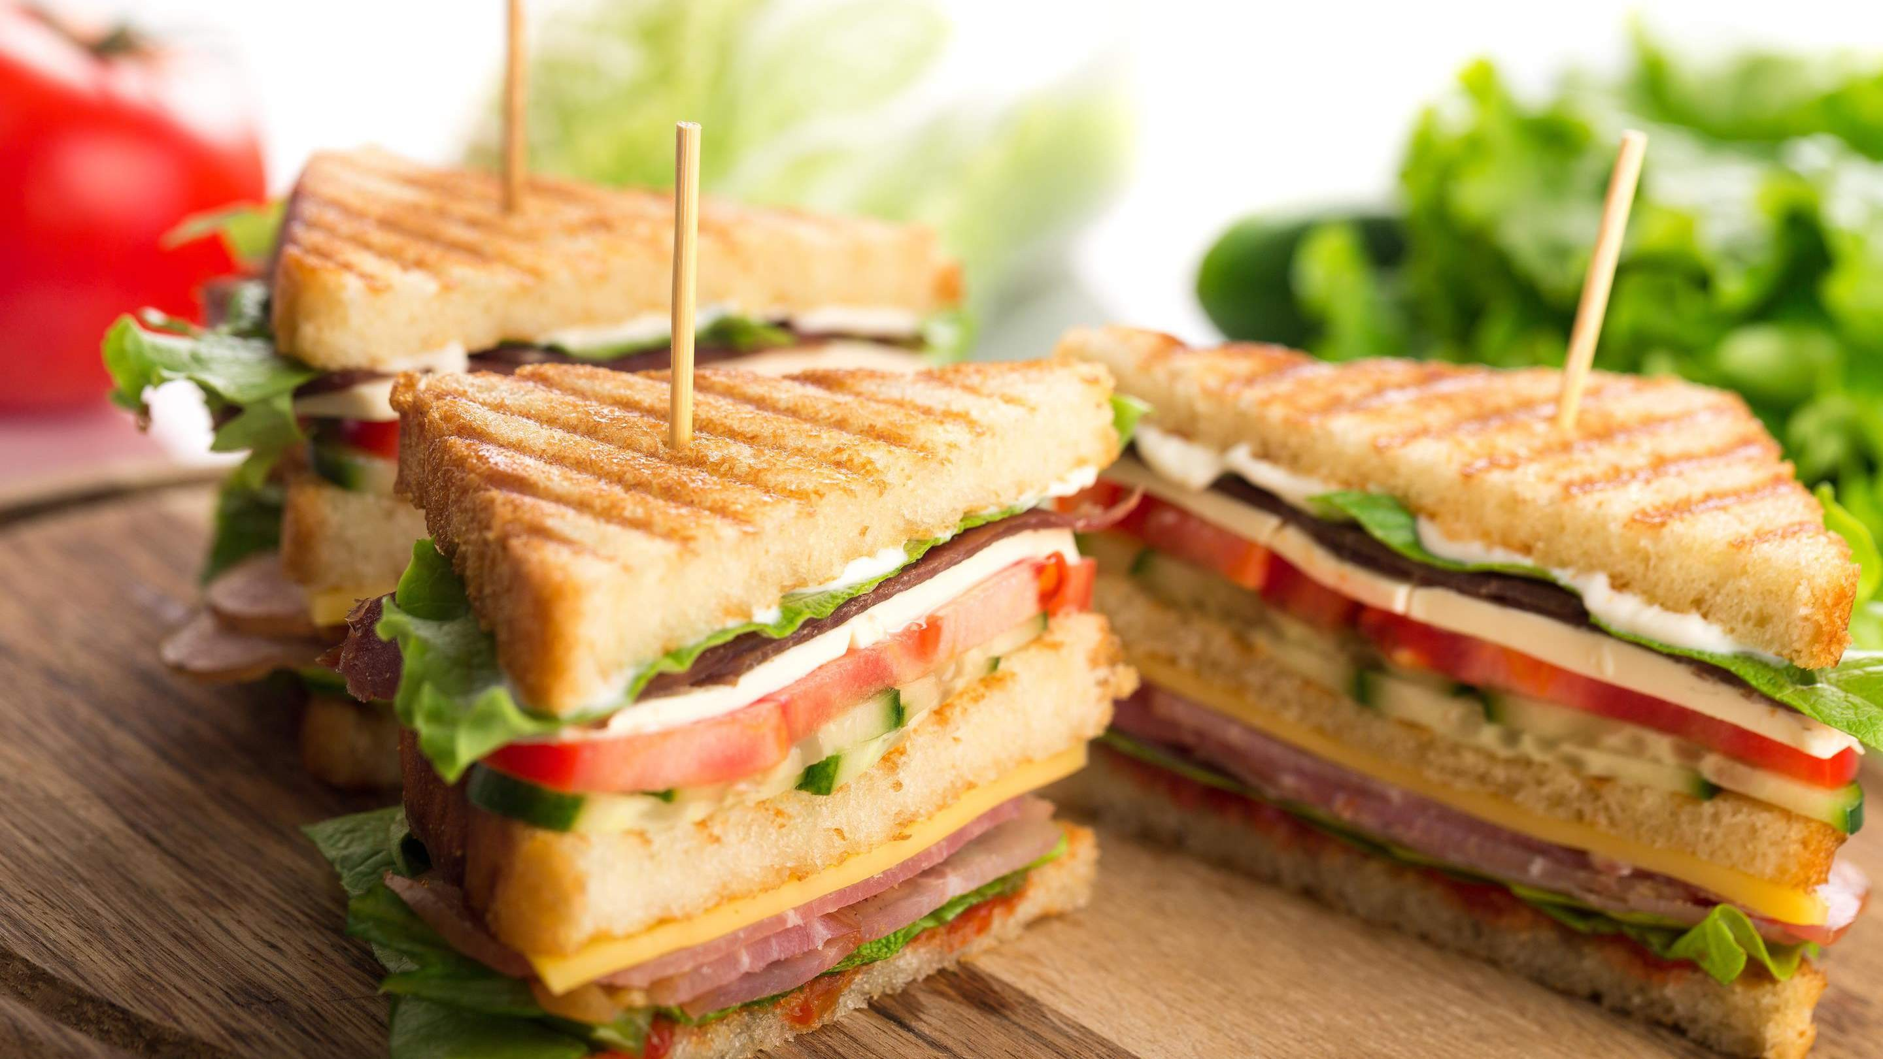

KEY INSIGHTS
20₋23
CAGR 5.50%
2030

Slide 4
REVENUE MARKET SHARE BY SEGMENTS 2022
Non-vegetarian
Vegetarian
Type Segment
Fresh Sandwiches
Pre-packaged Sandwiches
Product Segment

Slide 5
Global Sandwich Market Revenue share for 2022
North America 38 %

Slide 6
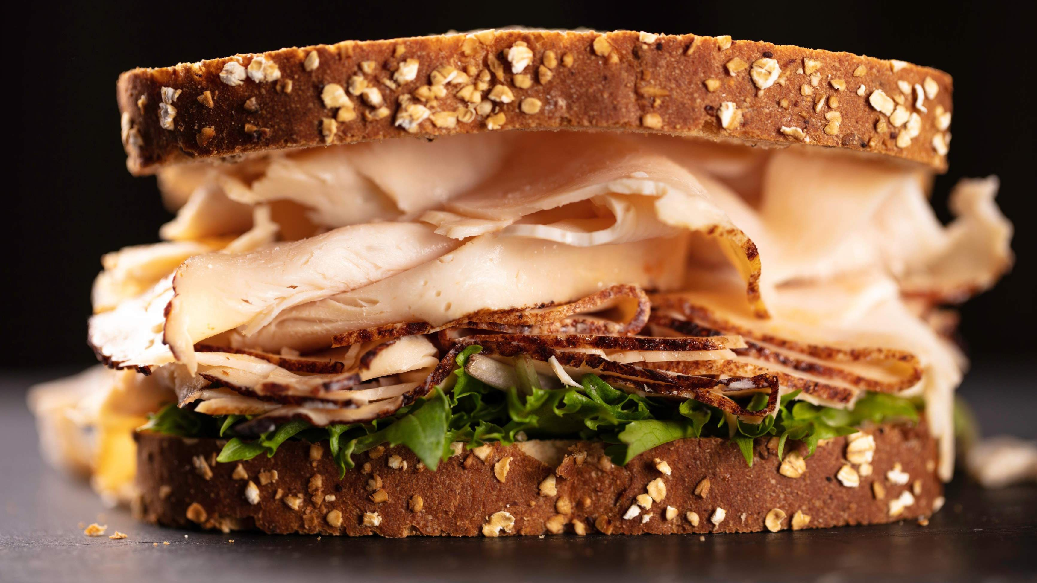



Slide 7

AUTHOR'S PERSPECTIVE
The Global Sandwich Market is witnessing significant growth in the near future.
Vegetarian sandwiches cater to the growing demand for meatless and vegan choices,
appealing to health- conscious consumers and those with dietary restrictions.
Pre- packaged sandwiches are convenient for on - the- go consumers who value portability and
longer shelf l ife.
In 2023 , the Non- vegetarian segment accounted for noticeable share of global Sandwich Market and is projected to experience significant
growth in the near future.
The Fresh Sandwiches segment is expected to expand at the significant CAGR retaining
position throughout the forecast period.

Slide 8
KEY PLAYERS

Slide 9


Contact us
For Full Report
COGNITIVE MARKET RESEARCH
Tel: + 1 312 - 376 - 8303 | + 44 020 - 8123 - 0732
India: ( + 91 ) 983 - 496 - 8611
sales@ cognitivemarketresearch. com
Access the Full Report : http://tinyurl.com/293jmur4
Please visit our website:
https://www.cognitivemarketresearch.com

