Slide 1
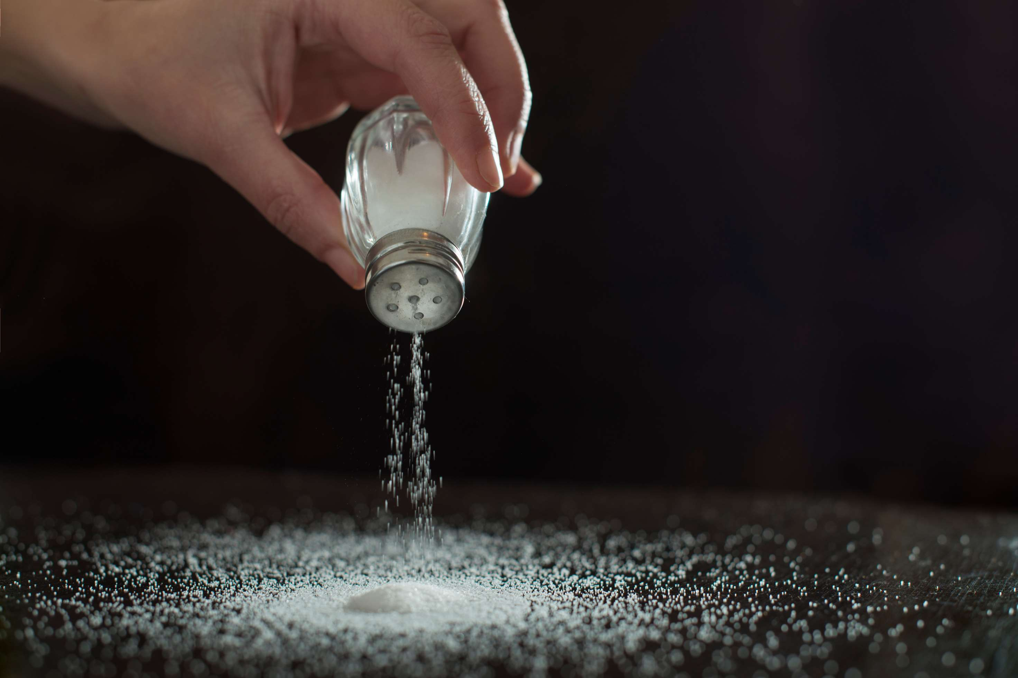

SALT
MARKET REPORT
2024
Qualitative Analysis + Quantitative Analysis

Slide 2
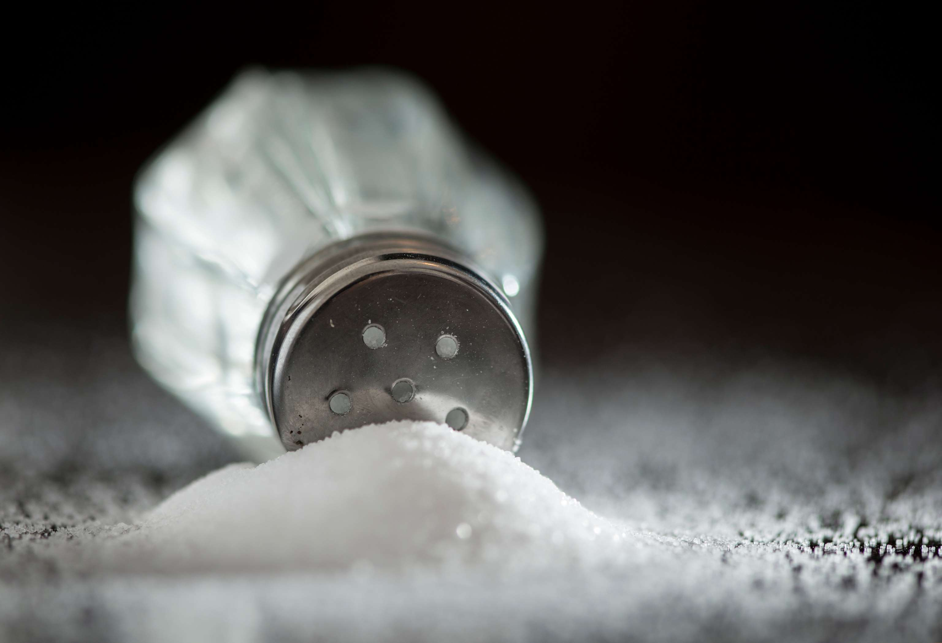
INTRODUCTION
One of the inorganic substances used in many different sectors is salt. It is one of the most precious minerals on the planet and a necessary component of the diet. The result is a sodium and chlorine mixture that is processed through a variety of steps, including mining, rock salt extraction, brine extraction, and seawater evaporation. The market is driven by the increasing demand for products from the chemical manufacturing sector, particularly in the production of chlorine-alkali chemicals. Since there isn't a viable substitute for the commodity, chlorine-alkali is widely used in the chemical sector. But in order to remove the material from mines, more permissions and permits are required from mining authorities all over the world. This is meant to limit production.

Slide 3
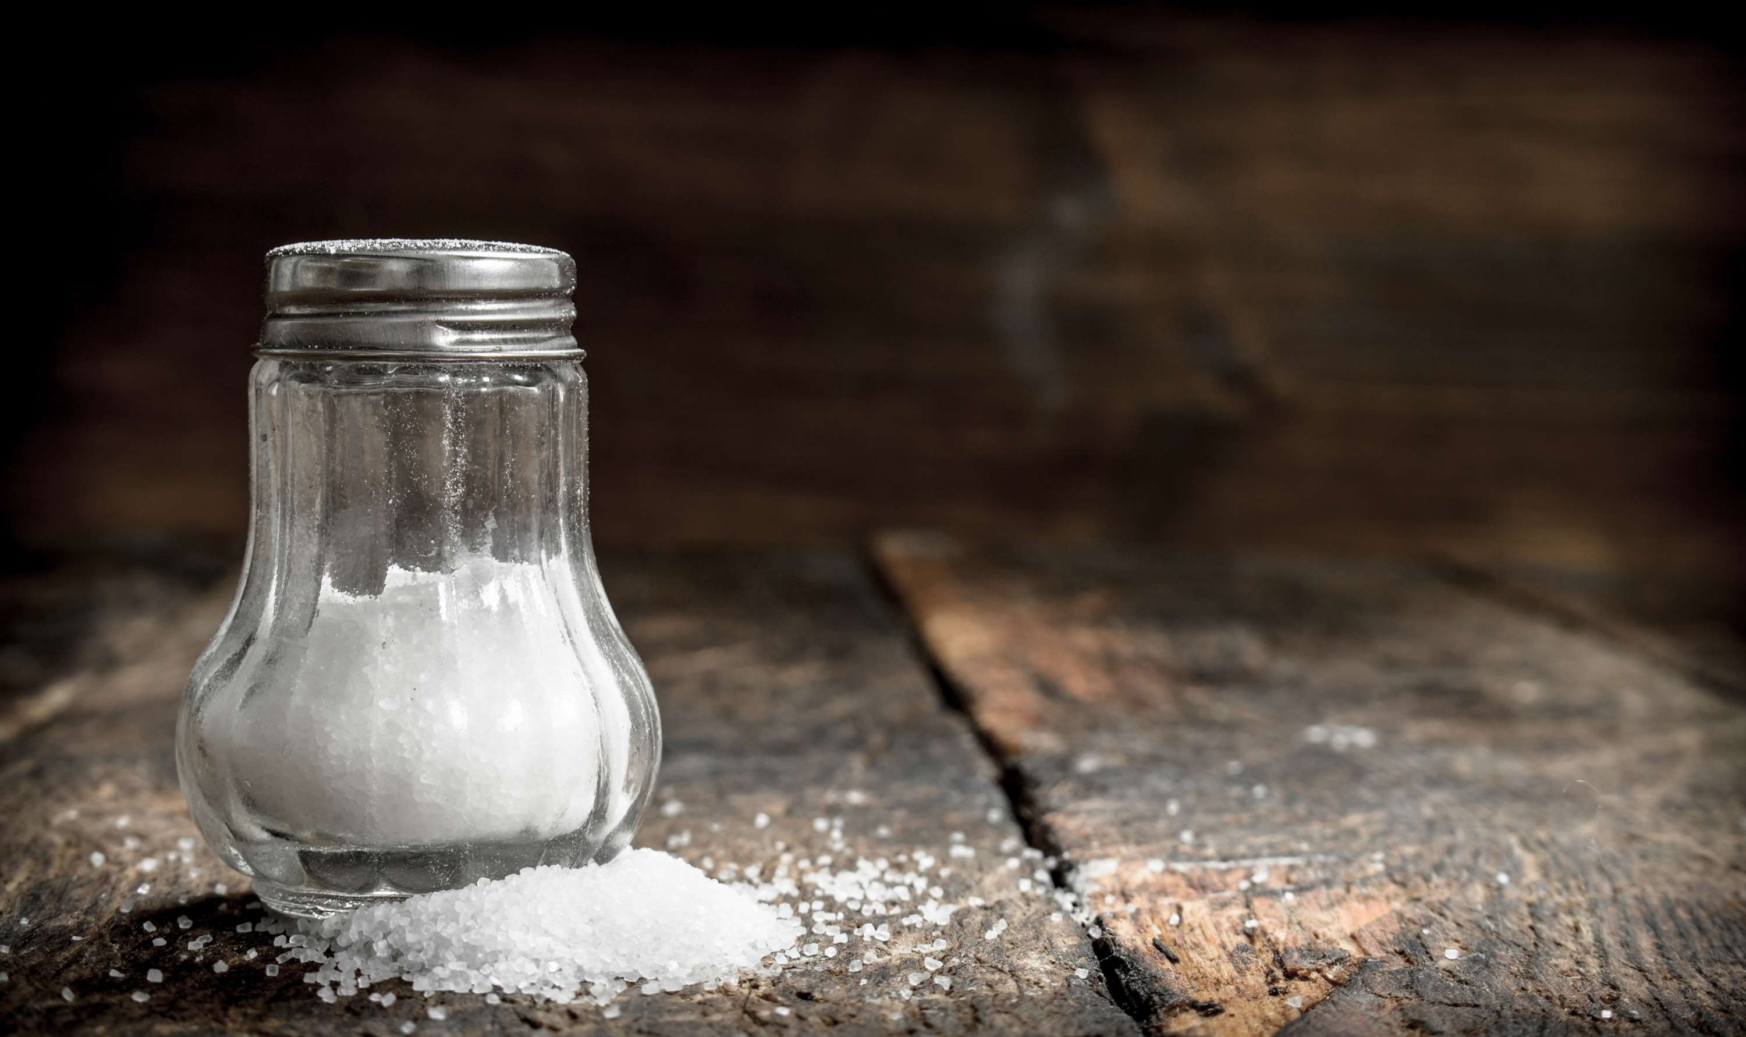

KEY INSIGHTS
MARKET SIZE
USD 35125.2 million
2024
CAGR
3.00%
2024- 2031

Slide 4
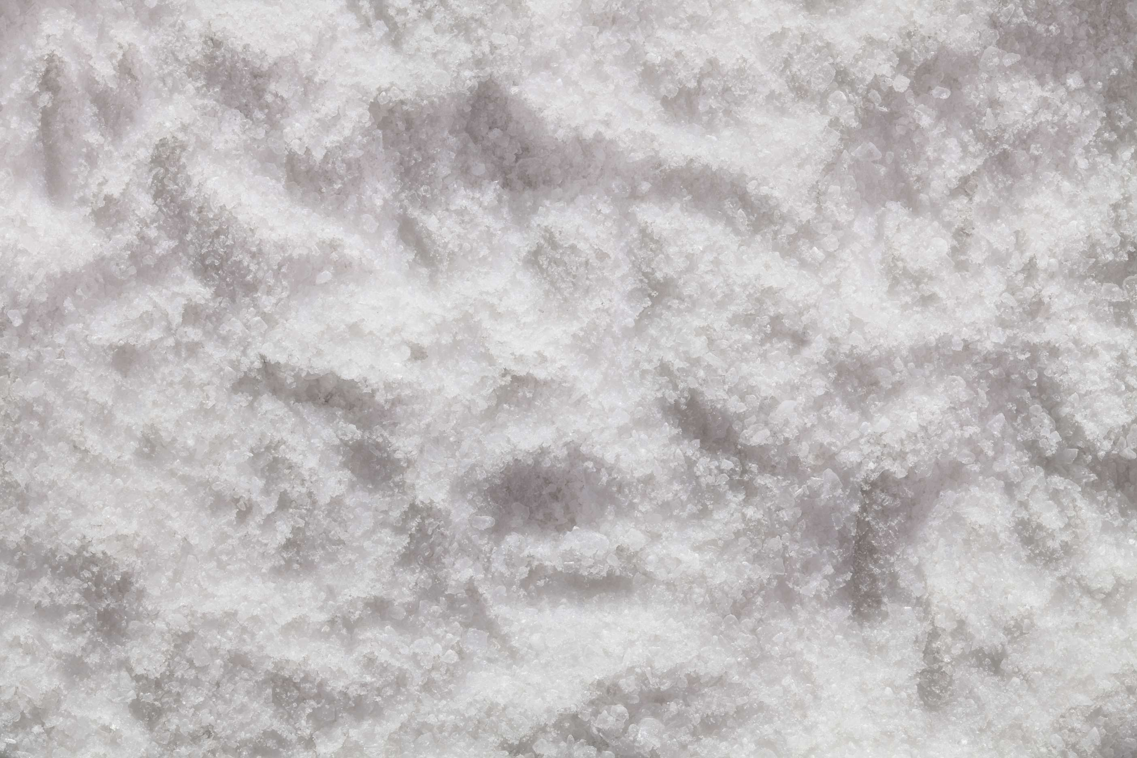
REVENUE MARKET SHARE BY SEGMENTS 2024
  rock salt stands out as the dominating category
  Solar Salt emerges as the fastest-growing category in the Salt market
Type Segment
  the dominating category is salt mines
  The fastest-growing category in the Salt market is brine
Source Segment
  Chemical Processing
  De-icing
  Water Treatment
  Oil & Gas
  Agriculture
Application Segment

Slide 5

REGION ANALYSIS
NORTH AMERICA
Europe
Asia Pacific
Latin America
MIDDLE EAST AFRICA
40%
30%
23%
5%
2%
North America Salt Market Revenue share for 2024 is 40%

Slide 6
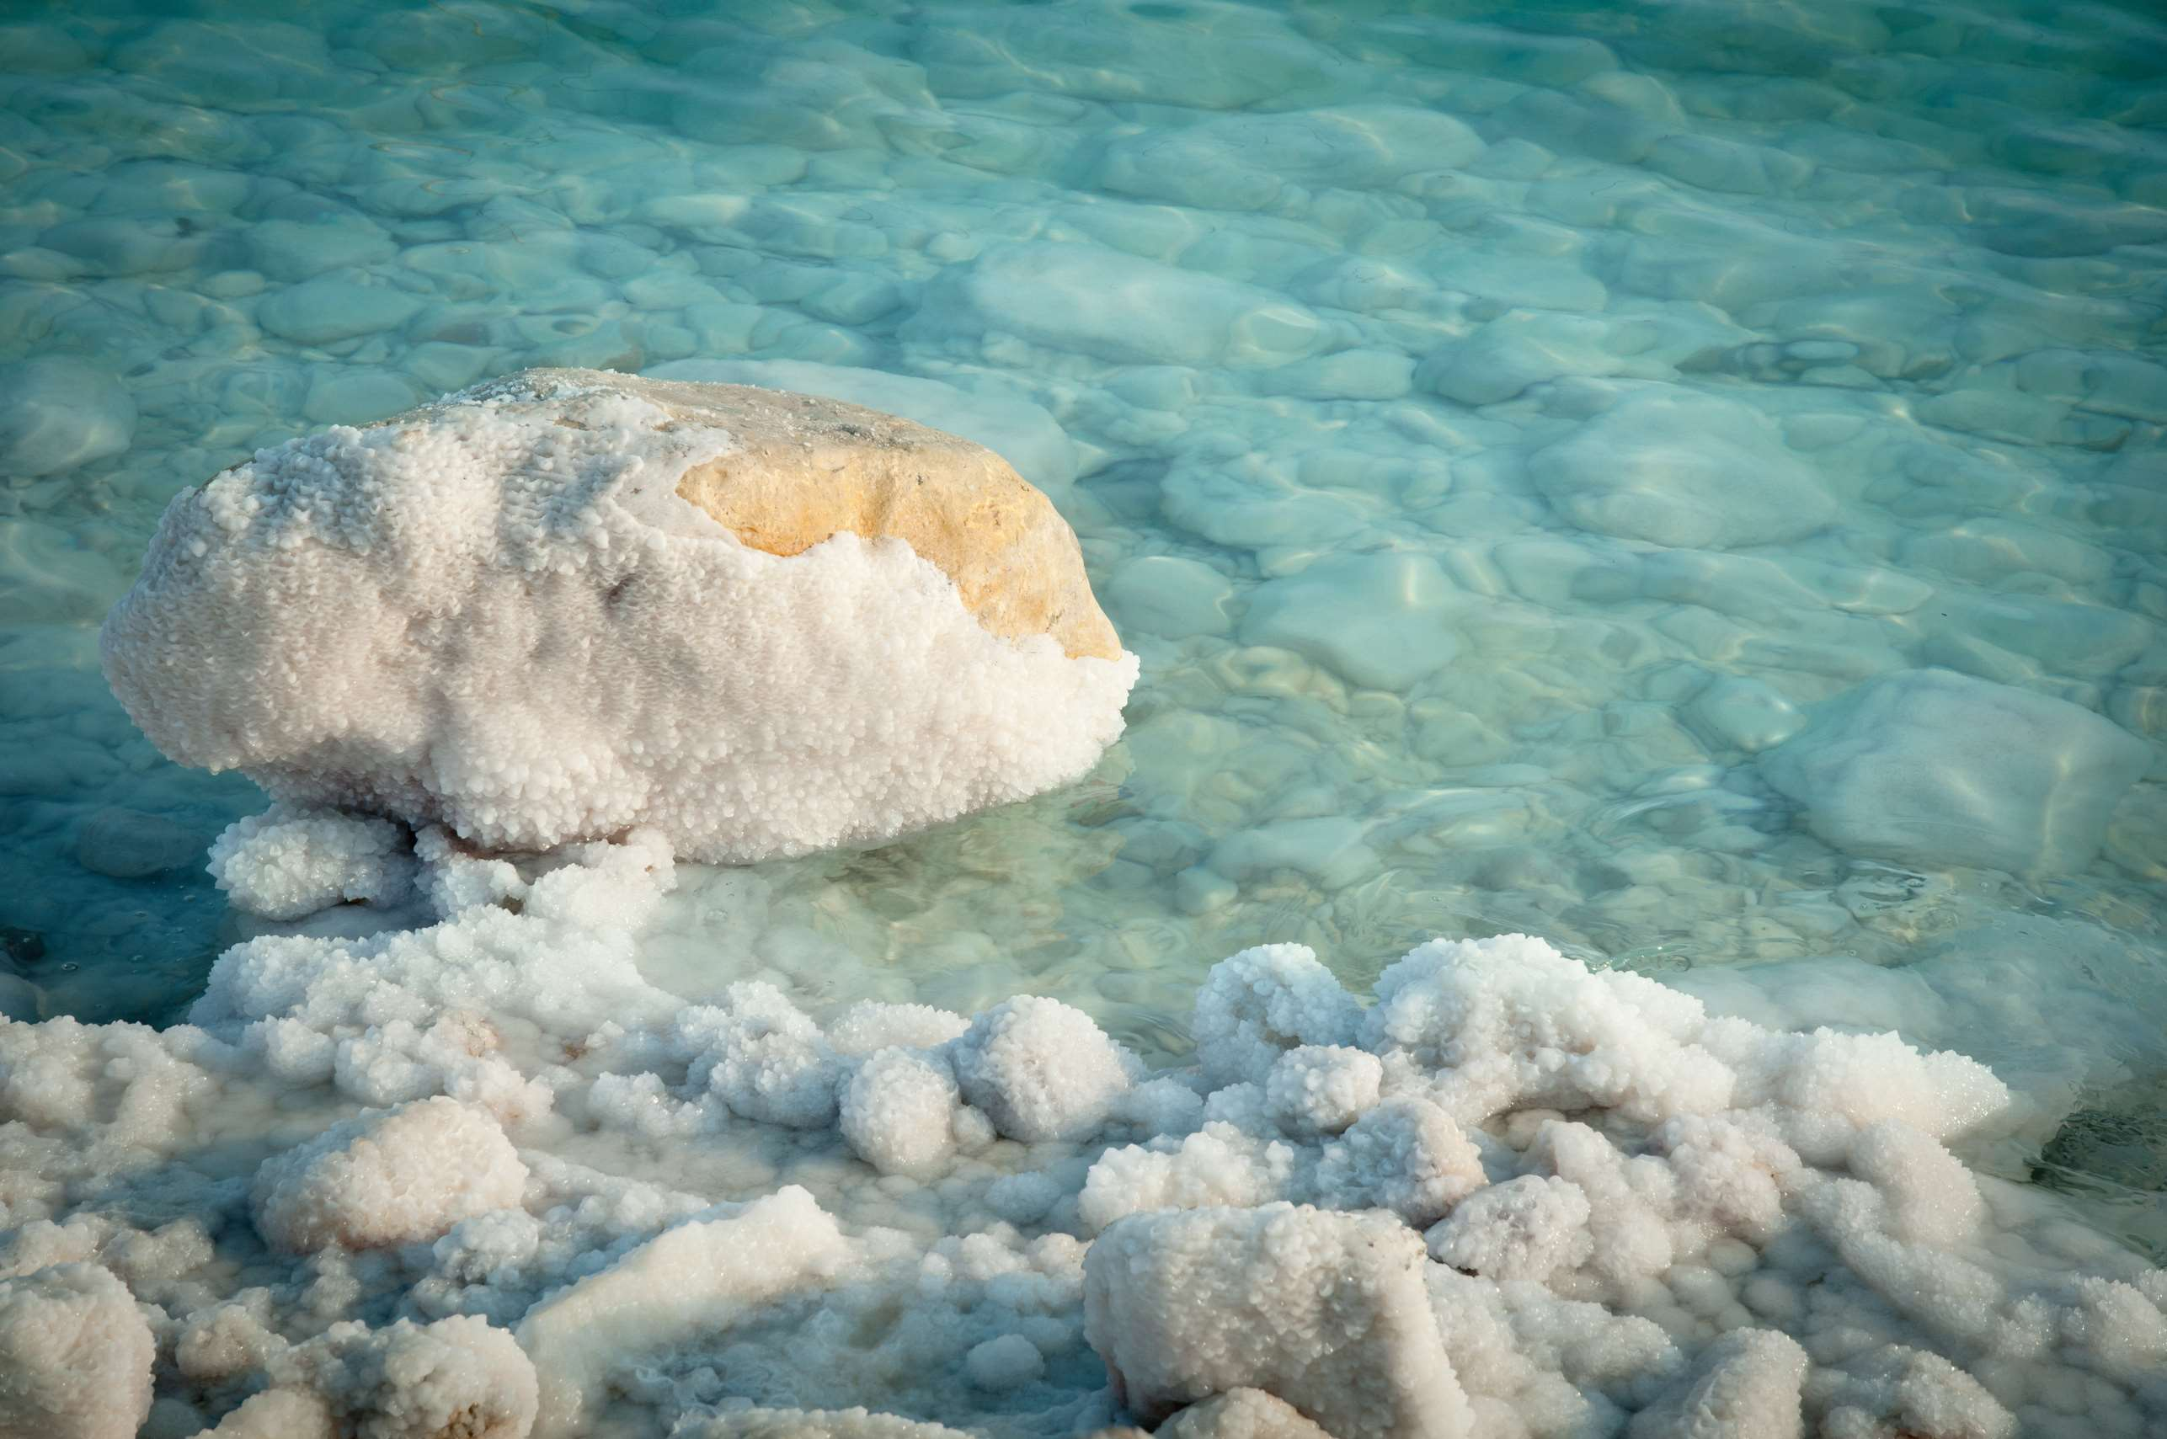
  Growing Use of Industrial Salt in the Chemical Sector to Increase the Demand Globally
  Increasing Requirement for Industrial Uses to Propel Market Growth
Drivers
Production-Related Environmental Issues to Limit the Sales
Restraints

Slide 7
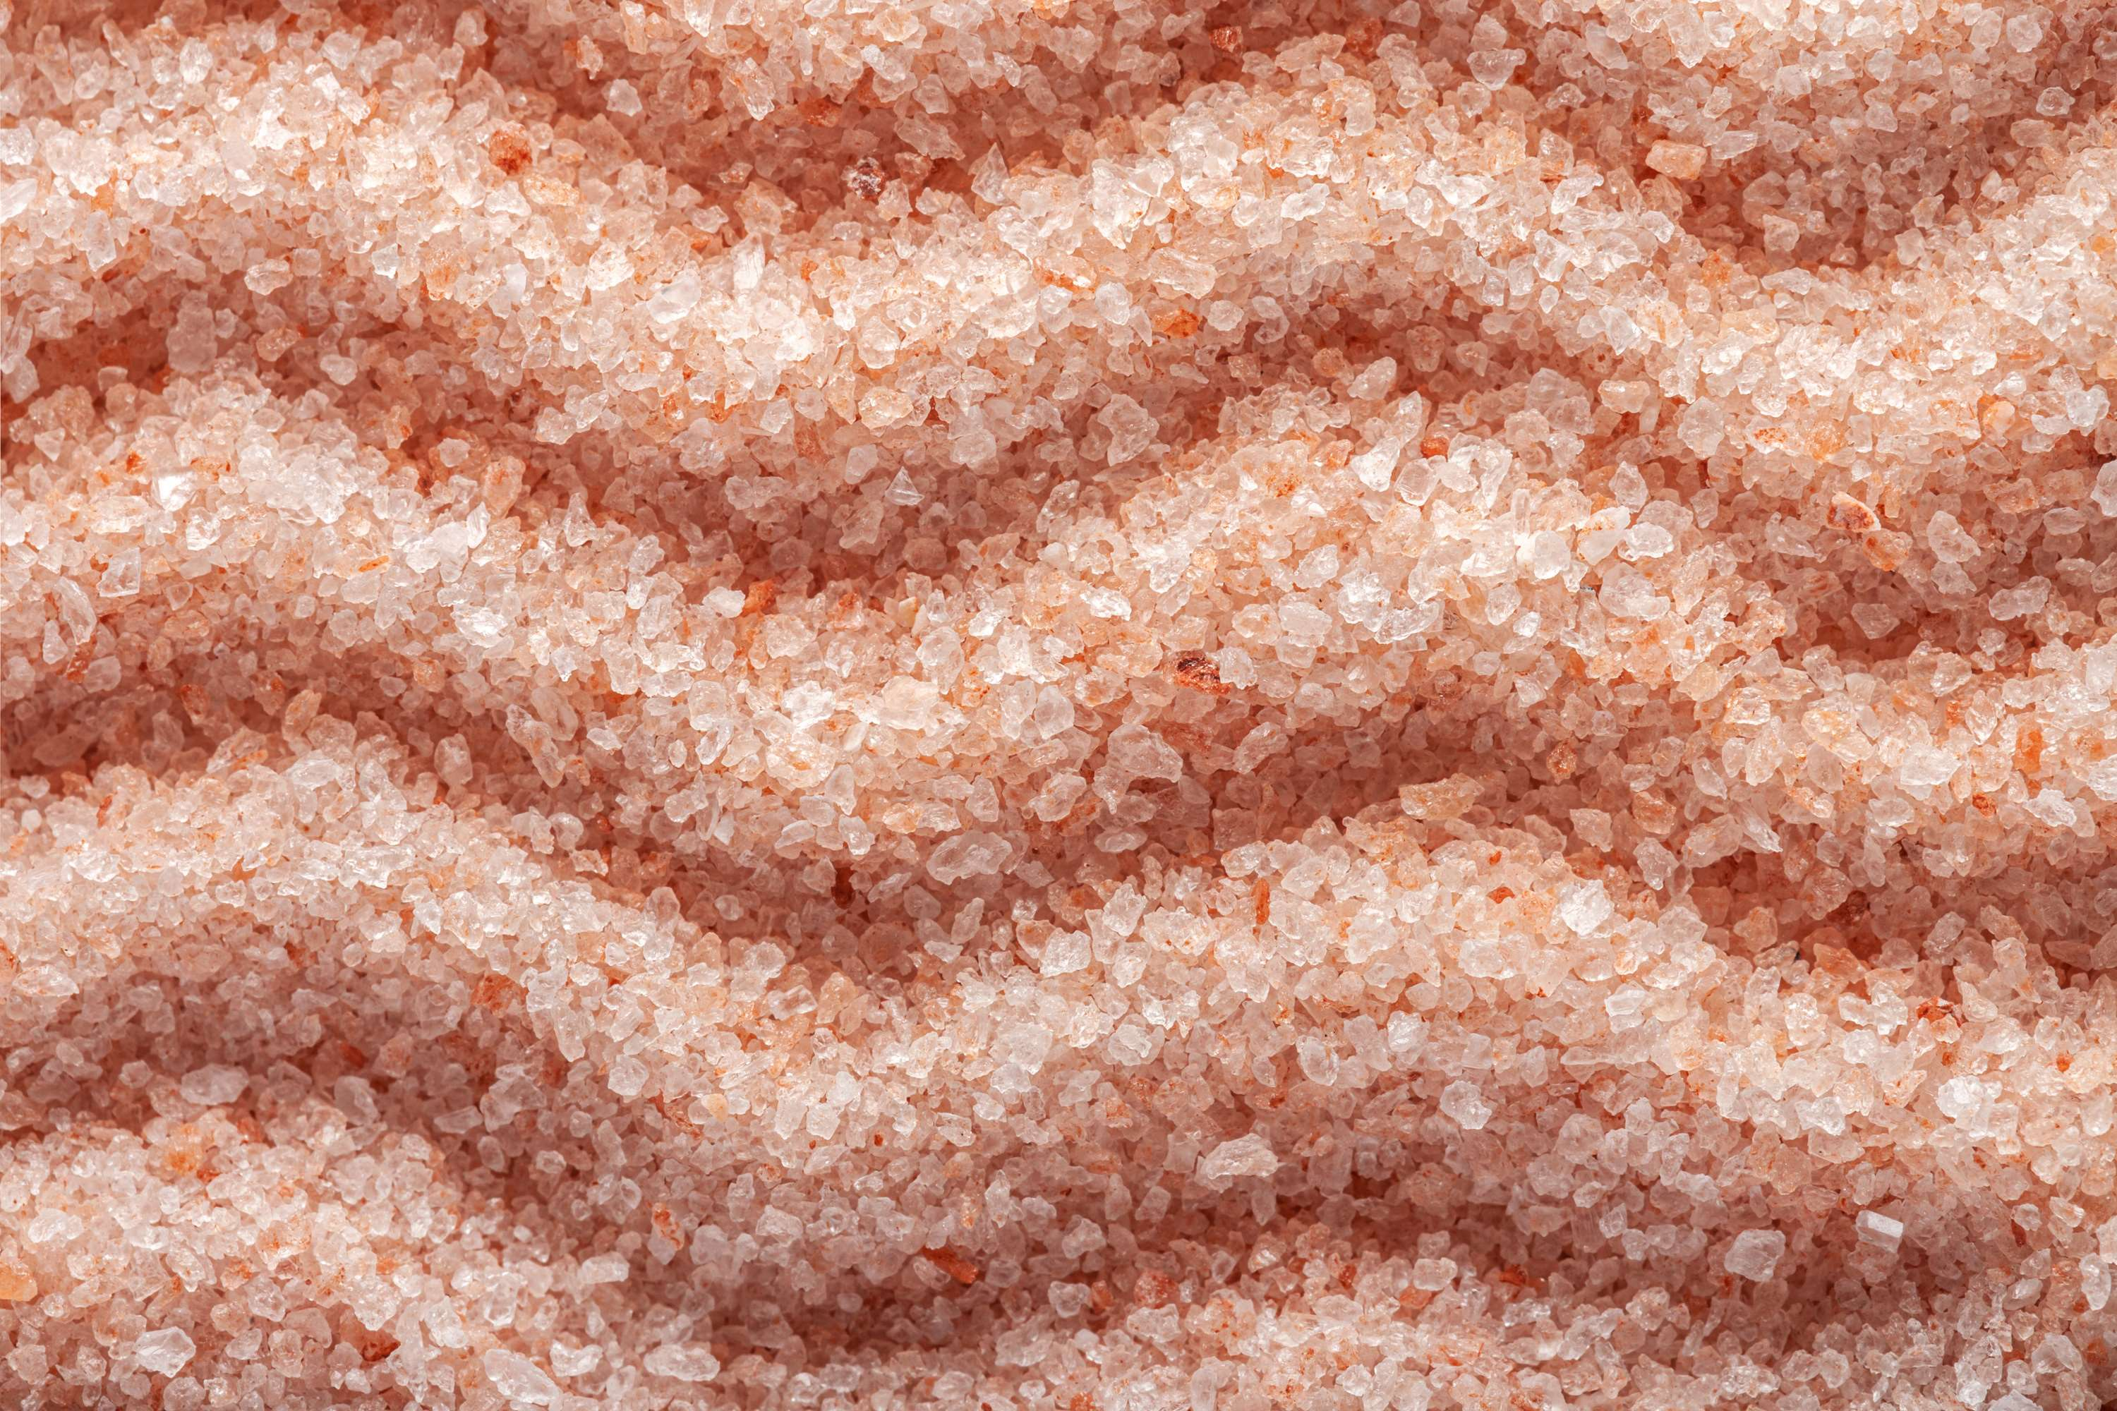
AUTHOR'S PERSPECTIVE
  The global Salt market will expand significantly by 3.00% CAGR between 2024 to 2031.
  Rock salt stands out as the dominating category. Evaporating lake or seawater yields rock salt, the least processed type of salt.
  Rock salt's intrinsic impurities can give it a range of colors, including yellow, blue, and red.
  The dominating category is Chemical Processing.
  Because of the growing use in the production of chlorine, caustic soda, and soda ash.

Slide 8
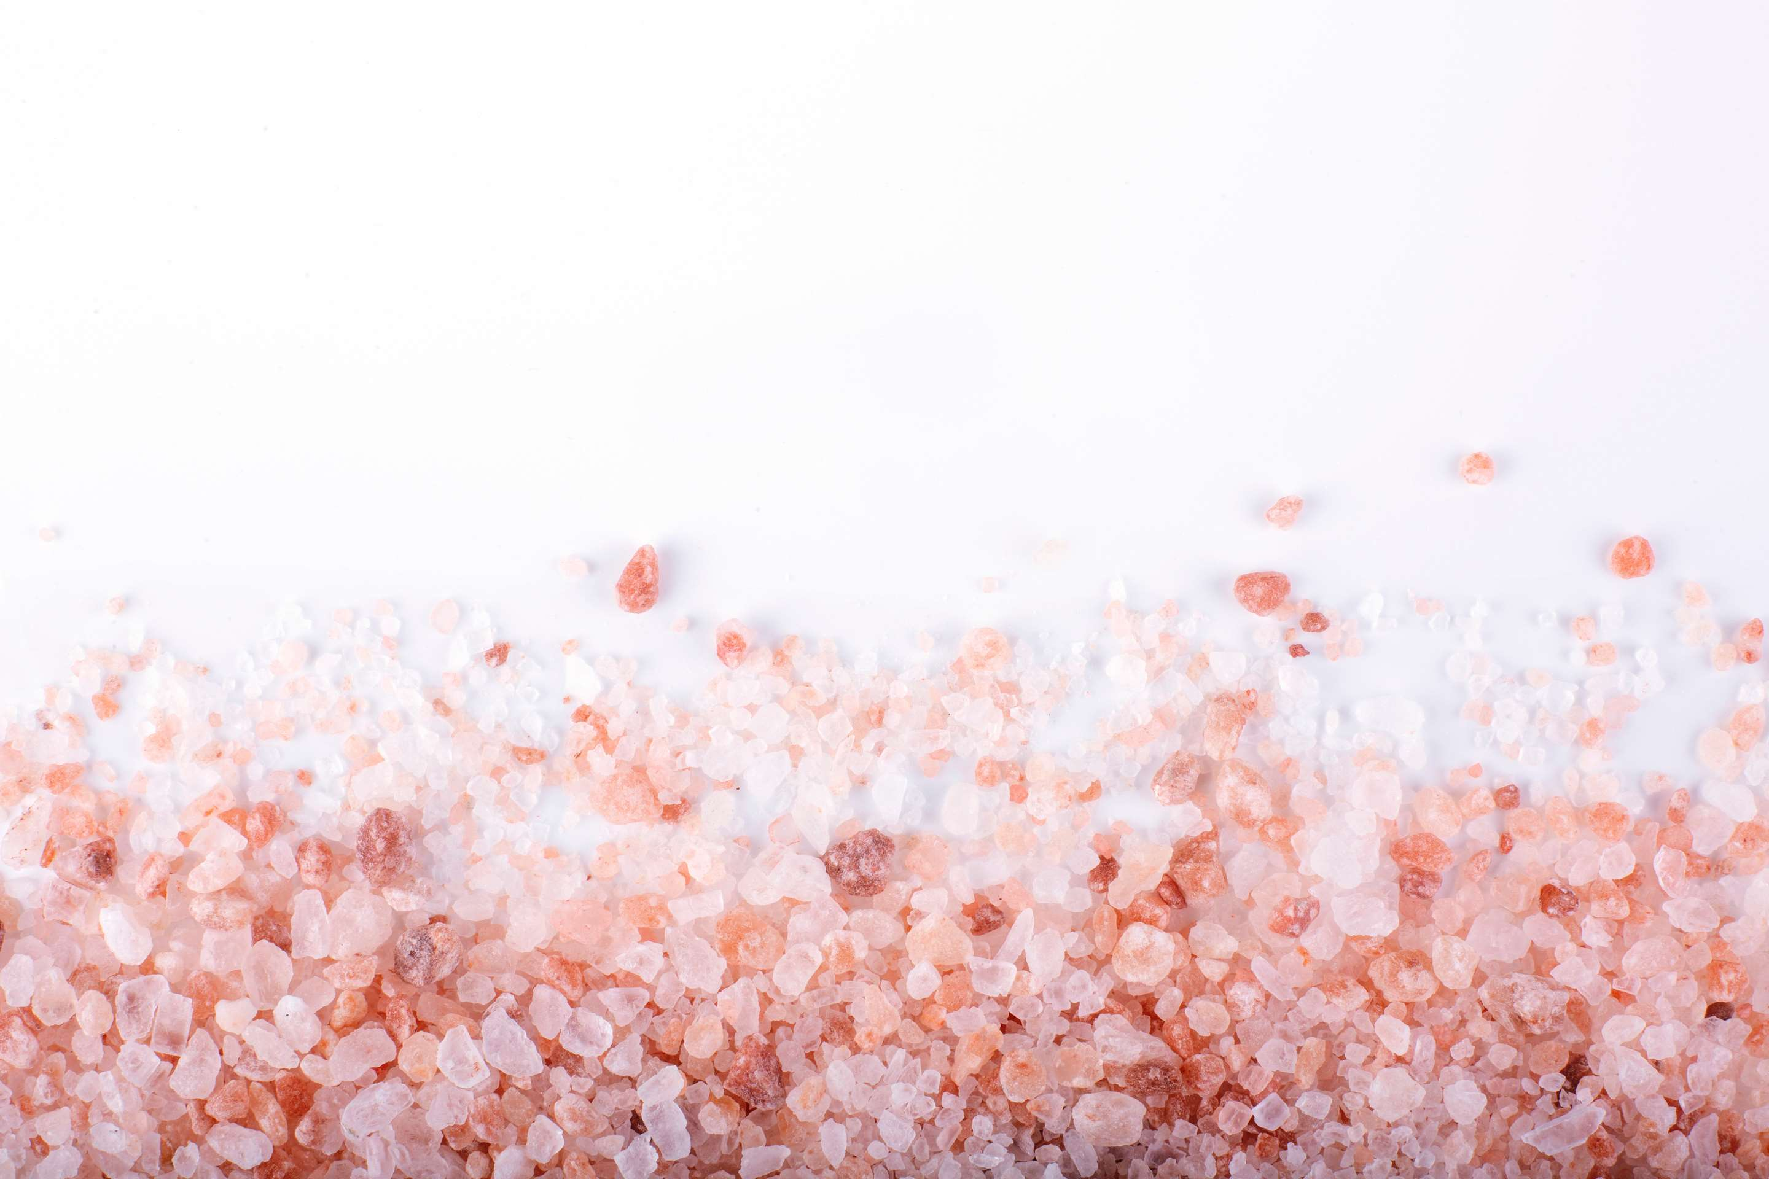
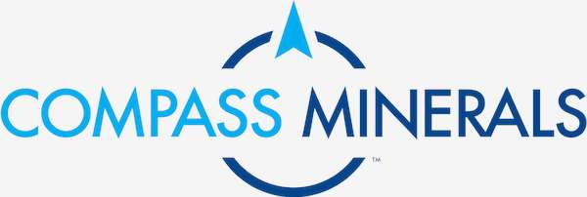
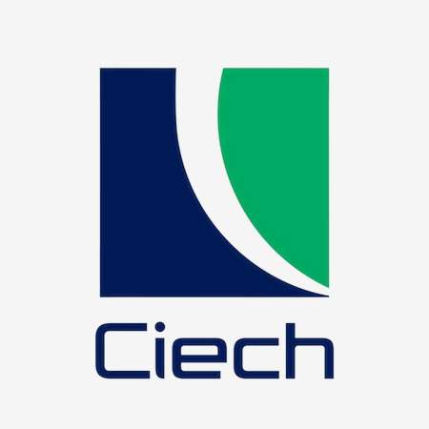
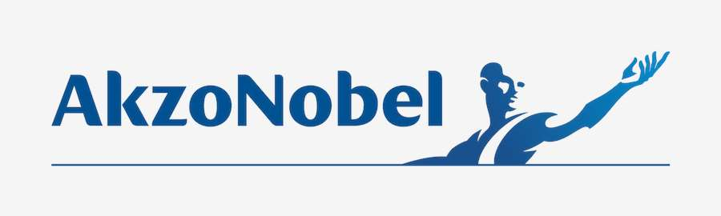
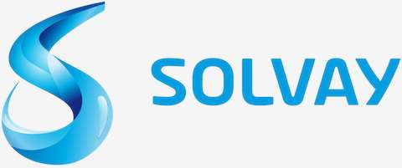
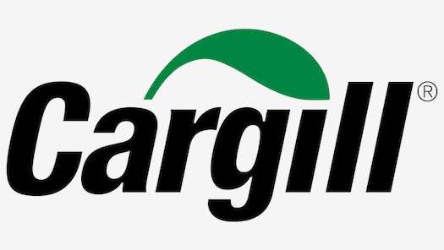


KEY PLAYERS

Slide 9

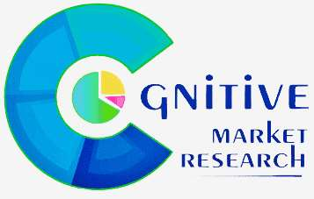
For Full Report
Contact us
COGNITIVE MARKET RESEARCH
Tel: +1 312-376-8303 | +44 020-8123-0732
India: (+91) 983-496-8611
sales@cognitivemarketresearch.com
Access the Full Report : https://tinyurl.com/5bsxactn
Please visit our website:
https://www.cognitivemarketresearch.com

