Slide 1
GLOBAL SALAMI
MARKET REPORT 2024
Global,Regional,CountryAnalysis

Slide 2
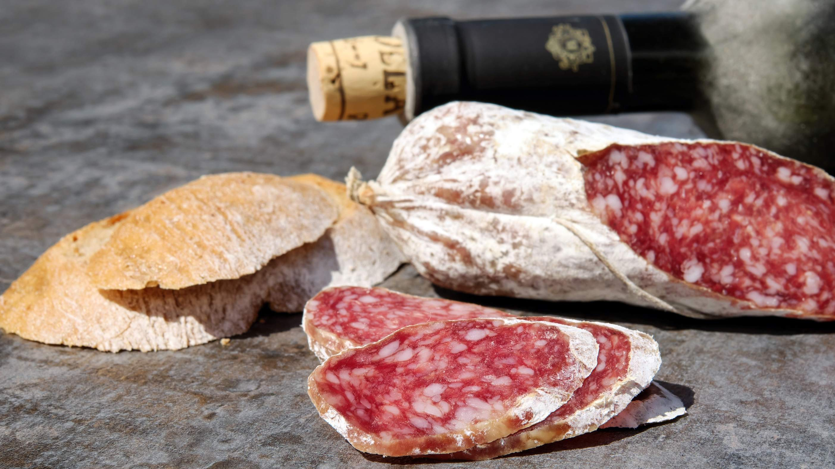
INTRODUCTION
The salami market is characterized by a diverse range of products catering to various consumer preferences. Offering options such as pork, beef, chicken, turkey, mutton, and vegetarian salami, the market spans applications from homes to restaurants, hotels, and airline catering. Different packaging formats, including vacuum-packed, canned, and fresh options, contribute to the industry's versatility. Distribution channels encompass online retail, supermarkets, convenience stores, and food service outlets. The market is influenced by evolving consumer trends, health considerations, and regional preferences, with competition driven by innovation in flavors, ingredients, and sustainable practices.
Regulatory compliance, particularly in food safety and quality, is paramount, and the market's dynamism creates opportunities for product development and market expansion, making it a sector of continual evolution.

Slide 3
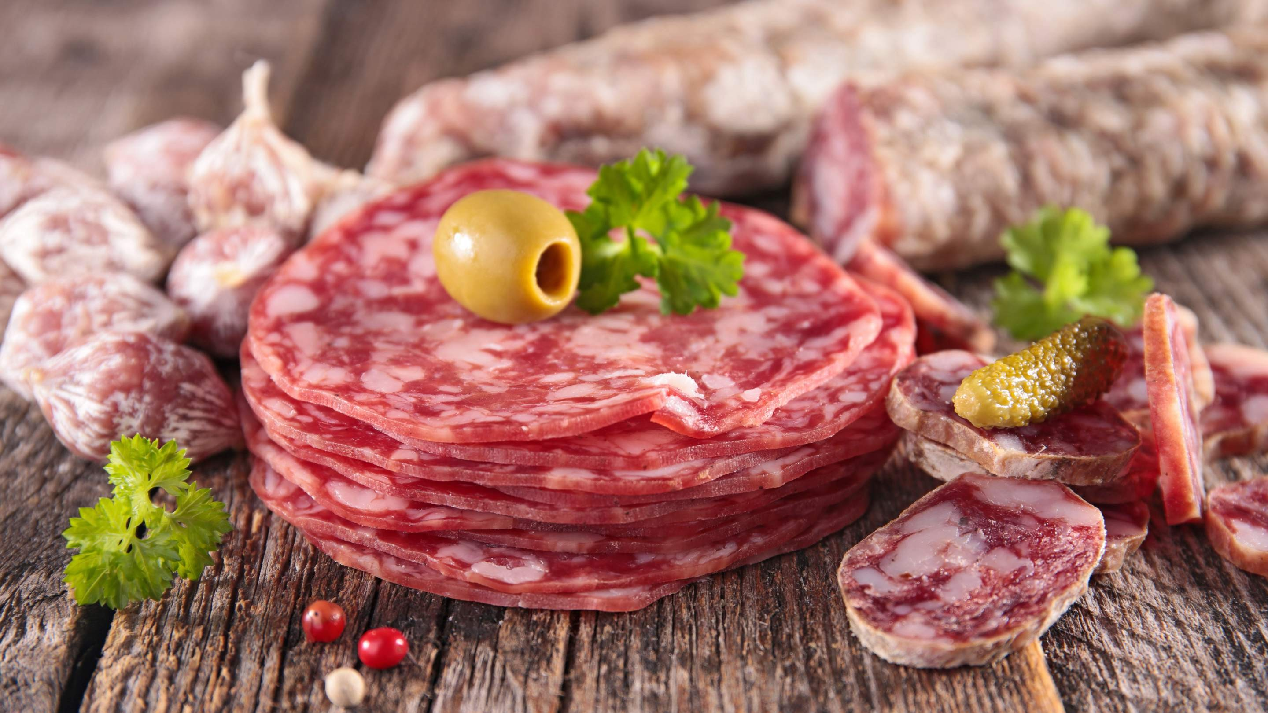

KEY INSIGHTS
20₋23
CAGR 5.60%
2030

Slide 4

REVENUE MARKET SHARE BY SEGMENTS 2022
Pork Salami Chicken Salami Beef Salami Turkey Salami Mutton Salami Vegetarian Salami
Type Segment
Home Restaurants Food Markets Hotels
Fast Food Outlets Delis
Airline Catering
Application Segment
Online Retail Supermarkets/Hypermarkets Convenience Stores
Food Service
Packaging Segment

Slide 5
Global Salami Market Revenue share for 2022
Europe 36%

Slide 6
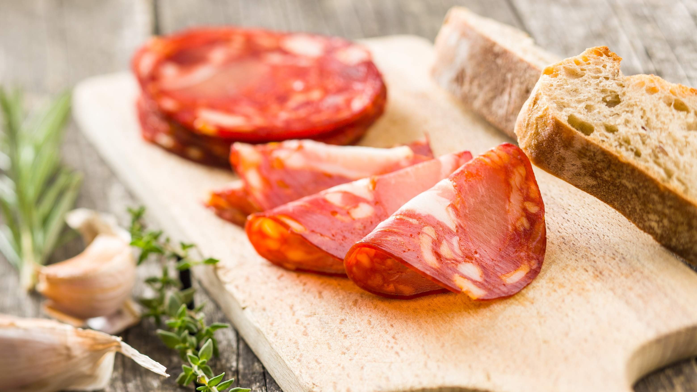
Convenience and Ready-to- Eat Trend to Propel Market Growth
Drivers
Health Concerns to Restrict Market Growth
Restraints

Slide 7

AUTHOR'S PERSPECTIVE
The Global Salami Market is witnessing significant growth in the near future.
Beef salami, being a traditional and widely consumed variety, might have maintained its popularity due to its familiar taste and versatility in various culinary applications.
Vegetarian salami is the fastest-growing category over the forecast period, showing remarkable growth potential over the forecast period.
The prominence of restaurants could be attributed to the widespread inclusion of salami in diverse culinary offerings, such as sandwiches, pizzas, and charcuterie boards, catering to a broad consumer base seeking convenient and flavourful dining experiences.
Salami, being a versatile and ready-to-consume product, aligns well with the demand for quick and satisfying snacks or meals for hotel guests.
The convenience and diverse applications of salami make it an attractive option for chefs and foodservice providers looking to enhance menu offerings.

Slide 8
KEY PLAYERS

Slide 9


Contact us
For Full Report
COGNITIVE MARKET RESEARCH
Tel: + 1 312 - 376 - 8303 | + 44 020 - 8123 - 0732
India: ( + 91 ) 983 - 496 - 8611
sales@ cognitivemarketresearch. com
Access the Full Report : http://tinyurl.com/yya5wbh2
Please visit our website:
https://www.cognitivemarketresearch.com

