Slide 1
GLOBAL SAFFRON MARKET REPORT 2024
Global,Regional,CountryAnalysis

Slide 2
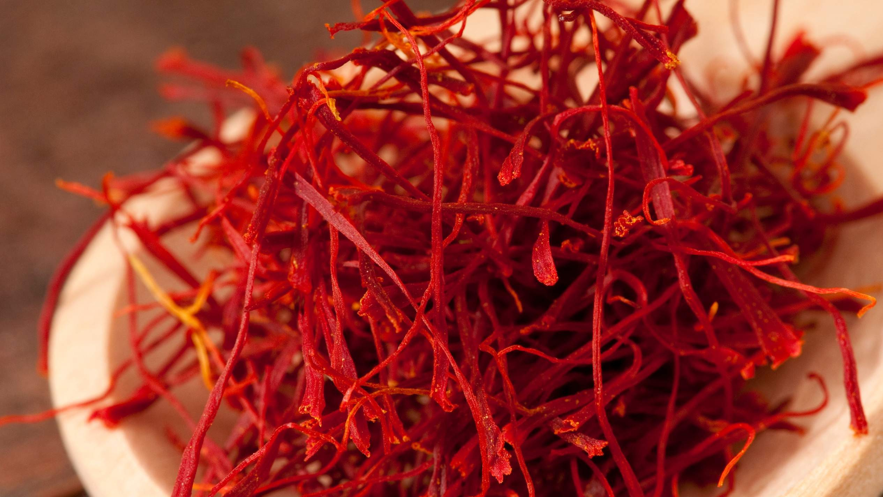
INTRODUCTION
During the anticipated period, the market will increase due to rising consumer demand for natural components, rising consumer awareness, and the availability of these ingredients in a variety of formats that make them easily usable. It is well-liked for treating measles, asthma, sneezes, and colds due to its high vitamin content and antibacterial, antidepressant, and antioxidant qualities.

Slide 3
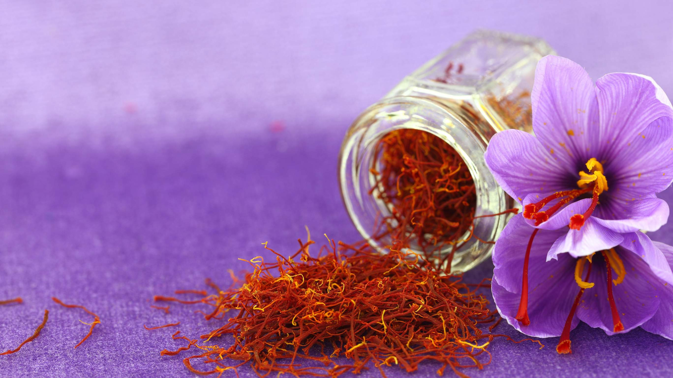

KEY INSIGHTS
MARKET SIZE
USD 0.554 billion
2023
CAGR 6.60%
2023
-
2030

Slide 4
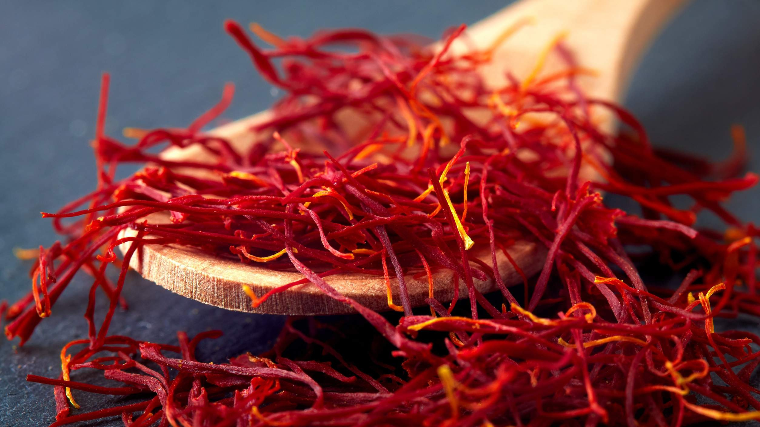
REVENUE MARKET SHARE BY SEGMENTS 2022
Food & Beverages Food Supplements Dietary Supplements Pharmaceutical Personal Care Cosmetic
Powder Liquid Stigma Petals
By Application
Form Segment
B2B B2C
Conventional Organic
Form Segment
Category Segment

Slide 5
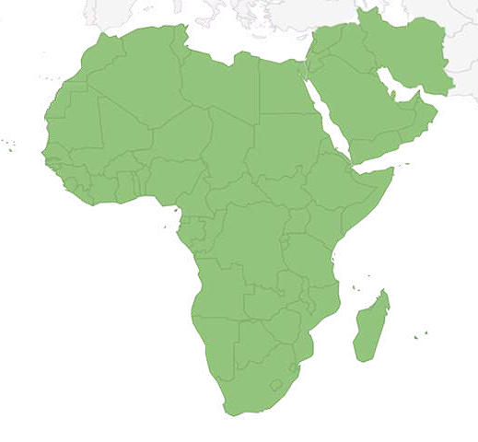
Global Saffron Market Revenue share for 2022
Middle East & Africa 50%

Slide 6
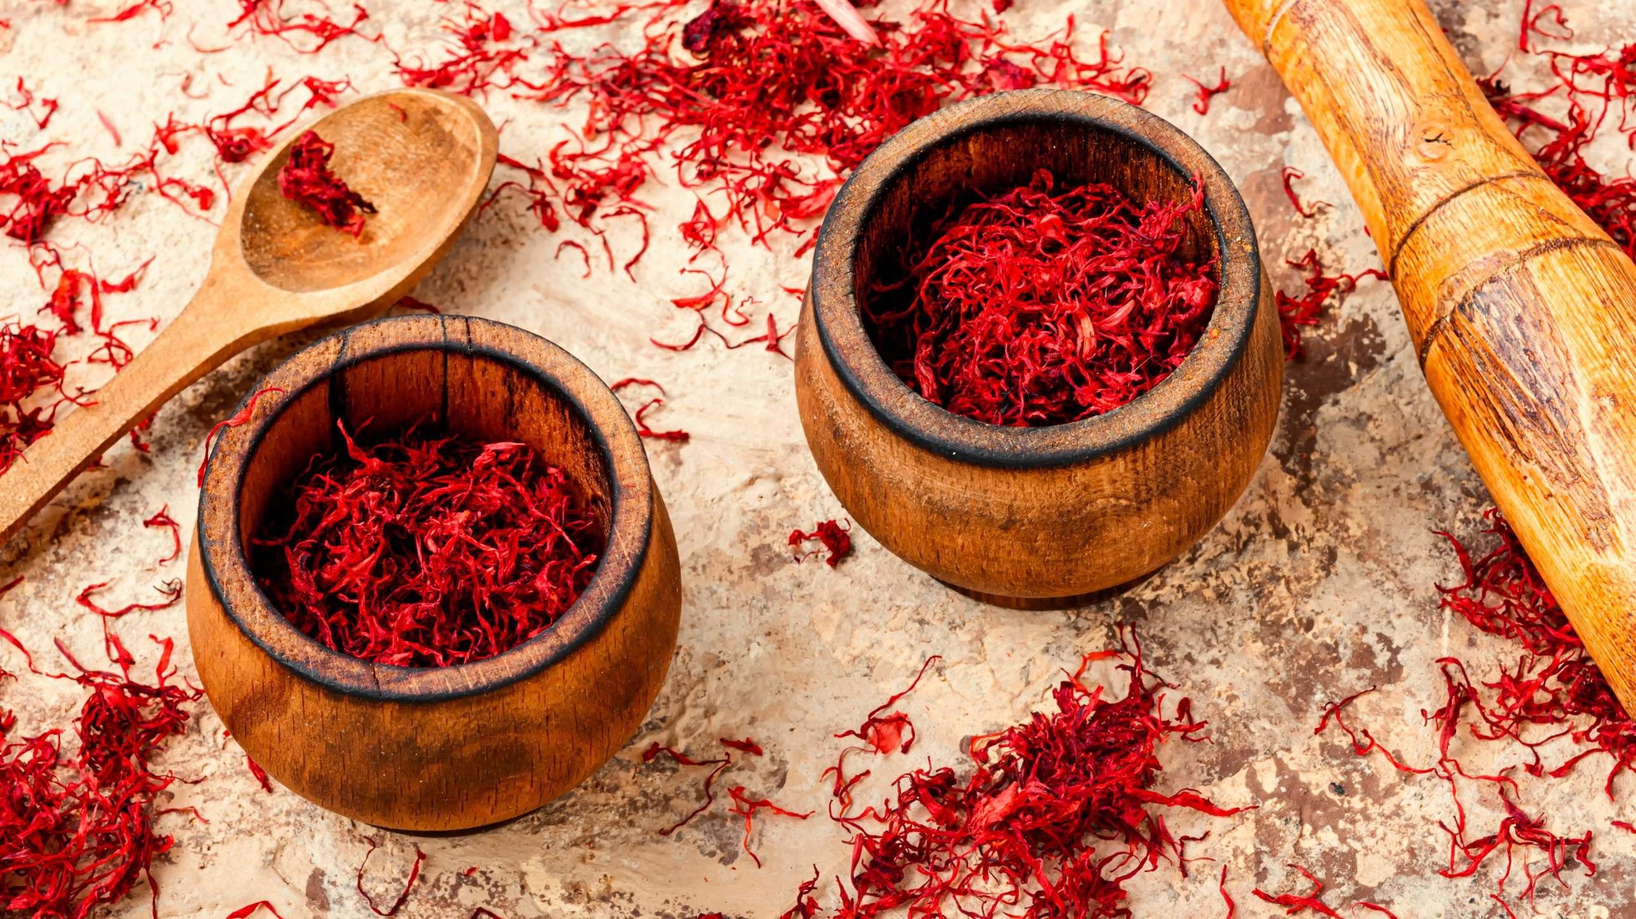
Growing Use in Cosmetics Industries to Propel Market Growth
Drivers
High Production Cost to Hinder Market Growth
Restraints

Slide 7
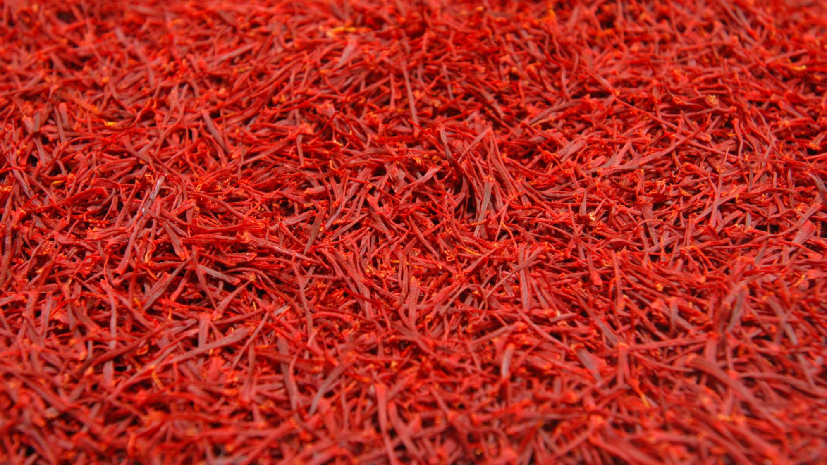
AUTHOR'S PERSPECTIVE
The Global Saffron Market is witnessing significant growth in the near future. Saffron is a highly prized spice that is used as a component in many different culinary and beverage products because of its distinct flavor, scent, and color. Saffron has been used for millennia in traditional medicine to treat a wide range of conditions, including sadness, anxiety, and menstrual cramps, in addition to its culinary applications.
Crocin, a yellow-orange pigment found in saffron flowers, can be isolated and applied to textiles and other materials to color them.
Furthermore, the emergence of e-commerce platforms has facilitated the direct purchase of saffron products from manufacturers by customers, resulting in heightened competition and reduced pricing.

Slide 8
KEY PLAYERS

Slide 9


Contact us
For Full Report
COGNITIVE MARKET RESEARCH
Tel: + 1 312 - 376 - 8303 | + 44 020 - 8123 - 0732
India: ( + 91 ) 983 - 496 - 8611
sales@ cognitivemarketresearch. com
Access the Full Report : http://tinyurl.com/ys68febr
Please visit our website:
https://www.cognitivemarketresearch.com

