Slide 1

GLOBAL
RYE FLOUR
MARKET REPORT 2024
Global,Regional,CountryAnalysis

Slide 2

INTRODUCTION
The expansion in consumer awareness regarding the health benefits of fibre has propelled the demand for fibre-rich products, driving the growth of the rye flour market. Rye flour, known for its high fibre content, has witnessed increased popularity as a key ingredient in various bakery products. This trend reflects a broader shift towards healthier eating habits, with consumers seeking nutritional value in their food choices. As a result, the rye flour market is experiencing a notable upswing, aligning with the rising preference for fibre-enriched diets.

Slide 3
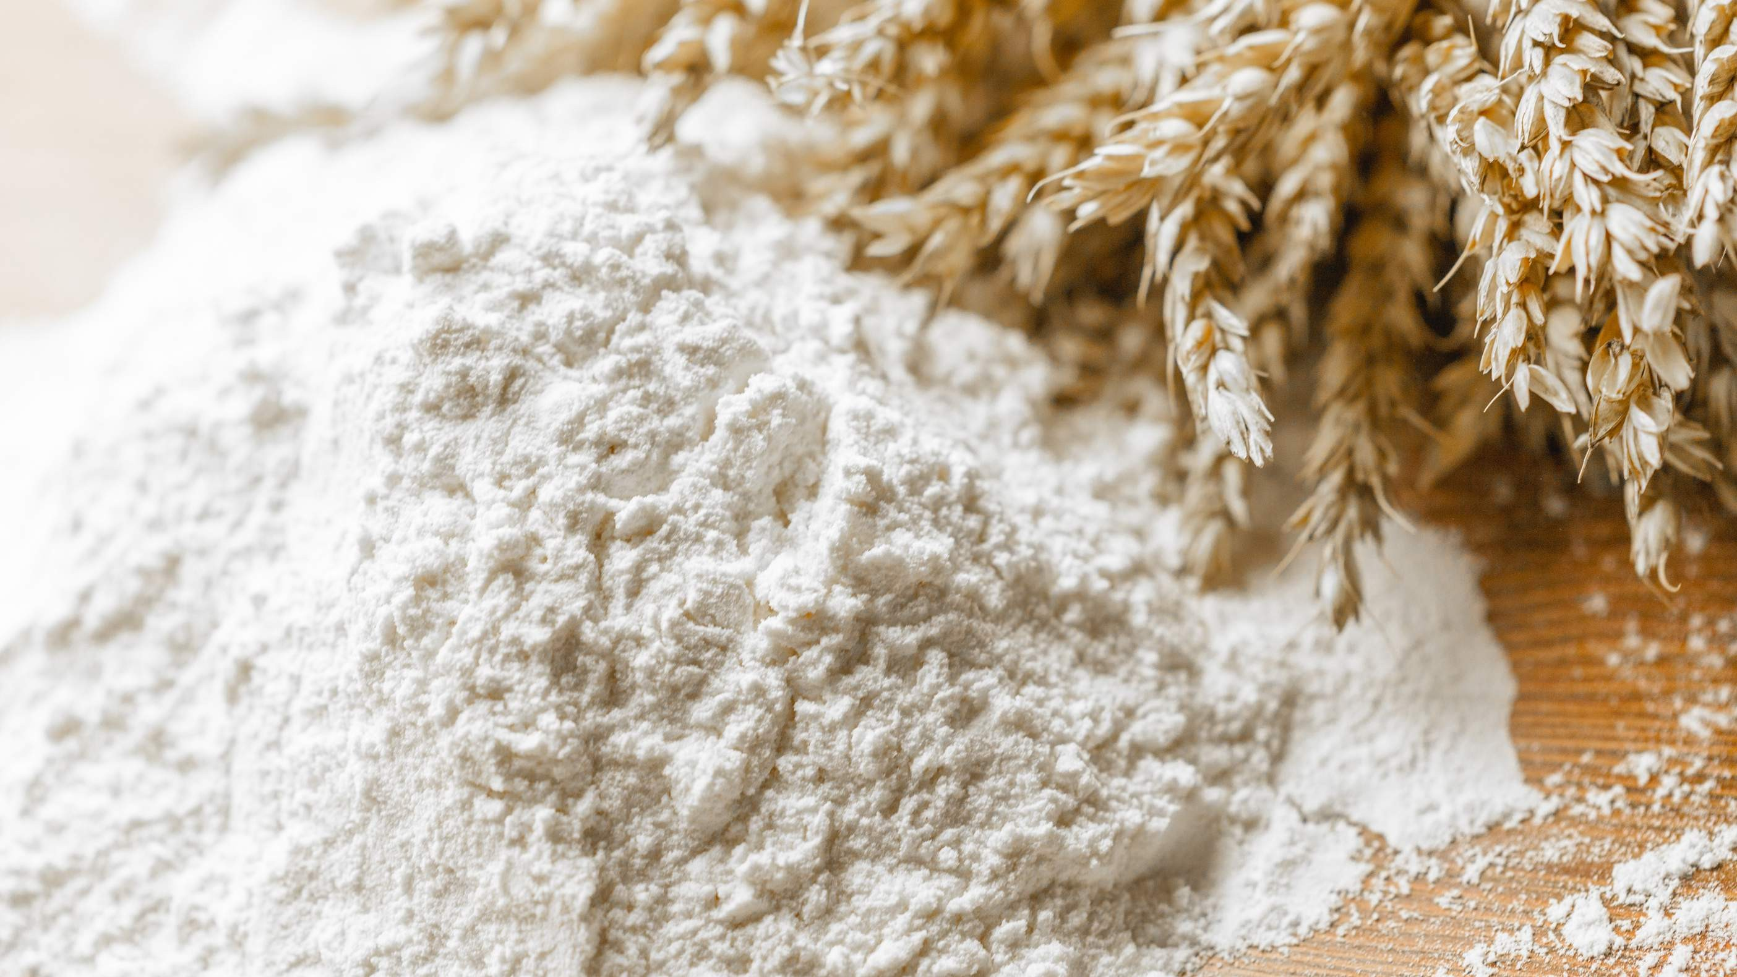

KEY INSIGHTS
MARKET SIZE
USD 39.5 billion
2023
20₋23
CAGR 2.50%
2030

Slide 4
REVENUE MARKET SHARE BY SEGMENTS 2022
Organic Conventional
White Medium Dark
Nature Segment
Product Segment
Bakery Snacks Confectionery
B2B B2C
End-User Segment
Distribution Channel

Slide 5
Global Rye Flour Market Revenue share for 2022
Asia Pacific 36%

Slide 6
Rising Demand for Premium And Super-Premium Bourbon Brands Propels Market Expansion
Drivers
Supply Chain Issues Limit Market Growth
Restraints

Slide 7

AUTHOR'S PERSPECTIVE
The Global Rye Flour Market is witnessing significant growth in the near future.
The conventional category is the fastest- growing over the projected period due to increasing consumer demand for healthier alternatives, especially rye flour's higher fibre content.
Snacks will be the fastest-growing category over the forecast period, owing to an expansion in demand for healthier options and gluten-free alternatives
White will be the fastest-growing category over the projected period due to the growing demand for healthier alternatives, gluten- free options, and the global trend towards artisanal and speciality foods

Slide 8
KEY PLAYERS

Slide 9


Contact us
For Full Report
COGNITIVE MARKET RESEARCH
Tel: + 1 312 - 376 - 8303 | + 44 020 - 8123 - 0732
India: ( + 91 ) 983 - 496 - 8611
sales@ cognitivemarketresearch. com
Access the Full Report : http://tinyurl.com/3a5y3n99
Please visit our website:
https://www.cognitivemarketresearch.com

