Slide 1

GLOBAL
RUM
MARKET REPORT
2024
Global,Regional,CountryAnalysis

Slide 2

INTRODUCTION
Rum is a distilled alcoholic beverage made from sugarcane byproducts, such as molasses or sugarcane juice. It is typically aged in oak barrels, which gives it its characteristic flavor profile. Rum can vary widely in flavor, ranging from light and subtle to rich and complex, depending on factors such as the type of sugarcane used, the distillation process, and the length of aging. It is commonly associated with tropical regions, particularly the Caribbean, where it has been produced for centuries. Rum is a versatile spirit that can be enjoyed neat, on the rocks, or as a key ingredient in cocktails such as the Mojito, Daiquiri, and Mai Tai. The Rum market is driven by several factor including rising disposable income, growing health and wellness trends, increasing investment, and the rising consumer preference.

Slide 3


KEY INSIGHTS
MARKET SIZE
USD 15842.2 million
2023
CAGR
6.00%
2023- 2030

Slide 4

REVENUE MARKET SHARE BY SEGMENTS 2022
  Plain Rum
  Flavored Rum
  Organic Rum
  Conventional Rum
Nature Segment
  Business to Business
  Hypermarkets or Supermarkets
  Specialty Stores
  Online Retails
Distribution Channel

Slide 5

Global Rum Market Revenue share for 2024
North America
40%

Slide 6

Rising Demand for Craft Rum to Propel the Market Revenue Growth
Drivers
Supply Chain Disruption to Limit the Expansion of the Market
Restraints

Slide 7

AUTHOR'S PERSPECTIVE
  The global Rum market will expand significantly by 6.00% CAGR between 2024 to 2031.
  Dark and golden rum stands out as the dominating category due to customer preferences and manufacturing.
  The dominating category is Conventional Rum.
  Conventional rum typically appeals to a broad consumer base due to its familiar flavor profile and versatility.

Slide 8

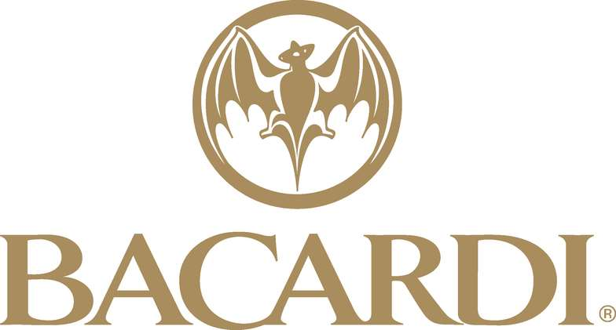









KEY PLAYERS

Slide 9


For Full Report
Contact us
COGNITIVE MARKET RESEARCH
Tel: +1 312-376-8303 | +44 020-8123-0732
India: (+91) 983-496-8611
sales@cognitivemarketresearch.com
Access the Full Report : https://tinyurl.com/3ypjackr
Please visit our website:
https://www.cognitivemarketresearch.com

