Slide 1
GLOBAL RUBIKS CUBE
MARKET REPORT 2024
Global,Regional,CountryAnalysis

Slide 2

INTRODUCTION
A classic and well-known puzzle toy, the Rubik’s Cube has long had a significant following on the international market. This vibrant, multi-dimensional puzzle, which Ern Rubik first created in 1974, has retained its allure for consumers of all ages, making it a durable and evergreen item in the toy and gaming market.

Slide 3


KEY INSIGHTS
CAGR 4.20%
2024
-
2031

Slide 4
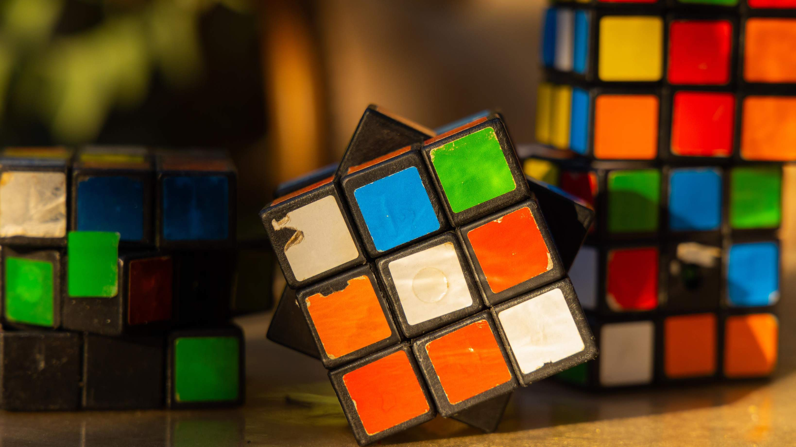
REVENUE MARKET SHARE BY SEGMENTS 2022
Ordinary Rubik’s Cube
Alien Rubik’s Cube
Smart Rubik’s Cube
Customizable Rubik’s
Cube
Children
Teenagers
Adults
Type Segment
Age Group Segment
Entertainment
Competition
Education
Collectibles
Low
Medium
High
Application Segment
Price Range Segment

Slide 5

Global Rubiks Cube Market Revenue share for 2024
North America 38%

Slide 6



Growing Innovation to Drive Market Growth
Competition to Hinder Market Growth

Slide 7
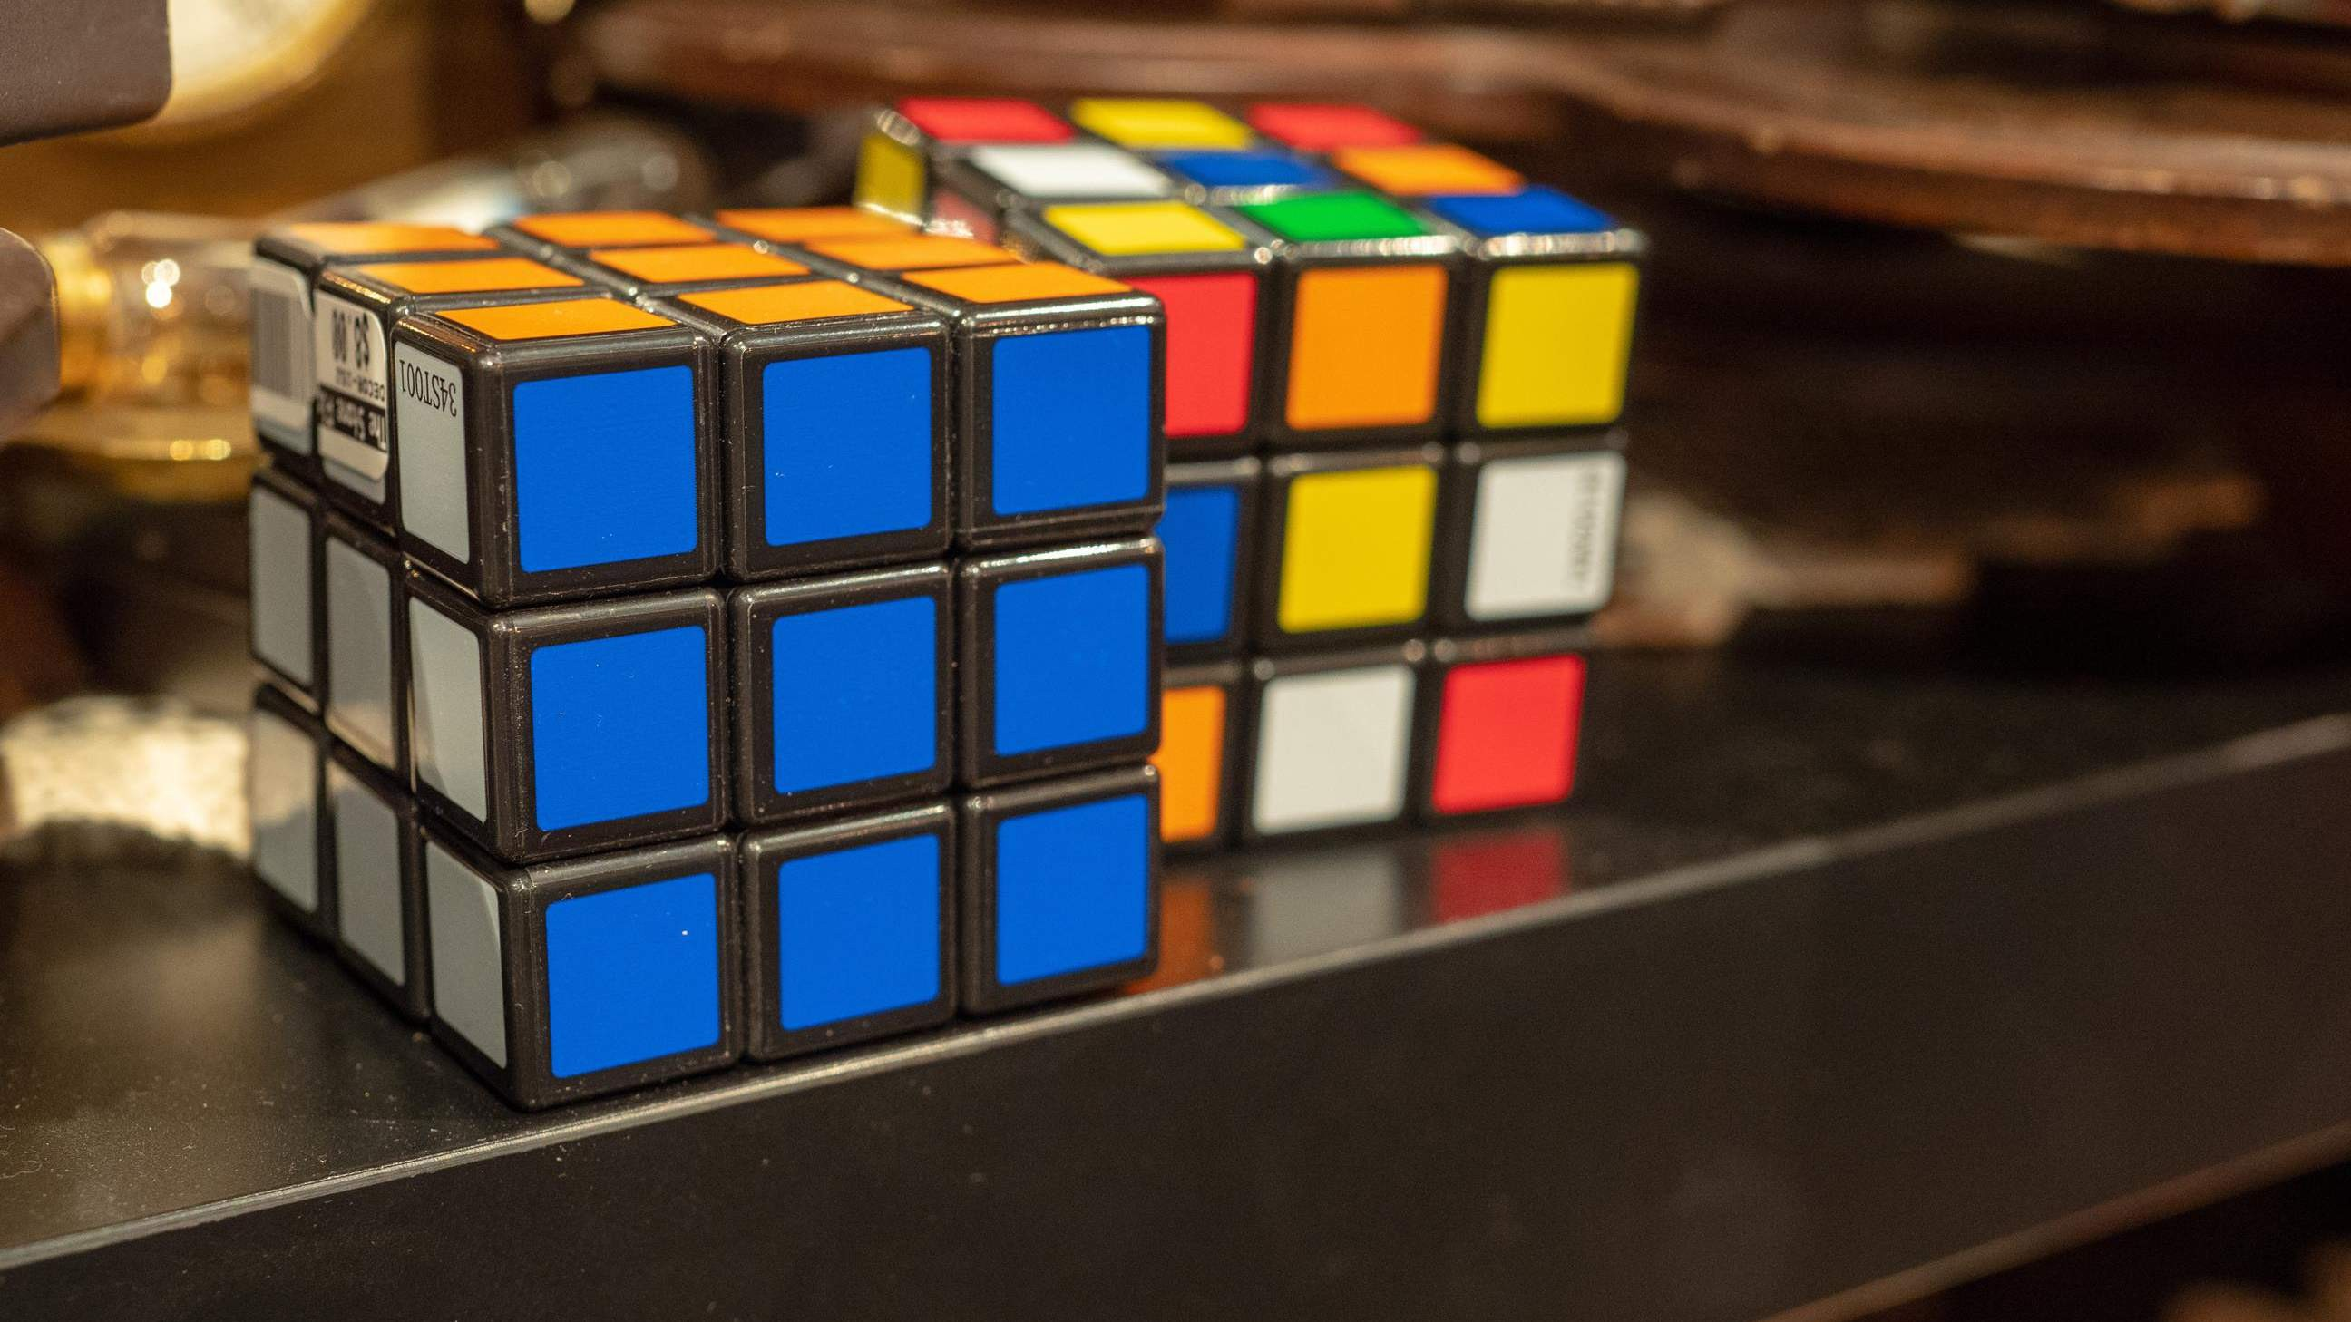
AUTHOR'S PERSPECTIVE
The Global Rubiks Cube Market is witnessing significant growth in the near future.
Rubik’s cubes primary and most common use is for entertainment and recreation.
Apps focusing on competitions may offer solving strategy guides and algorithms to help users get better results and faster times.
Gift shops, particularly in tourist destinations and museums, often stock rubik’s
cubes, including themed or branded cubes.
Stickerless rubik’s cubes, popular among cubers for their durability and vibrant
colors, are available at this price point.
Children often engage with friends and family in solving the rubik’s cube, fostering social interaction and cooperation. Entry-level 3x3 Rubik’s Cubes that offer a traditional solving experience at an affordable price point.

Slide 8

KEY PLAYERS

Slide 9


Contact us
For Full Report
COGNITIVE MARKET RESEARCH
Tel: + 1 312 - 376 - 8303 | + 44 020 - 8123 - 0732
India: ( + 91 ) 983 - 496 - 8611
sales@ cognitivemarketresearch. com
Access the Full Report : http://tinyurl.com/4hmwcpbe
Please visit our website:
https://www.cognitivemarketresearch.com

